Slide 1


Reliable Broadcast with Joint Forward Error Correction and Erasure Codes in Wireless Communication Networks
Pouya Ostovari and Jie Wu
Computer & Information Sciences
Temple University
Center for Networked Computing
http://www.cnc.temple.edu

Slide 2
Agenda
Introduction
Motivation
Cross-layer protection
Formulation
Proposed method
Evaluations
Conclusions
Notes:
First I will provide an introduction and motivation for our work
Then, I will talk about the benefits on network coding in robustness and throughput enhancement,
and I will talk about our partial results and future work.
At the end, I will conclude my talk

Slide 3


Introduction
Advances in technology of mobile devices
Smartphones and tablets
Wireless connections
Are widely used
Internet is accessible everywhere
Reliable transmission
ARQ
Erasure codes
Hybrid-ARQ
Fountain codes (rateless codes)
Notes:
In recent days, we are witnessing a fast development in the hardware technologies of mobile devices
such as tablets and smartphones
As a result of these advances, the mobile devices are becoming very popular
Using wireless connections is more convenient than the wired connections.
Moreover, they can solve the last mile problem

Slide 4
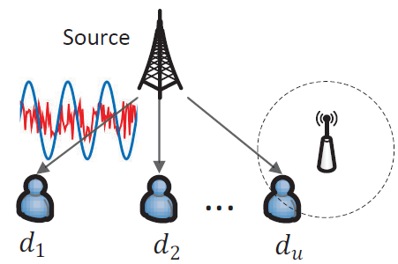
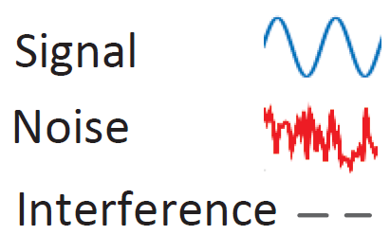
Transmission Errors
Noise
Forward error correcting codes (FEC)
Adding redundant bits to find and correct bit errors
Physical layer
Interference
Packet erasure codes (EC)
Transmitting redundant packets
Application and network layers
Notes:
Network coding is a promising method in providing reliable transmissions without using feedback messages
Specifically in Random linear network coding, instead of transmitting the original packets, Linear combinations of the packets are transmitted.
For example, if we have 3 original packets, the form of coded packets will be like this
Where, alpha is a random coefficient
There is a work that shows if we select the coefficients randomly, with a very high probability, any coded packet will be linearly independent to the other coded packets
In this way, the sender keeps transmitting Linear independent coded packets until the destination nodes receive enough coded packets
This advantage of NC motivated me to study it

Slide 5



Network Coding
Random linear network coding
Linear combinations of the packets
Gaussian elimination
Applications of network coding
Reliable transmissions
Throughput/capacity enhancement
Distributed storage systems/ Content distribution/ Layered multicast
$$q_{1}=α_{1,1}p_{1}+α_{1,2}p_{2}+α_{1,3}p_{3}$$
$${q_{2}=α}_{2,1}p_{1}+α_{2,2}p_{2}+α_{2,3}p_{3}$$
…
$${q_{n}=α}_{n,1}p_{1}+α_{n,2}p_{2}+α_{n,3}p_{3}$$
Notes:
Network coding is a promising method in providing reliable transmissions without using feedback messages
Specifically in Random linear network coding, instead of transmitting the original packets, Linear combinations of the packets are transmitted.
For example, if we have 3 original packets, the form of coded packets will be like this
Where, alpha is a random coefficient
There is a work that shows if we select the coefficients randomly, with a very high probability, any coded packet will be linearly independent to the other coded packets
In this way, the sender keeps transmitting Linear independent coded packets until the destination nodes receive enough coded packets
This advantage of NC motivated me to study it

Slide 6
Cross-Layer Reliable Transmission
Joint FEC and EC
Deciding about the amount of redundancy to be added for FEC and EC
Previous work
Theoretic result for the case of single destination
Muriel Medard: implementation on sensor network
Shows that joint FEC-NC is effective
Depending on noise and interference level, more NC or FEC redundancy enhances the reliability
No method for redundancy distribution

Slide 7
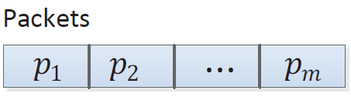
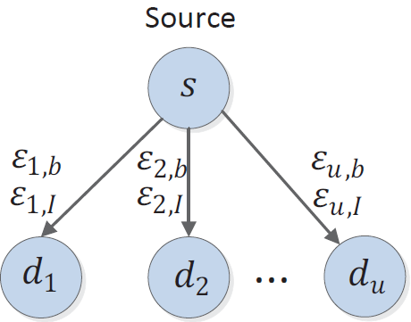
Setting
Single source
Transmits a set of m packets
Size of each packet: n bits
Source can transmit X bits
Two sources of errors
Noise and interference
Different noise and interference probabilities

Slide 8
Setting
Provide protection for the packets
Joint FEC and NC
Objective
Finding the optimal transmission scheme that maximizes the probability of receiving the m packets by the destinations

Slide 9
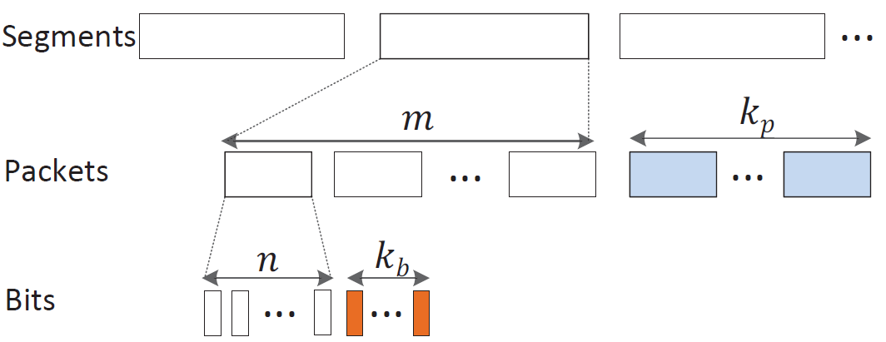
Joint Coding Scheme
Segmentation
Applying network coding
Adding FEC to each network coded packet
NC
FEC

Slide 10
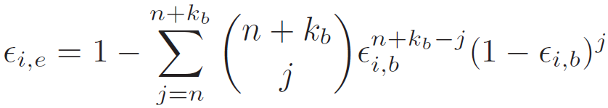

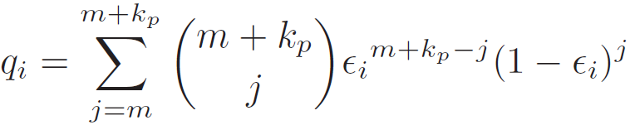
Problem Formulation
Erasure due to noise
When bit errors cannot be corrected
Erasure due to noise and interference
Successful transmission of the m packets

Slide 11
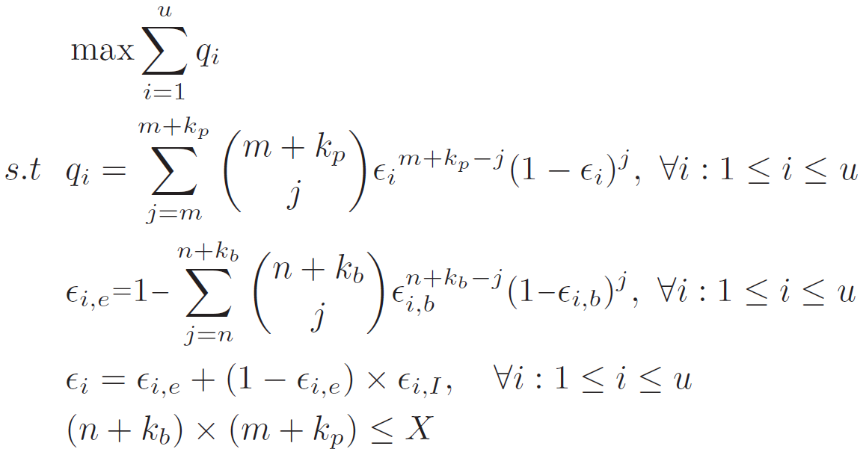

Problem Formulation

Slide 12
Finding Optimal Distribution
The probability equation cannot be simplified into a closed-form
Two-phases algorithm
Offline phase: creating a reference table which shows the success delivery of the packets for each possible FEC and NC redundancy levels
Online phase: performing a search on reference table to find the optimal FEC and NC levels
Depending on the noise and interference probabilities of the users

Slide 13
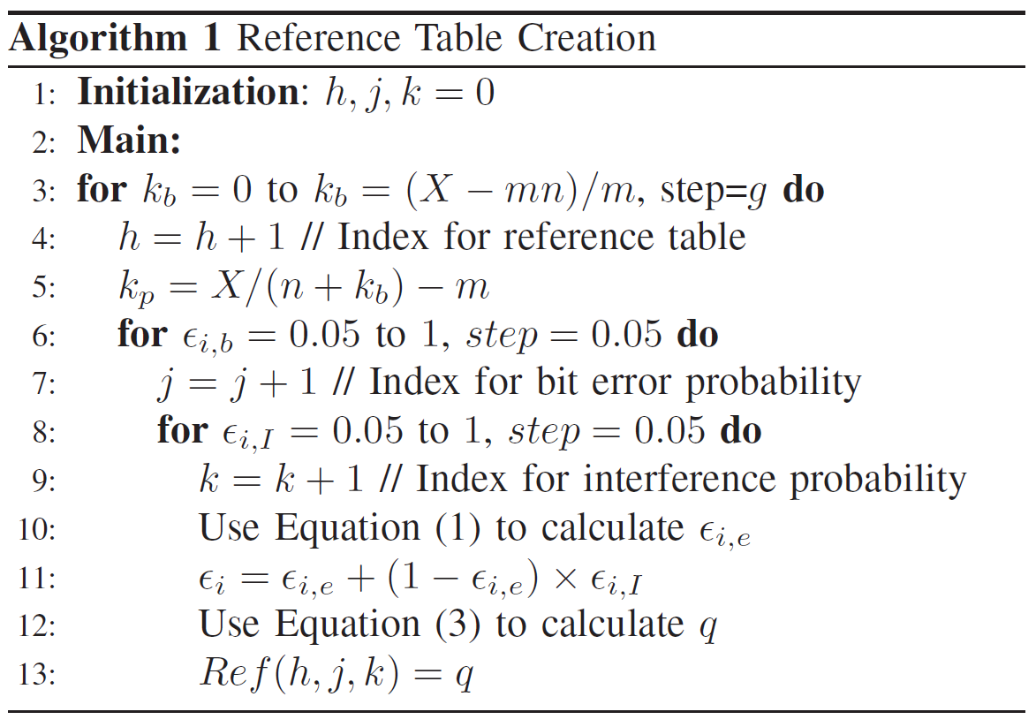
Reference Table Creation

Slide 14
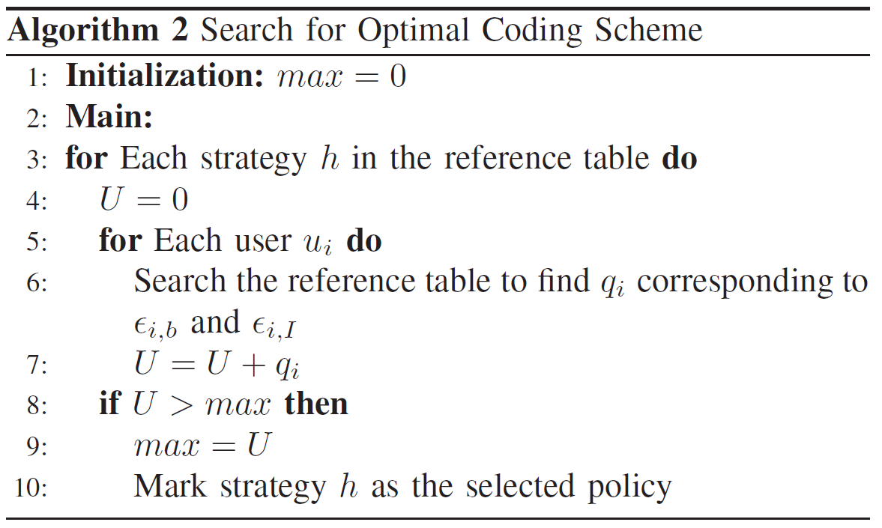
Search for Optimal Coding Scheme
1

Slide 15
Evaluations
Simulator in Matlab environment
1000 topologies with random bit error rate and interference probability
Bit error rate and interference probability of the destinations are independent
Comparing with only FEC and only NC methods

Slide 16
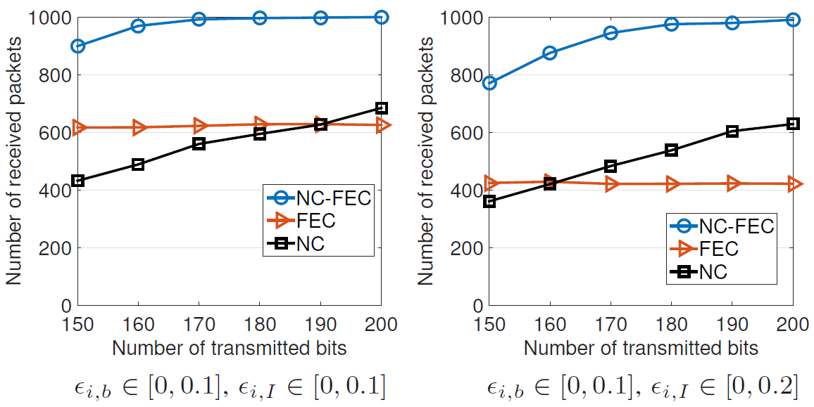
Evaluations
100 sets of packets
Each set contains 10 packets

Slide 17
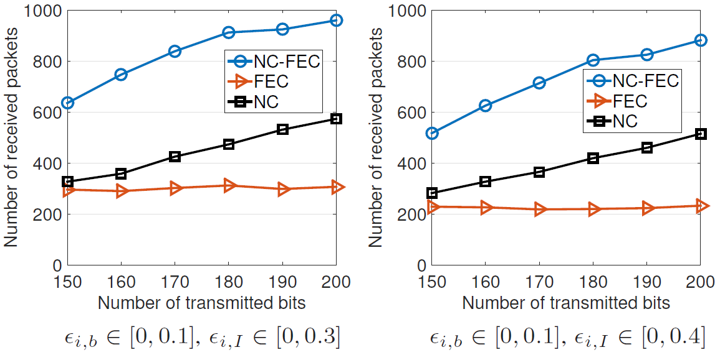
Evaluations
100 sets of packets
Each set contains 10 packets

Slide 18
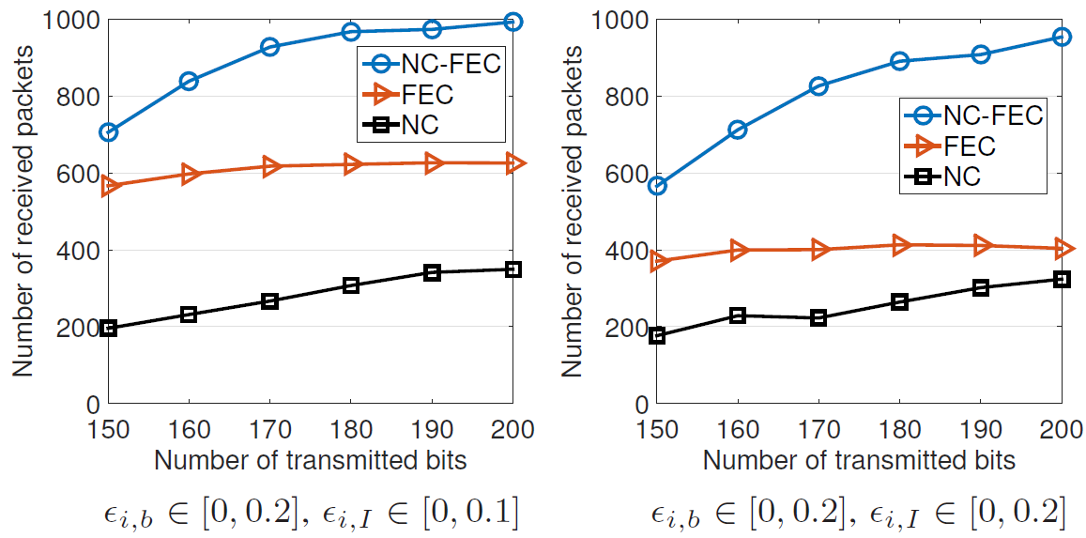
Evaluations
100 sets of packets
Each set contains 10 packets

Slide 19
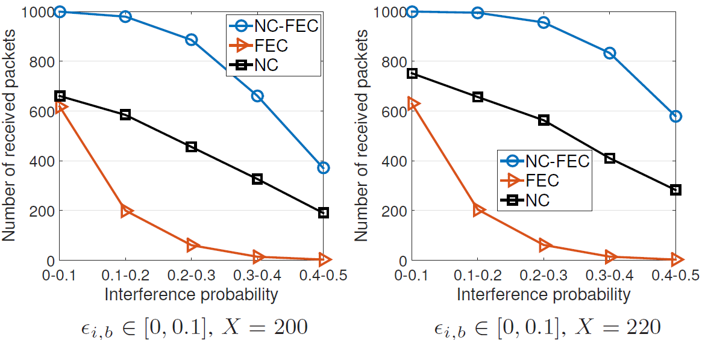
Evaluations
100 sets of packets
Each set contains 10 packets

Slide 20
Simulation Summary
For low noise probability FEC provides a better protection
As noise or interference probability increases, more redundancy is needed for NC (EC)
FEC performs poorly
FEC or NC?
For a given noise and interference probability, that depends on X

Slide 21
Conclusion
Cross-layer protection of transmitted packets
Joint FEC and NC to enhance reliability
Fixed redundancy
Finding the optimal transmission scheme
FEC redundancy
NC redundancy (erasure code)
Two-phases algorithm
Offline and online phases

Slide 22
Thank you

