Slide 1
22nd Annual IEEE International Conference on Sensing, Communication, and Networking (SECON)
03 – 05 June // Pisa, Italy

Slide 2



UniChirp: Unwrapping In-Chirp Phase
Misalignment for Weak LoRa Signal Demodulation
Hang Li, Shuai Tong, Jiarui Zhang, Shen Gao, Jiliang Wang, Jie Wu
Tsinghua University | China Telecom Cloud Computing Research Institute | Temple University
01
Notes:
Good afternoon everyone. My name is Hang Li from Tsinghua University.
Today, I will present our work, **UniChirp: Unwrapping In-Chirp Phase Misalignment for Weak LoRa Signal Demodulation**.
This work focuses on weak LoRa signal demodulation. The key question is: when LoRa packets become extremely weak, can we still recover them by better aggregating chirp energy?
Our answer is yes. UniChirp models and compensates the **in-chirp phase misalignment** that prevents coherent energy fusion in conventional LoRa demodulation.
I will first introduce the motivation, then explain the technical challenge, present the design, and finally show the main results.

Slide 3
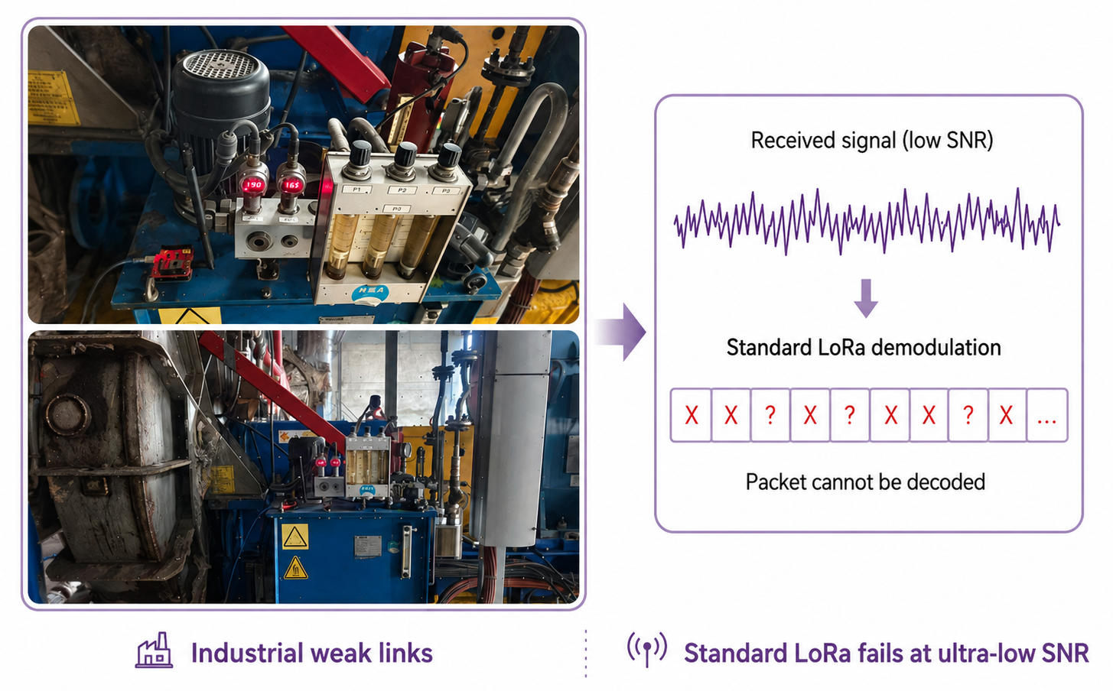
IEEE SECON 2026
Motivation: LoRa Fails in Industrial Weak Links
Received signals (low SNR)
1
Sensors are deployed inside pipelines,tanks,and dense machinery.
2
Occlusion, metal structures, multipath, and interference severely attenuate chirps.
Stardard LoRa demodulation
3
The received SNR can fall below the decoding threshold of standard LoRa.
Packet cannot be decoded
4
The receiver should improve robustness without changing end devices or protocol stacks.
Standard LoRa fails at ultra-low SNR
Industrial weak links
Problem focus: weak-signal demodulation under ultra-low SNR
Notes:
LoRa is widely used in low-power wide-area IoT because it supports long-range and energy-efficient communication.
However, in industrial deployments, LoRa links can become very weak. Sensors may be placed inside pipelines, tanks, cabinets, or dense machinery. These environments introduce occlusion, metal reflection, multipath, and interference.
As a result, the received SNR may fall below the decoding threshold of standard LoRa receivers. The receiver can still observe some signal energy, but standard demodulation cannot reliably decode the packet.
In practice, we want to improve robustness without modifying deployed LoRa nodes or protocol stacks. Therefore, this paper aims for a **software-only receiver-side solution**.

Slide 4
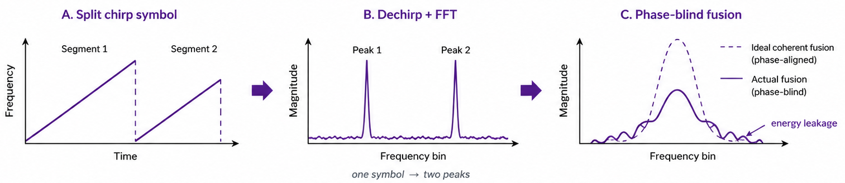
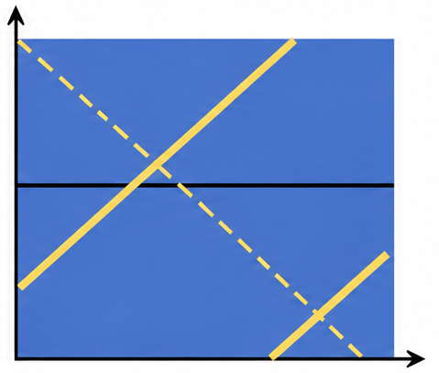
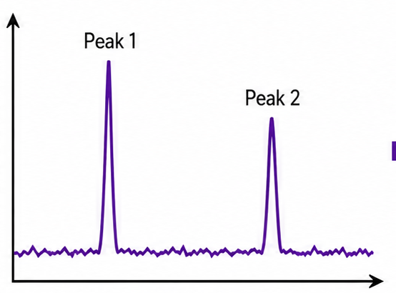
IEEE SECON 2026
Why Conventional LoRa Demodulation Breaks
A. Split chirp symbol
B. Dechirp + FFT
C. Phase-blind fusion
Segment 1
Peak 1
Ideal coherent fusion (phase-aligned)
Segment 2
Peak 2
Frequency
Magnitude
Magnitude
Actual fusion
(phase-blind)
energy leakage
Time
Frequency bin
Frequency bin
one symbol -> two peaks
Can we recover weak LoRa packets by restoring phase-coherent energy aggregation?
03
Notes:
Standard LoRa demodulation uses a dechirp-and-FFT pipeline. Ideally, one symbol produces one clear spectral peak, and the receiver detects the peak position.
But because of the cyclic frequency shift in LoRa modulation, one symbol may be split into two chirp segments. After dechirp and FFT, these segments appear as two spectral peaks.
These two peaks belong to the same symbol, so their energy should be combined. The problem is that conventional magnitude-based demodulation is phase-blind. It may combine magnitudes, but it cannot guarantee coherent addition in the complex domain.
When the two peaks have a phase mismatch, direct combination can cause energy leakage or even cancellation. This becomes critical under low SNR.
So the deeper problem is not only weak signal strength. It is the failure to **coherently aggregate split chirp energy**.

Slide 5
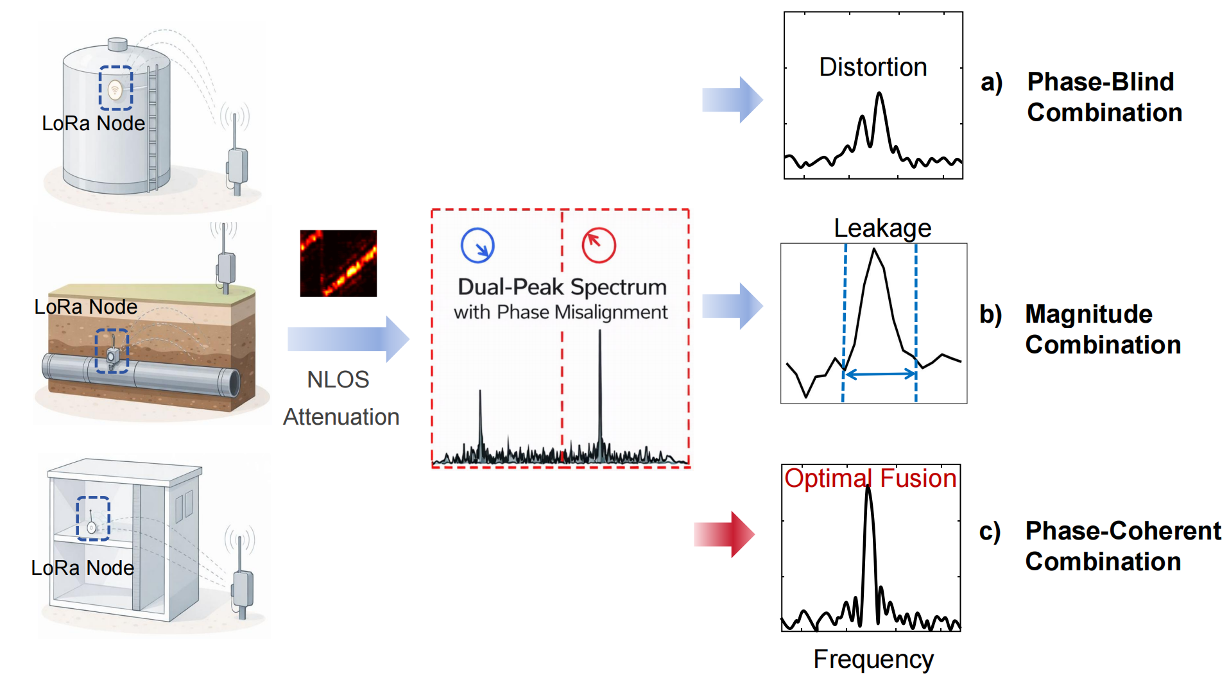
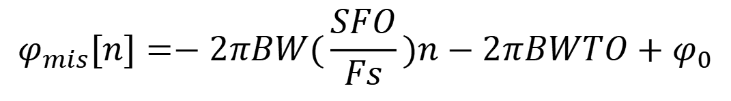
IEEE SECON 2026
Core Contribution: Phase-Coherent Weak-Signal Demodulation
Phase discontinuity is predictable
$$φ_{mis}[n]=−2πBW(\frac{SFO}{Fs})n−2πBWTO+φ_{0}$$
1
CFO: continuous rotation
does not break the in-chirp phase jump
2
TO: constant offset
3
SFO: linear trend
makes the jump drift across chirps
Model
closed-form phase trajectory
Predict
packet-level phase prior
Fuse
phase-aligned peak aggregation
04
Notes:
The key observation of UniChirp is that the in-chirp phase discontinuity is not random. It can be predicted from the LoRa signal structure and hardware offsets.
We analyze three factors.
First, CFO introduces continuous phase rotation, but it does not break the in-chirp phase jump structure.
Second, timing offset introduces a constant phase offset.
Third, sampling frequency offset introduces a linear phase trend across chirps.
Based on this analysis, UniChirp builds a closed-form phase model. It then uses preamble symbols to estimate a packet-level phase prior and applies this prior to align and fuse the dual peaks.
The core workflow is: **model, predict, and fuse**.

Slide 6
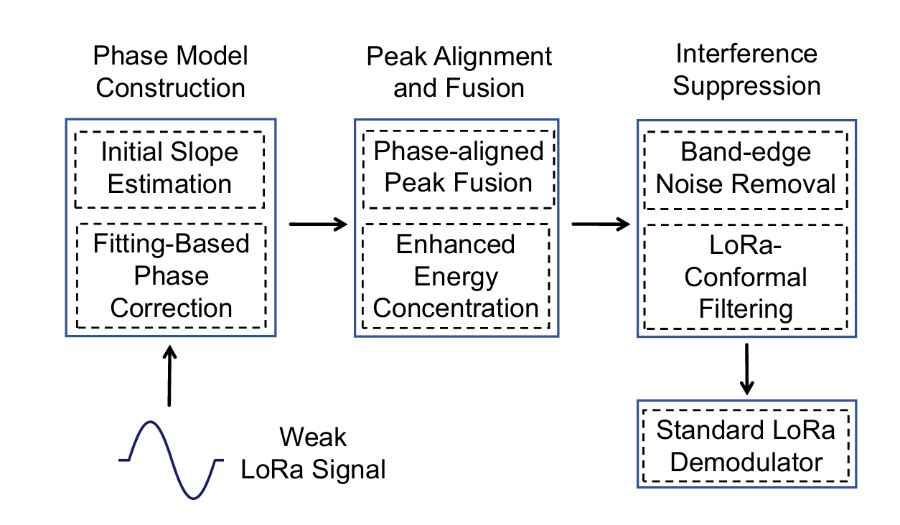
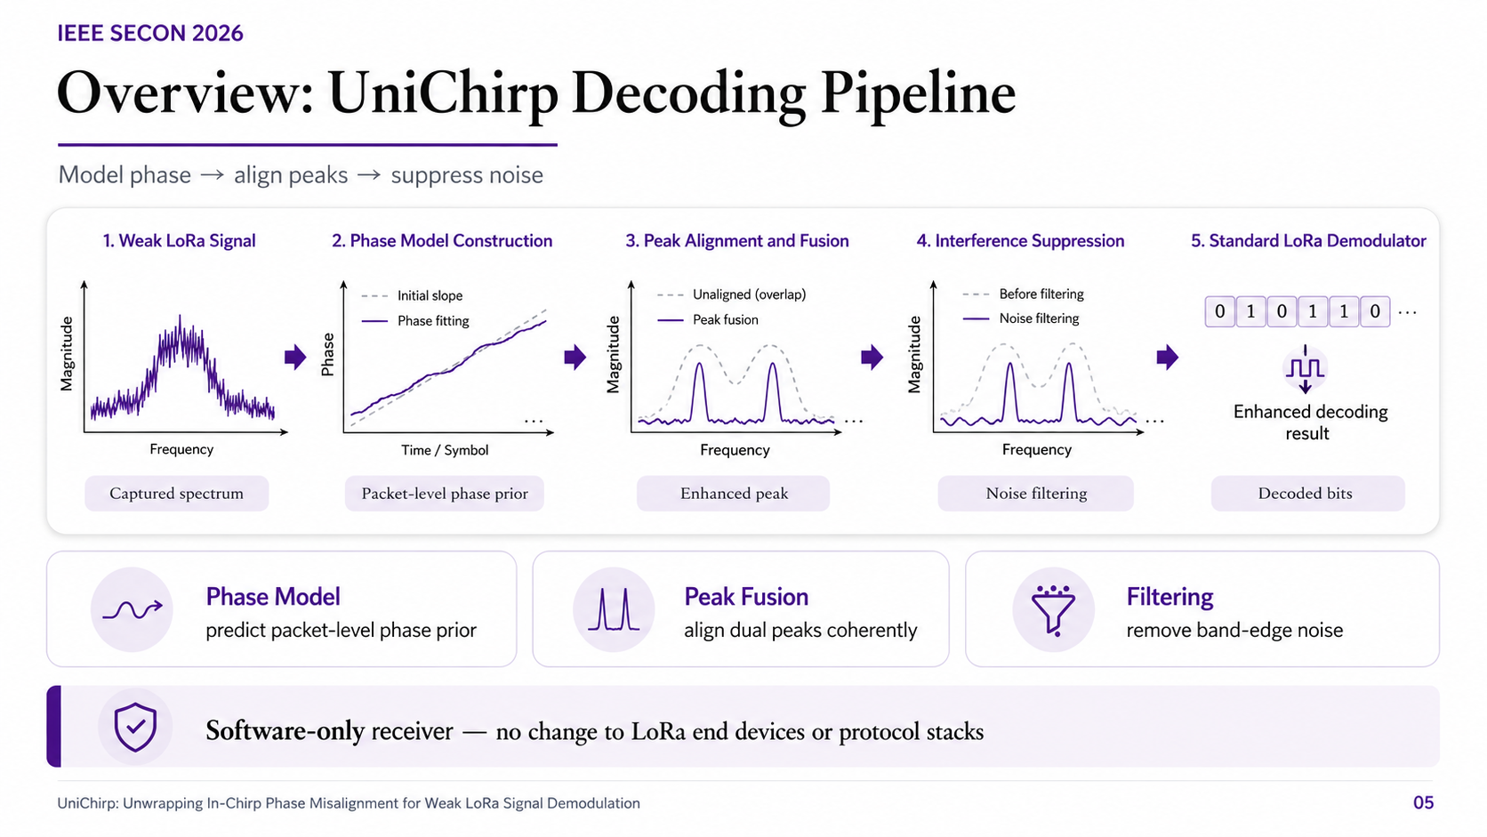
IEEE SECON 2026
Overview:
UniChirp Decoding Pipeline
Phase Model Construction
packet-level phase prior
Peak Alignment and Fusion
phase-coherent dual-peak aggregation
Interference Suppression
Interference Suppression
Software-only receiver — no change to LoRa end devices or protocol stacks
05
Notes:
UniChirp contains three main modules.
The first module constructs a phase prior from the preamble. It estimates the packet-level phase trajectory.
The second module performs peak alignment and fusion. It uses the phase prior to rotate the secondary peak and coherently add it to the primary peak.
The third module applies structure-aware spectral filtering to suppress out-of-band noise before demodulation.
After these modules, the enhanced signal can still be decoded by a standard LoRa demodulator.
Therefore, UniChirp is fully receiver-side and software-only. It does not require changes to the transmitter, packet format, or protocol stack.

Slide 7
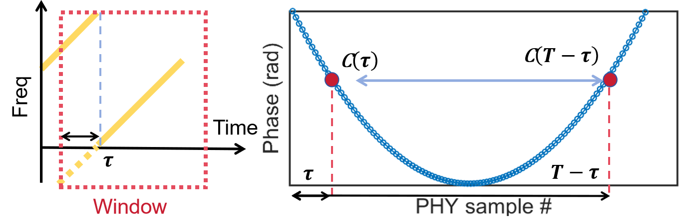
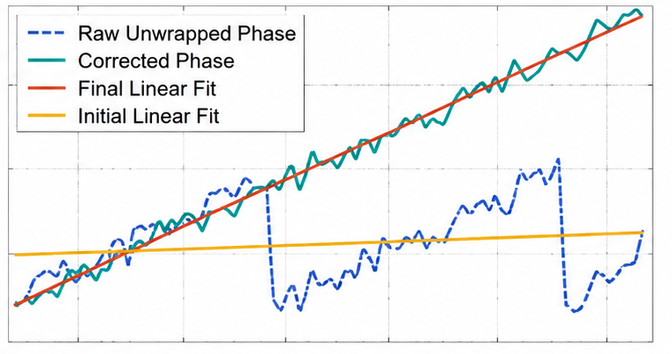
IEEE SECON 2026
MODULE 1
Preamble-Guided Phase Prior
Core idea
  Estimate packet-level phase trajectory from preamble symbols.
  Fit slope and intercept to construct a phase prior.
  Extrapolate the fitted trend to payload symbols.
Practical role
  Provides a packet-level phase prior that guides coherent fusion during payload decoding.
06
Notes:
The first module uses the preamble to construct a phase prior.
A LoRa packet starts with repeated preamble symbols. These repeated chirps provide useful observations of packet-level phase behavior.
UniChirp extracts phase observations from the preamble. Since these observations may be noisy and wrapped, UniChirp unwraps and corrects them, then fits a phase trajectory.
This trajectory can be represented by a slope and an intercept. The slope mainly captures phase drift caused by sampling frequency offset. The intercept captures the constant offset related to timing offset.
After fitting the trend from the preamble, UniChirp extrapolates it to payload symbols. In this way, the preamble is not only used for synchronization. It also provides a physical prior for phase-coherent energy aggregation.

Slide 8
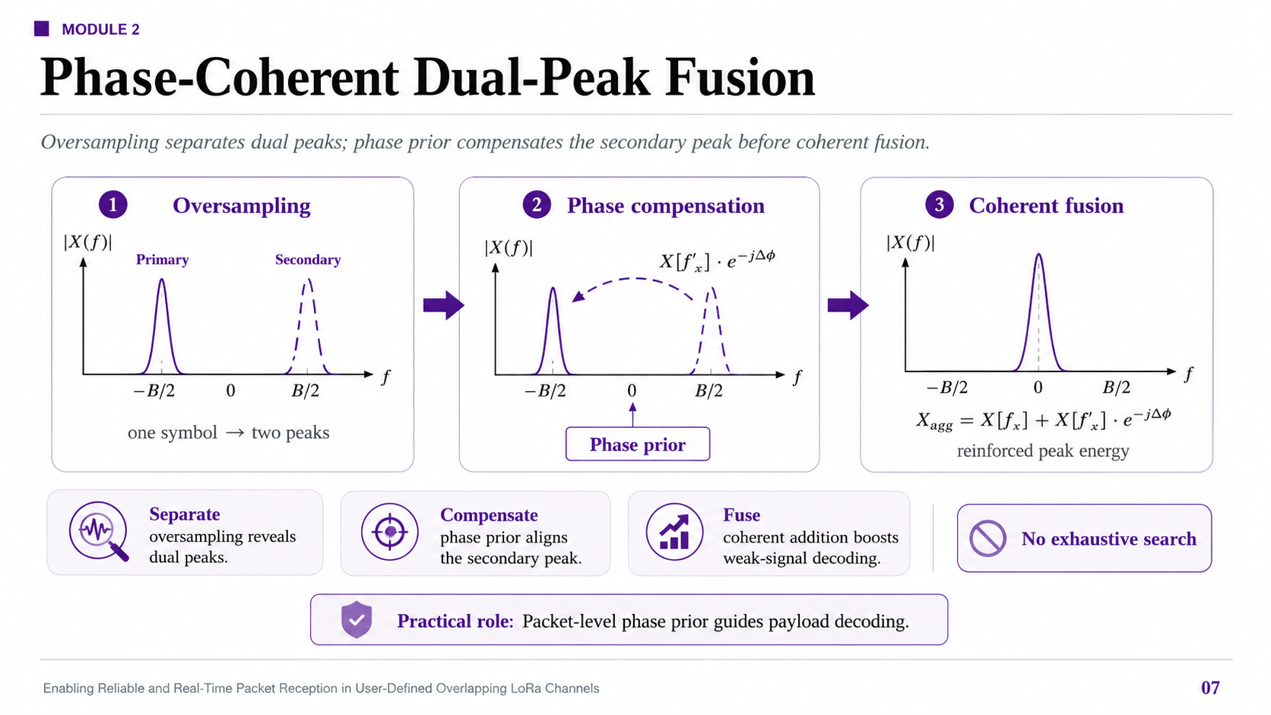



IEEE SECON 2026
MODULE 2
Phase-Coherent Dual-Peak Fusion
Oversampling
Oversampling
Phase compensation
Coherent fusion
Coherent fusion
$$|X(f)|$$
$$|X(f)|$$
$$|X(f)|$$
Primary
Secondary
$$|X(f_{x}^{’})|·e^{−j∆φ}$$
$$X_{agg}=X[f_{x}]+X[f_{x}^{’})]·e^{−j∆φ}$$
one symbol -> two peaks
one symbol -> two peaks
Phase prior
reinforced peak energy
Separate
Compensate
Fuse
phase prior aligns the secondary peak.
oversampling reveals dual peaks.
phase prior aligns the secondary peak.
coherent addition boosts weak-signal decoding.
07
Notes:
The second module is phase-coherent dual-peak fusion.
Under oversampling, a split LoRa symbol produces a primary peak and a secondary peak in the frequency domain. These two peaks correspond to two chirp segments of the same symbol.
UniChirp fuses them in three steps.
First, oversampling separates the two peaks.
Second, the phase prior is used to rotate the secondary peak in the complex domain, so that it becomes phase-aligned with the primary peak.
Third, the two peaks are coherently added.
The key operation is not magnitude summation, but **phase-aligned complex-domain addition**. This allows UniChirp to recover energy that would otherwise be lost due to phase mismatch.
It is also efficient because the packet-level phase prior avoids exhaustive phase search.

Slide 9
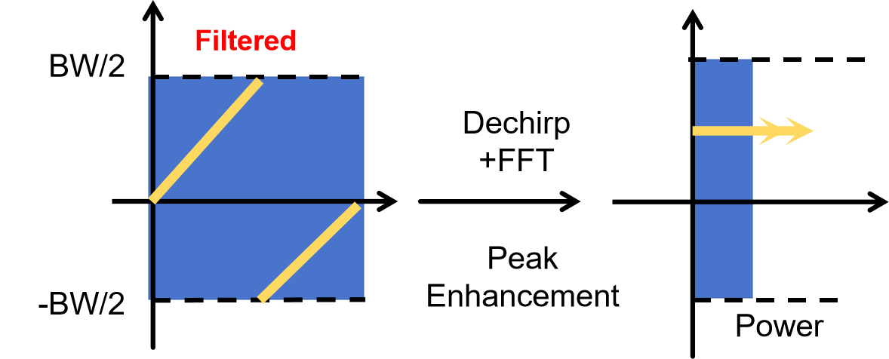
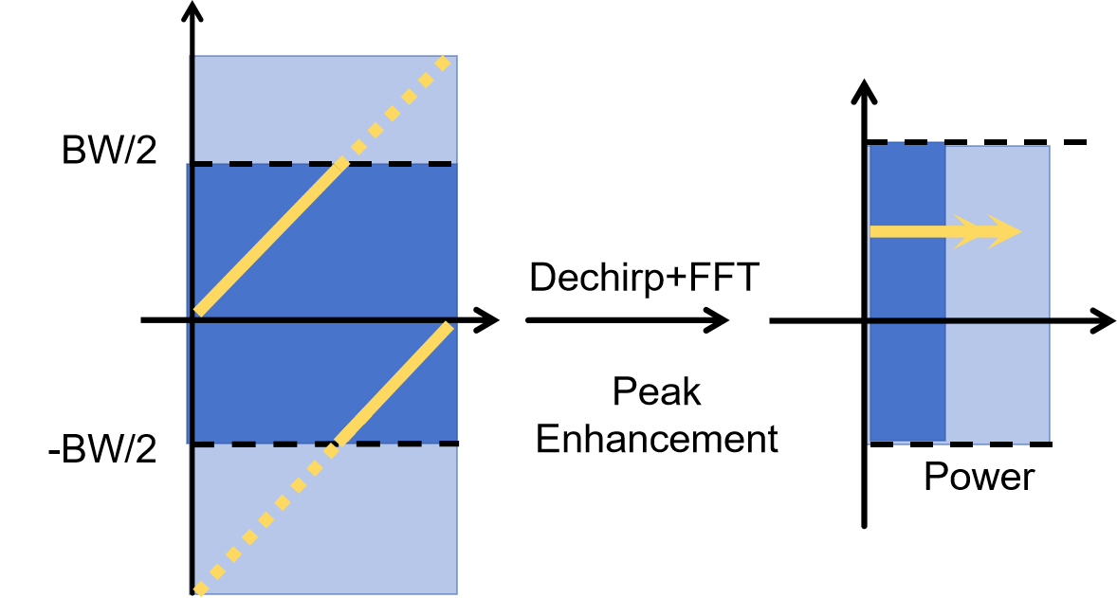
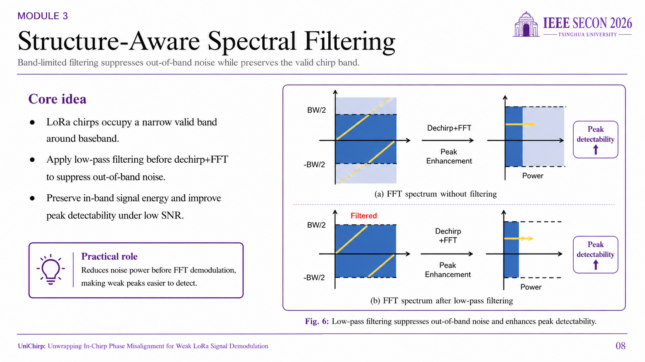
IEEE SECON 2026
MODULE 3
Structure-Aware Spectral Filtering
Core idea
  LoRa chirps occupy a narrow valid band around baseband.
  Apply low-pass filtering before dechirp+FFT to suppress out-of-band noise.
  Preserve in-band signal energy and improve peak detectability under low SNR.
Practical role
  Reduces noise power before FFT demodulation, making weak peaks easier to detect.
08
Notes:
The third module is structure-aware spectral filtering.
Even after phase alignment, low-SNR demodulation remains difficult because the FFT output may contain strong noise peaks.
LoRa chirps occupy a known valid band around baseband. However, the received signal may also contain wideband out-of-band noise.
Therefore, UniChirp applies low-pass filtering before dechirp and FFT. This preserves in-band LoRa signal energy while suppressing irrelevant noise.
This module complements phase-coherent fusion. The phase prior improves energy aggregation, while filtering reduces noise power and makes the target peak easier to detect.

Slide 10
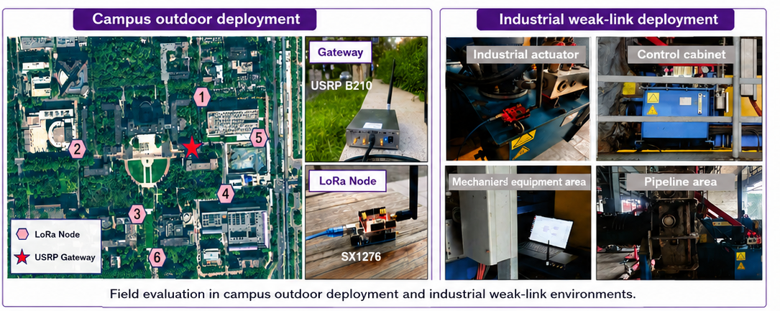
IEEE SECON 2026
Implementation and Evaluation Setup
Experimental settings
Campus outdoor deployment
Industrial weak-link deployment
  SDR testbed: USRP N210 / B210 with SBX daughterboards
  Baseband processing: GNU Radio + MATLAB
  Field nodes: off-the-shelf SX1276-based LoRa nodes
  Outdoor scenario: campus-scale deployment around buildings and vegetation
Baselines and metrics
LoRaWAN
Ostinato
Choir
LoRaTrimmer
NELoRa
Metrics
symbol accuracy, SER, BER, throughput, runtime
standard LoRa
demodulation
repeated-symbol accumulation
magnitude-domain dual-part summation
phase compensation with candidate search
learning-based weak-signal demodulation
09
Notes:
We implement UniChirp with software-defined radios and commercial LoRa devices.
The SDR testbed uses USRP devices, and the baseband processing is implemented in GNU Radio and MATLAB.
For field nodes, we use off-the-shelf LoRa devices. This confirms that UniChirp does not require customized transmitters.
We evaluate UniChirp in both campus outdoor and industrial weak-link environments. The industrial scenarios include control cabinets, mechanical equipment areas, and pipeline areas, where attenuation and multipath are severe.
We compare UniChirp with LoRaWAN, Ostinato, Choir, LoRaTrimmer, and NELoRa. The metrics include symbol accuracy, SER, BER, throughput, and runtime.

Slide 11
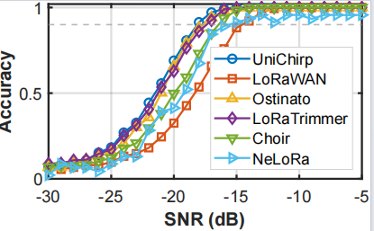
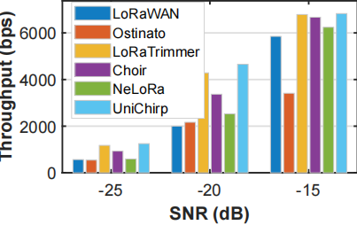
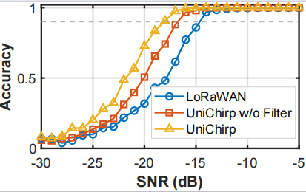
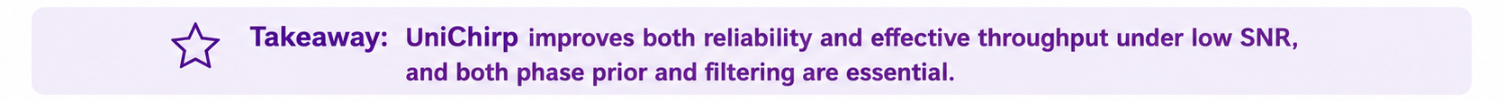
IEEE SECON 2026
Main Results: Better Robustness under Low SNR
  Highest throughput across tested SNRs
  Up to +3421.4 bps gain; up to 35.3% in low SNR
  Phase prior already brings clear gains
  w/o Filter: up to +18.8% at -20 dB
  Filtering adds another +22.2%
  90% accuracy down to -18 dB
  At -20 dB: +3.5% to +35.2% vs. baselines
Takeaway: UniChirp improves both reliability and effective throughput under low SNR, and both phase prior and filtering are essential.
10
Notes:
The main result is that UniChirp achieves stronger robustness under low SNR.
For symbol accuracy, UniChirp achieves the best performance across the tested SNR range. It maintains 90 percent symbol accuracy down to **-18 dB**.
At **-20 dB**, UniChirp improves symbol accuracy by **3.5 percent to 35.2 percent** compared with the baselines.
For throughput, UniChirp also achieves the highest throughput across the tested SNRs. The throughput gain reaches up to **3421.4 bits per second**, or **35.3 percent** in the low-SNR region.
The ablation study further shows that both components are useful. The preamble-guided phase prior already brings clear gains, and structure-aware filtering provides additional improvement.
So the takeaway is: UniChirp improves both reliability and effective throughput under weak-signal conditions.

Slide 12
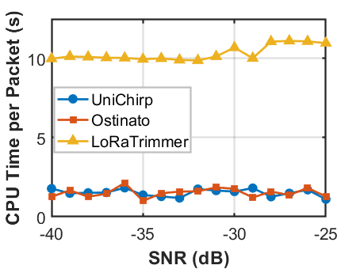
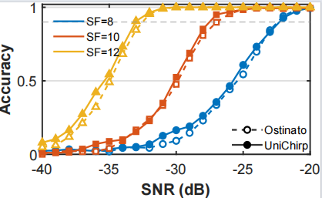
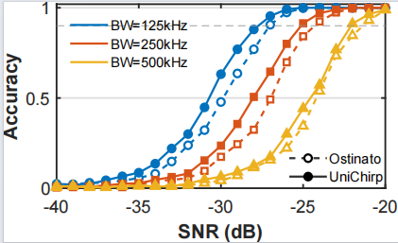
IEEE SECON 2026
Efficiency, Generality, and Takeaways
  At SF=12: 1675 ms for UniChirp vs. 10931 ms for LoRaTrimmer.
  LoRaTrimmer reaches 12156 ms, about 6.5× UniChirp.
  At -30 dB, gains reach 6.0% at SF=8 and 5.2% at SF=10.
  At -30 dB, gains are 11.2%, 4.0%, and 2.8% at 125/250/500 kHz.
Generalizes across LoRa parameter settings while maintaining practical receiver-side efficiency.
11
Notes:
UniChirp also generalizes across LoRa settings.
Across different spreading factors, UniChirp still improves accuracy under very low SNR.
Across different bandwidths, UniChirp also brings consistent gains under 125, 250, and 500 kHz.
In terms of runtime, UniChirp is much more efficient than the baseline of UniChirp.
This efficiency comes from the phase-prior-guided design. Instead of searching over many candidate phases, UniChirp uses the preamble-estimated phase trajectory to guide payload decoding.
The main message is that UniChirp is both general and practical for receiver-side deployment.

Slide 13
IEEE SECON 2026
Conclusion
Problem
Method
Result
  Weak industrial links fall below standard LoRa decoding thresholds.
  Phase misalignment prevents coherent chirp energy aggregation.
  Predict packet-level phase trajectory from preamble symbols.
  Compensate and fuse dual peaks without exhaustive search.
  90% accuracy down to −18 dB.
  Robust across LoRa settings with practical receiver-side runtime.
Thanks
12
Notes:
Let me conclude.
This paper studies weak LoRa signal demodulation in challenging industrial and outdoor environments.
The key problem is that standard LoRa demodulation cannot coherently aggregate split chirp energy when in-chirp phase misalignment exists.
UniChirp addresses this problem with three ideas.
First, it models the in-chirp phase discontinuity caused by timing and sampling offsets.
Second, it constructs a packet-level phase prior from preamble symbols.
Third, it uses this prior to compensate and fuse dual peaks coherently, together with spectral filtering to suppress out-of-band noise.
The evaluation shows that UniChirp improves low-SNR accuracy, throughput, generality, and runtime efficiency, while remaining a software-only receiver-side framework.
That concludes my presentation. Thank you very much. I am happy to take questions.

