Slide 1

ACM SIGKDD 2026 (KDD ’26)
Edge–Cloud Collaborative Multimodal
Dehazing for UAV Vision
Communication-efficient intelligent sensing under complex weather conditions
EDGE
LINK
CLOUD
Selective IR
In-band SEI
Parallel AI
Sensing + Communication
+ Computing, co-designed
Junwei Zhao · Qianchun Luo · Jie Wu*
China Telecom Cloud Computing Research Institute
Supported by the China Telecom Key Research Project on Intelligent Ubiquitous Cloud Technologies (No. 65996).

Slide 2
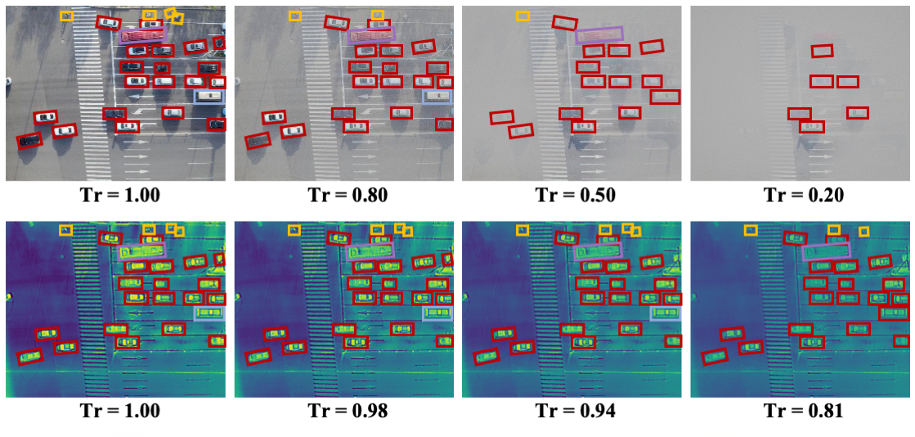
Low-Altitude Perception: Demand and Constraints
Infrastructure inspection
Emergency response
Low-altitude economy
Autonomous aerial sensing
WHAT CONSTRAINS IT
VISIBLE VS. INFRARED AS HAZE INCREASES
1
Device
Onboard compute and power budgets are tight — full-capacity models do not fit.
2
Link
The air-to-ground uplink is narrow and fluctuates; the per-frame bit budget is not stable.
3
Environment
Dense haze scatters the visible band and erases small ground targets.
Top: visible band — detections collapse as transmittance falls to 0.20.
Bottom: thermal infrared — the same targets persist. Source: paper Fig. 2(c).
4
Cloud
Capacity is abundant — but only reachable through constraint 2.
2 / 14

Slide 3
Why Neither Cloud-Only nor Edge-Only Works
Cloud-only
Edge-only
Collaborative
ship everything up, compute remotely
keep everything onboard
decide at the edge, reconstruct in the cloud
UAV
Cloud
UAV
✗
Cloud
UAV
Cloud
+65.5 kbit/frame
no uplink — but no capacity
+6.6 kbit/frame
✓
Full model capacity
✓
Lowest latency
✓
Full capacity, on the cloud side
✗
Second modality floods the uplink
✗
4 of 7 baselines exceed Orin Nano memory
✓
Sparse, task-selected uplink
✗
Transmission-bound latency
✗
Fastest that fits still needs 128 ms/frame
✓
Bounded latency under a weak link
How do we jointly optimise computation and communication?
EVIDENCE · TABLE 1
Full-frame IR alone costs 65.5 kbit/frame — 65.5 ms at 1 Mbps, twice the 33.3 ms budget of a 30 fps stream.
Not “which dehazing model is best”, but: given a fixed number of bits per frame, which bits do you spend?
3 / 14

Slide 4
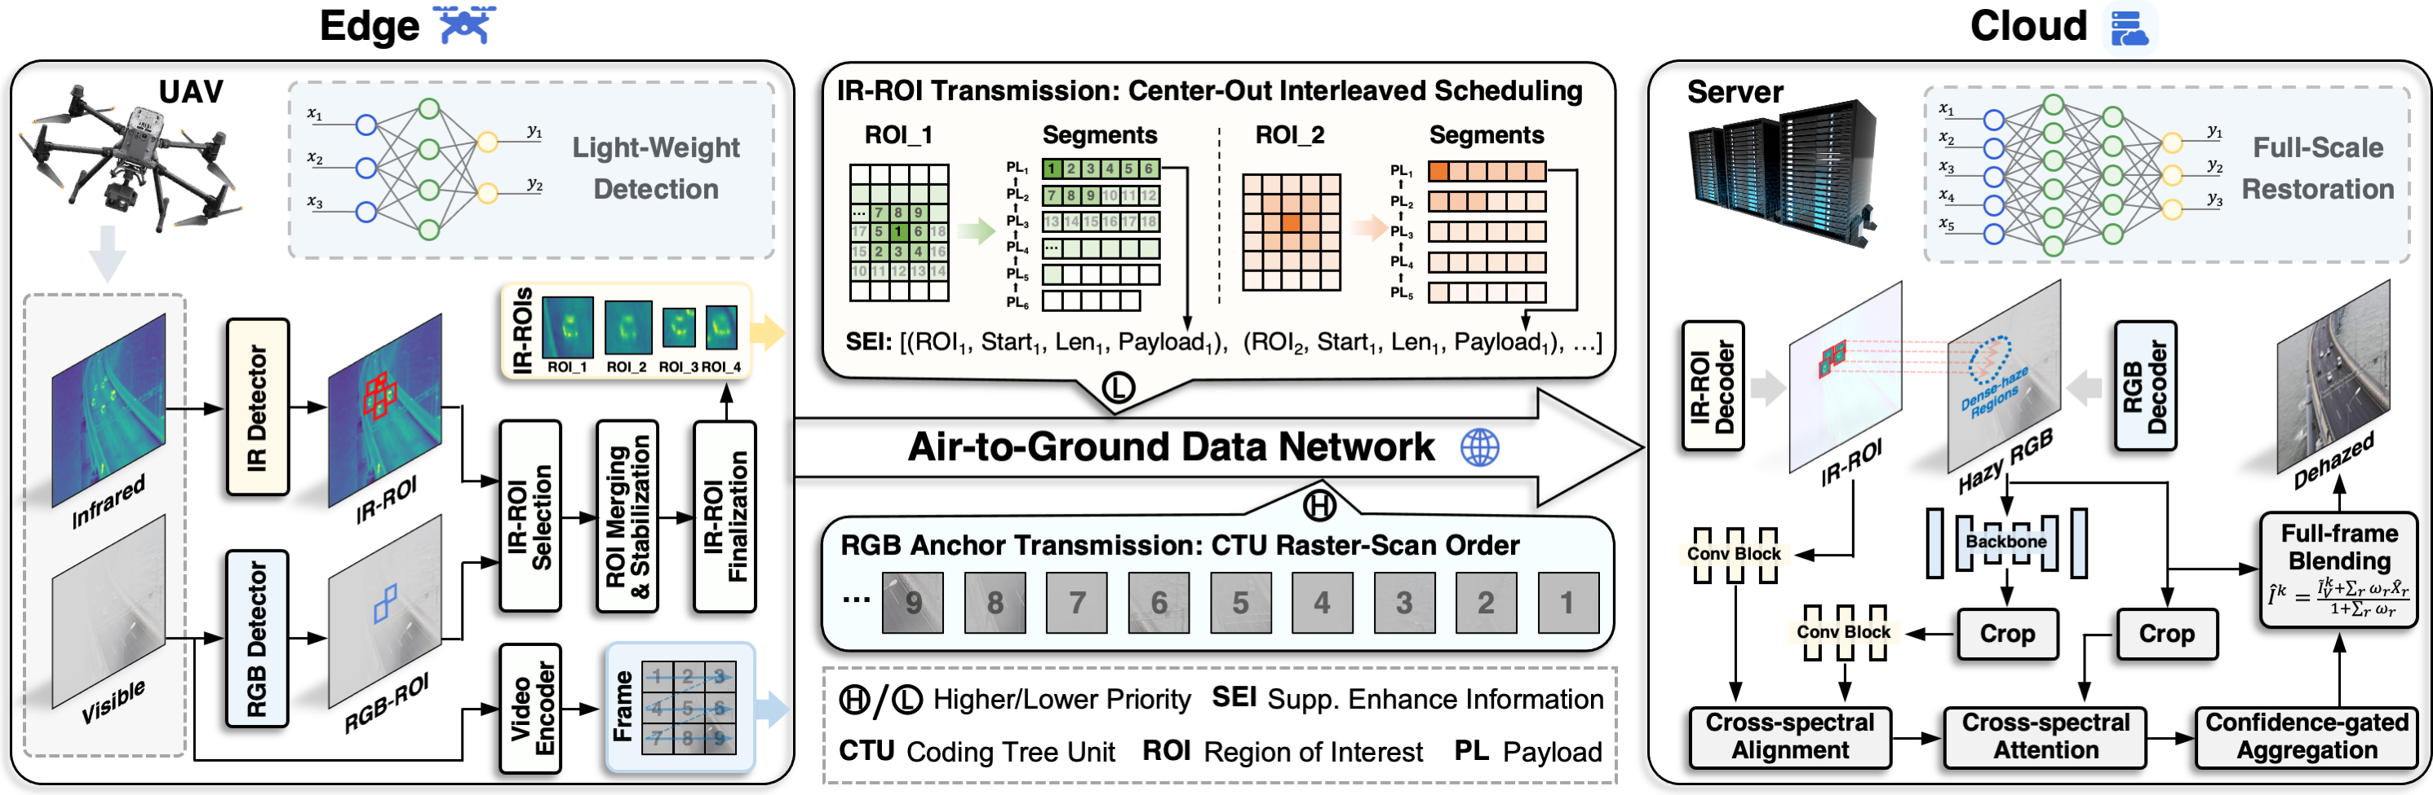
System Overview: The Collaborative Pipeline
EDGE · LINK · CLOUD
Three stages under one contract — the edge decides where, the link carries only that, the cloud reconstructs in parallel.
Edge decides where
Link carries only that
Cloud reconstructs in parallel
VIS is the anchor stream; infrared is requested only where visible evidence has collapsed.
A single H.26x track — IR pixels embedded in-band as SEI, with ROI cores ordered first.
Every ROI processed concurrently on GPU, then confidence-gated blending into the frame.
4 / 14

Slide 5
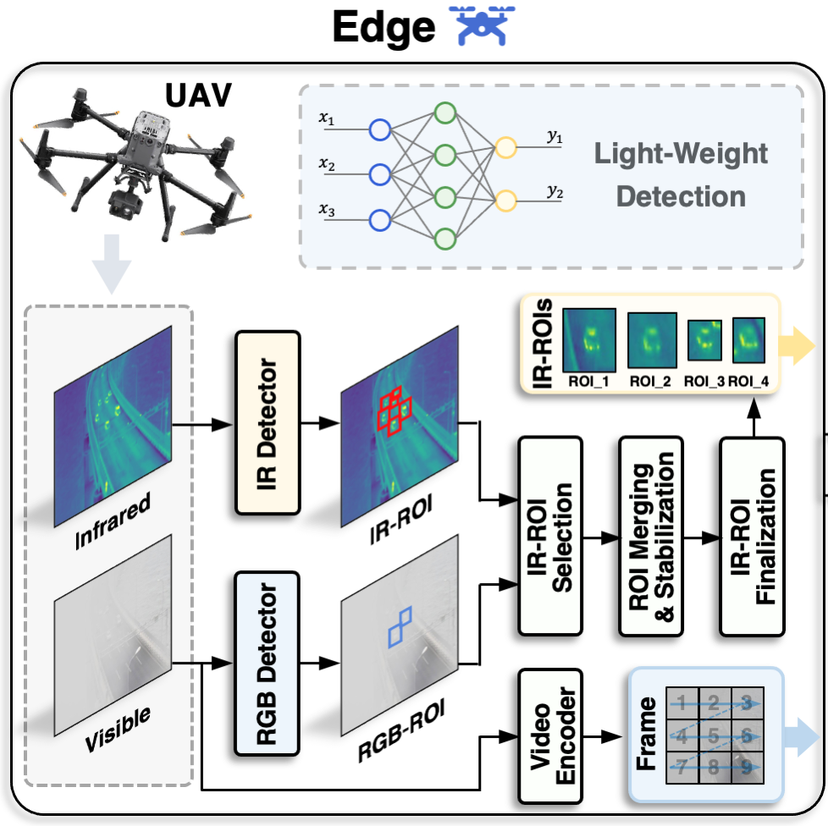
Edge Side: Deciding What Deserves the Uplink
EDGE
The edge does not compress the image — it performs selection, a far cheaper computation and a far larger bandwidth saving.
THE SELECTION RULE, IN WORDS
Transmit infrared where the IR detector is confident and no visible detection overlaps it — that is, where infrared carries information the visible stream has already lost.
Δ = ŝ_IR · (1 − IoU_max) · transmit if Δ ≥ θ_diff and area ≥ A_min · tuned optimum θ_diff = 0.4, A_min = 576 px² (Table 5)
WHAT RUNS AT THE EDGE — AND WHY IT BELONGS THERE
Module | Cost profile | Why the edge
Lightweight VIS + IR detectors | small, fixed-cost inference | must see raw sensor data before encoding
Differential ROI criterion | arithmetic on box lists | needs both modalities co-located
Merge · stabilise · track IDs | negligible | keeps the payload temporally coherent
Encoder + in-band SEI packing | hardware codec | the bit decision belongs where bits originate
Edge stage of the framework (paper Fig. 3, left panel)
6.6 kbit
per frame — the only infrared that leaves the aircraft. The payload scales with the area of degraded regions, not with frame size.
5 / 14

Slide 6
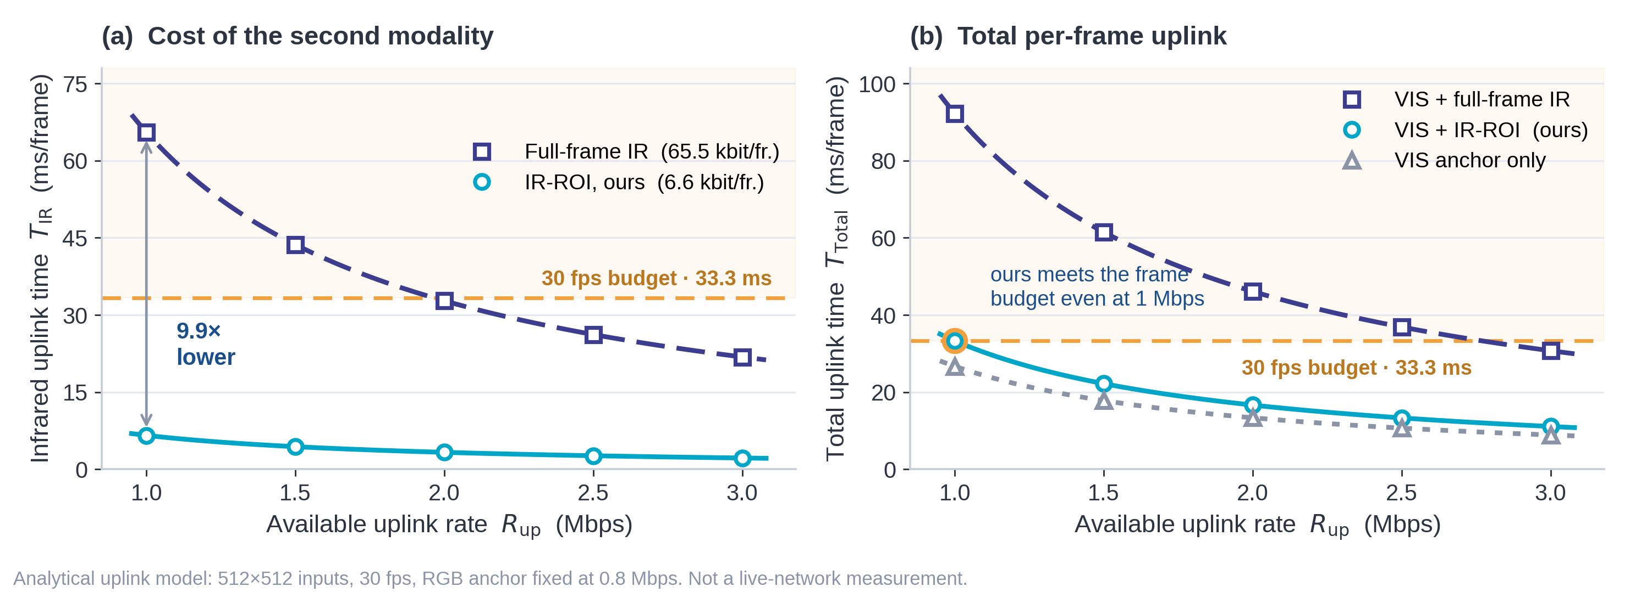
Communication-Efficient Transmission
LINK
Same restoration quality at roughly one tenth of the infrared uplink — the ratio, not the raw gain, is the contribution.
6.6 kbit
infrared payload per frame,
against 65.5 kbit for full-frame IR
− 89.9 %
infrared uplink volume
− 63.9 %
total per-frame uplink
THE COMMUNICATION–COMPUTATION TRADE-OFF IS MEASURED, NOT ASSERTED (VTUAV, Table 4)
Strategy | PSNR | mAP50 | Cloud time | IR uplink
VIS anchor only | 28.63 | 0.527 | 24 ms | 0
+ full-frame IR | 32.07 | 0.635 | 52 ms | 65.5 kbit
+ IR-ROI (ours) | 31.92 | 0.632 | 31 ms | 6.6 kbit
Give up 0.15 dB — 0.5 % — and buy 40 % of the cloud compute and 90 % of the infrared bits.
6 / 14

Slide 7
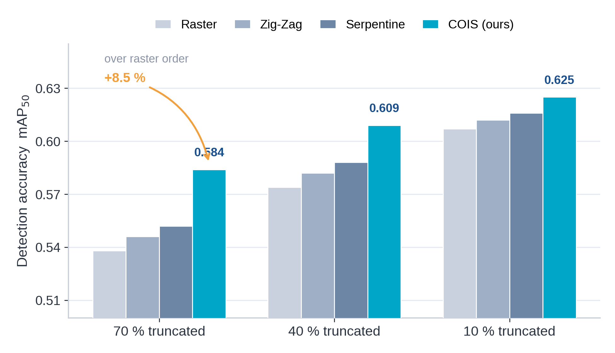
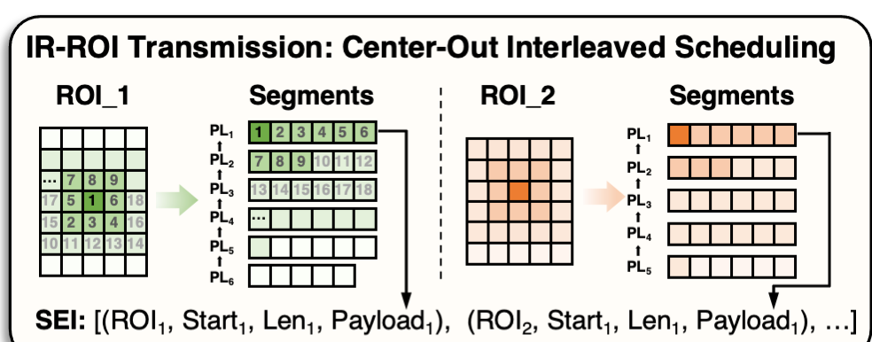
Robustness When the Uplink Fluctuates
LINK
Bandwidth loss is modelled as prefix truncation — core-first scheduling keeps a truncated stream semantically useful.
Center-out spiral
Each ROI is serialised from its core outward, so the earliest bits carry the most informative pixels.
Interleaved across ROIs
Segments from all active ROIs are interleaved core-first, so no single region monopolises a short prefix.
VTUAV · SEI prefix truncation at three levels · four serialisation orders (Table 6)
COIS gains are largest where the link is worst: +8.5 % mAP50 at 70 % truncation, tapering to +3.0 % at 10 %.
Any prefix is useful
COIS leads at every truncation level and against every alternative order.
7 / 14

Slide 8
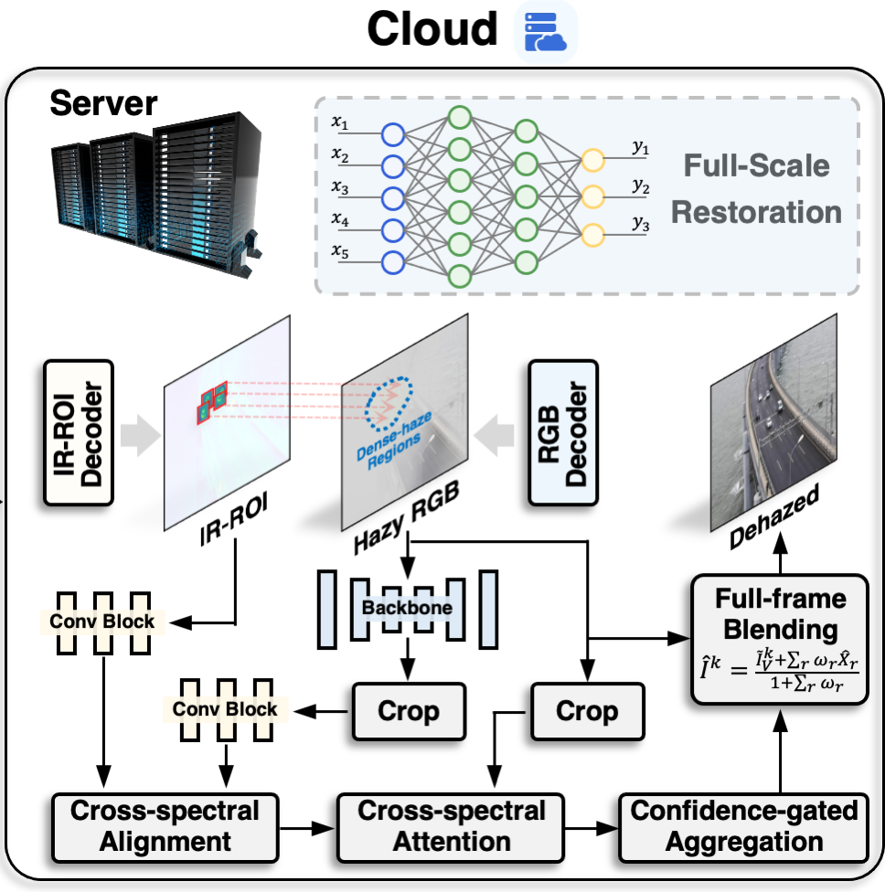
Cloud Side: Capacity Where It Actually Pays Off
CLOUD
The cloud’s advantage is parallelism as much as capacity — that is what keeps the frame deadline.
1
Scalable parallel execution
All ROIs of a frame run concurrently on GPU — cloud time falls from 52 ms (full-frame IR) to 31 ms.
2
Capacity the device cannot host
Cross-spectral alignment and attention that would not fit in onboard memory.
3
Three-stage processing
Align (coarse-to-fine displacement + confidence) → attend (inject IR residual where alignment is trusted) → aggregate (confidence-gated blending).
PIPELINED, SO THROUGHPUT IS max( · ) NOT sum( · )
Edge 26 ms
Cloud 31 ms
→ max(26, 31) = 31 ms ≤ 33.3 ms
Cloud stage of the framework (paper Fig. 3, right panel)
Graceful degradation floor. If no infrared arrives — link outage, no ROI triggered, truncated payload — the pixel falls back to the visible anchor. Enhancement is additive, never load-bearing.
8 / 14

Slide 9
What Actually Enables the Cooperation
Three mechanisms — each solving an edge–cloud systems problem.
1
2
3
Where to spend bits
Surviving a fluctuating link
Fusing across a lossy boundary
PROBLEM
PROBLEM
PROBLEM
The uplink budget is smaller than the second modality.
Bits available per frame are not known in advance.
VIS and IR arrive misaligned in time and space.
MECHANISM
MECHANISM
MECHANISM
VIS–IR differential ROI selection — transmit infrared only where visible evidence has collapsed.
ViStream-SEI with COIS — in-band single-track transport, ROI cores scheduled first.
Confidence-gated cross-spectral fusion — align, gate, and fall back to the anchor when unsure.
EVIDENCE
EVIDENCE
EVIDENCE
65.5 → 6.6 kbit/frame at −0.15 dB
+8.5 % mAP50 at 70 % truncation
+1.55 dB over HDCFN at 15 px shift
Tables 4, 10
Table 6
Table 9
9 / 14

Slide 10
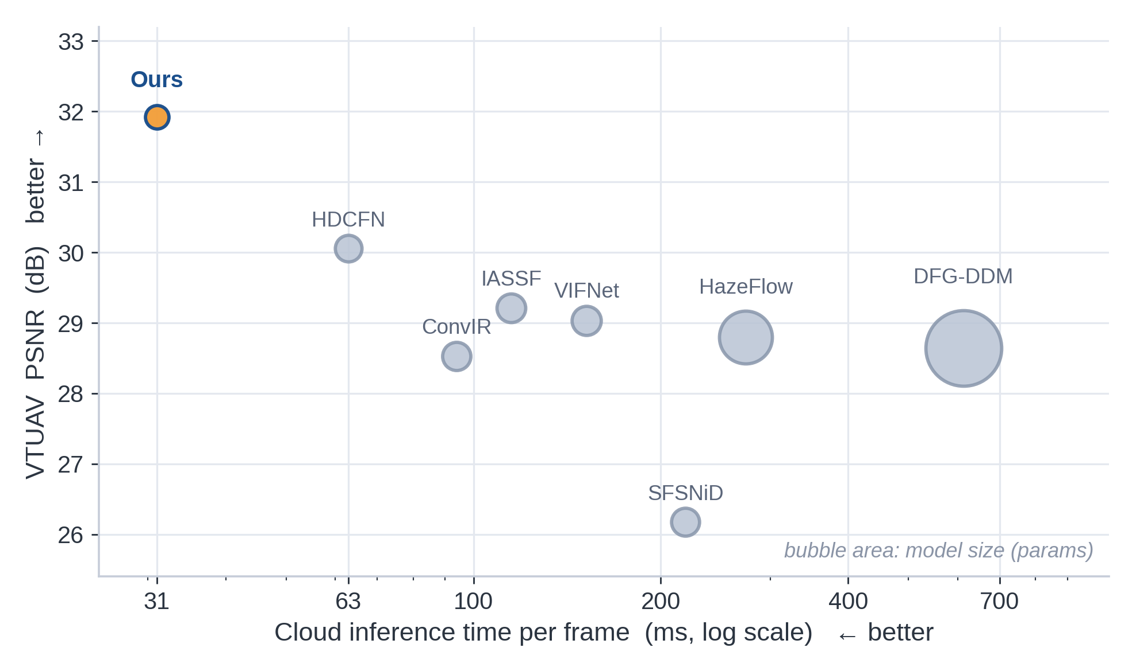
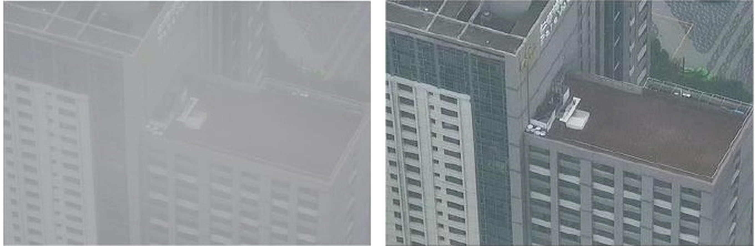
Experimental Validation Across Four System Axes
Validated as a system — quality, communication, computation and a real aircraft — not only as an image-quality benchmark.
① ③ QUALITY–COST FRONTIER · VTUAV, 7 baselines
② COMMUNICATION EFFICIENCY
−89.9 % infrared uplink · +8.5 % mAP50 at 70 % truncation
① DOWNSTREAM PERCEPTION · YOLOv8m on VTUAV
Metric | HDCFN | Ours | Gain
mAP50 | 0.581 | 0.632 | +8.8 %
mAR50 | 0.656 | 0.702 | +7.0 %
The recall gain is the meaningful one — fewer missed small, low-contrast targets.
④ REAL AIRCRAFT, REAL WEATHER
hazy input → ours
+1.86 dB PSNR over the best baseline · −49 % parameters · 4.9× faster on the edge device
Zenmuse H20T UAV · ~15,000 real VIS–IR frames · best NIQE 15.70 / PIQE 34.89
10 / 14

Slide 11
Deployment Concept: Cloud–Network–Edge Inspection
Architectural positioning — not evaluated in the paper. The paper models uplink at 1–3 Mbps citing an LTE–UAV feasibility study; it runs no 5G field trial, no end-to-end glass-to-glass latency measurement, and no multi-UAV scheduling evaluation.
UAV sensing
Edge gateway
Mobile network
Cloud AI platform
Decision support
VIS + IR capture
ROI selection, in-band packing
26 ms/frame, Orin-class device
uplink-constrained bearer
payload shaped to 1–3 Mbps
ROI-parallel enhancement
31 ms/frame on GPU
defect and hazard detection,
alerting, archival
Standards-compatible transport
Degradation is graceful, not cliff-edged
The infrared payload rides as user_data_unregistered SEI inside a single H.26x track. No second stream, no bespoke protocol, no change to the bearer — it traverses ordinary video infrastructure.
Bandwidth loss costs enhancement quality, never stream integrity. The visible anchor always survives, so the analytics pipeline never goes dark.
WHAT THIS WORK CONTRIBUTES AT EACH LAYER
Layer | Operator asset | Contribution of this work
Aircraft / edge gateway | UAV + onboard compute (Orin-class) | 26 ms/frame selection stage — fits the device budget
Access network | mobile uplink bearer | payload shaped to a 1–3 Mbps budget; single standard video track
Cloud | GPU inference platform | ROI-parallel enhancement at 31 ms/frame
11 / 14

Slide 12
Contributions: Computing, Communication, Intelligence
Three separable contributions — and it is worth being precise about which is which.
COMPUTING
COMMUNICATION
INTELLIGENCE
system architecture contribution
communication efficiency contribution
algorithm contribution
Collaborative workload allocation
ViStream-SEI with COIS
Differential selection + gated fusion
An asymmetric split: cheap, decisive selection at the edge; expensive, parallel reconstruction in the cloud — executed as a pipeline.
Single-track, in-band ROI transport whose any prefix is useful — and which needs no change to the bearer.
Infrared used exactly where the visible band has failed, gated by cross-spectral alignment confidence.
26 ms edge / 31 ms cloud
−89.9 % infrared uplink at −0.15 dB
+1.86 dB PSNR · +8.8 % mAP50
throughput = max( · ), not sum( · )
+8.5 % mAP50 under 70 % truncation
+7.0 % mAR50
3.47 M parameters — lowest in the comparison
standards-compatible H.26x SEI
robust to ±2-frame and 15-px misalignment
The system contribution is the ratio, not any single number: 0.5 % of quality for 90 % of the bits and 40 % of the cloud compute.
12 / 14

Slide 13
Thanks for watching!

