Slide 1




Exploiting Outlier Value Effects in Sparse Urban CrowdSensing
En Wang, Mijia Zhang, Yongjian Yang, Yuanbo Xu*
Jie Wu
Speaker: Mijia Zhang

Slide 2
Outlines
  Introduction and challenges
  Contributions
  Model
  Experiments

Slide 3
Section 1: Introduction and challenges

Slide 4
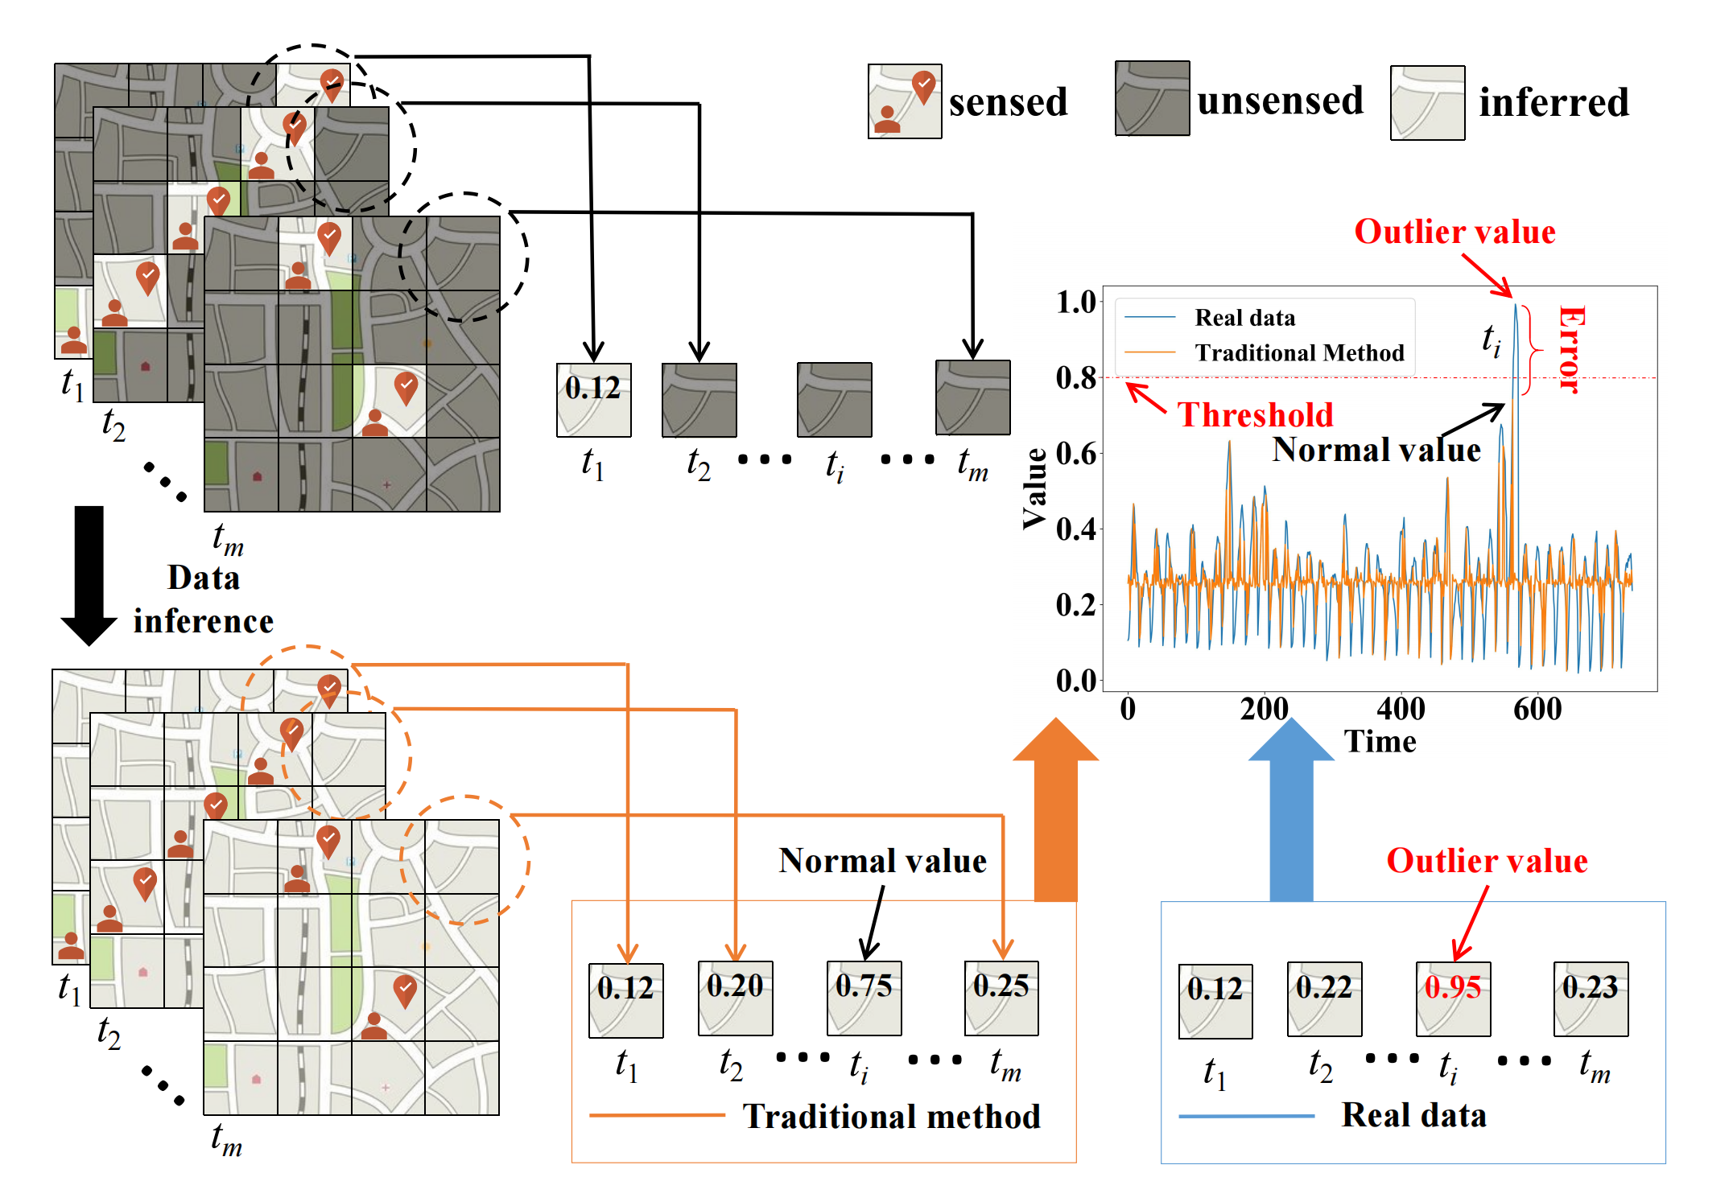
1. Introduction and challenges
  1) rarity and unpredictability
  2) inconsistency
  compared to normal values
  3) complex spatiotemporal relations
  An example to describe the outlier value effect in data
  inference problem.

Slide 5
1. Introduction and challenges
Challenges
  recover outlier values from such rare outlier value data
  deal with inconsistent data distribution
  extract the complex spatiotemporal relationship of outlier value data

Slide 6
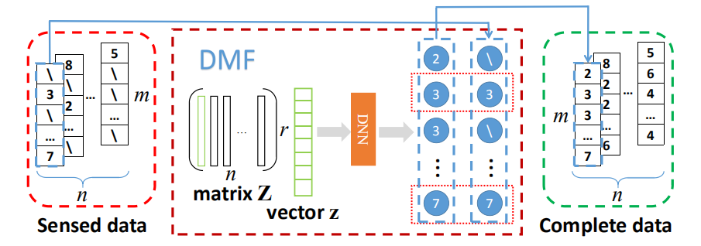
1. Introduction and challenges
How to deal with challenges
  DMF + OVLoss
  Outlier Value Model

Slide 7
Section 2: Contributions

Slide 8
2. Contributions
Our work has the following contributions:
  formalize the sparse urban crowdsensing problem
  propose an urban crowdsensing method named DMF-OV
  evaluate the proposed method on three real-world datasets with three typical urban sensing tasks.

Slide 9
Section 3: Model

Slide 10
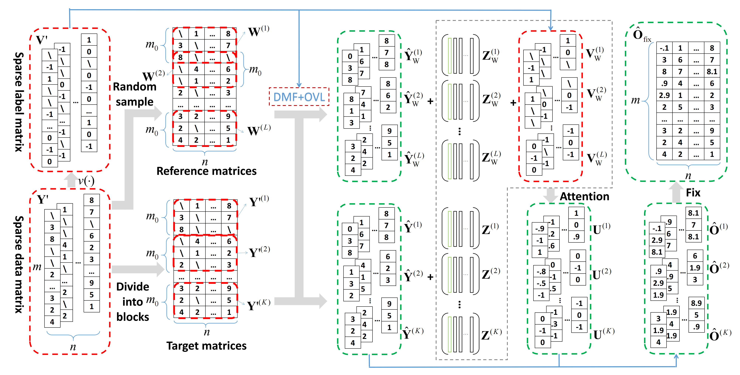
3. Model
Framework Overview (DMF + OVLoss)

Slide 11
3. Model
Framework Overview (Outlier Value Model)
Embedding Module
Label Matrix Module

Slide 12
Section 4: Experiments

Slide 13
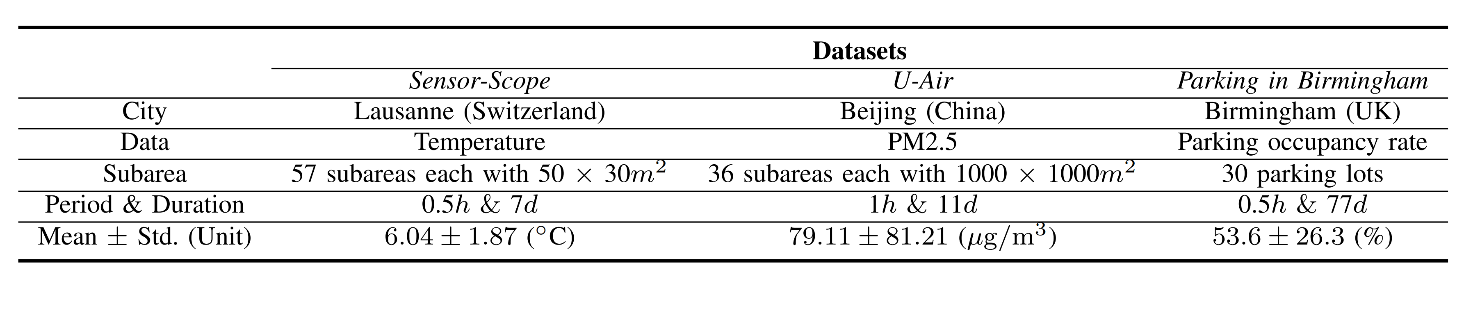
4. Experiments
Statistics of three evaluation datasets.
Baselines
  KNN
  GP
  DMF
  IGMC

Slide 14
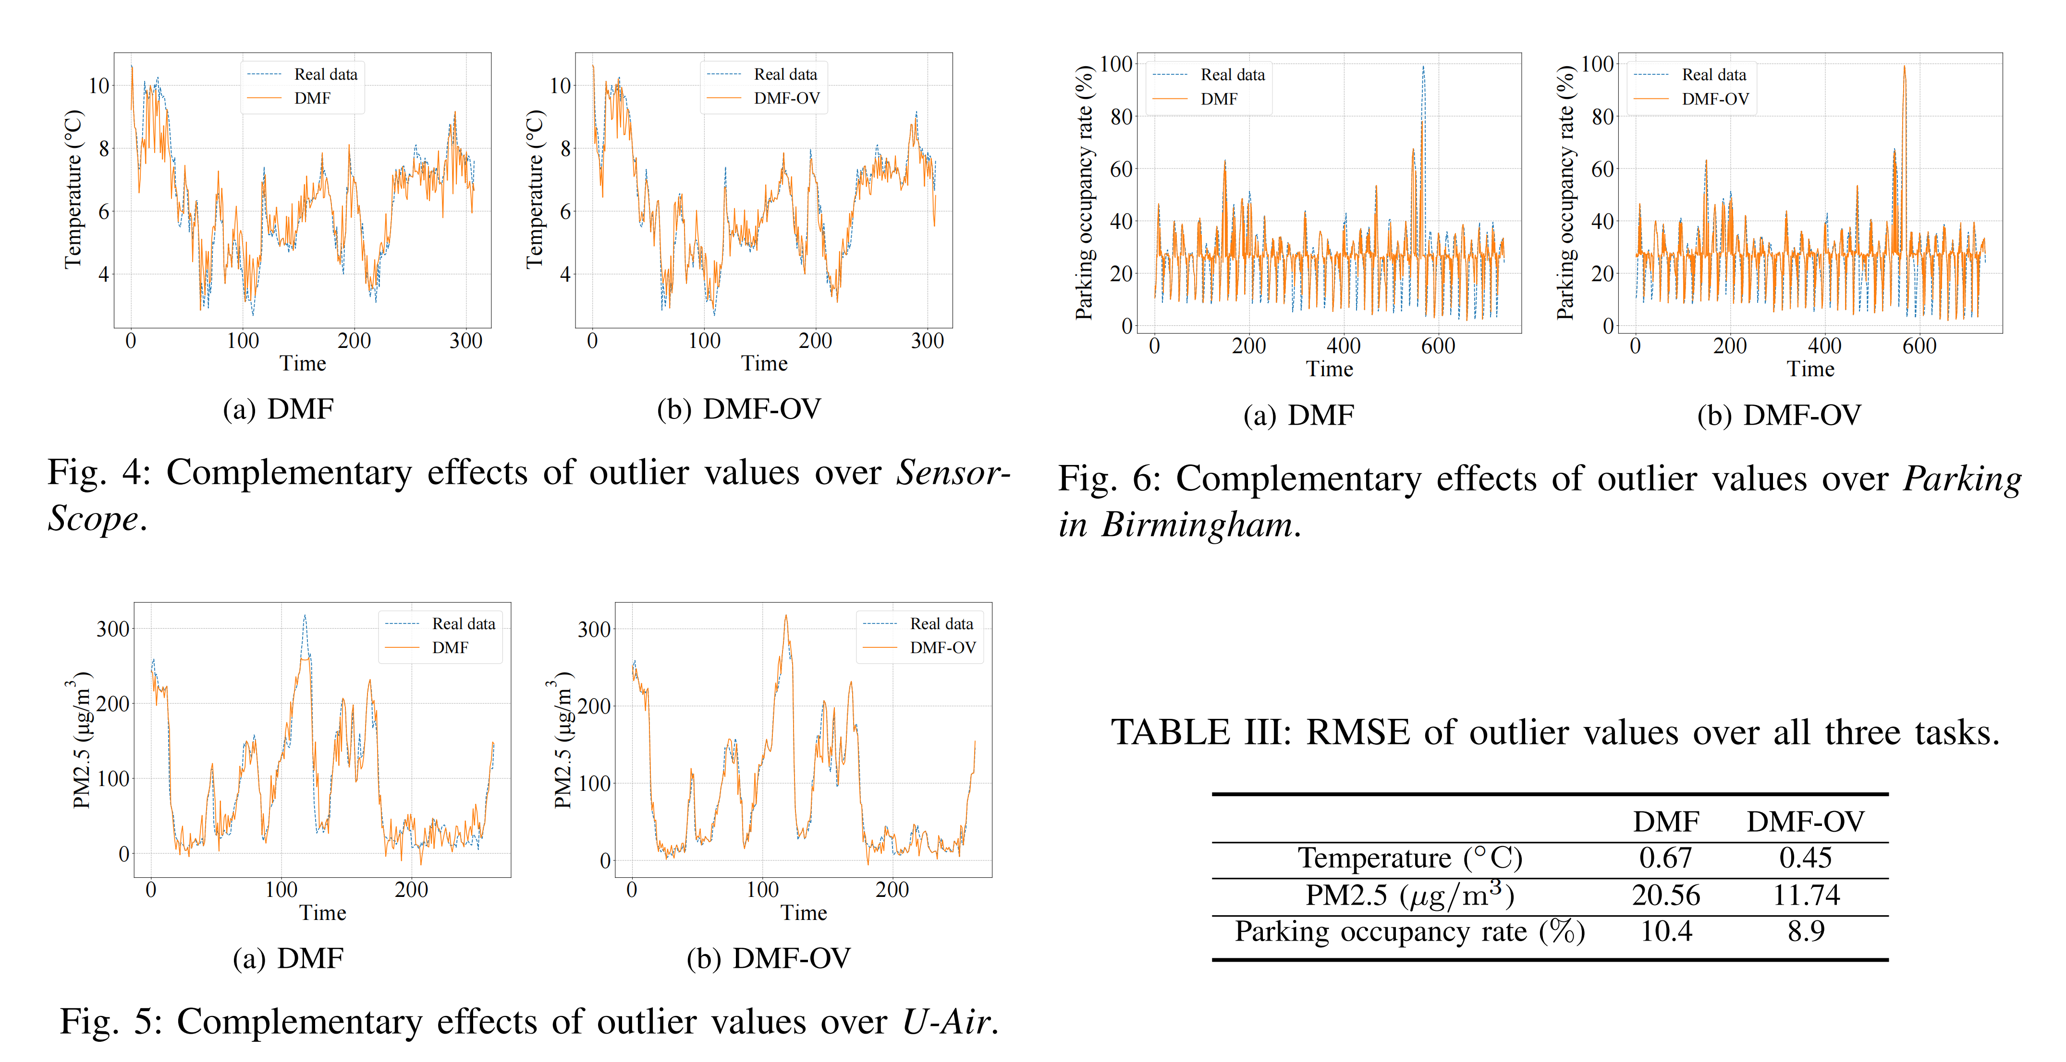
4. Experiments
RQ1: Does our method really work for outlier value data effectively?

Slide 15
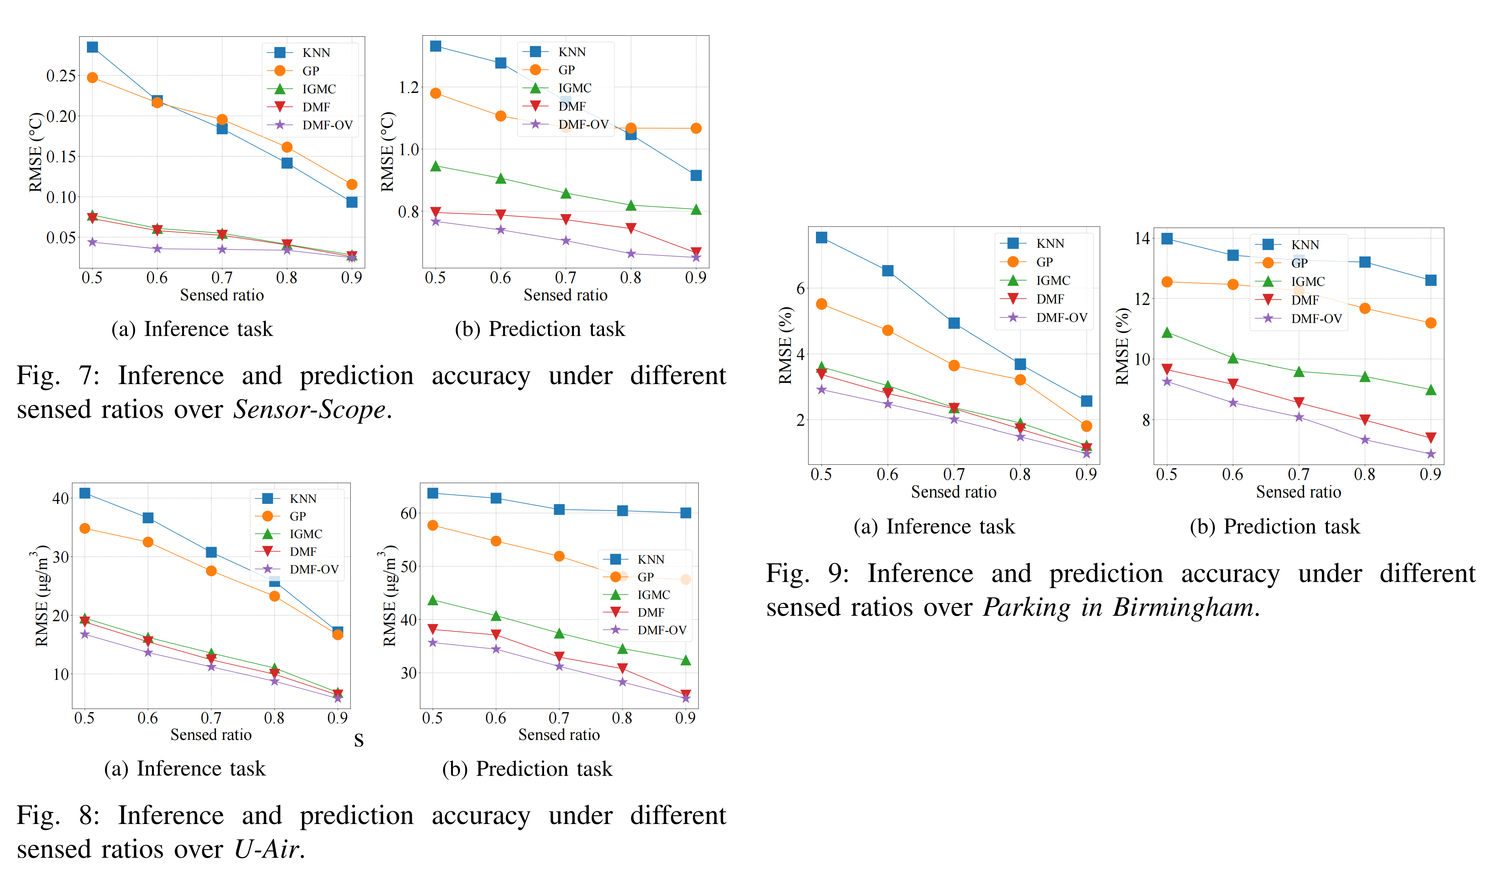
4. Experiments
RQ2: Does our method improve the accuracy of matrix completion and prediction?

Slide 16
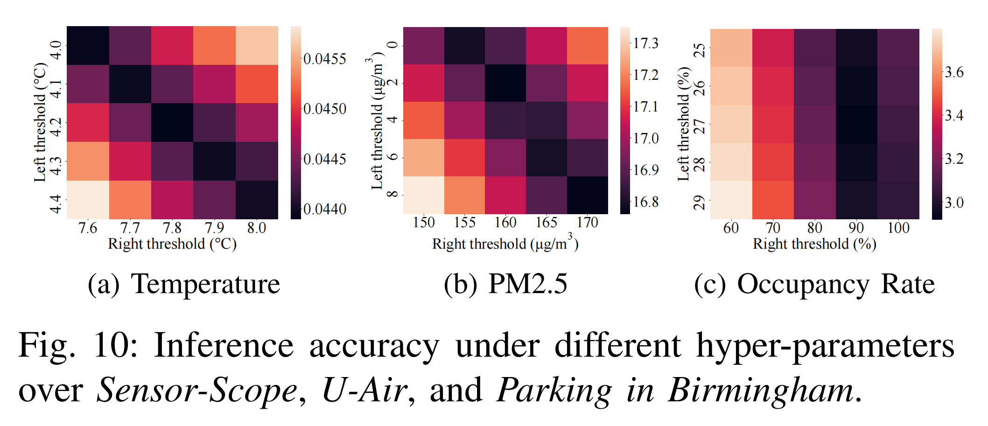
4. Experiments
RQ3: What are the influences of hyper-parameters in the model?

Slide 17

Thanks for listening.
Q&A

