Slide 1

Flow Migrations in Software Defined Networks:
Consistency, Feasibility, and Optimality
Yang Chen, Huanyang Zheng, and Jie Wu
Center for Networked Computing
Temple University, USA

Slide 2
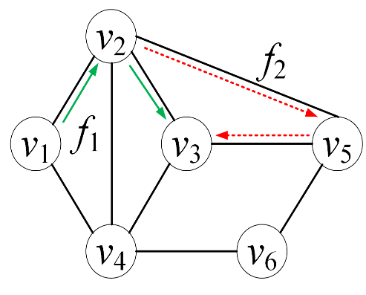
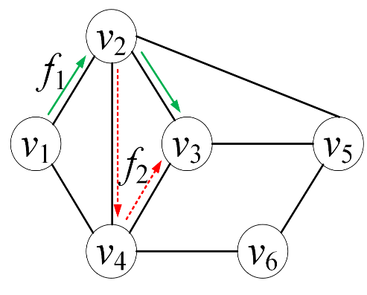
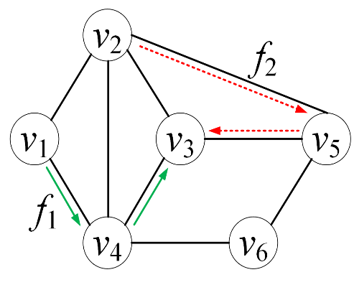
1. Introduction
Flow migration in SDN
Upon traffic changes
Challenges:
Asynchronous rule updates -> congestion -> deadlocks
Basic update methods:
Ordering migrate protocols
Two-phase migrate protocols
Flow | Tag | Action
f₂ | old | forward to v₄
f₂ | new | forward to v₅
… | … | …
Initial State Final State
Notes:
Causes of network update：(1) changes in security policies (2) traffic engineering in the network (3) network maintenance work (4) reaction to link
Networking updates in SDNs consist of hardware upgrades, deployment modifications, and configuration changes. Flow migration is an important kind of configuration change.
Only two flows: f1 and f2. Each directional link has a capacity of 1 and each flow has a bandwidth of 1.

Slide 3
Proposed Method
  Ordering migrate protocols
    Pros: no additional overhead
    Cons: do not always exist
  Two-phase migrate protocols
    Pros: simple and fast
    Cons: overhead from packet tagging and extra rules,
    imperfect synchronization
  In this paper we use spare paths for flow migration.

Slide 4
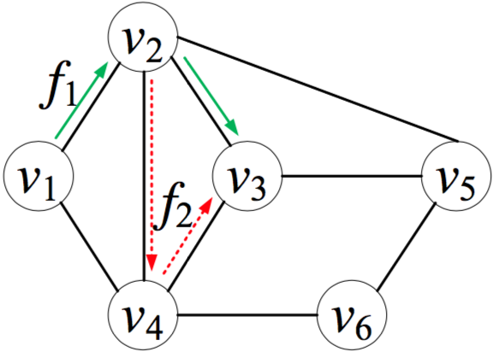
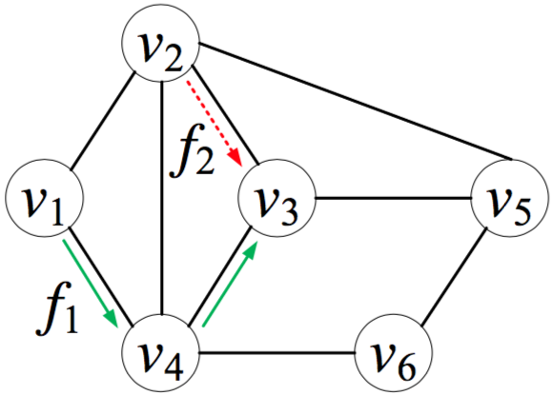
A Motivating Example
Ordering protocols do not always work
overlap between flows’ initial and final paths
Initial State Final State
Unit flow capacity/flow demand
Flows are un-splittable
The initial path of f₁ overlaps the final path of f₂, and vice versa
Notes:
Neither of the flows can migrate to their final paths because of the link congestion.

Slide 5
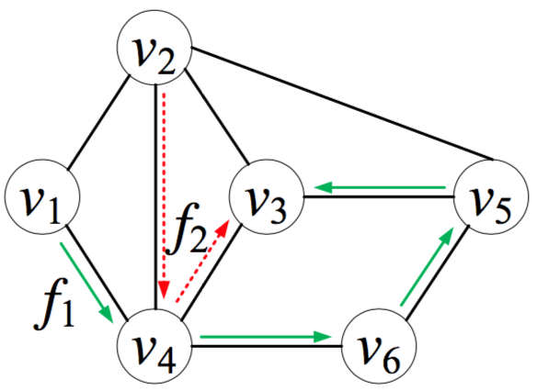
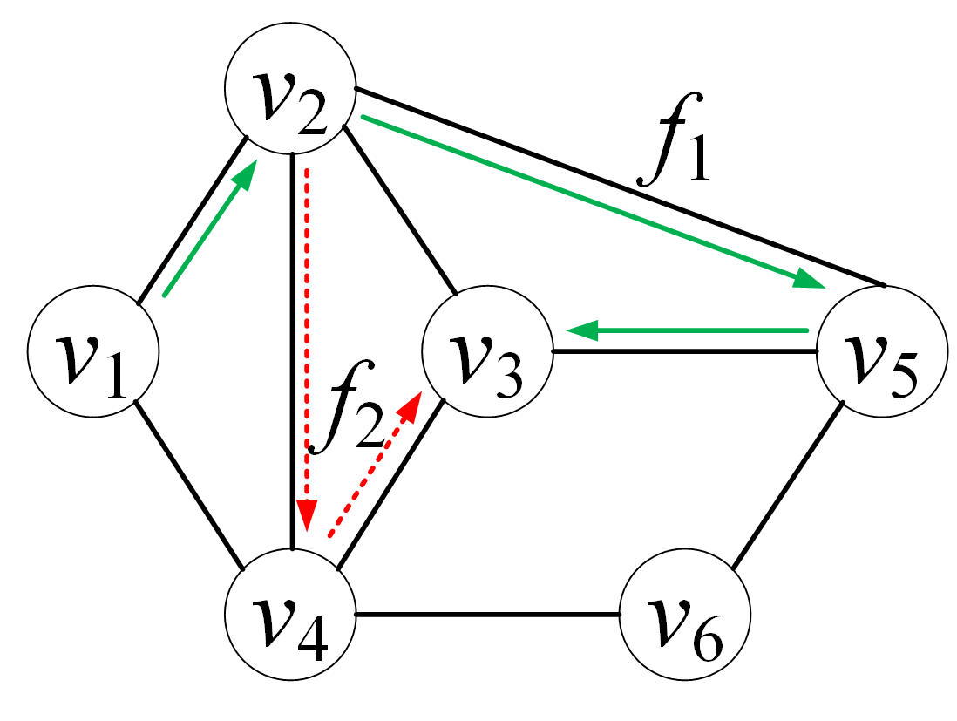
Example (Cont’d)
Spare path for flow f
  Enough bandwidth to hold f
  Same source and destination for f
  Does not overlap with initial or final paths of f
Multiple spare paths exist
Or
Initial State
Final State

Slide 6
2. Model
Model
A network with capacitated links and a set of flows with demands
Objective
  Migrate flows from given initial paths to final paths
Consistency
  Migration constraint: no congestion or packet loss
Feasibility
Existence of consistent flow migration
Optimality
Use the fewest spare links

Slide 7
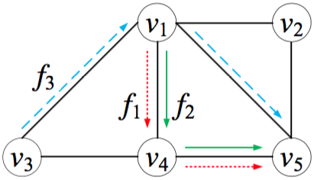
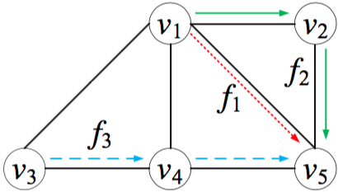
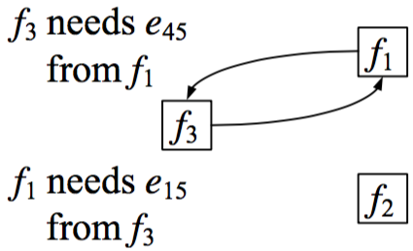
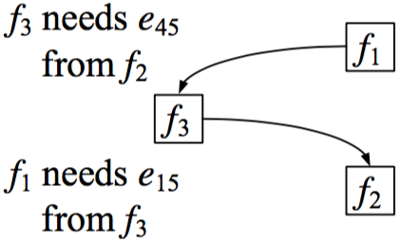
Concepts
Resource Dependency Graph (RDG)：RDGs are not unique
Deadlock: A cycle exists in all RDGs
Spare path collection: A set of spare paths resolve a deadlock
Initial state
Final state
One RDG
Another RDG
Unit flow demand. Link’s capacity: e₁₄=e₄₅=2; others= 1
Notes:
-The Resource Dependency Graph (RDG): Let each flow correspond to one of its minimal dependency sets.
-mapping flows and their dependency sets to nodes and directed edges, respectively
-Multiple RDGs can be obtained for a given network since a flow may depend on different minimal flow sets.

Slide 8
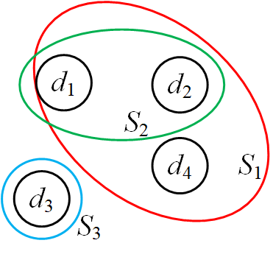
3. Feasibility and Optimality
Feasibility: Each deadlock has a spare path collection
Theorem: If multiple consistent flow migrations exist, it is NP- hard to find the optimal one which occupies the spare links.
Proof ideas:
Reduction from set cover problem
Deadlocks as elements: L= {d₁, d₂,…, d_{|L|}}
Spare path collections as sets: {S₁, S₂,…};
S₁={d₁, d₂, d₄}, S₂={d₁, d₂}, S₃={d₃}

Slide 9
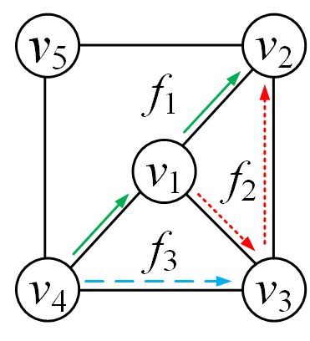
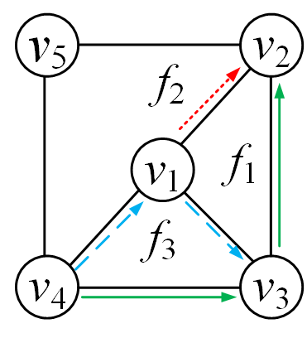
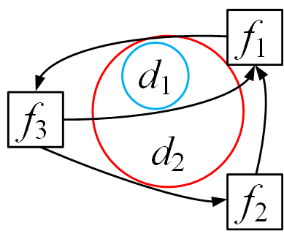
Intertwined Deadlocks: d₁ and d₂
A spare path collection resolves two deadlocks
  Move f₁ to a spare path {e₄₅, e₅₂}
  Move f₃ and then f₂
  Move f₁ to its final state
Initial State
Final State
Link’s capacity: 1
Flow demand: 1
RDG with two deadlocks

Slide 10
Network Update through Spare Links (NUSL)
Iteratively choose the spare path collection with the max marginal benefit-to-cost ratio
    Benefit: the number of broken deadlocks
    Cost: the marginal gain of spare resources
    until all deadlocks are resolved
    Managing the complexity
    H: the maximum number of hops in a spare path
    C: the maximum number of flow replacements (by its spare path) in resolving a deadlock
    (i.e., cardinality of a spare path collection)
Notes:
Marginal gain: total spare resources used before and after adding the flow to the selected spare path collection S

Slide 11

Complexity Analysis
The algorithm achieves an approximation ratio of O($H.C.ln |L|$)
Proof Ideas:
  Use the classic set cover approximation algorithm for reference
Worst case time complexity: O($\left|L\right|∙\sum_{i=1}^{C}{(\begin{matrix}|F| \\ i\end{matrix})}∙(|F|∙|E|H$)^{i})
Proof Ideas
  Use a spare path collection of i paths: $(\begin{matrix}|F| \\ i\end{matrix}) ∙(|F|∙|E|H$)^{i}
Notes:
Marginal gain: total spare resources used before and after adding the flow to the selected spare path collection S

Slide 12
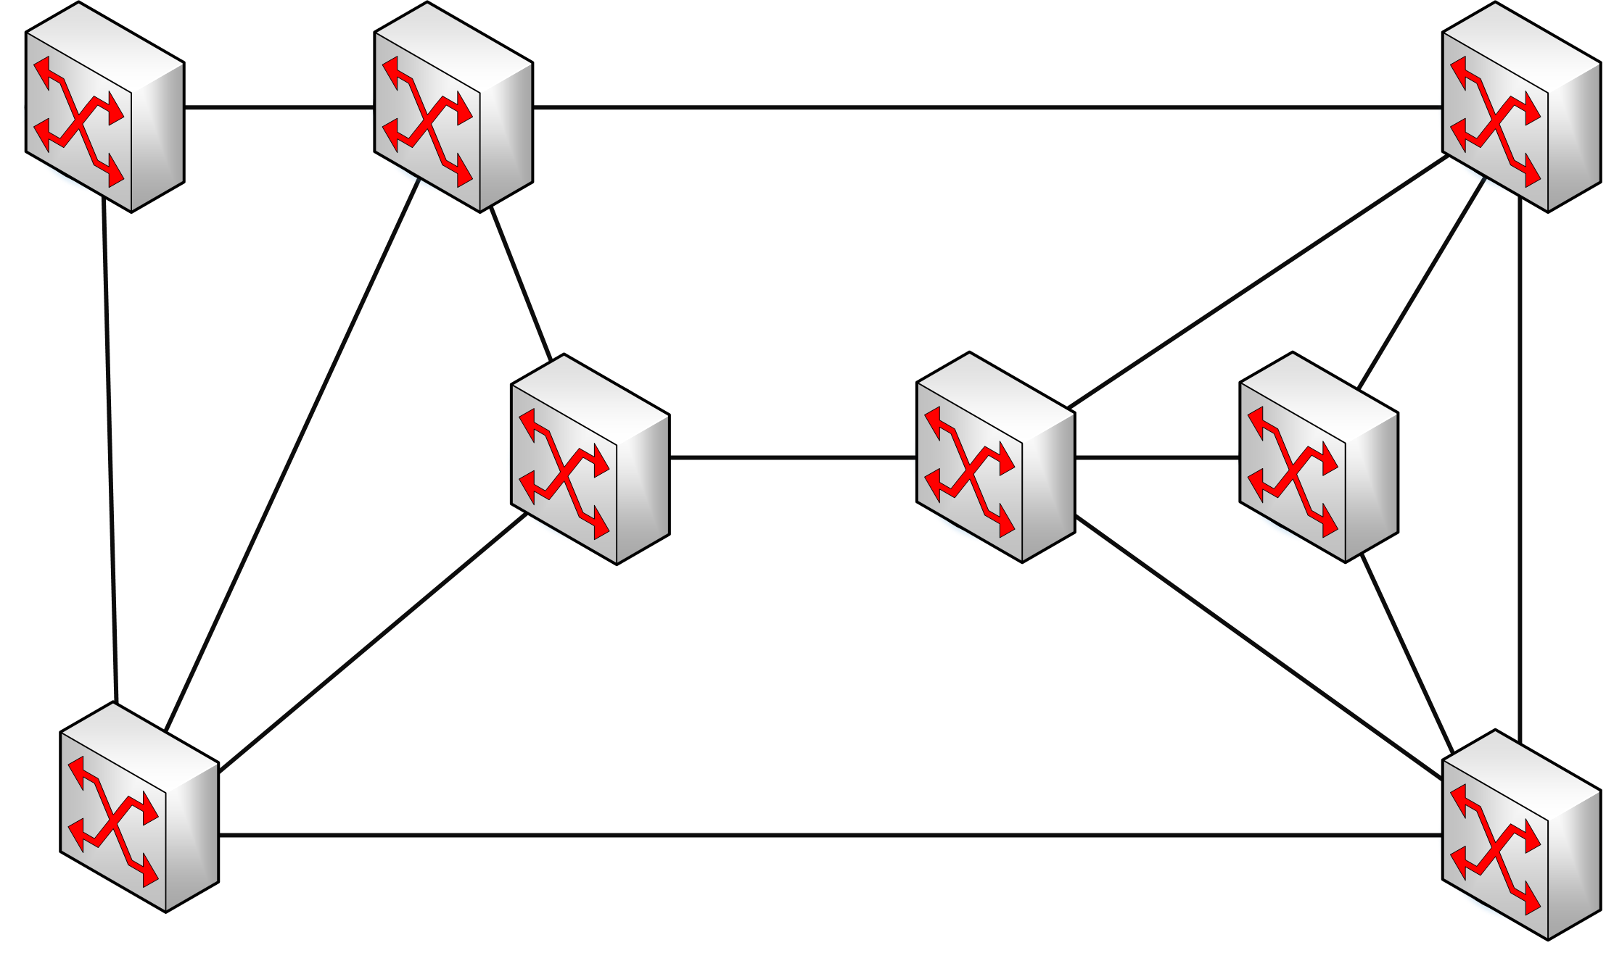
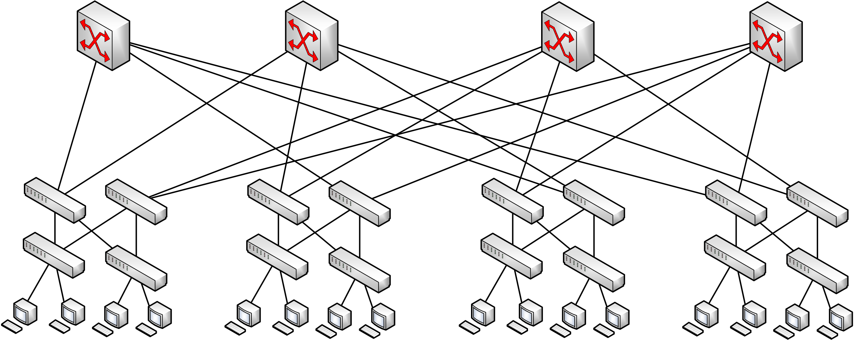
4. Simulation
Two comparison algorithms:
  One-shot: cuts off all the current flows and allows new ones in after the network is vacant (Baseline)
  Dionysus: migrates flows in a topological order and opportunistically rate limits flows as zero to resolve deadlocks (SIGCOMM 14)
Network topologies
WAN network
Fat-tree network

Slide 13
Settings and Measurements
Settings
  WAN topology (link capacity: 1 Gbps)
  Fat-tree topology (link capacity: 1 Gbps)
Measurements
  The number of rate-limiting flows
    when a consistent migration plan does not exist
  Update steps
    time from the first migration until all flows are migrated
  Traffic loss
    the total number of lost packets
Traffic load | 0.2 | 0.4 | 0.6 | 0.8
Flow number | 729 | 1538 | 2387 | 3120
Traffic load | 0.2 | 0.4 | 0.6 | 0.8
Flow number | 2168 | 4532 | 6352 | 8423

Slide 14
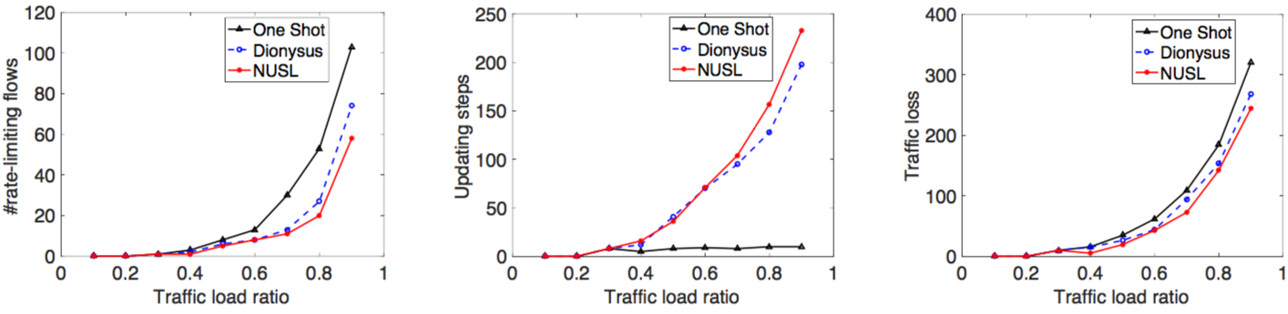
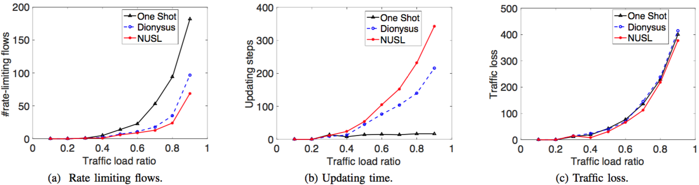
Simulation Results
Performance in the WAN topology
Performance in the fat-tree topology
NUSL rate-limiting: 51% of One Shot, 78% of Dionysus on average (80% ratio)
NUSLtakes about 19% (WAN) and 33% (fat-tree) more steps than Dionysus NUSL always has the least traffic loss

Slide 15
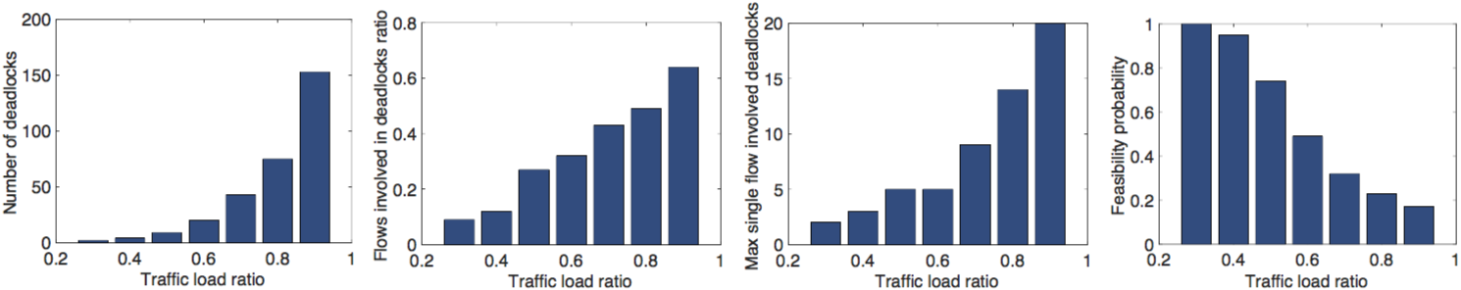
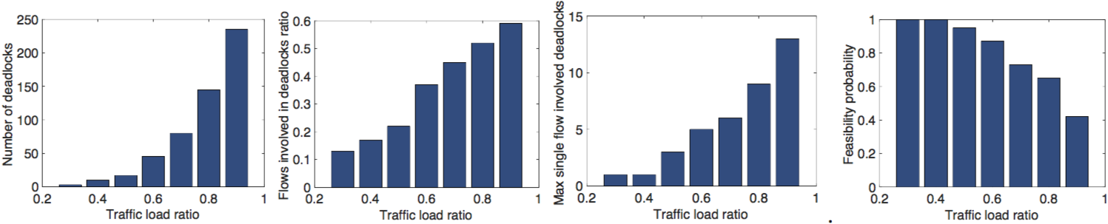
Simulation Results (cont’d)
Performance in the WAN topology
Performance in the fat-tree topology
Heavier traffic load causes more deadlock
Fat-tree topology is more likely to find a feasible solution
Notes:
Metrics related to deadlocks are also evaluated, including the number of deadlocks, the number of involved flows, the maximum number of deadlocks that a single flow can become involved in, and the probability of finding a feasible update plan with spare paths.

Slide 16
5. Conclusion
Migrate flows using spare paths
  Deadlock resolution
  Spare path feasibility determination
NP-hardness
  Deadlock resolution: using the fewest spare links
Approximation
  Set cover: deadlocks are covered by spare path collections
Future works
  Finer granularity: link-based migration solutions

