Slide 1




Local Monitoring and Maintenance for Operational Wireless Sensor Networks
Md Zakirul Alam Bhuiyan, Guojun Wang, Jiannong Cao, and Jie Wu
The 11th IEEE International Symposium on Parallel and Distributed Processing with Applications (ISPA-13) Melbourne, Australia, 16-18 July, 2013
  Contact email: zakirulalam@gmail.com; csgjwang@gmail.com

Slide 2
Outline
Motivation
Our Approach (LoMoM)
Two-part Monitoring Architecture
Local Monitoring and Maintenance
Evaluation
Conclusions

Slide 3
Motivation
Wireless sensor networks are increasingly being designed and deployed for event monitoring and surveillance applications.
  The single most important mechanism underlying such systems is the monitoring of the network itself, that is, the monitoring/control center (MC) needs to be constantly made aware of the existence/health of all the sensors in the network.
    Fault monitoring: detection and localization
    Fault removal/avoidance/recovery
Notes:
Because of the low-cost design, random deployment and the harsh condition.
The sensor nodes may become unreliable or degrade the performance.

Slide 4
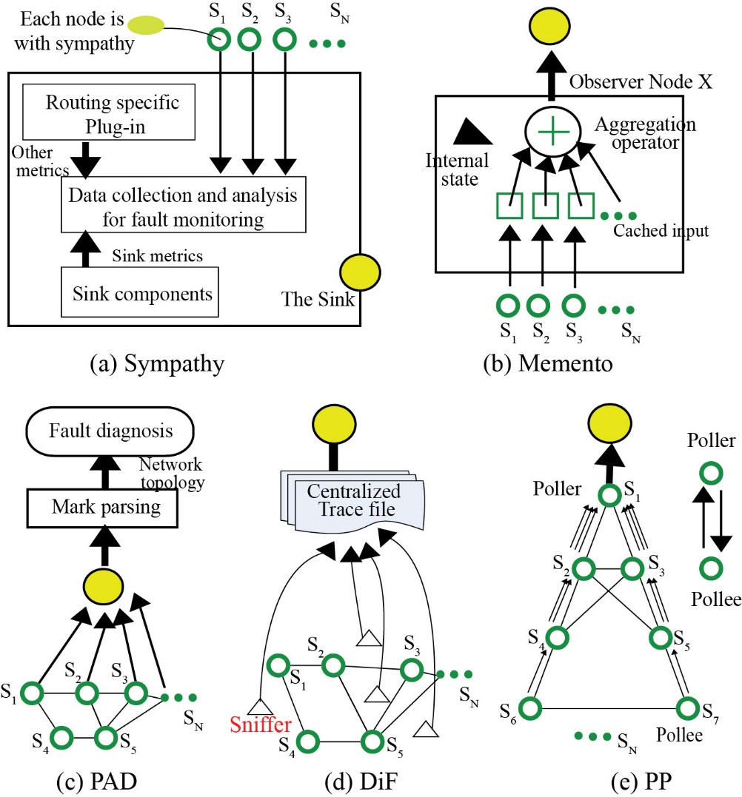
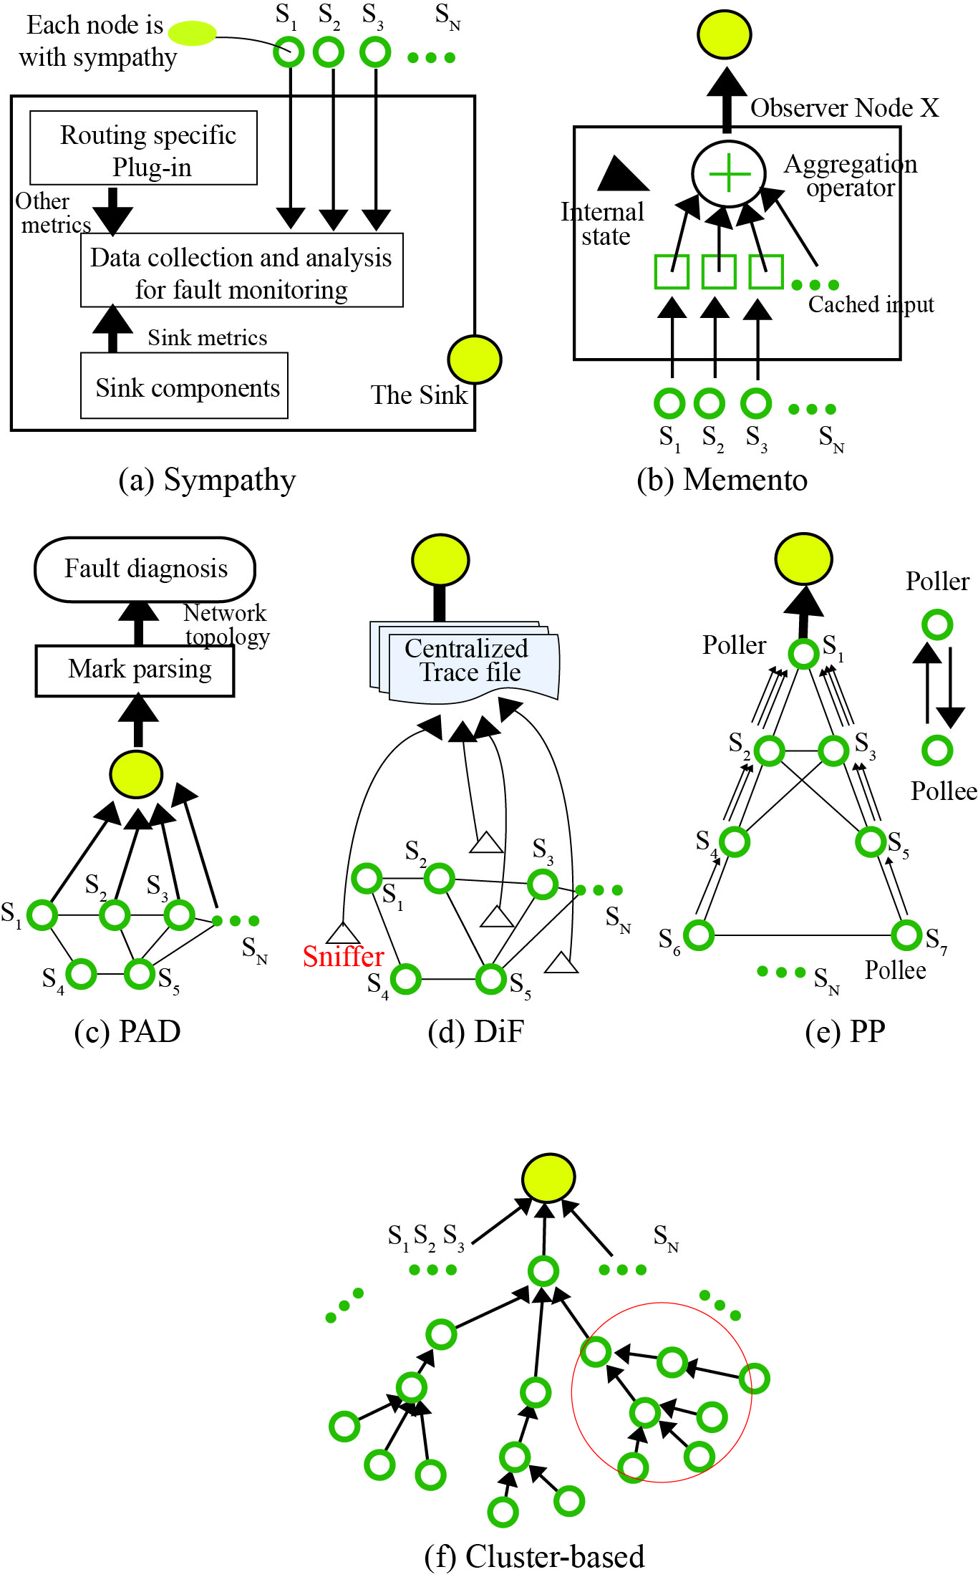
Difficulties in Existing Solutions
[1] N. Ramanathan et al. Sympathy for the sensor network debugger, in
SenSys’05.
[2] S. Rost et al. Memento: A health monitoring system for wireless sensor
networks, in SECON’06.
[3] Y. Liu at al, Passive Diagnosis for Wireless Sensor Networks, ToN, 2010.
[4] D. Yu et al. DiF: A diagnosis framework for wireless sensor networks, in
INFOCOM’10
[5] C. Liu et all. Distributed monitoring and aggregation in wireless sensor
networks, in INFOCOM’10.
[6] S. Tati et al. netCSI: A Generic Fault Diagnosis Algorithm for Large-Scale
Failures in Computer Networks, SRDS’11

Slide 5
Difficulties in Existing Solutions
Many are centralized
  The sink is responsible for fault monitoring
    It actively sends requests to the network for retrieving states of the network
Some are partially distributed
    Add-on modules, evaluation tools, etc.
    Need extra hardware for node monitoring
  Pros: Accurate
  Cons: Too much energy consumption, poor scalability, message implosion, not real-time.

Slide 6
More Importantly
Those approaches are not feasible in practice for a large scale resource-constrained WSN
  First, they require a large number of active nodes for the monitoring function.
  Second, the monitoring function is carried out separately, which should be, arguably, performed in conjunction with the normal operation of an application.
  Third, monitoring link behaviors are not seriously focused.
  Fourth, it is commonly assumed to deploy a PC close to the sink; it is, however, infeasible in practice
Need a fully distributed approach

Slide 7
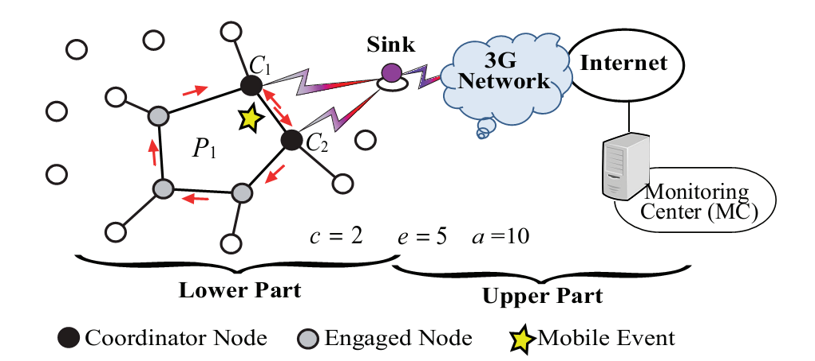
Our Approach: LoMoM
Local Monitoring and Maintenance for a WSN
  It performs monitoring operations, together with the operations of a mobile event monitoring application.
    Suppose that a subset E_{i} of engaged nodes, which are engaged in detecting an event of interest as it appears in a region P_{i} of the WSN, will monitor themselves (node/link failure, node faults, H/S/W faults, application flaws, etc.).

Slide 8
Our Approach: LoMoM
Local Monitoring and Maintenance for a WSN
  It performs monitoring operations, together with the operations of a mobile event monitoring application.
    A small subset C_{i} (of two or more nodes) from E_{i} , which has higher detection probability are called coordinators that collected both the event and node monitoring status. They repair the faults locally, also report to the sink if needed

Slide 9
The Problem
  Given:
    A resource-constrainted WSN with N identical nodes, a sink, a MC (located at a remote placed)
  Find:
    Coordinators (C_{i} ) from the engaged nodes (E_{i} ) that monitor all the engaged nodes and themselves and the links such that the coordinator gather monitoring status and repair the network if there is any fault status and reports to the sink, and the sink then reports to the MC.
  Objectives:
    Reducing the false alarm rate, F_{c}(h,T_{d})
    Reducing the detection latency
    Increasing lifetime, T=w_{r}/w_{m}

Slide 10

Monitoring Architecture
Two-part monitoring architecture
  Lower part is the WSN
    It is built on planar graphs. We apply related neighborhood graph (RNG) for our purpose ^{[7-11]}. A connected planar subgraph $G′⊆G$ is achieved without crossing edges, is neither unidirectional nor disconnected.
  Each subgraph contain one or more polygonal regions (faces in face routing techniques) ^{[7-11]}
[7] B. Leong et al, “Path vector face routing: Geographic routing with local face information,” in IEEE ICNP, 2005.
[8] J. Cartigny et al. “Localized LMST and RNG based minimum-energy broadcast protocols in Ad Hoc networks,” in Ad hoc Networks (Elsevier)
[9] Y.-J. Kim, R. Govindan, B. Karp, and S. Shenker, “Lazy cross-link removal for geographic routing,” in Proc. of ACM SenSys, 2006.
[10] M. Welsh and G. Mainland, “Programming sensor networks using abstract regions,” in Proc. of USENIX NSDI, 2004.
[11] G. Toussaint, “The relative neighborhood graph of finite planarset,” Pattern Recognition, vol. 12, no. 4, pp. 261–268, 1980.

Slide 11
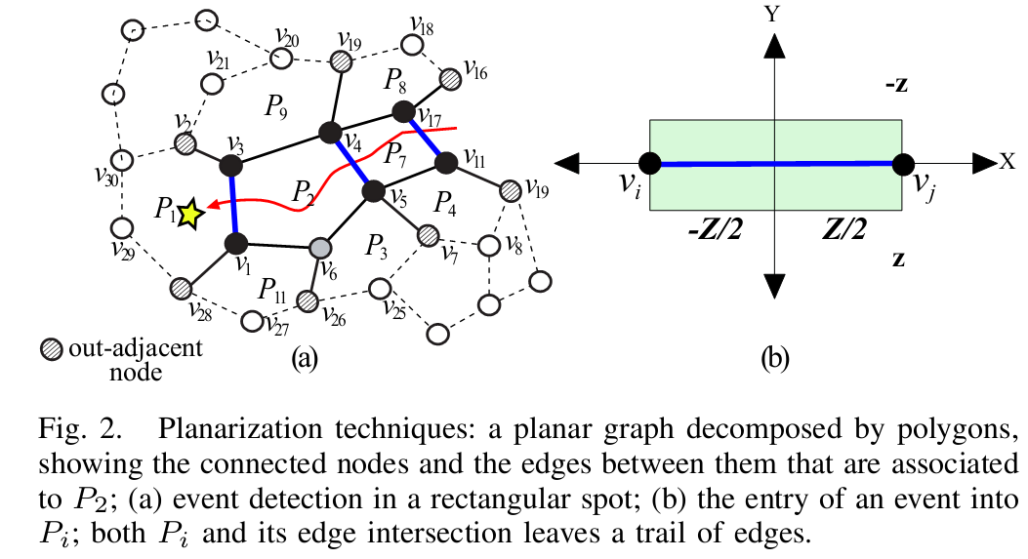
Monitoring Architecture
Edge Intersection Probability
  It is computed as an event goes across the common edge between P_{i} and P_{j}

Slide 12
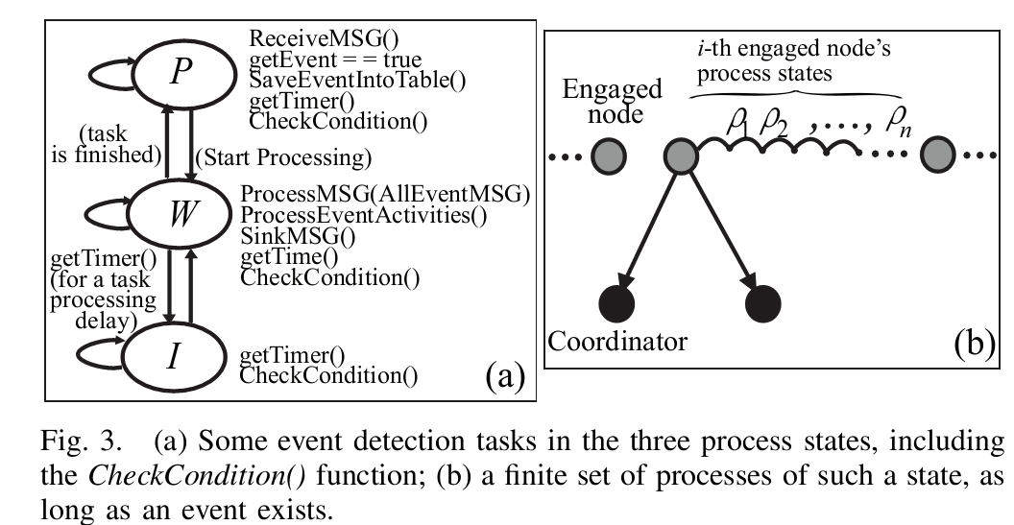
Local Monitoring: Node Self- Monitoring
We trace the faulty reasons by characterizing their fault patterns.
  Generally, a node usually has different modes of operation (e.g., active, waking, and sleeping).
>We divide the active mode into three consecutive process states.
>Each such process state consists of a lot of components.
This node can be monitored by the monitoring of its component run-time behaviors (e.g.,“1” for a successful run)

Slide 13
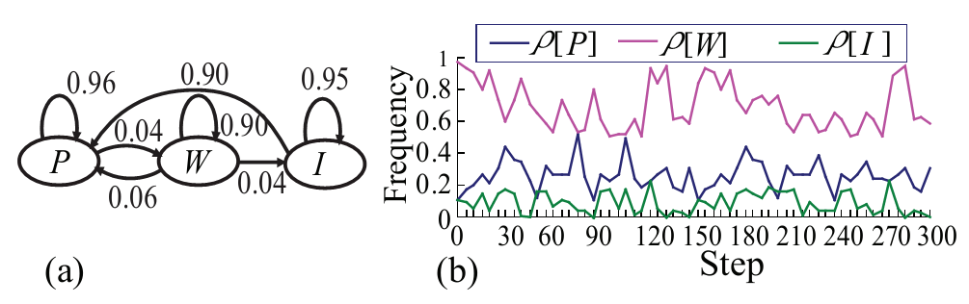
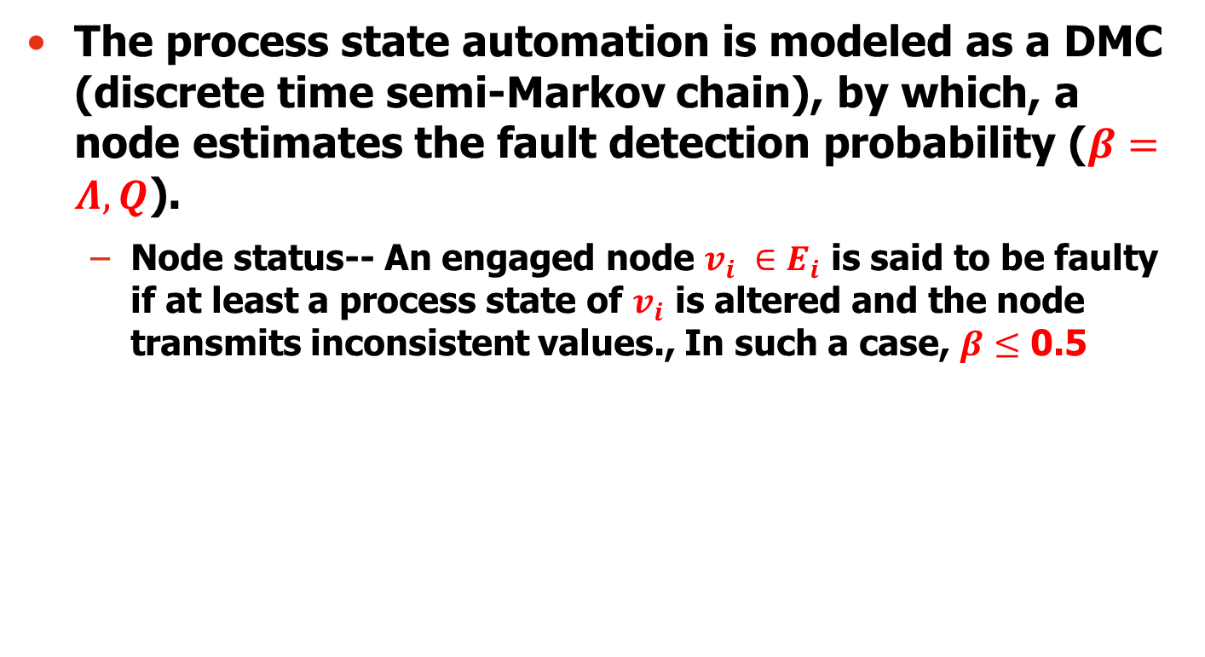
Local Monitoring: Node Self- Monitoring
The process state automation is modeled as a DMC (discrete time semi-Markov chain), by which, a node estimates the fault detection probability ($β=Λ,Q\text{)}$.
  Node status-- An engaged node $v_{i} ∈E_{i}$ is said to be faulty if at least a process state of $v_{i}$ is altered and the node transmits inconsistent values., In such a case, $β≤$ 0.5

Slide 14
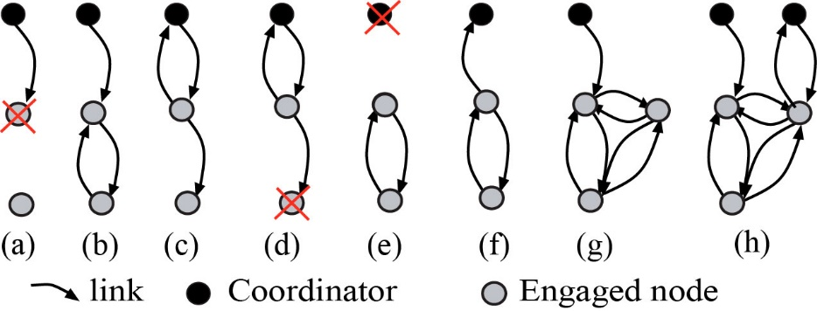
Local Monitoring: Link Monitoring
Link failure:
  A node itself may fail before a report transmission.
  A node may transmit the report, but there is an incident of consecutive report packet loss.
  A node is unreachable (the coordinators or the sink does not receive the status in a given time bound).

Slide 15
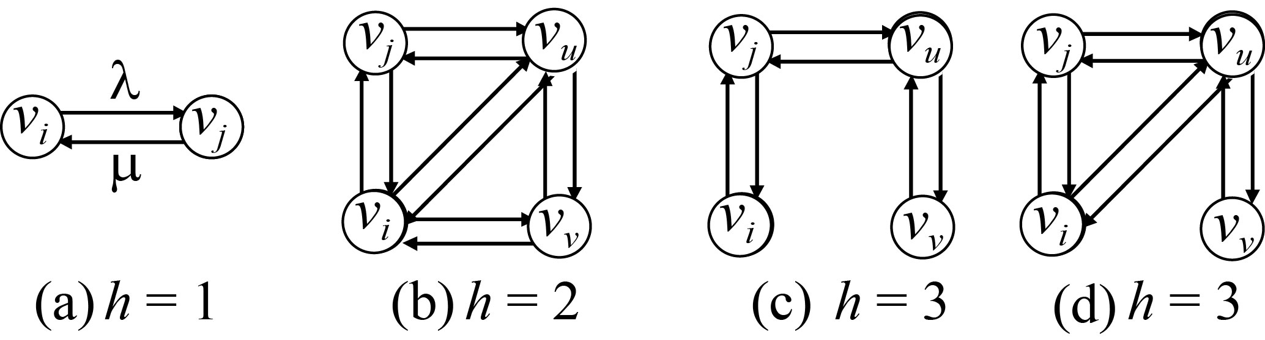
Local Monitoring: Link Monitoring
Techniques:
  We apply CMC (Continuous-time Markov Chain) technique.
    Each link is a part of a chain between two nodes. Each coordinator has the start and the end of the chain of links.
    Each node also individually monitors the links to its 1-hop neighbors, including the all adjacent neighbors in a Pi.
  State transition:

Slide 16
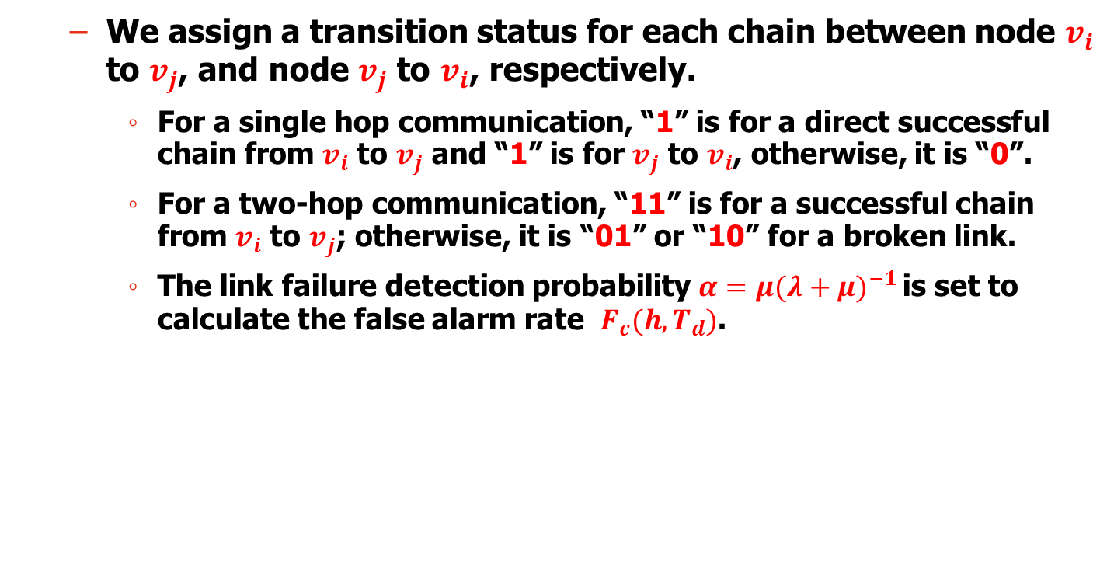
Local Monitoring: Link Monitoring
  We assign a transition status for each chain between node $v_{i}$ to $v_{j}$, and node $v_{j}$ to $v_{i}$, respectively.
    For a single hop communication, “1” is for a direct successful chain from $v_{i}$ to $v_{j}$ and “1” is for $v_{j}$ to $v_{i}$, otherwise, it is “0”.
    For a two-hop communication, “11” is for a successful chain from $v_{i}$ to $v_{j}$; otherwise, it is “01” or “10” for a broken link.
    The link failure detection probability ${α=μ(λ+μ)}^{−1 }$is set to calculate the false alarm rate $F_{c}(h,T_{d})$.

Slide 17
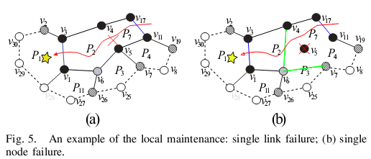
Local Maintenance
LoMoM is adaptive to network dynamics, and supports local maintenance as a link/node fault occurs.
  If one or more nodes fail, or even if all of the nodes in i-th P_{i} fail, that does not significantly affect the correctness of the performance of the mobile event application.
  Sensor fault and removal, connectivity hole, obstacle, etc., can be tackled with local operations, which do not require the sink’s mediation.

Slide 18
Evaluation
Simulations are performed with OmNet++ platform in two scenarios
  Scenario I and Scenario II are comprised of 200 nodes and 800 nodes that are randomly distributed in 2D planar fields of 200m*200m for Scenario I and 800m * 800m for Scenario II, respectively.
    We inject different types of faults (up to 20% of the nodes) randomly into the WSN. This invalidates the sensing and radio capabilities of 10% (5%+5%) of the nodes, and provides minimum power to 10% of the nodes so that they fail during runtime.
  More schemes are implemented: Memento, PP (poller-pollee), and DiMo (distributed monitoring), which are proposed only for monitoring WSNs.

Slide 19
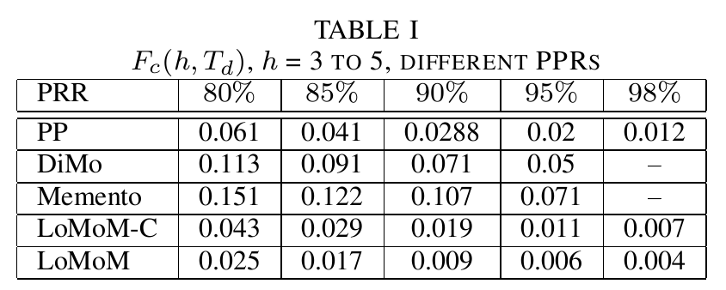
Results (1)

Slide 20
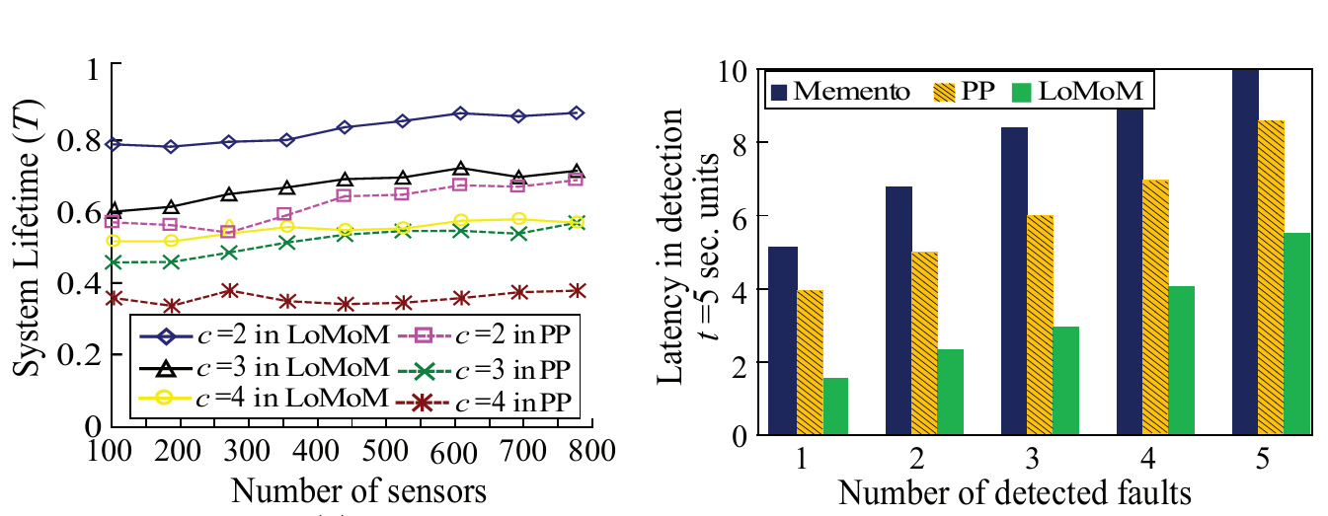
Results (2)

Slide 21
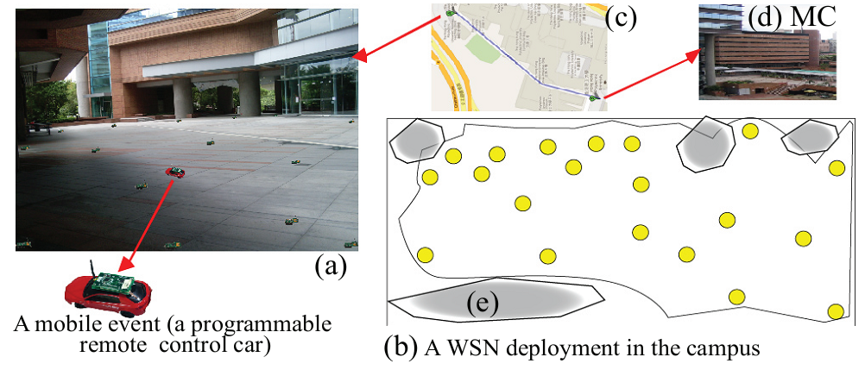
Real Implementation
A proof-of-concept system is implemented using the TinyOS on Imote2 sensor platforms.
  We deploy 20 Imote2, plus 1 sink Imote2.

Slide 22
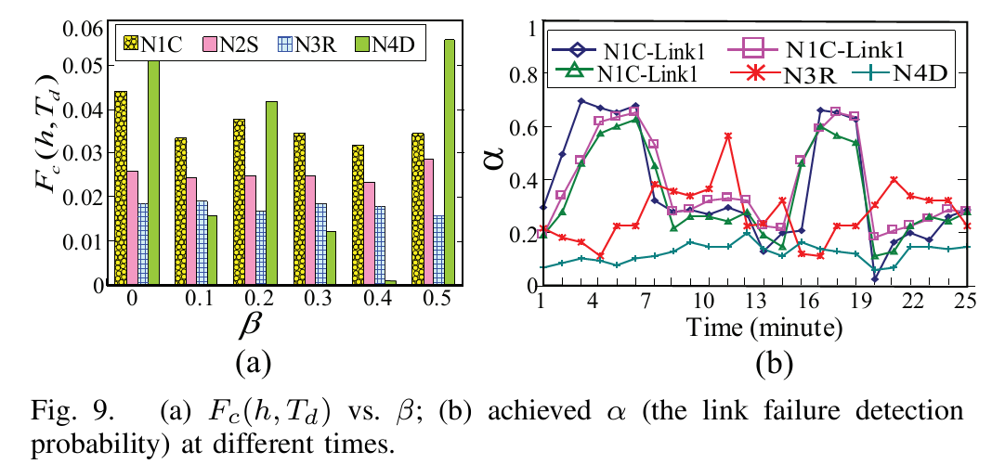
Result (3)
We inject 4 types of faults into four sensors:
>The communication fault (restarting radio) and sensing faults (invalidating sensing module) are injected every two minutes into two sensor nodes (N1C and N2S).
>One sensor (N3R) is set to restart every minute.
>Another sensor (N4D), preloaded with a local decision program, is set in a way in which it makes false decisions every three decisions.

Slide 23
Conclusions
An interesting research area since it is a practical issue for WSNs.
  Papers on distributed network monitoring on this issue are still lacking
  Instead of maintenance operation by the sink, software/system level maintenance by using neighbor nodes’ cooperation in a distributed manner should receive more attention.
The performance of event monitoring and the cost of local maintenance in WSNs can be further analyzed

Slide 24
Our previous work
G. Wang, M. Z. A. Bhuiyan, J. Cao, and J. Wu, “Detecting movements of a target using face tracking in wireless sensor networks,” IEEE Transactions on Parallel and Distributed Systems (TPDS), http://doi.ieeecomputersociety.org/10.1109/TPDS.2013.91, 2013.
G. Wang, M. Z. A. Bhuiyan, and L. Zhang, “Two-level cooperative and energy-efficient tracking algorithm in wireless sensor networks,” Wiley’s Concurrency and Computation: Practice & Experience, vol. 22, no. 4, pp. 518–537, 2010.
M. Z. A. Bhuiyan, G. Wang, and J. Wu, “Polygon-based tracking framework in surveillance wireless sensor networks,” in Proc. of IEEE ICPADS, 2009, pp. 174–181.
M. Z. A. Bhuiyan, G. Wang, and J. Wu, “Target tracking with monitor and backup sensors in wireless sensor networks,” in Proc. of IEEE ICCCN, 2009, pp. 1–6.

Slide 25
Q & A
Thank you for your attention
  Contact Email: zakirulalam@gmail.com; csgjwang@gmail.com;

Slide 26
Approaches
Offline Approaches
  Collect the data of system states so that later we can perform fault analysis.
Online approaches
  Find a fault during system runtime
    Component/module faults
    Link failure
    The energy level of some node are much lower…
    Sensor board temperature is larger…
(not suitable for a resource-constrained WSN
(Received more attention)

