Slide 1






PSFL: Parallel-Sequential Federated Learning with Convergence Guarantees
IEEE INFOCOM 2025
May 20, 2025
Jinrui Zhou¹ , Yu Zhao¹, Yin Xu¹, Mingjun Xiao¹, Jie Wu², Sheng Zhang³
1 School of Computer Science and Technology & Suzhou Institute for Advanced Study,
University of Science and Technology of China
2 Department of Computer and Information Sciences, Temple University, USA
3 Department of Computer Science and Technology, Nanjing University, China
Notes:
Hi, I am Jinrui Zhou, from University of Science and Technology of China, and my research focuses on federated learning. Today, our topic is “PSFL: Parallel-Sequential Federated Learning with Convergence Guarantees.”

Slide 2
CONTENTS
1
Introduction
2
System, Modeling, and Problem
3
Theorem, Optimization, and Algorithm
4
Experimental Evaluation
5
Conclusion

Slide 3
CONTENTS
1
Introduction
2
System, Modeling, and Problem
3
Theorem, Optimization, and Algorithm
4
Experimental Evaluation
5
Conclusion

Slide 4
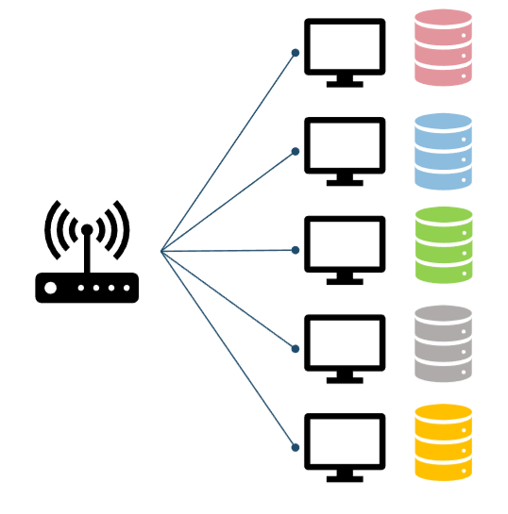
Introduction
Federated Learning (FL)
Concept of FL
A novel distributed learning paradigm which can coordinate multiple clients to jointly train a machine learning model by using their local data samples.
Procedure of Parallel FL (PFL)
Data stay locally on clients
Clients train models locally in parallel
Clients send models or updates to server
Server aggregate local models
Notes:
Let’s start with a brief introduction to the concept. Federated learning is a novel distributed learning paradigm which can coordinate multiple clients to jointly train a machine learning model by using their local data samples. Existing FL works can be roughly divided into two categories according to the modes of model training: Parallel FL (PFL) and Sequential FL (SFL). In the PFL mode, clients train local models in parallel before aggregating them to produce the global model.

Slide 5
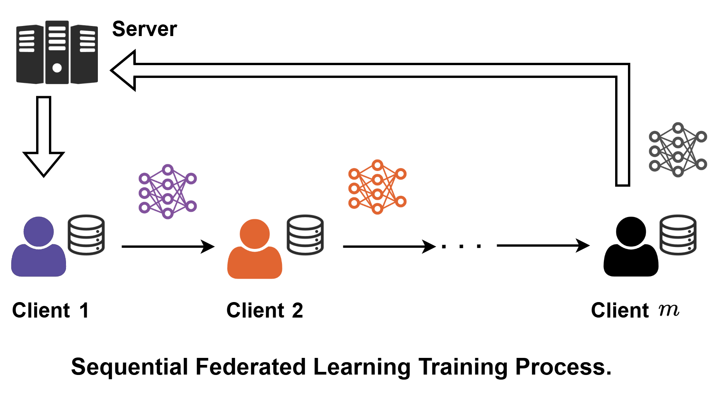
Introduction
Sequential FL (SFL)
Clients send models or updates to next client
Notes:
In the SFL mode, clients train and aggregate their local models in sequence. As shown in the figure, the process typically starts from an initial global model sent by the server to the first client. Client 1 trains the model on its local data and passes the updated model to Client 2. Then Client 2 does the same and forwards it to the next client. After all clients have contributed in turn, the final model is returned to the server.

Slide 6
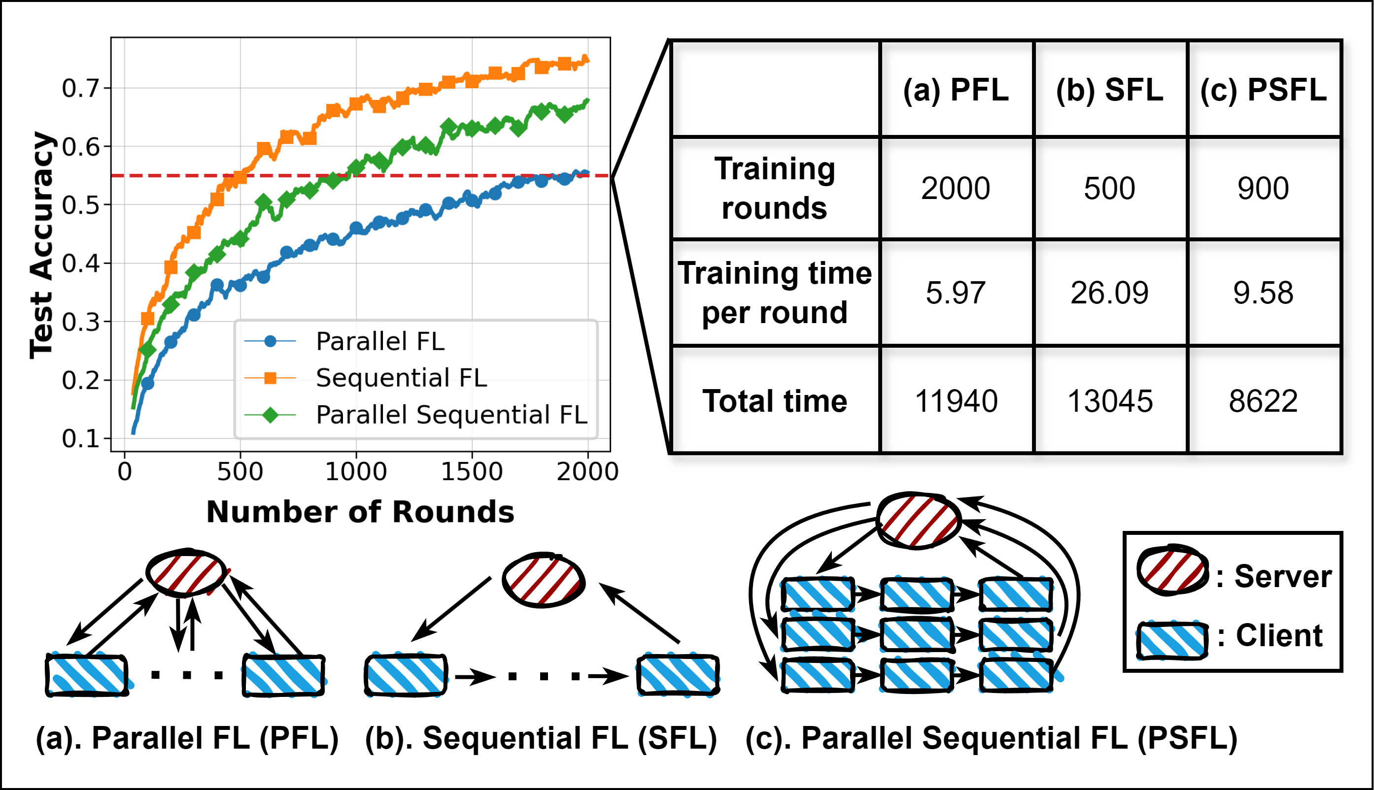
Introduction
Motivations
PFL significantly reduces the training time per round, but it typically requires many more rounds to reach the target accuracy.
SFL achieves faster accuracy improvement in fewer rounds, but each round takes much longer due to sequential updates.
Notes:
The PFL and SFL modes exhibit two opposing characteristics when facing the heterogeneity issue. PFL significantly reduces the training time per round, but it typically requires many more rounds to reach the target accuracy. On the other hand, SFL achieves faster accuracy improvement in fewer rounds, but each round takes much longer due to sequential updates. In this example, to reach the same target accuracy, PFL requires 2000 rounds, while SFL only needs 500 rounds. However, the time per round for SFL is also about four times longer than that of PFL. This observation motivates our work. To bridge the gap between PFL and SFL, we propose a new hybrid framework called Parallel-Sequential Federated Learning, or PSFL.

Slide 7
CONTENTS
1
Introduction
2
System, Modeling, and Problem
3
Theorem, Optimization, and Algorithm
4
Experimental Evaluation
5
Conclusion

Slide 8
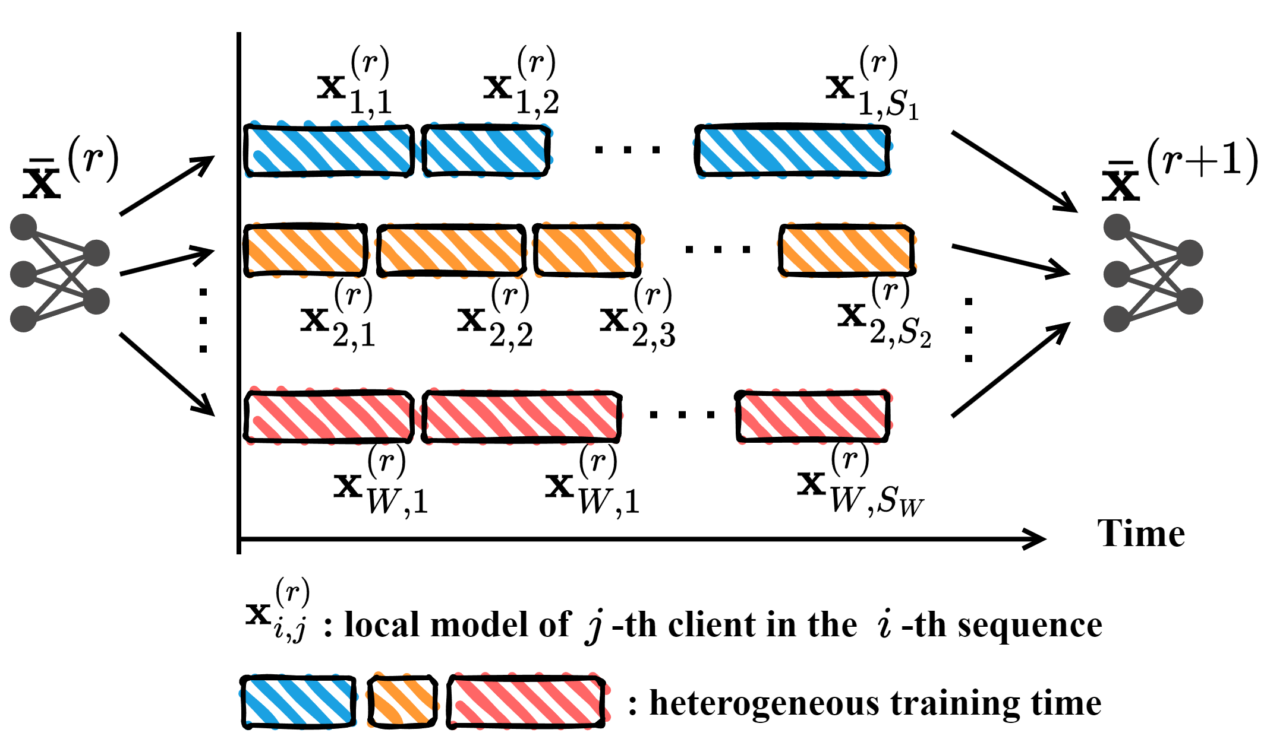
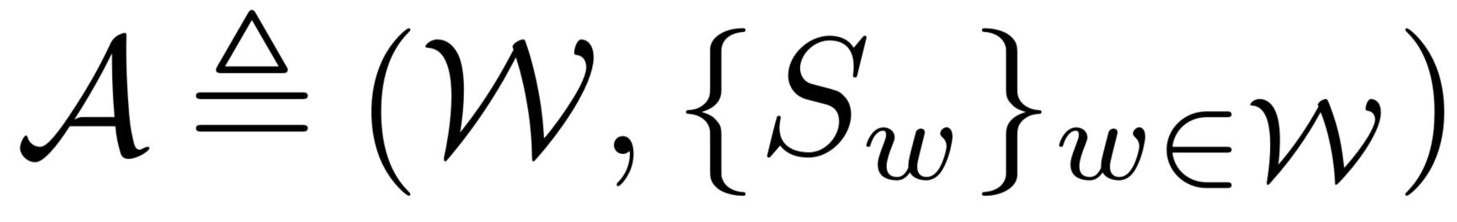
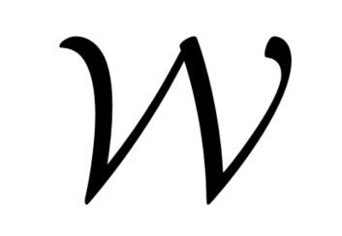

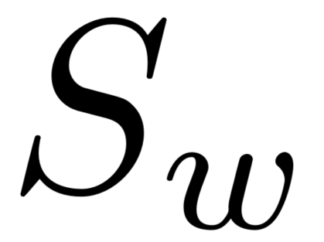
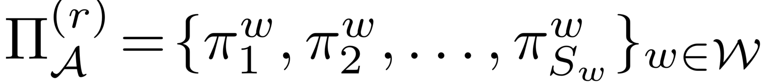
System, Modeling, and Problem
Parallel-Sequential FL (PSFL)
Training Structure:
Denoted by
represents a set of sequences
: parallel width
: sequence leagth
Client sampling strategy:
Notes:
Different from traditional FL systems, PSFL is structured with multiple parallel sequences. As shown in the figure, several clients form a sequence. The local model trained by each client is transmitted to the next client. Multiple sequences are trained in parallel and the local models of each sequence are finally aggregated together to form a global model.
We use a 2-tuple to define the training structure, and call the number of sequences as parallel width. Based on this 2-dimentional training structure, we define a client sampling strategy with respect to the training structure. Here, each π is the index of the sampled client in the corresponding position.

Slide 9
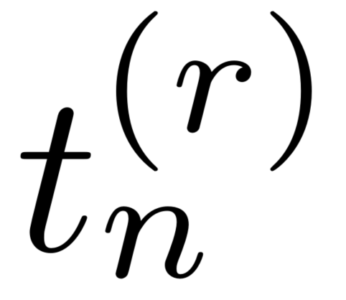
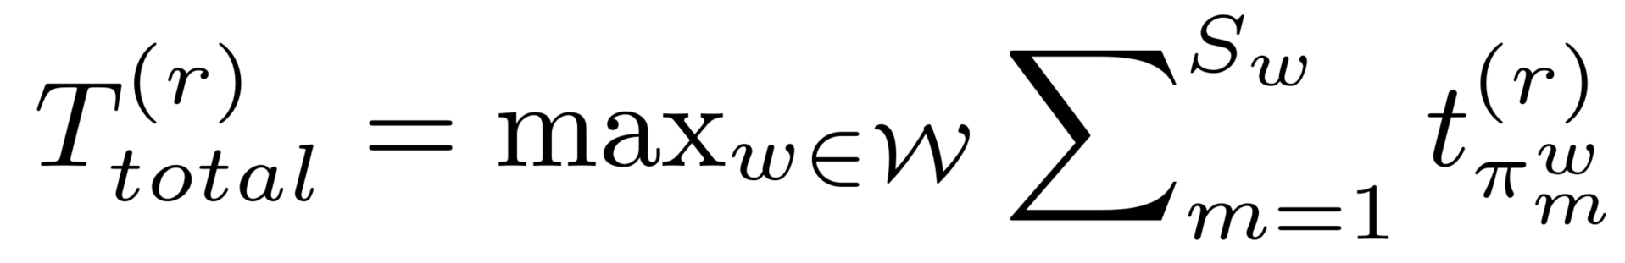
System, Modeling, and Problem
Parallel-Sequential FL (PSFL)
Statistical heterogeneity: the training data are distributed in an unbalanced and non-iid fashion among clients
System heterogeneity: clients exhibit heterogeneous capabilities in both computing and communication.
Training time:
Notes:
In addition to statistical heterogeneity, we also consider system heterogeneity. Clients might have different computing power, network speeds, or even energy constraints. So, naturally, their training time are different. In the figure, the length of the block reflects how long that client takes to finish its local update. We define the training time and the total time for one global training round depends on the slowest sequence. It is reflected by the max operator in the formula.

Slide 10
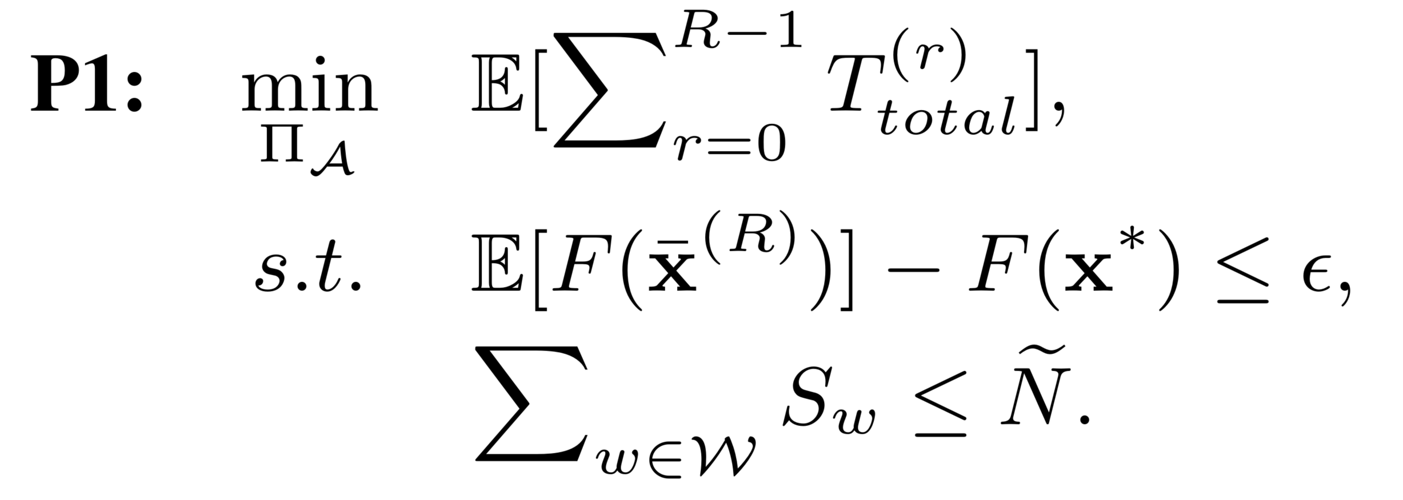
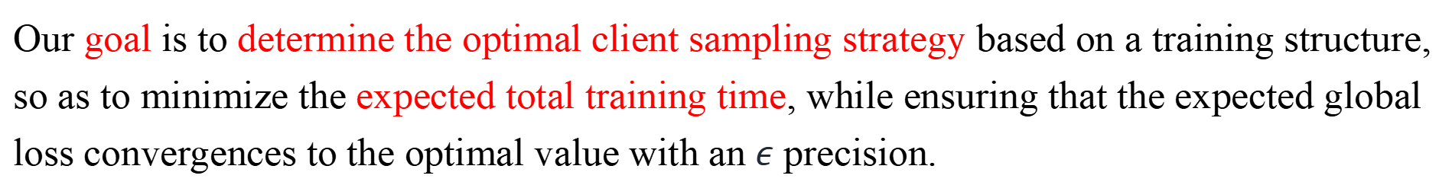
System, Modeling, and Problem
Problem formulation
Our goal is to determine the optimal client sampling strategy based on a training structure, so as to minimize the expected total training time, while ensuring that the expected global loss convergences to the optimal value with an $ε$ precision.
Expected total training time.
Convergence guarantee.
The number of selected clients
in each round is bounded.
Notes:
Our goal is to determine the optimal client sampling strategy based on a training structure, so as to minimize the expected total training time, while ensuring that the expected global loss convergences to the optimal value with an $ε$ precision. There are still two challenges. First, it is generally unclear how the chosen training structure will affect the final model. Thus, we need to derive an analytical expression to explore the complex impact of straining structure on model performance. Second, we should design a client sampling approach to minimize the total training time, while ensuring unbiasedness.

Slide 11
CONTENTS
1
Introduction
2
System, Modeling, and Problem
3
Theorem, Optimization, and Algorithm
4
Experimental Evaluation
5
Conclusion

Slide 12
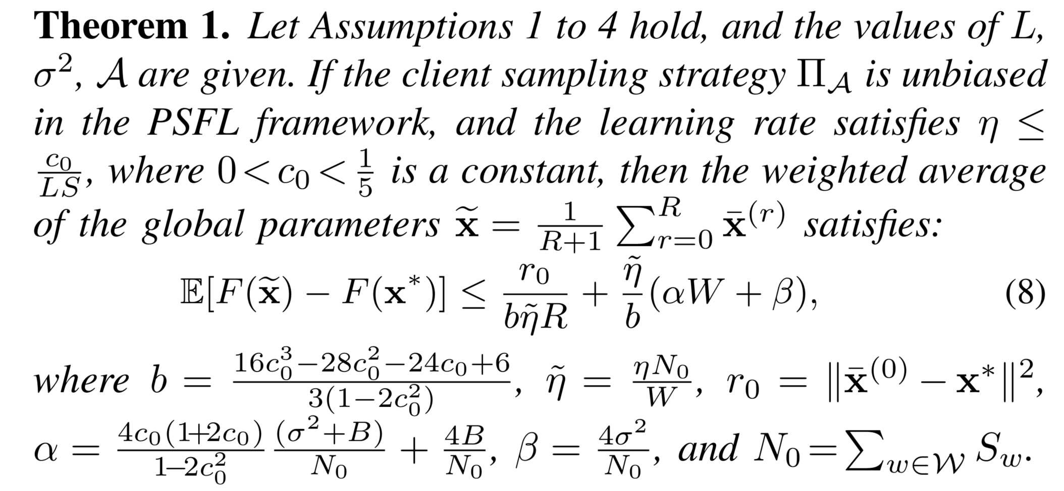
Theorem, Optimization, and Algorithm
Convergence Analysis
Notes:
We address the first challenge by deriving a new convergence bound for any given training structure. Based on some regular assumptions, like smoothness, convexity, unbiased gradient and bounded variance, we get the convergence bound for any unbiased client sampling strategy.

Slide 13
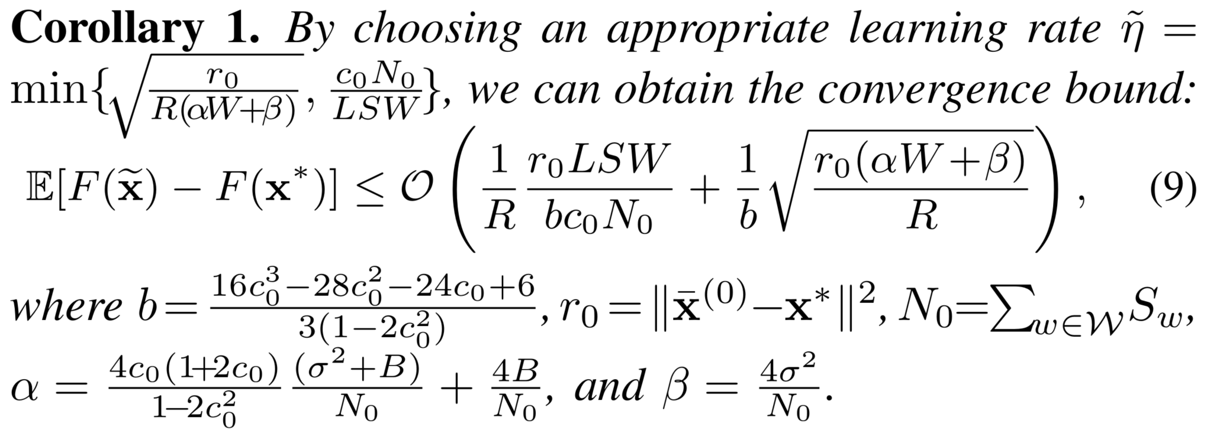
Theorem, Optimization, and Algorithm
Convergence Analysis
Notes:
By choosing an appropriate learning rate, we can obtain this corollary. The convergence bound contains two terms, which come from two different values of the learning rate. In fact, when the number of training rounds is sufficiently large, this convergence bound is reduced to the second term.

Slide 14
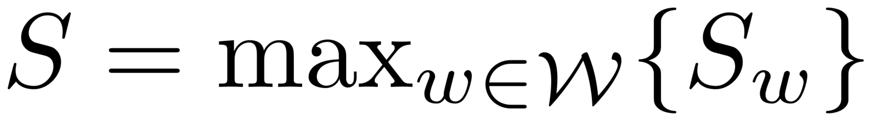
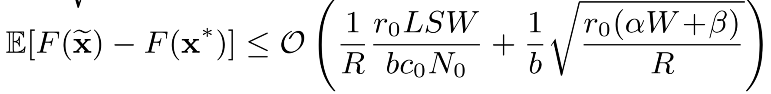
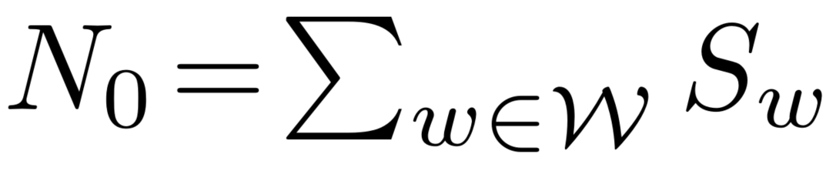
Theorem, Optimization, and Algorithm
Convergence Bound
, longest sequence length
The number of training rounds.
The parallel width.
Notes:
We now focus on the second term, we find a larger W slows convergence, while a larger R accelerates convergence. A larger W means that more sequences are trained in parallel, and it may cause a shorter sequence length at the same time. This is reasonable because the parallel mode has a worse performance than the sequential mode.

Slide 15
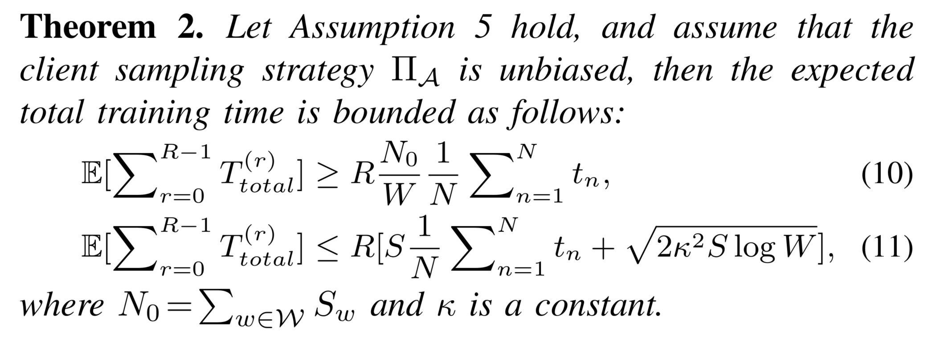
Theorem, Optimization, and Algorithm
Bound for the Expected Training Time
Subgaussian training time
Notes:
We then focus on the Bound for the Expected Training Time. First, this bound is established on the subgaussian training time assumption. Then, we use some inequalities based on the subgraussian property. Finally, the upper bound provides a term associated with sequence length and parallel width.

Slide 16
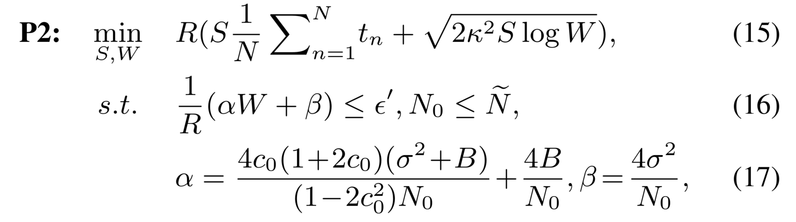
Theorem, Optimization, and Algorithm
Problem Transformation
Notes:
According to the convergence bound and the upper bound of the expected total training time, the original problem can be transformed. And we solve this problem to get the optimal training structure, that is, the sequence length S and parallel width W.

Slide 17
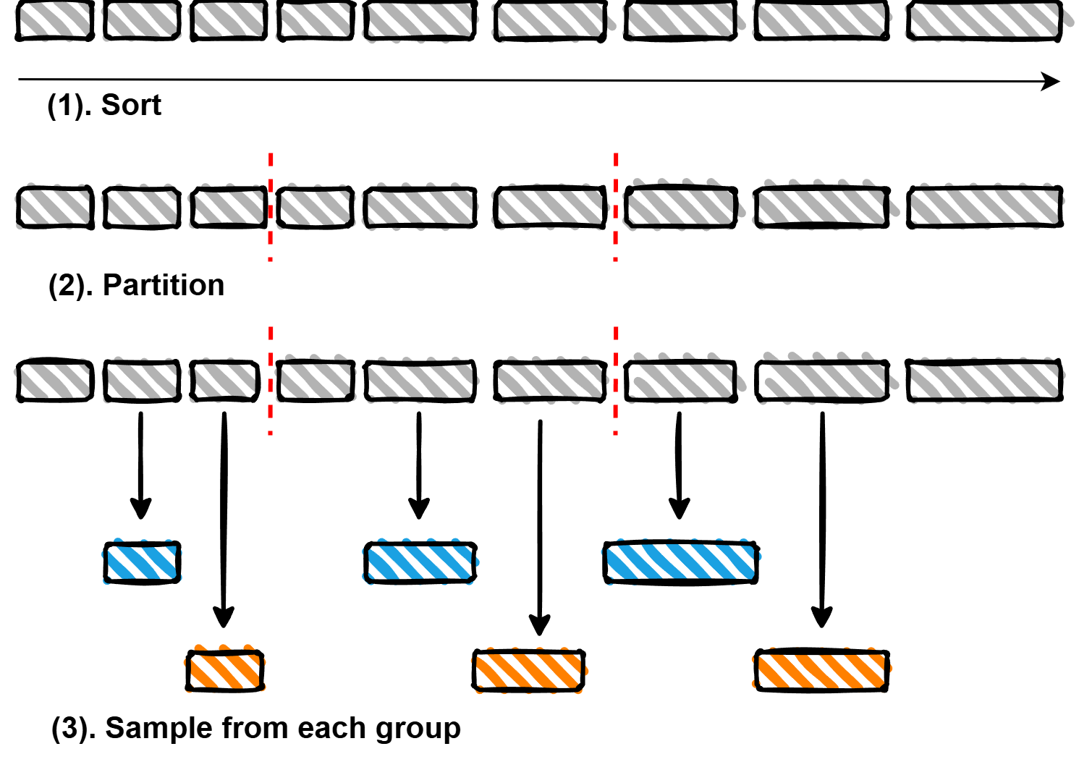
Theorem, Optimization, and Algorithm
Client Sampling Strategy
Unbiased
Any unbiased sampling strategy cannot reduce the training time of a sequence.
Minimize the variance between sequences
Notes:
Once we get the optimal training structure, we can design our client sampling strategy based on it. We note that any unbiased sampling strategy cannot reduce the training time of a sequence. This is because for any unbiased sampling strategy, the expected training time of a sequence is fixed. Therefore, to reduce the maximum training time across multiple sequences, we should minimize the variance between sequences. Based on this insight, we design a Time-based Partitioning and Sampling Strategy. The process of our sampling strategy unfolds as follows. First, we sort the clients according to their estimates of training time. Then, divide the clients into multiply groups based on this sorting. The number of groups is the value of sequence length. Finally, we uniformly sample a client from each group without replacement and generate a random permutation of these selected clients to form a sequence. Repeat W times to generate W sequences. We theoretically prove it is approximately unbiased, and it can reduce the variance of the training time between sequences.

Slide 18
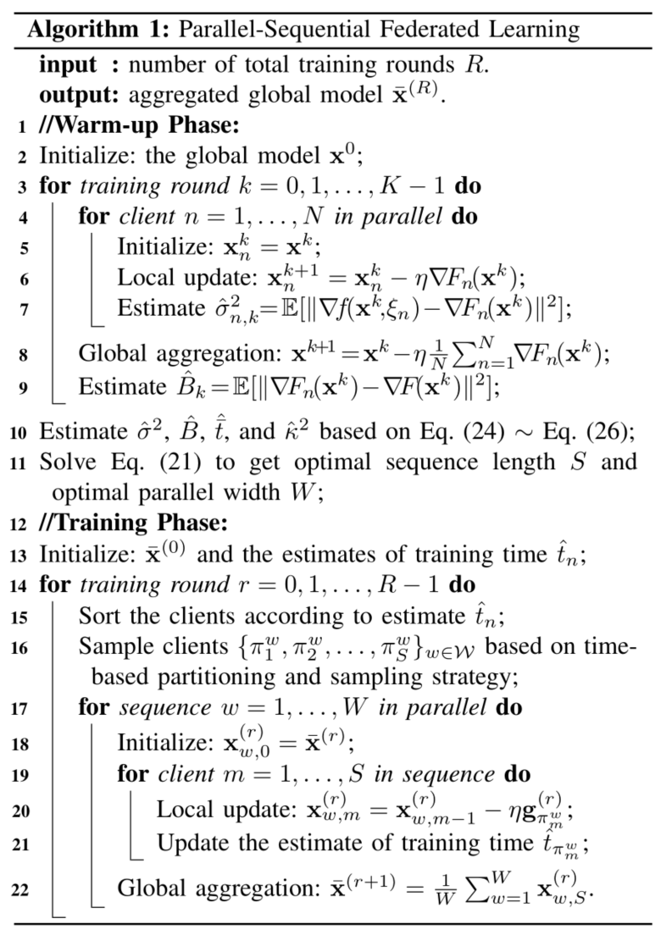
Theorem, Optimization, and Algorithm
Lines 1- 11:
Warm-up Phase: Estimate some parameters and solve the optimization problem to get optimal training structure
Lines 12- 22:
Training Phase: Based on the optimal training structure, sample clients and train the models.
Notes:
This is the final algorithm. It is divided into two main phases: the warm-up phase and the training phase. During the warm-up phase, we focus on estimating parameters related to statistical and system heterogeneity. Based on these estimates, the server determines the optimal training structure by solving the optimization problem. In the training phase, we focus on sampling clients according to the structure obtained in the warm-up phase and training them to achieve global model convergence.

Slide 19
CONTENTS
1
Introduction
2
System, Modeling, and Problem
3
Theorem, Optimization, and Algorithm
4
Experimental Evaluation
5
Conclusion

Slide 20
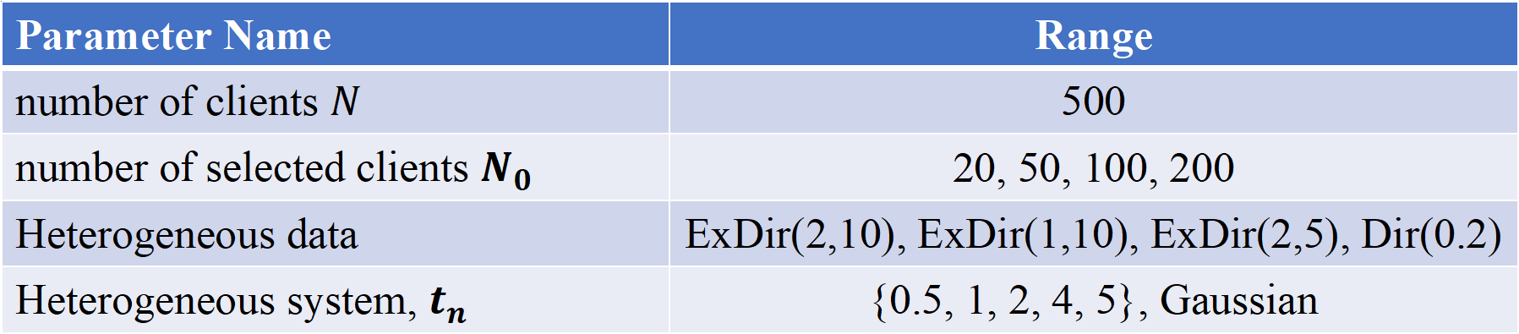
Experimental Evaluation
Evaluation Setup
Parameter Name | Range
number of clients $N$ | 500
number of selected clients $N_{0}$ | 20, 50, 100, 200
Heterogeneous data | ExDir(2,10), ExDir(1,10), ExDir(2,5), Dir(0.2)
Heterogeneous system, $t_{n}$ | {0.5, 1, 2, 4, 5}, Gaussian
Dataset:
CIFAR-10, CIFAR-100, HAM10000
Baselines:
PFL (FedAvg), SFL
Metrics:
test accuracy, total training time
Notes:
Here is some evaluation setup. Since other variant algorithms of PFL can be incorporated into PSFL by modifying the global model aggregation method, we only select two basic frameworks as baselines.

Slide 21
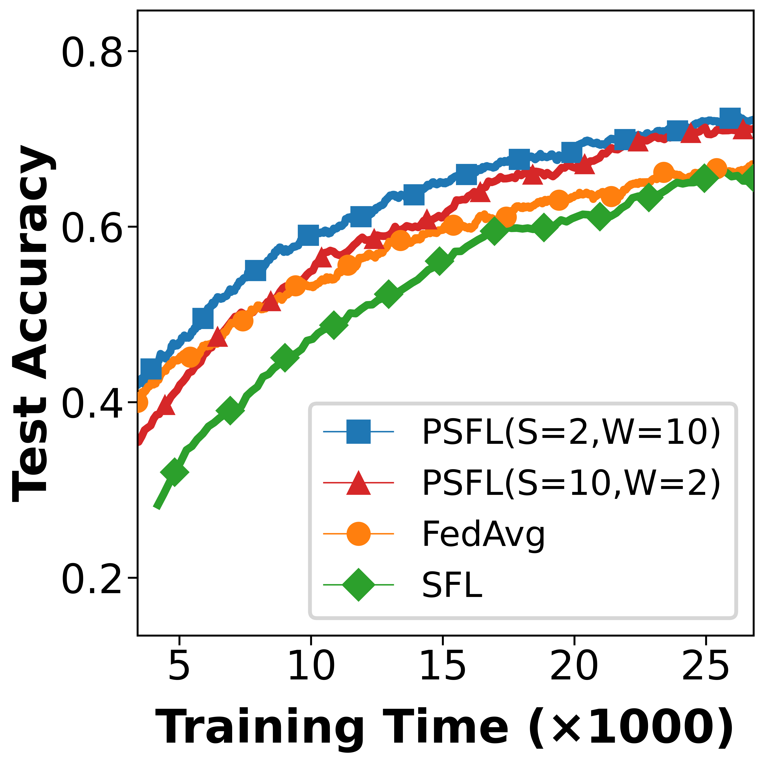
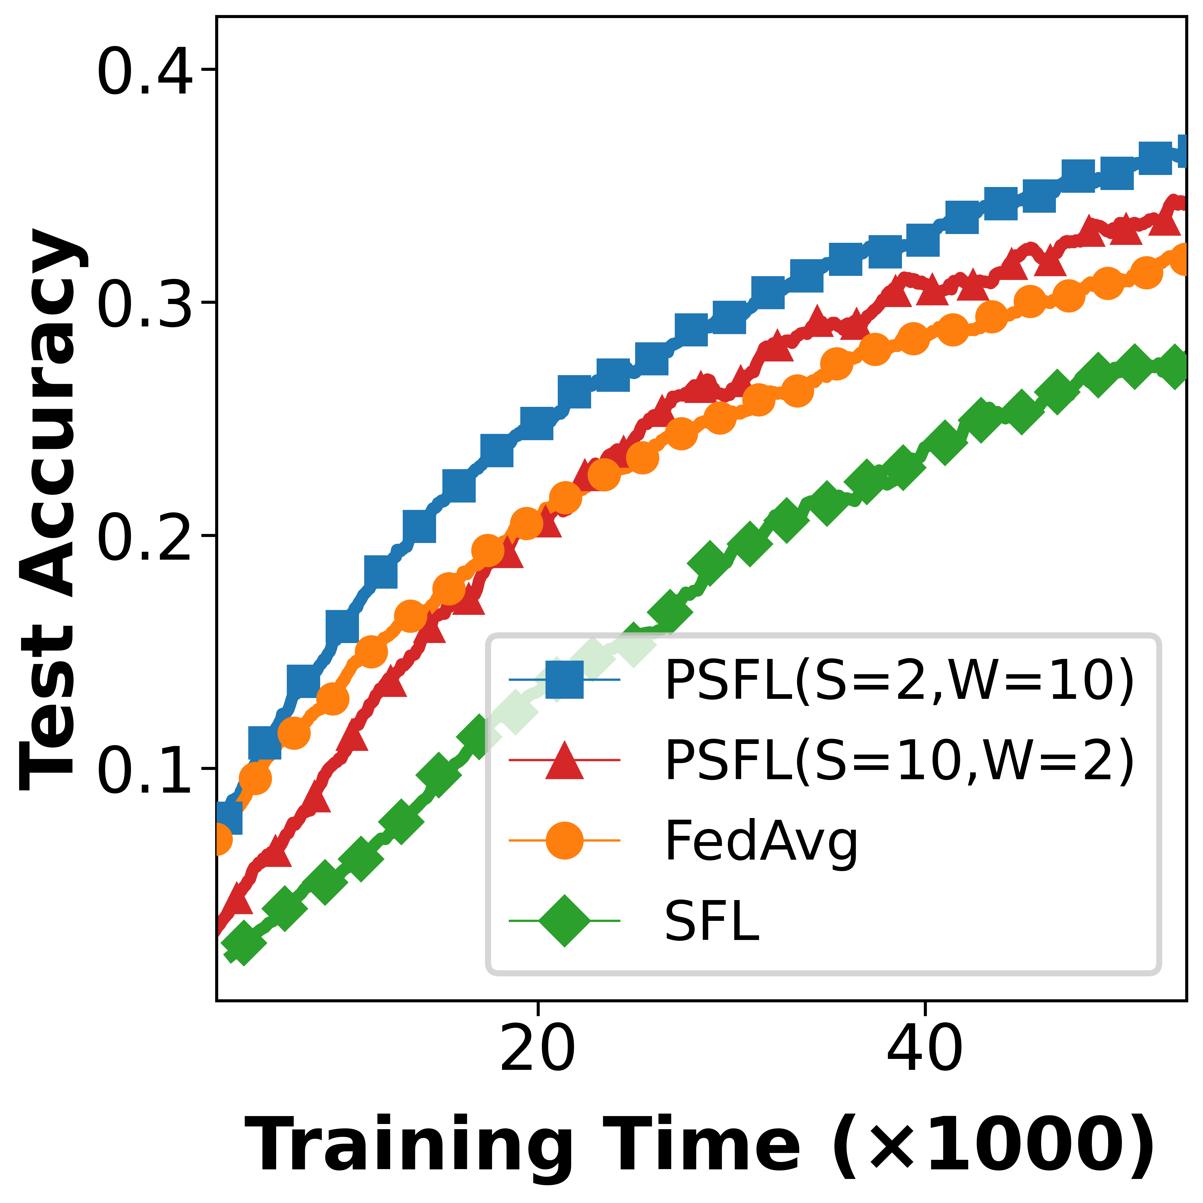
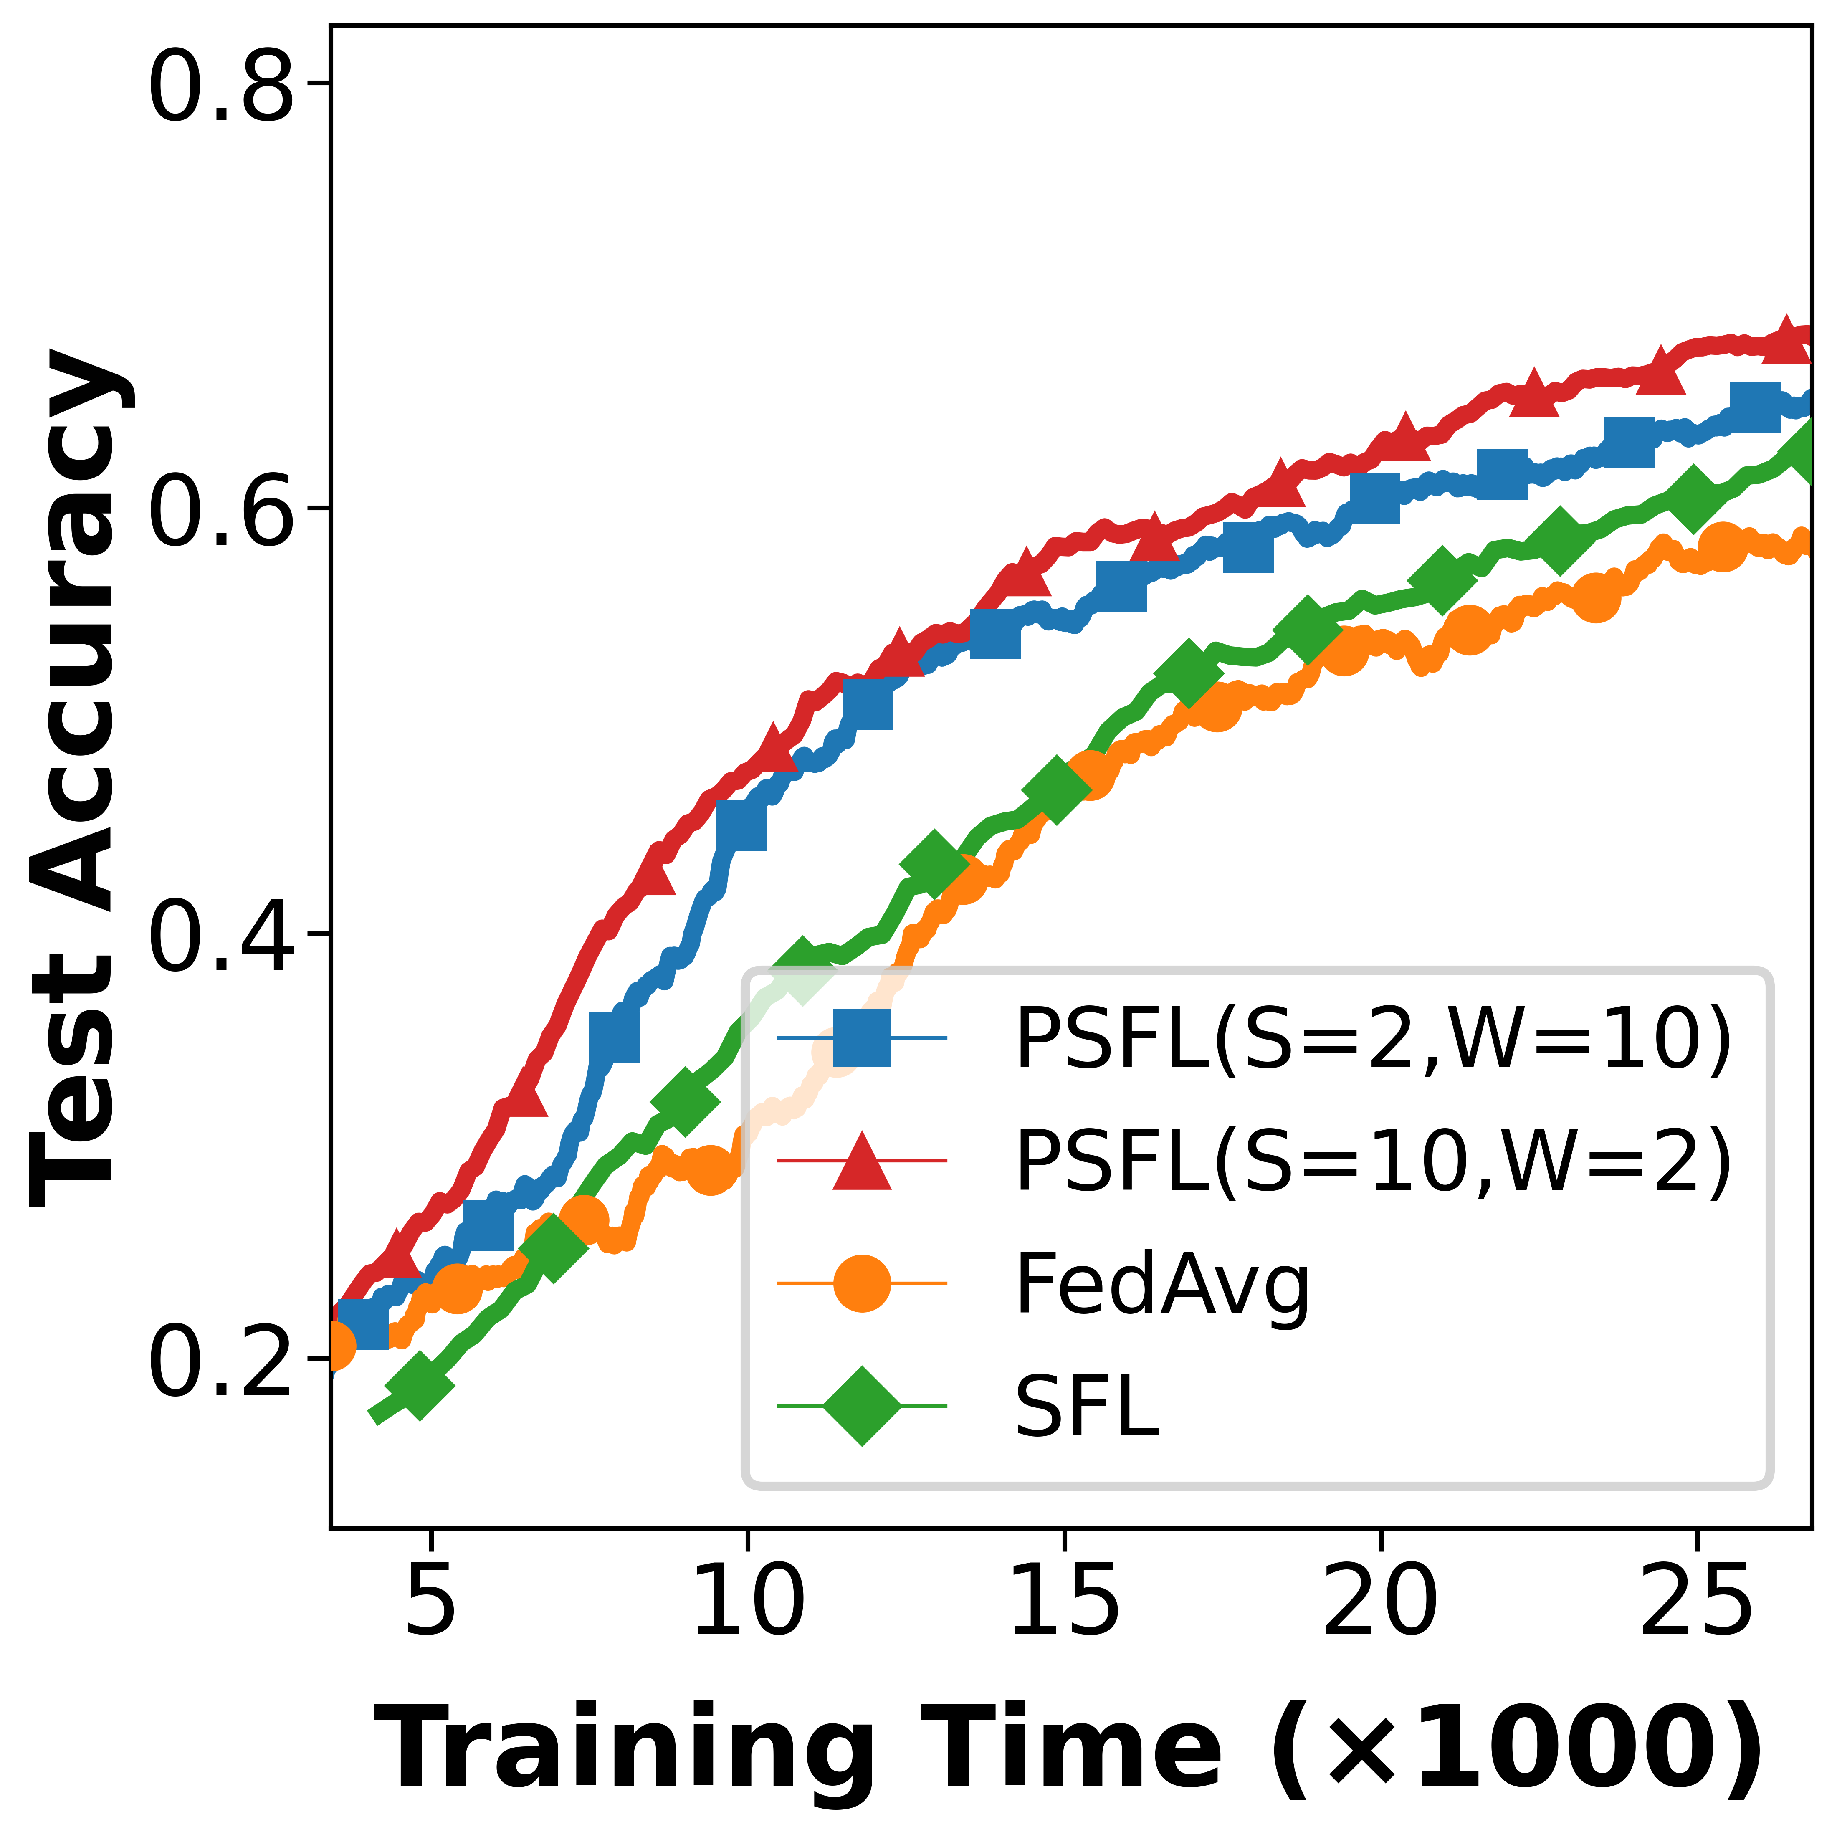
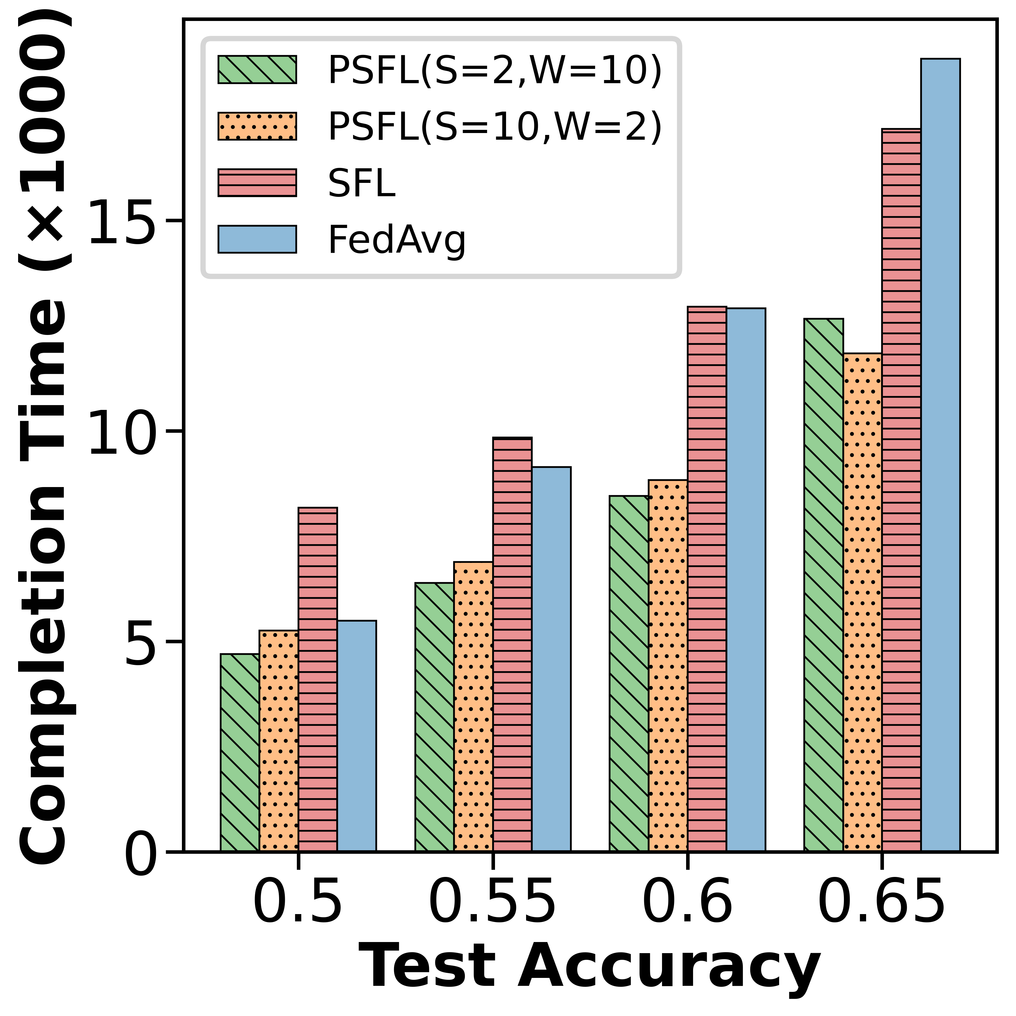
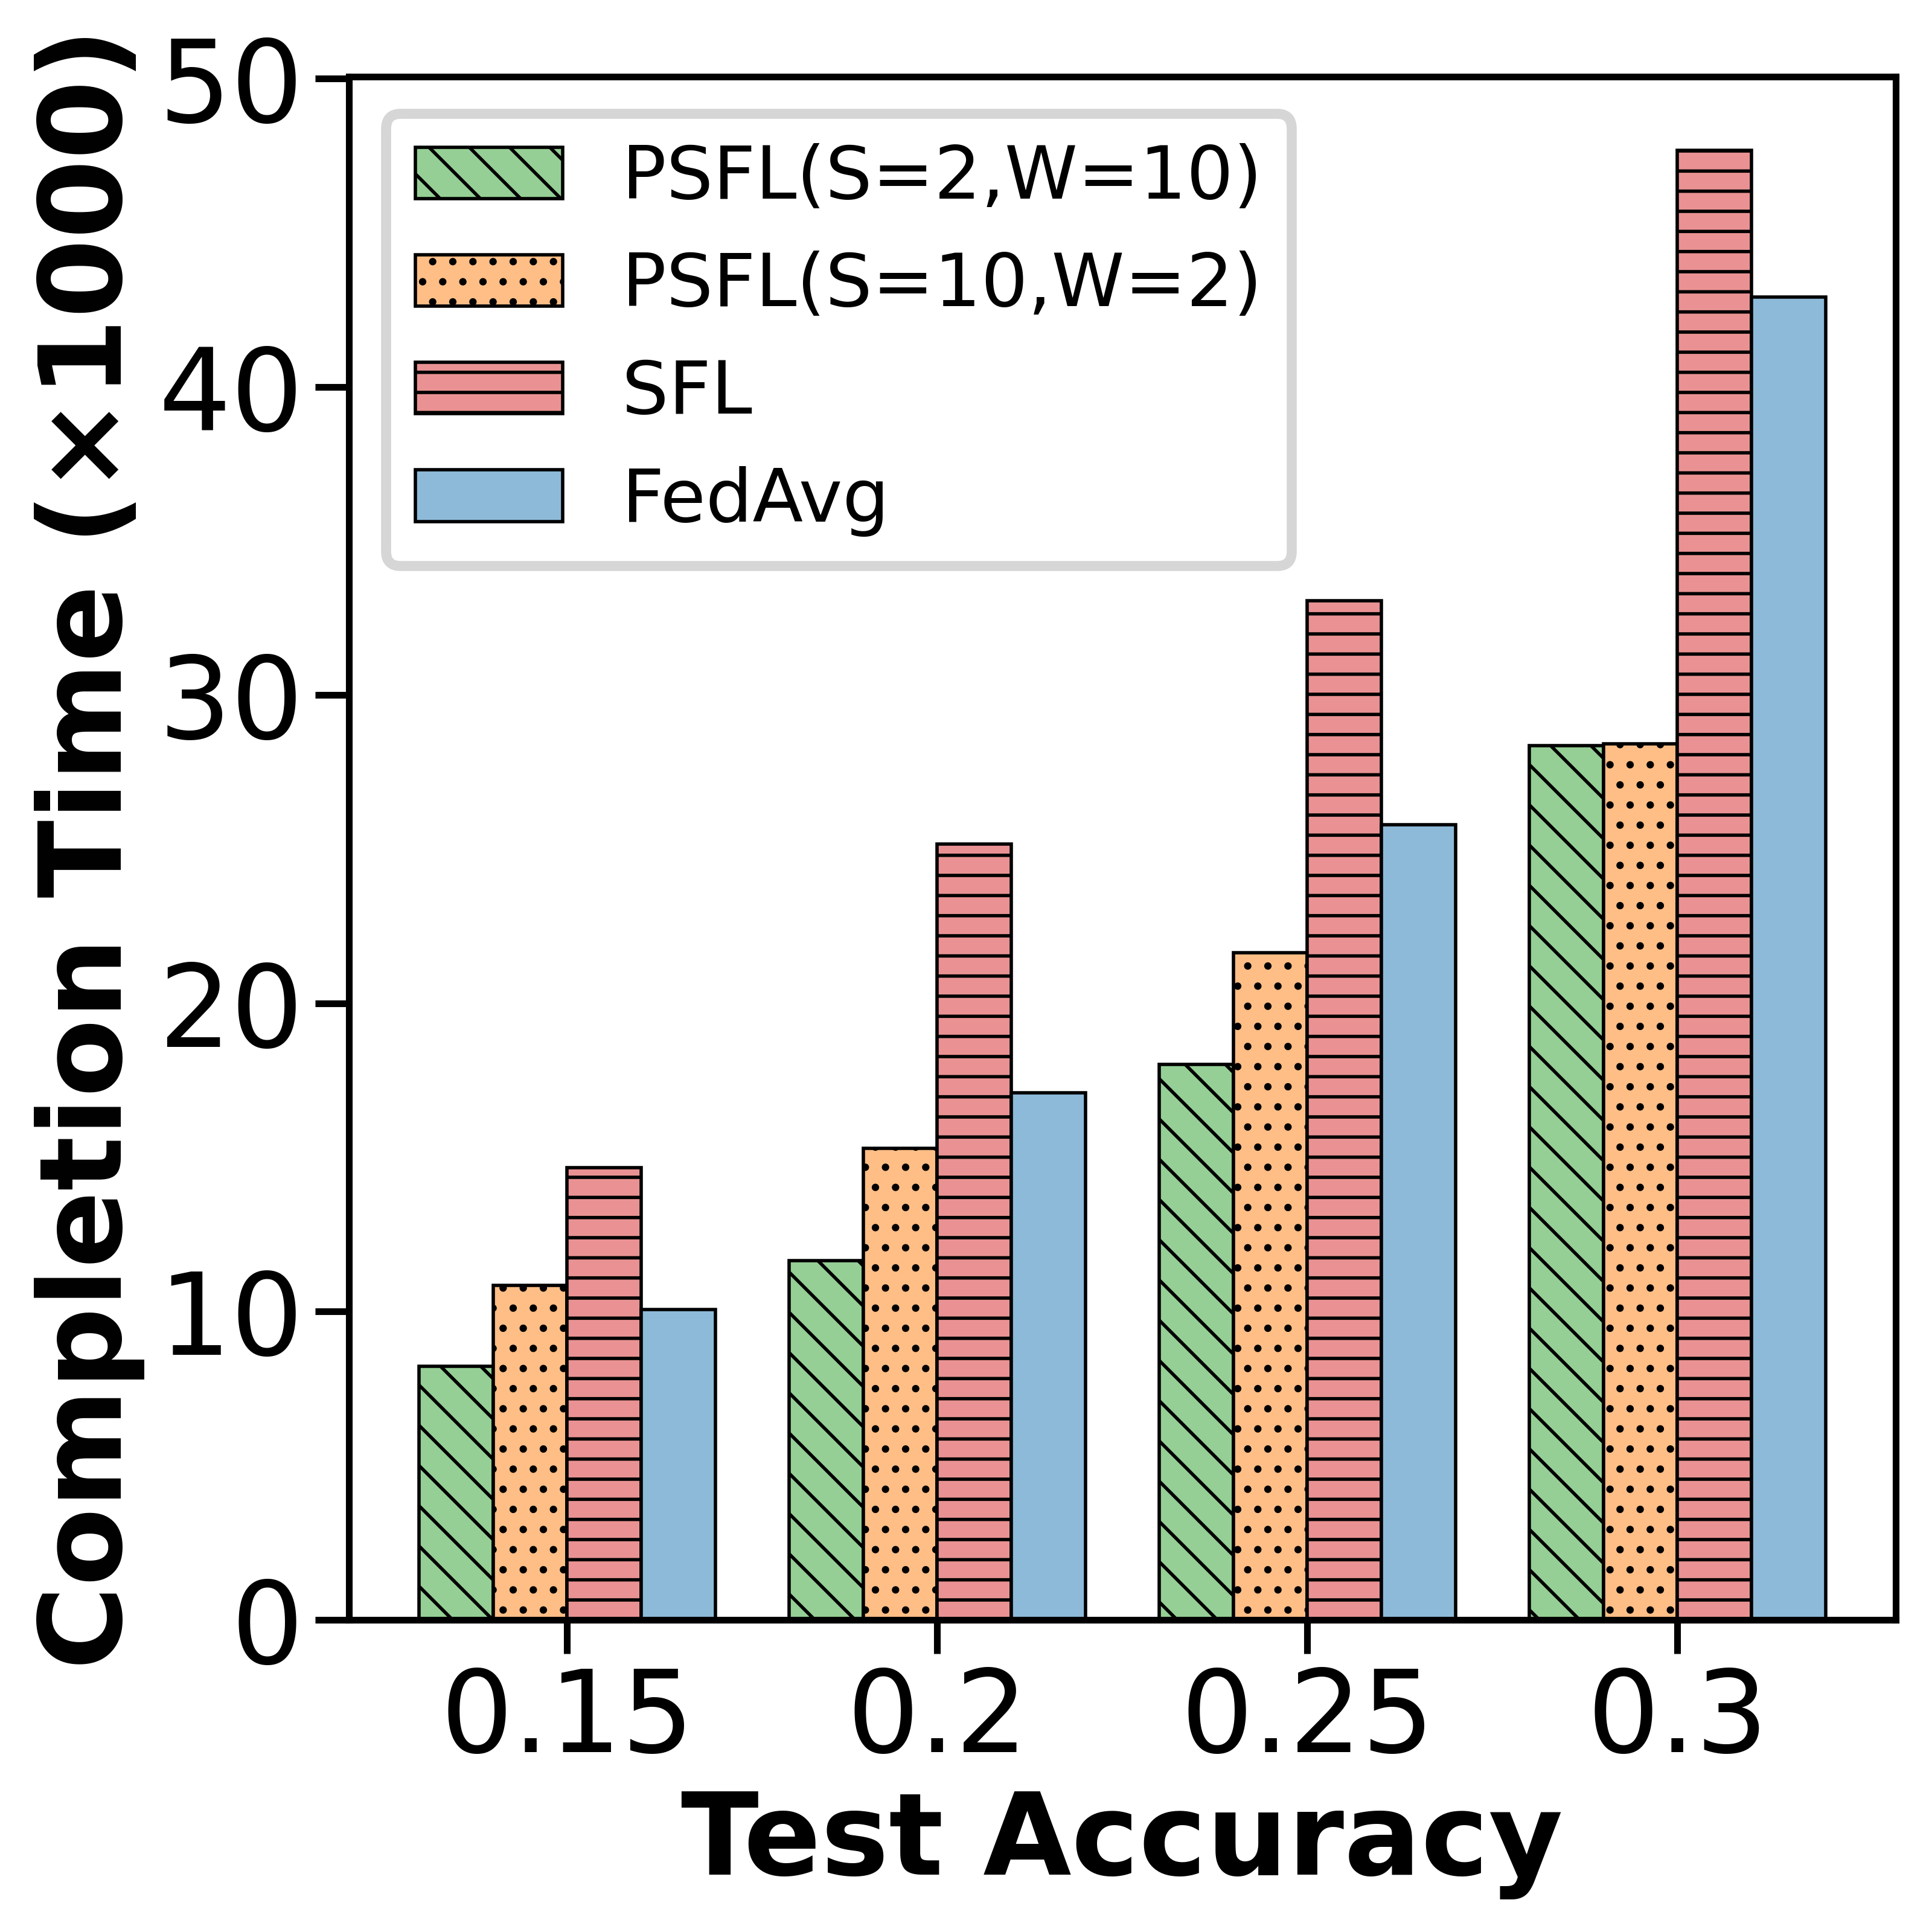
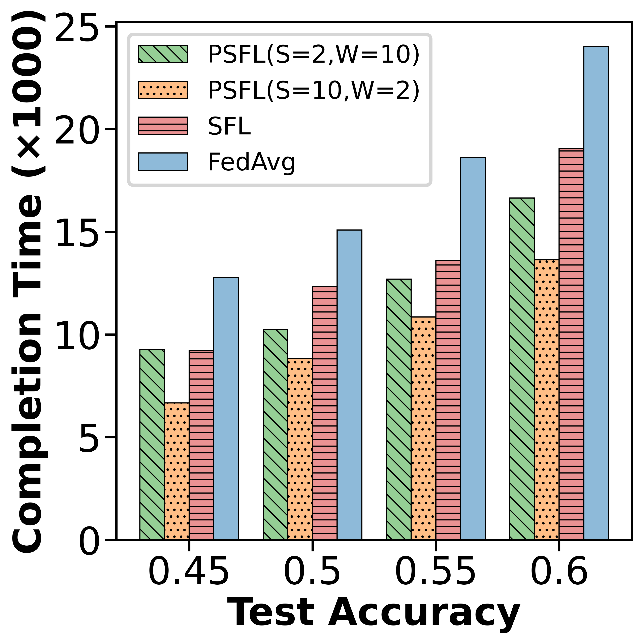
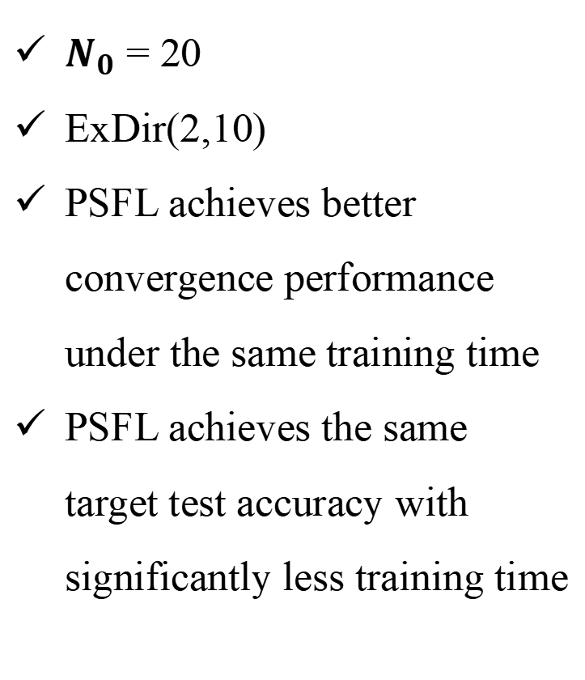
Experimental Evaluation
Comparing to baselines
$N_{0}$ = 20
ExDir(2,10)
PSFL achieves better convergence performance under the same training time
PSFL achieves the same target test accuracy with significantly less training time
Notes:
The results demonstrate that PSFL achieves better convergence performance under the same training time compared to the baselines across all datasets. Moreover, PSFL achieves the same target test accuracy with significantly less training time than the baselines.

Slide 22
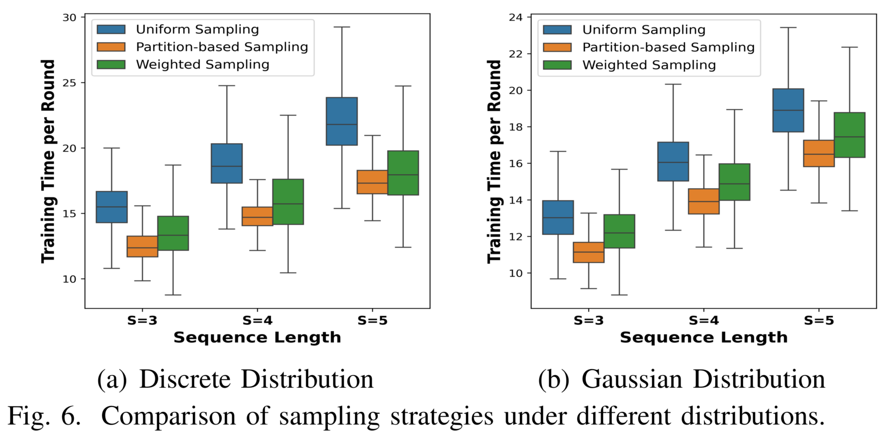
Experimental Evaluation
The efficiency of sampling strategy
Compared strategies:
  uniform sampling
  weighted sampling
Sequence lenngth: S = 3, 4, 5
time setting:
  discrete distribution
  gaussian distribution
Notes:
We evaluate the performance of our proposed client sampling strategy and compare it with two benchmarks. Overall, our sampling strategy demonstrates greater stability and lower training time across all distributions and sequence lengths, outperforming both uniform and weighted sampling.

Slide 23
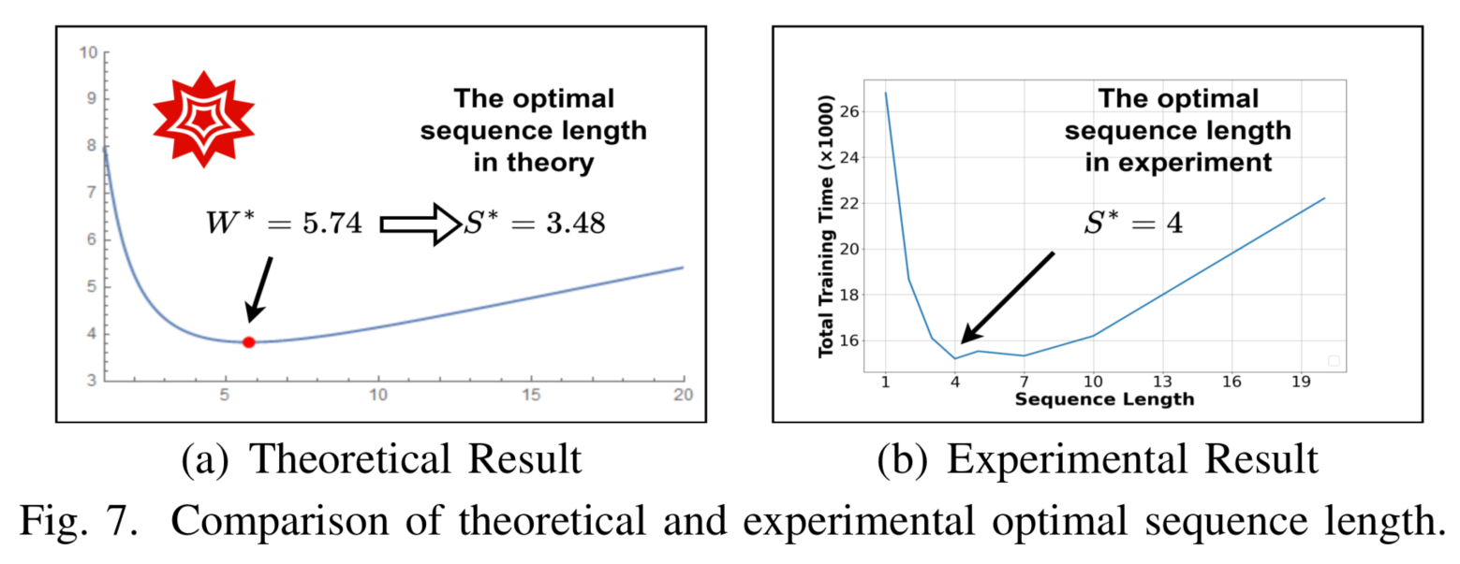
Experimental Evaluation
The efficiency of optimal structure
Notes:
We evaluate the performance of our theoretically optimal training structure and compare it with the experimental values. The results demonstrate they are very close.

Slide 24
CONTENTS
1
Introduction
2
System, Modeling, and Problem
3
Theorem, Optimization, and Algorithm
4
Experimental Evaluation
5
Conclusion

Slide 25
Conclusion
Propose a novel hybrid PSFL framework by integrating the parallel and sequential training modes together.
Provide a theoretical analysis to derive the upper bounds of the model convergence and the expected total training time for the PSFL framework.
  Solve the optimization problem and get the optimal training structure.
The performance is demonstrated on extensive simulations.
Notes:
To conclude, we propose a novel hybrid PSFL framework by integrating the parallel and sequential model training modes together. We provide a theoretical analysis to derive the upper bounds of the model convergence and the expected total training time for the PSFL framework. Based on the theoretical analysis, we solve the optimization problem and get the optimal training structure. Finally, the performance is demonstrated on extensive simulations.

Slide 26




Thank you for your attention!
INFOCOM 2025
Jinrui Zhou, Yu Zhao, Yin Xu, Mingjun Xiao, Jie Wu, Sheng Zhang
                zzkevin@mail.ustc.edu.cn
Notes:
That's all for my presentation. Thank you for your attention.

