Slide 1





FedCPD: Personalized Federated Learning with
Prototype-Enhanced Representation
and Memory Distillation
Kaili Jin¹, Li Xu¹, Xiaoding Wang^{1*}, Sun-Yuan Hsieh²,
Jie Wu^{3,4}, Limei Lin^{1*}
¹Fujian Normal University
²National Cheng Kung University
³China Telecom Cloud Computing Research Institute
⁴Temple University
Notes:
Good morning. I’m [xxx] from Fujian Normal University. Today I’ll present FedCPD—a personalized federated learning framework that preserves client history via feature distillation and improves generalization via prototype alignment/contrast. We validate it on FMNIST/CIFAR-10/100 with state-of-the-art results.

Slide 2
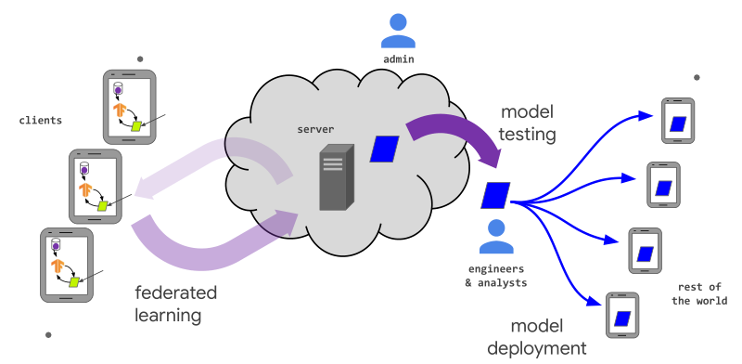
Challenges:
Federated Learning (FL)
  On-device training; data stays local → privacy
  Non-IID clients → one global model misfits individuals
Personalization challenges
  Historical forgetting: “drop on receive” (global ↓ local accuracy)
  Weak generalization: few/biased local data → overfitting, fuzzy boundaries, poor transfer
Limits of prior routes
  Parameter decoupling: local head only; extractor stays globally biased → local nuances lost
  Prototype sharing: helps generalization, doesn’t preserve client history
Notes:
Federated Learning keeps training on devices, so data never leaves the client—great for privacy and compliance. But in practice, client data are non-IID, and a single global model struggles to fit everyone well.
This creates three practical issues. First, historical forgetting: after each aggregation, when a client receives the new global model, we often observe a drop in local test accuracy—the “drop on receive.” Second, weak generalization: with few and skewed local samples, models overfit, class boundaries become fuzzy, and cross-client transfer is poor. Third, fairness: performance varies widely across clients, which is undesirable for deployment.
Existing approaches only partially help. Parameter decoupling keeps a personalized head, but the shared feature extractor is still driven by the global average, so fine-grained client structure gets diluted. Prototype sharing can improve generalization, but it doesn’t explicitly preserve client history.

Slide 3
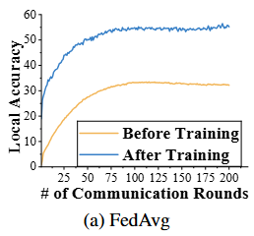
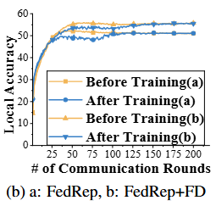
Motivation: Historical Information Forgetting
Setting: CIFAR-100, 20 non-IID clients
Color code: yellow = received global, blue = previous local
Observation: persistent “drop on receive” (global < previous local) → loss of personalization
FedRep limitation: local head kept, but shared extractor stays global-biased → lower post-training ceiling
Need: carry last-round local features forward to reduce update-induced forgetting
Notes:
Next, I’ll motivate our design with two empirical observations. Please focus on Fig. 2a ( FedAvg) and Fig. 2b (FedRep).
Each round, the client receives a global model; in both panels, the yellow curve (received global) is consistently below the blue curve (previous local). This “drop on receive” signals that aggregation washes out client-specific information—classic historical forgetting, especially under strong non-IID.
In Fig. 2b (FedRep), parameter decoupling helps by keeping a personalized head, but the shared feature extractor is still pulled by the global average, so fine client structure isn’t preserved. Result: the post-training ceiling is lower than FedAvg in this setting.
This sets up our first requirement: when a new global model arrives, the client should retain last-round local representations so accuracy doesn’t dip. In practice, we’ll do this with hierarchical feature distillation (details later).
However, preserving history alone doesn’t solve generalization. Next, I’ll show why we also need class-level signals.

Slide 4
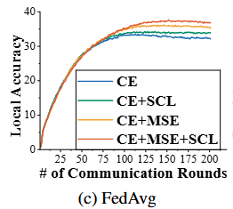
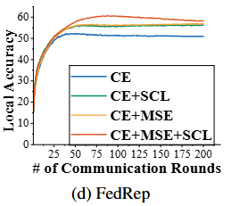
Motivation: Limited Generalization Performance
Setup: CE vs + alignment (pull to class center) vs + contrast (push from other classes) vs both
Fig. 2c (FedAvg): alignment already yields a clear gain; contrast also helps
Fig. 2d (FedRep): alignment + contrast is best (faster, more stable)
Need: inject class-level consistency + discriminability to improve generalization across clients
Notes:
Picking up from the previous slide, we now look at Fig. 2c (FedAvg) and Fig. 2d (FedRep), which compare four loss configurations: CE only, CE + alignment (pull features to their class center), CE + contrast (push away from other classes), and CE + alignment + contrast.
With CE only, class boundaries are fuzzy and generalization is limited. In Fig. 2c, adding alignment already gives a strong gain; contrast helps as well. In Fig. 2d, because FedRep is more representation-oriented, the combination of alignment + contrast is the best performer—it converges faster and more stably.
This sets up our second requirement: beyond preserving history, we need class-level signals that enforce intra-class compactness and inter-class separability to boost generalization, especially when data per class per client is scarce.
Transition: These two observations directly guide FedCPD: we preserve client history (via feature distillation) and inject class-level signals (via prototype alignment + contrast). I’ll detail the framework next.

Slide 5
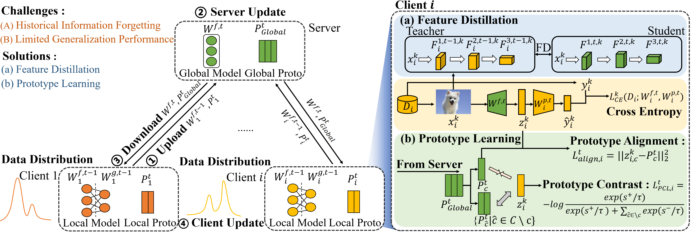
Framework Overview
Therefore, we tackle historical forgetting and weak generalization through (a) feature distillation, which preserves past knowledge, and (b) prototype learning, which sharpens class separation and improves generalization.
Notes:
Therefore, we tackle historical forgetting and weak generalization through (a) feature distillation, which preserves past knowledge, and (b) prototype learning, which sharpens class separation and improves generalization. The left panel shows the server–client interaction (aggregation and broadcast), while the right panel shows the client-side update process.

Slide 6
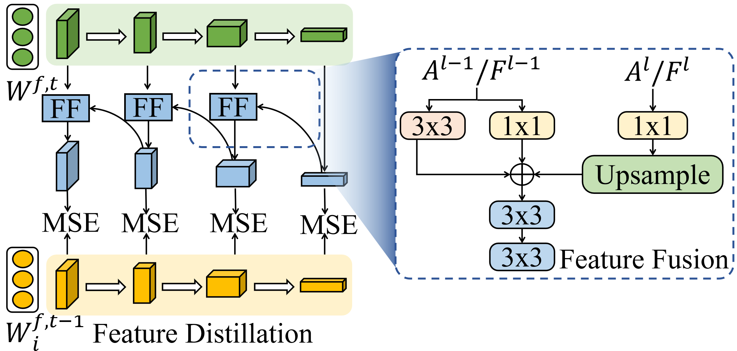
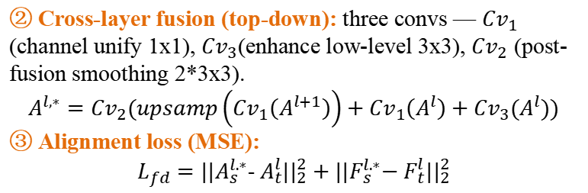
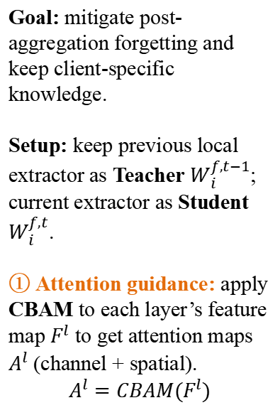
Feature Distillation
Feature Distillation: Preserve client history, reduce forgetting
Goal: mitigate post-aggregation forgetting and keep client-specific knowledge.
Setup: keep previous local extractor as Teacher $W_{i}^{f,t−1}$; current extractor as Student $W_{i}^{f,t}$.
① Attention guidance: apply CBAM to each layer’s feature map $F^{l}$ to get attention maps $A^{l}$ (channel + spatial).
$$A^{l}=CBAM(F^{l})$$
② Cross-layer fusion (top-down): three convs — ${Cv}_{1}$ (channel unify 1x1), ${Cv}_{3}$(enhance low-level 3x3), ${Cv}_{2}$ (post-fusion smoothing 2*3x3).
$$A^{l,∗}={Cv}_{2}(upsamp\left({Cv}_{1}\left(A^{l+1}\right)\right)+{Cv}_{1}\left(A^{l}\right)+{Cv}_{3}(A^{l}))$$
③ Alignment loss (MSE):
$L_{fd}=||A_{s}^{l.∗}$- $A_{t}^{l}||_{2}^{2}+||F_{s}^{l.∗}\text{− }F_{t}^{l}||_{2}^{2}$
Effect: smoother global→local transition, less “drop on receive,” higher personalized accuracy.
Notes:
Our first objective is to preserve client-specific history so accuracy doesn’t drop right after each global aggregation. We do this with a Teacher–Student setup: the previous round’s local extractor $W_{i}^{f,t−1}$ is the Teacher, and the current round’s extractor $W_{i}^{f,t}$ is the Student.
Before aligning features, we run CBAM on every layer’s feature map $F^{l}$. CBAM provides channel attention—which reweights informative channels—and spatial attention—which highlights important locations. This ensures the distillation focuses on where and what matters most.
Next, we add top-down cross-layer fusion on the Student side to combine high-level semantics with low-level details. Concretely, ${Cv}_{1}$ unifies channel dimensions, we upsample the higher-layer features, ${Cv}_{3}$ boosts low-level detail, and ${Cv}_{2}$ smooths the fused result:
$$A^{l,∗}={Cv}_{2}(upsamp\left({Cv}_{1}\left(A^{l+1}\right)\right)+{Cv}_{1}\left(A^{l}\right)+{Cv}_{3}(A^{l}))$$
. Finally, we apply an MSE alignment between Teacher and Student at each layer—on both attention maps and feature maps:
$L_{fd}=||A_{s}^{l.∗}$- $A_{t}^{l}||_{2}^{2}+||F_{s}^{l.∗}\text{− }F_{t}^{l}||_{2}^{2}$
This loss is added to the local objective (together with the classification and prototype terms) while training.
Intuitively, FD acts like a memory stabilizer: it transfers last round’s client-specific patterns into the current model, so the model doesn’t forget immediately after receiving the global update. In practice, this reduces the “drop on receive” and raises the personalized accuracy across rounds with modest overhead.

Slide 7
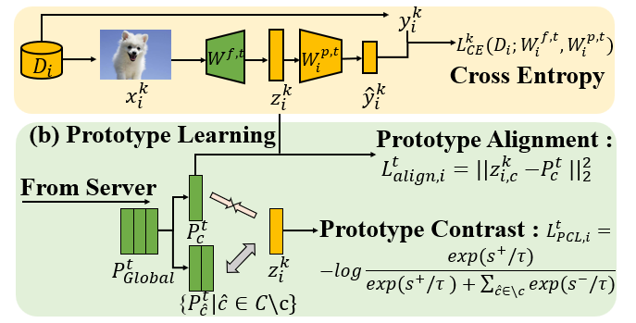
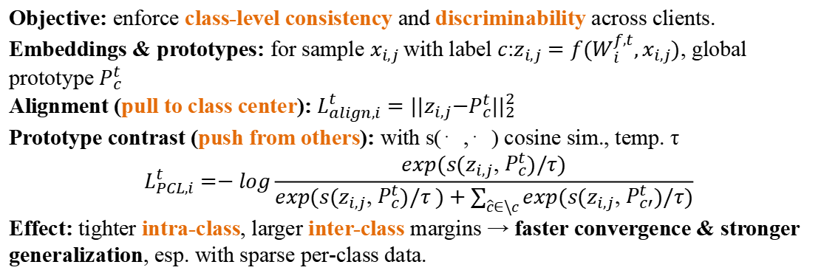
Prototype Learning
Objective: enforce class-level consistency and discriminability across clients.
Embeddings & prototypes: for sample $x_{i,j}$with label $c$:$z_{i,j}=f(W_{i}^{f,t},x_{i,j})$, global prototype $P_{c}^{t}$
Alignment (pull to class center): $L_{align,i}^{t}=||z_{i,j}{−P}_{c}^{t}||_{2}^{2}$
Prototype contrast (push from others): with s(⋅,⋅) cosine sim., temp. τ
$$L_{PCL,i}^{t}=−log\frac{exp(s(z_{i,j}\text{, }P_{c}^{t})/τ)}{exp(s(z_{i,j}\text{, }P_{c}^{t})/τ )+\sum_{\hat{c}∈\backslash c}{exp(s(z_{i,j}\text{, }P_{c′}^{t})/τ)}}$$
Effect: tighter intra-class, larger inter-class margins → faster convergence & stronger generalization, esp. with sparse per-class data.
Notes:
The goal of the Prototype Learning module is to inject class-level signals that survive across clients: make features consistent within a class and separable across classes.
For a local sample $x_{i,j}$with label c, we compute its embedding $z_{i,j}=f\left(W_{i}^{f,t},x_{i,j}\right).$Each round, clients form local prototypes $P_{i,c}^{t}$ as the mean of their embeddings per class; the server averages these to global prototypes $P_{c}^{t}$ and broadcasts them along with the global extractor.
Alignment loss. We pull each embedding toward its global class prototype:
$L_{align,i}^{t}=||z_{i,j}{−P}_{c}^{t}||_{2}^{2}$ This reduces variance within a class and combats overfitting on small, skewed local sets.
Prototype contrast. We then impose a contrastive margin at the class level. Using cosine similarity s(⋅,⋅) and temperature τ\tau, the loss favors the positive pair ($z_{i,j}$, $P_{c}^{t}$) over all negatives {$P_{c′}^{t}$:$c^{′}≠c\}:$
$$L_{PCL,i}^{t}=−log\frac{exp(s(z_{i,j}\text{, }P_{c}^{t})/τ)}{exp(s(z_{i,j}\text{, }P_{c}^{t})/τ )+\sum_{\hat{c}∈\backslash c}{exp(s(z_{i,j}\text{, }P_{c′}^{t})/τ)}}$$
Alignment gives consistency; contrast gives separation.
Prototypes act as class anchors shared across clients: they stabilize representation learning, make clusters tighter and boundaries clearer, and are particularly effective when classes are many and per-class data per client is scarce. Combined with FD, this yields better generalization without sacrificing personalization.

Slide 8
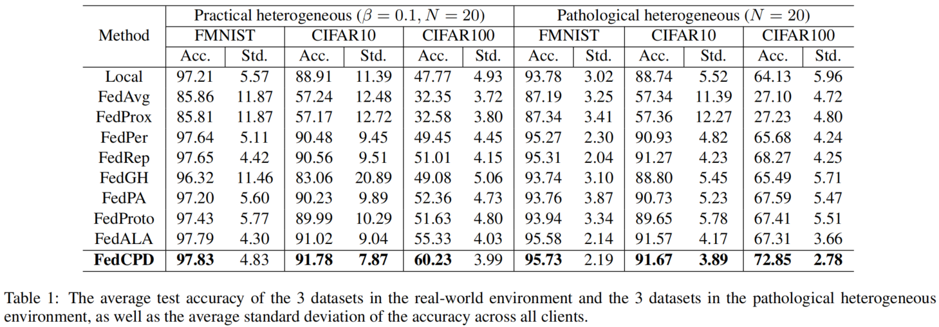
Main Results
Setup: FMNIST / CIFAR-10 / CIFAR-100; Dirichlet and class-per-client splits; metric: mean client test accuracy; baselines in Table 1.
Result: FedCPD achieves the highest mean accuracy on all datasets under both regimes.
Trend: Larger gains with more classes / stronger imbalance.
Rationale: FD reduces post-aggregation forgetting; prototypes increase intra-class compactness & inter-class separability.
Notes:
We evaluate three datasets under two non-IID partitions and report mean client test accuracy, comparing to representative FL baselines (Table I).
FedCPD attains the top mean accuracy across all datasets and both regimes, indicating consistent effectiveness.
The relative gains grow with class cardinality and label imbalance, suggesting robustness to diverse label distributions.
Mechanistically, feature distillation preserves client-specific history across rounds, while prototype alignment/contrast yields tighter clusters and clearer boundaries, improving generalization in sparse per-class settings.

Slide 9
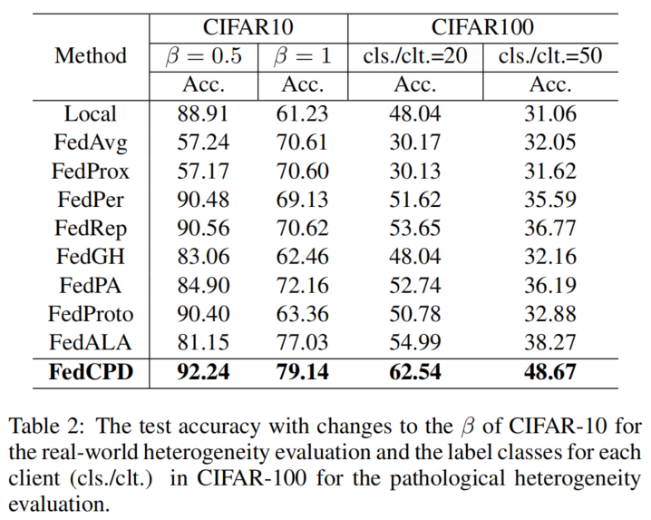
Main Results
Heterogeneity control (Table 2):
  CIFAR-10: vary Dirichlet β to adjust real-world non-IID level
  CIFAR-100: vary classes per client to create pathological non-IID
Result: FedCPD attains the highest mean test accuracy under both heterogeneity controls (Table 2) → robust generalization across distributions
Fairness (Tables 1-2): Lower standard deviation across clients; FedCPD consistently ranks among the best
Interpretation: Better balance between global sharing and local personalization → accuracy and fairness
Notes:
We evaluate robustness to distribution shift by tuning the non-IID level: (i) on CIFAR-10, we vary the Dirichlet β; (ii) on CIFAR-100, we vary the number of classes per client (Table II).
Across these conditions, FedCPD achieves the highest mean client test accuracy, indicating strong generalization under both realistic and pathological heterogeneity.
For fairness, we inspect the standard deviations reported in Tables I and II. FedCPD exhibits lower dispersion across clients and consistently ranks near the top, implying more uniform performance.
Mechanistically, feature distillation stabilizes local models by mitigating post-aggregation forgetting, while prototype alignment/contrast yields tighter intra-class clusters and clearer inter-class boundaries—together improving accuracy without sacrificing fairness.

Slide 10
Conclusion
Conclusion:
We propose FedCPD, a personalized FL framework that combines attention-guided hierarchical feature distillation and prototype alignment/contrast.
We provide theoretical support (convergence upper bound): FD mitigates aggregation-induced forgetting; prototypes enforce intra-class compactness and inter-class separability.
Comprehensive experiments on FMNIST/CIFAR-10/100 with Dirichlet and class-per-client splits show state-of-the-art personalized accuracy and robustness — up to +10.40% (generalization) and +4.90% (personalization), with lower client-wise variance.
Notes:
We introduce FedCPD. The feature-distillation path preserves client history across rounds, and the prototype module adds class-level consistency and discriminability shared across clients.
We prove a convergence upper bound. Intuitively, distillation reduces forgetting after aggregation, while prototype alignment/contrast makes features tighter within classes and farther across classes—which also stabilizes training.
Across FMNIST, CIFAR-10, CIFAR-100 and both non-IID regimes, FedCPD delivers the top mean client accuracy—up to +10.40% in generalization and +4.90% in personalization—with lower variance across clients. Ablations confirm the two components are complementary.
Overall, FedCPD balances personalization, generalization, and fairness under non-IID settings. Thank you.

