Slide 1


Origami: Efficient ML-Driven Metadata
Load Balancing for Distributed File System
﻿Yiduo Wang* Wenda Tang Linghang Meng Liang Li Jie Wu
China Telecom Cloud Computing Research Institute
ICPP`25 Paper Session 14: Software, AI & Performance;
Thursday, September 11
Notes:
Thanks to Professor Shende for the guidance and kind help before and during the conference.
Good afternoon, everyone, I'm Yiduo Wang from the China Telecom Cloud Computing Research Institute, today I'm very honored to share with you our recent work, on building an efficient, ML‑driven metadata load balancing framework for distributed file systems.

Slide 2

1. Why is metadata management important yet inefficient?
Origami: Efficient ML-Driven Metadata
Load Balancing for Distributed File System
2. Do we really need metadata load balancing?
3. How to make load balancing efficient, via ML?
Notes:
My talk will mainly focus on the following three questions: first, why metadata is important yet still inefficient; second, do we really need metadata load balancing; and third, how to make it efficient with machine learning. Let’s start with metadata.

Slide 3




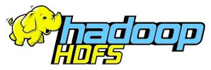
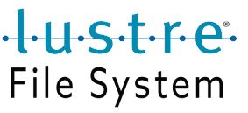



Distributed File System (DFS)
Cloud
AI
HPC
Distributed File Systems
HopsFS
CFS
Notes:
In today’s intelligent era, distributed file systems (DFS) have become a fundamental infrastructure, supporting many critical workloads, such as cloud computing, AI, and high performance computing. Examples include classic distributed file systems like CephFS and Lustre, as well as more recent developments such as HopsFS and CFS.

Slide 4


File System and Metadata
The logic structure of file system: metadata and data
/
usr
etc
Metadata:
a tree/DAG
bin
sbin
share
Namespace Structure
File/Dir Attribute
...
(name, parent inode...)
(access time, permission...)
dir
foo
bar
bar
Data
data
data
data
File Data
Notes:
Typically, a file system consists of two major parts. First, metadata: as shown in the figure, it can be viewed as a tree or Directed Acyclic Graph, that includes both the namespace structure such as file name, parent inode numer, and file attributes, such as the access time, permission bits. The second part is the data: the actual file contents of user.

Slide 5


Modern Architecture of DFS
Common architecture: metadata and data decoupled
/
usr
etc
Distributed File System
Metadata
create()
mkdir()
…
bin
sbin
share
Namespace Structure
File/Dir Attribute
...
Metadata Servers(MDSs)
Metadata requests
dir
foo
bar
bar
read()
write()
…
data
data
data
File Data
Data requests
Data
Notes:
After two decades of evolution, distributed file systems now have decoupled metadata management from data storage, allowing each to scale independently. A user’s POSIX system calls are translated into multiple internal file system operations—metadata operations such as create or mkdir, and data operations such as read or write. In this architecture, metadata operation lies on the critical path of user requests and are processed before data operations.

Slide 6
Modern Architecture of DFS
Distributed file system meets new challenges
New Scale
DFS capacity: hundreds of billions
DFS QPS: millions per second
Distributed File System
Metadata
create()
mkdir()
…
New Hardware
Metadata Servers(MDSs)
Metadata requests
SSD Bandwidth: ~15GB/s
NIC Bandwidth: 400Gb+
read()
write()
…
New Pattern
Data requests
Average file size: < 1MB
Metadata operation ratio: >90%
Data
Notes:
As mentioned, distributed file systems have been studied for more than two decades. Why are we still struggling with such an old problem? Because new challenges keep emerging. First, the scale: a single file system may now store hundreds of billions of files and handle millions of operations per second. Second, hardware: NVMe SSDs and high-bandwidth NICs have greatly reduced the data transfer latency, exposing the relative slowness of metadata operations. Third, workloads are becoming metadata-dominated. For example, if you mount a DFS through NFS, then up to 90 percent of the operations might be metadata operations.

Slide 7
Modern Architecture of DFS
Distributed file system meets new challenges
New Scale
DFS capacity: hundreds of billions
DFS QPS: millions per second
Distributed File System
Metadata
create()
mkdir()
…
New Hardware
Metadata Servers(MDSs)
Metadata requests
SSD Bandwidth: ~15GB/s
NIC Bandwidth: 400Gb+
read()
write()
…
Metadata becomes the primary bottleneck of modren DFS
New Pattern
Data requests
Average file size: < 1MB
Metadata operation ratio: >90%
Data
Notes:
These different challenges all point to the same conclusion: today, metadata has become the primary bottleneck in modern distributed file systems.

Slide 8

Scaling Metadata of DFS
Breaking the metadata bottleneck: multi-MDSs collaboration
/
MDS-0
Overcoming Single-MDS Capacity Limits
usr
etc
bin
sbin
share
MDS-1
Enabling Multi-MDS Parallel Processing
dir
Realizing Full In-Memory Metadata
MDS-0
foo
bar
bar
Notes:
But, don't panic, we do have solutions to scale the metadata. Modern distributed file systems such as CephFS, Lustre, and CFS support multiple collaborating MDSs to scale out. This allows us to go beyond the capacity limit of a single MDS, process metadata operations in parallel, and keep most metadata hot in memory. Sounds great, right?

Slide 9
And, what must we give in return?
“It promises great power, but it exacts a terrible price.”
—Medivh
Notes:
But, as the old saying goes, great power often comes with a terrible price. So, what do we have to give in return, for the metadata scalability?

Slide 10
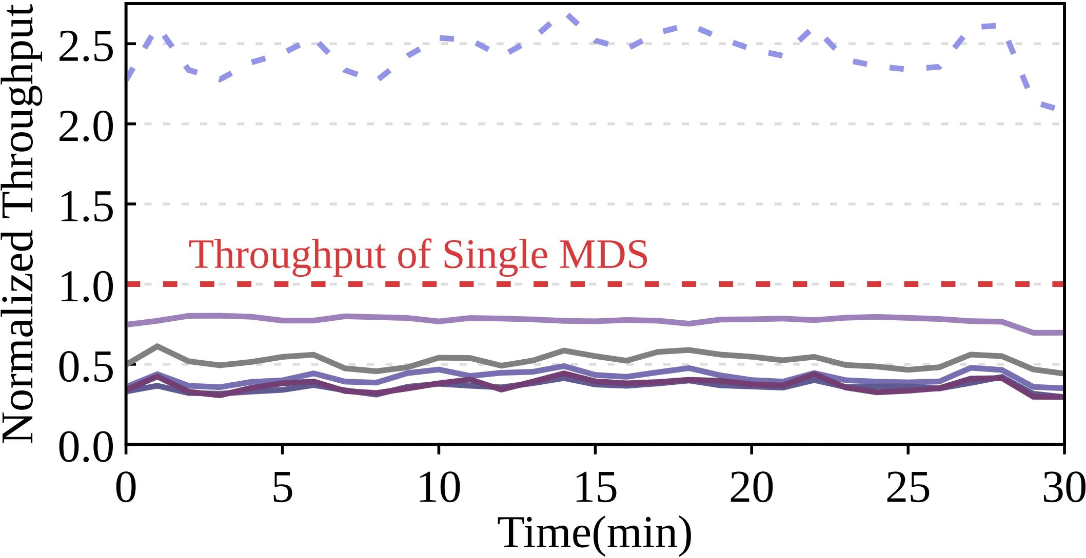
Scaling Out—But Not Efficiently
Evaluation on a CephFS cluster with 5-MDSs configuration
Read-only metadata-heavy workload, saturate metadata service with many clients
Partition metadata evenly via hashing
Known inefficiency: metadata load imbalance.
More critical: all MDS slow down.
Notes:
To answer that, we deployed a CephFS cluster with 5 MDSs. Using the built-in hash-based partitioning, we split the namespace evenly and ran a read-only, metadata-heavy workload. In this figure: M1 to M5 show per-MDS throughput; the purple dashed line is the aggregated throughput; the red dashed line is the single-MDS baseline. We can see two types of inefficiencies. First, load imbalance—which is studied in many research. Second, and more critically, each MDS’s throughput are lower than the single-MDS setup. In other words, all MDSs became much slower.

Slide 11
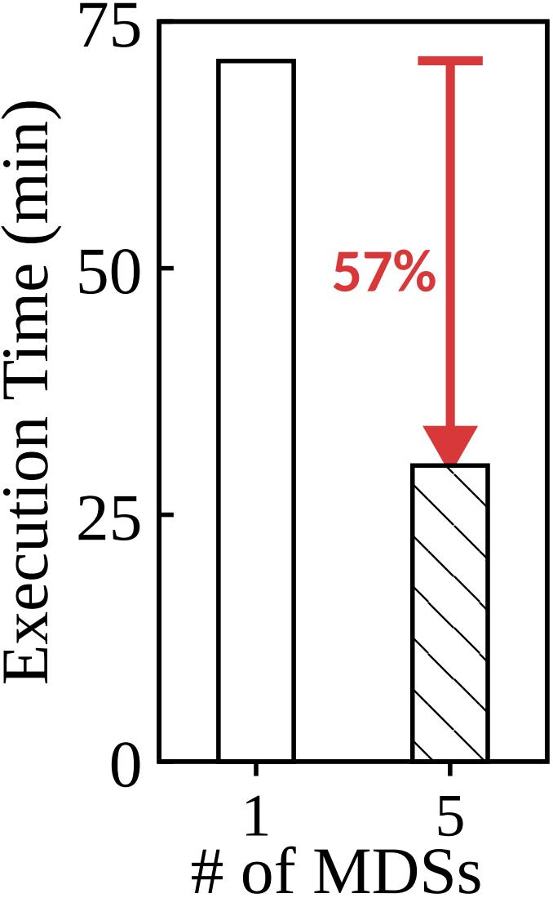
Scaling Out—But Not Efficiently
Evaluation on a CephFS cluster with 5-MDSs configuration
Read-only metadata-heavy workload, saturate metadata service with many clients
Partition metadata evenly via hashing
+400% hardware resource
-57% Job completion time
Notes:
We then looked at end-to-end job completion time—the metric that users really care about—under different setups. Surprisingly, although we give 5 time hardware resource, the user job completion time reduced by merely 57%, That's quite disappointing.

Slide 12
The Cost of Scaling: Degraded Locality
Metadata access pattern: path resolution first
Notes:
Why is the gain so limited? We found that scaling out breaks namespace locality. To be more specific, filesystem metadata has a unique characteristic that distinguishes it from other storage types: most operations require resolving the full path first to get the inode number.

Slide 13



The Cost of Scaling: Degraded Locality
Metadata access pattern: path resolution first
create(“/usr/bin/dir/foo”)
Clients
Partition Metadata in 3 MDSs
/
MDS-0
① path resolution
usr
etc
3x hardware process
② path resolution
balanced load and capacity
bin
sbin
share
MDS-1
3x RPC (remote process call)
dir
③ path resolution
& file creation
MDS-0
foo
bar
bar
higher request completion time
The handling of metadata is similar, as cross-MDS processing requires additional coordination overhead such as distributed lock.
Notes:
Here's an example: Suppose a client wants to create a new file, and the directories along that path are placed on three different MDSs. We must perform three sequential remote procedure calls for path resolution, before we can even start the metadata mutation. So, that is the price we paid. We add more hardware to spread the load and achieve a balanced load distribution, but we inflate the total number of RPCs and increase the latency. Moreover, this loss of locality not only affects path resolving, but also complicates metadata updates. We now need distributed coordination—such as distributed transaction with cross-server locking—to ensure the distributed consistency, and that is quite expensive.

Slide 14
The Cost of Scaling: Degraded Locality
Metadata access pattern: path resolution first
create(“/usr/bin/dir/foo”)
Clients
Partition Metadata in 3 MDSs
/
MDS-0
① path resolution
usr
etc
3x hardware process
② path resolution
balanced load and capacity
bin
sbin
share
MDS-1
3x RPC (remote process call)
dir
③ path resolution
& file creation
MDS-0
Even Partitioning Considered Harmful!
foo
bar
bar
higher request completion time
Notes:
After these observation and analysis, we believe that for the metadata, even partitioning consider harmful!

Slide 15




Existing Work for Metadata Partitioning
Metadata partitioning
Locality-preserved range partition
Hash-based partition
CephFS
SC’04
IndexFS
SC’14
Lustre-DNE1
2014
Lustre-DNE2
2014
Tectonic
FAST’21
CFS
EuroSys’23
HopsFS
FAST’17
LocoFS
SC’17
…
CalvinFS
FAST’15
InfiniFS
FAST’22
…
light-weight coordination
hotspots
load balance
expensive path resolution
Metadata Load Balancing
Programmability
Spatio-Temporal Locality
ML-based Balancing
Mantle
SC’15
MUSE
ICPADS’23
Lunule
SC’21
Lunule+
TOS’25
LDPP
ICPP’22
LoADM
DATE’24
When balance is prioritized and overhead is ignored, end-to-end gains remain limited.
Notes:
To make distributed metadata services more efficient, there is many existing work focusing on metadata partitioning methods. For example, CephFS and HopsFS adopt locality-preserved range partitioning, splitting the namespace into multiple subtrees and improving performance with lightweight coordination. However, these approaches are prone to hotspots, thus cannot scale very well in real-world dynamic workloads. Other distributed file systems such as Lustre and Tectonic partition metadata evenly by hashing the whole namespace to achieve load balance, but they must tolerate expensive path resolution and distributed coordination overhead. In addition to partitioning, some works try to improve load balancing from various aspects, such as Mantle focuses on enhancing programmability, Lunule consider both spatio-temporal locality, or recent studies try to adopting machine learning methods to predict furture popularity. However, they all focus on balance and ignore the corresponding path resolution overhead, so the end-to-end benefits are limited.

Slide 16
Goal and Challengs
Our goal: an efficient ML-driven metadata load balancing mechanism.
Key property: maximizing balance while minimizing additional overhead.
We believe: balance should be a means, not the end.
Challenge #1: Measuring appropriate metrics.
Challenge #2: Finding effective migration decisions.
Challenge #3: Collecting statistics and validating models.
Notes:
In this work, our goal is to build an efficient ML-driven metadata load balancing mechanism, which maximizes balance while minimizing extra overhead. In other words, we believe that: balance should be a means, not the end—we care about end-to-end user job completion time. This can be challenging, because we need to solve many problems, including figuring out how to measure balance metrics, how to make effective migration decisions during runtime, and how to train the models both quickly and precisely.

Slide 17
So, we want a best balancing strategy.
But what is “best balancing”?
Notes:
But let's be honest, the above challenges doesn't sound very difficult, and a little boring—"just find the best balancing" right? Actually, I think the real problem is: we have no idea about what the "best balancing" really is! How could we train a model to learn the best strategies, if we don't even know what is good or bad?

Slide 18
What is the Best?
Inspired by the classic Bélády’s algorithm — for the cache: if the access sequence is given, there exists an optimal cache replacement policy that maximizes the cache hit ratio.
Notes:
Fortunately, the classical Belady algorithm inspired us. The Belady algorithm tells us that for the cache, if the access sequence is given, there exists an optimal cache replacement policy that maximizes the cache hit ratio.

Slide 19
What is the Best?
Inspired by the classic Bélády’s algorithm — for the cache: if the access sequence is given, there exists an optimal cache replacement policy that maximizes the cache hit ratio.
Out insight: for the metadata: if the future metadata access sequence is given, there should also exist an optimal partitioning that minimizes end-to-end job completion time(JCT).
We can train a model to learn it!
Notes:
By analogy, we believe it is similar for metadata management: if the future metadata access sequence is given, there should also exist an optimal partitioning that minimizes end-to-end job completion time. So, we can train a model to learn it!

Slide 20
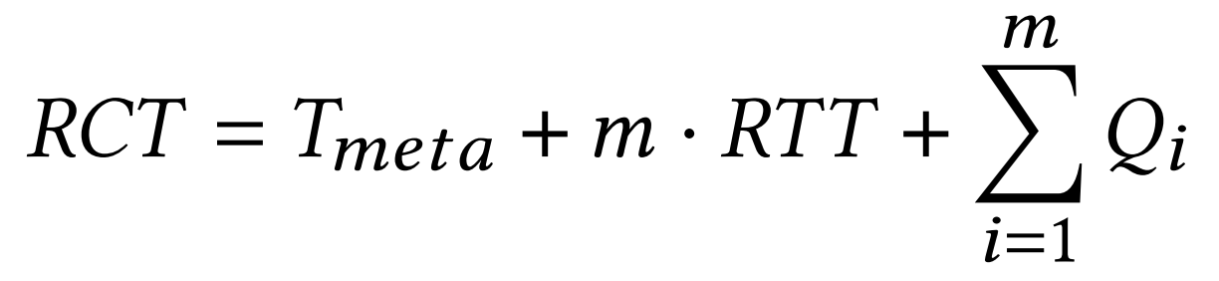
Measure RCT Instead of Balance
To find the optimal strategy, we need to know how partitioning affect the request completion time(RCT)?
For a single metadata request with： a path length of k and that is distributed among m distinct metadata partitions.
metadata processing time
RPCs incurred by path resolution
queuing at each partition
Notes:
However, minimizing job completion time is much harder than maximizing cache hit ratio, because we still don’t know how to calculate it. So first, we decompose it and approximate the completion time of each request as the sum of three parts: metadata processing time, path resolution time, and queuing time. All three are affected by how we partition the namespace, but metadata processing time is the most complex.
Because

Slide 21
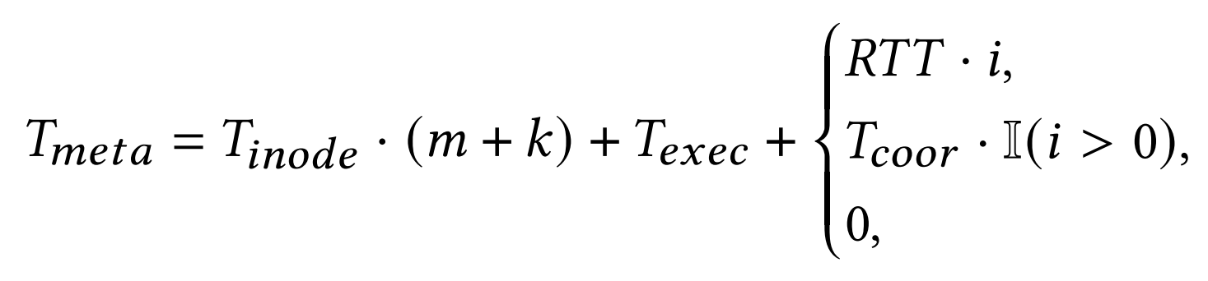
Measure RCT Instead of Balance
To find the optimal strategy, we need to know how partitioning affect the request completion time(RCT)?
For a single metadata request with： a path length of k and that is distributed among m distinct metadata partitions.
*
list directory, lsdir
namespace mutation, such as mkdir
other operations
*migrating the sub-files/directories to i other MDSs
Notes:
metadata operations are diverse, and developing computational approaches for each operation type is highly complex. Luckily, we find that they can be classified into three situations: for directory listing, splitting a directory into multiple partitions will introduce a linear increase in RPC count; for namespace mutations, such as create directory or remove file, partitioning will introduce distributed coordination overhead; and other operations, such as set permission or get attribute are not affected.

Slide 22
Measure RCT Instead of Balance
To find the optimal strategy, we need to know how partitioning affect the request completion time(RCT)?
For a metadata request calculate RCT by
How to determine the hyperparameters? Sampling under high load.
Approximating JCT by casting it as a bin-packing problem.
Notes:
The details of these calculations are in the paper. Our conclusion is that, given a set of hyperparameters of time cost, the above analysis allows us to estimate the request completion time. Although these hyperparameters do change with load, sampling them in all situations is nearly impossible. Fortunately, we only care about high load situations, where load balancing will be applied. After that, we approximate the Job Completion Time by casting it as a bin-packing problem.

Slide 23




Estimating the Benefits of Migration
MetaOPT: Finding the near-optimal migration and benefit
Input: namespace partitioning + access sequence
Enumerate candidate subtree migrations
Comparing the JCT before/after migration
Output: Estimated benefit + best migration plan
Notes:
Building on this, we designed an algorithm to find near-optimal migration decisions and benefits, which we call metaOPT. The input is the namespace partitioning and access sequence. metaOPT greedily traverse the namespace, comparing the job completion time before and after migration. Finally, it outputs the estimated benefits of each decision and the best migration decision.

Slide 24
Estimating the Benefits of Migration
MetaOPT: Finding the near-optimal migration and benefit
Is MetaOPT really Optimal?
No, but the benefit gap to optimal < Δ
Input: namespace partitioning + access sequence
Enumerate candidate subtree migrations
Comparing the JCT before/after migration
Output: Estimated benefit + best migration plan
Notes:
The details of metaOPT are in our paper, and I won't explain them in detail here. But if you wonder whether the greedy metaOPT is optimal, my answer is no—there will be some corner cases where we can only find a sub-optimal decision. For example, a combination of multiple decisions with lower benefits may be better than a single decision with the highest benefit. But don't worry, we have proved that: even in the worst case, the benefit gap from the optimal decision is smaller than a small delta. The proof can be found in the appendix.

Slide 25


Origami Overview and Workflow
Origami: a framework for training efficient balancing models
MetaOPT: to offline generate labels and execute decisions
Data Collector: to dump the runtime namespace state
Migrator: execute external migration decisions
Label Generation
Model Training
Model Validation
…
…
traces
workload
② collect stats
Online
Prediction
& Balancing
④ continue
…
MetaOPT
① run
③ generate labels
& execute decisions
ML models
OrigamiFS
Data Collector
Migrator
Data Collector
Migrator
Notes:
Now, let me introduce Origami—the framework we build to train efficient metadata balancing models. First, we implement the metaOPT algorithm, running on oour distributed filesystem, OrigamiFS. It support two distinct interfaces to dump the runtime namespace state for metaOPT calculation, and execute corresponding migration decision.

Slide 26
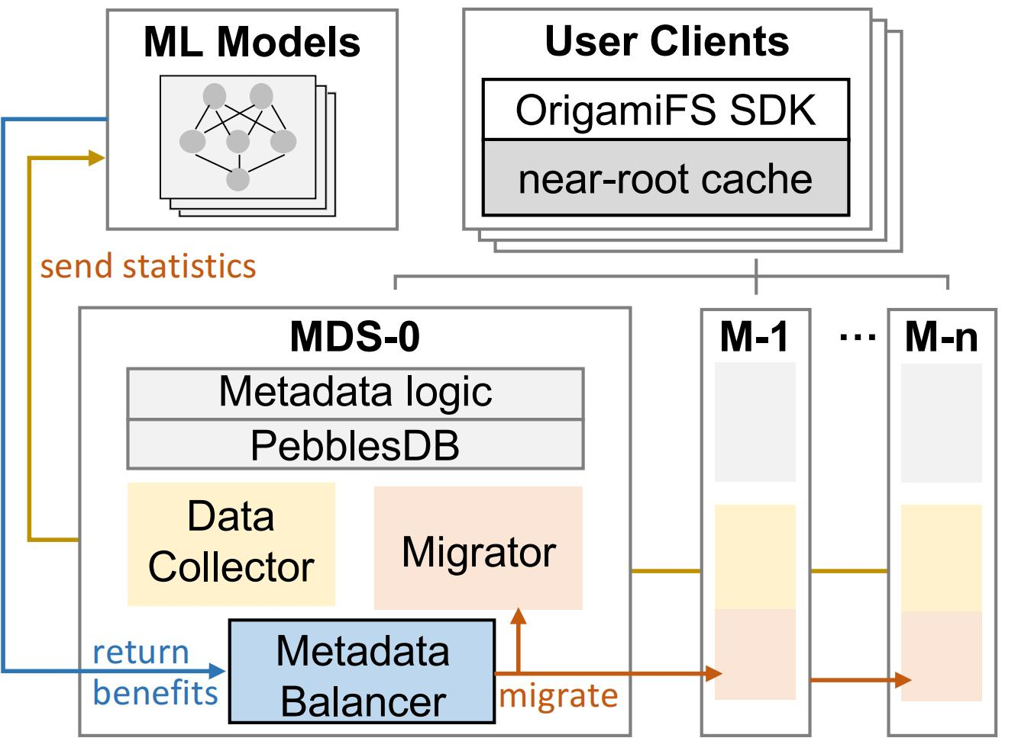
OrigamiFS Architecture
A prototype of distributed metadata service
Cache for near-root hotspot mitigation
Metadata disaggregation for scalability
Specific interface for training and validation
Notes:
The architecture of OrigamiFS is shown in this figure. In short, we develop a prototype of distributed metadata service, which adopts techniques from prior work, such as metadata caching to mitigate near-root hotspots, disaggregating metadata to a local Key Value store to scale, and the aforementioned interfaces for training and validation.

Slide 27


Origami Overview and Workflow
Origami: a framework for training efficient balancing models
Training feature: namespace statistics
Training label: migration benefit
Label Generation
Model Training
Model Validation
…
…
traces
workload
② collect stats
Online
Prediction
& Balancing
④ continue
…
MetaOPT
① run
③ generate labels
& execute decisions
ML models
OrigamiFS
Data Collector
Migrator
Data Collector
Migrator
Notes:
To train the balancing model, we use namespace statistics collected from OrigamiFS as features, and the output benefits from metaOPT as labels. After training the models offline, we use these models to predict benefits and find migration decisions online.

Slide 28
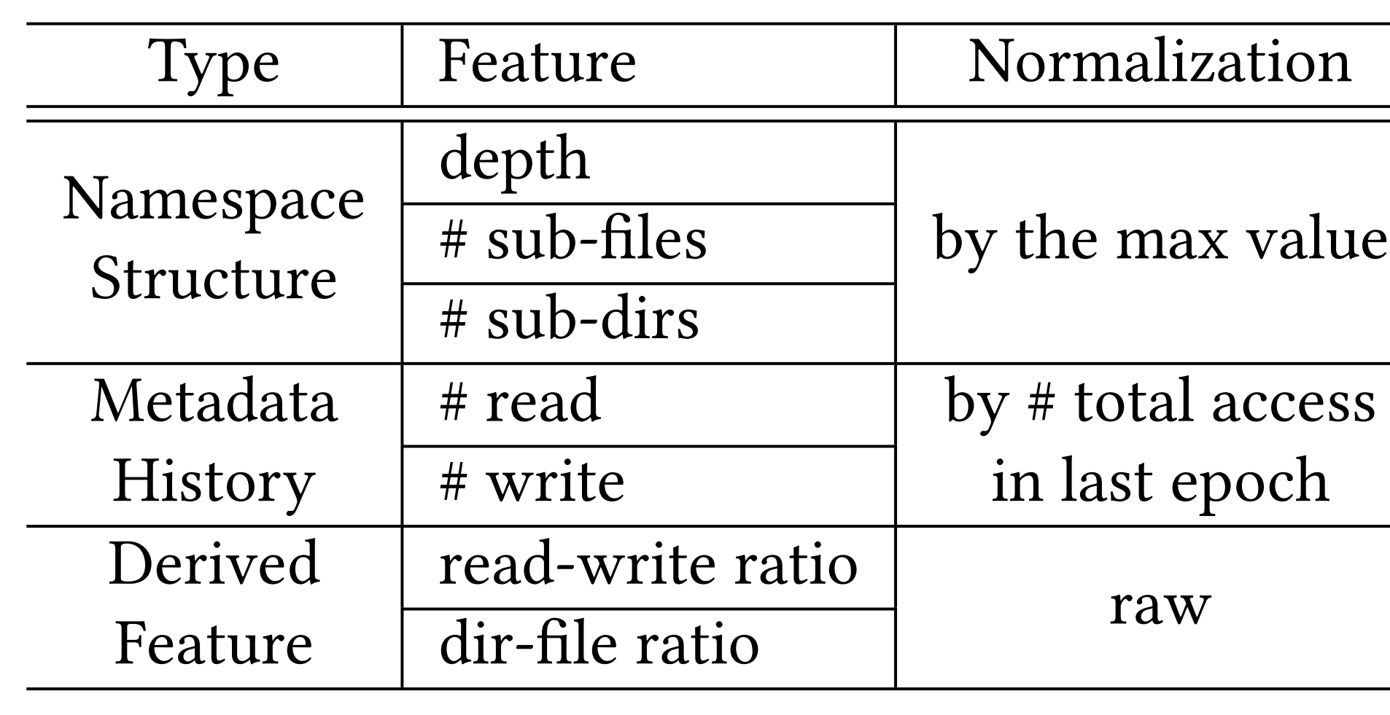
About the Models
Training feature
Model: LightGBM, GDBT, MLP
fastest yet precise enough
too slow
Notes:
We list the training features in this table, which includes both namespace structure information, such as the number of sub-files. And metadata history, such as the total read/write access count in the last epoch. We trained different models, but finally selected LightGBM because it is very fast and precise enough. We also tried MLP, but the inference time is much longer, especially considering that storage servers typically are not equipped with GPUs.

Slide 29
Questions to Answer
How does Origami impact the metadata performance?
Does Origami achieve better metadata load balance?
Does Origami scale meta-ops better than SOTA?
How does the near-root cache impact the performance?
Does Origami more efficient than other methods?
......
Notes:
Next, I will show you the overall performance and balance analysis of Origami in different scenarios. We also conducted other evaluations such as cache efficiency and data path impact analysis. To save time, I won't cover these additional experiments here—the complete evaluation details are presented in the paper.

Slide 30
Evaluation Setup
Baseline Systems
C-Hash: coarse-grained hash the top level directory of namespace, like HopsFS[FAST’17] and CephFS-pin[open-source];
F-Hash: a fine-grained approach that hashes all directory of the name-space, used in CFS[EuroSys’23], InfiniFS[FAST’22] and Tectnoic[FAST’21];
ML-tree: predicting the popularity of directory via lightGBM, and re-balancing by subtree[DATE’24][ICPP’22].
Deployment
5MDSs, 5Clients with multiple threads to saturate metadata service
Notes:
We compared Origami with the following representative baselines that we reproduced: First, C-Hash, which uses coarse-grained hashing of the top-level directory of the namespace, like HopsFS and CephFS-pin; second, the fine-grained approaches that hash all directories in the namespace. And we also compared recent ML-based research. We deployed a distributed filesystem cluster with five MDSs and ran enough client threads to saturate it.

Slide 31
Evaluation Setup
Workloads
Trace-RW: A large compilation task consisting of numerous complex metadata operations;
Trace-RO: A read-only web application access trace;
Trace-WI: A write-intensive trace from a productive cloud environment.
Notes:
And we reproduced three different workloads: a read-write mixed workload, involving compiling a large program,
a read-only workload of a large web server,
and a write-intensive workload from a productive cloud environment.
In most of our evaluations, we use one of them for better comparison.

Slide 32
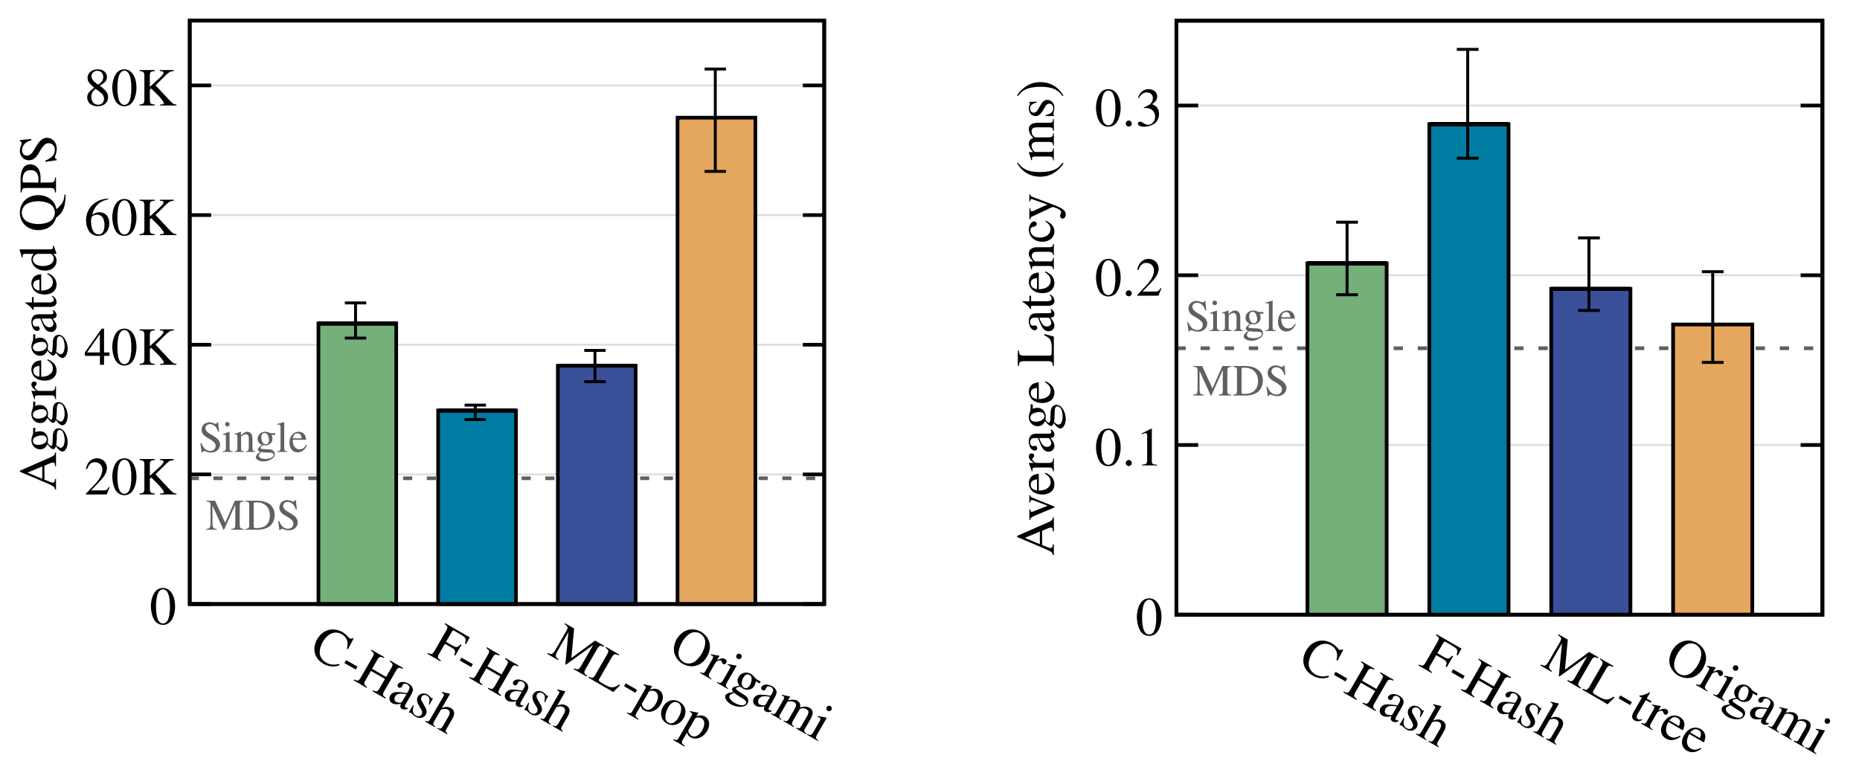
Evaluation: Overall Performance
Aggregated QPS under high load
3.86x
Notes:
First, let’s look at the aggregated metadata throughput under high load. Origami delivers the highest throughput among all baselines. Most importantly, the throughput with five MDSs is 3.86 times that of a single MDS, scaling near-linearly. In contrast, even the best-performing baseline only achieves an approximately 2× improvement in overall throughput.

Slide 33
Evaluation: Overall Performance
Aggregated QPS under high load
Average latency under sigle thread
3.86x
24.2%
Near-linear scales under high load while
liitle overhead under light load
Notes:
We further compared the average latency under a single thread. We can see that Origami achieves the lowest average latency among all baselines, and only increases latency by about twenty-four percent compared to a single MDS. These results demonstrate that Origami is able to accurately identify subtrees with higher migration benefits, thus strikes a good trade-off between metadata load balancing and locality preserving.

Slide 34
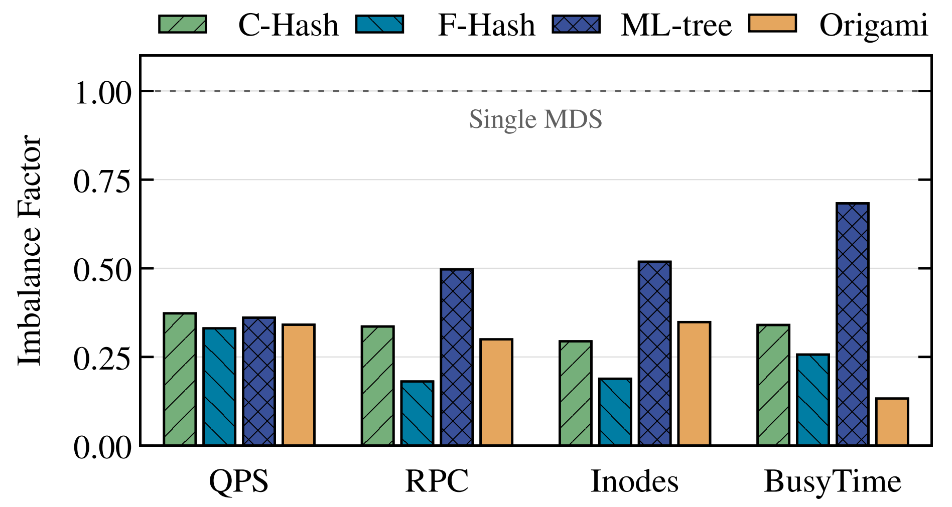

Evaluation: Balance Analysis
Using Imbalance Factor to evaluate the balancing
Skew
Balance
Origami is NOT more balance than baselines
Notes:
To explain why Origami outperforms other approaches, we dive deeper into the load balance of different methods. Here, we employ the Imbalance Factor as our evaluation metric, where lower values indicate better balance. Surprisingly, our analysis reveals that Origami does not achieve better load balance than the baseline methods across any of the three key dimensions: metadata throughput, RPC distribution, or inode capacity.

Slide 35
Evaluation: Balance Analysis
Using Imbalance Factor to evaluate the balancing
Skew
Balance
Excellent balance not means excellent performance,
keep all MDSs busy on the right way is the key.
Notes:
We then focus on per-MDS metadata processing time, which we call BusyTime. Surprisingly, Origami gets a very low imbalance factor in BusyTime, reducing it by nearly half compared to fine-grained hashing. This observation highlights one reason of Origami’s performance: ensuring all MDSs are busy is more efficient than evenly partitioning.

Slide 36
Conclusion
Problem: metadata load balancing is crucial but difficult
Key insight: even partition (no matter inodes or requests) is NOT suit for metadata load balancing
Key techniques of Origami
MetaOPT algorithm
OrigamiFS
Results
﻿Improves end-to-end performance
Bring minimal overhead
Find the near-optimal decision quickly
Collected statistic, train and validate models
Notes:
To conclude, metadata load balancing is crucial but difficult. Our key insight is that even partitioning—whether by inodes or by request counts—is NOT suitable for metadata load balancing. To efficiently balance metadata, we built Origami, which utilizes the MetaOPT algorithm to identify strategies and estimate migration benefits, then we trains and validates models on OrigamiFS. Experimental results show that Origami delivers the highest metadata throughput while introducing minimal additional overhead, compared to state-of-the-art solutions in real-world workloads.

Slide 37

Conclusion
Problem: metadata load balancing is crucial but difficult
Key insight: even partition (no matter inodes or requests) is NOT suit for metadata load balancing
Key techniques of Origami
MetaOPT algorithm
OrigamiFS
Results
﻿Improves end-to-end performance
Bring minimal overhead
Find the near-optimal decision quickly
Collected statistic, train and validate models
Thanks!
wangyd22@chinatelecom.cn
some other metadata work: https://yiduo.site
Notes:
Thanks you, and please feel free to ask me any questions!

