Slide 1


Dual Centric Data Center Network Architectures
Dawei Li, Jie Wu (Temple University)
Zhiyong Liu, and Fa Zhang (Chinese Academy of Sciences)
ICPP 2015

Slide 2
Agenda
Introduction
Preliminaries
Dual-Centric DCNs: FSquare And FRectangle
Comparison With Various DCN Architectures
Simulations
Conclusion And Future Works

Slide 3





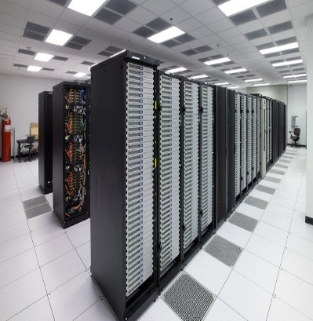







Introduction
  Data centers have become important infrastructures to support various cloud computing services,
  varying from web search, email, video streaming social networking, to distributed file systems and data processing engines.
Notes:
The data center networks (DCNs) specify how servers and various other components are interconnected in data centers.
DCNs have a significant influence on the quality of data center’s services.

Slide 4
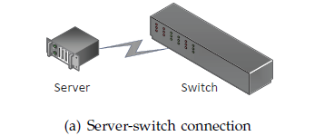
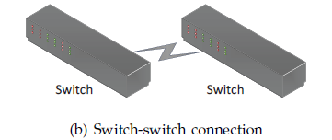
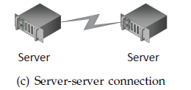
Introduction
Three types of connections:
  Server-switch connection (a)
  Switch-switch connection (b)
  Server-server connection (c)
Two classes of DCN architectures:
  Switch-centric architecture
    Only server-switch and switch-switch connections (a and b), no server-server connections. Eg, Fat-Tree Flattened Butterfly
  Server-centric architecture
    Mostly, only server-switch and server-server connections (a and c), no switch-switch connections. Eg: BCube, FiConn, DCell
Notes:
In Data center, there 3 types of connections,
Existing DCN architectures have been classified into 2 categories,

Slide 5
Introduction
Switch-centric vs. Server-centric.
  Switch-centric
  Fast switching capability
  Less programmability
  Expansive
  Power hungry
  Switch-centric
  Larger processing delays
  High programmability
  Can we combine the advantages of both categories?
  fast switching capability + High programmability
  How about dual-centric DCN architectures?
Notes:
Complex network control and management have to resort to high-end switches that are not only expansive but also

Slide 6
Introduction
Contributions
  We formally introduce a new class of DCN architectures: dual-centric DCN architectures, and propose two novel architectures: FSquare and FRectangle.
  To enable fair and meaningful comparisons among existing DCN architectures and our proposed ones, we propose a unified path length definition and a unified diameter definition, for general DCNs. Also, to characterize the power efficiency of a general DCN, we propose a unified DCN power consumption model.
  By investigating the two proposed architectures and by comparing them with existing DCN, we show that dual-centric architectures can have appealing properties for practical DCN designs.

Slide 7
Agenda
Introduction
Preliminaries
Dual-Centric DCN Architectures
More On FSquare And FRectangle
Simulations
Conclusion And Future Works

Slide 8
Preliminaries
  Packets on switches and servers experience 3 important delays: processing delay, transmission delay, and queuing delay.
d_{w,p}, d_{w,t}, d_{w,q}, and d_{v,p}, d_{v,t}, d_{v,q}.
  Switches can operate in 2 modes: store-and-forward & cut-through.
    Store-and-forward, d_{w} = d_{w,p}+ d_{w,t,} d_{w,t,} = S_{packet} / r_{bit}
    Cut-through, d_{w} = d_{w,p}= 2μs
Notes:
For the ease of presentation, we assume that all switches are homogeneous
For simplicity, we assume that queuing delay is zero.
In store&forward mode, a switch needs to receive all the flits of the packet before it forwards the packet to the next device.
In cut-through mode, a switch starts forwarding the packet when it receives the first flits of the packet.

Slide 9


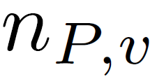
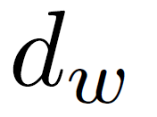
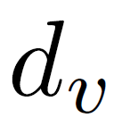

Preliminaries
  Unified Path Length Definition:
  Unified Diameter in a DCN:
: the number of switches in a path.
: the number of servers in a path (excluding the source and the destination).
: the processing delay on a switch.
: the processing delay on a server.
Notes:
In General DCN, both switch and servers involve in packet forwarding. From source to destination, there is a routing path, we define the path length as,
Under the unified path length definition, we define the diameter of a general DCN, the maximum path length of the shortest paths between all pairs of servers in DCN.
{p} is the set of shortest paths b/w all pairs of servers in DCN .
Is the
Typical value for d_w : 2 us
Typical value for d_v: depands on how the packet forwarding engine is implemented. Can be close to 2 us if it is implemented by hardware; Can be 10 us if it is implemented by software.
Thus, d_v can be 1 to several times of d_w.

Slide 10
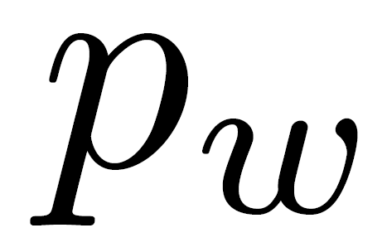
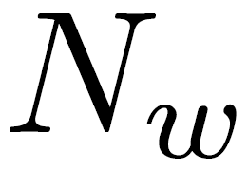
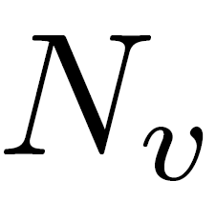
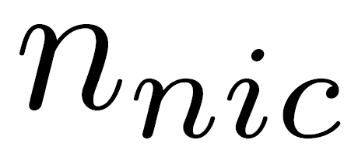

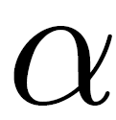
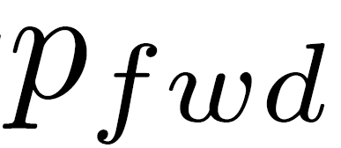
Preliminaries
  DCN power consumption per server:
: Power consumption of a switch
: The number of switches in a DCN
: The number of servers in a DCN
: The average number of NIC ports each server uses
: The power consumption of a NIC port
: Whether the server is involved in packet relaying
: Power consumption of a server’s packet forwarding engine.
Notes:
We consider the power consumption of all DCN devices.
p_w: 150 Watts
p_nic: 2 Watts
p_fwd: depends on how the forwarding engine is implemented; for software based implementation: about 2 to 5 Watts

Slide 11
Agenda
Introduction
Preliminaries
Dual-Centric DCNs: FSquare And FRectangle
Comparison With Various DCN Architectures
Simulations
Conclusion And Future Works

Slide 12
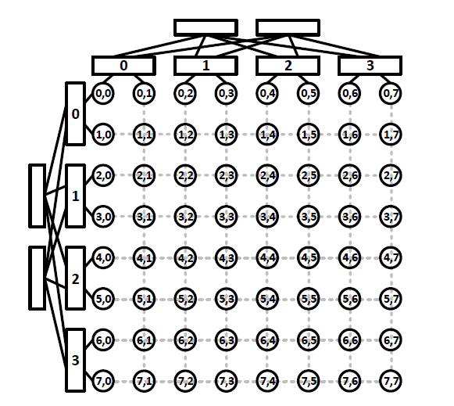
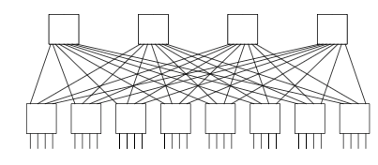
Dual-Centric DCNs: FSquare And FRectangle
FSquare Construction:
The switches and servers in each row and each column form a simple instance of the folded Clos topology.
Notes:
Fsquare has two dimensions, rows and columns, in each row and each column,

Slide 13
Dual-Centric DCNs: FSquare And FRectangle
FSquare (n):
Built from servers with 2 NIC ports and n-port switches
n level 1 switches
n/2 level 2 switches
The set of n/2 level 2 switches and the set of n level 1 switches form a complete bipartite graph.
level 2
level 1
Notes:
An Fsquare built from servers with ,
For each raw and each column, there 2 kinds switches, every level 2 switch connect with every level 1 switches
This figure only draw the zeroth row and the zeroth column

Slide 14
Dual-Centric DCNs: FSquare And FRectangle
FSquare (n):
Level 1 switch also called Top of Rack (ToR) switch.
Each server connect 2 ToR switches.
a_{i,j}’s row ToR switch:
^{th} ToR Switch in i row
^{th} ToR Switch in j column
Notes:
Each server connect with 2 tor switches, one row tor switch, one column tor switch
And given a server, which tor switch it should be connected?

Slide 15
Dual-Centric DCNs: FSquare And FRectangle
Routing in FSquare (n):
Source : a_{i,j} , Destination: a_{k,l}
If i=k:
the shortest path is within this row.
if , a_{i,j} and a_{k,l} are connected the same row ToR switch, the shortest path consists of one switch.
If ≠ , the shortest path consists of three switches.
Notes:
After construct the Fsquare architecture, we now consider the shortest path routing in Fsquare.

Slide 16
Dual-Centric DCNs: FSquare And FRectangle
Routing in FSquare (n):
Source : a_{i,j} , Destination: a_{k,l}
If i ≠ k and j ≠ l :
We can choose one from 2 intermediate servers a_{i,l} and a_{k,j}
Row first or column first, or based on traffic condition within the row or column
Notes:
Both servers and switches in Fsquare have same degree of routing intelligence, so the fast switching capability of switches and the high programmability of severs can be utilized.

Slide 17



Dual-Centric DCNs: Fsquare And FRectangle
FSquare Basic Properties
Notes:
N-quartered over 4
3 n-cubed over 2

Slide 18
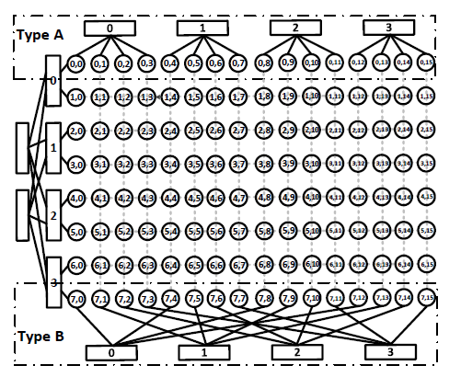
Dual-Centric DCNs: Fsquare And FRectangle
FRectangle Construction:
The switches and servers in each column form a simple instance of the folded Clos topology.
Switches in each row can adopt Type A or Type B connections.
Notes:
As we can see, the Fsquare architecture uses too many switches, increase the power consumption of the DCN.

Slide 19
Dual-Centric DCNs: Fsquare And FRectangle
FRectangle Construction:
Type A connections:
For a_{i,j} servers in the i^{th} row, if kn ≤ j ≤ kn+n-1, a_{i,j} connect to the k^{th} switch.
Type B connections:
For a_{i,j} servers in the i^{th} row, if j % n = k, a_{i,j} connect to the k^{th} switch.
Notes:
As we can see, the Fsquare architecture uses too many switches, increase the power consumption of the DCN.

Slide 20
Dual-Centric DCNs: Fsquare And FRectangle
FRectangle Construction:
Let FRectangle choose form the 2 types interconnection in an interleaved fashion.
If i % 2 = 0, type A
If i % 2 = 1, type B
Notes:
As we can see, the Fsquare architecture uses too many switches, increase the power consumption of the DCN.

Slide 21
Dual-Centric DCNs: Fsquare And FRectangle
Routing in FRectangle:
Source : a_{i,j} , Destination: a_{k,l}
If a_{i,j} & a_{k,l} belong to different row types, only need one relay server (along with multiple switches) to forward the packet.
If a_{i,j} & a_{k,l} belong to the same row types, may need three servers to relay the packet.
Notes:
As we can see, the Fsquare architecture uses too many switches, increase the power consumption of the DCN.

Slide 22
Dual-Centric DCNs: Fsquare And FRectangle
Routing in FRectangle:
Source : a_{i,j} , Destination: a_{k,l}
If i % 2 = 0, k % 2 = 1,
Find the column # c*,
a_{i,c*} and a_{i,j} connect same row ToR switch; a_{k,c*} and a_{k,l} connect same row ToR switch.
The shortest path from a_{i,j} to a_{k,l} consists of 3 segments:
  a_{i,j} →a_{i,c*} , a_{i,c*} → a_{k,c*} , a_{k,c*} → a_{k,l}

Slide 23
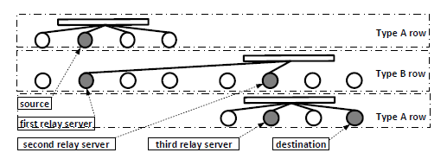
Dual-Centric DCNs: Fsquare And FRectangle
Routing in FRectangle:
Source : a_{i,j} , Destination: a_{k,l}
If i % 2 = k % 2 = 0 or i % 2 = k % 2 = 1,
  a_{i,j} →1st relay server, 1st relay server → 2nd relay server
  2nd relay server → 3rd relay server, 3rd relay server → a_{k,l}

Slide 24
Dual-Centric DCNs: Fsquare And FRectangle
FRectangle Basic Properties
Notes:
N-quartered over 4
3 n-cubed over 2

Slide 25



Dual-Centric DCNs: Fsquare And FRectangle
FRectangle Basic Properties

Slide 26
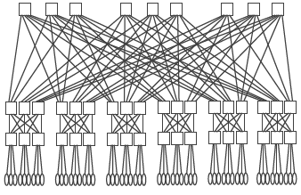
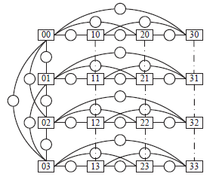
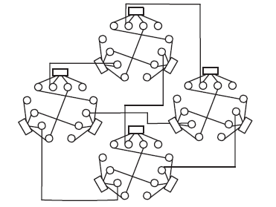
Comparisons Of Various DCN Architectures
Some Existing Architectures
Switch-centric
Server-centric
Fat-tree (FDCL)
Fattened Butterfly (FBFLY)
BCube, SWCube,
DPillar, DCell, FiConn
Fat-Tree
SWCube
FiConn

Slide 27
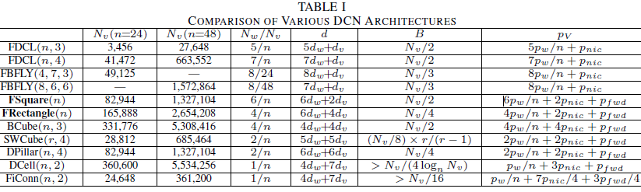
Comparisons Of Various DCN Architectures
From top (switch-centric) to bottom (server-centric),
  DCN power consumption per server decreases;
  Performances of architectures (bisection bandwidth) decreases;
  Diameter increasing
Notes:
d_v is 1 to several (can be 5 or 10) times of d_w
From top to bottom, the diameter increases; the bisection bandwidth decreases; the power consumption decreases.

Slide 28
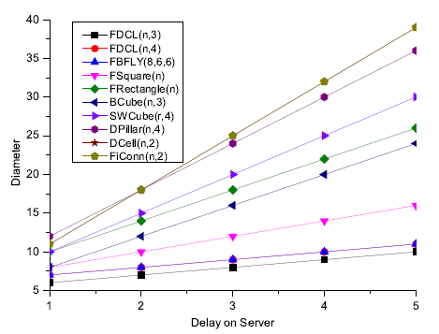
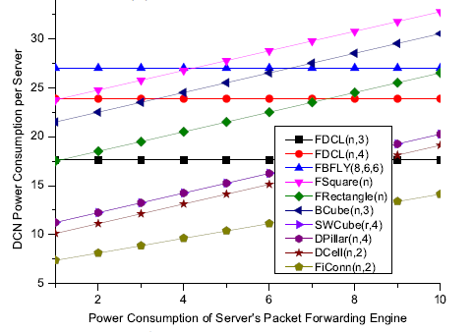
Comparisons Of Various DCN Architectures
  FSquare: lower diameter than all server-centric architectures; Larger bisection bandwidth than switch-centric; high power consumption.
  FRectangle: less power consumption than switch-centric; less diameter than most of server-centric; Larger bisection bandwidth than most of server-centric;

Slide 29
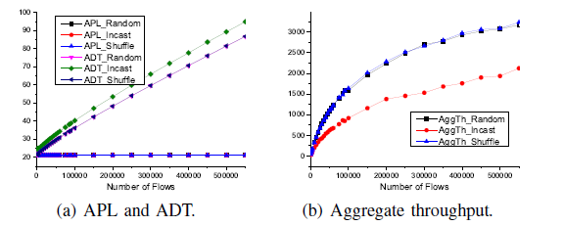
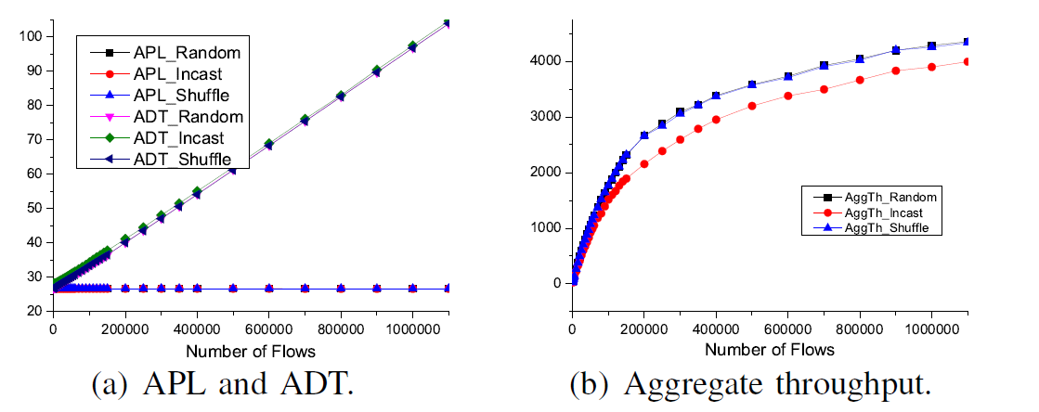
Simulations
We conduct simulations on FCell for both random traffic and bursty traffic.
FSquare Aggregate throughput
FRectangle Aggregate throughput
  when flows number is small, the AggTh values increase almost linearly.
  when flows number is large, the increasing rates of the AggTh becomes smaller and smaller. (Network become congested)
Notes:
To investigate the performances of 2 proposed architectures under various traffic conditions.
APL: Average Path Length
ADT: Average Delivery Time

Slide 30
Simulations
We conduct simulations on FCell for both random traffic and bursty traffic.
FSquare APL and ADL
FRectangle APL and ADL
  when flows number increases significantly and become congested, ADTs in both architectures only increase linearly.
Notes:
To investigate the performances of 2 proposed architectures under various traffic conditions.
APL: Average Path Length
ADT: Average Delivery Time

Slide 31
Conclusion and Future Works
In this paper, we formally introduce a new category of DCN architectures: the dual-centric DCN architectures, where outing intelligence can be placed on both switches and servers.
We propose two typical dual-centric DCN architectures: FSquare and FRectangle.
By comparing them with existing architectures and by investigating themselves, we show that these two dual-centric DCN architectures have various nice properties for practical data centers, and provide flexible choices in designing DCN architectures.
The proposed dual-centric design philosophy will certainly become a potential candidate in future DCN architecture designs.

Slide 32
Conclusion and Future Works
Future works can be cast in, but are not limited to, the following directions:
  1.) designing efficient and/or adaptive routing schemes for FSquare and FRectangle;
  2.) exploring other possible dual-centric architectures that also have appealing properties;
  3.) designing dual-centric architectures where each server uses more than 2 NIC ports; and
  4.) exploring the limitations of the dual-centric design philosophy, and how to control and apply them in practical DCN designs.

Slide 33
Thank you!
Questions can be sent to: dawei.li@temple.edu

Slide 34
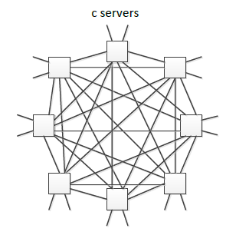
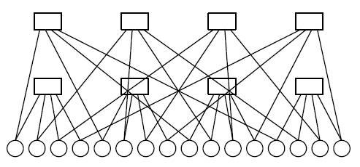
Backup slides
Flattened Butterfly (one dimensional)
BCube (two level):

Slide 35
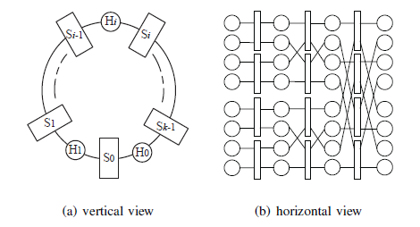
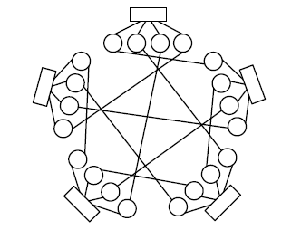
DPillar:
DCell (two level):

