Slide 1

The 55th International Conference on Parallel Processing(ICPP 2026)
IHS-LM: Intra-batch Hybrid Scheduling and Layer Migration for VLM Pipeline Inference Acceleration on Edge Devices
Yun Li¹, Tianfu Pang¹, Zhiyu Cai¹ , Zhenxiang Pan¹, Yingchi Mao¹, Jie Wu²
¹ College of Computer Science and Software Engineering, Hohai University, Nanjing, China
²Center for Networked Computing, Temple University, Philadelphia, USA
September 29, 2026

Slide 2
Outline
1. Introduction
2. Approach
3. Experimental Evaluation
4. Conclusion

Slide 3








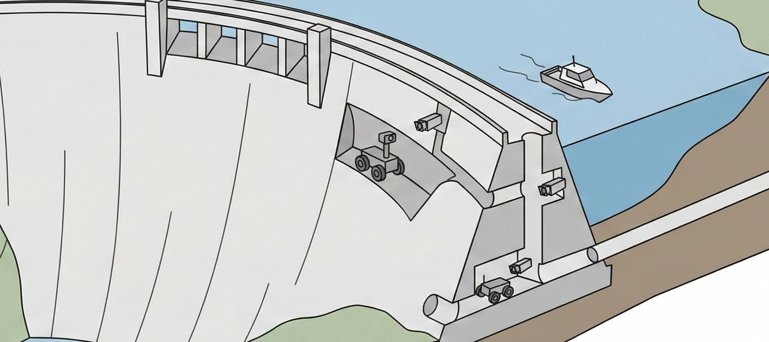



Why Collaborative VLM Inference On Edge Devices?
edge devices
collaborative inference across multiple edge devices
Model
Large Model Parameter Sizes
the evolution of edge intelligence requirements
Please perform road and bridge inspection
Remarkable Reasonig Capability
The inspection report is as follows ......
Deployment: Large Model Weights Mismatch Edge Devices with Limited Memory Resources
Single-Device Inference: Limited GPU Memory
Collaborative Inference Across Multiple Edge Devices

Slide 4


Why Pipeline Parallelism Fits Edge VLM Inference?
Edge Devices
Limited Memory Constrained Bandwidth
Data Parallelism(DP)
Sequence Parallelism(SP)
Full Model
Full Model
Tensor Sync.
DP &SP
  High memory demand
Seq.1
Seq.1
Subseq.1
Subseq.1
TP
  High bandwidth demand
Seq.2
Seq.2
Subseq.2
Subseq.2
Full Model
Full Model
Tensor Parallelism(TP)
Pipeline Parallelism(PP)
Model Block 1
Tensor Sync.
Model
Block 1
Model
Block 2
PP
  Lower bandwidth demand
  Lower memory demand
Seq.1
Seq.1
Seq.1
Seq.1
Model Block 2
PP is preferred because it reduces per-device model storage and avoids frequent global communication

Slide 5
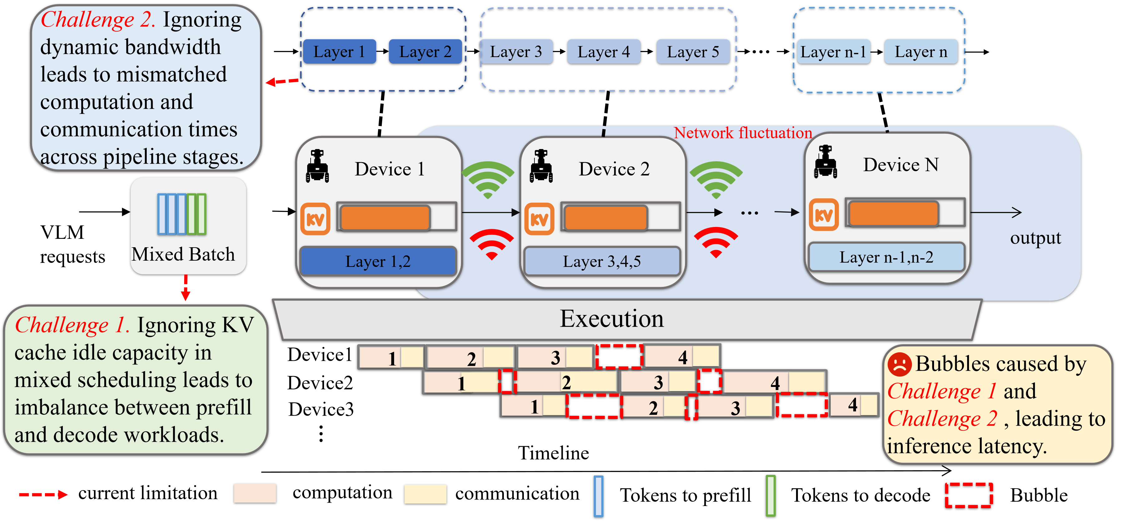
Challenges in Pipeline-Parallel Inference on Edge Devices

Slide 6
Outline
1. Introduction
2. Approach
3. Experimental Evaluation
4. Conclusion

Slide 7
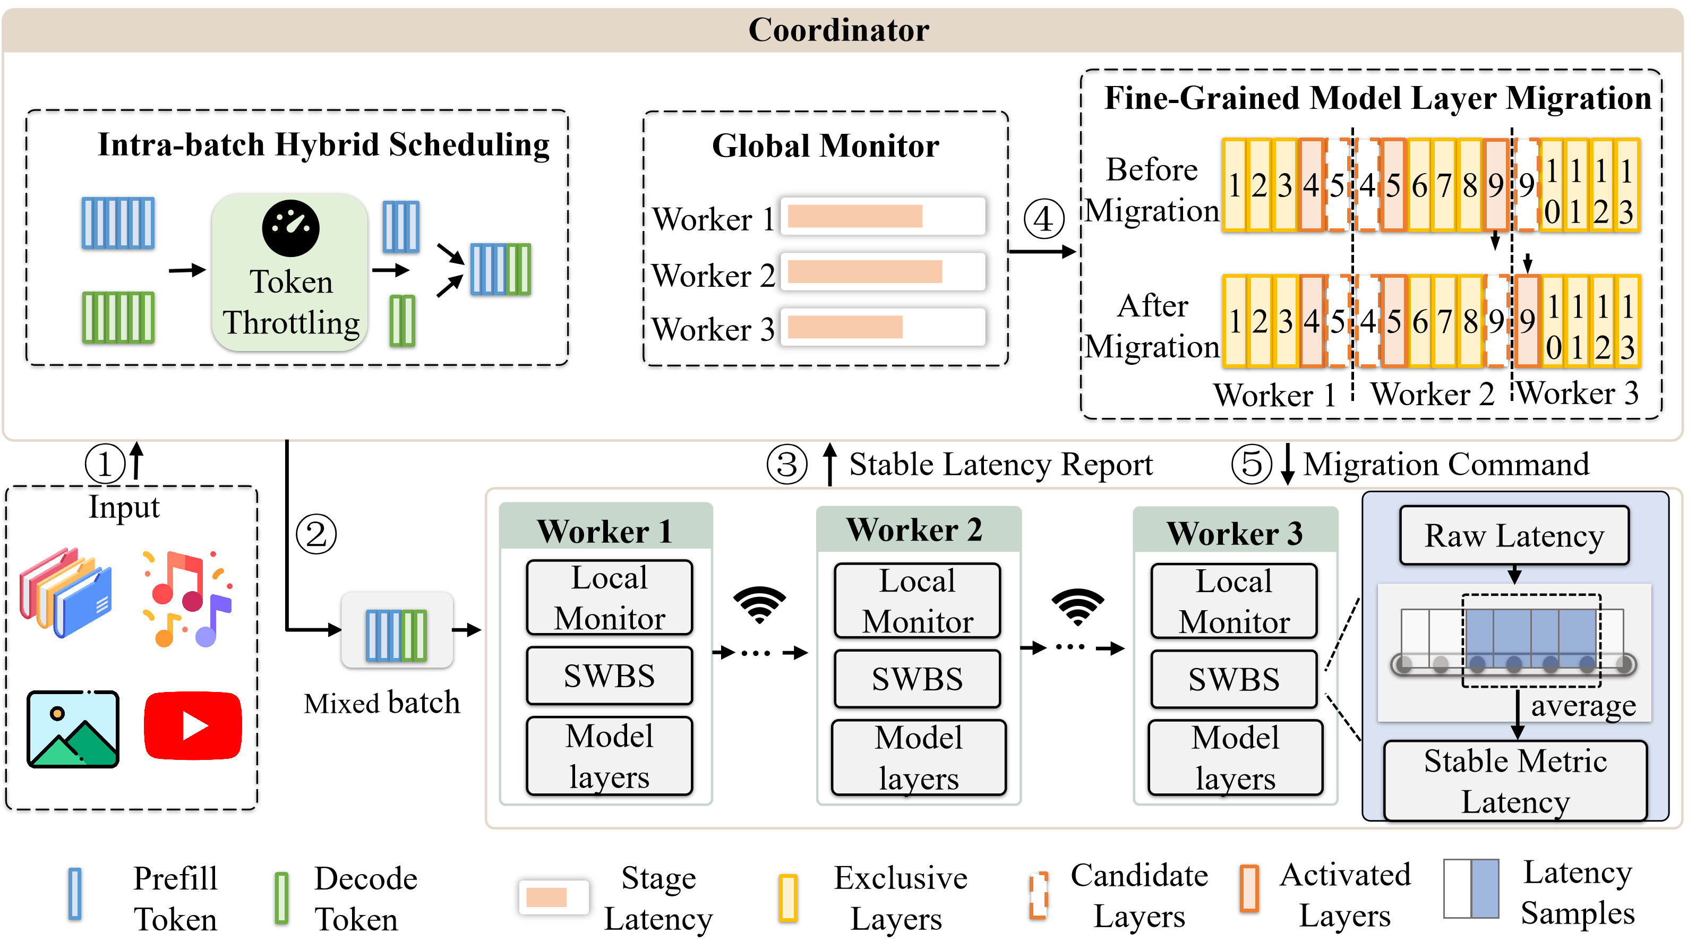
System Overview
Upload multimodal inputs to the coordinator
IHS balances prefill/decode tokens and dispatches the batch
Workers report smoothed latency using sliding-window sensing
The coordinator checks whether stage latency is persistently unbalanced
BAMLM shifts layer boundaries via activate/freeze commands

Slide 8
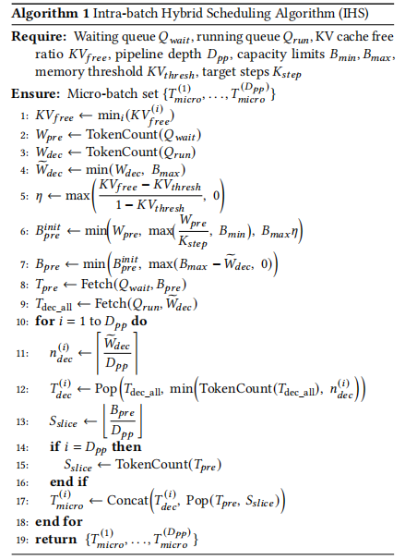
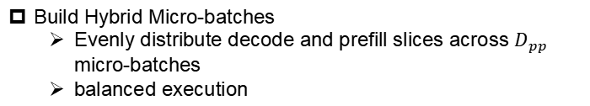
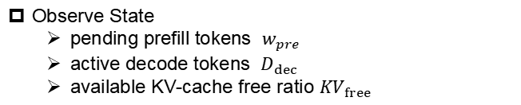
Intra-batch Hybrid Scheduling
Observe State
  pending prefill tokens $w_{pre}$
  active decode tokens $D_{dec}$
  available KV-cache free ratio ${KV}_{free}$
Compute Quotas
  Throttle prefill by KV-cache availability
  Reserve token budget for decode first
Build Hybrid Micro-batches
  Evenly distribute decode and prefill slices across $D_{pp}$ micro-batches
  balanced execution

Slide 9

IHS Balances Micro-batches to Reduce Pipeline Bubbles
IHS produces more uniform micro-batches, reducing pipeline idle time
Sarathi-Serve[1]
Device 1
1
2
3
4
5
6
7
8
Device 2
1
2
3
4
5
6
7
8
Device 3
Micro-batch
1
2
3
4
5
6
7
8
IHS
Device 1
1
2
3
4
5
6
7
8
Token
Throttling
Device 2
1
2
3
4
5
6
7
8
Device 3
1
2
3
4
5
6
7
8
Bubble
inter-stage dependency
inter-batch dependency
Prefill Token
Decode Token
[1] Agrawal A, Kedia N, Panwar A, et al. Taming {Throughput-Latency} tradeoff in {LLM} inference with {Sarathi-Serve}[C]//18th USENIX symposium on operating systems design and implementation (OSDI 24). 2024: 117-134.
Notes:
Now let me explain what LAMP does at a high level.
LAMP takes four inputs: compute utilization and available memory — the inter-device bandwidth, and the current batch size.
Based on these inputs, LAMP assigns model layers to devices in a load-aware manner. Devices with higher compute capacity and more free memory receive more layers. The assignment is designed so that all pipeline stages complete at roughly the same time — eliminating idle waiting and pipeline bubbles.
As shown on the slide, the result is a well-balanced layer distribution across the device cluster.

Slide 10
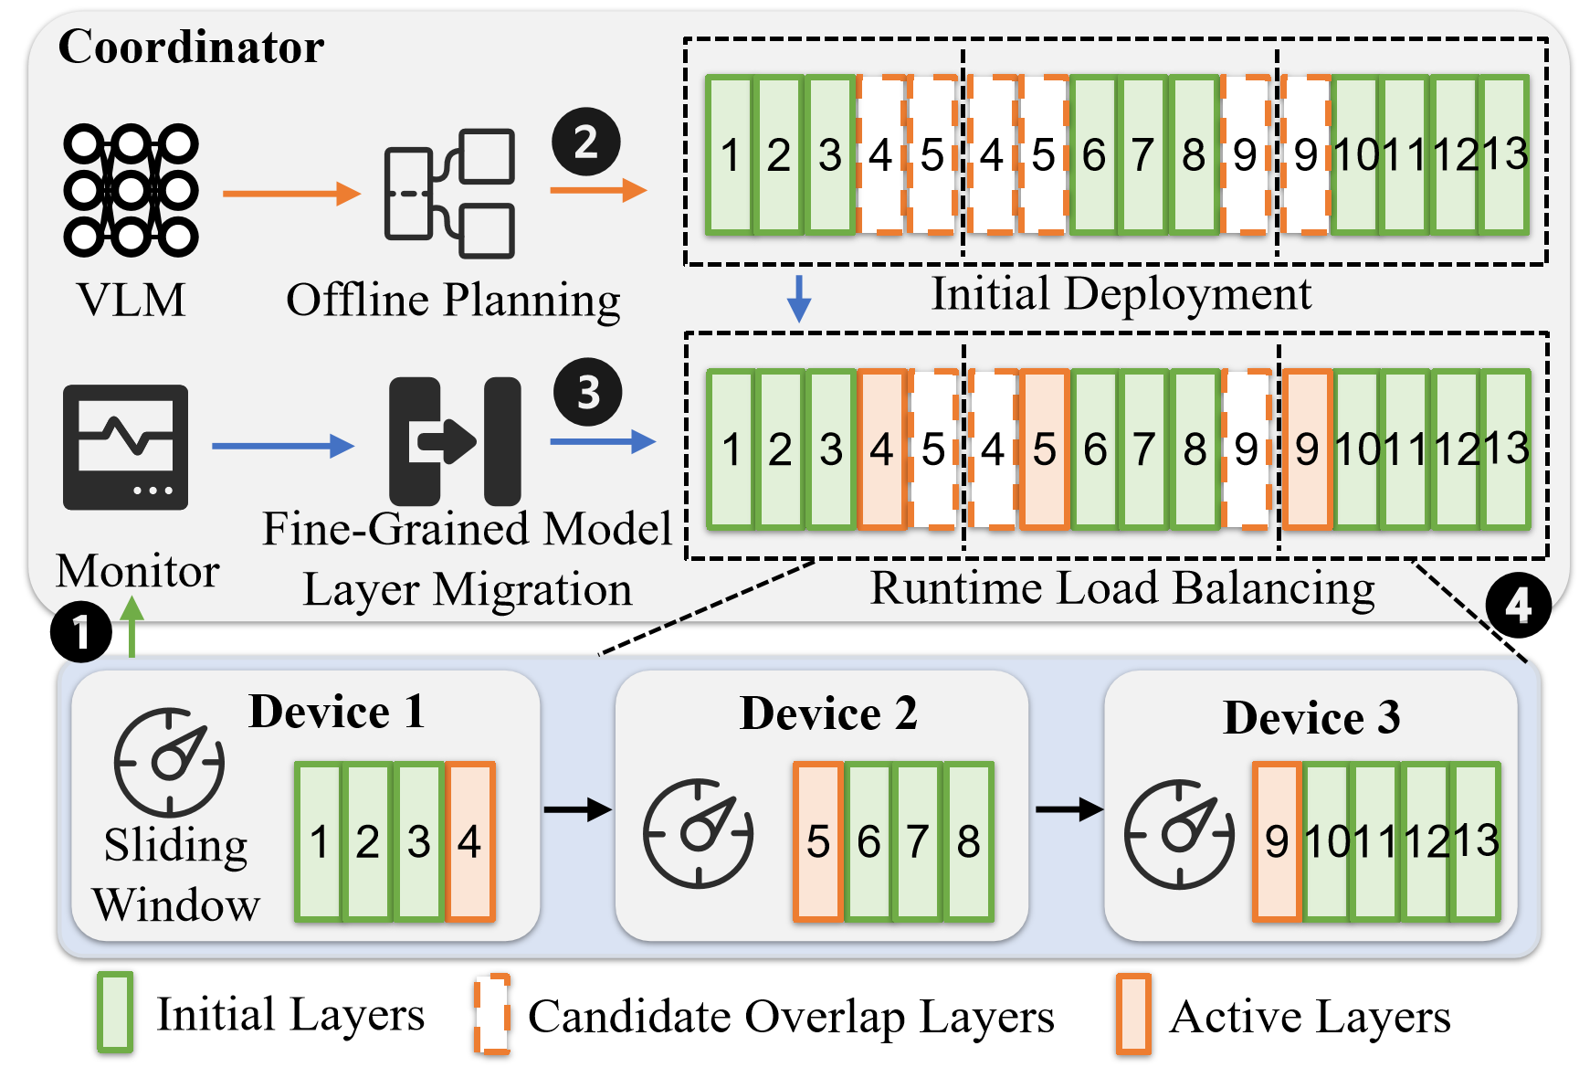
Bandwidth-Aware Layer Migration
Monitor Stage Latency
  Smooth noisy latency with sliding windows
Detect Persistent Imbalance
  Trigger migration when latency gap exceeds threshold
Shift Boundary Layers
  Activate / freeze preloaded candidate layers
Notes:
Now let me explain what LAMP does at a high level.
LAMP takes four inputs: compute utilization and available memory — the inter-device bandwidth, and the current batch size.
Based on these inputs, LAMP assigns model layers to devices in a load-aware manner. Devices with higher compute capacity and more free memory receive more layers. The assignment is designed so that all pipeline stages complete at roughly the same time — eliminating idle waiting and pipeline bubbles.
As shown on the slide, the result is a well-balanced layer distribution across the device cluster.

Slide 11
Outline
1. Introduction
2. Approach
3. Experimental Evaluation
4. Conclusion

Slide 12
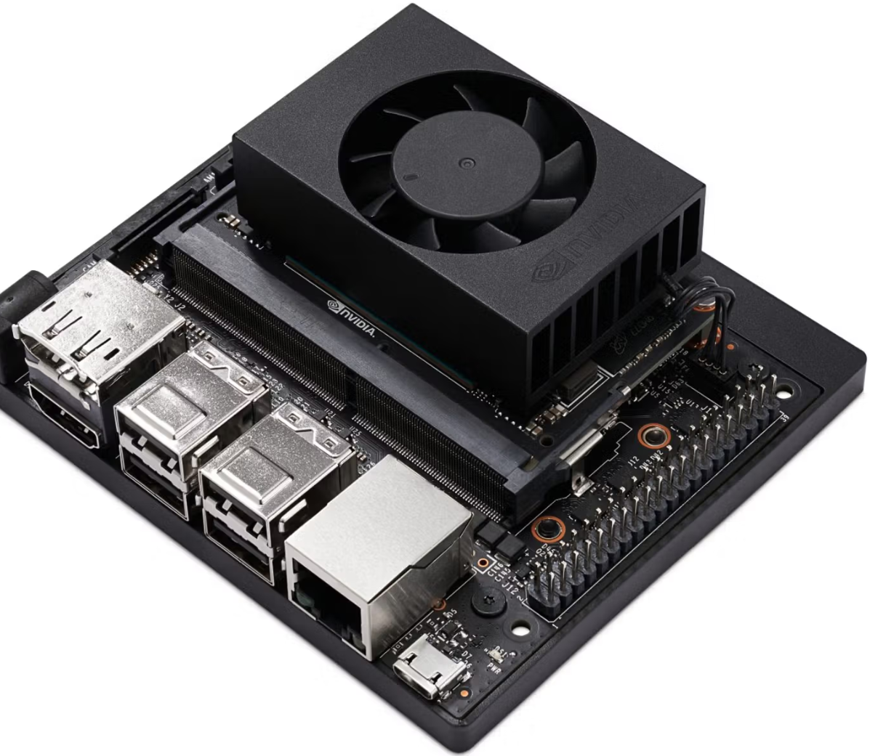
Experimental Settings
Device | Quantity | CPU | Memory Capacity
Jetson Orin Nano | 2 | 6-core Arm Cortex-A78AE | 8 GB
Jetson Orin NX | 2 | 8-core Arm Cortex-A78AE | 16 GB
Jetson AGX Orin | 1 | 12-core Arm Cortex-A78AE | 64 GB
Dataset | Task Type | Scenario Characteristics | Total Samples | Validation Samples
GYU-DET | Classification | Six Typical Surface Defect Categories | 11,123 | 1,112
VizWiz-VQA | Visual Question Answering (VQA) | Open-ended Daily-Life Scenarios | 31,173 | 4,319

Slide 13
Experimental Settings
Metrics
Average Inference Latency (AIL): defined as the average time to generate a single token
Inference Accuracy: representing the proportion of correctly predicted samples
Peak GPU Memory Usage: denoting the maximum consumption across all devices
Time to First Token (TTFT): The elapsed time from request arrival to the generation of the first output token. TTFT mainly reflects queuing, prefill, image encoding, and initial pipeline execution latency
Time Per Output Token (TPOT): The average decoding time per output token after the first token is generated. For a request with 𝐿generated tokens, TPOT is computed as (𝑡finish − 𝑡first)/(𝐿 − 1)

Slide 14
Experimental Settings
FasterTransformer[1]: static batching
Orca[2]: iteration-level scheduling
Sarathi-Serve[3]: chunked prefill + hybrid batching
LinguaLinked[4]: offline overlap-based edge partitioning
DynaPipe[5]: computation-aware dynamic layer assignment
[1] NVIDIA Corporation. 2019. FasterTransformer. https://github.com/NVIDIA/FasterTransformer.
[2] Yu, Gyeong-In, et al. "Orca: A distributed serving system for {Transformer-Based} generative models." 16th USENIX symposium on operating systems design and implementation (OSDI 22). 2022.
[3] Agrawal, Amey, et al. "Taming {Throughput-Latency} tradeoff in {LLM} inference with {Sarathi-Serve}." 18th USENIX symposium on operating systems design and implementation (OSDI 24). 2024.
[4] Zhao, Junchen, et al. "LinguaLinked: Distributed large language model inference on mobile devices." Proceedings of the 62nd Annual Meeting of the Association for Computational Linguistics (Volume 3: System Demonstrations). 2024.
[5] Jiang, Chenyu, et al. "DynaPipe: Optimizing multi-task training through dynamic pipelines." Proceedings of the Nineteenth European Conference on Computer Systems. 2024.

Slide 15
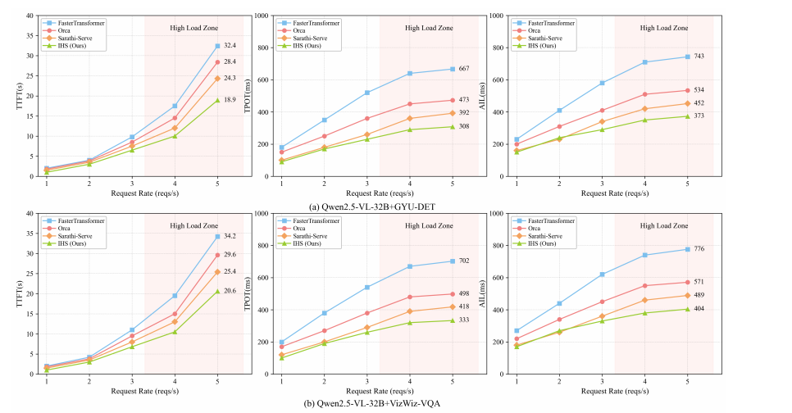
Analysis of Intra-Batch Scheduling (IHS) Performance
Figure 1:Performance Variation of Different Scheduling Methods Under Dynamic Load

Slide 16
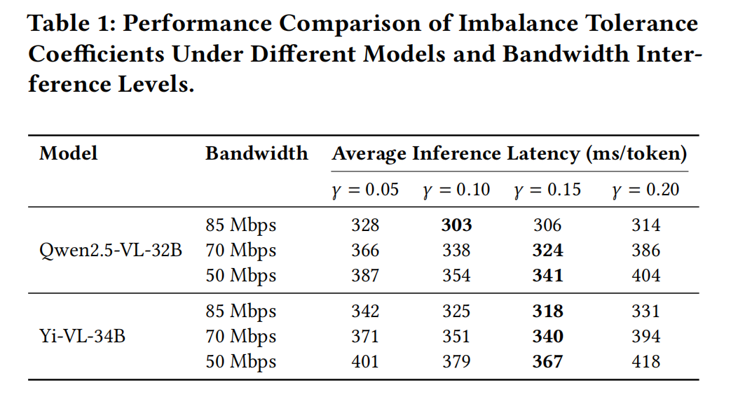
Sensitivity Analysis of Migration Threshold γ
We set γ = 0.15 to balance responsiveness and stability.
We set γ = 0.15 to balance responsiveness and stability

Slide 17
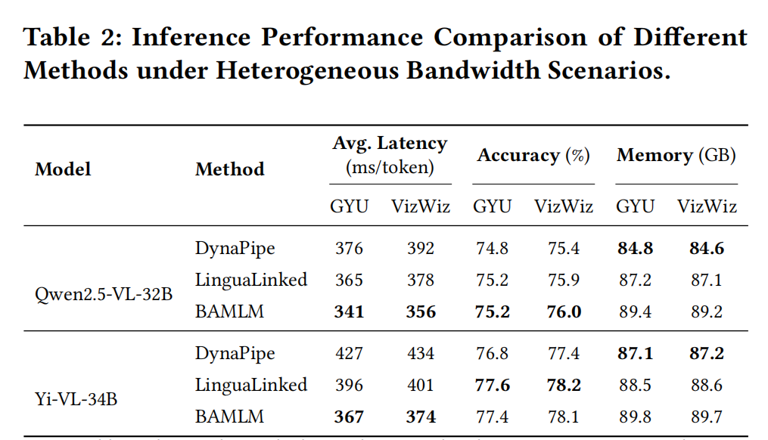
Analysis of BAMLM Performance
BAMLM achieves the lowest latency while preserving accuracy with acceptable memory overhead

Slide 18
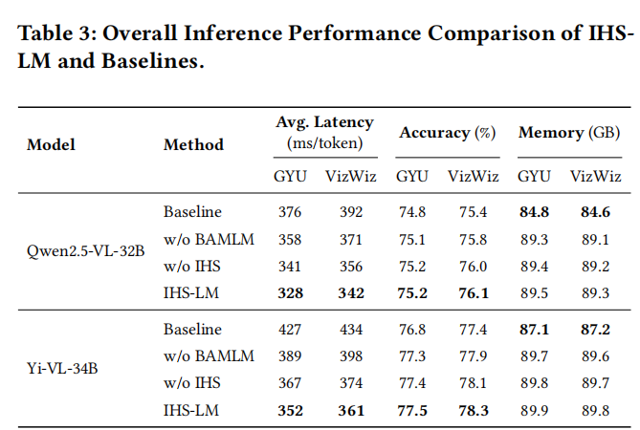
Overall Performance Evaluation of IHS-LM
Sarathi-Serve and DynaPipe
IHS with Sarathi-Serve
BAMLM with DynaPipe
IHS-LM achieves the lowest latency while preserving accuracy, with moderate memory overhead

Slide 19
Outline
1. Introduction
2. Approach
3. Experimental Evaluation
4. Conclusion

Slide 20
Conclusion
IHS balances prefill/decode workloads with KV-aware token scheduling
BAMLM mitigates bandwidth-induced stage imbalance via dynamic layer migration
Real Jetson-cluster experiments show lower latency with preserved accuracy
Thank You!
Email: 3113679296@qq.com

