Slide 1




Distributed Game-Theoretical Route Navigation for Vehicular Crowdsensing
En Wang¹, Dongming Luan¹, Yongjian Yang¹, Zihe Wang², Pengmin Dong¹, Dawei Li³, Wenbin Liu¹, and Jie Wu⁴
¹Jinlin University, ²Renmin University of China ³Montclair State University, ⁴Temple University

Slide 2
Outline
Motivation and Problem
Challenges
Contributions
System Model
Strategy
Theoretical Analysis
Performance Evaluation

Slide 3
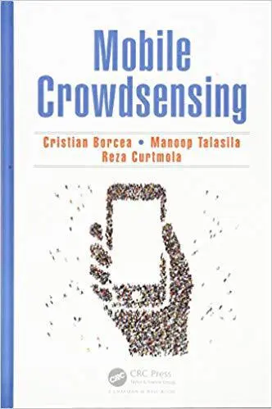
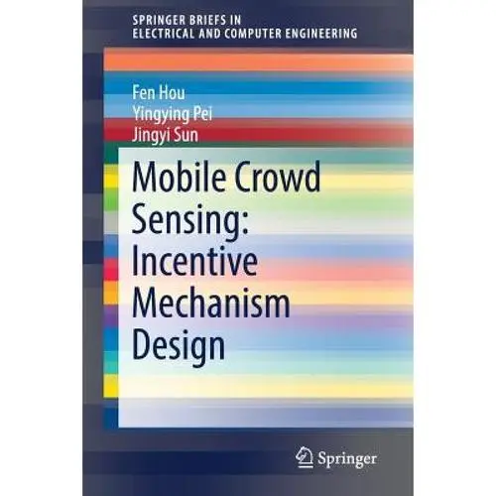
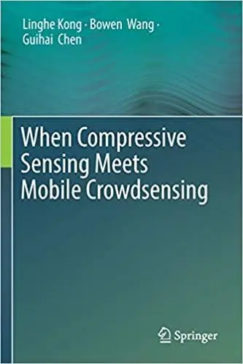
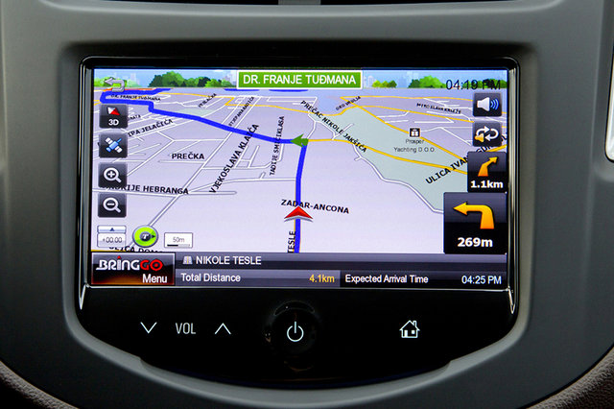






Motivation
Vehicular crowdsensing
The existing task allocation strategies:
A heavy computation complexity
Fail to satisfy the preferences of users and the system.
Mobile Crowdsensing (MCS)
Upload
Platform
Distributed task allocation with the route navigation
Traffic monitoring
Noise monitoring

Slide 4
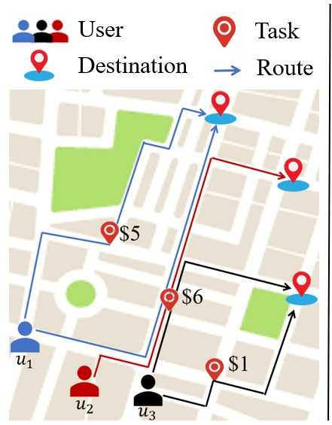
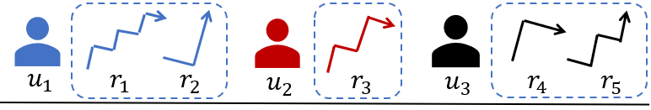
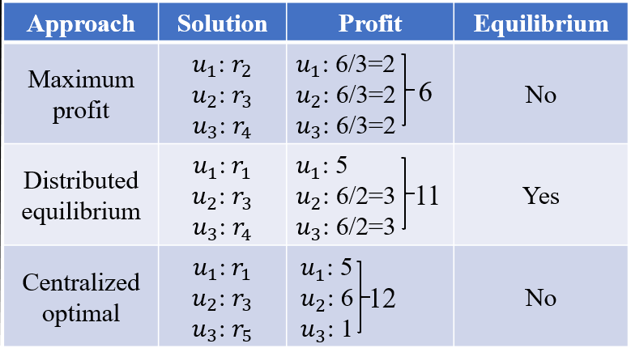
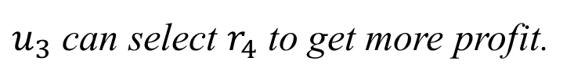
Problem
How to find an equilibrium state?
$u_{3}$ can select $r_{4}$ to get more profit.

Slide 5
Challenges
  How to construct a distributed model to achieve the equilibrium while guaranteeing the profit performance?
  How to design a unified distributed algorithm such that it could take the requirements of both the platform and users into consideration?
  How to guarantee a lower performance bound with
  respect to the centralized optimal solution?

Slide 6
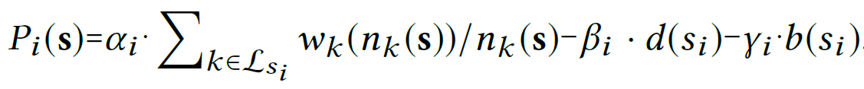


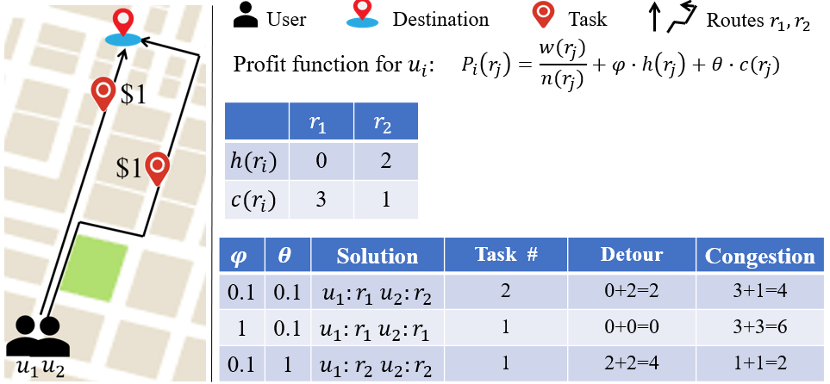

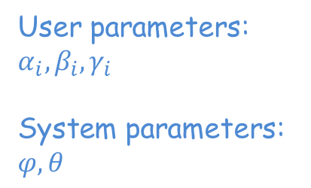
System model
Profit of user $i$ under strategy profile $s$: $s=(s_{i},s_{−i})$
the cost incurred by traveling the detour distance
the cost incurred by the congestion
User parameters: $α_{i}, β_{i}, γ_{i}$
System parameters: $φ, θ$
Maximize task #
Minimize detour
Minimize congestion
An illustrative example of the influence of ϕ and θ

Slide 7
Theoretical Analysis
NP-hardness of The Centralized Problem
Theorem 1. The problem of finding the solution with the maximum
total profit in a centralized manner is NP-hard.
Nash equilibrium
No user can improve the profit by altering the strategy unilaterally in a Nash equilibrium
Potential game
Nash equilibrium existence
Finite improvement property
Potential game proof
Theorem 2. The multi-user route navigation game is a weighted potential game and has a Nash equilibrium and finite improvement property.

Slide 8
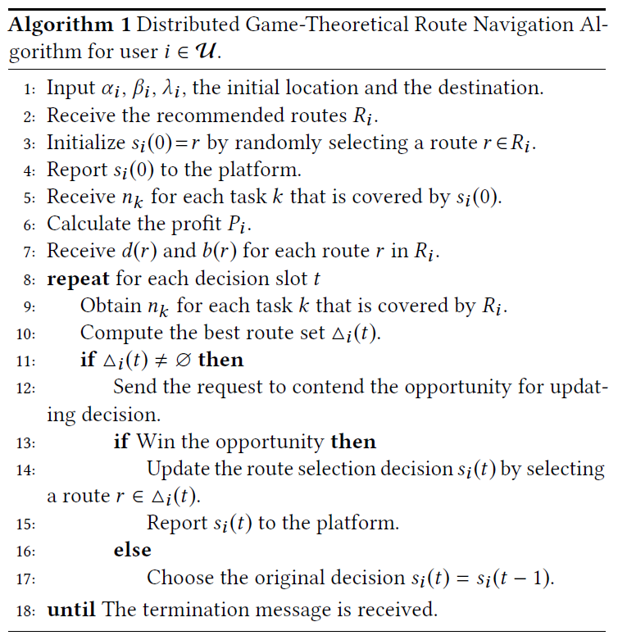
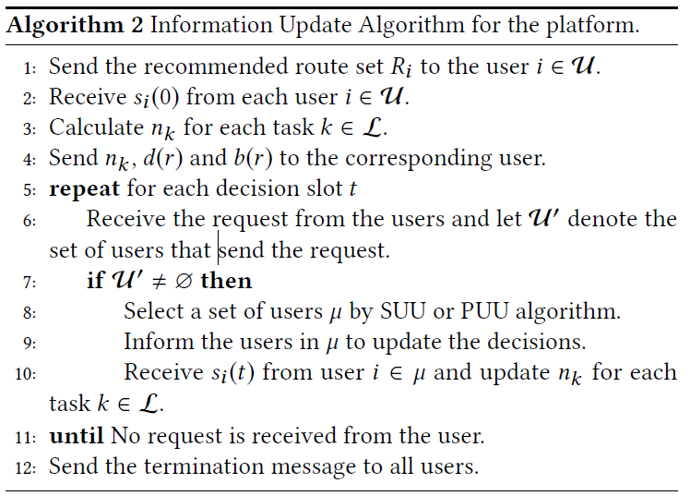
Strategies
For user
For platform
Initialization Phase
Update strategy
Terminate the algorithm
Send the information to users
Select a set of users to update the strategy

Slide 9
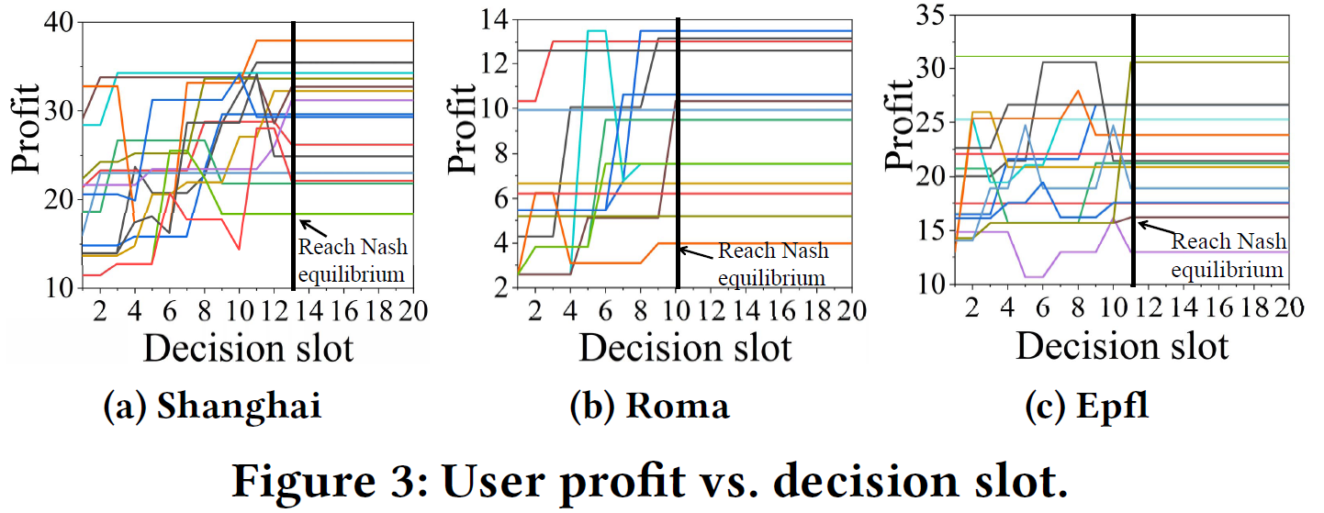
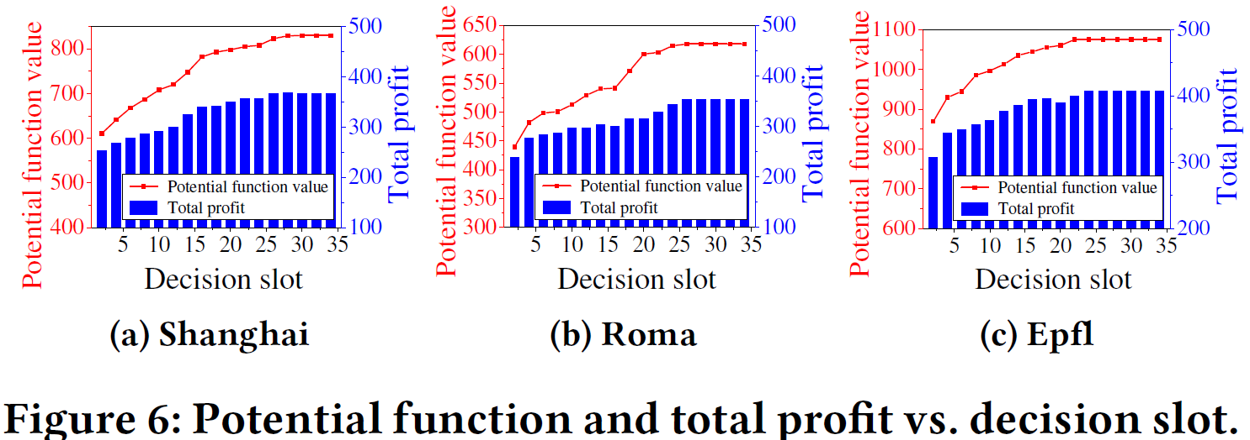
Performance Evaluation
Convergence for Nash equilibrium

Slide 10
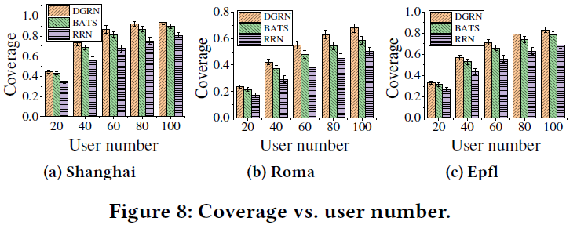
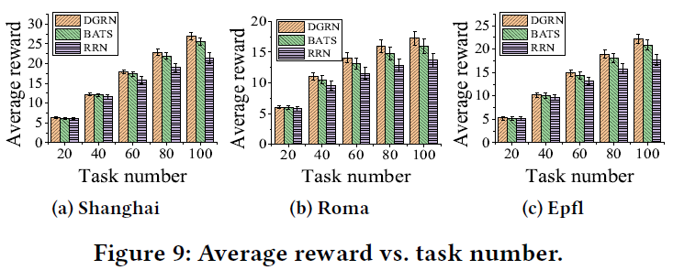
Performance Evaluation
Coverage and reward

Slide 11
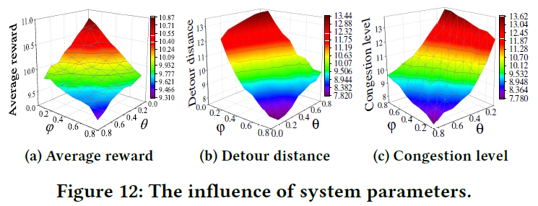
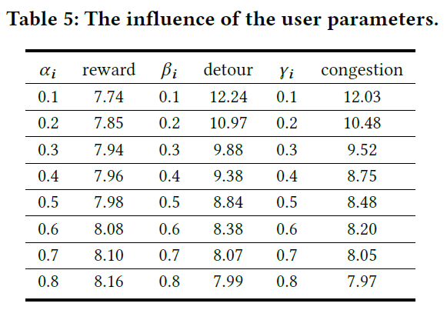
Performance Evaluation
The influence of user and system parameters

Slide 12


Thanks for listening

