Slide 1
The 29th IEEE International Conference on Parallel and Distributed Systems (ICPADS 2023)
Efficient Microservice Deployment with Dependencies
in Multi-Access Edge Computing
1st Shuaibing Lu
Faculty of Information Technology
Beijing University of Technology
Beijing, China
2nd Ran Yan
Faculty of Information Technology
Beijing University of Technology
Beijing, China
3rd Jie Wu
Center for Networked Computing
Temple University
Philadelphia, USA
Notes:
Hi, everyone. I'm yan ran from beijing University of Technology. Today I will talk about Efficient Microservice Deployment with Dependencies in Multi-Access Edge Computing

Slide 2
1
Introduction
2
Model and Formulation
CONTENTS
3
Algorithm Design
4
Experiment and Results
Notes:
Here is the outline.

Slide 3

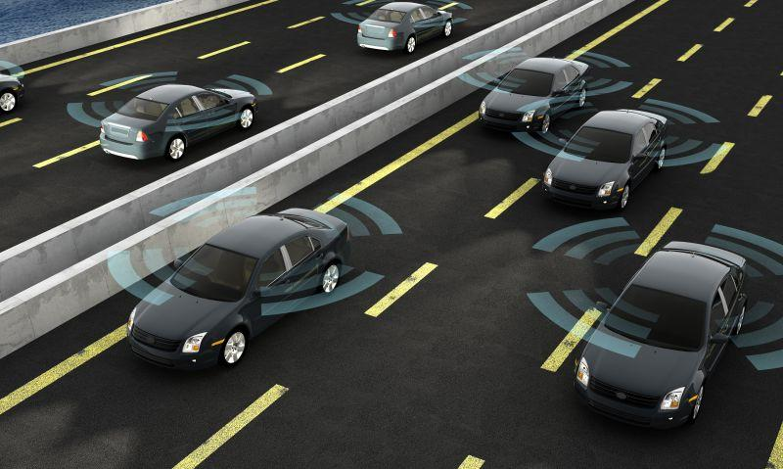

Edge computing is emerging
The recent advances in edge computing technologies have enabled a wide range of data-intensive and time-critical applications
Edge systems → multiple services, a number of users…
Smart City
Automated Driving
AR/VR
Notes:
The vigorous development of Internet of things (IoT) technology has led to the explosive growth of mobile terminal equipment and data volume. At the same time, The recent advances in edge computing technologies have enabled a wide range of data-intensive and time-critical applications, such as Smart City, Automated Driving, and augmented reality (AR)/virtual reality (VR), have emerged and been widely used.

Slide 4


Microservice architecture
The limitations of traditional monolithic applications in terms of scalability and flexibility.
A lightweight and highly flexible architectural pattern.
Notes:
The limitations of traditional monolithic applications in terms of scalability and flexibility have led to the emergence of microservice architecture, a lightweight and highly flexible architectural pattern.

Slide 5
Problem
How to deploy the microservices with dependencies especially under resource constrained edge computing systems still remains a problem?
Notes:
With the continuous rise of 5G technology, although mobile devices have become more intelligent and powerful, the emergence of new applications and the growing demand for portable services are bringing huge computational and communication burdens
In this context, Mobile Edge Computing (MEC), as an innovative computing paradigm, offloads computation-intensive tasks from resource-constrained mobile devices to edge servers located closer to end users. This effectively alleviates the computational load on mobile devices and the core network, while addressing the issue of high-latency communication.

Slide 6
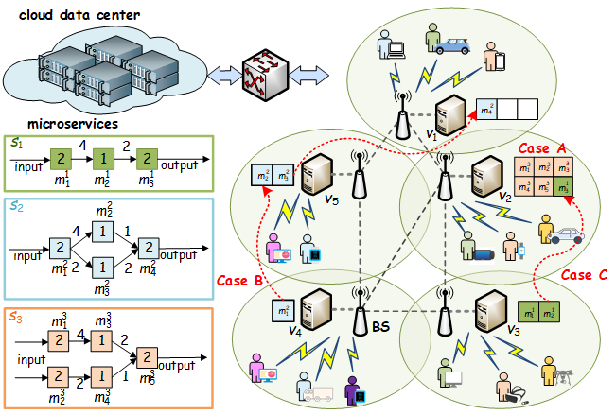
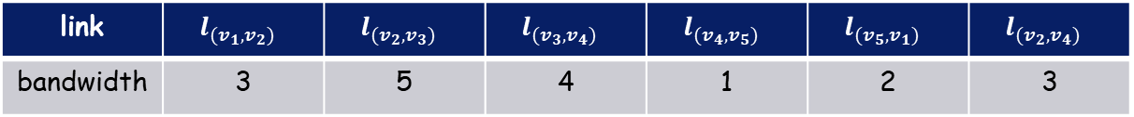
An example scenario
Server | Computing capability | Storage capability
v1 | 5 | 3
v2 | 1 | 6
v3 | 2 | 2
v4 | 4 | 1
v5 | 3 | 2
link | $$l_{(v_{1},v_{2})}$$ | $$l_{(v_{2},v_{3})}$$ | $$l_{(v_{3},v_{4})}$$ | $$l_{(v_{4},v_{5})}$$ | $$l_{(v_{5},v_{1})}$$ | $$l_{(v_{2},v_{4})}$$
bandwidth | 3 | 5 | 4 | 1 | 2 | 3
Notes:
However, the expensive cost and limited computational capacity of these servers, along with the instability of activities among multiple end-users, present a series of challenges for enhancing the profit of MNOs. In order to maximize the profit of MNOs and adapt to the ever-evolving demands of mobile networks, this paper delves deep into the study of joint server deployment and service placement in multi-user scenarios.

Slide 7
Challenges
1. How can complex dependencies among microservices be effectively dealt with to improve the overall efficiency?
2. How to balance the trade-off between processing and transmission time for optimal deployment without overwhelming the resource constraints?
Notes:
With the continuous rise of 5G technology, although mobile devices have become more intelligent and powerful, the emergence of new applications and the growing demand for portable services are bringing huge computational and communication burdens
In this context, Mobile Edge Computing (MEC), as an innovative computing paradigm, offloads computation-intensive tasks from resource-constrained mobile devices to edge servers located closer to end users. This effectively alleviates the computational load on mobile devices and the core network, while addressing the issue of high-latency communication.

Slide 8
1
Introduction
2
Model and Formulation
CONTENTS
3
Algorithm Design
4
Experiment and Results

Slide 9
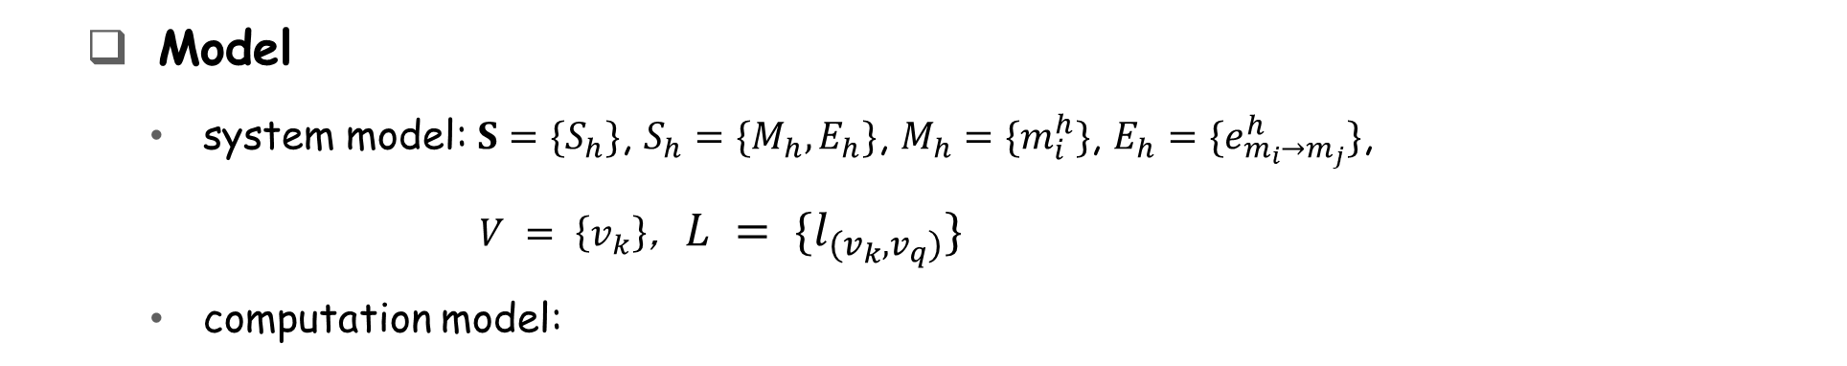

Model and Formulation
Model
system model: $S=\{S_{h}\}$, $S_{h}=\{M_{h},E_{h}\}$, $M_{h}=\{m_{i}^{h}\}$, $E_{h}=\{e_{m_{i}→m_{j}}^{h}\}$,
$V = \left\{v_{k}\right\}$, $L = \{l_{(v_{k},v_{q})}\}$
computation model:
$$d_{c}\left(m_{i}^{h}\right)=x\left(i, k\right)∙q_{m_{i}^{h}}/c_{(v_{k})}$$
Required processing capability
Computing capability
of edge server
Notes:
This page shows the existing research on server deployment strategy
Ning et al. \cite{b3} formulated models for dynamic multi-user computation offloading and edge server deployment problems using stochastic game theory. However, the applicability is limited despite considering unmanned aerial vehicle scenarios.
Mazloomi et al. \cite{b2} modeled the practical problem using reinforcement learning to solve the challenge of minimizing network latency and the number of edge servers. However, they did not consider server heterogeneity.
In their work, HE et al. \cite{b1} developed a two-stage algorithm based on Binary and GA to obtain optimal and suboptimal placement schemes for ES. But it did not consider user mobility

Slide 10

Model and Formulation
Model
communication model:
$$d_{l}\left(e_{m_{i}→m_{j}}^{h}\right)=y\left(i, k\right) {∙r}_{m_{i}→m_{j}}^{h}/b_{(v_{k},v_{q})}$$
Data flow size
between microservices
Communication capability
of edge server
Notes:
This page shows the existing research on server deployment strategy
Ning et al. \cite{b3} formulated models for dynamic multi-user computation offloading and edge server deployment problems using stochastic game theory. However, the applicability is limited despite considering unmanned aerial vehicle scenarios.
Mazloomi et al. \cite{b2} modeled the practical problem using reinforcement learning to solve the challenge of minimizing network latency and the number of edge servers. However, they did not consider server heterogeneity.
In their work, HE et al. \cite{b1} developed a two-stage algorithm based on Binary and GA to obtain optimal and suboptimal placement schemes for ES. But it did not consider user mobility

Slide 11




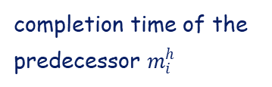
Model and Formulation
Model
makespan model:
$$f\left(m_{j}^{h}\right)=\max_{∀i,j}\left\{f\left(m_{i}^{h}\right)+d_{c}\left(m_{j}^{h}\right)+d_{l}\left(e_{m_{i}→m_{j}}^{h}\right)\right\}$$
completion time of the predecessor $m_{i}^{h}$
computation time of $m_{j}^{h}$
transmission time for data transferred
$$T_{h}= \max_{∀j,S_{h}∈S}\left\{f\left(m_{j}^{h}\right)\right\}$$
the makespan of service $S_{h}$
$$T= \max_{∀S_{h}∈S}\left\{T_{h}\right\}$$
makespan of services in set S
Notes:
This page shows the existing research on server deployment strategy
Ning et al. \cite{b3} formulated models for dynamic multi-user computation offloading and edge server deployment problems using stochastic game theory. However, the applicability is limited despite considering unmanned aerial vehicle scenarios.
Mazloomi et al. \cite{b2} modeled the practical problem using reinforcement learning to solve the challenge of minimizing network latency and the number of edge servers. However, they did not consider server heterogeneity.
In their work, HE et al. \cite{b1} developed a two-stage algorithm based on Binary and GA to obtain optimal and suboptimal placement schemes for ES. But it did not consider user mobility

Slide 12
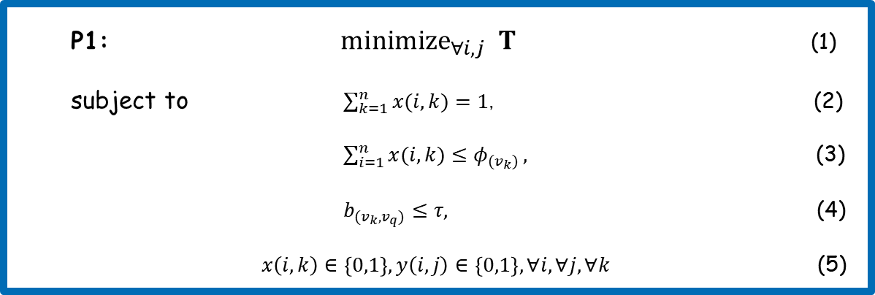
Model and Formulation
objective function
Formulation
P1: ${minimize}_{∀i,j} T$ (1)
subject to $\sum_{k=1}^{n}{x(i,k)}=1$, (2)
$\sum_{i=1}^{n}{x(i,k)≤φ_{{(v}_{k})}},$ (3)
$b_{(v_{k},v_{q})}≤τ,$ (4)
$x\left(i,k\right)∈\left\{0,1\right\}, y\left(i,j\right)∈\left\{0,1\right\}, ∀i,∀j,∀k$ (5)
constraints
Optimal Microservice Deployment with Dependencies (OMDD problem): OMDD problem is how to find a strategy for microservice in S to minimize P1 under the constraints (2)-(5).
Notes:
This page shows the existing research on server deployment strategy
Ning et al. \cite{b3} formulated models for dynamic multi-user computation offloading and edge server deployment problems using stochastic game theory. However, the applicability is limited despite considering unmanned aerial vehicle scenarios.
Mazloomi et al. \cite{b2} modeled the practical problem using reinforcement learning to solve the challenge of minimizing network latency and the number of edge servers. However, they did not consider server heterogeneity.
In their work, HE et al. \cite{b1} developed a two-stage algorithm based on Binary and GA to obtain optimal and suboptimal placement schemes for ES. But it did not consider user mobility

Slide 13
1
Introduction
2
Background
CONTENTS
3
Algorithm Design
4
Experiment and Results

Slide 14
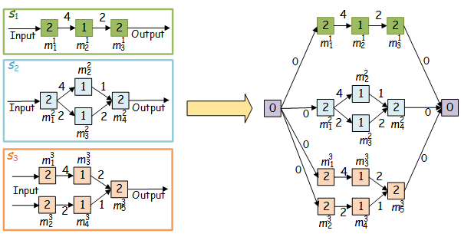
enhanced graph construction
prioritization among multiple services
Notes:
We assume that the servers are heterogeneous, and different prices are determined by varying processors and storage
The total transmission cost is divided into two components: one is the transmission cost generated by servers dealing with service requests, and the other is the transmission cost generated by cloud service dealing with service requests.
The computation cost is incurred due to computation delay. In order to better represent the computation delay, the processing of service requests by each edge server is modeled as an M/M/1 queuing model
Income is collected by providing services to users. Let us assume that a replica of service serves a request of service and generates income
Our objective is to maximize the profit of all servers under constraints including distance thresholds, resource limitations, and connectivity requirements. Therefore, the formal definition of this issue is shown in the PowerPoint

Slide 15
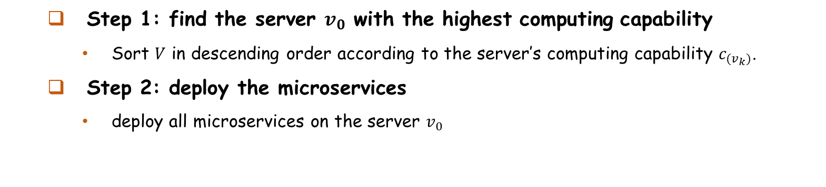
Scenario 1: OMDD with no storage constraint
How to balance the computing and communication resources?
Step 1: find the server $v_{0}$ with the highest computing capability
Sort $V$ in descending order according to the server’s computing capability $c_{(v_{k})}$.
Step 2: deploy the microservices
deploy all microservices on the server $v_{0}$
Theorem : OMDD-US is an optimal solution for solving P1 under the constraints (7), (9)-(11).
Notes:
We assume that the servers are heterogeneous, and different prices are determined by varying processors and storage
The total transmission cost is divided into two components: one is the transmission cost generated by servers dealing with service requests, and the other is the transmission cost generated by cloud service dealing with service requests.
The computation cost is incurred due to computation delay. In order to better represent the computation delay, the processing of service requests by each edge server is modeled as an M/M/1 queuing model
Income is collected by providing services to users. Let us assume that a replica of service serves a request of service and generates income
Our objective is to maximize the profit of all servers under constraints including distance thresholds, resource limitations, and connectivity requirements. Therefore, the formal definition of this issue is shown in the PowerPoint

Slide 16
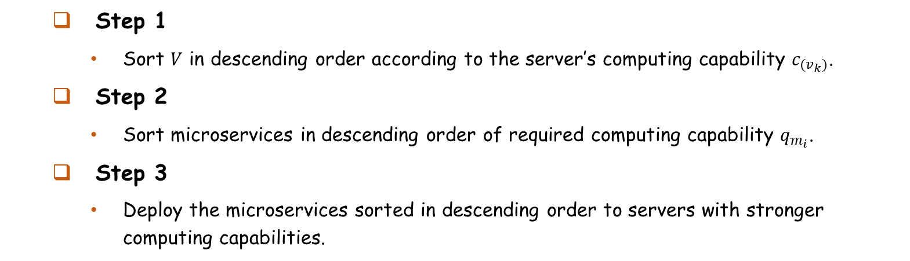
Scenario 2: OMDD with no communication constraint
how to balance the computing and storage resources?
Step 1
Sort $V$ in descending order according to the server’s computing capability $c_{(v_{k})}$.
Step 2
Sort microservices in descending order of required computing capability $q_{m_{i}}$.
Step 3
Deploy the microservices sorted in descending order to servers with stronger computing capabilities.
Theorem : OMDD-UB is an optimal solution on solving P1 under the constraints (7)-(8), (10).
Notes:
We assume that the servers are heterogeneous, and different prices are determined by varying processors and storage
The total transmission cost is divided into two components: one is the transmission cost generated by servers dealing with service requests, and the other is the transmission cost generated by cloud service dealing with service requests.
The computation cost is incurred due to computation delay. In order to better represent the computation delay, the processing of service requests by each edge server is modeled as an M/M/1 queuing model
Income is collected by providing services to users. Let us assume that a replica of service serves a request of service and generates income
Our objective is to maximize the profit of all servers under constraints including distance thresholds, resource limitations, and connectivity requirements. Therefore, the formal definition of this issue is shown in the PowerPoint

Slide 17
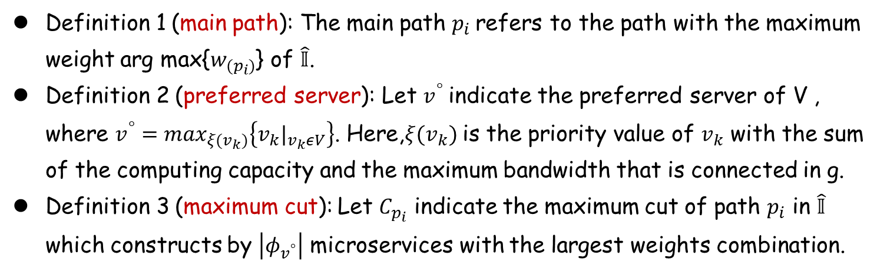
Scenario 3: OMDD with constraints (7)-(10)
Definition 1 (main path): The main path $p_{i}$refers to the path with the maximum weight arg max{$w_{(p_{i})}$} of $\hat{𝕀}$.
Definition 2 (preferred server): Let $v^{°}$indicate the preferred server of V , where $v^{°}=\max_{ξ(v_{k})}\left\{v_{k}|_{v_{k}εV}\right\}$. Here,$ξ(v_{k})$is the priority value of $v_{k}$ with the sum of the computing capacity and the maximum bandwidth that is connected in g.
Definition 3 (maximum cut): Let $C_{p_{i}}$ indicate the maximum cut of path $p_{i}$ in $\hat{𝕀}$ which constructs by $\left|φ_{v^{°}}\right|$ microservices with the largest weights combination.
Theorem : The main path will become the critical path when server computation capacities and inter-server bandwidths are equal, where $\left\{c_{(v_{i})}=b_{(v_{k},v_{q})}|_{∀v_{i}∈V,∀l_{(v_{k},v_{q})}∈L}\right\}.$
Notes:
We assume that the servers are heterogeneous, and different prices are determined by varying processors and storage
The total transmission cost is divided into two components: one is the transmission cost generated by servers dealing with service requests, and the other is the transmission cost generated by cloud service dealing with service requests.
The computation cost is incurred due to computation delay. In order to better represent the computation delay, the processing of service requests by each edge server is modeled as an M/M/1 queuing model
Income is collected by providing services to users. Let us assume that a replica of service serves a request of service and generates income
Our objective is to maximize the profit of all servers under constraints including distance thresholds, resource limitations, and connectivity requirements. Therefore, the formal definition of this issue is shown in the PowerPoint

Slide 18
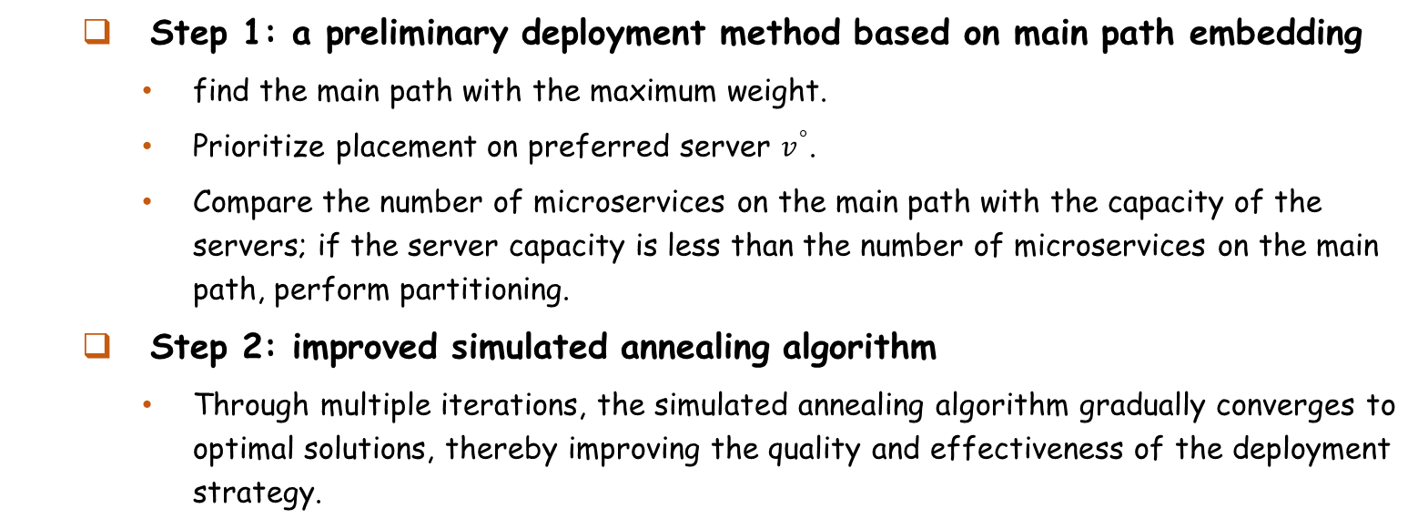
Scenario 3: OMDD with constraints (7)-(10)
Step 1: a preliminary deployment method based on main path embedding
find the main path with the maximum weight.
Prioritize placement on preferred server $v^{°}$.
Compare the number of microservices on the main path with the capacity of the servers; if the server capacity is less than the number of microservices on the main path, perform partitioning.
Step 2: improved simulated annealing algorithm
Through multiple iterations, the simulated annealing algorithm gradually converges to optimal solutions, thereby improving the quality and effectiveness of the deployment strategy.
Notes:
We assume that the servers are heterogeneous, and different prices are determined by varying processors and storage
The total transmission cost is divided into two components: one is the transmission cost generated by servers dealing with service requests, and the other is the transmission cost generated by cloud service dealing with service requests.
The computation cost is incurred due to computation delay. In order to better represent the computation delay, the processing of service requests by each edge server is modeled as an M/M/1 queuing model
Income is collected by providing services to users. Let us assume that a replica of service serves a request of service and generates income
Our objective is to maximize the profit of all servers under constraints including distance thresholds, resource limitations, and connectivity requirements. Therefore, the formal definition of this issue is shown in the PowerPoint

Slide 19
1
Introduction
2
Model and Formulation
CONTENTS
3
Algorithm Design
4
Experiment and Results
Notes:
This is the outline of my talk.
I will first give an introduction, and introduce the background related with our work. Then I will introduce our proposed approach in this work. Finally I will show some experimental results.

Slide 20
Experiment and Results
Basic Setting
Hardware: Windows 10 with an Intel(R) Xeon(R) Silver 4210R CPU @ 2.40GHz, NVIDIA RTX5000 GPU, and 32GB memory.
Dataset: China Telecom Shanghai Company(3,233 base station locations and their corresponding user connections in June 2014.)
Range: Randomly selected subsets of locations containing 6, 20, and 50 base stations. Each service was abstracted as a DAG and generated with the number of 18, 50, and 120 microservices, respectively.
Notes:
The parameters used in our proposed algorithm are summarized in the Table I.
In stage I, we introduced five baselines in comparison with our proposed SDQ algorithm:"The first, Top-K, prioritizes base stations with the highest workload. The second, K-means, iteratively adjusts the parameter K to fulfill thresholds, resource limitations, and connectivity requirements constraints. The third, Top-DoF, favors base stations with a higher number of neighbors. The fourth, K-means and Top-K (KmTK), employs K-means iteratively until cluster constraints are satisfied, subsequently selecting the base station with the highest workload within each cluster as the edge server. Finally, the Random approach involves randomly selecting locations for deploying edge servers from among the available base stations.“
In stage II, we introduced three baselines in comparison with our proposed SPIB-TDB algorithm:The first, GP prioritizes services with the highest request rates. The second, GPI combines the greedy algorithm by giving priority to services with both high request rates and considerable income. The third, Random, involves determining the placement of services in a completely random manner.

Slide 21
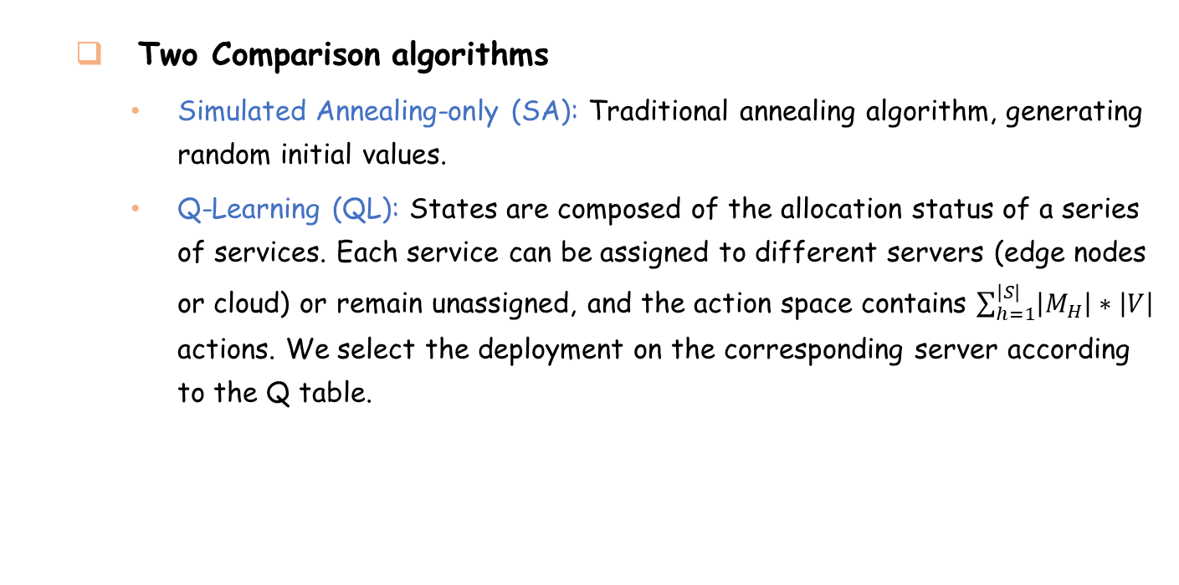
Experiment and Results
Two Comparison algorithms
Simulated Annealing-only (SA): Traditional annealing algorithm, generating random initial values.
Q-Learning (QL): States are composed of the allocation status of a series of services. Each service can be assigned to different servers (edge nodes or cloud) or remain unassigned, and the action space contains $\sum_{h=1}^{\left|S\right|}{\left|M_{H}\right|∗\left|V\right|}$ actions. We select the deployment on the corresponding server according to the Q table.
Notes:
The parameters used in our proposed algorithm are summarized in the Table I.
In stage I, we introduced five baselines in comparison with our proposed SDQ algorithm:"The first, Top-K, prioritizes base stations with the highest workload. The second, K-means, iteratively adjusts the parameter K to fulfill thresholds, resource limitations, and connectivity requirements constraints. The third, Top-DoF, favors base stations with a higher number of neighbors. The fourth, K-means and Top-K (KmTK), employs K-means iteratively until cluster constraints are satisfied, subsequently selecting the base station with the highest workload within each cluster as the edge server. Finally, the Random approach involves randomly selecting locations for deploying edge servers from among the available base stations.“
In stage II, we introduced three baselines in comparison with our proposed SPIB-TDB algorithm:The first, GP prioritizes services with the highest request rates. The second, GPI combines the greedy algorithm by giving priority to services with both high request rates and considerable income. The third, Random, involves determining the placement of services in a completely random manner.

Slide 22
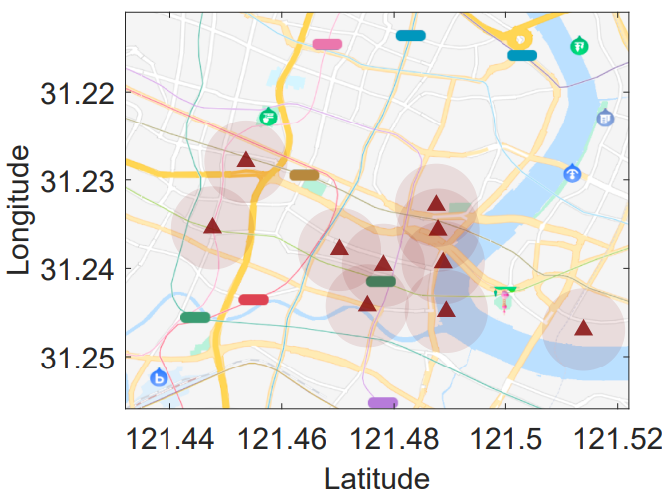
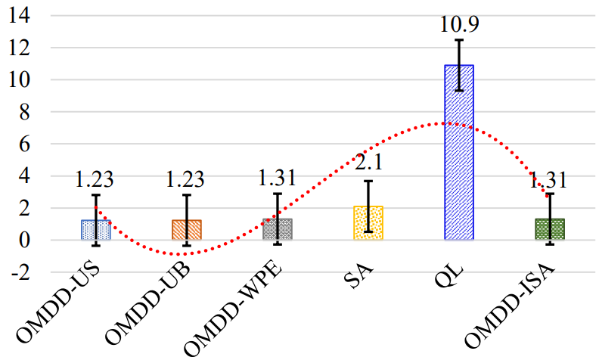
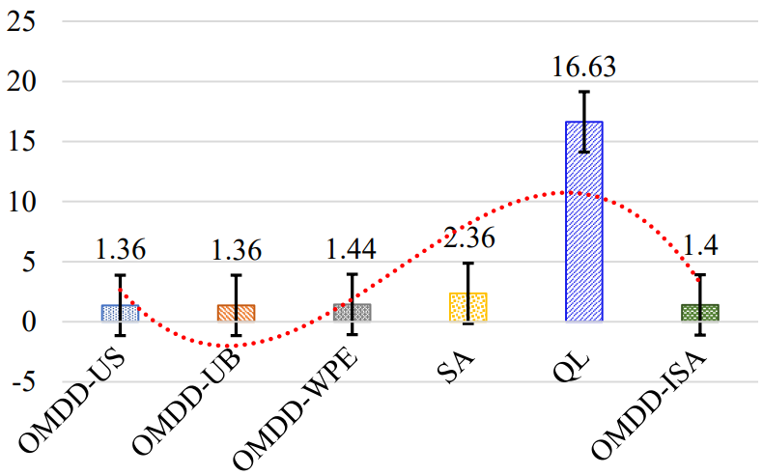
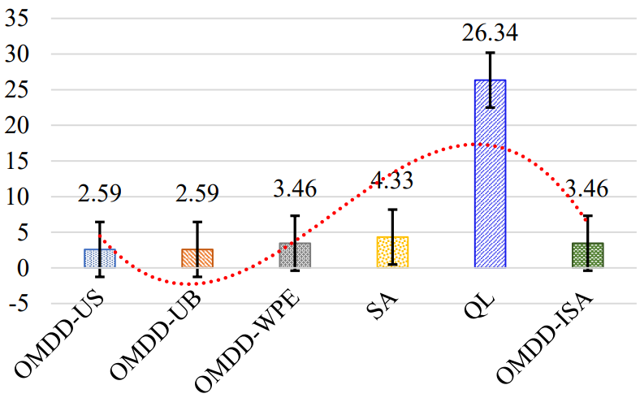
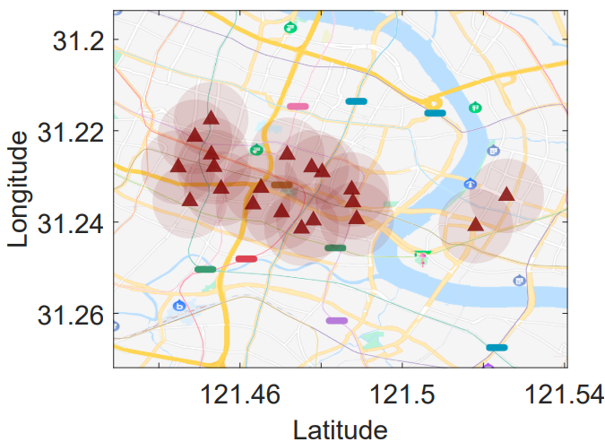
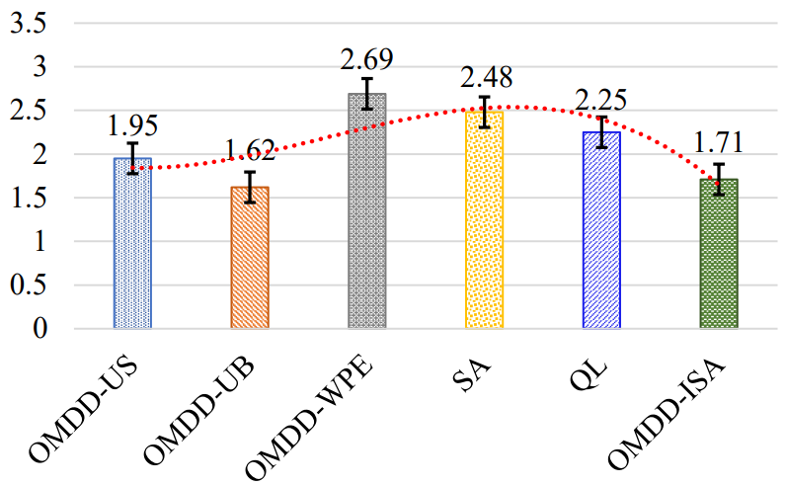
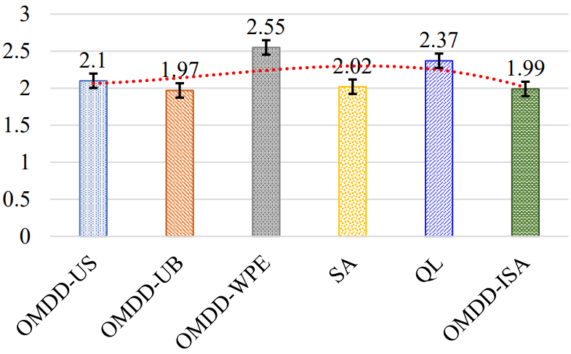
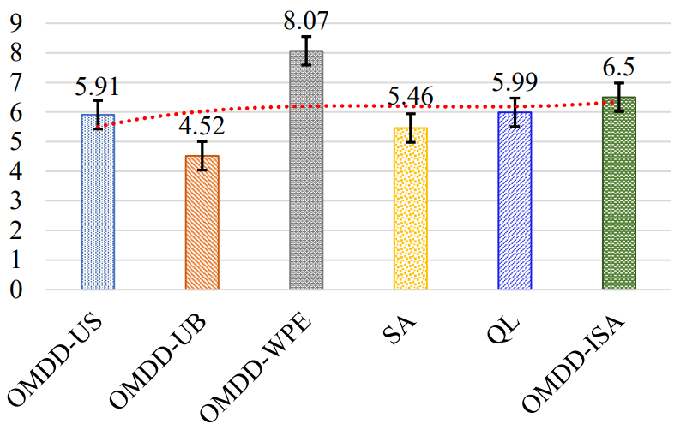
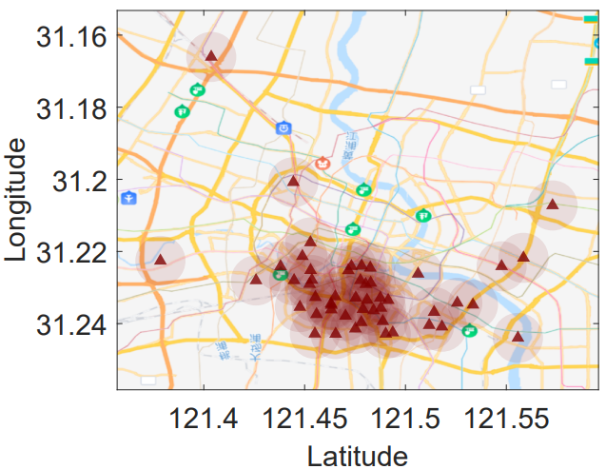
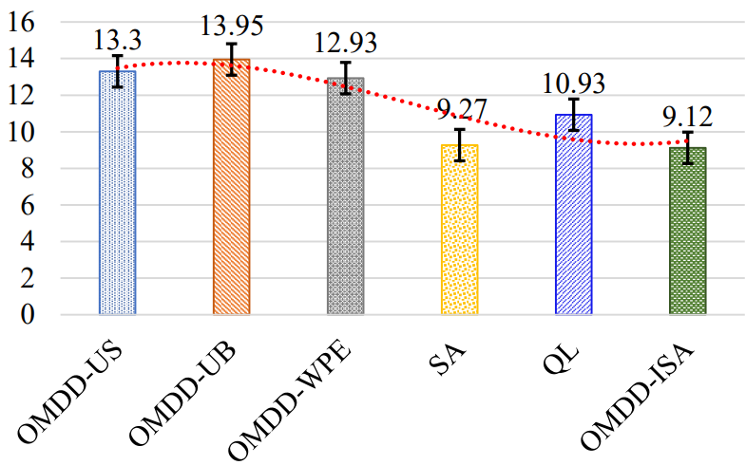
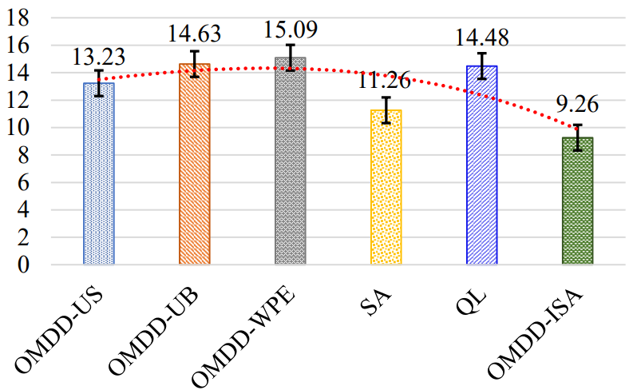
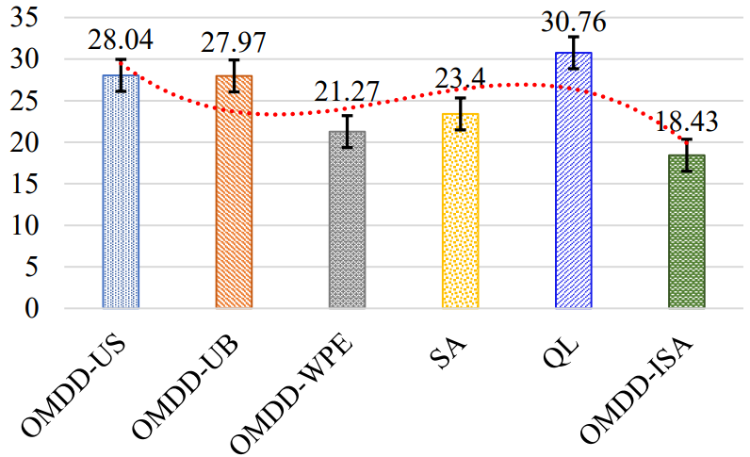
Experiment and Results
Fig. 2. 10 servers and 25 microservices.
Fig. 3. 20 servers and 50 microservices.
Fig. 4. 50 servers and 120 microservices.
Notes:
through continuous iterations, the agent gradually approximates the optimal actions, ultimately converging to a stable state (see Figure \ref{fig2}). The vertical axis in the graph represents the total cost, which corresponds to the objective function value of stage I.
Figure \ref{fig3} displays the total cost for all algorithms across different numbers of base stations. As the number of base stations increases, we observe that the SDQ algorithm always maintains a relatively low total cost.

Slide 23
Conclusion
We investigate the microservice deployment problem with dependencies by formulating to minimize the makespan of multiple services under the resources constraints in multiaccess edge computing, and we theoretically analyze and demonstrate the complexity of this problem through the proof of NP-hardness.
We propose three microservice deployment strategies by offering flexibility and adaptability for various application scenarios. We initially consider two straightforward scenarios: one with unlimited storage resources under the bandwidth constraint, and the other with unlimited bandwidth resources under the storage constraint. For each of these two scenarios, we introduce a novel enhanced graph construction method and design two optimal solutions.
Notes:
In conclusion, we investigate the problem of server deployment and service placement in a multi-user scenario, aiming to enhance the profit of MNOs while considering constraints related to distance thresholds, resource limitations, and connectivity requirements.
Based on that, we employ a two-stage method to decouple the problem, breaking it down into two distinct yet interconnected stages.
we conducted experiments using a real dataset to verify the superior performance of our proposed algorithms.
That’s all. Thank you.

Slide 24
Conclusion
We then consider a more complicated scenario with resource limitations on storage, computing, and communication. We produce a feasible solution by introducing an effective embedding method based on the novel definitions of the main path and preferred server, which are extracted based on the topology features of the services and edge environment, respectively. Based on that, we propose an updating method by introducing an improved simulated annealing strategy, and we analyze the complexity.
We conducted extensive experiments to compare our strategies with several baselines based on the China Telecom Shanghai Company dataset, which was constructed by the geographic information of 3,233 base stations. The results are shown from different perspectives to provide conclusions.
Notes:
In conclusion, we investigate the problem of server deployment and service placement in a multi-user scenario, aiming to enhance the profit of MNOs while considering constraints related to distance thresholds, resource limitations, and connectivity requirements.
Based on that, we employ a two-stage method to decouple the problem, breaking it down into two distinct yet interconnected stages.
we conducted experiments using a real dataset to verify the superior performance of our proposed algorithms.
That’s all. Thank you.

Slide 25
THANK YOU

