Slide 1
On Optimal Partitioning and Scheduling of DNNs in Mobile Edge/Cloud Computing
Jie Wu
Dept. of Computer and Information Sciences
Temple University, USA

Slide 2
Outline
  On Problem Solving
  Mobile Cloud Computing (MCC)
    DNN inferencing
    Offloading
  Optimal Scheduling
  Optimal Partition and Scheduling
  Conclusions and Future Work
  Some Reflections

Slide 3
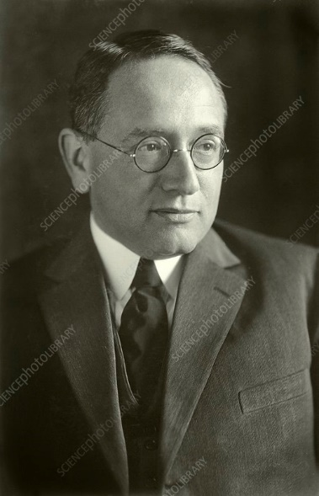
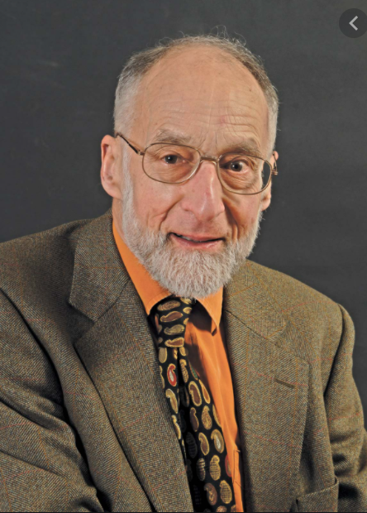
1. On Problem Solving
  How to Solve It (Poyla, 1945)
  If you can’t solve a problem, then there is
  an easier problem you can solve: find it.
Is Computing An Experimental Science ? (Milner, 1986)
A theory can only emerge through
protracted exposure to application.
Ideas and applications developed side-by-side
TX
Notes:
Formal Method in the Field

Slide 4
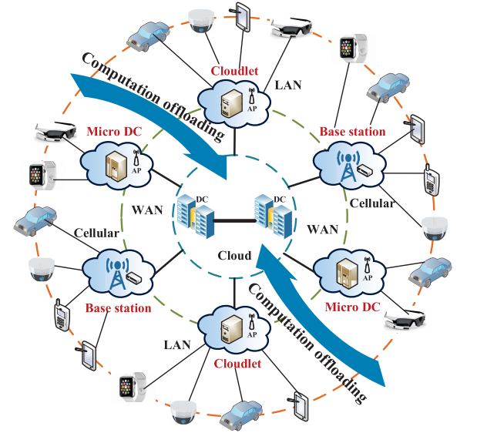
2. Mobile Cloud Computing (MCC)
Cloud/Edge Computing
  Application-driven: VR/AR, video analytics using IoTs
  Better QoE: cloud computing and mobile/edge device
  Key indicators: latency, accuracy, energy, and privacy
  Latency-sensitive: how to bring rich computational resources to mobile users?
50 billion IoT devices by 2020
TX
Notes:
Smartphones, wearable devices (google glass and apple watch), cameras, vehicles_

Slide 5
DNN Inferencing
Deep Neural Networks (DNNs)
  Technologies: GPU (graphic) and TPU (tensor)
AI applications
  Computer vision: AlexNet, VGG-16, Inception, RandWire
  Natural language processing: GPT-3
Graph models of DNNs
TX

Slide 6
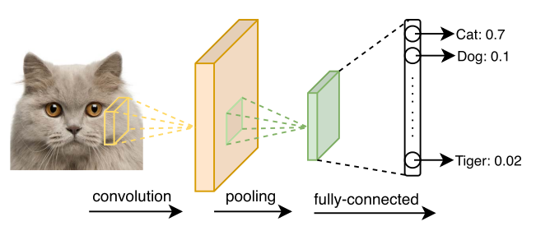
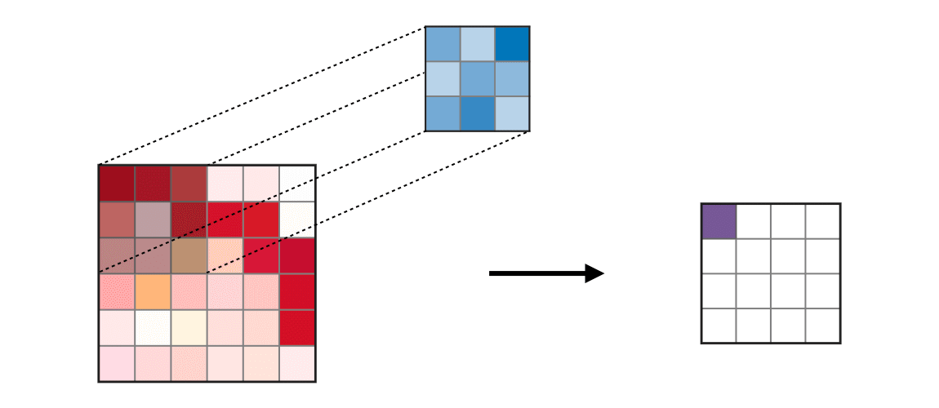
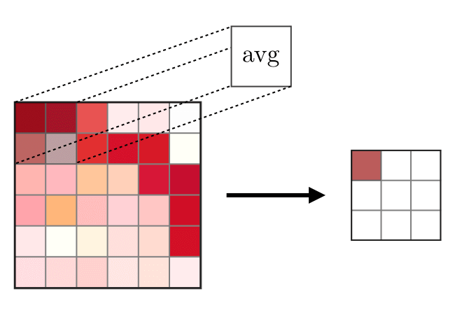
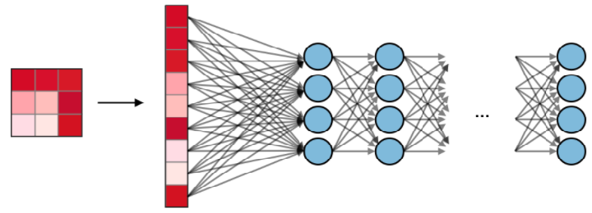
Convolution NNs
CNNs (image classification)
convolution (filtering), pooling (max/avg), fully-connected (neurons)
TX
Notes:
The convolution layer (CONV) uses filters that perform convolution operations as it is scanning the input II with respect to its dimensions. Its hyperparameters include the filter size FF and stride SS. The resulting output OO is called feature map or activation map.

Slide 7
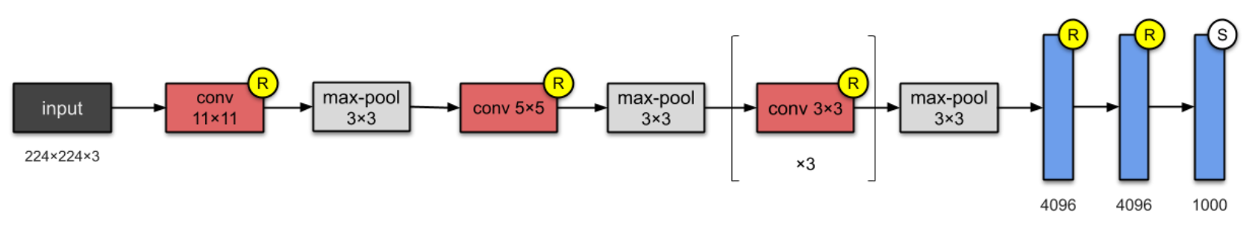
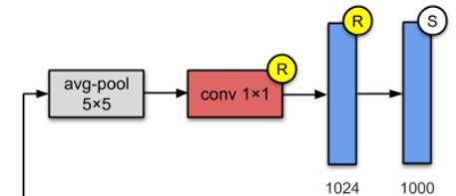
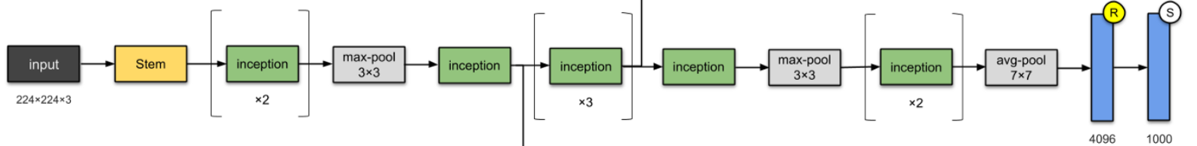
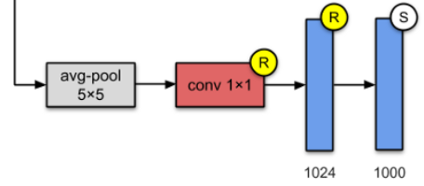
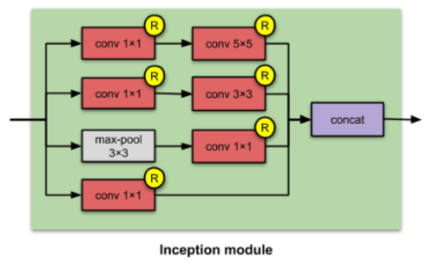
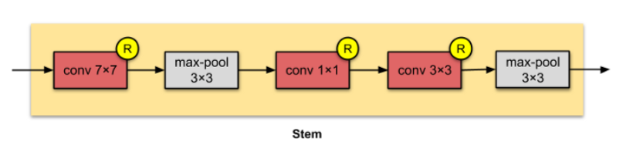
Sample CNNs
  AlexNet (Red: CONV, Gray: POOL, Blue: FC)
Inception-V1
TX

Slide 8


Offloading
Three-stage collaborative computation offloading
  Local computation: processing on local devices
  Communication: transmitting intermediate DNN layers’ outputs
  Remote computation: completing the remote processing in cloud
Three models
  On-device optimization
  Cloud-only offloading
  Mixed-mode offloading
offloading
TX

Slide 9
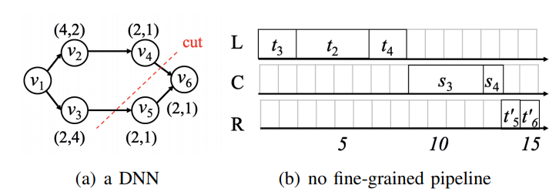
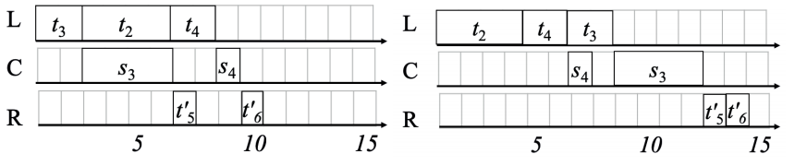
Offloading Samples
Given a partition (i.e., cut)
  Course-grained pipeline: local, comm, and remote
  Fine-grained pipeline: path-based
TX

Slide 10
3. Optimal Scheduling
DNN Computation Offloading Optimization (DCOO)
  DCOO: optimal scheduling (in terms of minimum makespan) for a given partition (i.e., cut).
Cases of DNN
  Line-structure: trivial
  Multi-path: hard
  DAG: hard
Theorem 1: DCOO is NP-hard for a multi-path DNN.
Proof: Reduce 3-machine flow-shop to DCOO.
TX
Notes:
Flow shop scheduling is a special case of job shop scheduling where there is strict order of all operations to be performed on all jobs

Slide 11
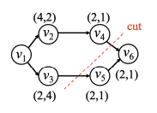
Multi-Path Scheduling
Single-path
  Straightforward solution, even without a given cut
Multi-path
  Path: a path from input to cut or from cut to output
  Non-overlaps among paths (except input and output)
  E.g., v₁-v₂-v₄, v₁-v₃, v₆, v₅-v₆
Theorem 2: In multi-path DNNs, the optimal schedule can be achieved via the non-preemptive path-based schedule.

Slide 12
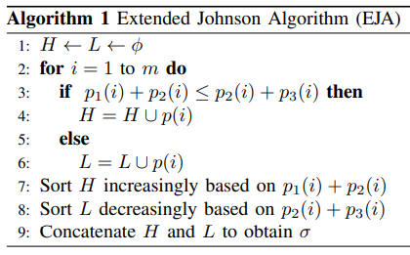
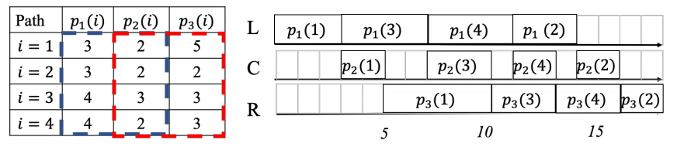
Extended Johnson Algorithm (EJA)
Path p(i) in three stages
  P₁(i), P₂(i), P₃(i)
Linear solution (EJA)
  Dividing paths into H and L
  E.g., H = {1}, L = {3, 4, 2}
Notes:
H depends on N and ESP capacity

Slide 13
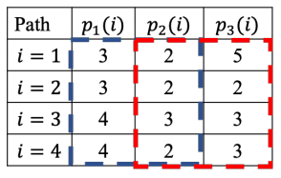

Optimality
Theorem 3*: If stage 2 is dominated by either stage 1 or 3, max{min p₁(i), min p₃(i)} $≥$ max p₂(i), EJA is optimal.
If Theorem 3 fails, EJA still achieves an approximation ratio of 5/3⁺.
4
*Chen et al, A new heuristic for three-machine flow shop scheduling, OR, 1996.
⁺Framinan et al, A review and classification of heuristics for permutation flow
shop scheduling with makespan objectives, JORS, 2004.
Notes:
H depends on N and ESP capacity

Slide 14
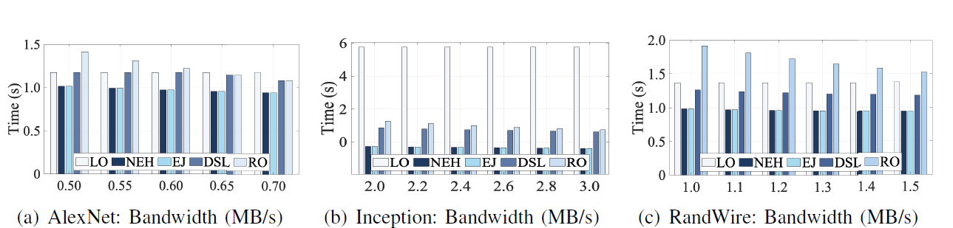
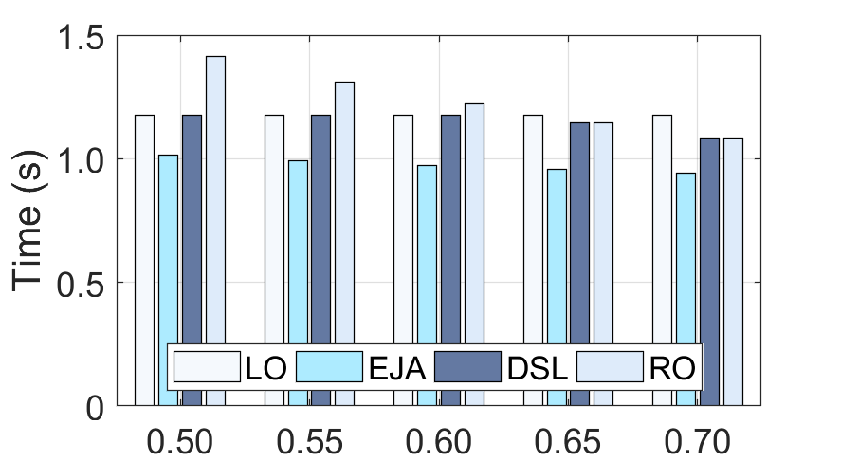
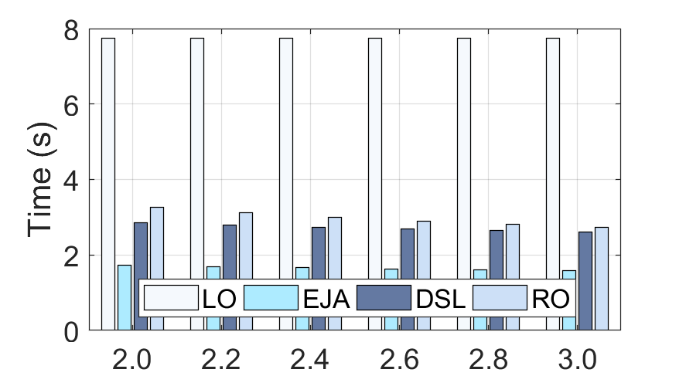
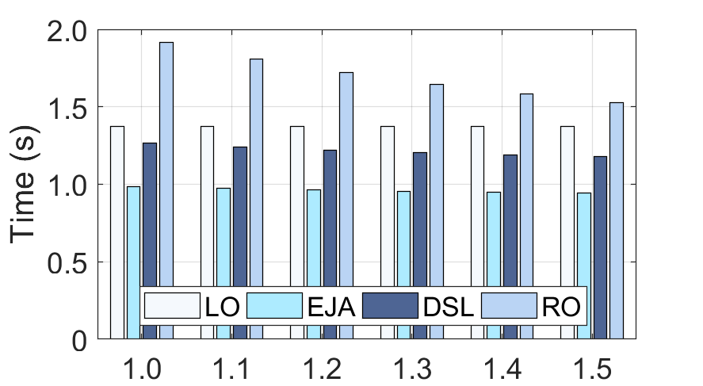
Simulation
Local and Cloud
  Local: Raspberry Pi, Cloud: Amazon EC2
Algorithms
  LO: local only, EJA: Extended Johnson’s Algorithm,
  DSL: no fine-grained pipeline, RO: remote only

Slide 15
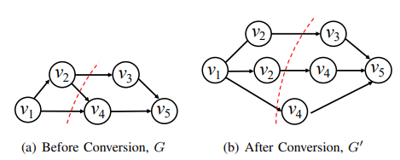
Extensions
General structure: DAG
  Conversion to multi-path
  Replicated nodes at join and fork
Heuristic solution
  Scheduling: EJA on multi-path
  Execution: Replicated node executed once (the first time)
fork
join
TX

Slide 16
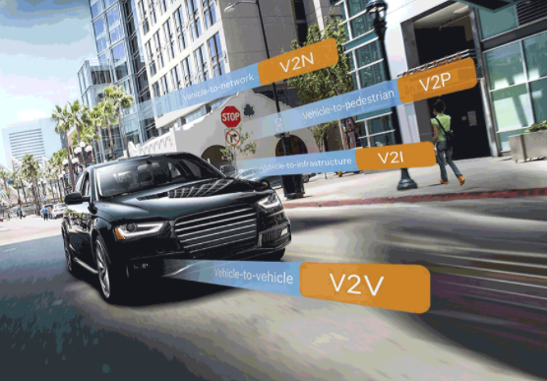
Multiple DNNs Offloading to Edges
Internet of Vehicles: smart city
Autonomous driving systems: perception is a key
Multiple cameras/sensors: multiple (identical) DNNs
V2X: V (vehicle), I (infrastructure), N (network), P (pedestrian)
Notes:
200 sensors: Radar, Light Detection and Ranging sensors, Sonar, Global Navigation Satellite Systems (GNSS)

Slide 17
4. Optimal Partition and Scheduling
Multiple line-structure DNNs
  AlexNet and VGG-16
  Video analytics and VR/AR
Optimal partition and scheduling
  Brute force: O(k^{n})
  n: # of copies, k: # of layers
Existence of a better solution?
  Exploring special application properties

Slide 18
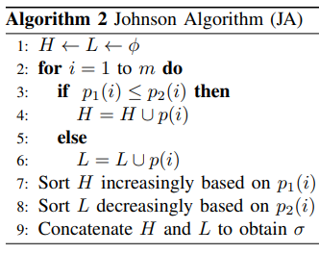
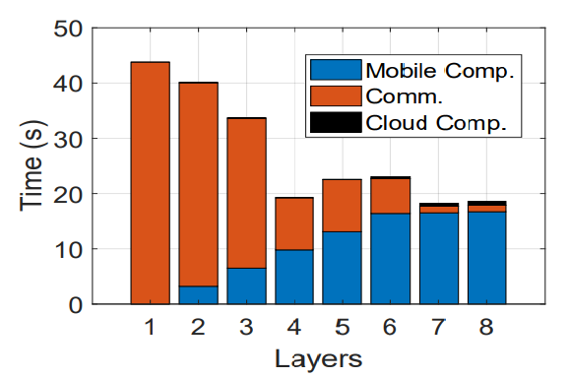
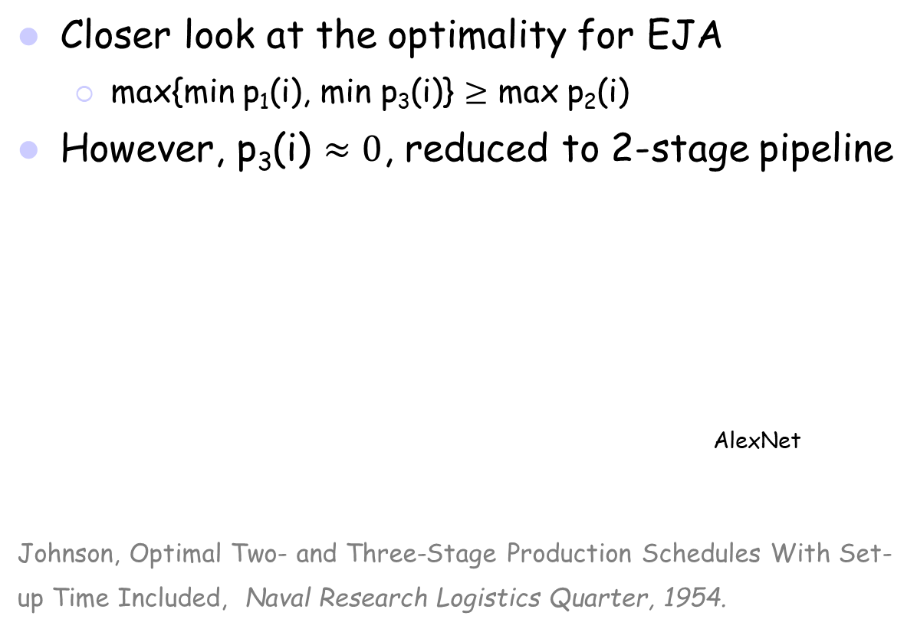
Johnson Algorithm (JA)
Closer look at the optimality for EJA
  max{min p₁(i), min p₃(i)} $≥$ max p₂(i)
However, p₃(i) $≈0$, reduced to 2-stage pipeline
AlexNet
Johnson, Optimal Two- and Three-Stage Production Schedules With Set-up Time Included, Naval Research Logistics Quarter, 1954.
TX

Slide 19
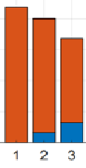
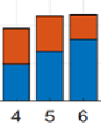
JA in Illustration
Optimality is guaranteed: JA on 2-stage pipeline
First six layers of AlexNet
  One copy for each partition 6 copies
  H = {1, 2, 3}, increasing order of blue
  L = {4, 5, 6}, decreasing order of red
  Comm.-domination (or comp.-domination)
1
1
2
2
3
3
5
6
5
6
3
3
4
4
2
2
4
5
4
5
6
6
TX

Slide 20
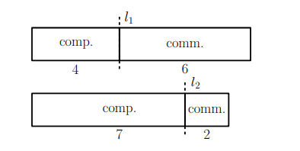
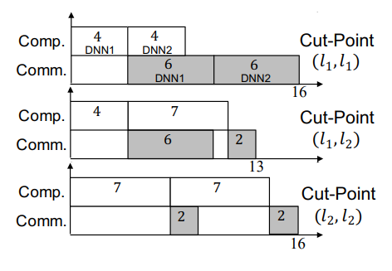
Multiple Line-Structure Example
Two copies of line-structure DNN
Three possible partitions and scheduling

Slide 21
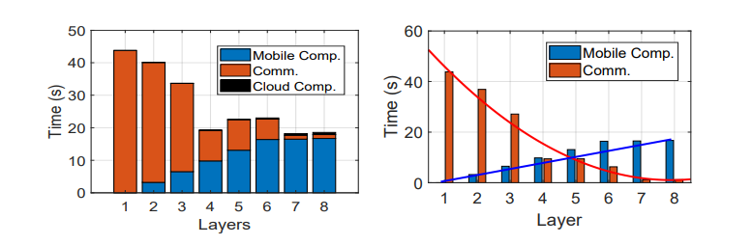
Special Application Property
Line-structure (as the layer increases)
  Computation time: linear increasing (convex) function
  Communication time: monotonic decreasing convex function
Computation vs. communication
  Data size: 2 – 12 MB
  Speed (uplink): 2-5 Mpbs (4G) and 6-54 Mpbs (WiFi)

Slide 22
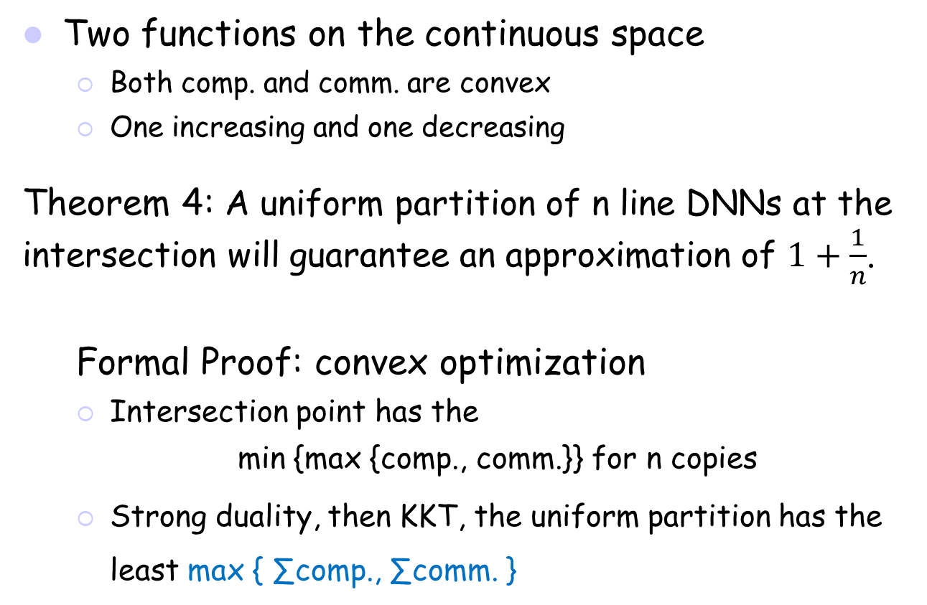
Optimization Approximation
Two functions on the continuous space
  Both comp. and comm. are convex
  One increasing and one decreasing
Theorem 4: A uniform partition of n line DNNs at the intersection will guarantee an approximation of $1+\frac{1}{n}$.
  Formal Proof: convex optimization
  Intersection point has the
  min {max {comp., comm.}} for n copies
  Strong duality, then KKT, the uniform partition has the least max { ∑comp., ∑comm. }

Slide 23
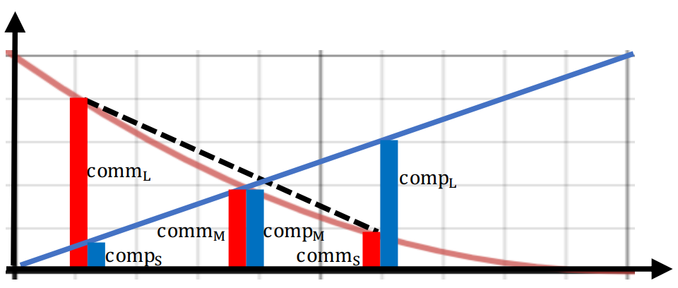
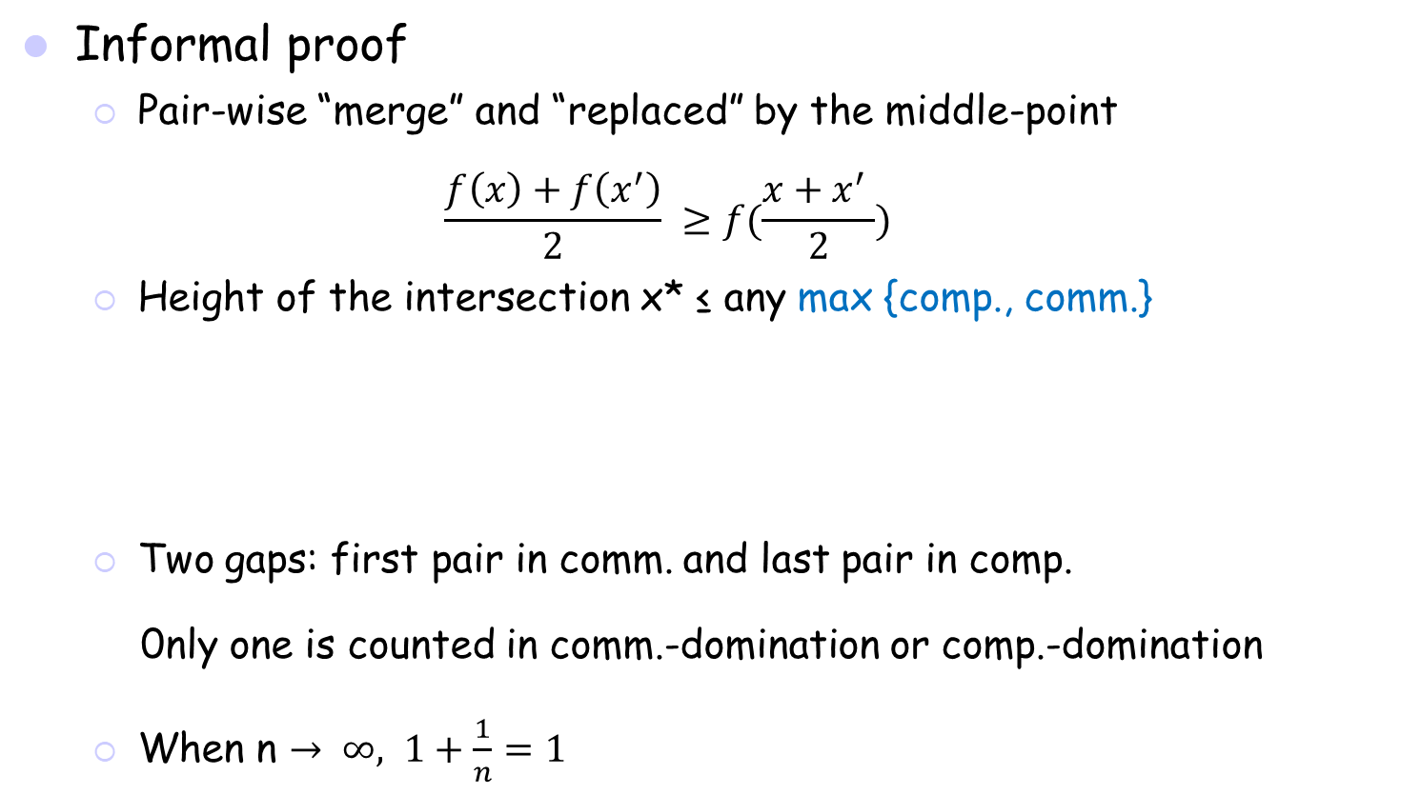

Optimization Approximation (cont’d)
Informal proof
  Pair-wise “merge” and “replaced” by the middle-point
  $$\frac{f\left(x\right)+f\left(x^{′}\right)}{2} ≥f(\frac{x+x^{′} }{2})$$
  Height of the intersection x* ≤ any max {comp., comm.}
  Two gaps: first pair in comm. and last pair in comp.
  0nly one is counted in comm.-domination or comp.-domination
  When n $→ ∞, 1+\frac{1}{n}=1$
$$→$$

Slide 24
Sufficient Condition for Optimality
For a given set of partitions
  Left/right most partition: (comp_{s}, comm_{l} ) / (comp_{l}, comm_{s})
Intersection partition: (comp_{m,} comm_{m})
Theorem 5: The uniform partition beats the given set if
3comp_{m} < comp_{s} + comp_{l} + comm_{s} and 3comm_{m} < comp_{s} + comm_{l} + comm_{s}

Slide 25
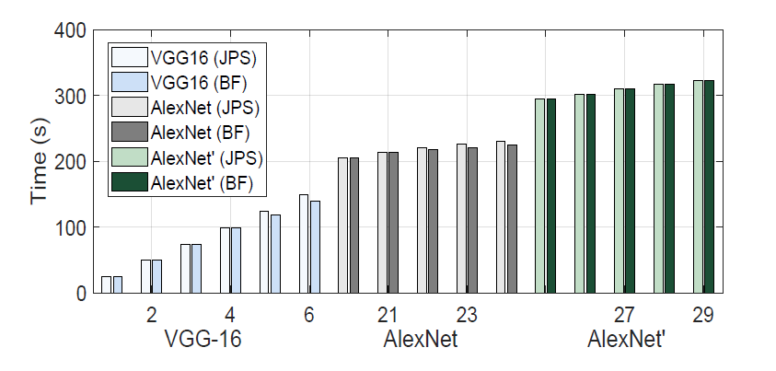
Simulation (cont’d)
Partition methods
  Joint Partition and Scheduling: JPS, Brute Force: BF
Application
  VGG-16, AlexNet, and AlexNet’ (curve fitting) with n = 1, …, 29

Slide 26
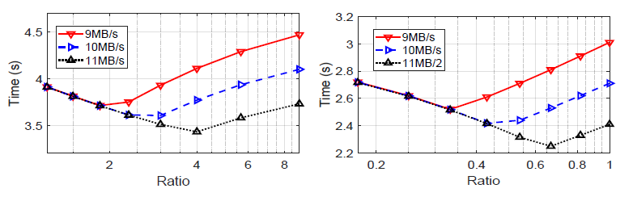
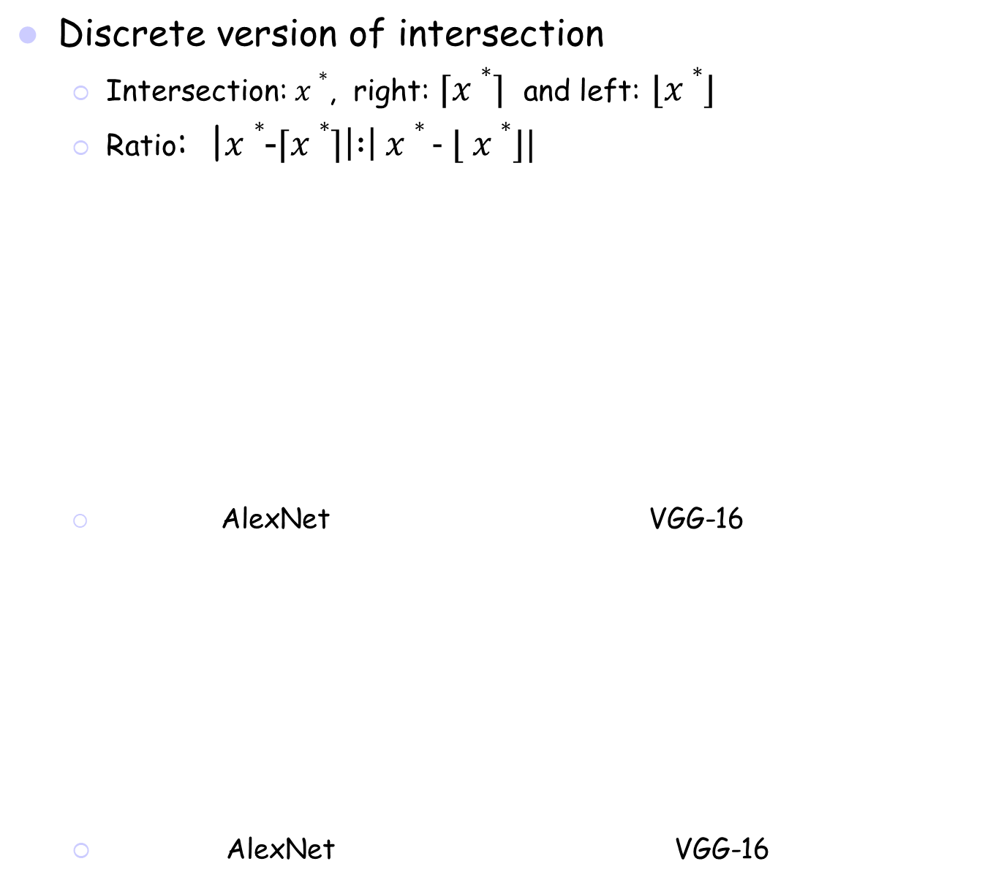
Simulation (cont’d)
Discrete version of intersection
  Intersection: $x∗$, right: ⌈$x∗⌉$ and left: $⌊x∗⌋$
  Ratio: |$x∗$-⌈$x∗⌉\left| :\right|$ $x∗$- $⌊ x∗⌋$|
  AlexNet VGG-16
  AlexNet VGG-16

Slide 27
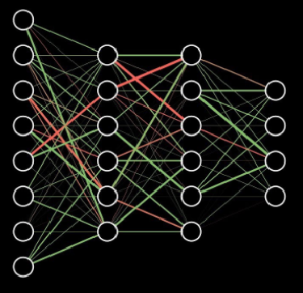

5. Conclusions and Future Work
Offloading as a Service
  Edge/cloud networks
Different DNNs
  Single path, multi-path, and DAG
Joint partition and scheduling
  Johnson’s rule and its extensions using pipelines
  Unique properties of comp. and comm. of DNNs
Future work
  Multi-tier offloading: edge and then cloud pipeline
  Optimal partition and scheduling of special DAGs

Slide 28
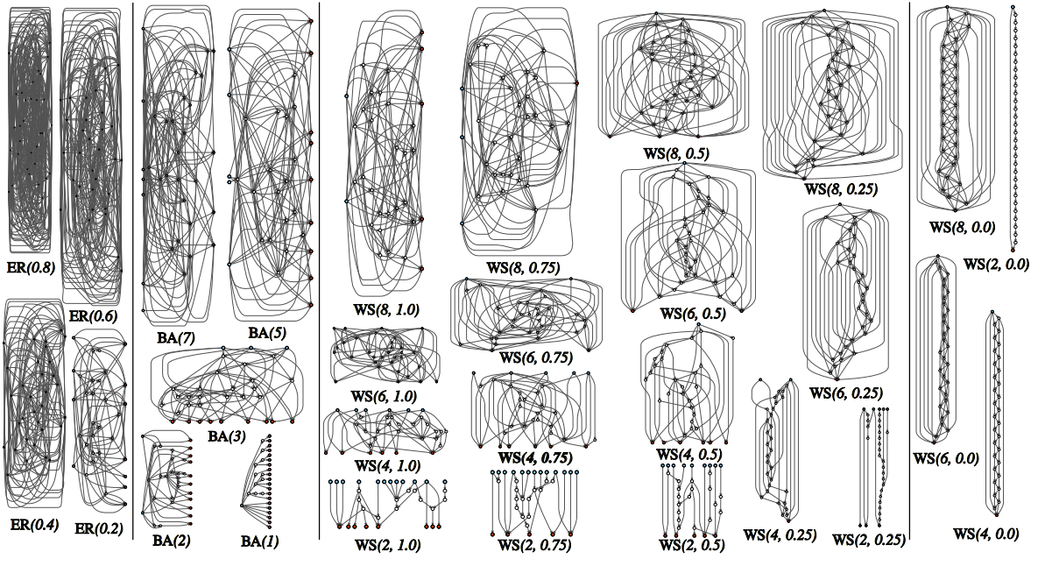
6. Some Reflections
  Back to the past: interconnection networks
  Randomly wired NNs (random graphs): neuroscience
  Erdos-Renyi (ER): random, Barabasi-Albert (BA): preferential
  Watts-Strogatz (WS): small-world
Xie et al, Exploring Randomly Wired Neural Networks for Image Recognition, ICCV’19
Notes:
Kaiming He

Slide 29
Avoiding: Reinventing the Wheel
  Reference searching practice
  1 to 3 iterative process: references, references’ references
  Knowledge span
  Career span: 5 to 7 years in MS + PhD period
  Art of citations
  Good practice for citation: yearly distributions
  Zheng and Wu, Snowballing Effects in Preferential Attachment, ICCCN’15
TX

Slide 30

Questions
Collaborators: Ning Wang (Rowan U.) and Yubin Duan (Temple U.)

