Slide 1
Deadline-aware Broadcasting in Wireless Networks with Local Network Coding
Pouya Ostovari, Jie Wu, and Abdallah Khreishah
Computer & Information Sciences Department,
Temple University,
USA

Slide 2
Alice and Bob (No coding)
X
Y
Alice
R
Bob
Y
X
4 transmissions

Slide 3
Alice and Bob (Coding)
X
Y
Alice
R
Bob
X+Y
3 transmissions

Slide 4
Deadline-Aware Broadcasting
X:
Generation : slot 1
Deadline: 6
Y:
Generation: slot 3
Deadline: 6
Z:
Generation: slot 5
Deadline: 7
X
Y
1
2
3
4
5
Z

Slide 5
Deadline-Aware Broadcasting
X:
Generation : slot 1
Deadline: 6
Y:
Generation: slot 3
Deadline: 6
Z:
Generation: slot 5
Deadline: 7
X
Y
1
X
2
Z
Z
X
Y
Y
3
3 transmissions by the relay node
No deadline misses
Without waiting
Z
X
X
Y
4
Y
5
Z
Z
Time slot 5
Time slot 4
Time slot 1
Time slot 3
Time slot 2
Time slot 7
Time slot 6

Slide 6
Deadline-Aware Broadcasting
X:
Generation : slot 1
Deadline: 6
Y:
Generation: slot 3
Deadline: 6
Z:
Generation: slot 5
Deadline: 7
X
Y
1
X+Y+Z
X
2
Z
X
Y
3
1 transmissions by the relay node
Deadline misses
Waiting time=4
Z
X
X+Y+Z
Y
4
5
Z
Z
Time slot 3
Time slot 1
Time slot 7
Time slot 2
Time slot 4
Time slot 5
Time slot 6

Slide 7
Deadline-Aware Broadcasting
X:
Generation : slot 1
Deadline: 6
Y:
Generation: slot 3
Deadline: 6
Z:
Generation: slot 5
Deadline: 7
X
Y
1
Z
X+Y
X
2
X+Y
Z
X
Y
3
2 transmissions by the relay node
No deadline misses
Waiting time=2
Z
X
Y
4
5
X+Y
X+Y
Z
Z
Time slot 7
Time slot 5
Time slot 4
Time slot 1
Time slot 3
Time slot 2
Time slot 6

Slide 8
Setting
All-to-all broadcast
Perfect links
MIMO capability
Two-hop local information
Objective: minimizing the number of transmissions
Constraint: Each packet has a deadline to be received by all nodes.

Slide 9
High Level Approach
Selecting forwarder nodes
Any deterministic forwarding method
Partial Dominant Pruning
Calculating waiting time of each packet at relay nodes
Velocity based waiting time
Proportional distribution of waiting time
Random waiting time

Slide 10
Partial Dominant Pruning (PDP) (W. Lou and J. Wu, 2002)
The source node selects a subset of its neighbors such that they cover two-hop neighbors of the source.
Two-hop local information
The source add the forwarder list to the packets.
Each forwarder node performs the same instruction.

Slide 11
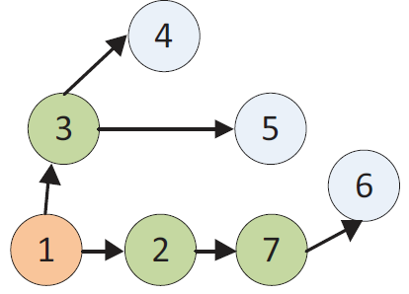
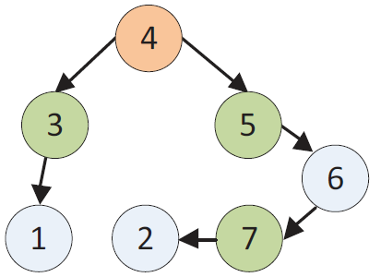
Velocity-Based Waiting Time
Remaining time of packet i at node j
Current time
Deadline of packet i
Extra time of packet i at node j
Waiting time of packet i at node j
Maximum remaining hop of packet i at node j
$$S_{1}=1$$
4
Time slot=1
Time slot=2
$$D_{1}=7$$
3
5
6
1
2
7
$$R_{1,3}=7−2=5$$
$$W_{1,2}=0$$
$$S_{4}=3$$
$$E_{1,3}=5−1=4$$
$$D_{4}=8$$
$$W_{1,3}=4$$

Slide 12
Velocity-Based Waiting Time
Remaining time of packet i at node j
Current time
Deadline of packet i
Extra time of packet i at node j
Waiting time of packet i at node j
Maximum remaining hop of packet i at node j
$$S_{1}=1$$
4
Time slot=3
Time slot=4
$$D_{1}=7$$
3
5
6
1
2
7
$$W_{1,7}=\frac{\left(7−3\right)−1}{1}$$
$$W_{4,5}=0$$
$$S_{4}=3$$
$$W_{4,3}=\frac{\left(8−4\right)−1}{1}=3$$
$$D_{4}=8$$

Slide 13
Velocity-Based Waiting Time
Remaining time of packet i at node j
Current time
Deadline of packet i
Extra time of packet i at node j
Waiting time of packet i at node j
Maximum remaining hop of packet i at node j
$$S_{1}=1$$
4
Time slot=6
Time slot=5
$$D_{1}=7$$
3
5
6
1
2
7
$$W_{4,6}=0$$
$$S_{4}=3$$
$$W_{4,7}=\frac{\left(8−6\right)−1}{1}=1$$
$$D_{4}=8$$

Slide 14
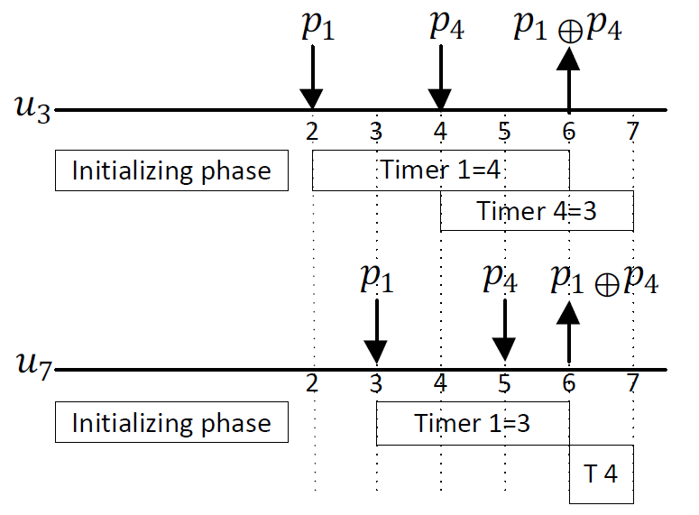
Velocity-Based Waiting Time
Remaining time of packet i at node j
Current time
Deadline of packet i
Extra time of packet i at node j
Waiting time of packet i at node j
Maximum remaining hop of packet i at node j
4
3
5
6
1
2
7

Slide 15
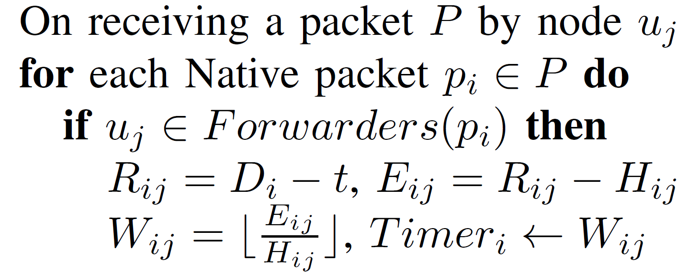
Velocity-Based Waiting Time
Algorithm

Slide 16
Coding

Slide 17
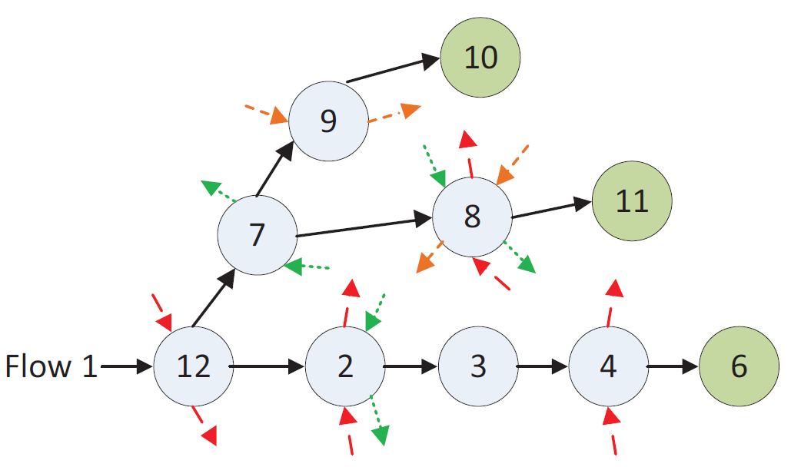
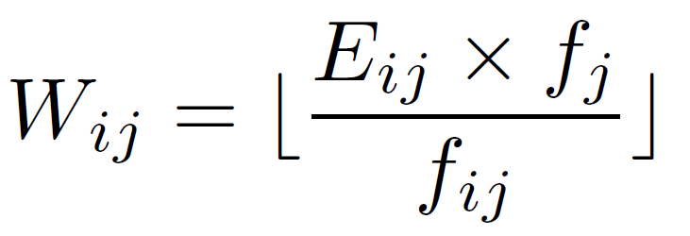
Proportional Distribution of Waiting Time
More Crossing flows more coding chance
Number of flows that pass from node j
Average number of passing flows from children nodes of node j in i-th tree

Slide 18
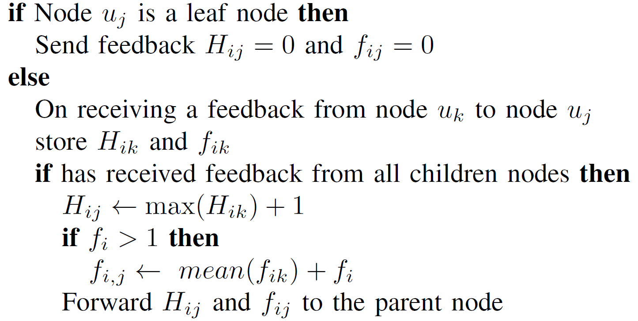
PDWT (Initializing Phase)

Slide 19
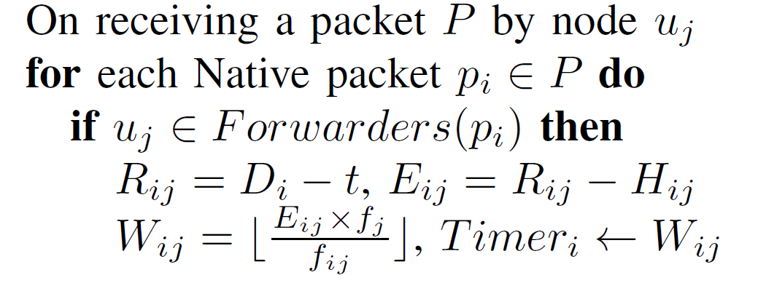
PDWT (Running Phase)

Slide 20
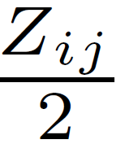
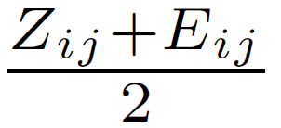
Random Waiting Time
The deadline should be less than to ensure meeting the deadline.
Lower bound:
Upper bound:
The computed waiting time using the proportional method
The extra time of packet i at node j

Slide 21
Random Waiting Time

Slide 22
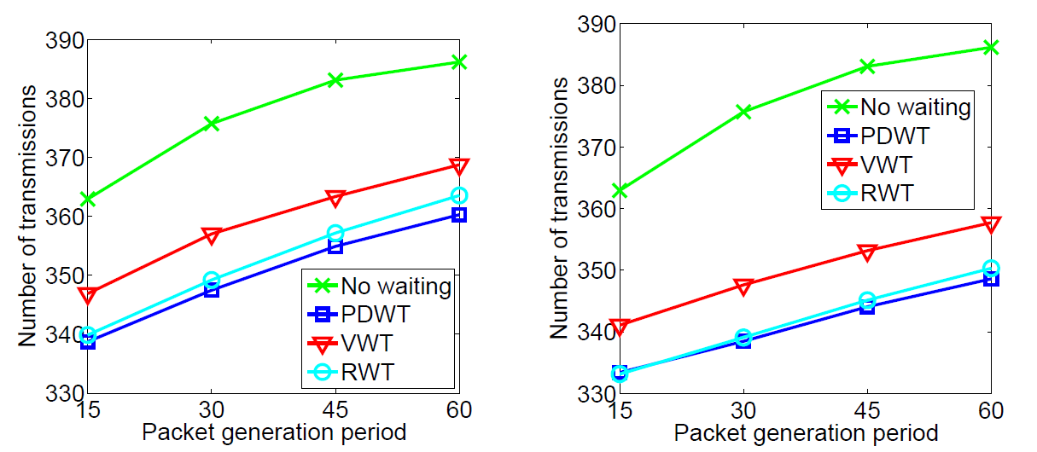
Simulations
VWT: Velocity based Waiting Time
PDWT: Proportional Distribution of Waiting Time
RWT: Random Waiting Time

Slide 23
Simulations
VWT: Velocity based Waiting Time
PDWT: Proportional Distribution of Waiting Time
RWT: Random Waiting Time
M=30, G=60
M=30, G=30

Slide 24
Simulations
VWT: Velocity based Waiting Time
PDWT: Proportional Distribution of Waiting Time
RWT: Random Waiting Time
M=30, G=60
M=30, G=30

Slide 25
Summary
Deterministic forwarding approach
PDP
Local network coding
Delaying forwarding to increase coding opportunities
Velocity based waiting time
Proportional distribution of waiting time
Random waiting time

Slide 26
Questions

