Slide 1

Algorithmic Crowdsourcing and Applications in the Big Data Era
Jie Wu
Dept. of Computer and Info. Sciences
Temple University

Slide 2
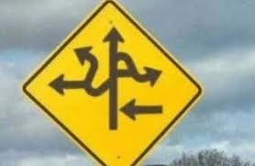
Road Map
Introduction
Mechanical Turk
Sample Applications
Algorithmic Paradigms
Challenges and Opportunities
Conclusion

Slide 3
INTRODUCTION
Big data era
What and why
Basic components
Motivation examples

Slide 4
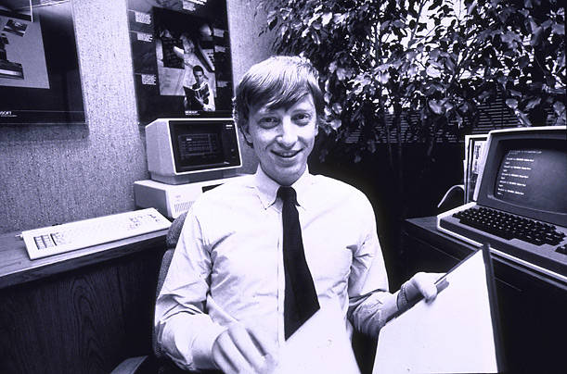
How Much Data?
Facebook: 40 B photos; 30 B pieces of content shared every month
WeChat: 846 M users and 20 B message per day
Global Internet traffic: quadrupled from 2010 to 2015, reaching 966 EB (10¹⁸) per year
(The total of all human knowledge created from the dawn of man to 2003 is totaled 5 EB)
640K ought to be enough for anybody.

Slide 5

Big Data Era
“In information technology, big data consists of datasets that grow so large that they become awkward to work with using on-hand database management tools.”
Computers are not efficient in processing or creating certain things: pattern recognition, complex communication, and ideation.

Slide 6
What is Crowdsourcing?
Coordinating a crowd (a large group of people online) to do microwork (small jobs) that solves problems (that software or one user cannot easily do)
Crowdsourcing: crowd + outsourcing (through Internet)
Amazon’s Mechanical Turk and CrowdFlower
Notes:
The reasons for participating in crowdsourcing:
For fun: game style– put task in certain form of games
For money: tiny dollar, such as Amazon Mturk
based on the quality of results
based on the working time or completed amount

Slide 7
The Benefits of Crowdsourcing
Performance
Inexpensive and fast
The whole is greater than the sum of its parts
Human Processing Unit (HPU)
More effective than CPU (for some apps)
Verification and validation: Image labeling
Interpretation and analysis: language translation
Surveys: Social network survey
High adoption in business (85% of the top global brands) based on eYeka
Notes:
CACM Gaining Wisdom from Crowds: (1) 57,000-plus players to discovery the structure of a protein. (2) Wiki Spanish version in just 80 hours by 1M people.

Slide 8
Basic Components
Requester
People submit jobs (microwork)
Human Intelligence Tasks (HITs)
Worker
People work on jobs
Platform
Job management
Amazon Mechanical Turk (MTurk): 18th century chess playing robot with a human inside
Notes:
Requester: work owner; submit work onto a crowdsourcing platform
Workers: a undefined group of users
Platform: usually websites or apps
provides places for publishing work and finding workers
provide payment approach
but get service fee from both requester and workers

Slide 9
History
1714: Longitude Prize: tried to find a way to measure a ship’s longitudinal position
1884: 800 volunteers catalogued words to create Oxford English Dictionary
2001: Wikipedia: free-access, free content Internet encyclopedia
2005: Threadless.com, with members creating own design
2006: Howe and Robinson introduced the term in Wired
2008: Brabham published first scholarly work using the term
Notes:
Requester: work owner; submit work onto a crowdsourcing platform
Workers: a undefined group of users
Platform: usually websites or apps
provides places for publishing work and finding workers
provide payment approach
but get service fee from both requester and workers

Slide 10
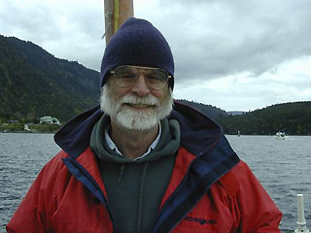
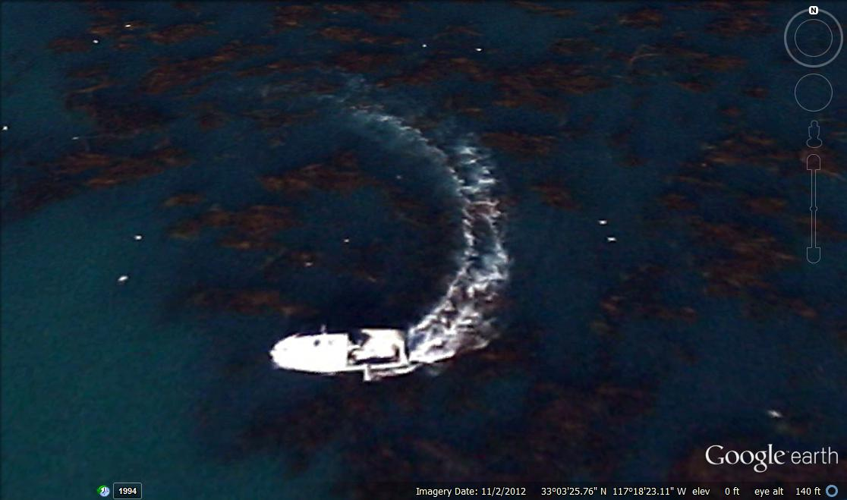
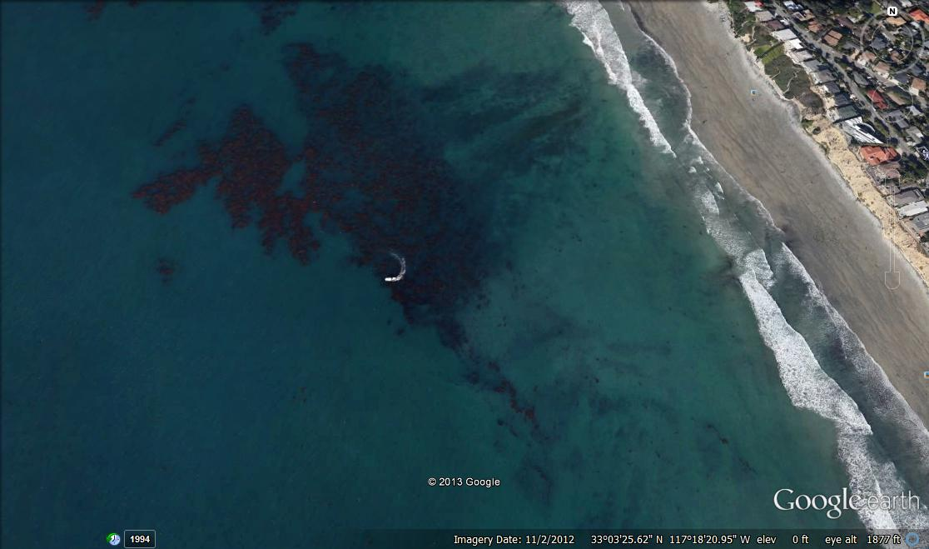
Help Find Jim Gray
Jim Gray, Turing Award winner, went missing with his sailboat outside San Francisco Bay in January 2007.
Use satellite image to search for his sailboat.
Notes:
In current crowdsourcing platforms, 100,000 tasks can be completed in about 2 days.
We can use satellite image to find and locate the missing boat.
Accuracy: human intelligence
Fast: multiple workers; works in parallel

Slide 11

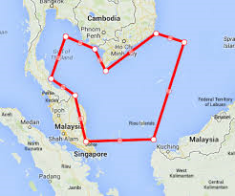
Malaysia Airlines Flight MH 370
DigitalGlobe
Crowdsourcing volunteers comb satellite photos for Malaysia Airlines jet
March 11, 2014 (from CSU prof. email)
I just saw on our local Denver Fox news (KDVR.com) that a local company, DigitalGlobe, has reoriented their satellites to take high-res images in the area where the plane may have crashed. Crowdsourcing efforts are on to have people scan these images and find signs of debris. I was reminded of Jie Wu's talk earlier this month.
Notes:
In current crowdsourcing platforms, 100,000 tasks can be completed in about 2 days.
We can use satellite image to find and locate the missing boat.
Accuracy: human intelligence
Fast: multiple workers; works in parallel

Slide 12
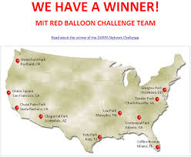

DARPA Network Challenges
Problem (2009): $40,000 challenge award for the first team to find 10 balloons.
MIT team won under 9 hours.
Winning strategy
$2,000 per balloon to the first person to send the correct location
$1,000 to the person who invited the winner
$500 to whoever invited the inviter
… (or to charity) …
Notes:
Special point: how to design the rewarding scheme

Slide 13
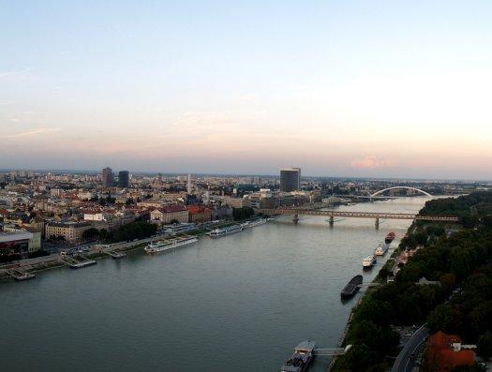
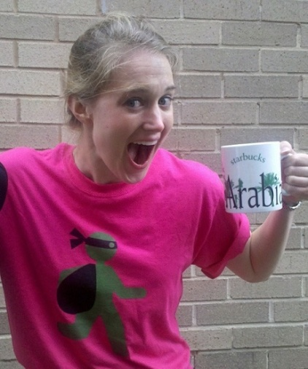
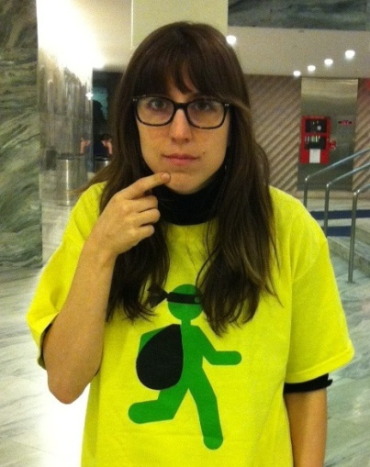

Tag Challenges
Problem (March 31, 2012): Find five suspects in Washington, D.C., New York, London, Stockholm, and Bratislava.
Winner from UCSD CrowdScanner: located 3 of the 5 suspects.
Winning strategy: same as MIT. Also, recruiters of the first 2,000 get $1.
Washington DC
New York City
Bratislava

Slide 14
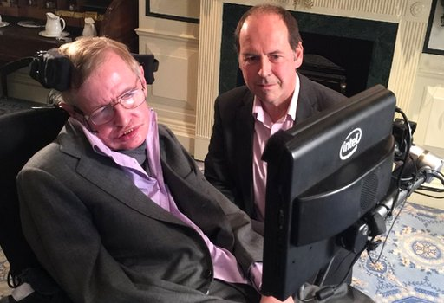



AI Could End Human Race (Stephen Hawking)
Stephen Hawking
"Humans, who are limited by slow biological evolution, couldn't compete, and would be superseded.“
Recent movies
Her (2014) & Ex-Machina (2015)

Slide 15
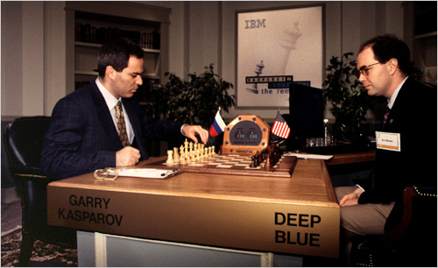
Smarter Than You Think
1997 (Chess)
Kasparov vs. Deep Blue
1998
Kasparov vs. Topalov: 4:0
Kasparov + machine vs.
Topalov + machine: 3:3
2005 (freestyle tournament)
Grand-master (>2,500)
Machine (Hydra)
Grand-master + machine
Amateurs (>1,500) + machine *
2016 (Go game)
AlphaGo vs. Lee Sedol: 4:1
AlphaGo vs. Jie Ke: 3:0 (May 2017)
Who is smarter
Human or computer?
AI will redefine
What it means to be human
Our Machine Masters
NY Times, Oct. 31, 2014
Notes:
Special point: how to design the rewarding scheme

Slide 16
MECHANICAL TURK
Platform
HIT
Worker

Slide 17
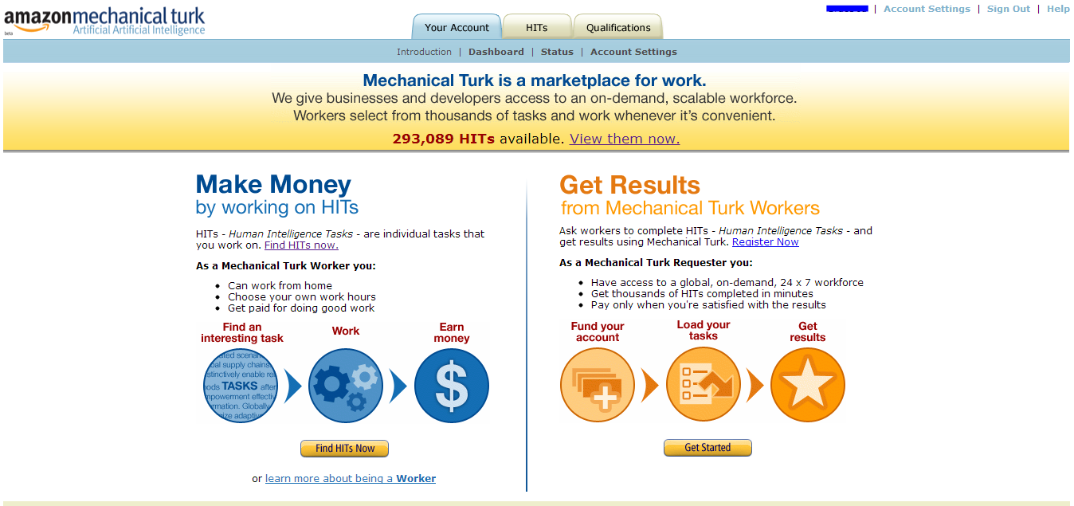
Name
As a worker, make an average of $0.05 per task
Paid directly to Amazon account
130 M tasks posted (2009-2014)
As requester, set up simple tasks for workers to complete
Quality control is possible through MTurk services
Notes:
General information about Amazon Mturk:
Cheap: $0.03 per task
Platform for requester and workers
Supporting functions for both sides: the successive rate in history; work speed; quality;

Slide 18
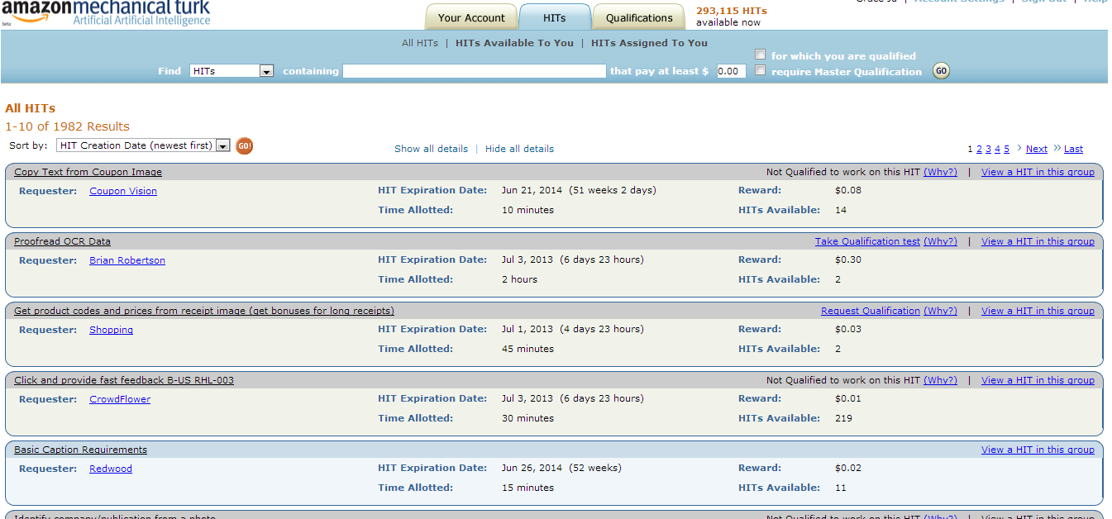
Worker: Contract for a HIT
Select a HIT
By creation date, payment amount, time allotment
Notes:
Interface for workers: pickup any work that you want to
You can see the general information about the available tasks, such as time, money, and owners

Slide 19
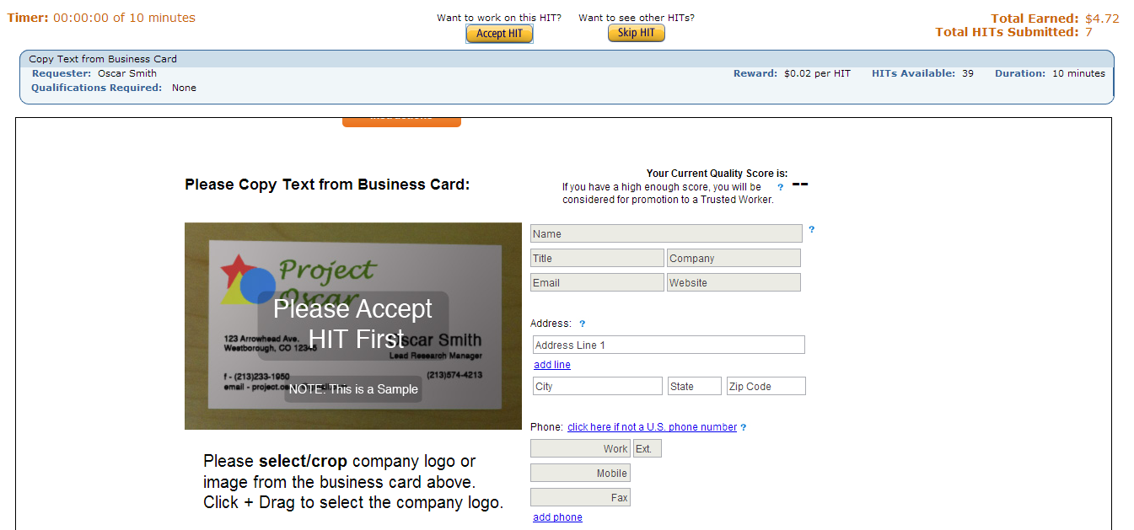
Worker: Reviewing a HIT
Review the HIT before accepting
Shown full task, allotted time (10 minutes), reward amount ($0.02)
Notes:
Worker can further check the details about the task before accepting the task

Slide 20
Types of HITs
Information Finding
Searching the web to answer a question
Interpretation and Analysis
Interpreting web content
Verification and Validation
Verifying and validating certain information
Content Creation
Generating new content
Content Access
Accessing web content
Surveys
Taking appropriate action based on the survey result

Slide 21
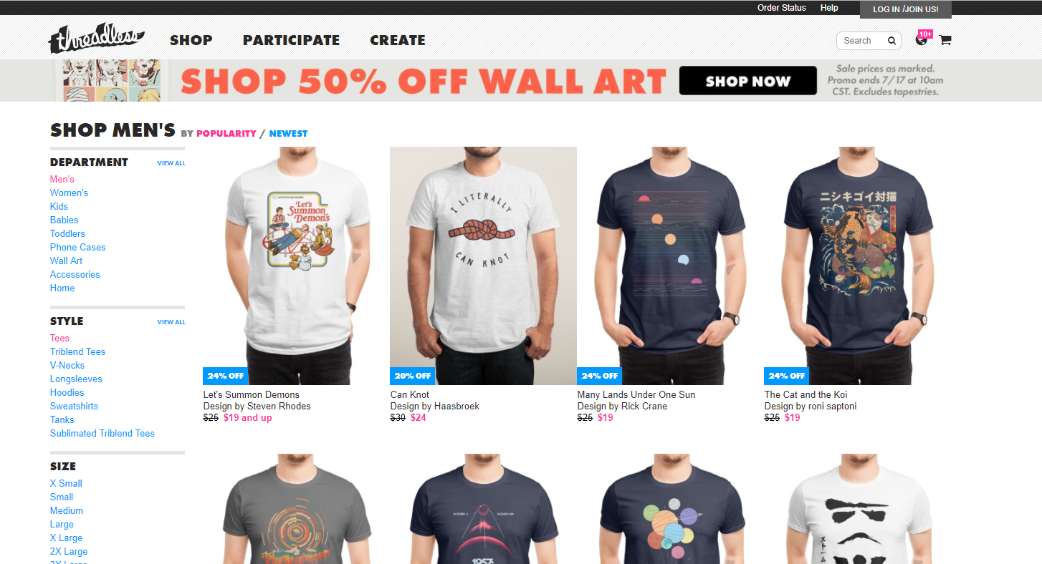
Threadless

Slide 22
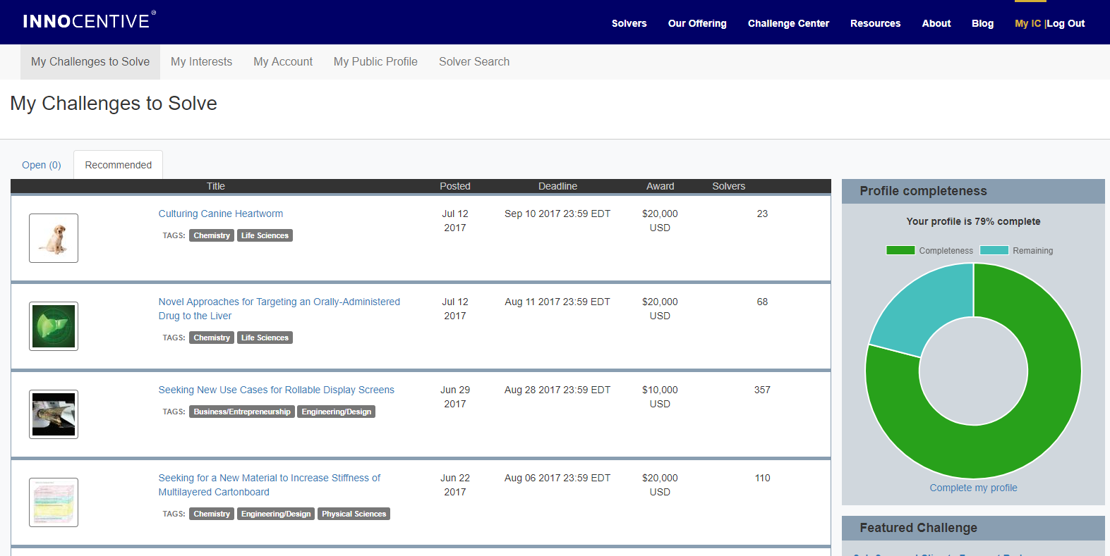
InnoCentive

Slide 23
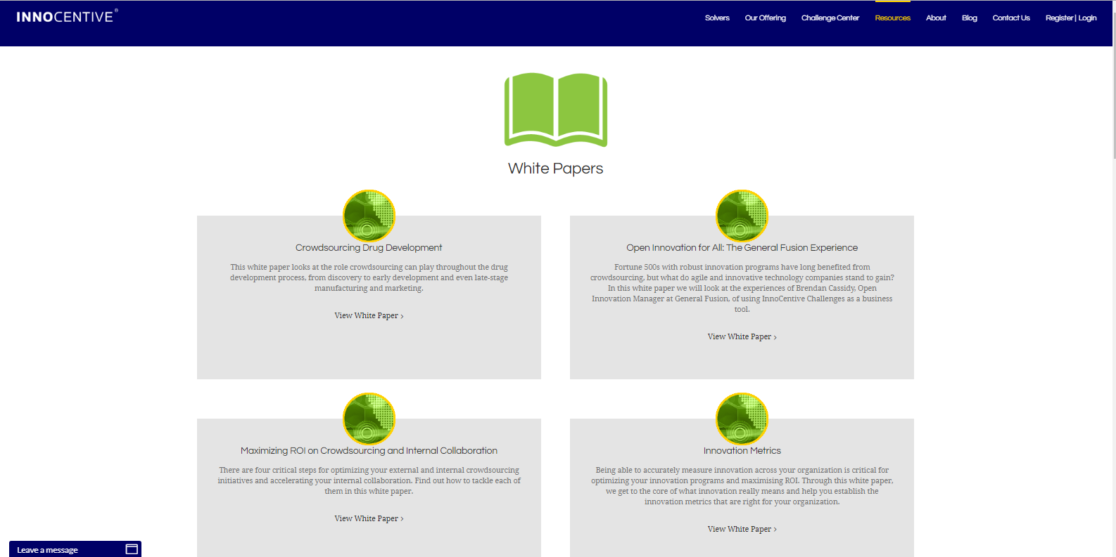
InnoCentive

Slide 24
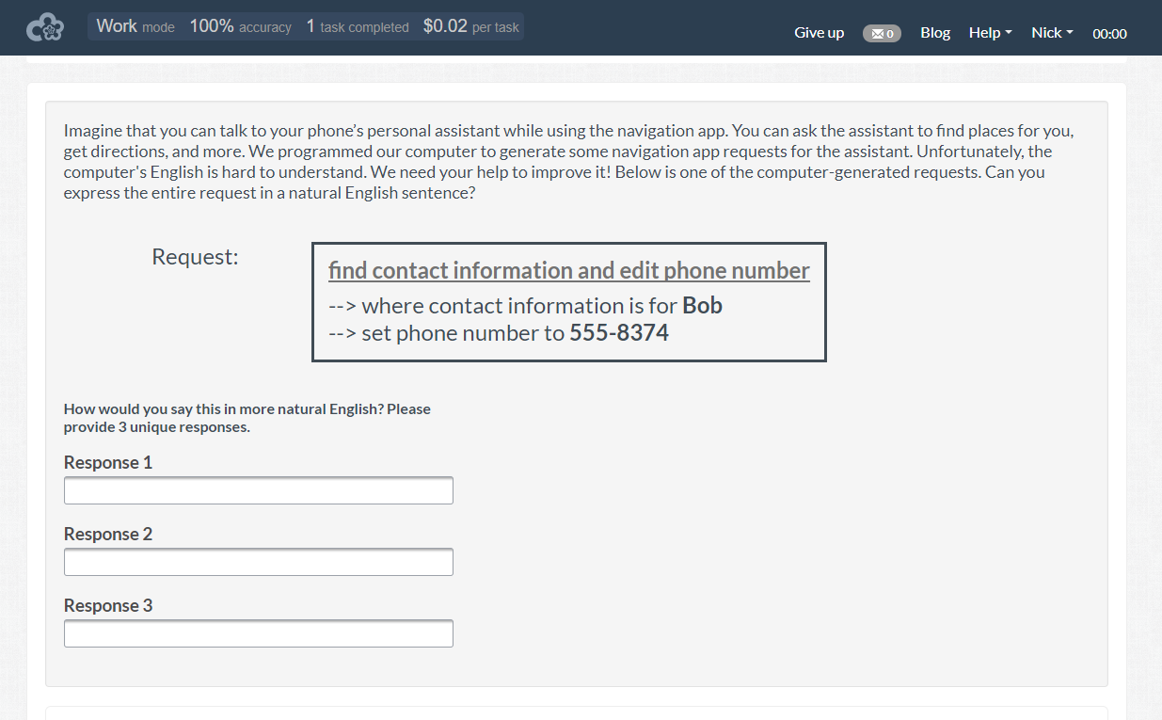
Crowdflower

Slide 25
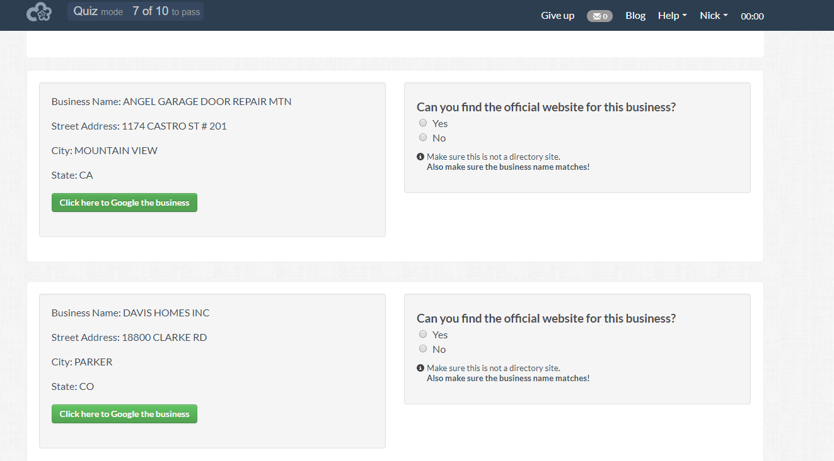
Crowdflower

Slide 26

iStock Photo

Slide 27
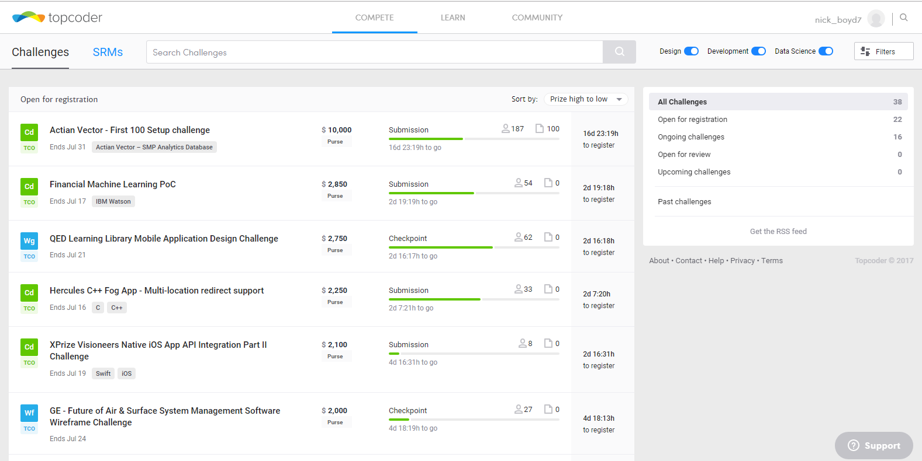
TopCoder

Slide 28
Major Types of Crowdsourcing
Virtual labor markets (VLM) – Platforms where users can complete work for monetary compensation (e.g., Amazon’s Mturk)
Tournament Crowdsourcing (TC) – Also known as ideas competitions, where only the best solution is compensated (e.g., Crowdflower and TopCoder)
Open collaboration (OC) - Typically do not offer monetary compensation, people are often prompted through social media with the opportunity to help out; like an open call to anyone (e.g., Wikipedia)

Slide 29
APPS: Image Processing
Galaxy Zoo
Fine-grained Recognition

Slide 30
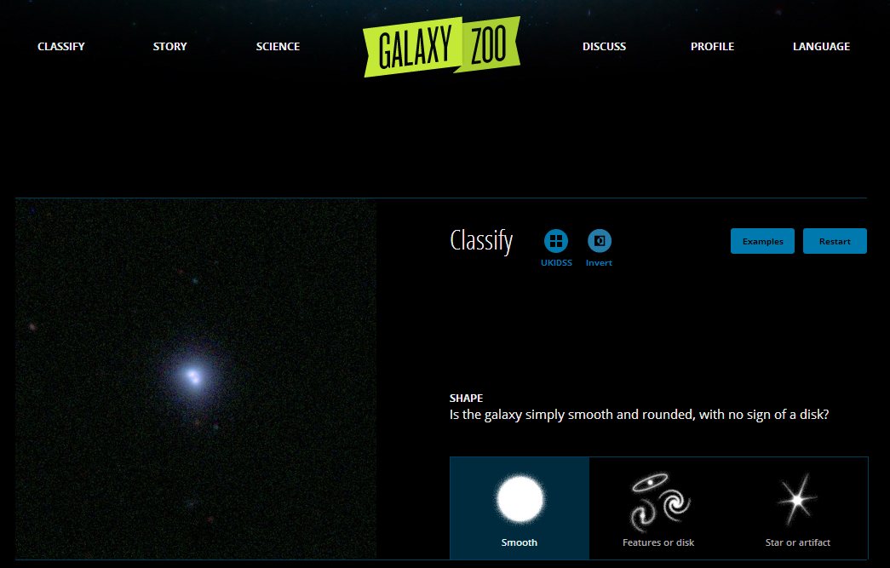
GalaxyZoo: Zooniverse
Notes:
Satellite images of galaxies, with labeling instructions.
Given a galaxy image (left), choose a label from right side
There are 3 types:
Smooth
Features or disks
Star or artifact

Slide 31
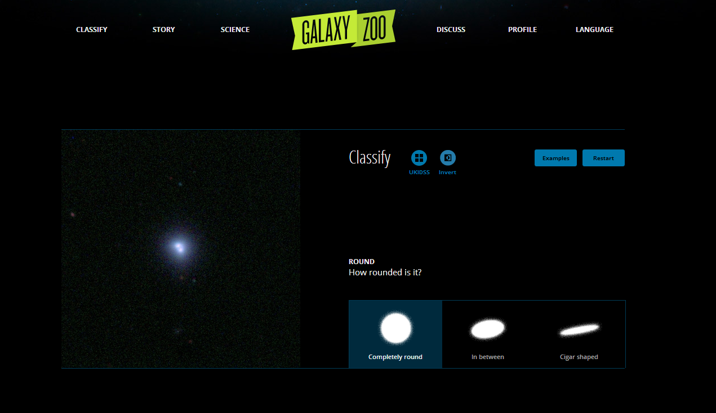
GalaxyZoo: Zooniverse
Notes:
Satellite images of galaxies, with labeling instructions.
Given a galaxy image (left), choose a label from right side
There are 3 types:
Smooth
Features or disks
Star or artifact

Slide 32
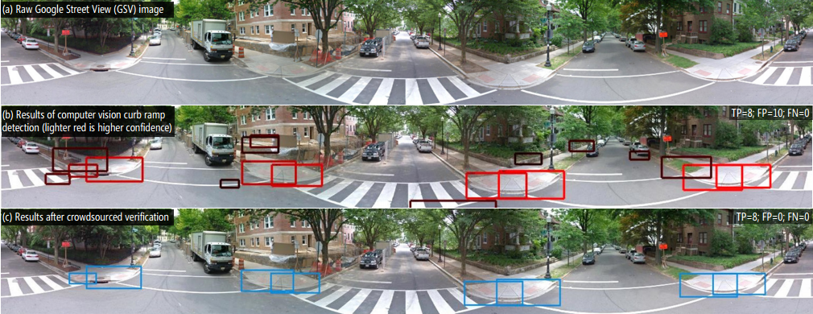
Fine-Grained Recognition: Tohme
K. Hara et al, “Tohme: Detecting Curb Ramps in Google Street View Using Crowdsourcing, Computer Vision, and Machine Learning,” UIST 2014
Notes:
Label image for training research dataset

Slide 33
APPS: Commonsense Knowledge
GWAP.com
reCAPTCHA
Crowdvoting (Crowdfunding and Crowdsearching)

Slide 34
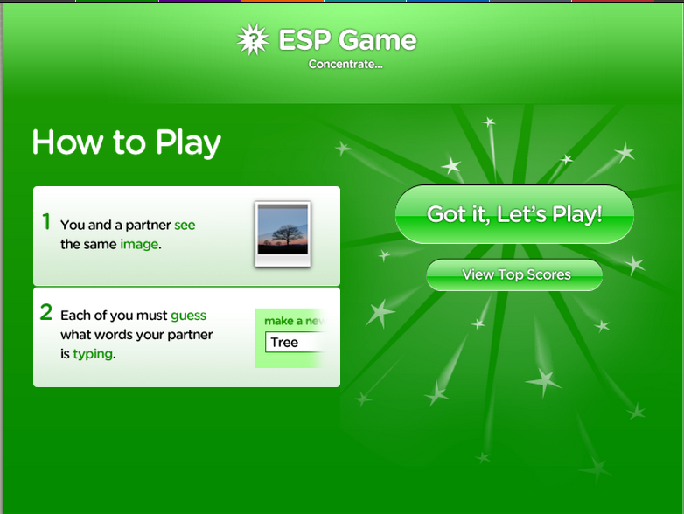
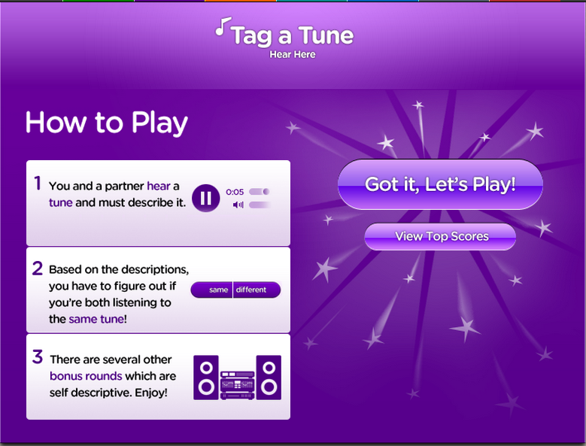
GWAP.com: CMU
ESP Game
Tag a Tune
Labeling images
Labeling tunes
Notes:
Simple labeling games
Left: label pic
Right: label music

Slide 35
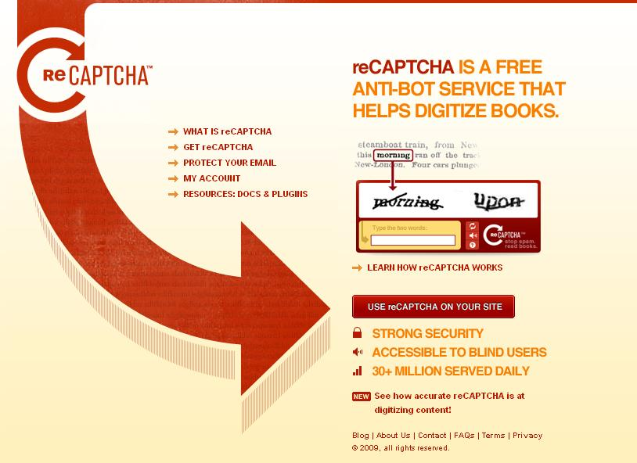
reCAPTCHA: CMU
Notes:
One word is correct; one word is wrong. http://www.google.com/recaptcha/learnmore
Scan old newspaper into image, then transcribe into electronic records
USENIX: CAPTCHA attack to break security through crowdsourcing

Slide 36
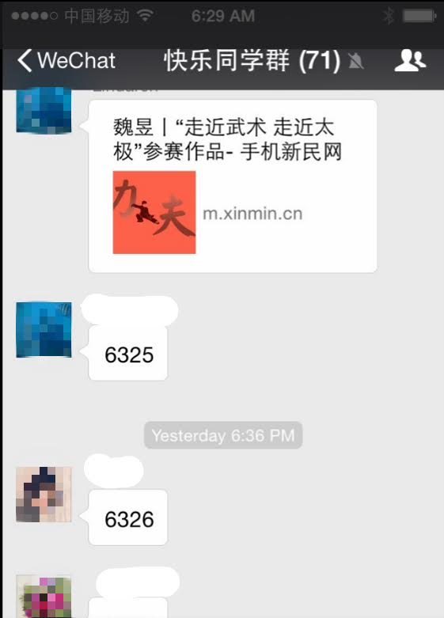
Crowdvoting in Social Networks
Online voting
Example
WeChat group
Social recognition as
incentive
Others
Crowdfunding
Crowdsearching

Slide 37
APPS: Large Projects
Software Engineering
Online feedback
Waze
Crowdsensing (Smart city)

Slide 38
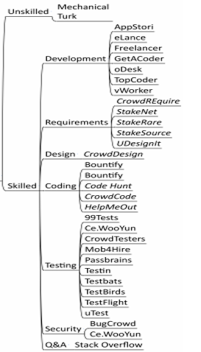
Software Engineering
Issues/concerns
Planning, scheduling, coordination, motivation, intellectual property
Some solutions
Mturk and TopCoder use monetary rewards
Ke Mao et al., “A survey of the use of of crowdsourcing in software engineering,” Journal of Systems and Software, 2017

Slide 39
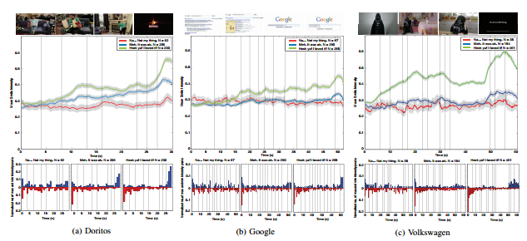
Online Feedback
Crowdsourcing facial responses to online videos
D. McDuff et al., "Crowdsourcing facial responses to online videos.“ Proc. of Int’l Conf. on Affective Computing and Intelligent Interaction (ACII), 2015.

Slide 40
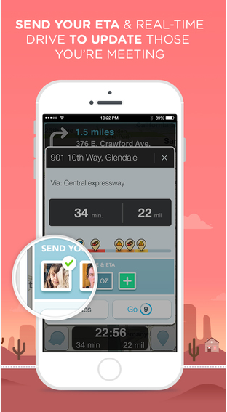
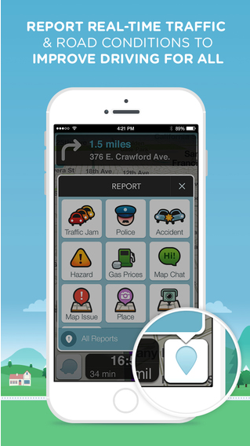
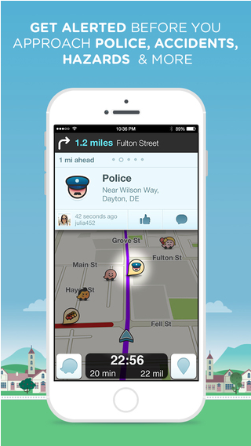
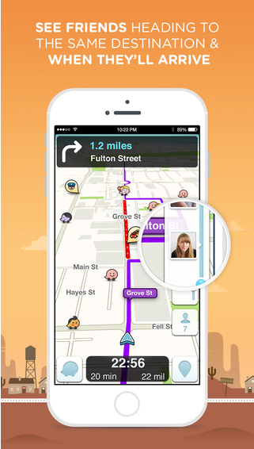
Waze as Mobile Crowdsourcing
Waze is the world's largest community-based traffic and navigation app.

Slide 41
Smartphone-based Crowdsensing
Smart city
Public information reposting
B. Guo et al, “FlierMeet: A Mobile Crowdsensing System for Corss-Space Public Info. Reposting, Tagging, and Sharing,” IEEE TMC, Oct. 2015
Public transportation
Z. He et al, “High Quality Participant Recruitment in Vehicle-based Crowdsourcing using Predicatable Mobility,” INFOCOM 2015
Indoor map construction
R. Gao et al, “Multi-story Indoor Floor Plan Reconstruction via Mobile Crowdsensing,” IEEE TMC April 2016
Street view service
Y. Wu et al, “Photo Crowdsourcing for Area Coverage in Resource Constrained Environments, ” INFOCOM 2017
Some challenges
Data redundancy
C. Meng et al, “Tackling the Redundancy and Sparsity in Crowd Sensing Applications,” SenSys 2016
Trustfulness & Game
G. Wang et al, “Defending Against Sybil Devices in Crowdsourced Mapping Services,” MobiSys 2016
T. Luo et al, “Crowdsourcing with Tullock Contests: a New Perspective,” INFOCOM 2015
Online assignment
Y. Tong et al, “Online Mobile Micro-Task Allocation in Spatial Crowdsourcing,” ICDE 2016
Incentive
H. Jin et al, “CENTURION: Incentivizing Multi-Requester Mobile Crowd Sensing,” INFOCOM 2017
Notes:
4W1H: what/when/where/who/how

Slide 42
Paradigms
Sequential
Iterative and Parallel
Divide-and-Conquer and Aggregate

Slide 43
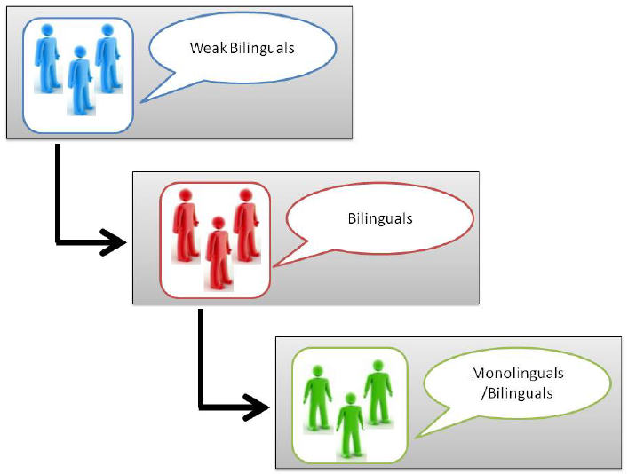
Sequential: Collaborative Workflow
Lexical translation
(weak bilinguals or machine)
Assistive translation
(strong bilinguals)
Refine sentence (monolinguals)
V. Ambati et al, “Collaborative Workflow for Crowdsourcing Translation,” CSCW 2012
Notes:
There are 3 phases for collaboratively translating:
Lexical translation (weak bilinguals or machine)
Assistive translation (strong bilinguals)
Refine sentence (monolinguals)

Slide 44
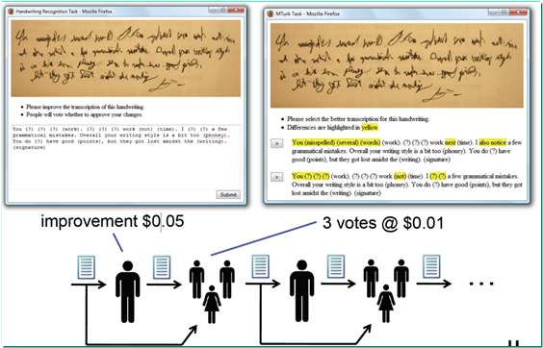
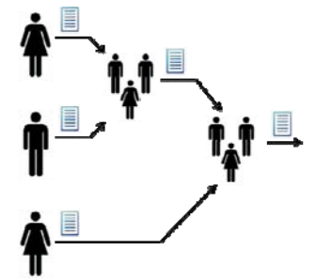
Iterative and Parallel
Iterative improve and vote
Greg Little et al. “Exploring iterative and parallel human computation
processes.” HCOMP 2010.
G. Little et al, “Exploring Iterative and Parallel Human Computation Processes,” HCOMP 2010
Notes:
Left: iterative improve: use previous worker’s results as the inputs of the next work
Right: multiple workers work on their own. Select the best one from them.
The iterative scheme takes more time but has more accuracy.

Slide 45
Divide-and-Conquer and Aggregate
Divide-and-Conquer and Aggregate
Decompose a problem statement and aggregate the results
Two special aggregates
Merge
Reduce
P. Minder et al, “Crowdlang - First Steps Towards Programmable
Human Computers for General Computation,” AAAI 2011.
Notes:
By using the concept of Map-reduce, a complex work can be done via the combinations of three operations: partition(design sub-problems) , map (collecting information), and reduce (summary information and write a related article).
Example: writing a tourist book
Two types of aggregation:
1.merge:
2.reduce: have certain reduce rules

Slide 46
Challenges and Opportunities
Challenges
Opportunities

Slide 47
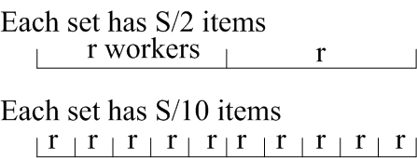
Challenges
Trade-offs: time, cost, and quality
Max algorithm with human error (with a probability)
Maximize quality (via redundancy) subject to cost and time
P. Venetis et al, “Max Algorithms in Crowdsourcing Environments,” WWW 2012
R. Kawajiri et al. “Steered Crowdsensing: Incentive Design Towards Quality-oriented Place-centric Crowdsensing”, UBICOMP 2014
Incentive: money, social recognition, and self esteem
Platform-centric: a Stackelberg game
User-centric: auction-based incentive mechanism
D. Yang et al, “Crowdsourcing to Smartphones: Incentive Mechanism Design for Mobile Phone Sensing,” MobiCom 2012.
Notes:
Trade-off:
Max algorithm: for instance, select the best Facebook profile that matches a given person or the best photo that describes a given restaurant.
r: the number of workers for each work set
S: the number of items in each work set
More worker, smaller size of work size ➔ high quality but high cost
Larger work set, less worker ➔ low quality and low cost
Cite 2: for game theory in Crowdsourcing, the incentive should not be simply increasing the number of workers; it should be increase the quality of the results.
L. Thanh et al, “BudgetFix: Budget Limited Crowdsourcing for Interdependent Task Allocation with Quality Guarantees,” AAMAS 2014
Above Cite: a job is consist of several phases. Fixed budget, selecting which workers (quality vs cost) at which phase?
Incentive: two types of games
1: the owner give a total reward R onto platform, multiple workers divide the rewords. The owner acts as a leader in the Stackelberg game since the owner proposed the reward first;
2. Bid game: workers provide a bid and the amount of work that they can provide. There is no upper bound on the total rewards.

Slide 48
Challenges: HPU + CPU
CrowdDB:
M. Franklin et al, “CrowdDB: Answering Queries with Crowdsourcing,” SIGMOD 2011
Notes:
A crowd of your own:
Two techniques to predict ratings of a requester.
In taste-matching, workers rate according to their own preferences; Worker I is most similar to the requestor and thus influences the prediction.
In taste-grokking, workers see the requester’s prior ratings and make predictions.
CrowdDB:
Divide Database into two parts:
CPU solves traditional problem
Human intelligence solves the problems that a computer cannot.

Slide 49
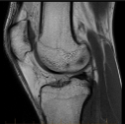
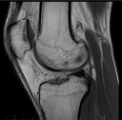
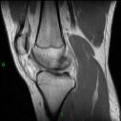
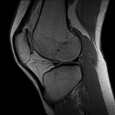
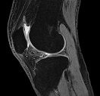
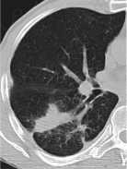
CPU-assisted HPU
Entity Matching
e.g. JHU matches John Hopkins Univ.
Radiology
Filter
Diagnose
HPU:
CPU:
tuberculosis
CPU
HPU
tuberculosis
C. Gokhale etal, “Corleone: Hands-off Crowdsourcing for Entity Matching,” SIGMOD 2014
Notes:
Entity matching:
Traditional approach: expert generate matching rule→ matching results → crowd verification
HPC assisted: CPU use random forest to generate plenty of rules →apply rule and get result → crowd verify results matching or not → pruning the rule

Slide 50
Opportunities
Beyond simple workflows
Graph search
Graph match
Beyond simple worker selection
Dynamic procurement
Beyond independent workers
Social networks

Slide 51
Beyond Simple Workflows
Blend of bottom-up and open process with top-down organization goals
Graph search (for macrowork)
Human-assisted graph search
Best sequence of questions with simple Y/N answers
A. Parameswaran et al, “Human-Assisted Graph Search: It’s Okay to Ask Questions,” VLDB 2010
Graph match
People graph (who knows and/or communicates with whom)
Puzzle graph (ideas are compatible and can merge)
Natural dynamic for people to merge their compatible ideas
C. Brummitt et al, “Jigsaw Percolation: What Social Networks Can Collaboratively Solve a Puzzle,” 2012
Notes:
Graph search:
Given a set of labels, such as car, nissan, audi, sentra, altima, and a set of car images, find the best label for the images. The task can be done by asking a serials of y/n questions. However, each question may related with payments to workers. The goal is to design the optimal strategy such that the total number of questions is minimum.

Slide 52
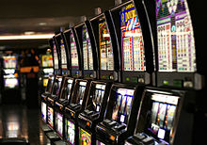
Beyond Simple Worker Selection
Dynamic Procurement
(multi-armed bandit)
A gambler facing a row of slot machines
Which one to play, how many times, and in which order
Each machine having a random reward from a fixed distribution
Objective: maximizing the sum of rewards earned through a sequence of lever pulls
A. Badanidiyuru et al, “Bandits with Knapsacks: Dynamic Procurement for Crowdsourcing,” 2013
Beyond independent workers
Notes:
Model the crowdsourcing problem by multi-armed bandit problem with budget constraint.
A serials of workers u1, u2, …, uk, …., each one associated with a payment p1, p2, …, pk, … and the contributes that the user can give r1, r2,…, rk, … The features follow a certain hidden distribution, which is unknown.
Given total budget B, how to hire the workers such that the total contributions is maximized.

Slide 53
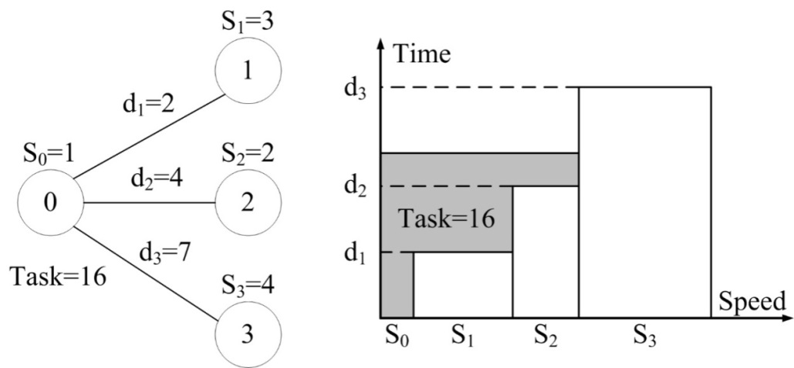
Beyond Independent Workers Social network of workers Recruitment of workers through social ties
Friends help friends
Response delay
Computation (by a friend)
Reply delay
Water-filling
d_{i}: response + reply
M. Xiao, J. Wu, L. Huang, Y. Wang, and C. Liu, “Multi-task Assignment for Crowdsensing in Mobile Social Networks,” INFOCOM 2015

Slide 54
Survey: recursive (gather through reduce)
Initial label is L = "2" (subtract L by 1 when forwarding this request to QQ friends)
When L = 0, return the total number of QQ friends
When L > 0, do the following:
Forward this request to all QQ friends
After receiving the first 10 replies, compute the average number of friends, and send them back to me
QQ: 200 million simultaneous online users

Slide 55
Survey: recursive (gather through merge)
Initial label is L = "2" (subtract L by 1 when forwarding this request to QQ friends)
When L = 0, return the following:
Basic information (B)
Number of friends (N)
Timestamps (T)
When L > 0, do the following:
Forward this request to all QQ friends
Pack the first 10 replies, together with your own information (B, N, T), and send them back to me

Slide 56
Conclusion
Summary
Acknowledgements

Slide 57
Summary
HPU as a new paradigm to compliment the traditional CPU-based computing for big data
Many un(der)explored algorithmic problems
Social connections and proper training of workers
Workflow design
Cost-time-quality-uncertainty trade-offs
Incentive, gamification, and satisfaction mechanisms
Mobile crowdsourcing: energy consumption, communication cost, truthfulness, and privacy

Slide 58
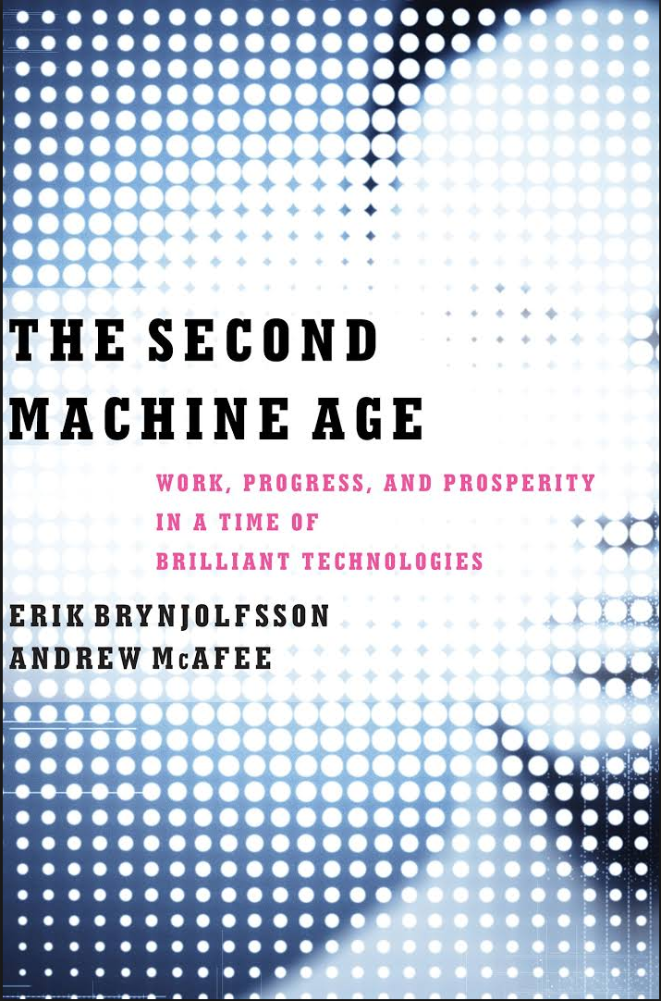
Summary
Collective intelligence = networked brain +
massively connected & intelligent machine
Finding ways to race with the machine rather than racing against it
MTurk as “artificial artificial intelligence” as a way for people to race with machine

Slide 59

Acknowledgements
Wei Chang
Saint Joseph’s University
Grace Ju
Carnegie Mellon University
Wenjun Jiang
Hunan University
Ying Dai
Google

