Slide 1

MACRO: Incentivizing Multi-leader Game-based Pareto-efficiency Crowdsourcing for Video Analytics
Yu Chen, Sheng Zhang, Ziying Zhou, Xiaokun Wang, Yu Liang, Ning Chen, Yuting Yan, Mingjun Xiao, Jie Wu, Zhuzhong Qian and Harry Xu
Nanjing University
Notes:
Hello, everyone!
My Name is XXX from Nanjing University, China.
Today I am talking our work, MACRO: Incentivizing Multi-leader Game-based Pareto-efficiency Crowdsourcing for Video Analytics.

Slide 2

Crowdsourcing
Crowdsourcing: Crowd + Outsourcing
Turning to a Crowd of People to Obtain the Needed Data or Data Analysis Services
E.g., Survey, Idea Competition, Wikipedia
Basic Components: Task Requestor, Platform, Worker
Requestors
Platforms
Worker Pool
Notes:
As we know, mobile crowdsourcing has emerged as a prominent paradigm, resulting in the proliferation of various platforms (e.g., CrowdFlower, AMT), which publish diverse tasks and employ workers with mobile devices to complete them.

Slide 3



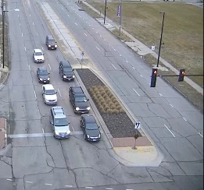
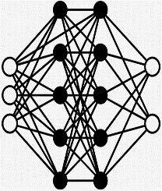
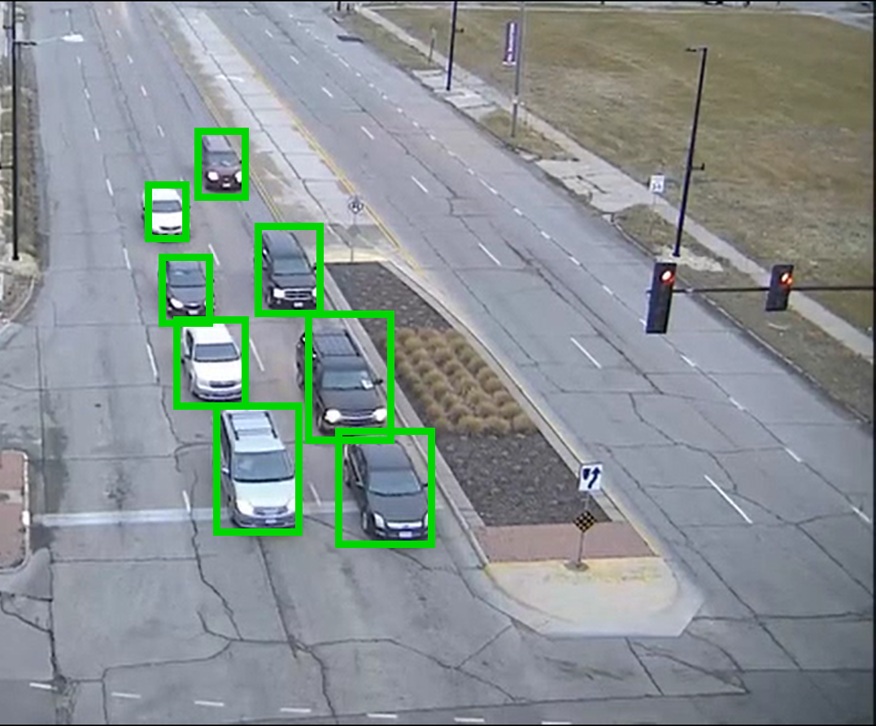
Video Analytics
Workers Equipped with Mobile Devices for Video Analytics
Mobile Devices: Mobile Phone, Tablets, Intelligent Vehicle
Video Analytics: Computer Vision Methods (e.g., Object Detection, Identification and Tracking) based on DNN Models (e.g., YOLO)
Typical Applications: Image Labelling, Mobile Sensing and Traffic Prediction
Notes:
Meanwhile, the performance of workers’ mobile devices (e.g., smartphones, tablets, and laptops) is continuously improving, and computer vision technologies are evolving steadily.
Benefiting from the above, among various crowdsourcing tasks, video analytics has garnered much attention due to its practical implications.

Slide 4
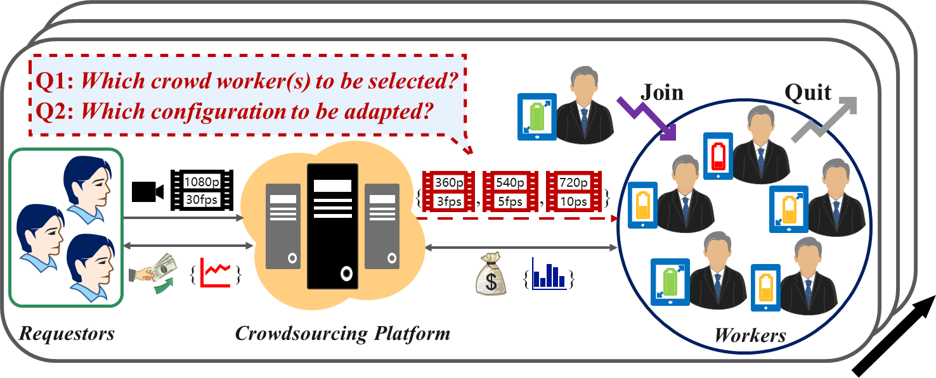
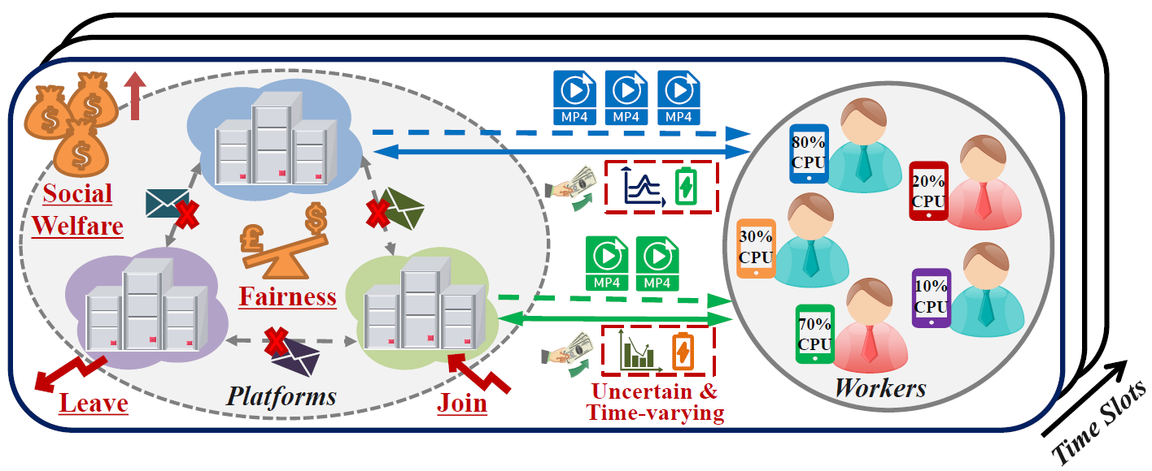
Crowdsourcing for Video Analytics
Crowdsourcing for Video Analytics
Platforms hire proper workers, send video data to them, and select the configurations (frame rates, resolutions and models) to maximize their profits
Existing Related Works:
Type 1: Address Conflicts among Workers
E.g., LOL [Infocom’22], LOL-C [TMC’24]
Type 2: Address Conflicts among Platforms
E.g., Crowd2 [Infocom’23]
Research Gap:
Conflicts between platforms and workers can arise
Conflicts among workers where some workers may not be selected by platform
Conflicts among platforms where multiple platforms may select the same workers
Notes:
Specifically, for video analytics tasks, platforms hire workers, send video data to them, and strategically select the configurations (i.e., frame rates, resolutions and models) to maximize their profits.
Existing research on crowdsourcing for video analytics has considered two different conflicts.
(1) Conflicts among workers (e.g., LOL [Infocom’22], LOL-C [TMC’24]) are the competitions among workers when platforms recruit them for task completion, and some workers may not be selected.
(2) Conflicts among platforms (e.g., Crowd2 [Infocom’23]) occur when multiple platforms face the challenge of simultaneously selecting the same workers for the limited computational resources.
However, we notice that for video analytics crowdsourcing, a research gap exists in conflicts between platforms and workers, which can also arise.

Slide 5
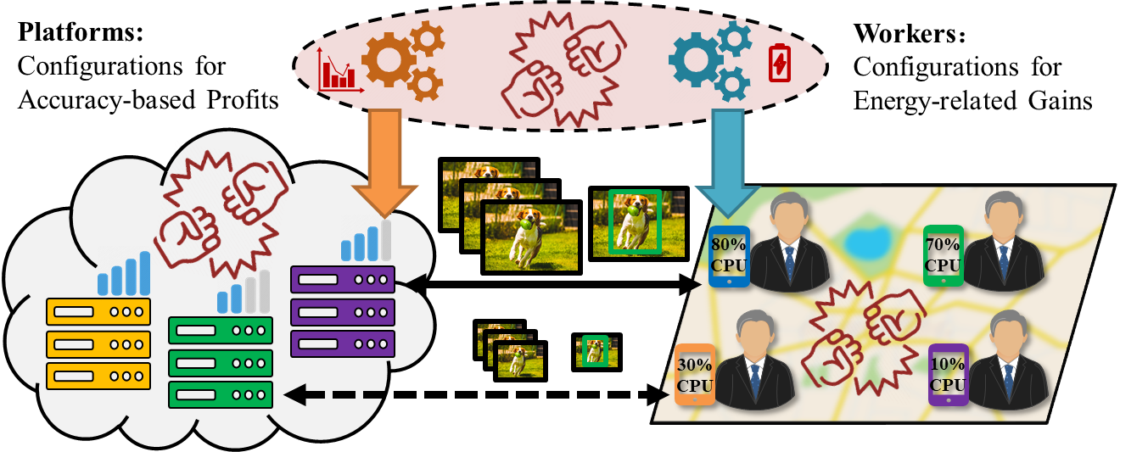
Conflicts between Platforms and Workers
Different Optimization Goals when Determining Video Analytics Configurations
Platforms recruit workers and strategically select the configurations to maximize their accuracy-based profits
Workers can flexibly accept the task or not, and tailor the configurations for their energy consumption-related individual gains
Notes:
Platforms and workers have different optimization goals when determining video analytics configurations.
For platforms, they recruit workers and strategically select the configurations to maximize their accuracy-based profits.
For workers, they possess the flexibility to accept the video analytics tasks or not, and tailor the configurations for their energy consumption-related individual gains (e.g., for transmission and computation).

Slide 6




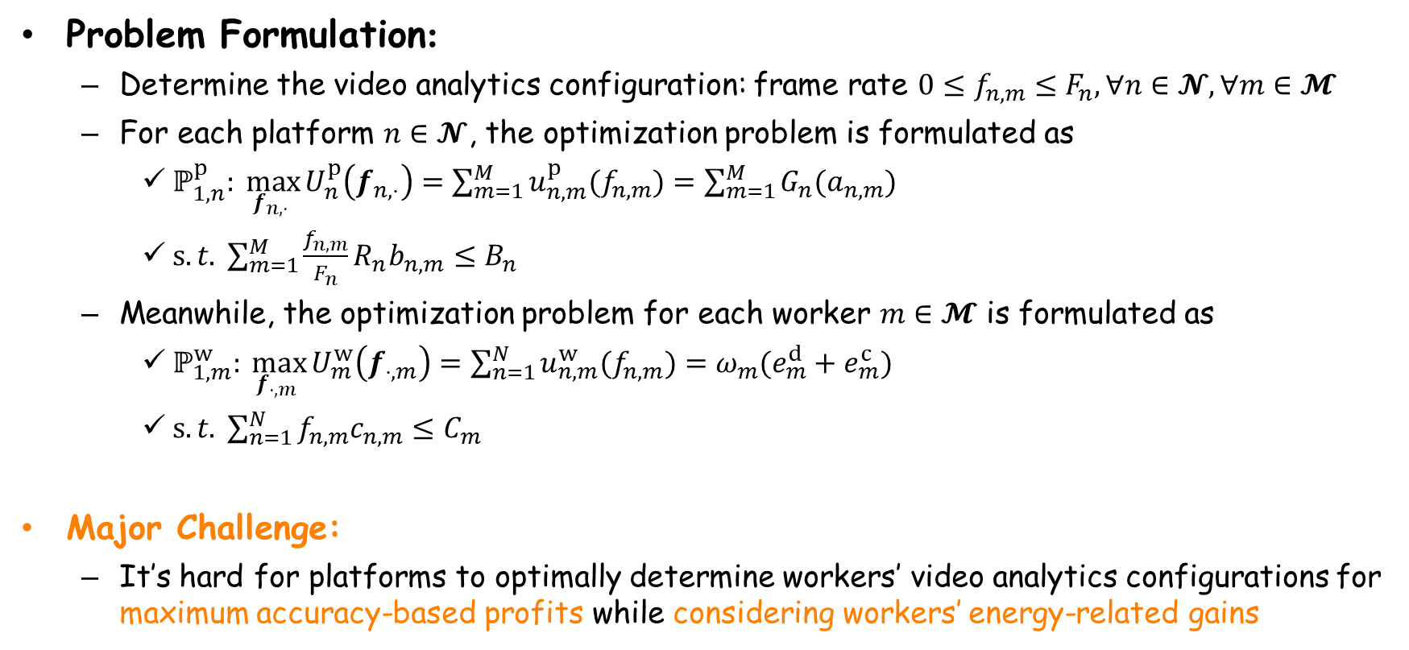
Conflicts between Platforms and Workers
Problem Formulation:
Determine the video analytics configuration: frame rate $0≤f_{n,m}≤F_{n},∀n∈𝓝,∀m∈𝓜$
For each platform $n∈𝓝$, the optimization problem is formulated as
$ℙ_{1,n}^{p}: \max_{f_{n,⋅} }{U_{n}^{p}\left(f_{n,⋅}\right)=\sum_{m=1}^{M}{u_{n,m}^{p}(f_{n,m})}=\sum_{m=1}^{M}{G_{n}(a_{n,m})}}$
$s.t. \sum_{m=1}^{M}{\frac{f_{n,m}}{F_{n}}R_{n}b_{n,m}}≤B_{n}$
Meanwhile, the optimization problem for each worker $m∈𝓜$ is formulated as
$ℙ_{1,m}^{w}: \max_{f_{⋅,m} }{U_{m}^{w}\left(f_{⋅,m}\right)=\sum_{n=1}^{N}{u_{n,m}^{w}(f_{n,m})}=ω_{m}(e_{m}^{d}+e_{m}^{c})}$
$s.t. \sum_{n=1}^{N}{f_{n,m}c_{n,m}}≤C_{m}$
Major Challenge:
It’s hard for platforms to optimally determine workers’ video analytics configurations for maximum accuracy-based profits while considering workers’ energy-related gains
Accuracy-Based Profits
Limited Bandwidth Budgets for Video Data Transmission
Gains Related to Energy Consumption of Downloads and Computations
Constrained Computing Resource for Video Analytics
Notes:
Here we present the problem formulation for the conflicts between platforms and workers.
Each platform needs to select the proper workers and determines the frame rate decision within its bandwidth budget to maximize the analytics accuracy-based revenue.
Meanwhile, each worker can also adjust its frame rate decision to maximize its energy consumption-related utility under the computing resource constraint.
Notably, it is challenging for platforms to optimally choose the recruited workers and determine the video analytics configurations for maximum accuracy-based profits while considering the workers’ energy-related gains

Slide 7
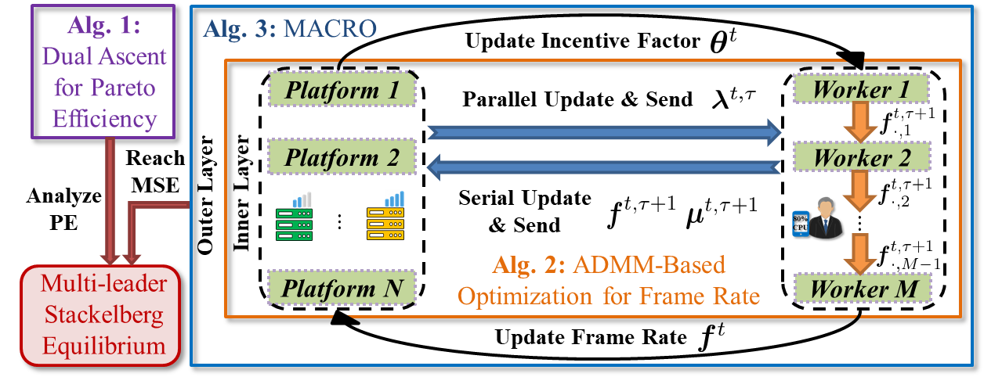
Overview of Our Work: MACRO
Multi-Platform Game for Pareto Efficiency (PE)
[Alg. 1] For multi-platform game, we achieve the Pareto efficiency for platforms via a dual ascent-based method to determine proper video analytics configurations
Incentivized Multi-Leader Game for Multi-Leader Stackelberg Equilibrium (MSE)
[Alg. 2, Alg. 3] For multi-leader game, we design the incentive function and its incentive factor updating strategy, and present an incentive maximization method, reaching MSE
Notes:
To overcome the above challenges, we propose MACRO, the first work to address the platform-worker conflicts for video analytics tasks upon crowdsourcing.
This is the overview of our work.
We first analyze the multi-platform game, and achieve the Pareto efficiency for platforms via a dual ascent-based method (presented in Alg. 1) to determine proper video analytics configurations.
After that, to encourage workers to contribute to platforms’ Pareto efficiency, we design the incentive function and its incentive factor updating strategy, and present an incentive maximization method (presented in Alg. 2 and Alg. 3), reaching the multi-leader Stackelberg equilibrium.

Slide 8
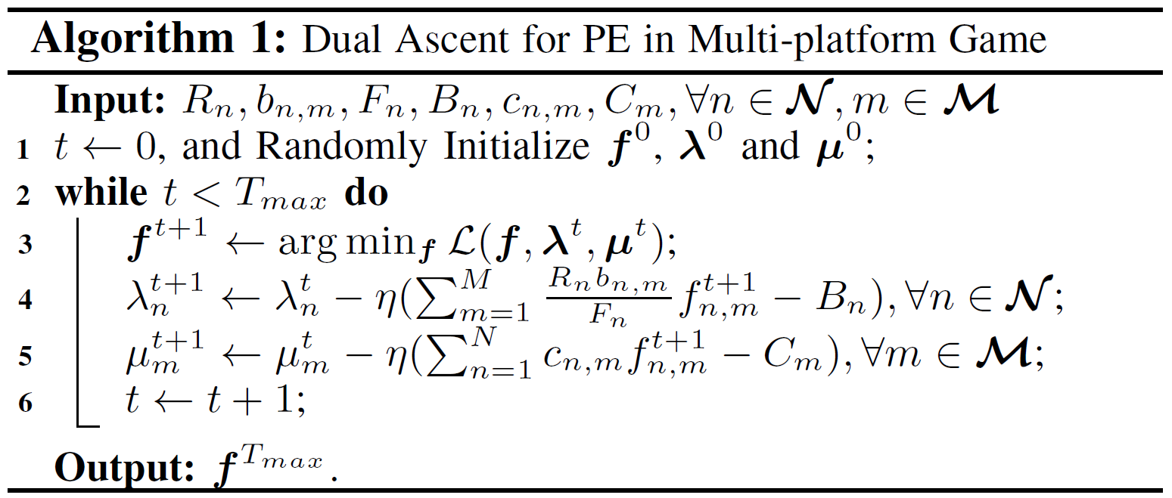

Multi-Platform Game for Pareto Efficiency
Before additionally considering workers’ individual gains, we first maximize platforms’ accuracy-based profits via a dual ascent-based approach (Alg. 1)
Main Idea: Maximize the Social Welfare of All Platforms, $\sum_{n=1}^{N}{U_{n}^{P}\left(f_{n,⋅}\right)}$
Theoretical Analysis: Pareto Efficiency can be achieved by Alg. 1, where no platform can change its strategy to increase its payoff without decreasing others’ in multi-platform game
Optimize the Social Welfare by Dual Ascent-Based Update
Notes:
Before additionally considering workers’ individual gains, we firstly analyze the multi-platform game, where platforms compete in hiring workers for video analytics due to the limited computing resource of workers.
We propose a dual ascent-based approach in Alg. 1 to maximize platforms’ accuracy-based profits.
Its main idea is to maximize the social welfare of all platforms.
As shown in line 3 in Alg. 1, we optimize the social welfare by dual ascent-based update.
Through theoretical analysis, Pareto efficiency can be achieved by Alg. 1, where no platform can change its strategy to increase its payoff without decreasing others’ in multi-platform game.

Slide 9
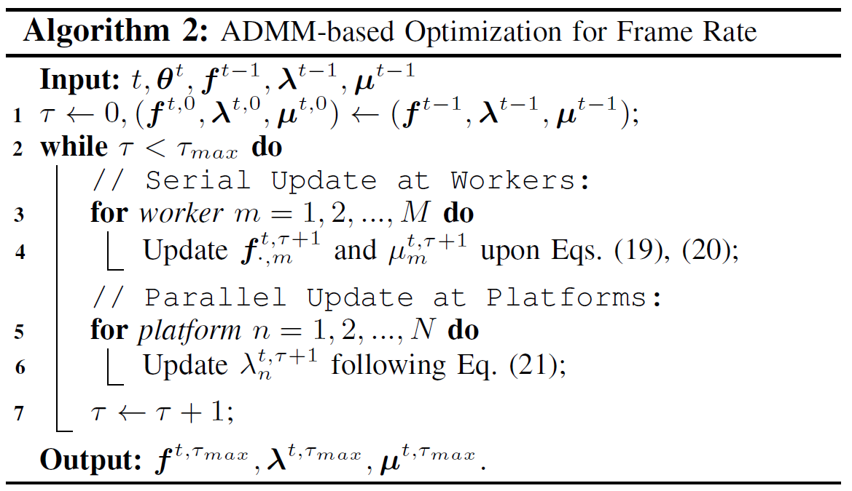
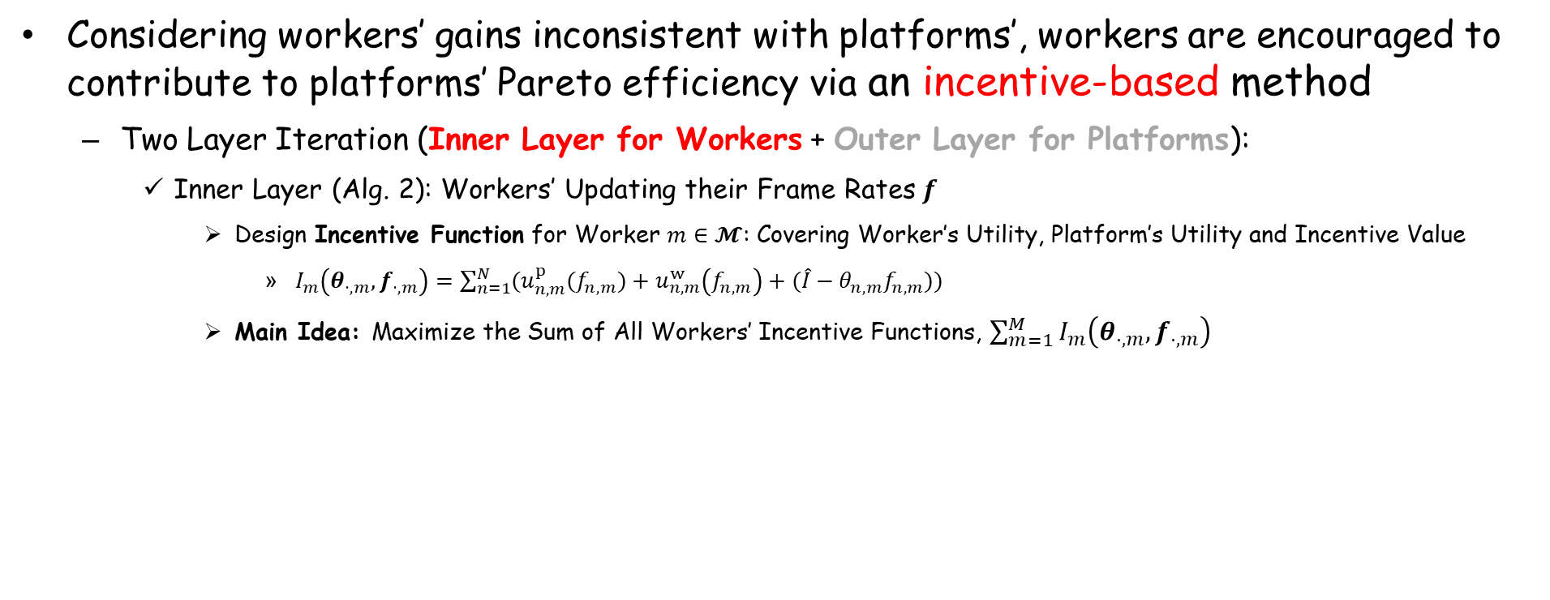
Incentivized Multi-Leader Game for MSE
Considering workers’ gains inconsistent with platforms’, workers are encouraged to contribute to platforms’ Pareto efficiency via an incentive-based method
Two Layer Iteration (Inner Layer for Workers + Outer Layer for Platforms):
Inner Layer (Alg. 2): Workers’ Updating their Frame Rates $f$
Design Incentive Function for Worker $m∈𝓜$: Covering Worker’s Utility, Platform’s Utility and Incentive Value
$I_{m}\left(θ_{⋅,m},f_{⋅,m}\right)=\sum_{n=1}^{N}{(u_{n,m}^{p}(f_{n,m})+u_{n,m}^{w}\left(f_{n,m}\right)+(\hat{I}−θ_{n,m}f_{n,m}))}$
Main Idea: Maximize the Sum of All Workers’ Incentive Functions, $\sum_{m=1}^{M}{I_{m}\left(θ_{⋅,m},f_{⋅,m}\right)}$
Optimize the Sum of All Workers’ Incentive Functions
Notes:
Furthermore, considering workers’ gains inconsistent with platforms’, an incentive-based method is desired to encourage workers to contribute to platforms’ Pareto efficiency.
Our proposed incentive-based method MACRO is composed of two-layer iterations.
The inner layer presented in Alg. 2 focuses on workers’ updating their frame rates.
We design the incentive function for each worker, which covers the worker’s utility, platform’s utility and incentive value.
The main idea of Alg. 2 is to maximize the sum of all workers’ incentive functions.
As shown in line 4 in Alg. 2, we optimize the frame rates for maximum of workers’ incentive functions.

Slide 10
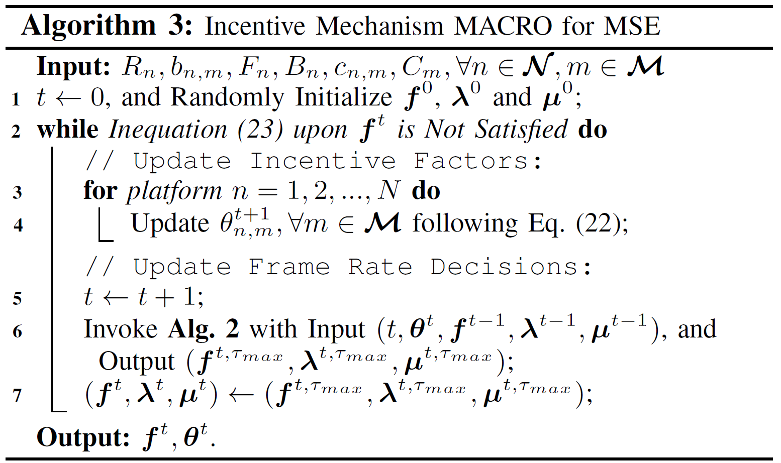
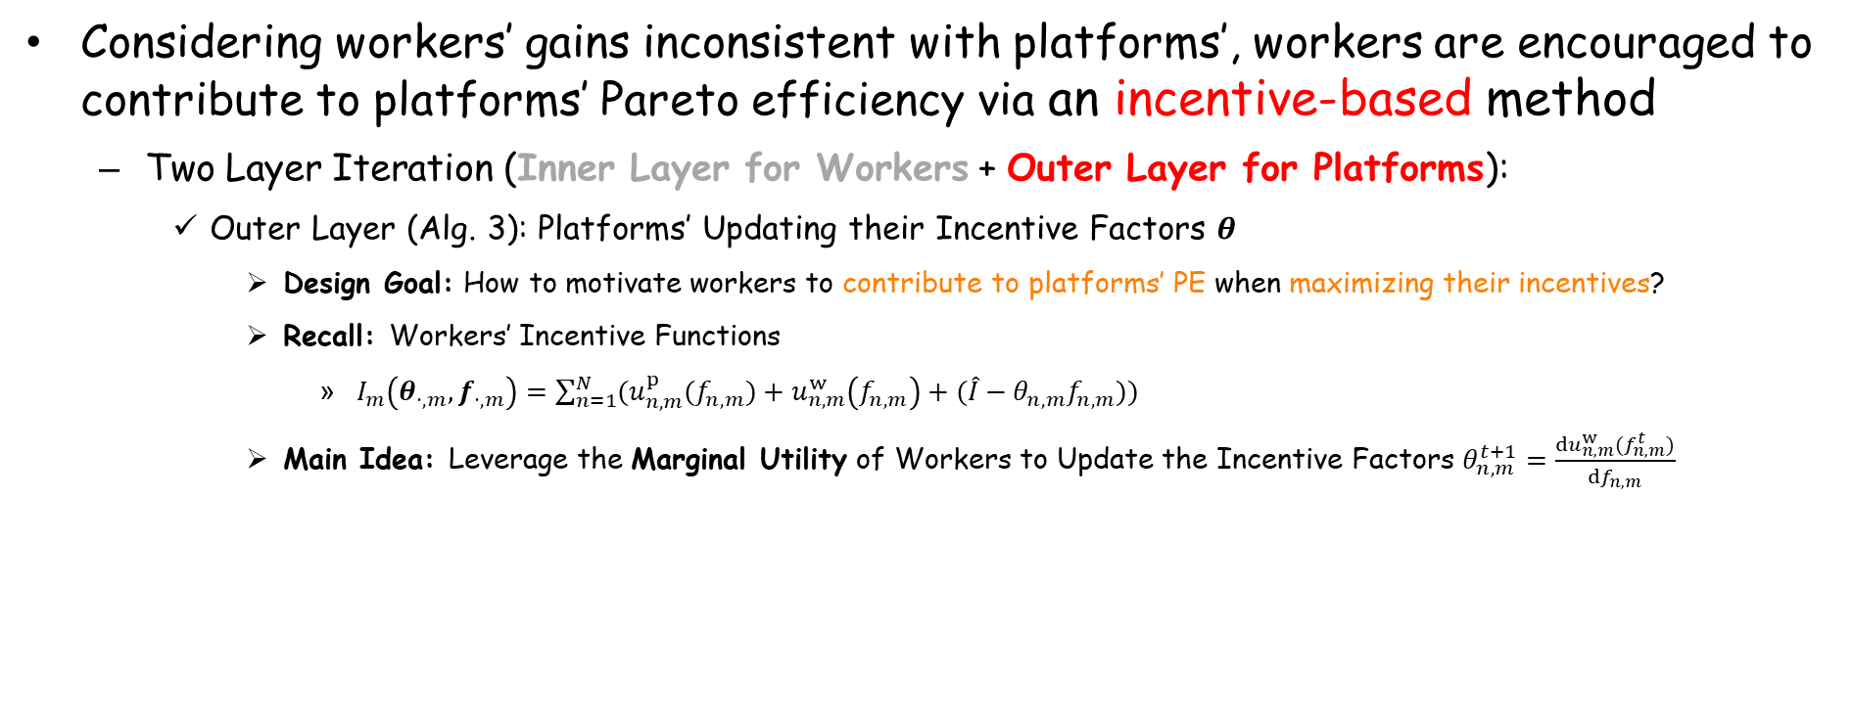
Incentivized Multi-Leader Game for MSE
Considering workers’ gains inconsistent with platforms’, workers are encouraged to contribute to platforms’ Pareto efficiency via an incentive-based method
Two Layer Iteration (Inner Layer for Workers + Outer Layer for Platforms):
Outer Layer (Alg. 3): Platforms’ Updating their Incentive Factors $θ$
Design Goal: How to motivate workers to contribute to platforms’ PE when maximizing their incentives?
Recall: Workers’ Incentive Functions
$I_{m}\left(θ_{⋅,m},f_{⋅,m}\right)=\sum_{n=1}^{N}{(u_{n,m}^{p}(f_{n,m})+u_{n,m}^{w}\left(f_{n,m}\right)+(\hat{I}−θ_{n,m}f_{n,m}))}$
Main Idea: Leverage the Marginal Utility of Workers to Update the Incentive Factors $θ_{n,m}^{t+1}=\frac{du_{n,m}^{w}(f_{n,m}^{t})}{df_{n,m}}$
How to offset each other?
Optimize the Incentive Factors
Notes:
Besides, the outer layer presented in Alg. 3 focuses on platforms’ updating their incentive factors.
Our design goal is to motivate workers to contribute to platforms’ Pareto efficiency when maximizing their incentives.
We recall workers’ incentive functions, where we need to offset the platform’s utility and incentive value.
Our main idea is to leverage the marginal utility of workers to update the incentive factors to achieve the above goal.
As shown in line 4 in Alg. 3, we optimize the incentive factors.

Slide 11
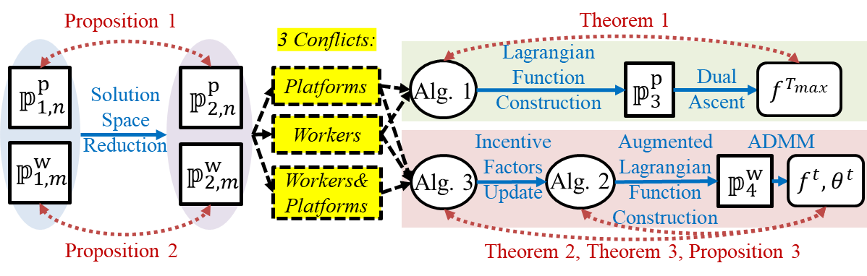
Incentivized Multi-Leader Game for MSE
Considering workers’ gains inconsistent with platforms’, workers are encouraged to contribute to platforms’ Pareto efficiency via an incentive-based method
Two Layer Iteration (Inner Layer for Workers + Outer Layer for Platforms)
Theoretical Analysis:
Multi-leader Stackelberg equilibrium can be achieved
Specifically, platforms’ Pareto efficiency is guaranteed, and none of the platforms and workers have incentives to alter their strategies for higher payoff when others’ keep unchanged
Notes:
Additionally, through theoretical analysis, multi-leader Stackelberg equilibrium can be achieved.
Specifically, when multi-leader Stackelberg equilibrium is achieved, platforms’ Pareto efficiency is guaranteed, and none of the platforms and workers have incentives to alter their strategies for higher payoff when others’ keep unchanged.

Slide 12
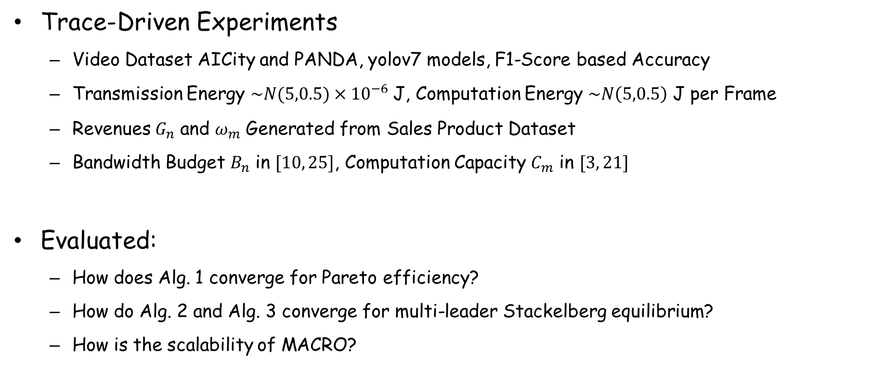
Evaluation
Trace-Driven Experiments
Video Dataset AICity and PANDA, yolov7 models, F1-Score based Accuracy
Transmission Energy $\sim N(5,0.5)×{10}^{−6}$ J, Computation Energy $\sim N\left(5,0.5\right)$ J per Frame
Revenues $G_{n}$ and $ω_{m}$ Generated from Sales Product Dataset
Bandwidth Budget $B_{n}$ in $[10, 25]$, Computation Capacity $C_{m}$ in $[3, 21]$
Evaluated:
How does Alg. 1 converge for Pareto efficiency?
How do Alg. 2 and Alg. 3 converge for multi-leader Stackelberg equilibrium?
How is the scalability of MACRO?
Notes:
We evaluate our proposed algorithms with trace-driven experiments based on video data AICity and PANDA, and yolov7 models.
Video analytics accuracy is computed according to F1-score.
Some other experiment parameters are also listed as follows.
Through evaluation, we mainly answer the following three questions.

Slide 13
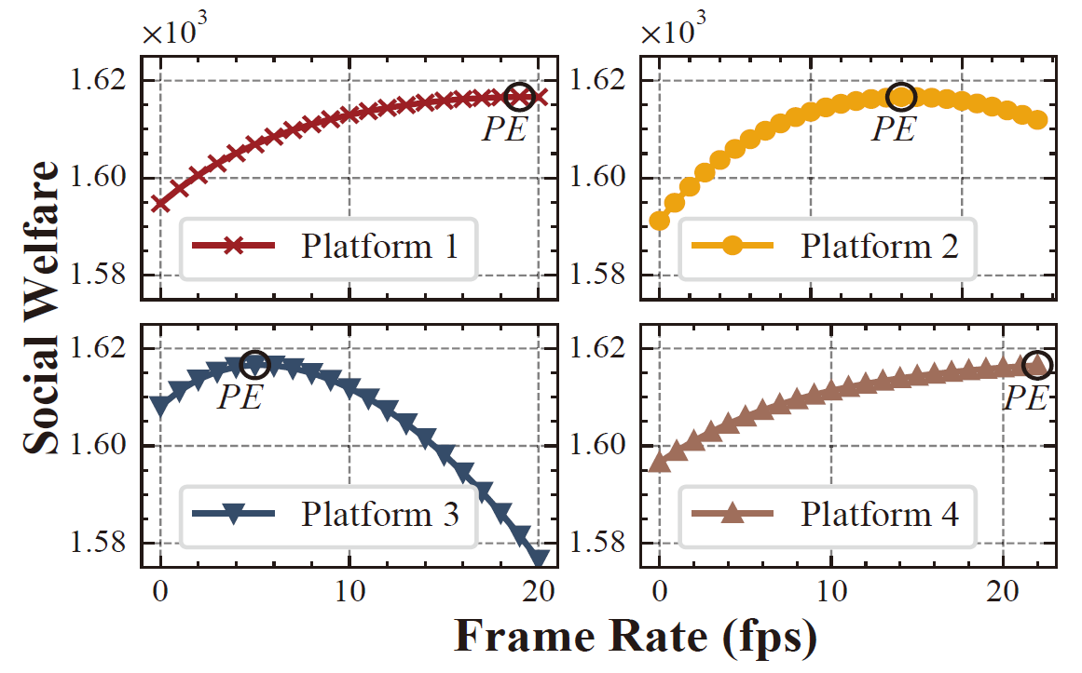
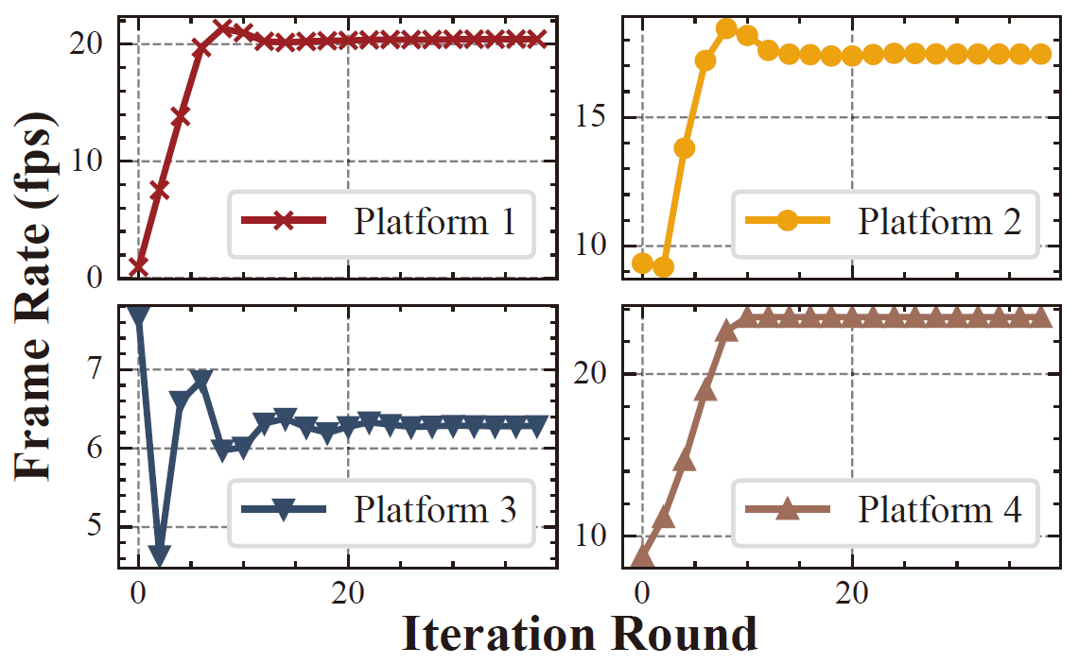
Converge for Pareto efficiency
How does Alg. 1 converge for Pareto efficiency?
Platform cannot changes its frame rate to improve the social welfare
Convergence of Frame Rate
Pareto Efficiency
Notes:
First, how does Alg. 1 converge for Pareto efficiency?
We demonstrate the convergence of frame rate and Pareto efficiency obtained from Alg. 1.
We notice that at about the 15th iteration round, the frame rate decision for each platform all keep a steady state, which indicates the convergence of Alg. 1.
When Pareto efficiency is achieved, platform cannot changes its frame rate to improve the social welfare.

Slide 14
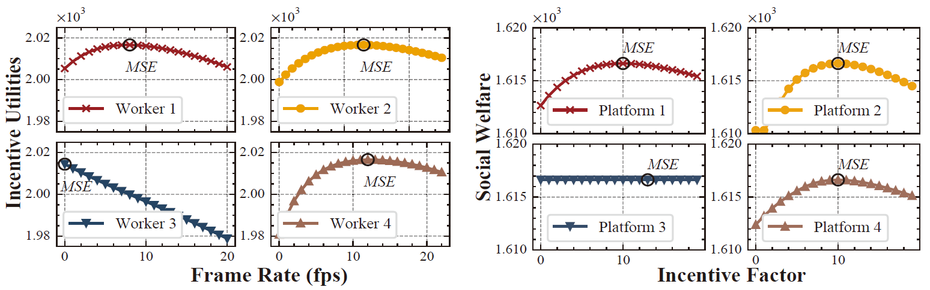
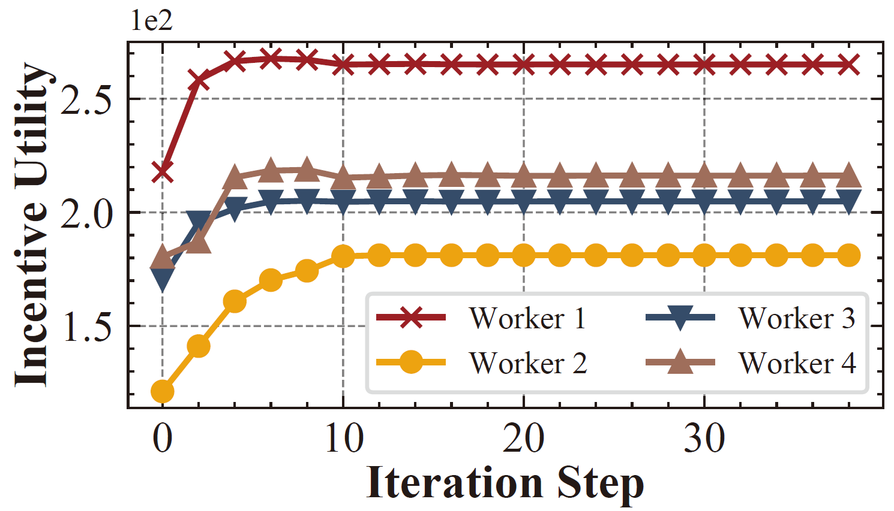
Converge for MSE
How do Alg. 2 and Alg. 3 converge for multi-leader Stackelberg equilibrium?
Worker and platform cannot change their strategies to raise their utility
Convergence of Incentive Utility
MSE for Workers
MSE for Platforms
Notes:
Second, how do Alg. 2 and Alg. 3 converge for multi-leader Stackelberg equilibrium?
We show the convergence of incentive utility via Alg. 2, and the multi-leader Stackelberg equilibrium obtained from Alg. 3.
It is observed at about the 10th iteration step, Alg. 2, serving as the inner layer of MACRO, converges to the maximum of all workers’ incentive utilities.
When multi-leader Stackelberg equilibrium is reached, worker and platform cannot change their strategies to raise their utility.

Slide 15
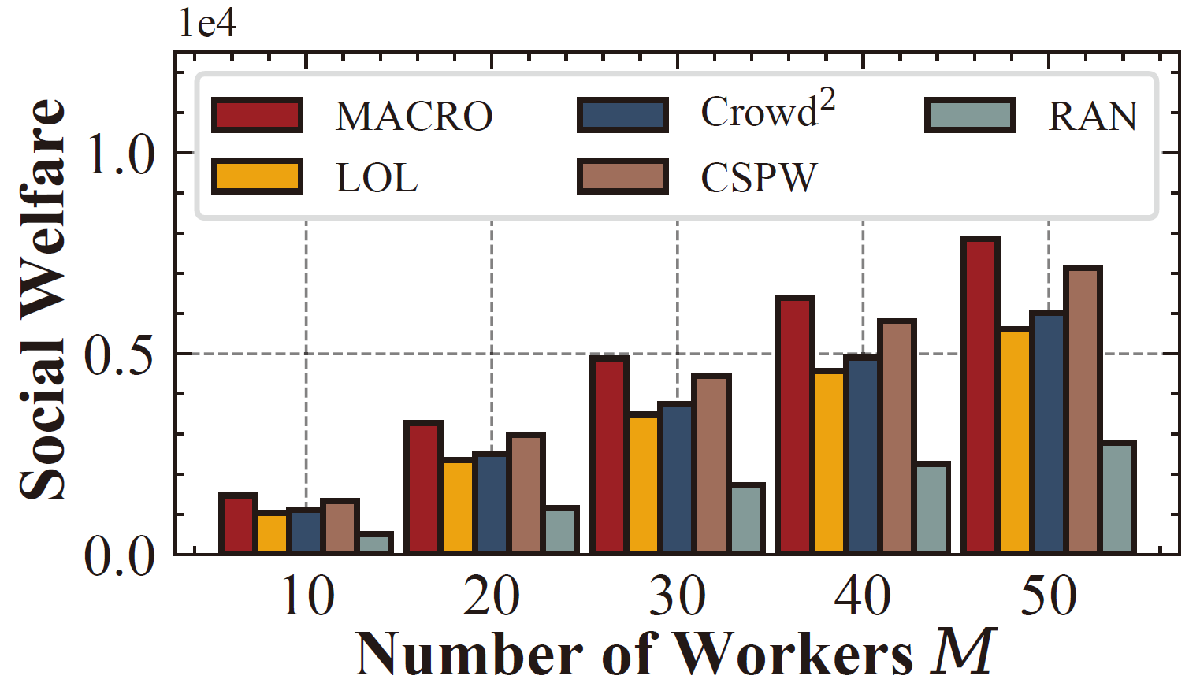
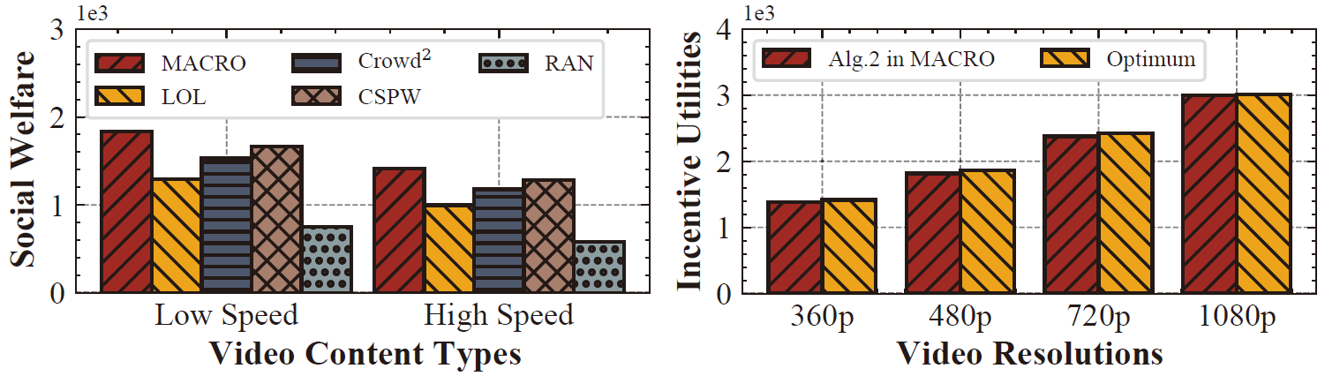
Scalability of MACRO
How is the scalability of MACRO?
MACRO improves the social welfare by 26% on average
Varying Number of Workers
Various Video Content Types
Various Video Resolution
Notes:
Third, how is the scalability of MACRO?
We vary the number of workers, video content types, and video resolutions, and show the higher social welfare obtained from MACRO, compared with other methods.
In summary, MACRO improves the social welfare by 26% on average.

Slide 16
Conclusion
MACRO: firstly considering the platform-worker conflicts for video analytics tasks upon crowdsourcing
For multi-platform game, we achieve the Pareto efficiency for platforms via a dual ascent-based method to determine proper video analytics configurations
For multi-leader game, we design the incentive function and its incentive factor updating strategy, and present an incentive maximization method, reaching the multi-leader Stackelberg equilibrium
Notes:
Finally, we summarize our work.
MACRO is the first to consider the platform-worker conflicts for video analytics tasks upon crowdsourcing.
For multi-platform game, we achieve the Pareto efficiency for platforms via a dual ascent-based method to determine proper video analytics configurations.
For multi-leader game, we design the incentive function and its incentive factor updating strategy, and present an incentive maximization method, reaching the multi-leader Stackelberg equilibrium.

