Slide 1




Physics-Inspired Decomposition for Weak Low-Rank Spatiotemporal Completion in Sparse Crowdsensing
Mijia Zhang¹, En Wang^{1,*}, Wenbin Liu^{1,*}, Junwei Zhao², Yang Xu³, Bo Yang¹, Jie Wu²
¹College of Computer Science and Technology, Jilin University
²China Telecom Cloud Computing Research Institute
³College of Computer Science and Electronic Engineering, Hunan University
Presenter: Mijia Zhang
Notes:
Hello everyone, my name is Mijia Zhang. Today I am very glad to be here and introduce our recent work accepted at IEEE ICDCS 2026, titled "Physics-Inspired Decomposition for Weak Low-Rank Spatiotemporal Completion in Sparse Crowdsensing."
This work is a team effort. I am joined by En Wang, Wenbin Liu, Junwei Zhao, Yang Xu, Bo Yang, and Jie Wu. En Wang, Wenbin Liu, Bo Yang and I are from the College of Computer Science and Technology at Jilin University in Changchun, China. Junwei Zhao and Jie Wu are from the China Telecom Cloud Computing Research Institute in Beijing. Yang Xu is from the College of Computer Science and Electronic Engineering at Hunan University in Changsha.
In general, this work is an effective attempt to combine traditional data-based methods with physics knowledge to solve the weak low-rank problem in sparse crowdsensing. We build a multi-step sparse data completion framework that achieves better results than existing methods and makes the whole process easier to understand.

Slide 2
Outlines
  Introduction and challenges
  Contributions
  Model
  Experiments
Notes:
Here, I will give you the outline of my talk. I will go through four parts:
Part 1: Introduction and challenges in sparse crowdsensing
Part 2: Contributions of this work
Part 3: Model details of our proposed framework
Part 4: Experimental results

Slide 3
  Introduction and challenges
  Contributions
  Model
  Experiments
Notes:
In Section 1, I will introduce the background and challenges in sparse crowdsensing. First, let me explain what the weak low-rank problem is.

Slide 4
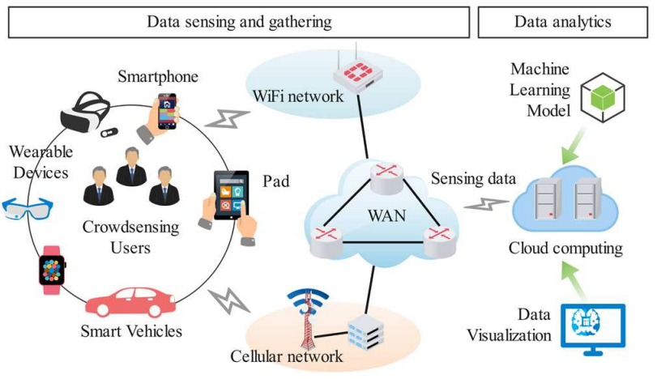
1. Introduction and challenges
Mobile CrowdSensing (MCS)
  Task publisher
  Server platform
  Task executor
Notes:
First, let me introduce what mobile crowdsensing is. An MCS system usually includes three parts: the task publisher, the server platform, and the task executor.
Here is how it works: users carry mobile devices that connect to the server platform through nearby WiFi or 4G/5G networks. The task publisher sends sensing tasks through the server platform. These tasks are then assigned to task performers. In practice, the platform usually offers rewards to encourage users to join the task. Finally, the MCS platform collects all the data from users and sends it back to the task publisher.
However, the cost of sensing is limited. This leads to the main problem we talk about today: sparse MCS.

Slide 5
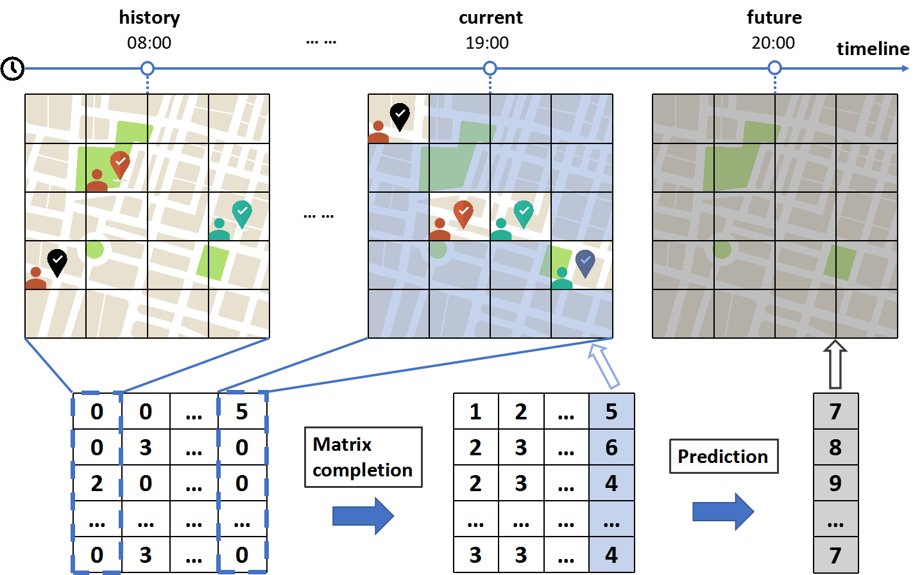
1. Introduction and challenges
Sparse MCS
Notes:
Sparse MCS tries to find patterns in data from only a few sensing areas, and then guess the data for other areas that were not sensed.
In other words, sparse MCS helps us discover information and make decisions when we only have a small amount of sensed data.
As shown in the figure, we want to get the full sensing map of a city that is split into 5 by 4 grids, which makes 20 grids in total. Because of budget limits and uncertain user movement, sparse MCS only gets data from 3 out of the 20 grids. Then, we use these 3 data points to guess the data for the remaining 17 grids.

Slide 6
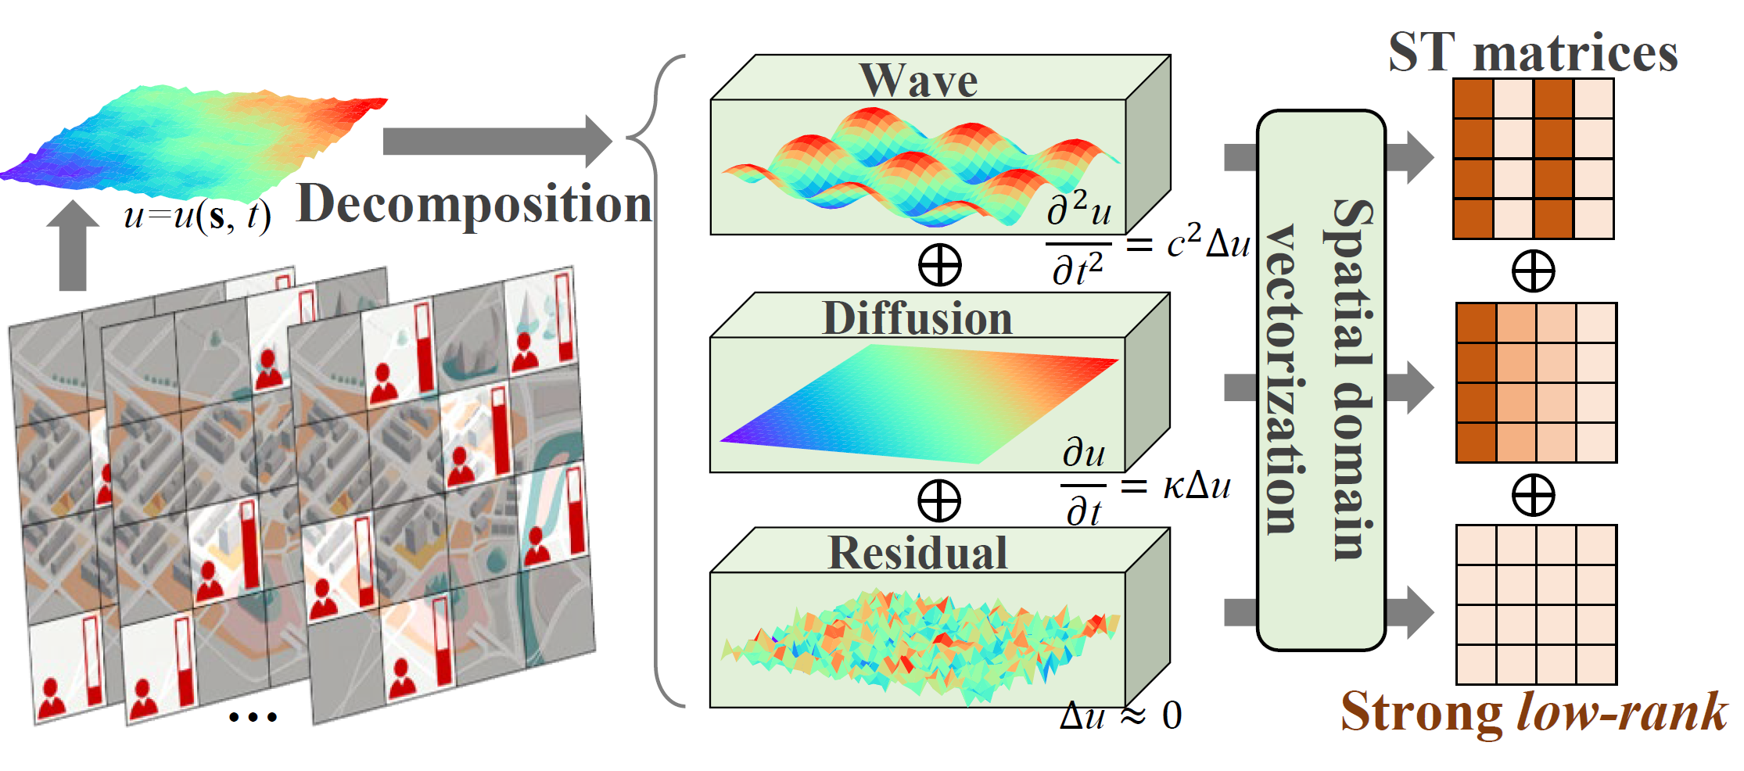
1. Introduction and challenges
  Exemplary scenarios illustrating physics-inspired decomposition for interpretable spatiotemporal completion ideas and challenges in sparse crowdsensing.
Notes:
In most mobile crowdsensing projects, when we have only a few data points, current methods can fill in missing information quite well. They do this by finding hidden patterns in the data over time and location.
But in real life, the places and conditions where data is collected are very different. Because of this, those patterns are not always clear or strong. When that happens, older methods stop working well. Weak patterns can hide important information, which could lead to wrong results — especially in systems where safety is critical. We call this problem "weak low-rank degeneration."
Another challenge is that we often don't have enough labeled data to train computer models. Without enough examples, even smart data-driven models struggle to make correct predictions.
So, if we want reliable results, we need to solve both problems: unclear patterns in the data and not having enough labeled training data.

Slide 7
1. Introduction and challenges
Challenges
  the effective component decomposition method
  the subsequent processing after decomposition
  the spatiotemporal completion accuracy achieved by the physics-inspired method
Notes:
To address these issues, we use a physics-based method to analyze the underlying physical patterns in spatiotemporal data. However, inferring such complex spatiotemporal fields under sparse MCS conditions faces three major challenges:
Challenge 1: How to design an effective method to decompose spatiotemporal data into wave, diffusion, and residual components, while enforcing the correct physics rules on each component during decomposition.
Challenge 2: How to determine the best model structure and processing steps after decomposition, so that each component is handled according to its specific characteristics.
Challenge 3: How to ensure that the physics-inspired approach achieves competitive accuracy compared to purely data-driven methods, and how to handle the limitations of physics models.

Slide 8
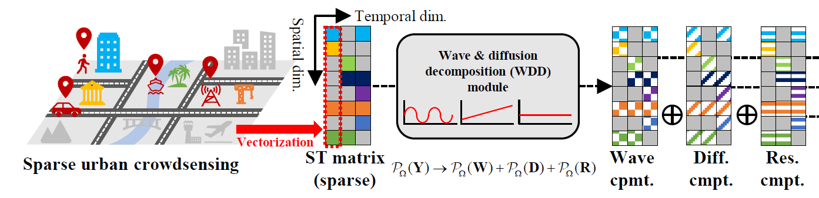
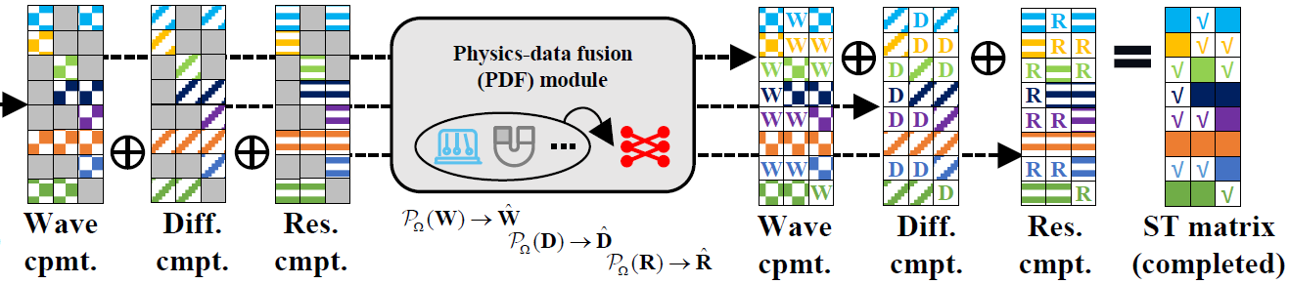
1. Introduction and challenges
  The framework employs physics-inspired decomposition for interpretable spatiotemporal completion.
Notes:
To address these three challenges, we propose MCWDD. MCWDD performs component decomposition using physics equations with iterative smoothing for the wave and diffusion components.
After decomposition, we perform completion on each of the three components separately. For each component, we use a hybrid approach that combines physical models with data-driven methods. This strategy helps avoid the negative impact on accuracy that could come from using only physical models.
The final completed result is obtained by adding the completed versions of these three components together.

Slide 9
  Introduction and challenges
  Contributions
  Model
  Experiments
Notes:
In the second section, I will summarize the contributions of this work.

Slide 10
2. Contributions
Our work has the following contributions:
  We propose a novel spatiotemporal completion framework MCWDD, which uses PDEs to decompose data matrices into three physically interpretable components.
  MCWDD employs analytical regularization to enforce strong low-rank properties in each component.
  The combination of data and knowledge enabling robust completion for weak low-rank data.
  Extensive experiments on synthetic and real-world data show MCWDD achieves higher completion accuracy.
Notes:
The core innovations and technical contributions of this work are as follows:
First, we propose a new spatiotemporal completion framework named MCWDD. It uses partial differential equations (PDEs) to decompose data matrices into three physically meaningful components: wave, diffusion, and residual.
Second, MCWDD uses analytical regularization to enforce strong low-rank properties in each component. This makes completion robust even for complex data where traditional methods fail.
Third, MCWDD combines PDE-based physical priors with data-driven deep matrix factorization. The former enforces rules and reduces overfitting when data is sparse, while the latter captures unmodeled dynamics that simple physics cannot explain.
Finally, extensive experiments on synthetic and real-world data show that MCWDD achieves higher completion accuracy (over 5% compared to conventional methods) and better interpretability than existing methods.

Slide 11
  Introduction and challenges
  Contributions
  Model
  Experiments
Notes:
In the third section, I will introduce the model details of MCWDD.

Slide 12
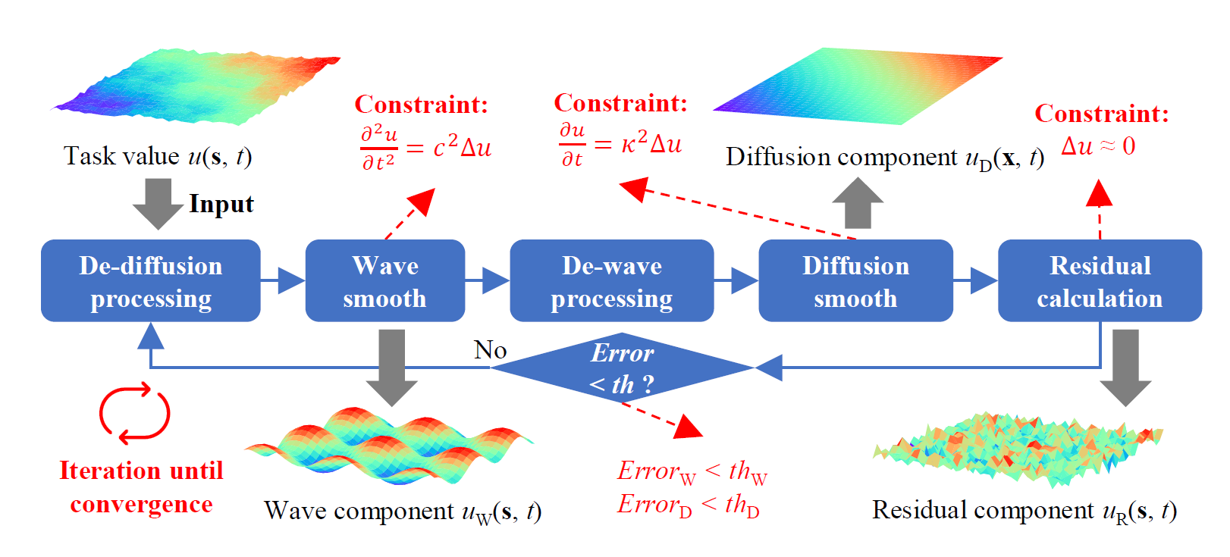
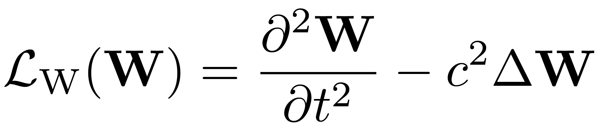
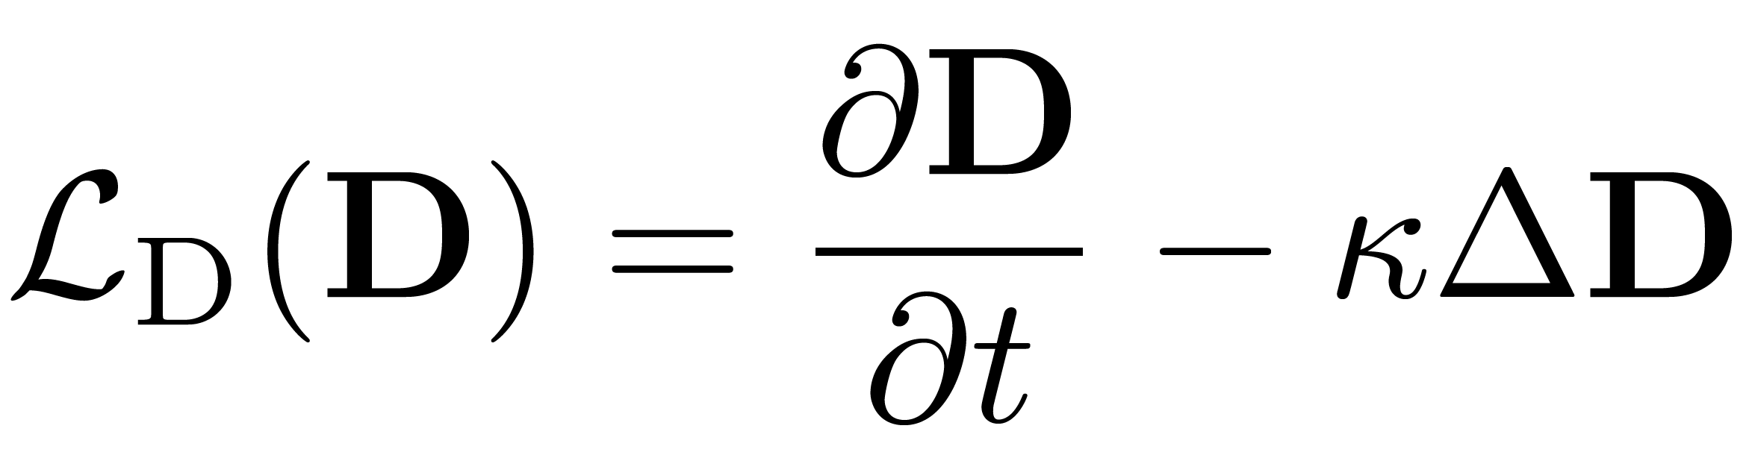
3. Model
Wave and Diffusion Decomposition Module
Loss Function:
Notes:
Now let me introduce the core structure of our framework: the Wave and Diffusion Decomposition Module.
As shown in the diagram, the input to our system is the task value, represented as a spatiotemporal field u(s, t). The main goal of this module is to decompose this complex signal into two physically meaningful components: the Wave component and the Diffusion component.
We achieve this through an alternating iterative optimization process.
First, in the De-diffusion stage, we try to remove the diffusive characteristics from the signal. This allows us to isolate the Wave component in the subsequent Wave smooth step. During this phase, we enforce the Wave constraint, which follows the standard wave equation. This equation includes a learnable speed parameter c, allowing the model to adapt to different propagation speeds.
Once the Wave component is extracted, it goes through a De-wave step to remove wave-like oscillations. Then, the Diffusion smooth stage reconstructs the Diffusion component. Here, we apply the Diffusion constraint based on the heat equation, which includes another learnable parameter k, representing the diffusion rate.
We then calculate the Residual component, which captures the information that fits neither the wave nor the diffusion pattern.
To ensure the decomposition is accurate, we use specific loss functions for each part. The loss for the wave part penalizes deviations from the wave equation, while the diffusion loss enforces the diffusion physics.
Finally, the system uses an iterative feedback loop. The module keeps refining the components. If the reconstruction error for either part exceeds a predefined threshold, the process repeats until it converges. This ensures that we get a highly accurate and physically consistent decomposition of the original data.

Slide 13
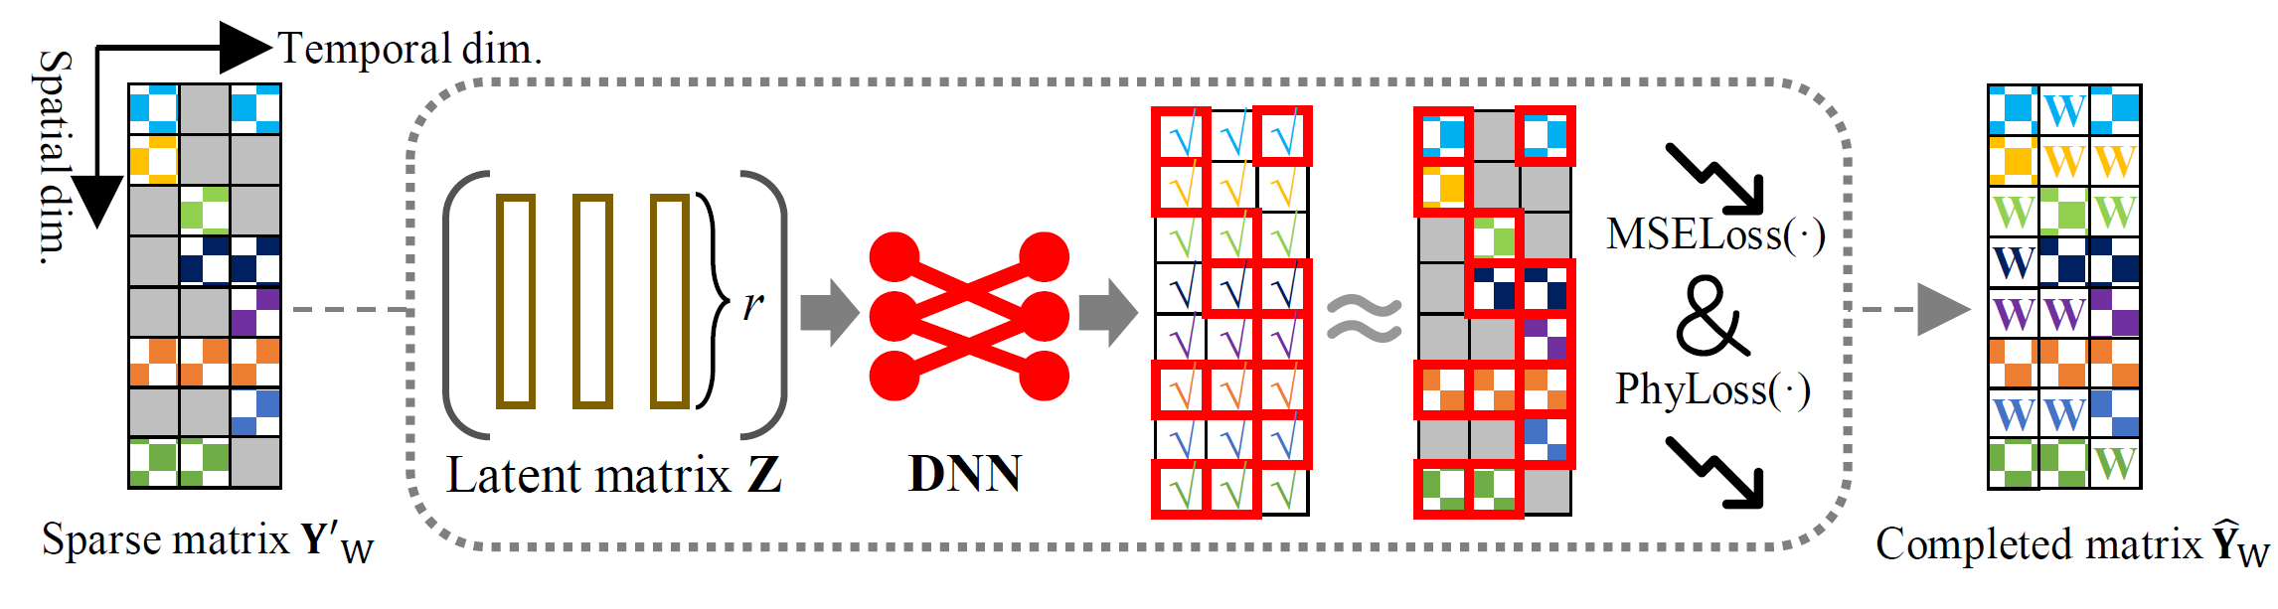
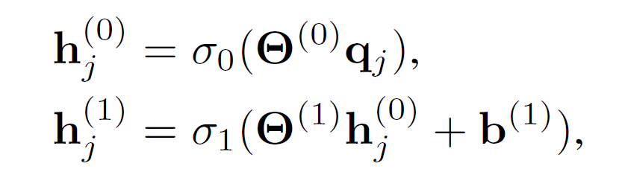
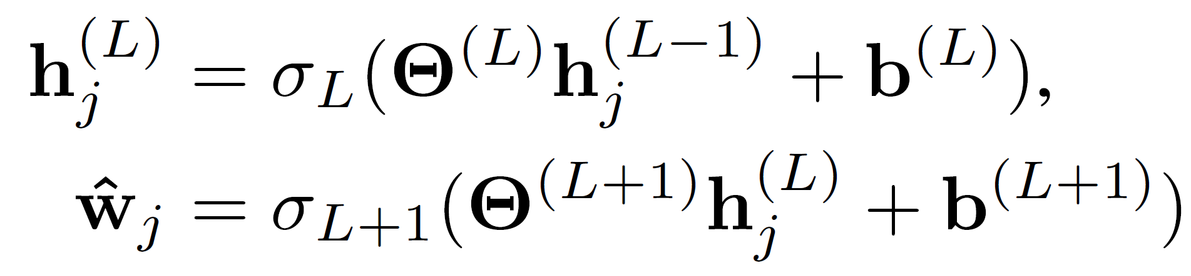
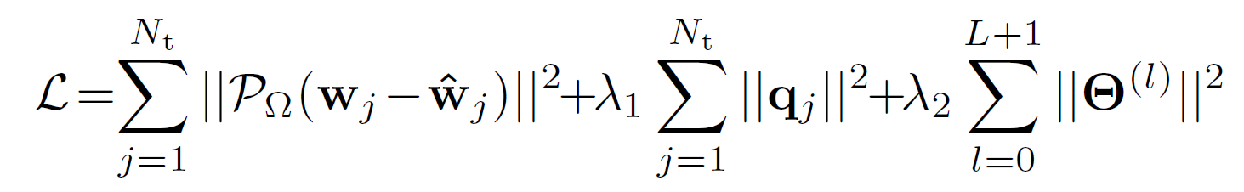
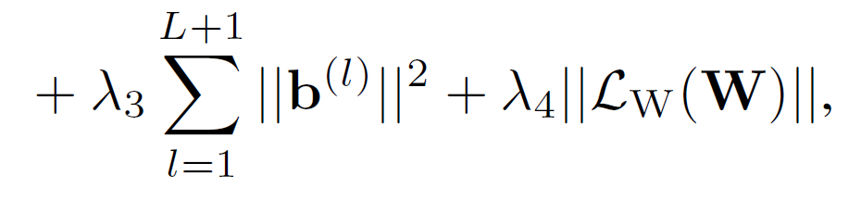
3. Model
Physics-Data Fusion Module
Deep Interaction Layers:
…
Loss Function :
MSE Loss
Regularization Penalty
Physics Loss
Notes:
Next, let me introduce the second core module of our framework: the Physics-Data Fusion Module.
As shown in the diagram, the input to this module is a sparse matrix. The gray blocks represent missing data points, while the colored squares are the observed values. Our goal is to accurately complete this sparse matrix.
Instead of directly feeding the raw sparse data into a neural network, we first factorize it into a low-rank Latent matrix Z. This step compresses the essential features of the data, effectively reducing the dimensionality and computational burden.
This latent representation is then fed into a Deep Interaction Layer, which consists of a Deep Neural Network (DNN). This network is designed to capture the complex, non-linear relationships within the data.
Now, here is the key innovation of this module: the integration of physics. We enforce physics-informed constraints alongside traditional data-driven learning. We compute two types of losses: MSELoss and Physics Loss

Slide 14
  Introduction and challenges
  Contributions
  Model
  Experiments
Notes:
In Section 4, I will introduce our experimental results.

Slide 15
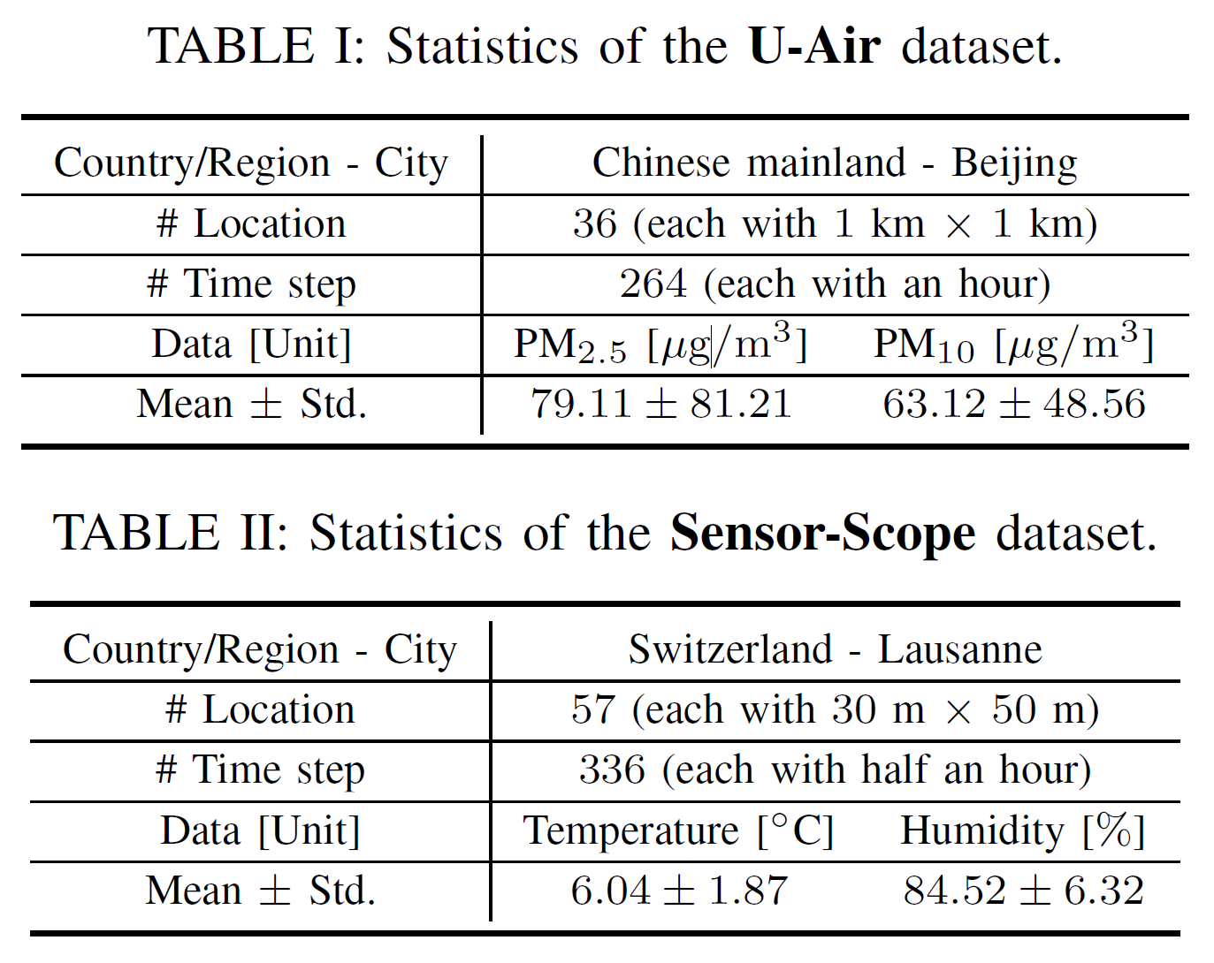
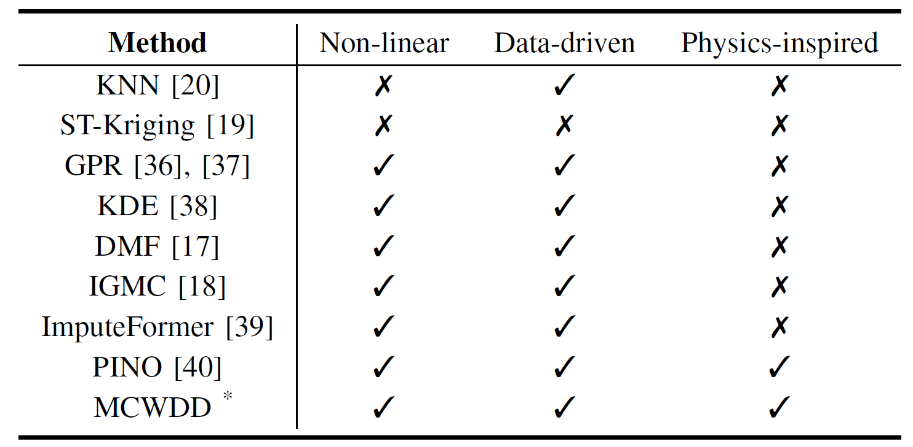
4. Experiments
Statistics of two evaluation datasets.
Baselines
Notes:
We evaluate our proposed method MCWDD on two popular real-world datasets: Sensor-Scope and U-Air.
The U-Air dataset covers Beijing, China, with 36 locations, 264 hourly time steps, measuring PM2.5 and PM10. The Sensor-Scope dataset covers Lausanne, Switzerland, with 57 locations, 336 half-hour time steps, measuring temperature and humidity.
Our baselines include non-linear models, data-driven models, and other physics-inspired models. Specifically: KNN, ST-Kriging, GPR, KDE, DMF, IGMC, ImputeFormer, and PINO.

Slide 16
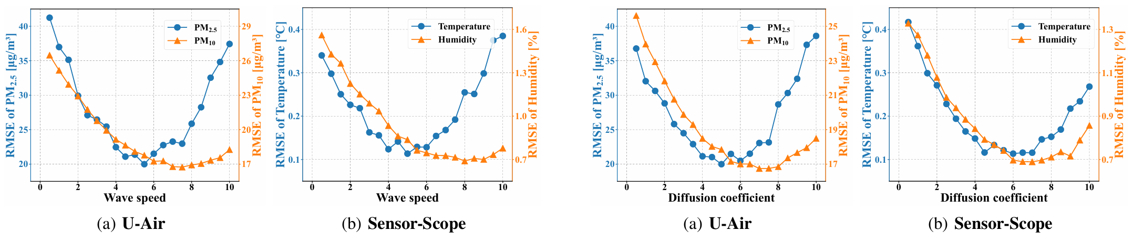
4. Experiments
RQ1: How do the hyper-parameters affect the performance of MCWDD
  Impact of Hyper-Parameters:
  wave speed & diffusion coefficient
  Completion error vs. wave speed
  Completion error vs. diffusion coefficient
Notes:
We conducted a comprehensive sensitivity analysis for the wave speed (c) and diffusion coefficient (k), testing a range of values to find the best configuration.
Experimental results show that these parameters signifficantly influence the completion error, with different optimal values for different datasets and sensing tasks.

Slide 17
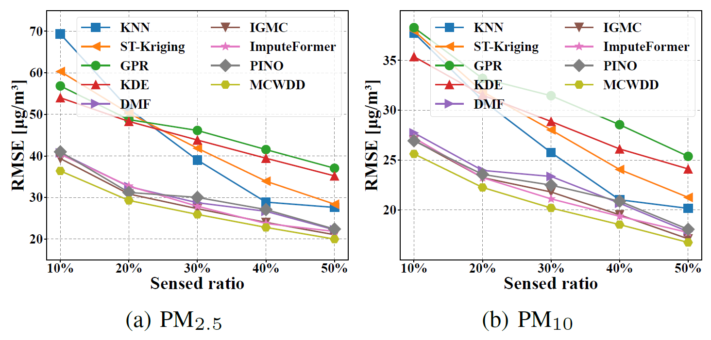
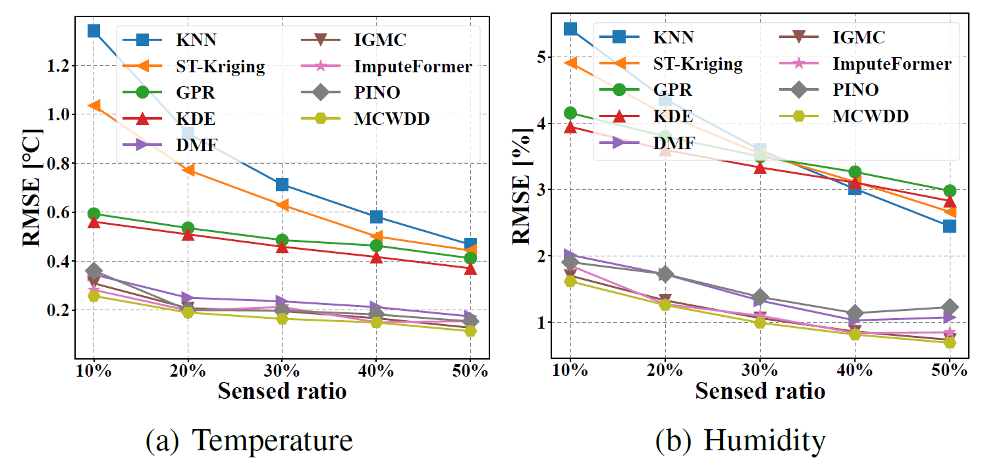
4. Experiments
RQ2: Whether the performance of MCWDD in terms of data completion accuracy exceeds the baseline method
  Robustness Analysis:
  Completion error vs. sensed ratios
  U-Air
  Sensor-Scope
Notes:
To evaluate robustness, we compared MCWDD against eight baselines across various sensed ratios ranging from 10% to 50%.
MCWDD consistently outperformed all baselines, maintaining the lowest completion error even as sensed data increased. especially, it achieved over 5% error reduction compared to the best-performing baseline methods.

Slide 18
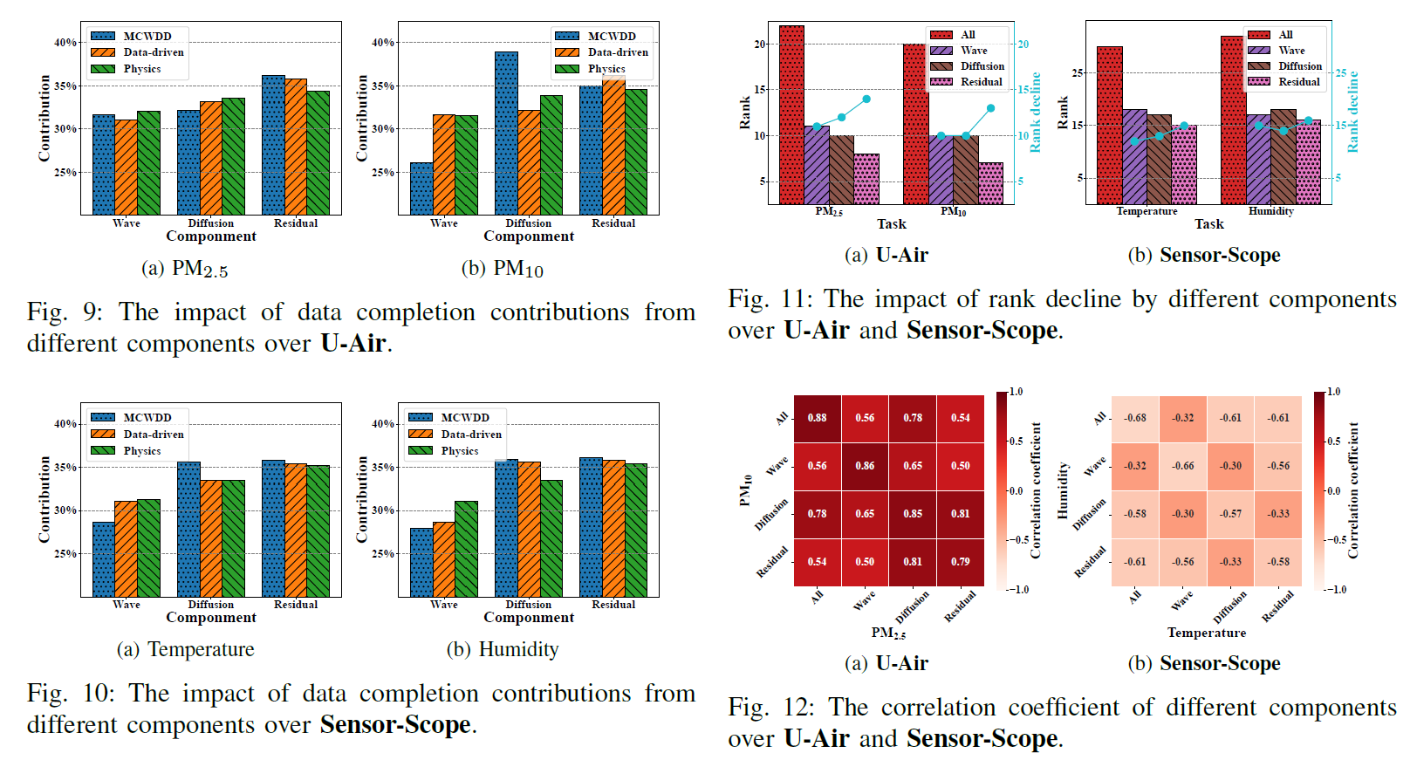
4. Experiments
RQ3: How much impact does each component of WDD have on data completion results
Notes:
We analyzed the contribution of each decomposed component — wave, diffusion, and residual — to the final accuracy.
Results show that the rank of each individual component is significantly lower than that of the original spatiotemporal matrix. This validates our core ideas: physics-inspired decomposition transforms a "weak low-rank" problem into several "strong low-rank" sub-problems.
Furthermore, correlation analysis confirms that the decomposition successfully isolates distinct physical patterns into separate channels. This structural simplification is the key to the framework's superior performance.

Slide 19
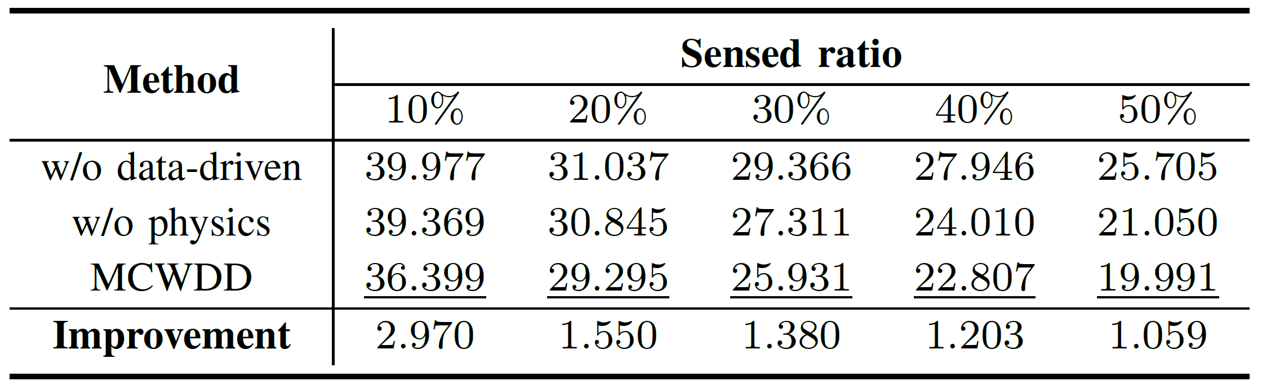
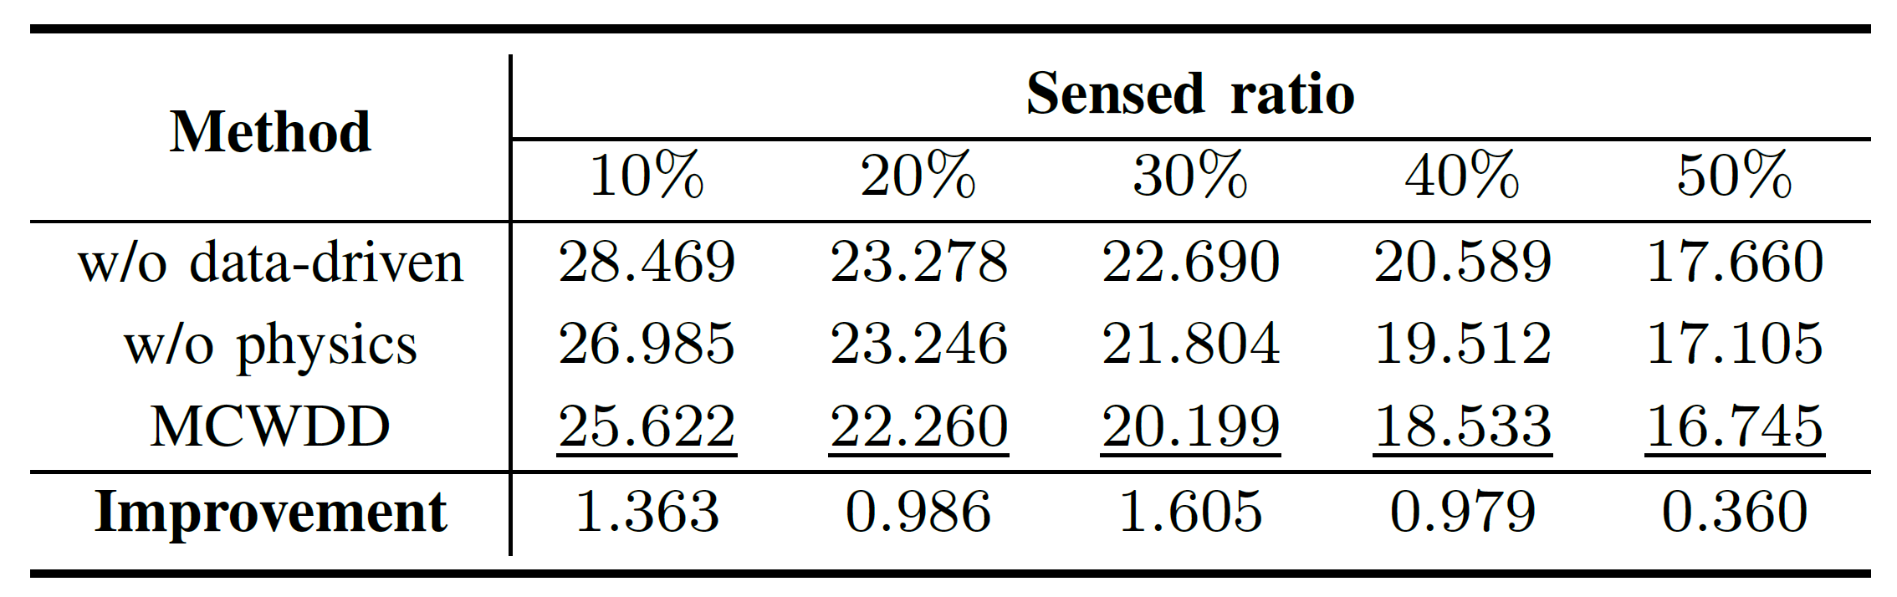
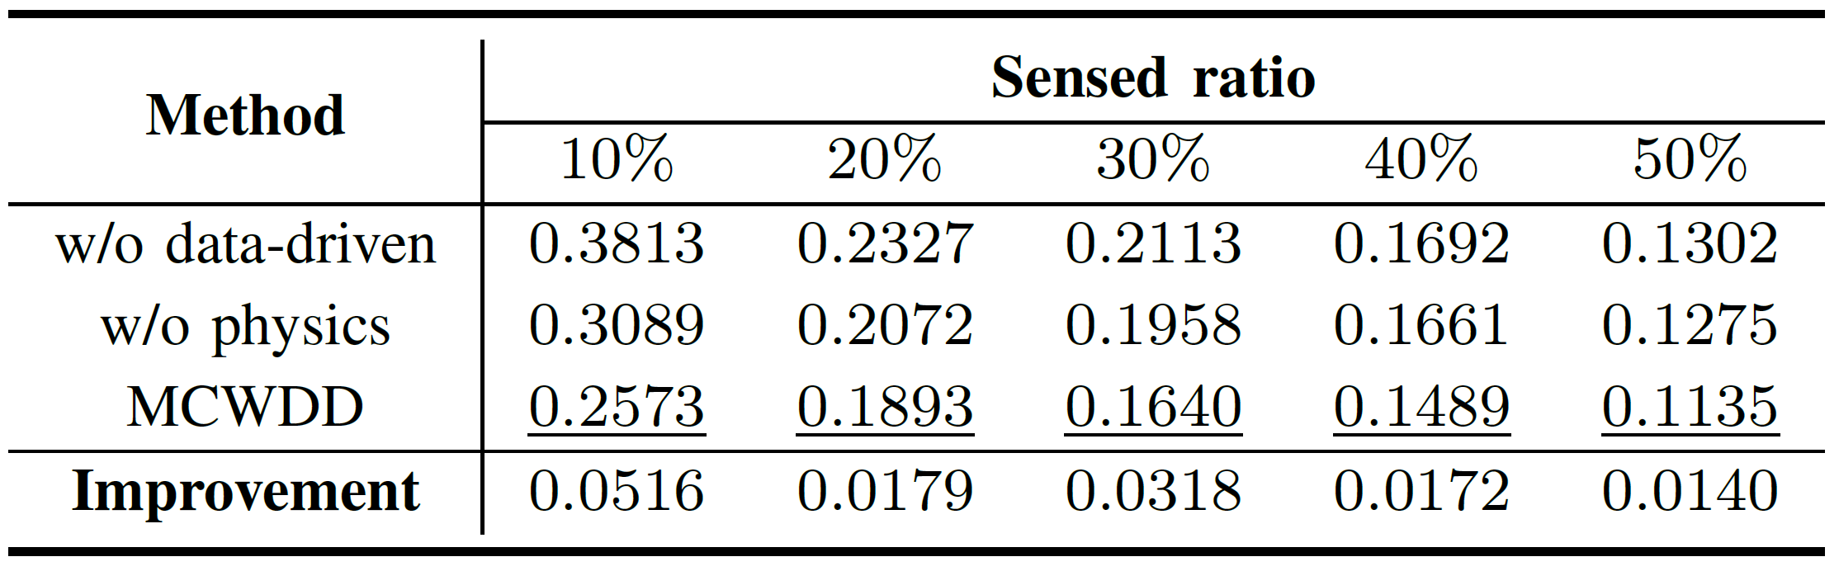
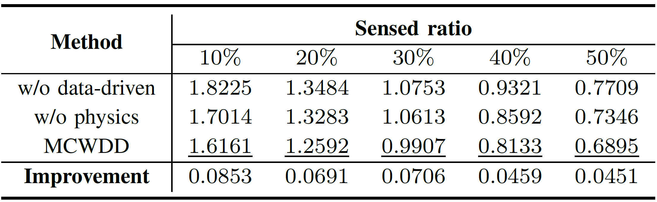
4. Experiments
RQ4: How does the removal or alteration of specific components affect the overall performance of MCWDD
  Completion error of PM_{2.5}/PM₁₀ vs. sensed ratios over U-Air
  Completion error of Temperature/Humidity vs. sensed ratios over Sensor-Scope
Notes:
Ablation studies were performed to measure the necessity of the physics-informed and data-driven modules.
Removing either module led to a noticeable drop in performance, confirming that they are complementary rather than any useless.

Slide 20
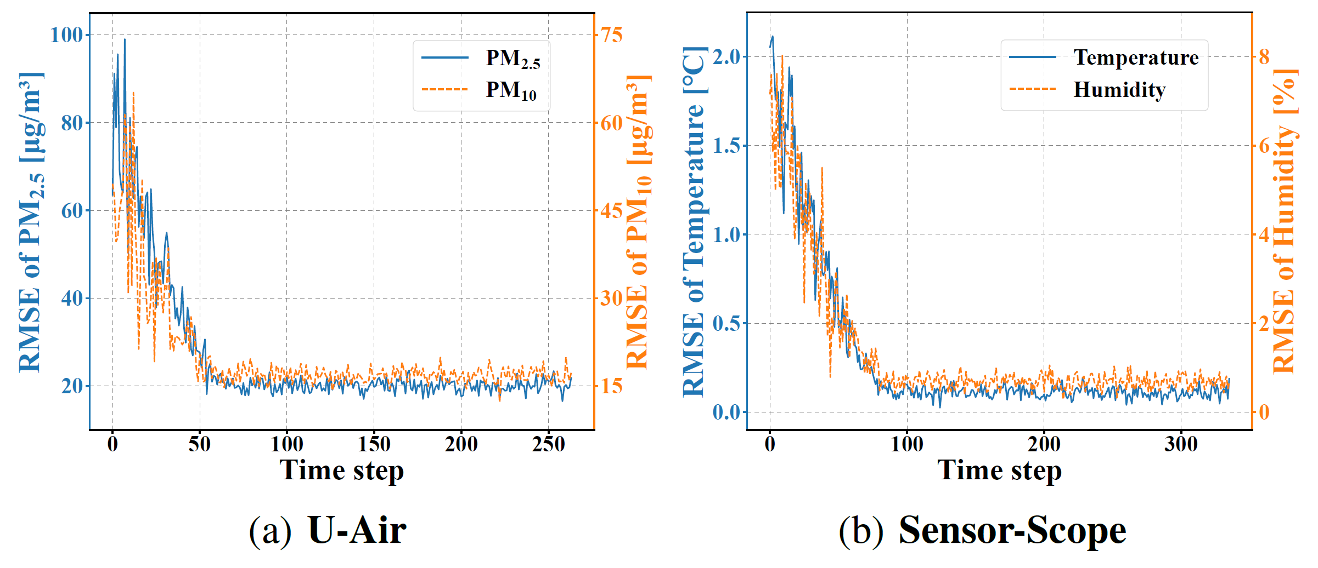
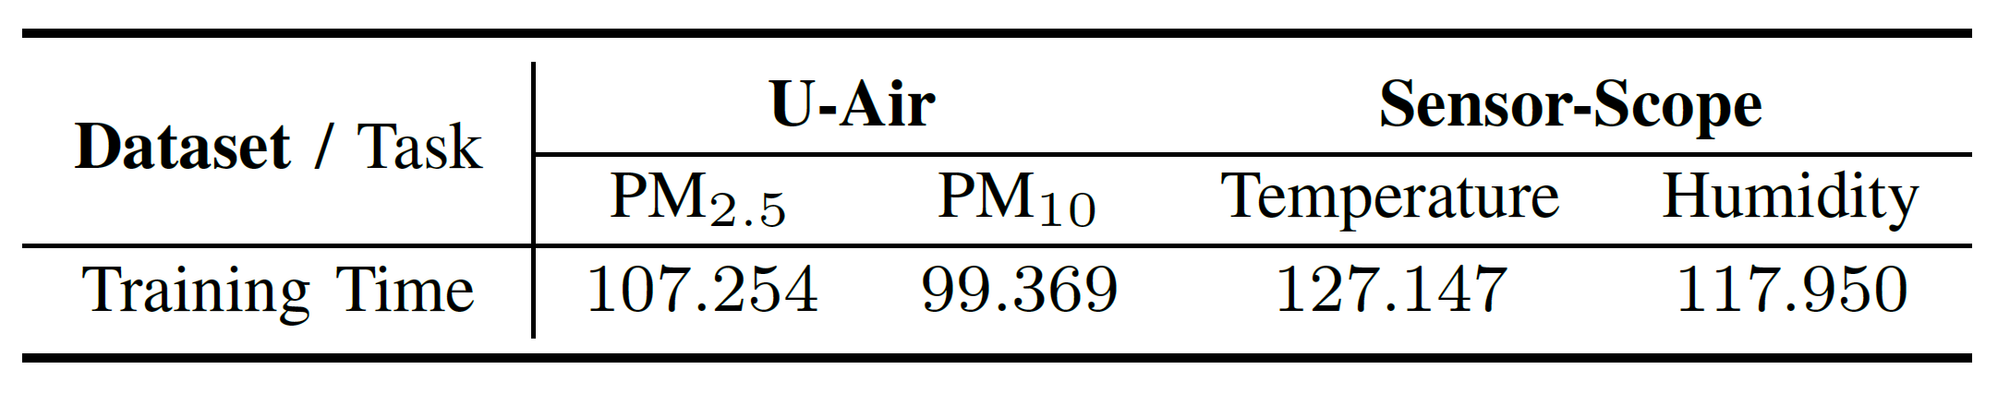
4. Experiments
RQ5: What is the training cost of MCWDD?
  Inference accuracy under different input time steps
  Training Time over U-Air and Sensor-Scope
Notes:
We evaluated the computational efficiency and data requirements of MCWDD on standard hardware.
The model achieves stable performance with only about 70 to 100 time steps, indicating a low demand for historical data.

Slide 21

Thank you for listening!
Q&A
Notes:
In this paper, To overcome limitations of traditional low-rank methods in sparse crowdsensing data completion, MCWDD uses PDEs to decompose data into three regularized components, imposing physically meaningful structure that ensures each component exhibits strong low-rank properties for robust completion while holding core physical constraints. By fusing PDE priors with data-driven residuals, MCWDD offers a general solution beyond global low-rank options.
Thanks for all the audience. more details can be found in our camera-ready paper, and if you have any question, please contact us. That’s all. Thank you.

