Slide 1
Selection of Virtual Machines Based on Classification of MapReduce Jobs
Adam Pasqua Blaisse, Zachary Andrew Wagner, and Jie Wu
Department of Computer and Information Sciences, Temple University

Slide 2
Cloud Computing
Large number of physical machines (PM)
Strongly networked together
Resources sold on an hourly basis as virtual machines (VM)
Eucalyptus
Amazon EC2

Slide 3
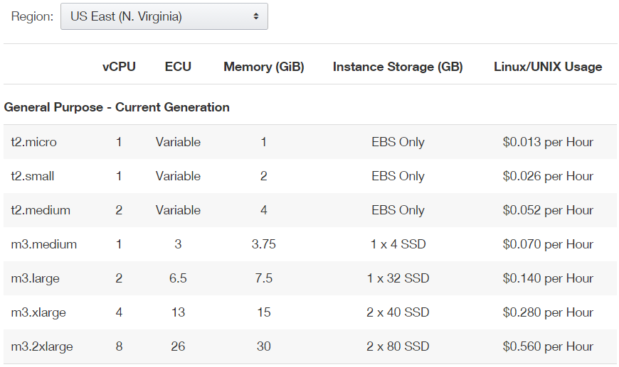
Motivation
Find the minimal virtual machine that will run a Map Reduce job as fast as possible

Slide 4
Map Reduce
Programming Paradigm for distributed computing
Two phases
  Map Phase
  Reduce Phase
Apache Hadoop
  Open source implementation used

Slide 5
Hadoop Implementation of Map Reduce
Map
  Many small Map tasks
  Each task takes a small chunk of data
  Turn the data into Key value pair (i.e <the,1>)
  Number of Map tasks varies based on input data size
  When all Map task are finished data is Pasted to the Reduce Phase
Reduce
  Very few set number of Reduce tasks
  Combine all the input key value pairs from the maps
  Also takes care of shuffling data from Map Locations to Reduce Locations

Slide 6
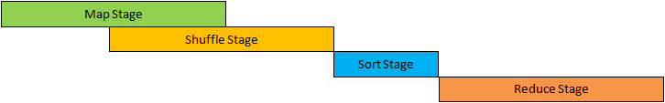
Hadoop Implementation of Map Reduce
Reduce
  All Mapping must finish before Reducing can start
  Shuffling can start before Mapping ends

Slide 7
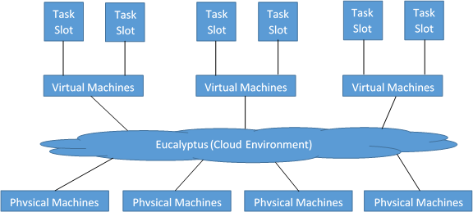
Issues when Used Together
Some jobs run better on different configurations of virtual machines
Different configurations of virtual machines have different costs
Some jobs may need more CPU’s while others may need I/O
I.E Generating Data is I/O intense, and would be best run on Memory rich system

Slide 8
Our Approach
Attempt to classify tasks into two types
  CPU Bound Jobs
    Jobs spent more time doing CPU work then I/O
    Jobs need more CPUS’s and less I/O
    Smaller more numerous machines
  I/O Bound Jobs
    Jobs spent more time doing I/O work then CPU
    Jobs need more I/O and less CPU
    Less Larger Machines

Slide 9
Mapping to machines
If a job is classified as
  CPU Bound Job
    Many virtual machines
    Little memory per virtual machine
  I/O Bound Job
    Fewer virtual machines
    Each virtual machine has larger amounts of memory

Slide 10
Why?
If a job is I/O bound
  Would like to keep job running in memory rather then hit HDD
  I/O more important then number of cores
If a job is CPU bound
  More important to have many cores running the maps
  Less likely to hit HDD while running

Slide 11
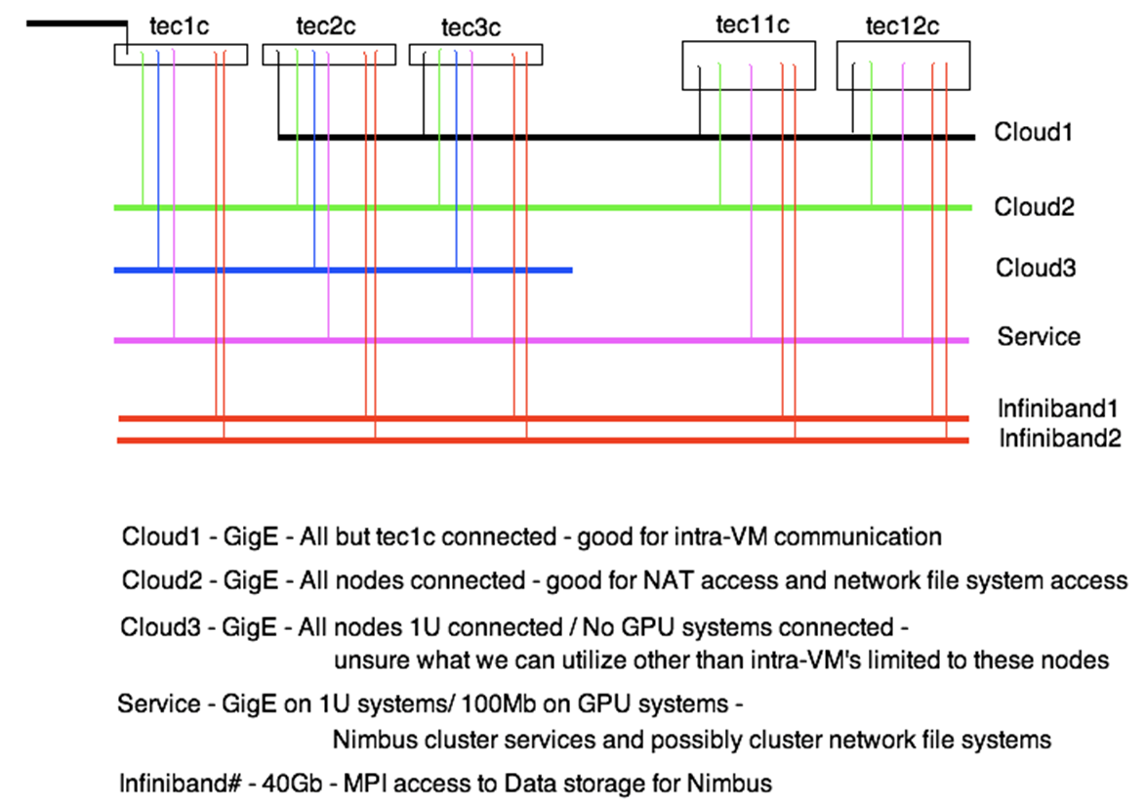
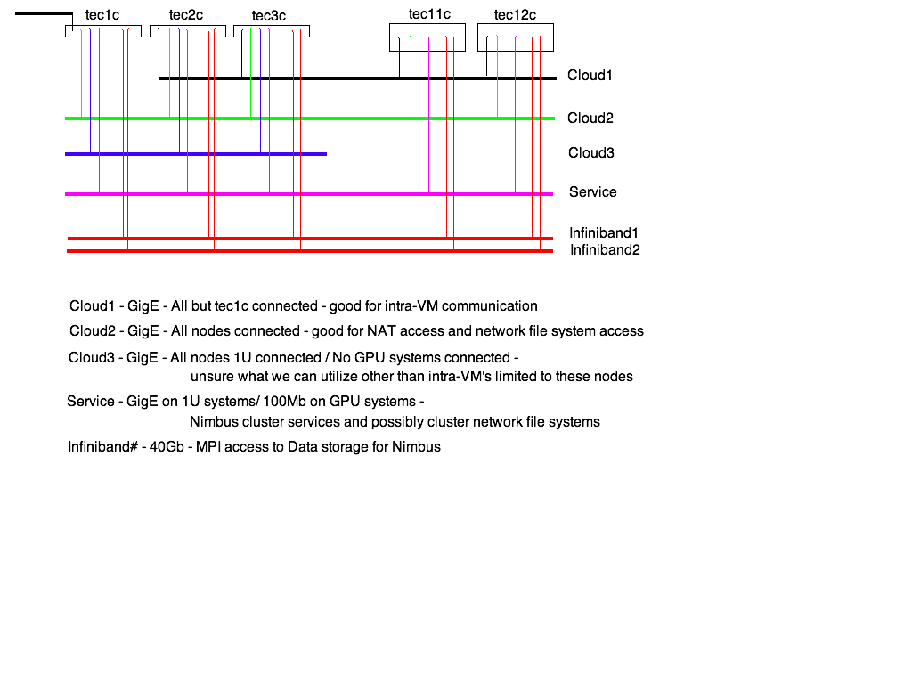
TCloud (Virtual Cluster)
Hardware
  12 Dell Power Edge R614 Servers
  96 conventional CPU Cores
  4-Way redundant 10 GB Ethernet
  2-Way redundant InfiniBand
Software
  Eucalyptus 3.3 (Amazon EC2 compatible)
Public cloud used to create virtual machine clusters

Slide 12
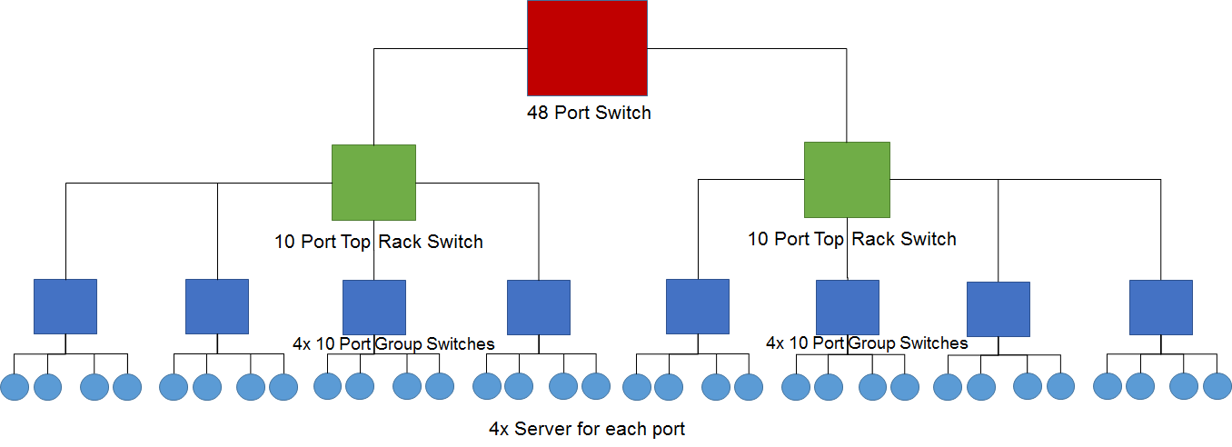
Net Cloud (Physical Cluster)
Hardware
  32 Dell PowerEdge R210 servers
  Each server has
    4 GB of RAM Memory
    500 GB HDD
Software
  Hadoop version 1.2.1
  CentOS 6.6
Physical machine cluster used for prediction

Slide 13
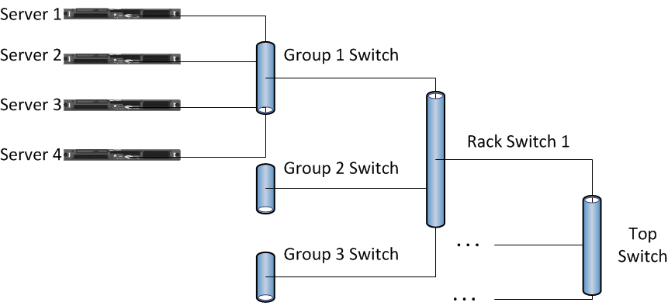
Net Cloud (continued)
Networking
  Tree like structure
  4 machines to 1 group switch
  4 group switchs to 1 rack switch
  2 rack switches connected to 1 Top Switch

Slide 14
How to classify
Metrics
  Shuffle_bytes
  CPU_time
(Shuffle_bytes/CPU_time)
  Take the average of the map tasks
  If value is over 1, then job is I/O Bound
  Else CPU Bound

Slide 15
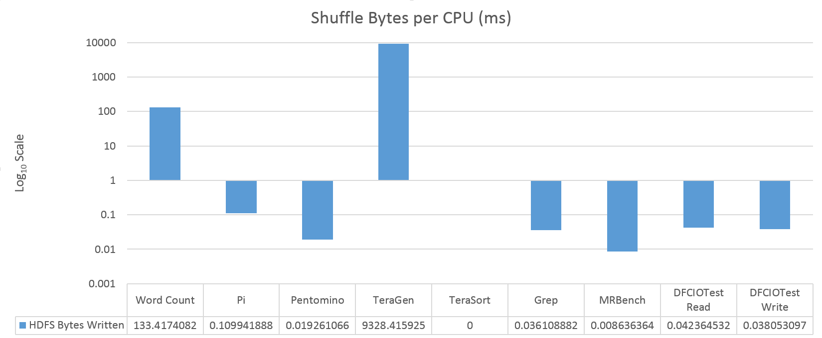
Results from Physical Machine runs
CPU Bound

Slide 16
Results on the Virtual Clusters
Job | I/O Bound System (S) | CPU Bound System (S)
Word Count | 257.2338 | 235.2299
PI | 473.3364 | 419.88242
Pentomino | 408.1599 | 355.0055
TeraSort | 603.9358 | 183.1389
TeraGen | 89.2324 | 116.62483
Grep | 217.8305 | 188.0857
MRBench | 21.0116 | 18.6668
DFSCIOTest read | 24.5882 | 19.5072
DFSCIOTest write | 25.2971 | 20.2712

Slide 17
Conclusion
Presented a method for selecting virtual machines
Showed the intuition behind the selection process
Tested the method on two test beds at Temple
Future works
  Finding a good constant to multiply by to for a cluster
  Including more types of virtual machines
  Including more metrics for prediction

Slide 18
Questions?
Contact
  Adam.blaisse@temple.edu
  Astro.temple.edu/~tuc47904

