Slide 1
An Analysis of Onion-Based Anonymous Routing in Delay Tolerant Networks
Kazuya Sakai, Tokyo Metropolitan University
Min-Te Sun, National Central University
Wei-Shinn Ku, Auburn University
Jie Wu, Temple University
Faisal S. Analazi, The Ohio State University
June 27-30, 2016

Slide 2
Outline
Introduction
Preliminary and Related Works
Abstract Onion-Based Anonymous Routing
Analyses
Simulations
Conclusions

Slide 3





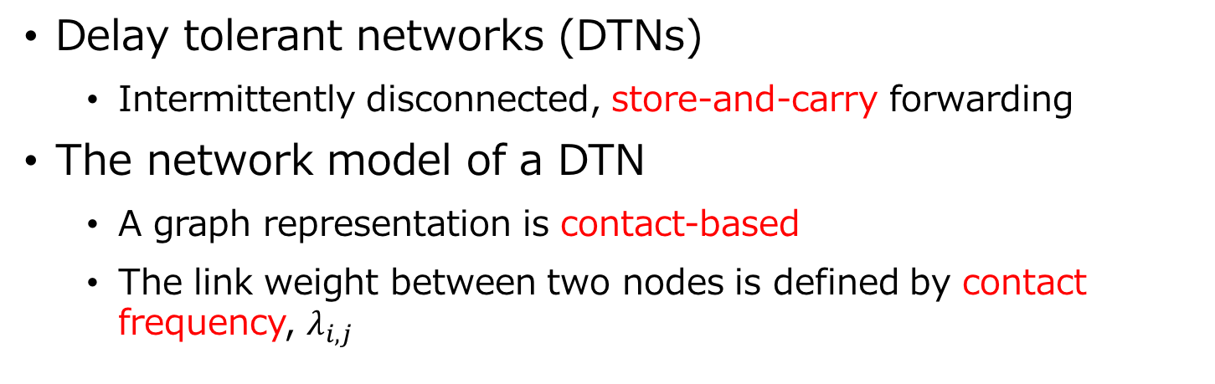
1. Introduction
Delay tolerant networks (DTNs)
Intermittently disconnected, store-and-carry forwarding
The network model of a DTN
A graph representation is contact-based
The link weight between two nodes is defined by contact frequency, $λ_{i,j}$
$$λ_{1,2}=1/80$$
2
$$λ_{2,4}=1/100$$
$$λ_{4,5}=1/120$$
1
4
5
$$λ_{1,3}=1/60$$
$$λ_{3,4}=1/70$$
3

Slide 4




Introduction (Cont.)
Anonymous communications
Protect the privacy of end hosts
Prevent from traffic analyses
Intermediate nodes never know where a packet comes from and goes to
Applications
Critical communications, e.g., battle fields
Sink

Slide 5
2. Preliminary and Related Works
Onion Routing, e.g., Tor
Layered encryptions are applied to a message

Slide 6
Related Works
Many anonymous routing protocols have been proposed for ad hoc networks
Onion-based, zone-based, and so on
But, only a few protocols have been designed for DTNs
e.g., onion-based [1] and threshold-based
No protocol with multi-copy forwarding has been designed
No theoretical work has been done
[1] C. Shi, X. Luo, P. Traynor, M. H. Ammar, and E. W. Zegura, “ARDEN: Anonymous Networking in Delay Tolerant Networks,” Ad Hoc Netw., vol. 10, no. 6, pp. 918–930, 2012.

Slide 7
3. Abstract Onion-Based Anonymous Routing
Abstract onion-based anonymous routing protocol
Introduction of onion groups
A set of nodes consists of an onion group
Anycast-lilke forwarding
Single-copy and multi-copy forwarding

Slide 8
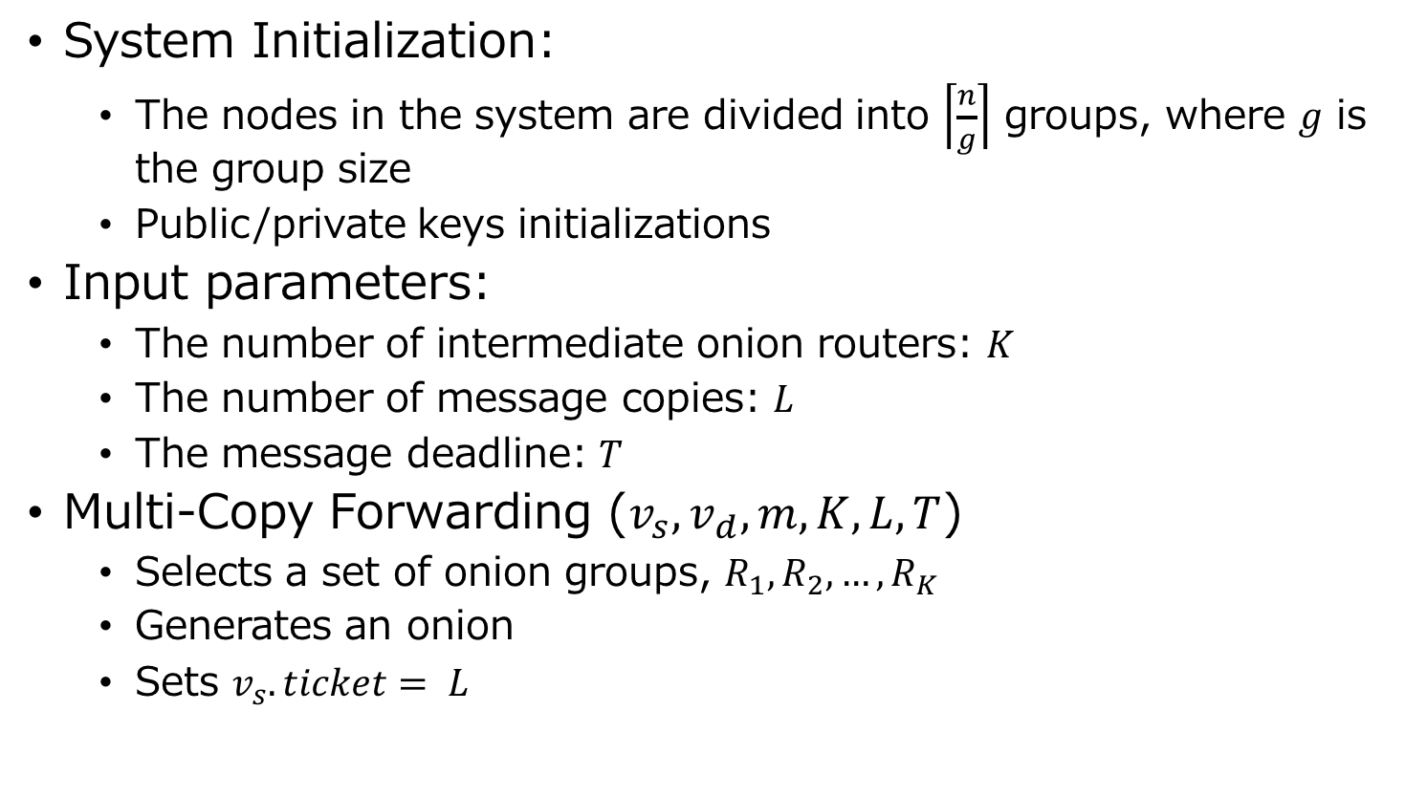
Multi-Copy Forwarding
System Initialization:
The nodes in the system are divided into $\left\lceil \frac{n}{g}\right\rceil$ groups, where $g$ is the group size
Public/private keys initializations
Input parameters:
The number of intermediate onion routers: $K$
The number of message copies: $L$
The message deadline: $T$
Multi-Copy Forwarding ($v_{s}, v_{d}, m, K, L, T$)
Selects a set of onion groups, $R_{1}, R_{2}, …, R_{K}$
Generates an onion
Sets $v_{s}.ticket= L$

Slide 9
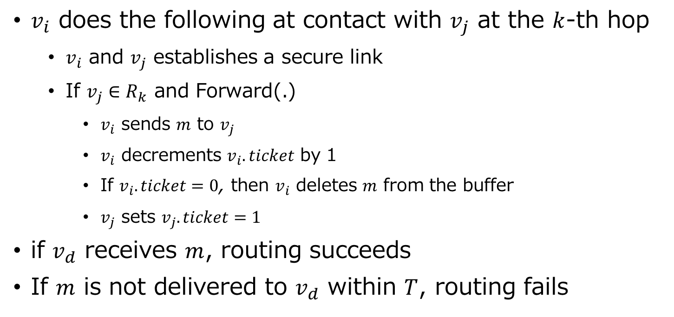
Multi-Copy Forwarding (Cont.)
$v_{i}$ does the following at contact with $v_{j}$ at the $k$-th hop
$v_{i}$ and $v_{j}$ establishes a secure link
If $v_{j}∈R_{k}$ and Forward(.)
$v_{i}$ sends $m$ to $v_{j}$
$v_{i}$ decrements $v_{i}.ticket$ by 1
If $v_{i}.ticket=0$, then $v_{i}$ deletes $m$ from the buffer
$v_{j}$ sets $v_{j}.ticket=1$
if $v_{d}$ receives $m$, routing succeeds
If $m$ is not delivered to $v_{d}$ within $T$, routing fails
Note: the definition of Forward(.) is left to application designers
e.g., intermediate onion relays are allow to have one copy

Slide 10
4. Analyses
Analyses
Performance : delivery rate and message overhead
Security : traceable rate and path anonymity
The attack model
The compromise attack: a node is physically compromised, and the transmission of a message is monitored
Compromised nodes are randomly chosen by the uniform distribution

Slide 11
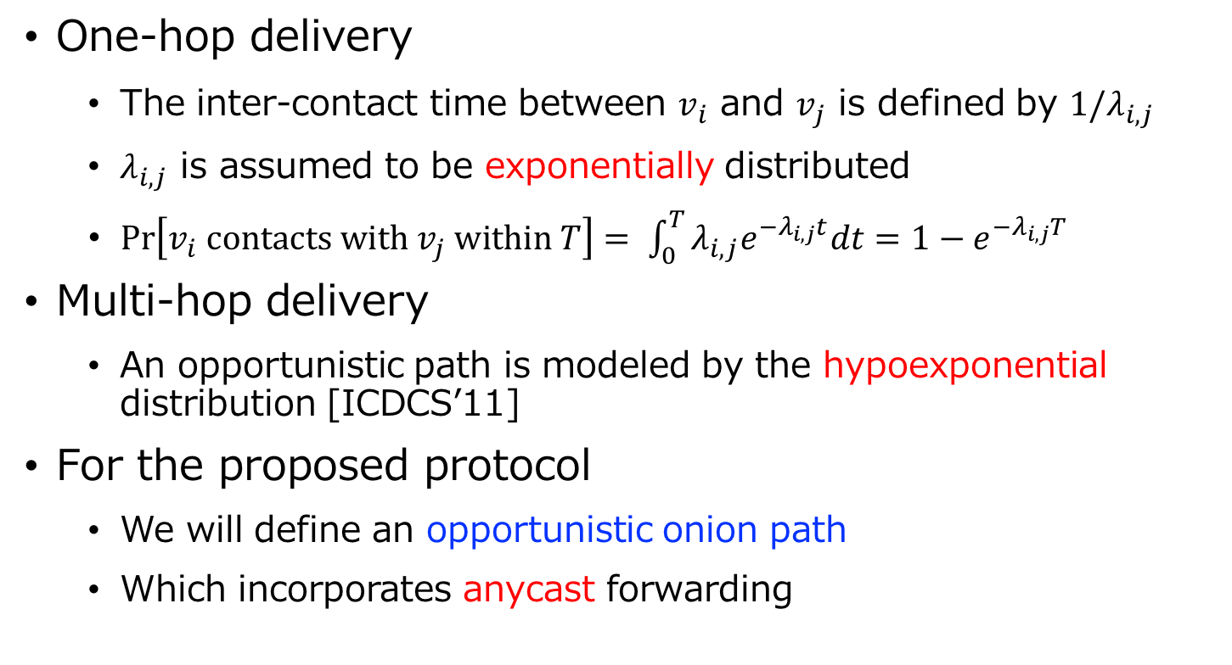
Delivery Rate
One-hop delivery
The inter-contact time between $v_{i}$ and $v_{j}$ is defined by $1/λ_{i,j}$
$λ_{i,j}$ is assumed to be exponentially distributed
$Pr\left[v_{i} contacts with v_{j} within T\right]= \int_{0}^{T}{λ_{i,j}e^{−λ_{i,j}t}dt}=1−e^{−λ_{i,j}T}$
Multi-hop delivery
An opportunistic path is modeled by the hypoexponential distribution [ICDCS’11]
For the proposed protocol
We will define an opportunistic onion path
Which incorporates anycast forwarding
[ICDCS’11] W. Gao, G. Cao, A. Iyengar, and M. Srivatsa, “Supporting Cooperative Caching in Disruption Tolerant Networks,” in ICDCS, 2011, pp. 151– 161.

Slide 12




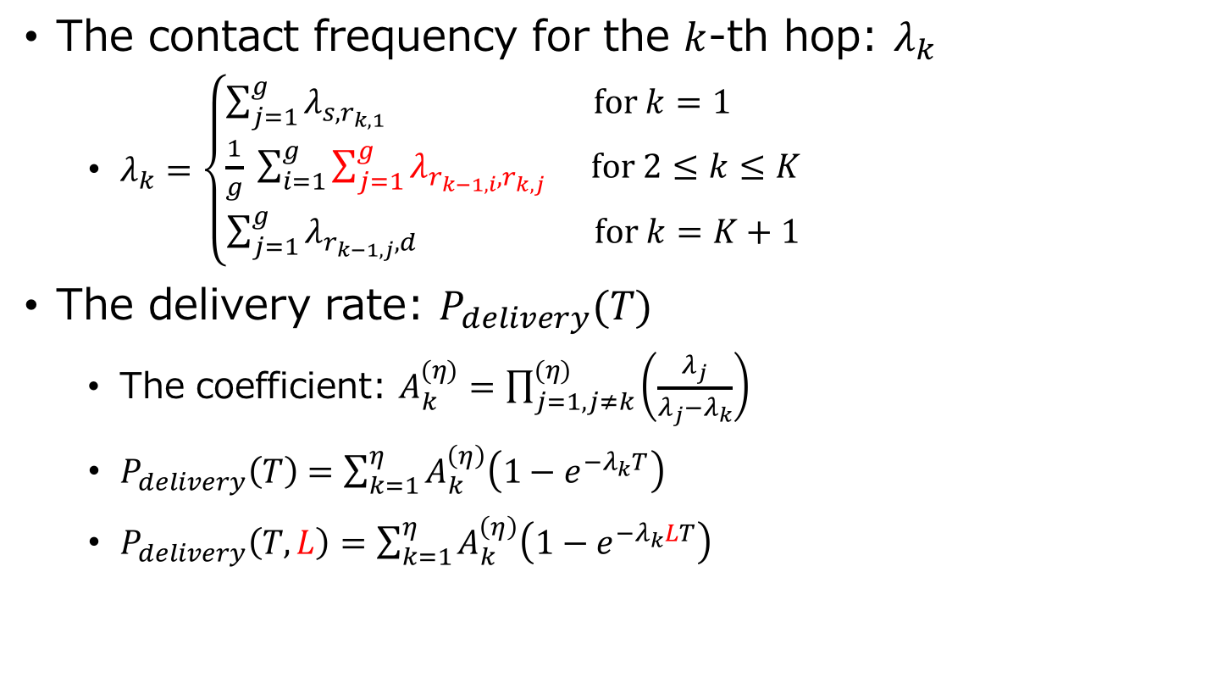






Delivery Rate (Cont.)
The contact frequency for the $k$-th hop: $λ_{k}$
$λ_{k}=\left\{\begin{aligned}\sum_{j=1}^{g}{λ_{s,r_{k,1}}} for k=1 \\ \frac{1}{g} \sum_{i=1}^{g}{\sum_{j=1}^{g}{λ_{r_{k−1,i},r_{k,j}}}} for 2≤k≤K \\ \sum_{j=1}^{g}{λ_{r_{k−1,j},d}} for k=K+1\end{aligned}\right.$
The delivery rate: $P_{delivery}(T)$
The coefficient: $A_{k}^{(η)}=\prod_{j=1,j≠k}^{(η)}{\left(\frac{λ_{j}}{λ_{j}−λ_{k}}\right)}$
$P_{delivery}\left(T\right)=\sum_{k=1}^{η}{A_{k}^{\left(η\right)}\left(1−e^{−λ_{k}T}\right)}$
$P_{delivery}\left(T,L\right)=\sum_{k=1}^{η}{A_{k}^{\left(η\right)}\left(1−e^{−λ_{k}LT}\right)}$
$$r_{1,1}$$
$$v_{s}$$
$$r_{1,2}$$
…
$$r_{1,g}$$
Fig 1. The first hop.
$$r_{k−1,1}$$
$$r_{k,1}$$
$$r_{k−1,2}$$
$$r_{k,2}$$
…
…
$$r_{k−1,g}$$
$$r_{k,g}$$
Fig 1. The k-th hop.

Slide 13



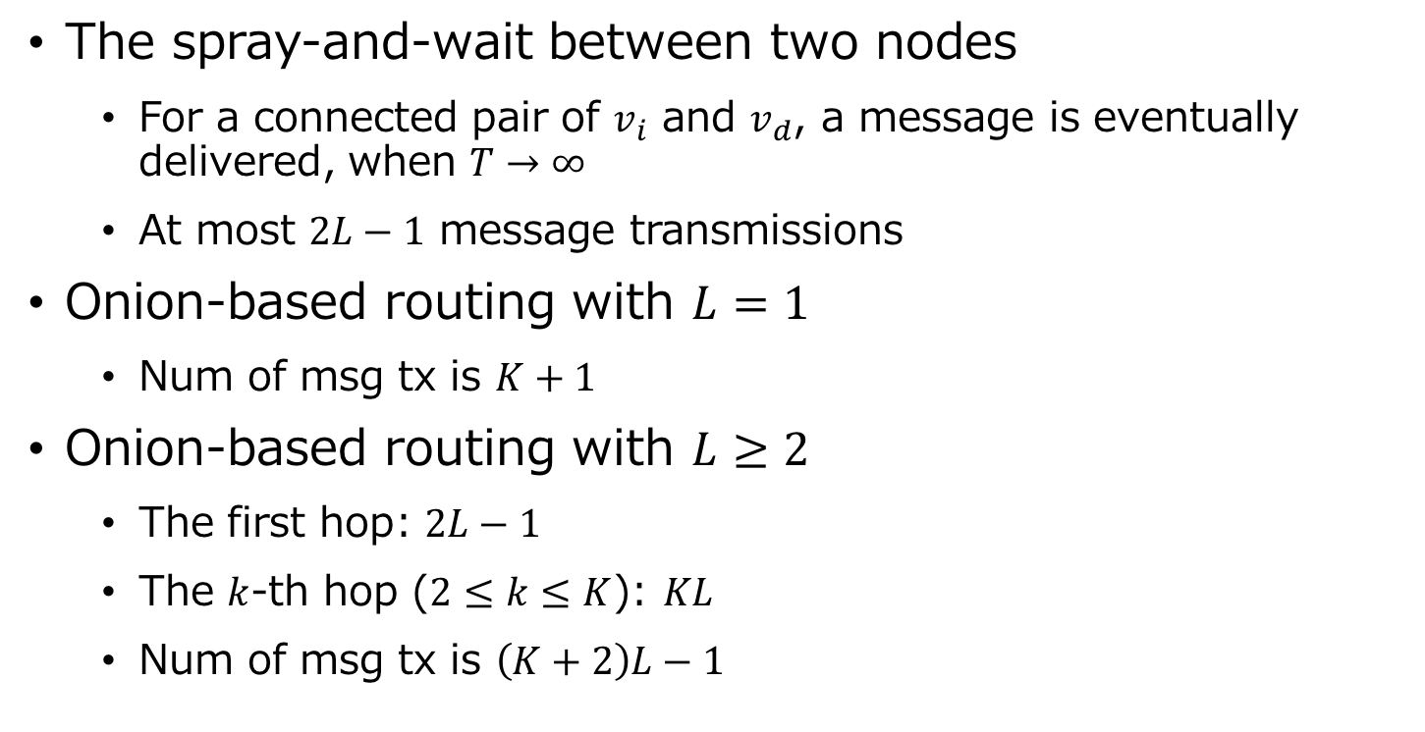
Message Forwarding Cost
The spray-and-wait between two nodes
For a connected pair of $v_{i}$ and $v_{d}$, a message is eventually delivered, when $T→∞$
At most $2L−1$ message transmissions
Onion-based routing with $L=1$
Num of msg tx is $K+1$
Onion-based routing with $L≥2$
The first hop: $2L−1$
The $k$-th hop ($2≤k≤K$): $KL$
Num of msg tx is $\left(K+2\right)L−1$
1
s
2
d
…
L-1
Fig 1. Source spray-and-wait
$$2\left(L−1\right)+1=2L−1$$
$$r_{k−1,1}$$
$$r_{k,1}$$
$$r_{k−1,2}$$
$$r_{k,2}$$
…
…
$$r_{k−1,L}$$
$$r_{k,L}$$
Fig 2. Msg TX btwn 2 groups ($L≤g$ holds)

Slide 14
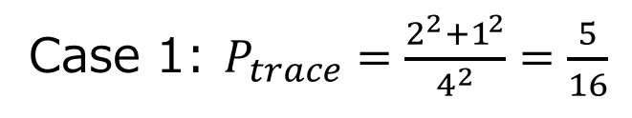
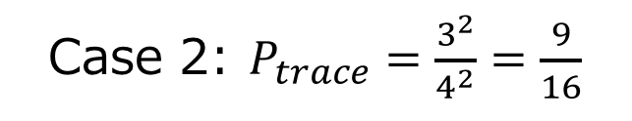


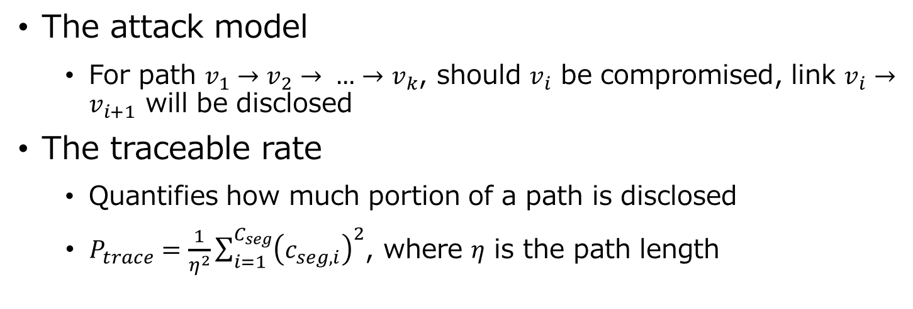
The Traceable Rate
The attack model
For path $v_{1}→v_{2}→ …→v_{k}$, should $v_{i}$ be compromised, link $v_{i}→v_{i+1}$ will be disclosed
The traceable rate
Quantifies how much portion of a path is disclosed
$P_{trace}=\frac{1}{η^{2}}\sum_{i=1}^{C_{seg}}{{\left(c_{seg,i}\right)}^{2}}$, where $η$ is the path length
$$v_{1}→v_{2}→v_{3}→v_{4}→v_{5}$$
$$v_{1}→v_{2}→v_{3}→v_{4}→v_{5}$$
Case 1: $P_{trace}=\frac{2^{2}+1^{2}}{4^{2}}=\frac{5}{16}$
Case 2: $P_{trace}=\frac{3^{2}}{4^{2}}=\frac{9}{16}$

Slide 15


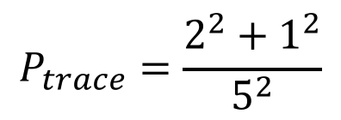
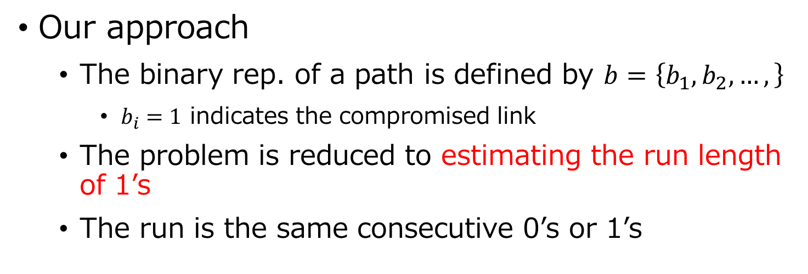
The Traceable Rate (Cont.)
Our approach
The binary rep. of a path is defined by $b=\left\{b_{1}, b_{2}, …,\right\}$
$b_{i}=1$ indicates the compromised link
The problem is reduced to estimating the run length of 1’s
The run is the same consecutive 0’s or 1’s
$$v_{1}→v_{2}→v_{3}→v_{4}→v_{5}→v_{6}$$
$$b=01101$$
$$P_{trace}=\frac{2^{2}+1^{2}}{5^{2}}$$

Slide 16
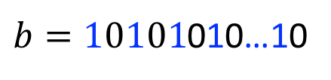

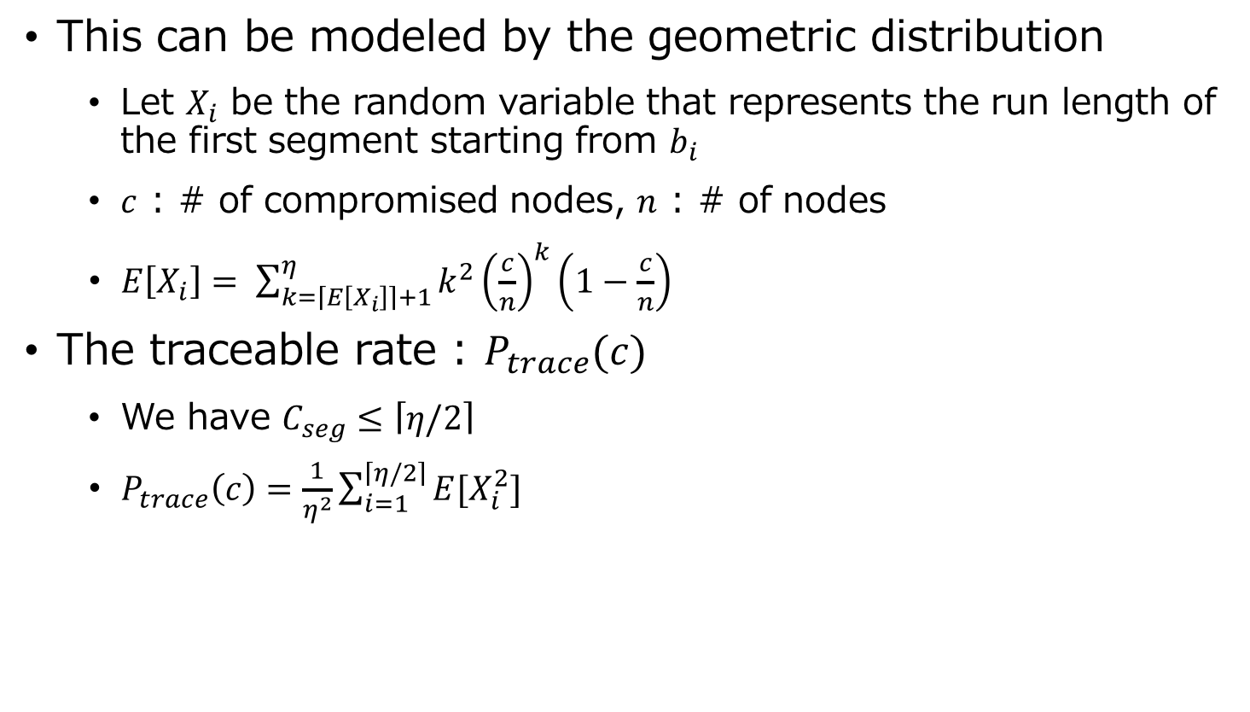
The Traceable Rate (Cont.)
This can be modeled by the geometric distribution
Let $X_{i}$ be the random variable that represents the run length of the first segment starting from $b_{i}$
$c$ : # of compromised nodes, $n$ : # of nodes
$E\left[X_{i}\right]= \sum_{k=\left\lceil E\left[X_{i}\right]\right\rceil +1}^{η}{k^{2}{\left(\frac{c}{n}\right)}^{k}\left(1−\frac{c}{n}\right)}$
The traceable rate : $P_{trace}(c)$
We have $C_{seg}≤\left\lceil η/2\right\rceil$
$P_{trace}\left(c\right)=\frac{1}{η^{2}}\sum_{i=1}^{\left\lceil η/2\right\rceil }{E[X_{i}^{2}]}$
$b=10101$010…10
$η$-bit
There is 0 between neighboring segments

Slide 17

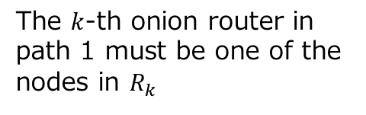

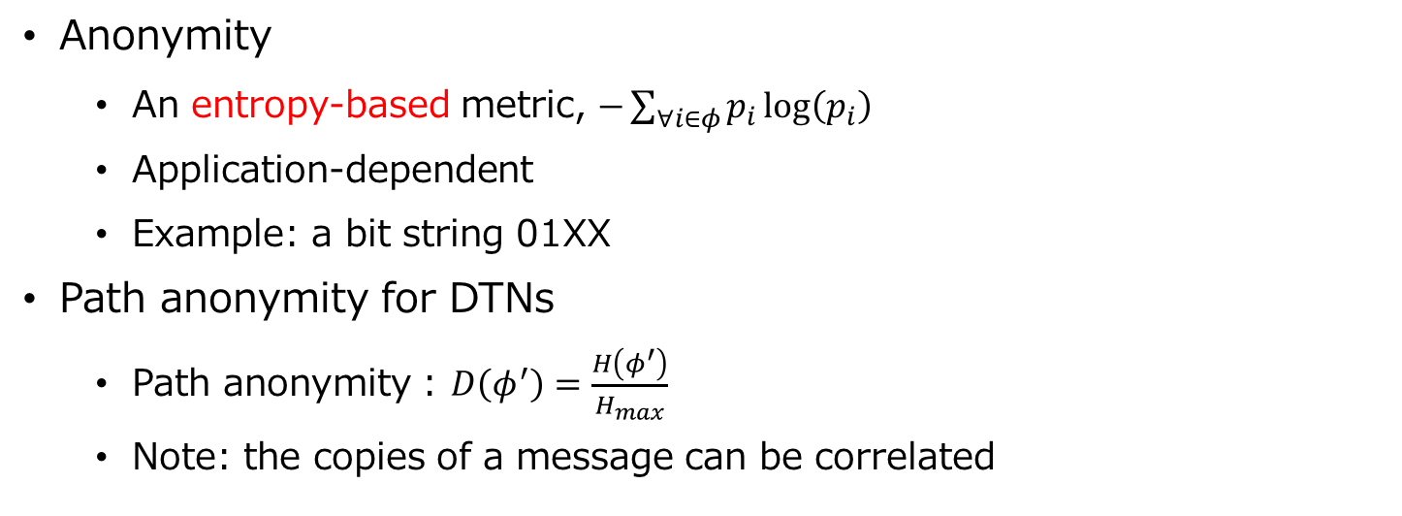
Path Anonymity
Anonymity
An entropy-based metric, $−\sum_{∀i∈φ}{p_{i}\log\left(p_{i}\right)}$
Application-dependent
Example: a bit string 01XX
Path anonymity for DTNs
Path anonymity : $D\left(φ^{′}\right)=\frac{H\left(φ^{′}\right)}{H_{max}}$
Note: the copies of a message can be correlated
{ 0100, 0101,
0110, 0111 }
Path 1
1
$$R_{k}$$
The $k$-th onion router in path 1 must be one of the nodes in $R_{k}$
2
…
$$g$$
Path 2
Compromised node

Slide 18
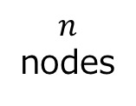
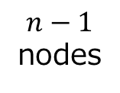
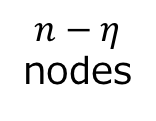
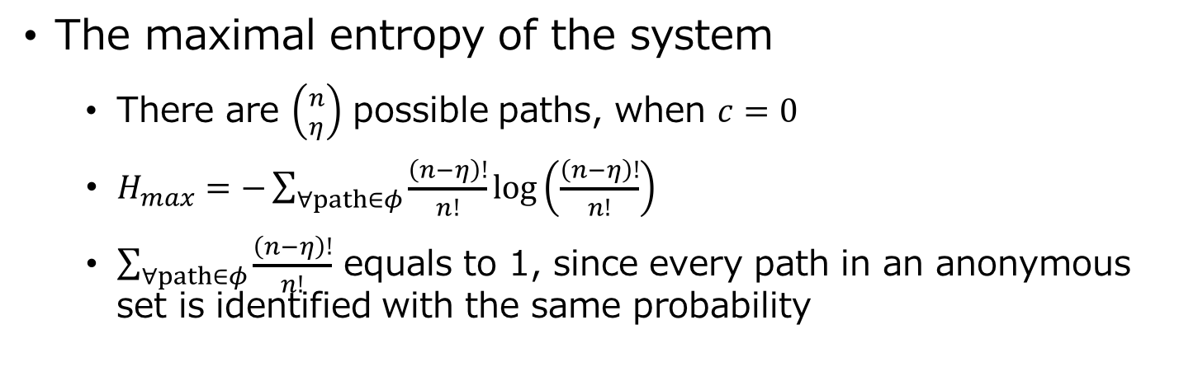
Path Anonymity (Cont.)
The maximal entropy of the system
There are $\left({n \atop η}\right)$ possible paths, when $c=0$
$H_{max}=−\sum_{∀path∈φ}{\frac{\left(n−η\right)!}{n!}}\log\left(\frac{\left(n−η\right)!}{n!}\right)$
$\sum_{∀path∈φ}{\frac{\left(n−η\right)!}{n!}}$ equals to 1, since every path in an anonymous set is identified with the same probability
$$n$$
nodes
$n−1$ nodes
$n−η$ nodes
…

Slide 19
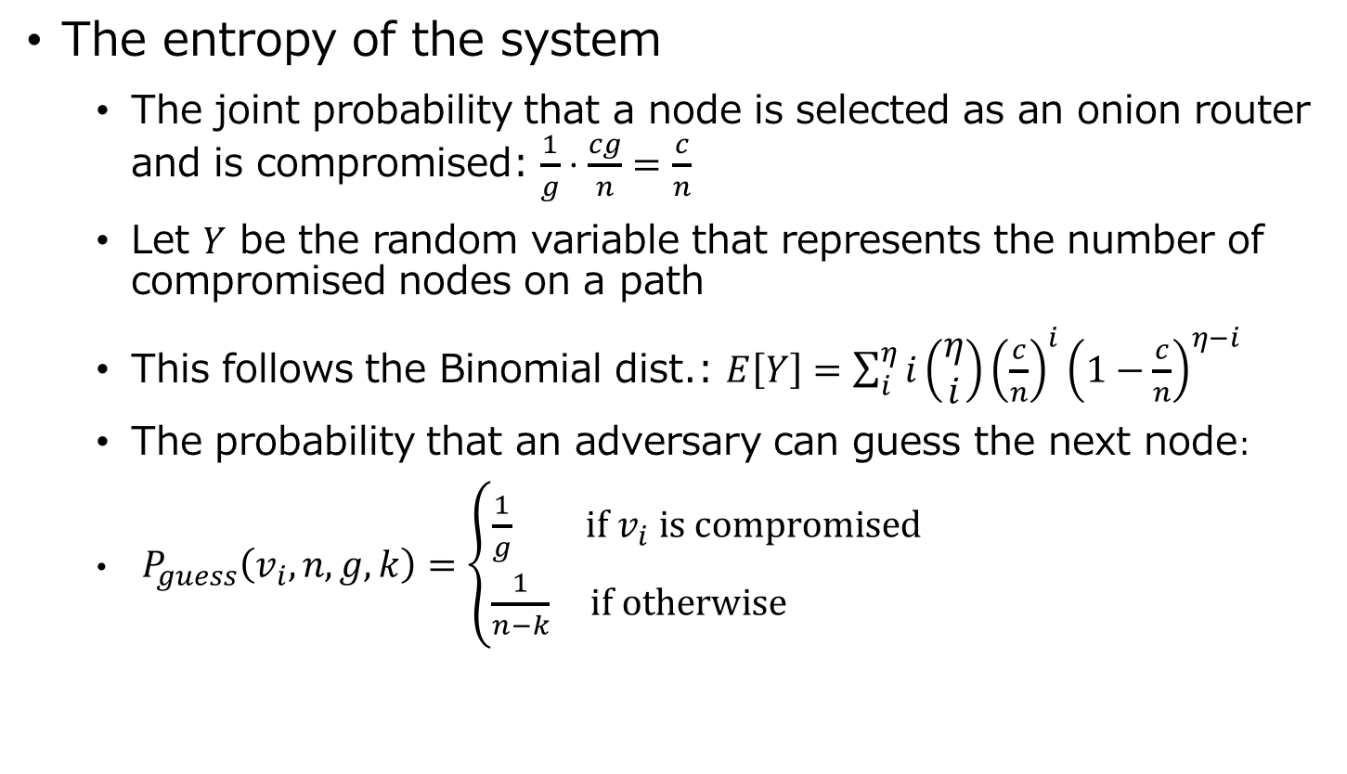
Path Anonymity (Cont.)
The entropy of the system
The joint probability that a node is selected as an onion router and is compromised: $\frac{1}{g}⋅\frac{cg}{n}=\frac{c}{n}$
Let $Y$ be the random variable that represents the number of compromised nodes on a path
This follows the Binomial dist.: $E\left[Y\right]=\sum_{i}^{η}{i\left(\begin{aligned}η \\ i\end{aligned}\right)}{\left(\frac{c}{n}\right)}^{i}{\left(1−\frac{c}{n}\right)}^{η−i}$
The probability that an adversary can guess the next node:
$P_{guess}\left(v_{i}, n, g, k\right)=\left\{\begin{aligned}\frac{1}{g} if v_{i} is compromised \\ \frac{1}{n−k} if otherwise \end{aligned}\right.$

Slide 20
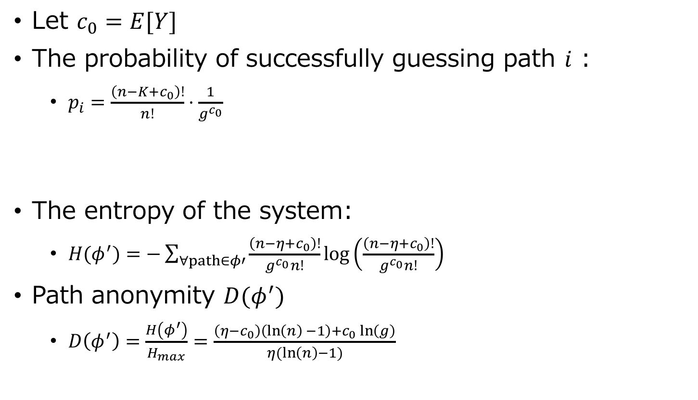
Path Anonymity (Cont.)
Let $c_{0}=E[Y]$
The probability of successfully guessing path $i$ :
$p_{i}=\frac{\left(n−K+c_{0}\right)!}{n!}⋅\frac{1}{g^{c_{0}}}$
The entropy of the system:
$H(φ^{′})=−\sum_{∀path∈φ′}{\frac{\left(n−η+c_{0}\right)!}{g^{c_{0}}n!}}\log\left(\frac{\left(n−η+c_{0}\right)!}{g^{c_{0}}n!}\right)$
Path anonymity $D(φ^{′})$
$D\left(φ^{′}\right)=\frac{H\left(φ^{′}\right)}{H_{max}}=\frac{\left(η−c_{0}\right)\left(\ln\left(n\right) −1\right)+c_{0}\ln\left(g\right)}{η(\ln\left(n\right)−1)}$
In the case that a node is compromised
In the case that a node is NOT compromised

Slide 21
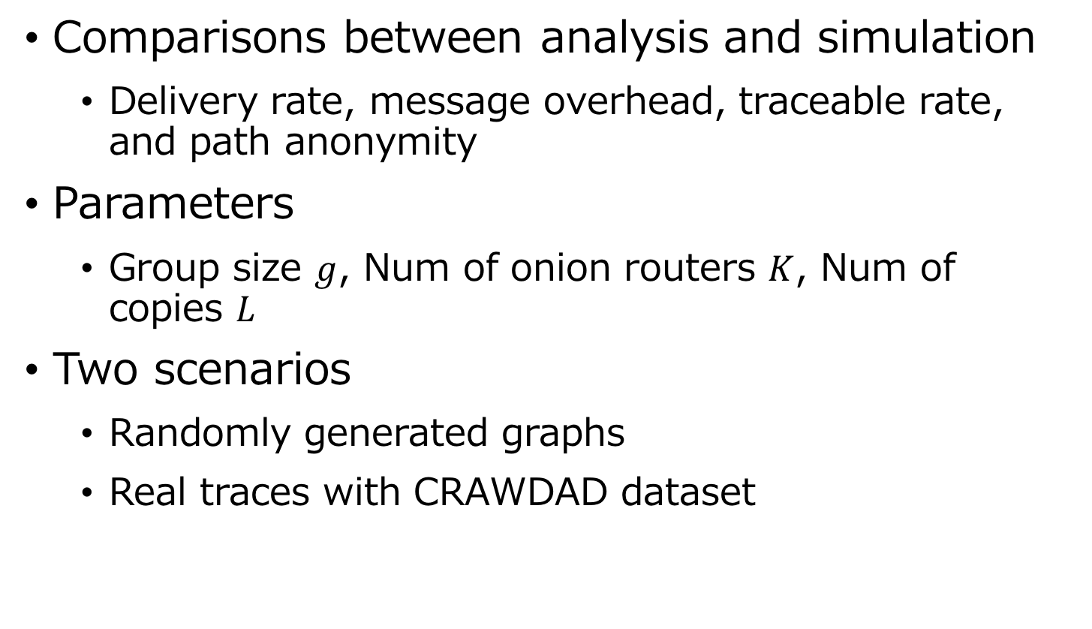
5. Simulations
Comparisons between analysis and simulation
Delivery rate, message overhead, traceable rate, and path anonymity
Parameters
Group size $g$, Num of onion routers $K$, Num of copies $L$
Two scenarios
Randomly generated graphs
Real traces with CRAWDAD dataset

Slide 22
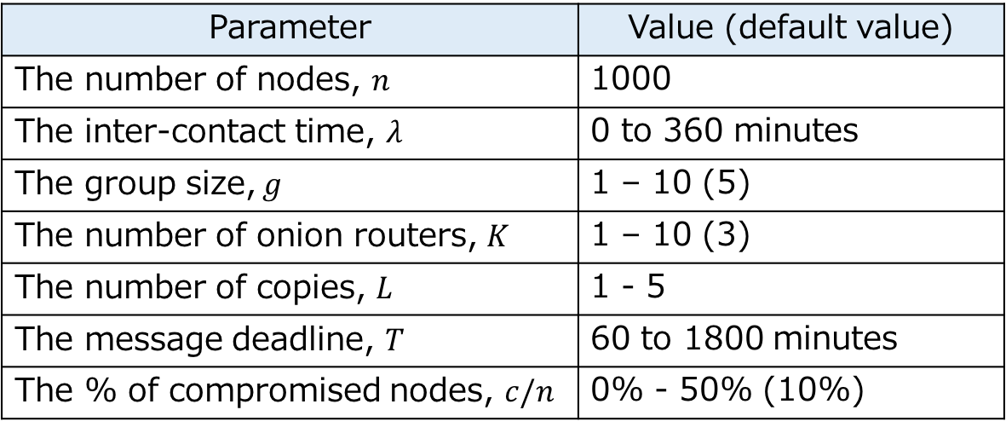
Simulations with Random Graphs
A contact graphs are randomly generated
1000 simulations experiments are conducted
Table. Simulation parameters.
Parameter | Value (default value)
The number of nodes, $n$ | 1000
The inter-contact time, $λ$ | 0 to 360 minutes
The group size, $g$ | 1 – 10 (5)
The number of onion routers, $K$ | 1 – 10 (3)
The number of copies, $L$ | 1 - 5
The message deadline, $T$ | 60 to 1800 minutes
The % of compromised nodes, $c/n$ | 0% - 50% (10%)

Slide 23

Delivery Rate and Message Overhead
Fig. Delivery rate
Fig. Message overhead
The delivery rate increases as the value of $L$ increases
The # of msg forwarding increases, as the value of $L$ increases

Slide 24
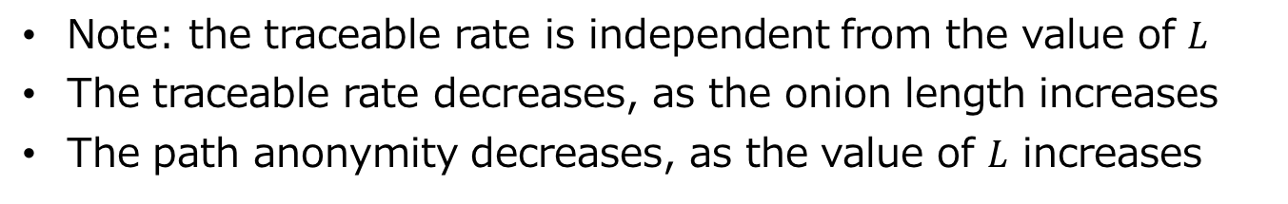
Traceable Rate and Anonymity
Fig. Traceable rate
Fig. Path Anonymity
Note: the traceable rate is independent from the value of $L$
The traceable rate decreases, as the onion length increases
The path anonymity decreases, as the value of $L$ increases

Slide 25
Results with Real Traces
Fig. the delivery rate
Cambridge traces (a small and dense network with 12 iMotes)
Fig. the delivery rate
Infocom’15 traces (a medium size network with 41 iMotes)
There exist on and off-business hours

Slide 26
6. Conclusions
We emphasize the theoretical aspects of onion-based anonymous routing in DTNs
An abstract of onion-based anonymous routing protocols
The analysis of the delivery rate, message overhead, traceable rate, and path anonymity
The analyses provide the closed-form solutions to approximate the simulation results

Slide 27
Thank you

Slide 28
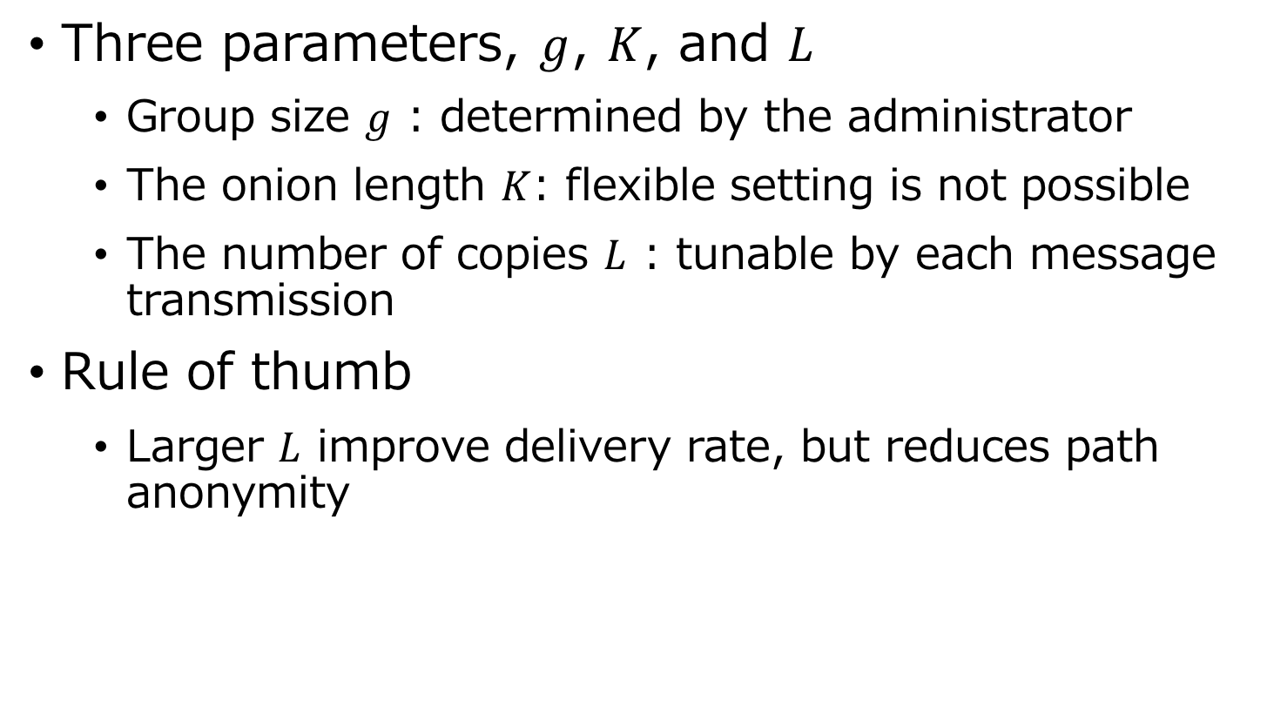
Observations
Three parameters, $g$, $K$, and $L$
Group size $g$ : determined by the administrator
The onion length $K$: flexible setting is not possible
The number of copies $L$ : tunable by each message transmission
Rule of thumb
Larger $L$ improve delivery rate, but reduces path anonymity

