Slide 1

Emerging Research Challenges in the Era of IoT
Jie Wu
Temple University

Slide 2
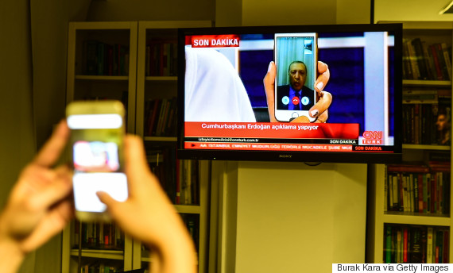
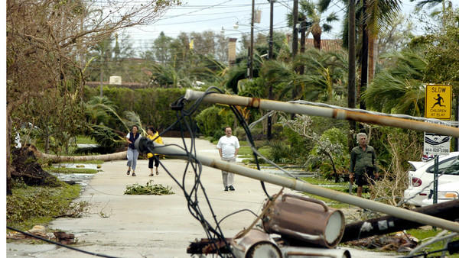
IoT for Emergency Response
Infrastructure
Erdogan used FaceTime to reach out during military coup in Turkey (July 2016)
Infrastructureless
6 millions people without power for two weeks in South Florida (Nov. 2005, hurricane Wilma)
Evolution of Smart-Phone Based Emergency Communications Network (NSF project)

Slide 3
Theoretical Foundations: Autonomous IoT
Approximate computing
  Energy- and accuracy-aware
  Online vs. offline
  Local vs. global algorithms
Local algorithms
  Local interactions with global properties
  Minimizing state information
  Adaptive to changes
  Implicit coordination
What can be efficiently and locally computed?
e.g. Virtual backbone coverage & connectivity
  Marking process: A node is marked if it has two unconnected neighbors
  Good performance for geometric graphs
x
y
v
u
w
n
m
Notes:
Context-aware and social-aware. Compressed sensing with reduced number of sampling points

Slide 4
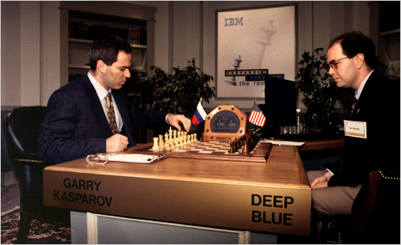
Human-in-the-loop: Crowdsensing
Crowdsourcing: crowdsensing
  Security, privacy, and trust
Things (Intelligent IoT)
  Smarter Than You Think
Who is smarter?
  Human, things, or a combination of both?
1997 (Chess)
  Kasparov vs. Deep Blue
1998
  Kasparov vs. Topalov: 4:0
  Kasparov + machine vs.
  Topalov + machine: 3:3
2005 (Freestyle tournament)
  Grand-master (>2,500)
  Machine (Hydra)
  Grand-master + machine
  Amateurs (>1,500) + machine *
2016 (Go game)
  AlphaGo vs. Lee Sedol: 4:1
Notes:
Smart-objects are human-carried or human-related devices. Trust: friendship, ownership, and community. Social IoT

Slide 5
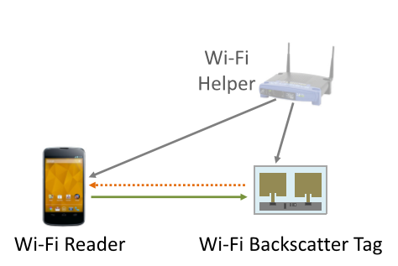
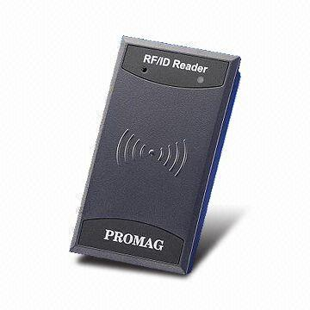
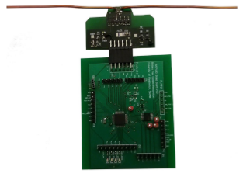
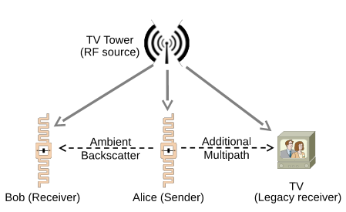
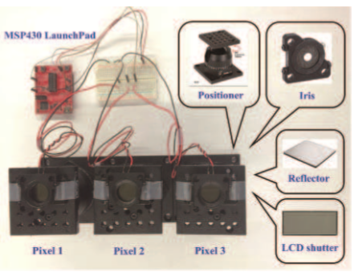
Energy-Related Technology
Wireless Energy Transfer & Battery Free Devices
Energy from RFID reader
Energy from Wi-Fi signal
Achieving average accuracy of 97% for distances of up to 2.5 feet (outdoor) and 1.5 feet (NSDI’14)
Achieving rates of 1 kbps and ranges of up to 2.1 meters (SIGCOMM’15)
Energy from TV tower
Energy from visible light
Achieving rates of 1 kbps over distances of 2.5 feet and 1.5 feet (SIGCOMM’13)
600 bps is achieved at 2 meters (airXiv’16)

Slide 6
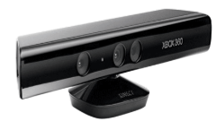
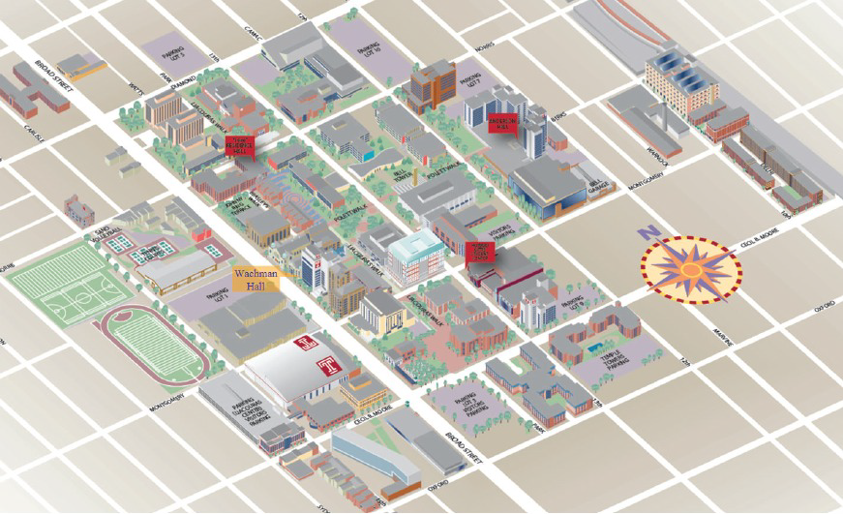

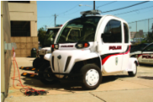



Applications in US Ignite for Smart City
Safety surveillance system on campus police
Key features
Use 3D cameras (e.g. Kinect) for monitoring
Supercluster backend for video surveillance
QoS-based rate adaptation
Secure data transmission and data sharing
Mobility-Enhanced Public Safety Surveillance System using 3D Cameras and High Speed Broadband Networks (NSF project)
Adjust video quality
Adjust wireless quality
On-board processing
Remote processing
Notes:
6
5 billions people in urban sitting (2030). Smart governance, mobility, utilities, building, and environment. European and China smart cities projects.

Slide 7





Advanced Wireless Research Initiative
Future
200B connected devices globally by 2020
1000x improvements
Technologies
mmWave
Dynamic spectrum sharing
Network virtualization (SDN)
Mobility-at-scale
…
Exciting news
$400M: next seven years
FCC Spectrum Frontier: open up spectrum bands
21 companies
Applications
Environmental sensing
Telemedicine
Autonomous vehicles
Immersive communications
…
Notes:
Integration of Cloud Computing and IoT

