Slide 1
Fast Information Cascade Prediction Through
Spatiotemporal Decompositions
Huanyang Zheng and Jie Wu
Department of Computer and Information Science
Temple University, USA

Slide 2

Introduction
Online social network:
Fundamental medium for information spreading
Share startling news, creative
ideas, and interesting stories
Information cascade:
If Alice shares a photo, Bob may scan this photo and then further share it with his/her followers later
Iterative information propagations

Slide 3

Introduction
Cascade predictions are important:
Control of online rumors
Forecast of marketing strategies
Challenges:
When will a user further propagate the information?
How should we process the social topological and time information?

Slide 4

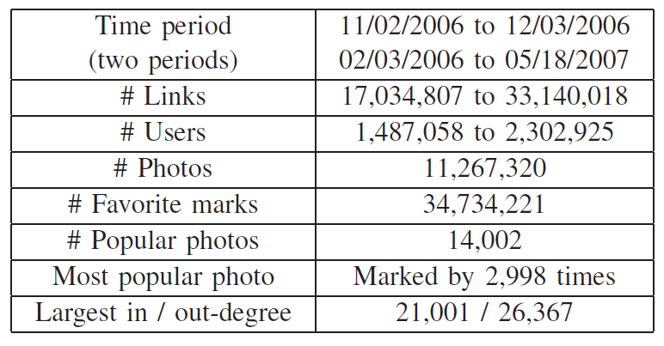
Dataset observations
Flickr dataset:
An online social network site for
sharing photos among users
Photos can be labeled by “favorite-mark” (cascade)

Slide 5
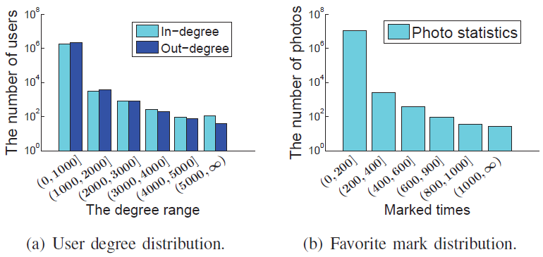
Dataset observations
Dataset observations:
A large amount of data!
Social topological information
Time information (cascade time)

Slide 6
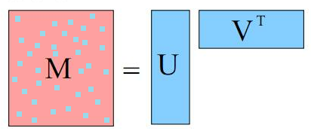
Ideas
Objective – predict the number of propagated users at a future time slot
Idea – decompose the spatiotemporal cascade information to user characteristics
Conduct predictions based on user characteristics
Reduce the time complexity of the algorithm
Detail – convert matrix to vectors
Cascade information – a matrix
User characteristics – two vectors

Slide 7
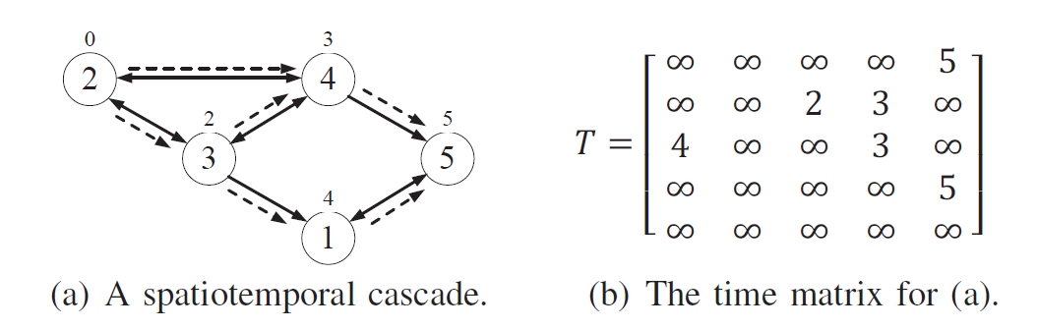
Ideas: Spatiotemporal Information
Spatiotemporal cascade information
A time matrix also includes the space information:
  Nodes that are closer within the social topology are more likely to be propagated at closer times.
Let t_{ij} be the time when user j starts to propagate information after having been influenced by user i.

Slide 8
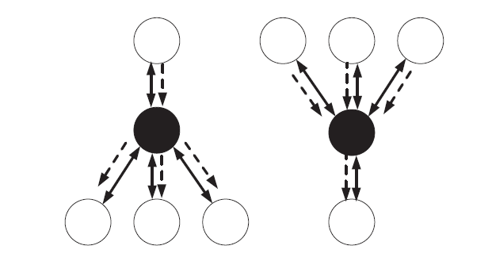
Ideas: User Characteristics
User characteristics (two vectors)
Persuasiveness (information sender)
  Followees’ abilities to propagate information
Receptiveness (information receiver)
  Followers’ willingness to accept information.
High persuasiveness
and receptiveness
Low persuasiveness
and receptiveness

Slide 9
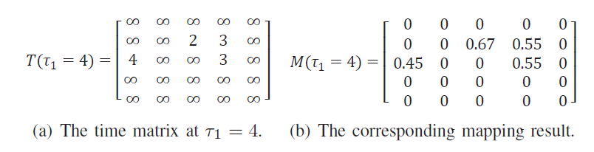
Decomposition
Step 1: map the time matrix to a weighted matrix
Mapping objective
  Tune the weights of space and time information
  Earlier cascades are more important (larger value)
Use exponential functions (memoryless function)

Slide 10
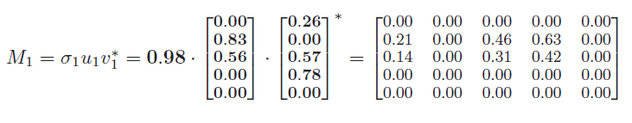
Decomposition
Step 2: singular value decomposition (SVD)
Approximately reconstruct the weighted matrix (the tuned time matrix) by two vectors
Two vectors represent persuasiveness and receptiveness, respectively
Larger value in the matrix (earlier cascades)
  Result in larger persuasiveness and receptiveness

Slide 11
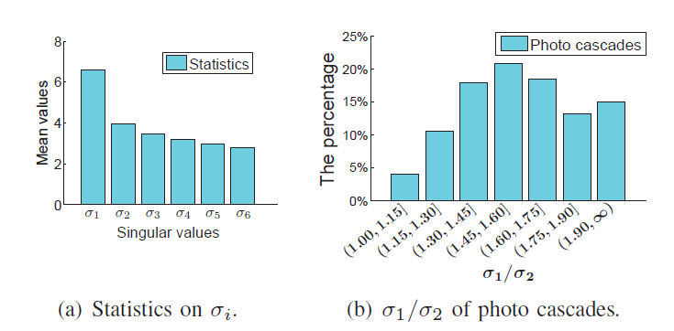
Decomposition
Information loss in the decomposition
Can be revealed by the largest singular values
Information loss is limited!

Slide 12
Cascade prediction
The pattern of persuasiveness
If a node with a high out-degree is spatially far away from the information source, it may not be propagated, and thus it cannot positively propagate the information further (i.e., low persuasiveness).
In the case of a temporal remote node, it also has low persuasiveness, since its followers may have been propagated by other nodes.
A similar rule works for the receptiveness.

Slide 13
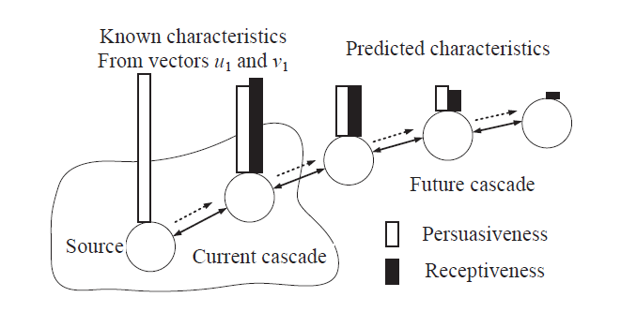
Cascade prediction
The pattern of the cascade
Persuasiveness and receptiveness should decay with respect to their spatiotemporal distances to the source

Slide 14
Cascade prediction
Non-historical predictions
Predict persuasiveness and receptiveness hop by hop
Along the shortest path tree from the source to the other nodes
Historical predictions
Use historical data as predictions
Assemble predicted persuasiveness/receptiveness
Recover the time matrix as the final prediction

Slide 15
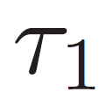
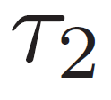
Evaluations
We focus on cascades of popular photos that are marked “favorite” more than 100 times
Photos of different levels of popularity stand for cascades of different types
Each photo may be involved in multiple cascades that are independent of each other
Only the largest cascade is selected
Define as the current time, and as the future time for the cascade prediction

Slide 16
Evaluations
Baseline algorithms:
Largest in-degree: the largest in-degree node (in social topology) would be the next propagated node
Most influenced: the node that has the largest number of incoming propagated neighbors would be the next propagated node
Most active: the node that is the most active (propagated by former cascades for the most times), would be the next propagated node
User personality: incorporate extra user personality

Slide 17
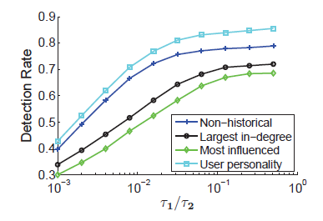
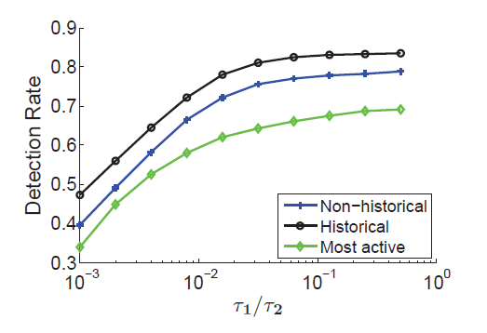
Evaluations
Non-historical v.s. historical (detection rate):

Slide 18
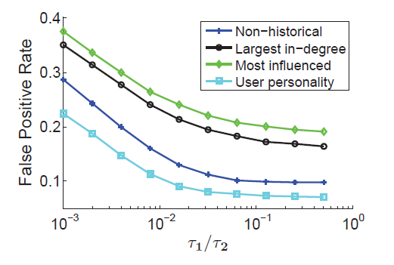
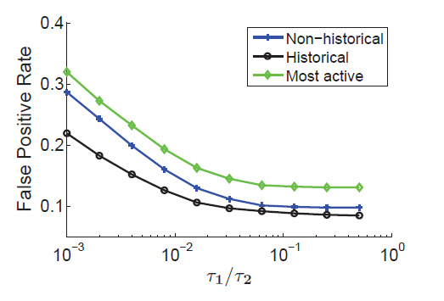
Evaluations
Non-historical v.s. historical (false positive rate):

Slide 19
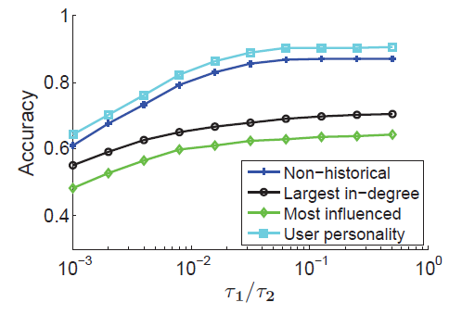
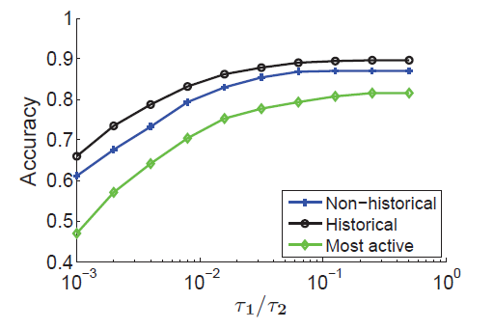
Evaluations
Non-historical v.s. historical (accuracy):

Slide 20

Evaluations
Evaluation summary:
For non-historical predictions, our algorithm gets about 20% higher accuracy than the two baselines (for )
For historical predictions, our algorithm gets about 15% higher accuracy than the baseline, and 10% higher accuracy than the non-historical algorithm
The future of the cascade is very “predictable”. A small amount of existing information can provide very accurate future predictions

Slide 21
Conclusions
Conclusions:
Decompose the space and time cascade information into user characteristics
The information loss in the decomposition is limited
Use the shortest path tree to infer the trace of the information propagation
Future work
Parallel and distributed computing

Slide 22
End
Thank you!
Questions?

