Slide 1

Optimizing MapReduce through Joint Scheduling of Overlapping Phases
Huanyang Zheng, Ziqi Wan, and Jie Wu
Dept. of Computer and Info. Sciences
Temple University
Notes:
1

Slide 2

Road Map
  Introduction
  Model and Formulation
  Observation and Ideas
  Algorithms
  Experiments
  Conclusion

Slide 3
1. Introduction
  Map-Shuffle-Reduce
  Map and Reduce: CPU-intensive
  Shuffle: I/O-intensive
  Merge Sort
  Map: sorts local arrays
  Shuffle: shuffles sorted arrays
  Reduce: merges sorted arrays
map
shuffle
reduce
Local sort
Local sort
Merge
Local sort

Slide 4
Introduction
  Map-Shuffle-Reduce Jobs
  Reduce is not discussed (Zaharia, OSDI 2008)
  Only 7% of jobs in MapReduce are reduce-heavy
  Map and Shuffle
  CPU-intensive and I/O-intensive (can overlap)
  Centralized scheduler
  Determine an execution order of jobs
  on map pipeline and shuffle pipeline

Slide 5
Introduction
  Dependency relationship
  The map emits data at a given rate
  Shuffle waits for the data emitted by map
  may be delayed by the scheduling policy
  Job classification
  Map-heavy: map workload > shuffle workload
  Balanced: map workload = shuffle workload
  Shuffle-heavy: map workload < shuffle workload

Slide 6
Introduction
  Impact of overlapping map and shuffle phases
map pipeline
shuffle pipeline
Word count (map-heavy)
Merge sort (shuffle-heavy)

Slide 7
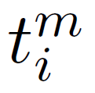




2. Model and Formulation
  Jobs in Map-Shuffle-Reduce
  A set of n jobs:
  J = { J₁, J₂, …, J_{n} }
  map workload of J_{i}
  shuffle workload of J_{i}
  Job classification:
  Map-heavy if
  Shuffle-heavy if
  Balanced if

Slide 8
Model and Formulation
  Schedule objective
  Minimize average job completion time
  includes waiting time before job start
  Schedule is NP-hard
  Offline scenarios
  All jobs arrival at the beginning (waiting for schedule)

Slide 9

3. Observation and Ideas
  When all jobs are map-heavy, balanced, or shuffle-heavy
  Optimal schedule:
  Sort job by dominant workload
  Smaller jobs are executed earlier
map
pipeline
shuffle
pipeline

Slide 10

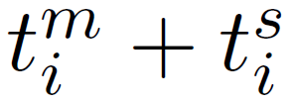
Perfect Pair
  When jobs can be perfectly “paired”
  Jobs J_{i} and J_{j} are paired, if
  Optimal schedule:
  Pair jobs (shuffle-heavy before map-heavy)
  Sort job pair by total workload
  Smaller pairs are executed earlier
map pipeline
shuffle pipeline

Slide 11
Theorem
Theorem: If jobs can be perfectly paired, the optimal schedule pairwisely executes jobs in a pair.
In each pair, shuffle-heavy job is executed before map-heavy job
Job pairs with smaller total workloads are executed earlier
Proof:
In each pair, shuffle-heavy job is executed before map-heavy job
Otherwise a swap leads to a better result
Job pairs with smaller total workloads are executed earlier
Otherwise a swap leads to a better result

Slide 12
Proof
  Proof: jobs in a pair are executed together
  Induction: shuffle-heavy J₁ and map-heavy J₂
  Base case validates
  Suppose the theorem validates for J
  Prove validation for J₁, J₂, and J
  Theorem also holds for uniform data rate

Slide 13
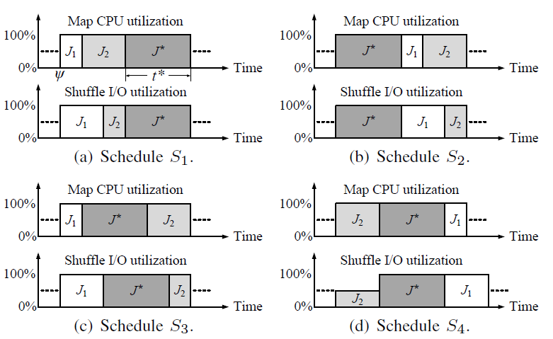
Proof
Induction validates: the best schedule is S₁ or S₂

Slide 14
Two Insights
  Two scheduling factors for non-perfectly paired
  Schedule smaller jobs first (dominant)
  Jobs should be paired (non-dominant)

Slide 15
4. Algorithms
  Two-stage scheduling algorithm
  Group jobs by their workloads (first factor)
  Optimally divide jobs into k groups
  Criterion: minimize the sum of maximum job
  workload difference within each group
  Execute the group of smaller jobs earlier
  Job are paired in each group (second factor)
  Jobs in each group have close workloads
  Pair shuffle-heaviest and map-heaviest jobs:

Slide 16
Algorithms
  Example: two-stage scheduling algorithm
  (order only)

Slide 17

Algorithms
  Dominant workload scheduling policy (DWSP)
  Group jobs by dominant workloads,
  Performs well when jobs are simultaneously
  map-heavy, balanced, or shuffle-heavy
  Total workload scheduling policy (TWSP)
  Group jobs by total workloads,
  Performs well, when jobs can be perfectly paired
  Weighted workload scheduling policy (WWSP)
  A tradeoff between pair-based and couple-based policies
  Group jobs by weighted workloads

Slide 18
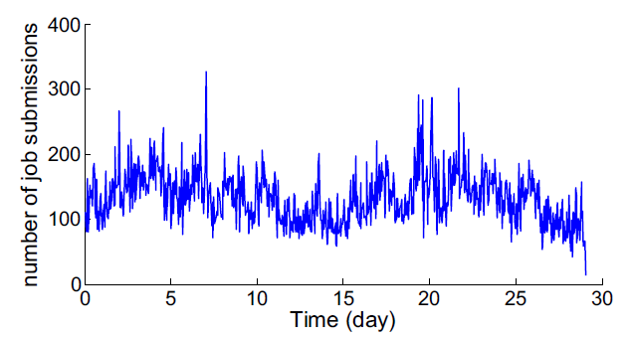
5. Experiments
  Google Cluster Dataset
  About 11,000 machines
  96,182 jobs over 29 days in May 2011 (time collapsed)
  Number of job submissions per hour (arrival rate)

Slide 19
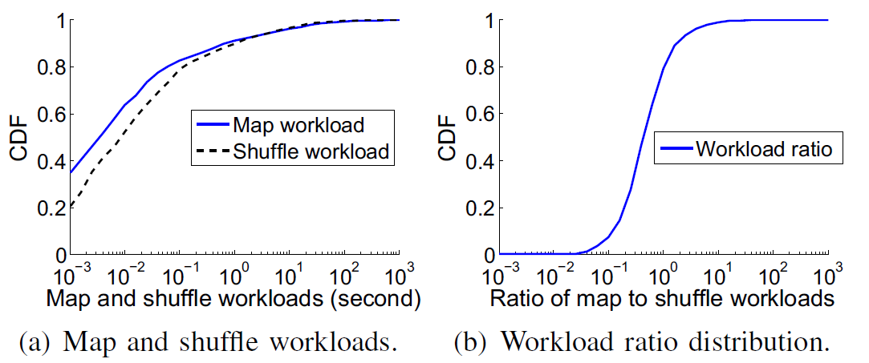
Experiments
  Google Cluster Dataset
  Distribution of map and shuffle time

Slide 20
Experiments
  Comparison algorithms
  Pairwise: has only one group, then iteratively pairs the
  map-heaviest and shuffle-heaviest jobs in the group
  MaxTotal: rank jobs by total workload
  smaller total workload is executed earlier
  MaxSRPT: rank jobs by dominant workload
  smaller dominant workload is executed earlier

Slide 21
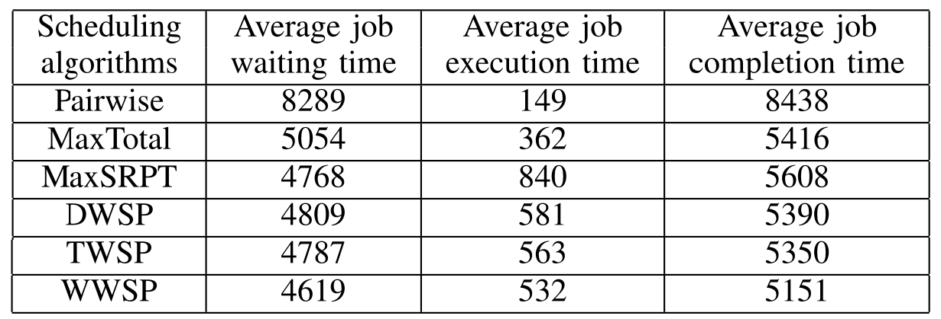
Experiments
  Performance (group k = 20 and weight α = 0.5)
  Improvement by considering both job workloads and pairs

Slide 22
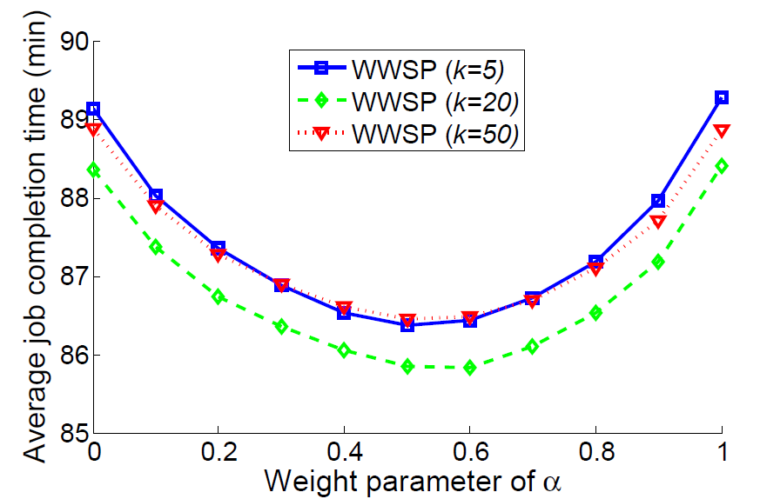
Experiments
  Impact of k and α
  Group-based scheduling policy with k groups
  Sort jobs by
  Small/Large group k
  Small/large weight α
Minimized
when α = 0.57

Slide 23
Simulation Summary
  Pairwise has the smallest average job execution time, but
  large job waiting time, since job workloads are ignored
  MaxTotal and MaxSPRT do not balance the trade-off between job size and job pair
  DWSP, TWSP, and WWSP jointly consider job sizes and job pairs

Slide 24
6. Conclusion
  Map and Shuffle phases can overlap
  CPU and I/O resource
  Objective: minimize average job completion time
  Two-stage schedule
  Job workloads (dominant factor)
  Job pairs (avoid I/O underutilization)
  Optimality under certain scenarios

