Slide 1



KV Cache Reuse for Elastic LLM Inference
on Edge Devices
Peishuo Wang, Zhenzhe Zheng, Xiaoyao Huang†, Jie Wu†*, Fan Wu, Guihai Chen
Shanghai Jiao Tong University & †China Telecom & *Temple University
2026-6-22
IEEE ICDCS 2026, Seoul, South Korea
Notes:
Good afternoon everyone. Today I will introduce our work, "KV Cache Reuse for Elastic LLM Inference on Edge Devices. "

Slide 2
Outline
1. Background & Motivation
2. Design of ElastKV
3. Improvements for Practical Deployment
4. Evaluation
5. Conclusion
Notes:
Here is the outline of my talk. I'll first introduce the background and motivation, then present our design called ElastKV, discuss practical deployment improvements, show evaluation that demonstrates the effectiveness of our method, and finally our conclusion.

Slide 3
Background & Motivation
Notes:
The first part is Background and Motivation.

Slide 4






Background: On-Device LLM Services
LLMs deployed on edge devices for privacy, low latency, and personalization
personalized data
general knowledge
Stock in Smart Fridge
bell pepper, brocoli, carrot
What to cook today?
History Orders
2026-6-20, Mexican Cuisine
Chat Records
… I’m allergic to peanuts …
Prefix Caching: reuses KV pairs from common prefixes across requests
Multi-trun QA
Shared prefix
Turn 1
Turn 2
Turn 3
Q1
A1
Syetem Prompt
User Rules
Q1
Reused KV
Q1
A1
Q2
A2
Q1
A1
Q2
A2
Q3
A3
Syetem Prompt
User Rules
Q2
Prefilling
Notes:
Large language models are attracting growing interest for deployment on edge devices due to privacy and personalization requirements. At the top, we show an example, to answer the question well, the model may need both personalized data and general knowledge.
Due to resource constraints, LLM deployed on edge devices requires efficient inference techniques. Prefix KV caching is an example.
KV cache stores intermediate computation states to avoid redundant computation during autoregressive generation. Prefix caching reuse KV pairs from common prefixes across different requests. At the bottom, we show two examples: KV cache can be reused in multi-turn question answering tasks and across different queries if there exists common prefix such as system prompt and rules created by user.

Slide 5


Background: Elastic LLM Inference on Edge Devices
Fluctuating resources: edge devices often experience fluctuating memory and compute resources
Fluctuating resources makes elastic inference essential for on-device LLM deployment.
Opening a new app
High resources
Low resources
Elastic Inference: dynamically switches between different versions of the model
Low resources
Medium resources
High resources
4-bit
moel
6-bit
moel
8-bit
moel
Challenge: How to support both KV cache reuse in elastic LLM inference?
Notes:
However, edge devices often experience fluctuating resources. For example, when the user opens a new application, the available resources for the LLM service may drop from high to low.
This makes elastic inference essential. The lower part of the slide shows the idea. We have a model of different sizes. When resources are low, the system may run a smaller model, such as a four-bit model. When resources are abundant, it can use an eight-bit model for better accuracy. This enables adaptive on-device deployment under changing resources.
But now we have a key challenge: How can we support KV cache reuse in elastic LLM inference? In other words, if the model switches between different precisions, can we still safely reuse old KV values?

Slide 6
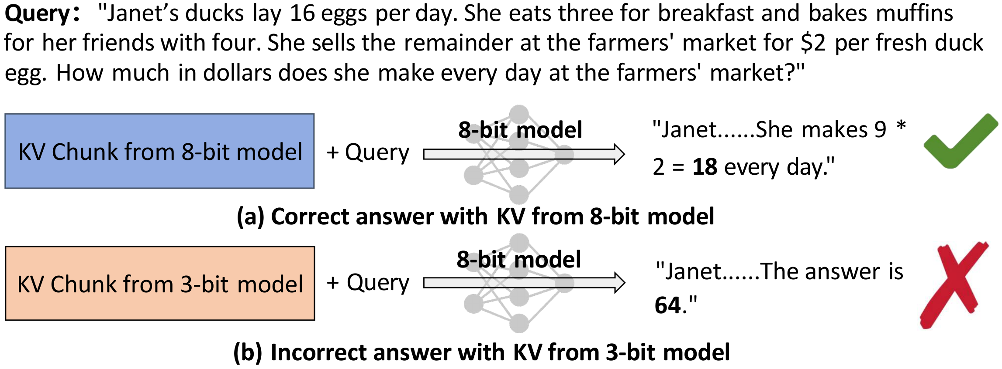
Motivation: The Cross-Precision KV Reuse Problem
When resources fluctuate, system switches model precision:
High memory → 8-bit model (higher accuracy)
Low memory → 3-bit model (lower footprint)
Prior KV caches may come from different precision models.
Directly reusing KV from lower-precision → wrong answer!
Notes:
As noted earlier, prior KV values may come from different precision models.
The bottom shows a math problem example. When an eight-bit model reuses KV generated by itself at eight-bit precision, it gives the right answer. But when the same eight-bit model reuses KV generated by the three-bit model, it gives the wrong answer.
So the direct reuse of old KV cache may lead to incorrect output.

Slide 7
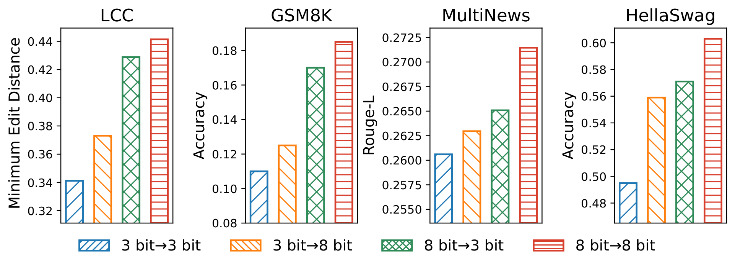
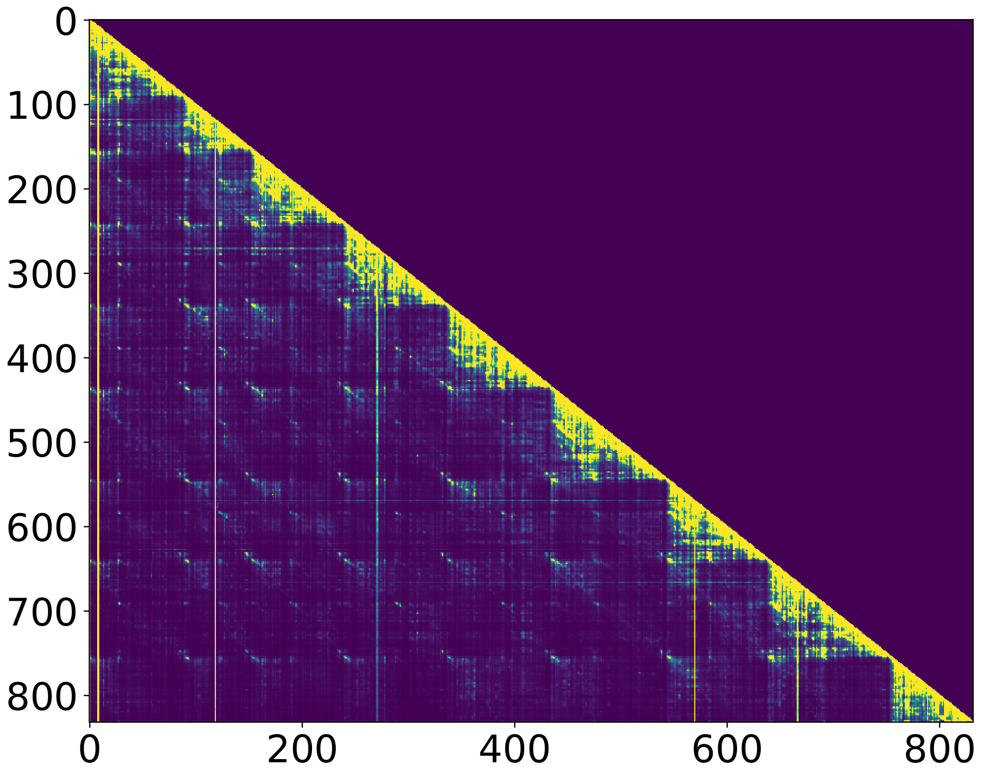
Key Observations
Observation 1:
Low-precision KV → harms high-precision model
High-precision KV → can improve low-precision model
Observation 2:
Attention sparsity: few tokens receive high attention
LLMs can tolerate small KV deviations
→ Selective recomputation can correct most deviations!
Notes:
We further test this on four datasets. For each input, we split the prompt into two halves. One model processes the first half, while another model reuses the cache to process the second half and give the output. We evaluate all four combinations of three-bit and eight-bit. The results show that cache from three-bit model degrades the performance of eight-bit model, while cache from eight-bit model improves the performance of three-bit model. This suggests that not all cross-precision KV reuse is harmful.
Can we reuse KV without recomputing all tokens? The second observation is shown by the attention heatmap at the bottom right. Only a small number of token positions receive high attention. This means not all tokens are equally important for the final output.
Based on the observation, we get the opportunity: selective recomputation may be enough to correct most harmful KV deviations, we only need to identify and recompute the KV values of the most important tokens.

Slide 8
Challenges
Challenge 1: Cross-Precision Caching
The reliability of reusing or recomputing them is unclear. A recomputation rule is needed.
Challenge 2: Recomputation Across Models
Existing KV recomputation methods are designed for single model scenarios.
Quantifying each token's KV deviation impact on output — output tokens unavailable.
Challenge 3: Overhead Control
Accurate estimation requires two inference rounds — impractical for edge devices.
Careful control of extra computational overhead, especially on edge devices.
Notes:
Designing efficient and elastic LLM services for edge devices faces three key challenges.
First, the reliability of recomputing is unclear. Recomputing without proper guidance can result in unnecessary overhead and accuracy loss. Thus, a principled recomputation rule is crucial.
Second, existing KV recomputation methods mainly focus on position encoding or cross-attention issues. Our setting is different: cached chunks may be produced by different precision versions of the same model. Therefore, the main challenge is the numerical KV deviation caused by mixed-precision models. To select tokens effectively, we need to estimate how each token’s KV deviation affects the final output.
Third, this estimation must be lightweight. A very accurate estimation may require two inference rounds, which is impractical for edge device., so the overhead must be carefully controlled.

Slide 9
Design of ElastKV
Notes:
(7-8min)
Now I will introduce our design. The design has three main components.
First, we define a recomputation rule to decide which cached KV entries are safe to reuse and which ones should be considered for recomputation.
Second, we estimate token priority by considering both local KV deviation and influence on later tokens.
Third, we perform selective KV recomputation: only the selected tokens are recomputed, while the remaining KV cache is reused.

Slide 10
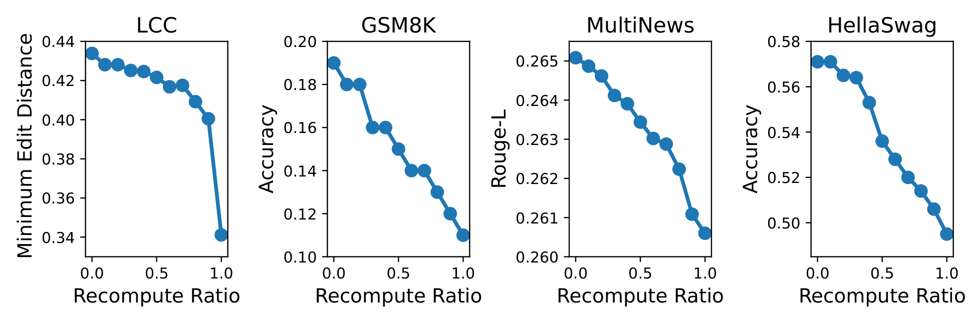
Design: Insights and Recomputation Rule
Impact of Recomputing KV from Higher-bit Models:
Recomputing KV from higher-precision with lower-precision model degrades performance.
Rule: R(Bt, bt)_i = 1 if bt > Bt,i
(only recompute when current model is higher precision)
Fully reuse KV from higher-precision models
Selectively recompute KV from lower-precision models
Notes:
This slide presents the recomputation rule.
Before defining the rule, we conduct a more comprehensive study of what happens if a lower-precision model recomputes KV cache generated by a higher-precision model. The four line graphs shows that, as the recomputation ratio increases, performance consistently drops. This means that if we use a lower-precision model to overwrite high-precision KV values, we may actually make the cache worse.
This motivates a simple rule as the formula shows. In words, we fully reuse KV from higher-precision models, and we selectively recompute KV from lower-precision models. This simple rule prevents unnecessary and harmful recomputation.

Slide 11
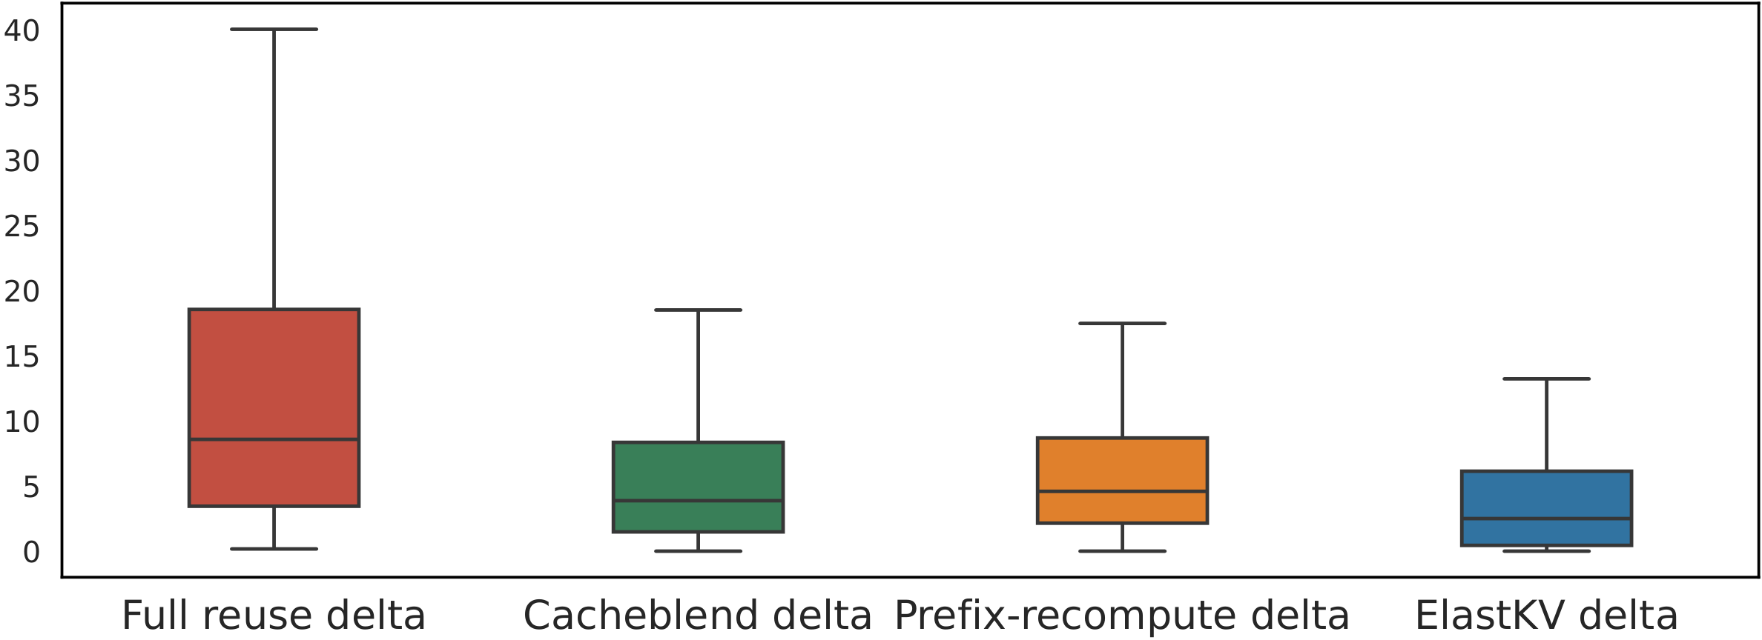

Design: Token Priority Estimation - Taylor approximation
Drawbacks of Prior Work:
KV delta degrades model performance. Existing methods fail to sufficiently reduce it as they only considered repairing position encoding error and cross attention error.
Estimate the impact of each token’s KV deviation on subsequent tokens:
We use first-order Taylor expansion:
(I_ij: influence of token j's KV deviation on output at position i)
Then we compute the L2 norm to get scalar values for easier comparison.
Avoids the need for two inference rounds
Notes:
After applying the recomputation rule, we get a candidate token set. Now the question is: which candidate tokens should we recompute?
A straightforward idea is to use existing selective recomputation methods, but they are designed for a different scenario. Therefore, we evaluate them in our scenario by measuring output deviation from the full 8-bit model. As the box plot shows, full reuse has the largest deviation. CacheBlend and prefix recomputation reduce it, but the gap remains large.
So instead of relying solely on local KV deviation, like existing methods do, the most logical approach is to estimate how each token's deviation affects the model output. The first step is estimating its impact on subsequent tokens.
The equation at the bottom is a first-order Taylor approximation. It estimates how a token's KV deviation influences the output at another token position. After computing this influence, we take the L-two norm to turn them into scalar values for easy comparison. The advantage is that it avoids two full inference rounds so that we can estimate the influence efficiently.

Slide 12
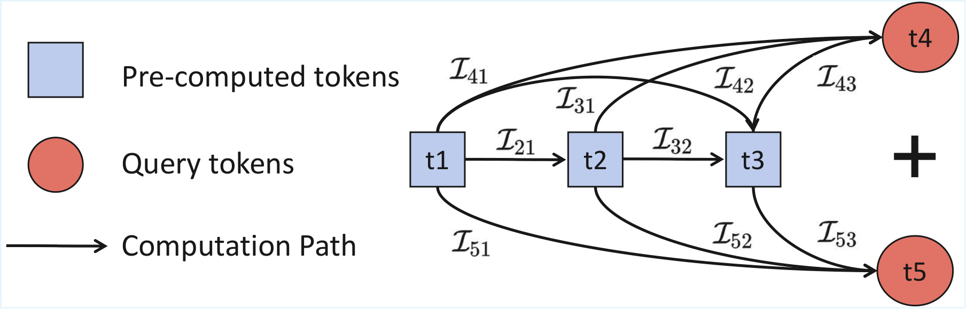
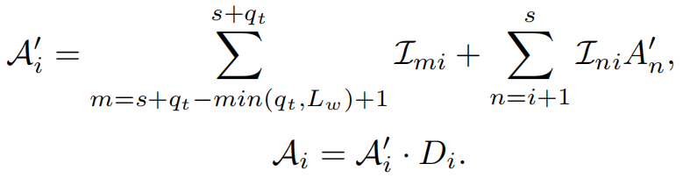
Design: Token Priority Estimation - Influence Path Propagation
Estimate impact through all paths:
KV delta has cascading influence on subsequent tokens
We combine all influence paths to get more precise impact on subsequent tokens.
Estimating the impact of each prior token on the final output
We estimate it by estimating their influence on each token within the query(user input).
Notes:
The previous slide estimates pairwise influence between two tokens. But in Transformer, influence is not only direct. It can propagate through multiple subsequent tokens. The diagram on this slide illustrates this. The blue nodes are cached tokens, red nodes are query tokens. The arrows show influence propagation. For example, token t-one can directly affect t-four, but it also affect t-two and t-two affects t-four. So if we only look at direct influence, we may underestimate the importance of earlier tokens.
Therefore, we combines all influence paths to estimate each prior token’s impact on later tokens.
Another important issue is that output tokens are not available during prefill. To handle this, we use the output tokens at the positions of the last few query tokens as a proxy for the final output.
The equation at the bottom shows the final priority computation. We add KV deviation to consider the error of the token itself
So a token receives high priority only when it has a large KV deviation and this deviation strongly influences future or output-related tokens.

Slide 13
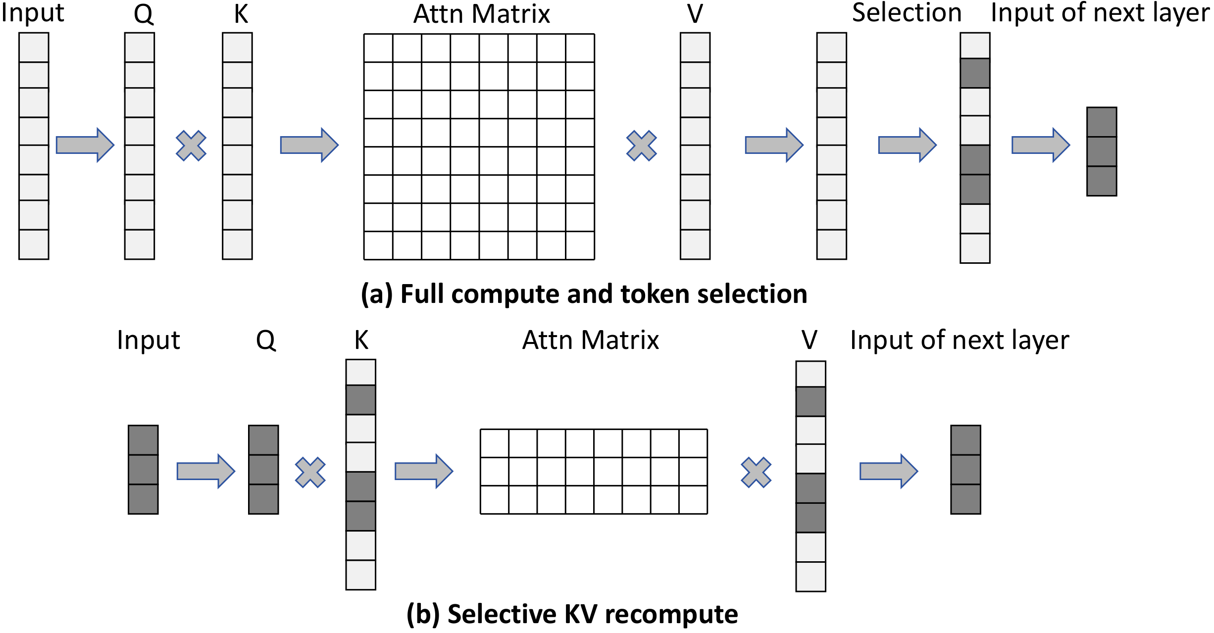
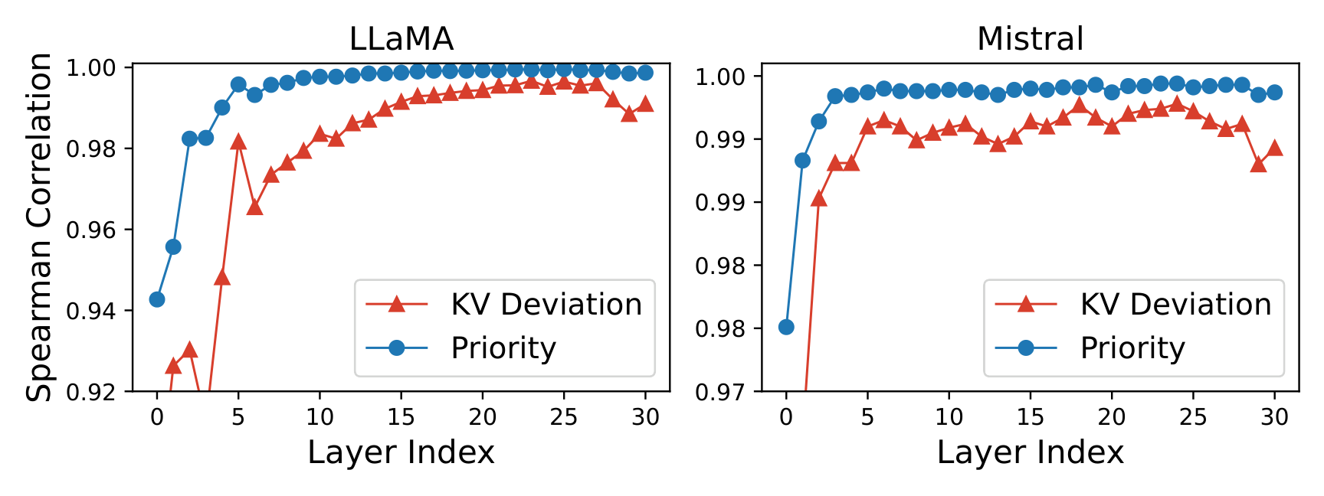
Design: Selective KV Recomputation Workflow
Step 1: Apply recomputation rule → candidate set Ct
Step 2: Estimate priority At at shallow layer
(Taylor + influence paths)
Step 3: Select top r% tokens from Ct by priority
Step 4: Recompute KV for selected, reuse the rest
Token selection fixed across layers (Spearman > 0.92)
Notes:
This slide summarizes the workflow of ElastKV.There are four steps.
First, we apply the recomputation rule and obtain the candidate set.
Second, we estimate the priority vector at a shallow layer, using Taylor approximation and influence-path propagation.
Third, we select the top r-percent tokens from the candidate set according to their priority scores.
Fourth, we recompute only the selected tokens and reuse the rest, as illustrated by the diagrams on the right（ comparing full computation with selective KV recomputation.）
At the bottom, the Spearman correlation plots show that token importance is stable across adjacent layers. Therefore, we fix the selected token set across later layers （instead of reselecting tokens at every layer）. This further reduces overhead.

Slide 14
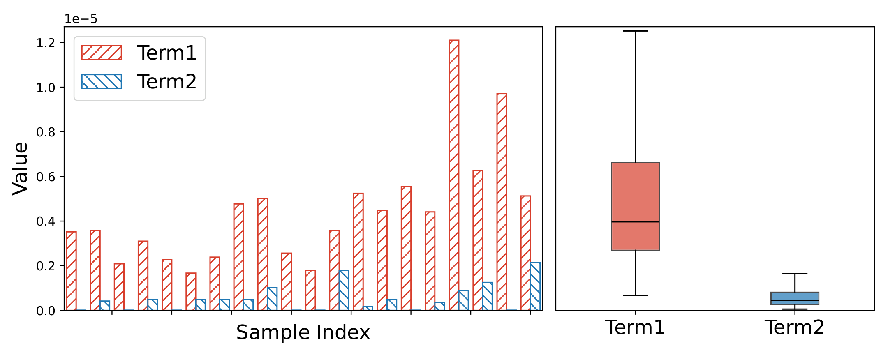

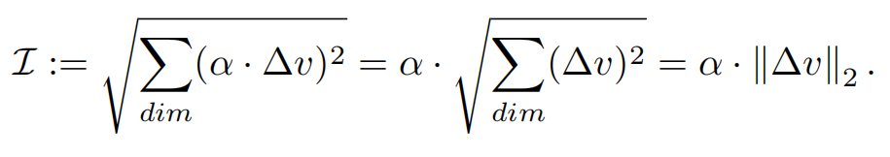

Improvements for Practical Deployment
Taylor Simplification:
First term dominates → Retain term1 only
Memory-Efficient L2 Norm:
precompute L2 norm to avoid 256GB tensor (for 7B model)
If use both terms, we omit cross-product term
Reason : near-orthogonality (cos ≈ -0.009)
Omit
Omit
Notes:
To make ElastKV practical, we introduce two optimizations.
The first is Taylor simplification. The original Taylor approximation consists of two terms. The bar chart and box plots shows that the first term is much larger than the second term in most cases. Moreover, the second term requires significantly more computation than the first term. Therefore, we retain only the first term.
The second optimization is memory-efficient L-two norm. In the default procedure, L-two norm over the attention head dimension is needed finally, which requires storing the entire high-dimensional intermediate tensor. For a seven-B model, this intermediate tensor requires two hundred fifty-six GigaBytes of memory, which is unacceptable. To avoid this, we swap the order: compute the L-two norm first, then apply the attention weight. This does not change the result.
Additionally, if we want to use both the first and second Taylor terms, there is a cross-product term that we can’t get because we compute L-two norm first. Fortunately, the two terms are nearly orthogonal, so we can omit the cross-product term.
These optimizations make our method deployable.

Slide 15
Experiments
Notes:
Next, I will present the experiments.
(14.5-15min)

Slide 16
Experiment Setup
Models:
LLaMA2-7B
Mistral-7B
TinyLLaMA-1.1B
OPT-350M
Hardware:
Server:
RTX 3090 (24GB)
Edge devices:
Laptop: RTX 4060 (8GB)
Laptop: GTX 1650 (4GB)
Datasets:
HellaSwag (commonsense reasoning)
GSM8K (mathematical reasoning)
LCC (code generation, ~4K tokens)
MultiNews (long context summarization, ~4K tokens)
Baselines:
Full KV Recomputation
Full KV Reuse
CacheBlend (Selective Recomputation)
EPIC (Prefix Recomputation)
Quantization method:
K-means quantization (from Any-Precision-LLM)
Notes:
This slide shows our experiment setup. We evaluate four models of varying sizes. For hardware, we use one server and two edge devices. For datasets, we cover both short-context and long-context tasks. We compare ElastKV with four baselines. For quantization, we use K-means quantization that supports multiple precision levels.

Slide 17
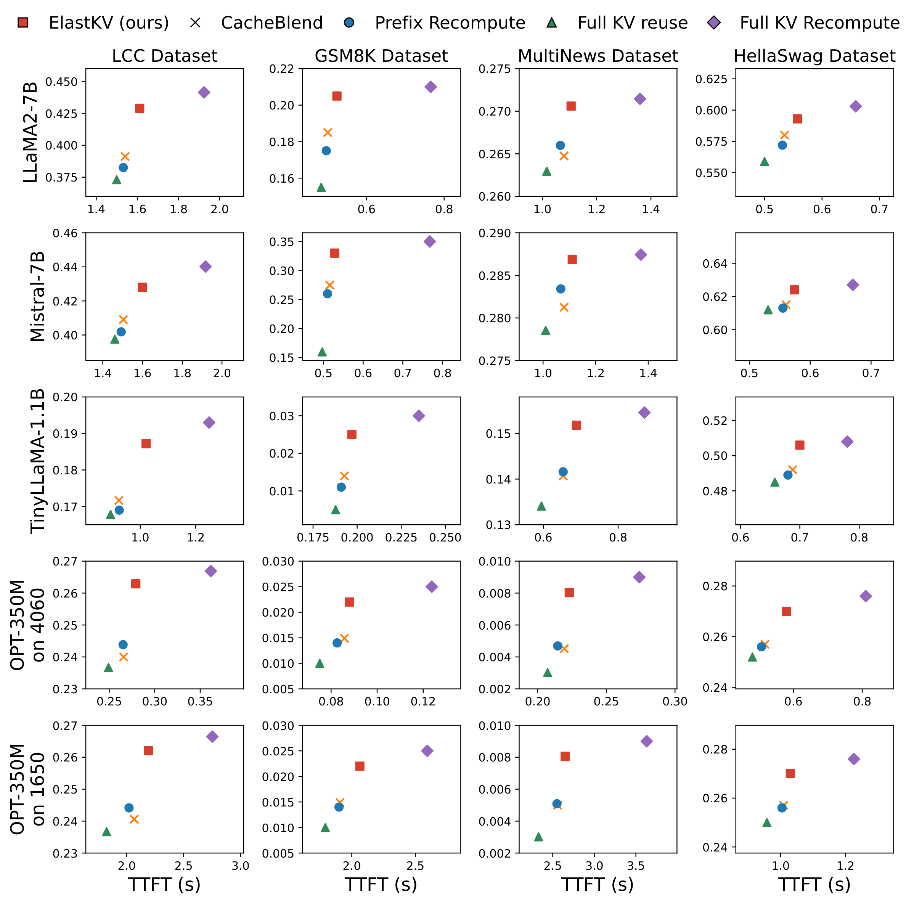
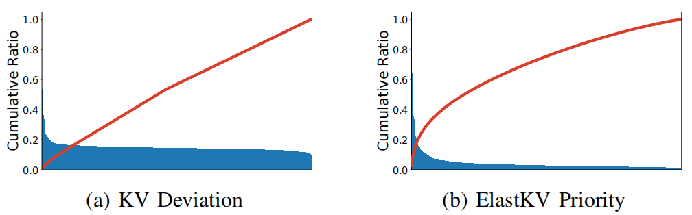
Main Results: Speed-Quality Trade-off
Only 3-bit -> 8 bit
Key Results:
≤2% accuracy loss
~3× speedup vs. full recomputation
Notes:
In the main experiment, we only focus on the three-bit to eight-bit setting. The model processes the first half of the context in three-bit, then switches to eight-bit for the second half. This simulates a real scenario where the model switches precision levels. Other settings will be shown later.
Across all settings, ElastKV achieves quality comparable to full recomputation while being about three times faster.
The bottom right explains why ElastKV works. ElastKV leaves only a small set of high-priority tokens.

Slide 18
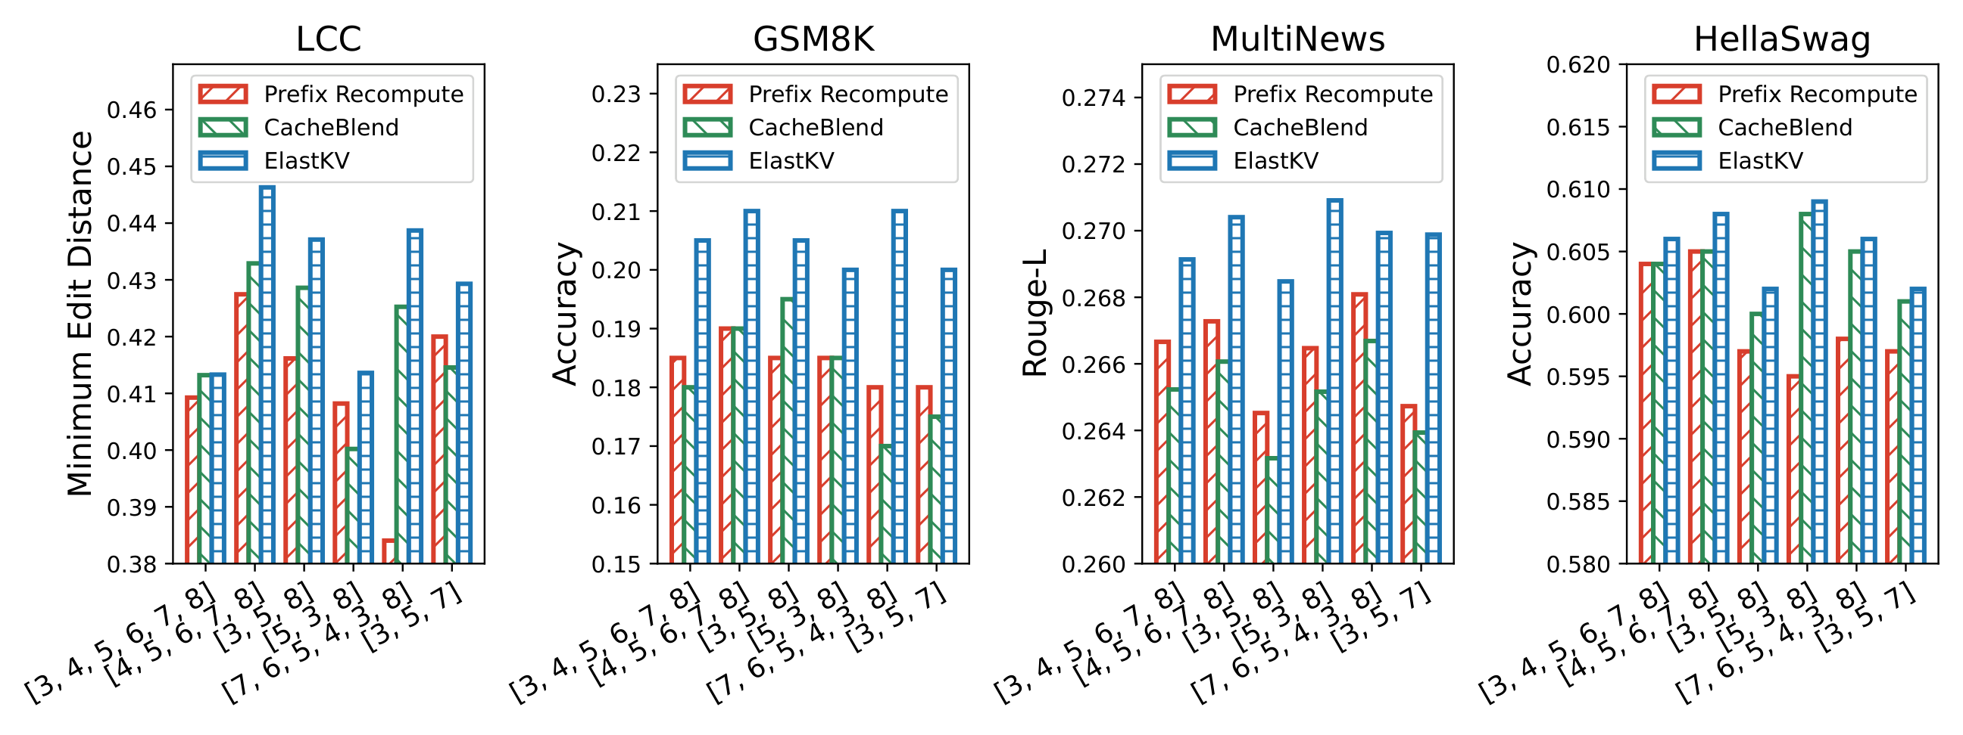
Sensitivity Analysis: Multi-Precision & Varying Ratios
Varying Chunk Numbers and Precisions.
This setup simulates elastic inference under resource fluctuations.
Context is partitioned into more chunks, each processed by a model of distinct precision.
Only LLaMA2-7B
ElastKV adapts better to precision switching than previous approaches
Notes:
Now we evaluate a more general setting. The prefix is split into multiple chunks, each processed by a model with a different precision. The x-axis shows precision sequences.
The bar charts show that ElastKV achieves the best performance in general.

Slide 19
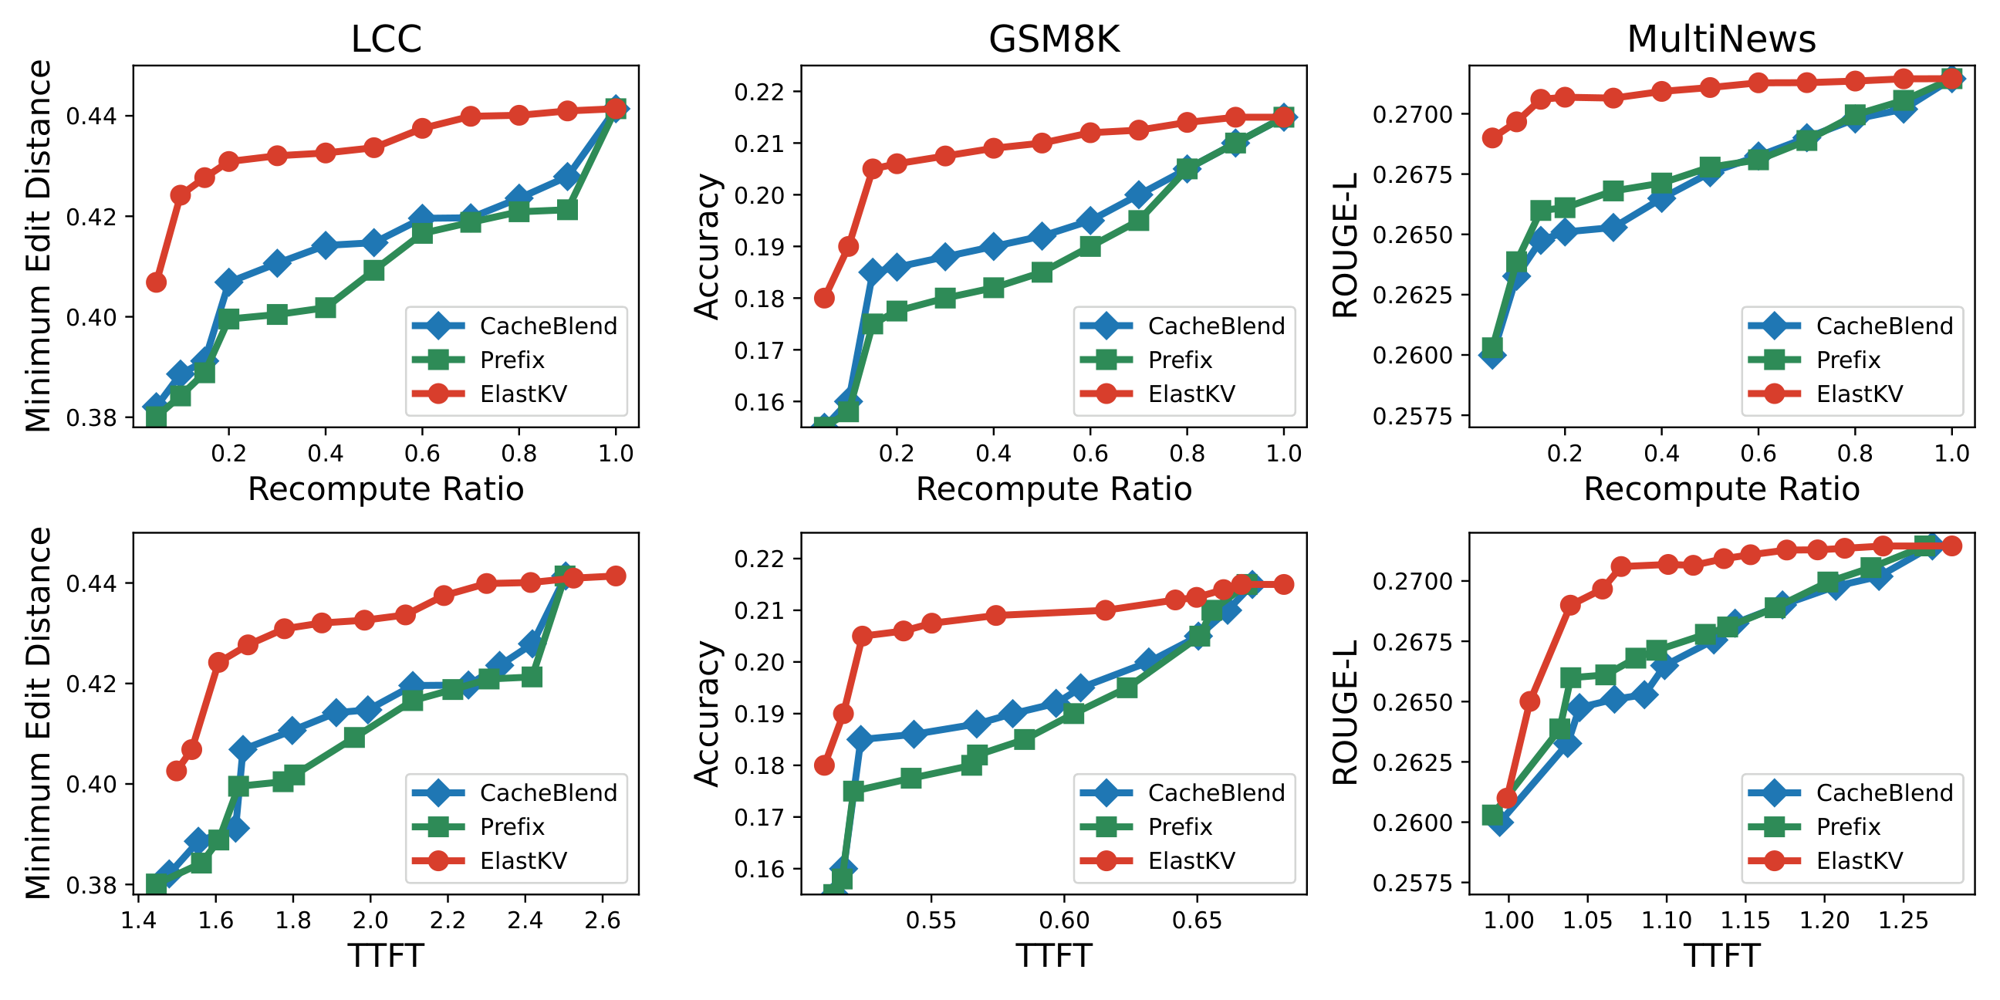
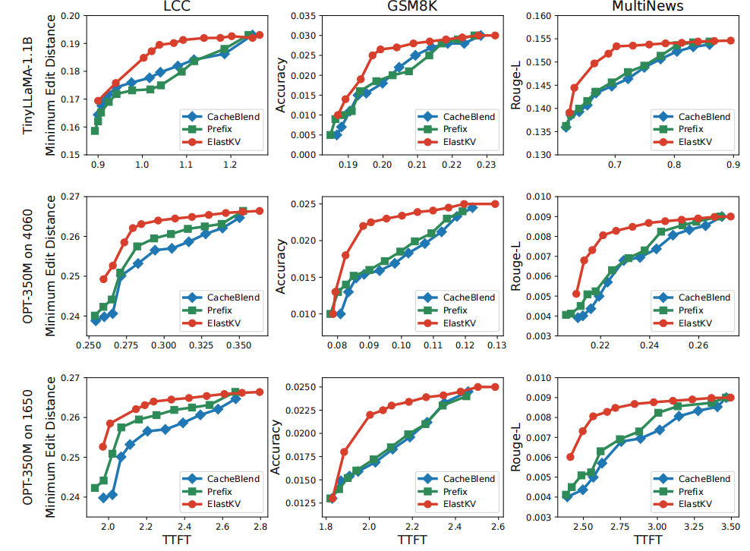
Sensitivity Analysis: Multi-Precision & Varying Ratios
Varying Recompute Ratios.
We compare ElastKV and baselines across varying recompute ratios and TTFT (time to first token) on three datasets, evaluated with LLaMA2-7B.
Since inputs in HellaSwag are very short, we do not include HellaSwag in this experiment
At a very low ratio, ElastKV exhibits a worse trade-off due to extra estimation overhead. However, such a low ratio is not practical.
With practical ratios, ElastKV outperforms previous approaches
Notes:
This slide shows the trade-off between recomputation ratio, time-to-first-token, and model quality. We evaluate each method across a range of recomputation ratios and time-to-first-token values,
At practical recomputation ratios, ElastKV consistently outperforms the baselines. This confirms that ElastKV is more effective in our scenario.

Slide 20
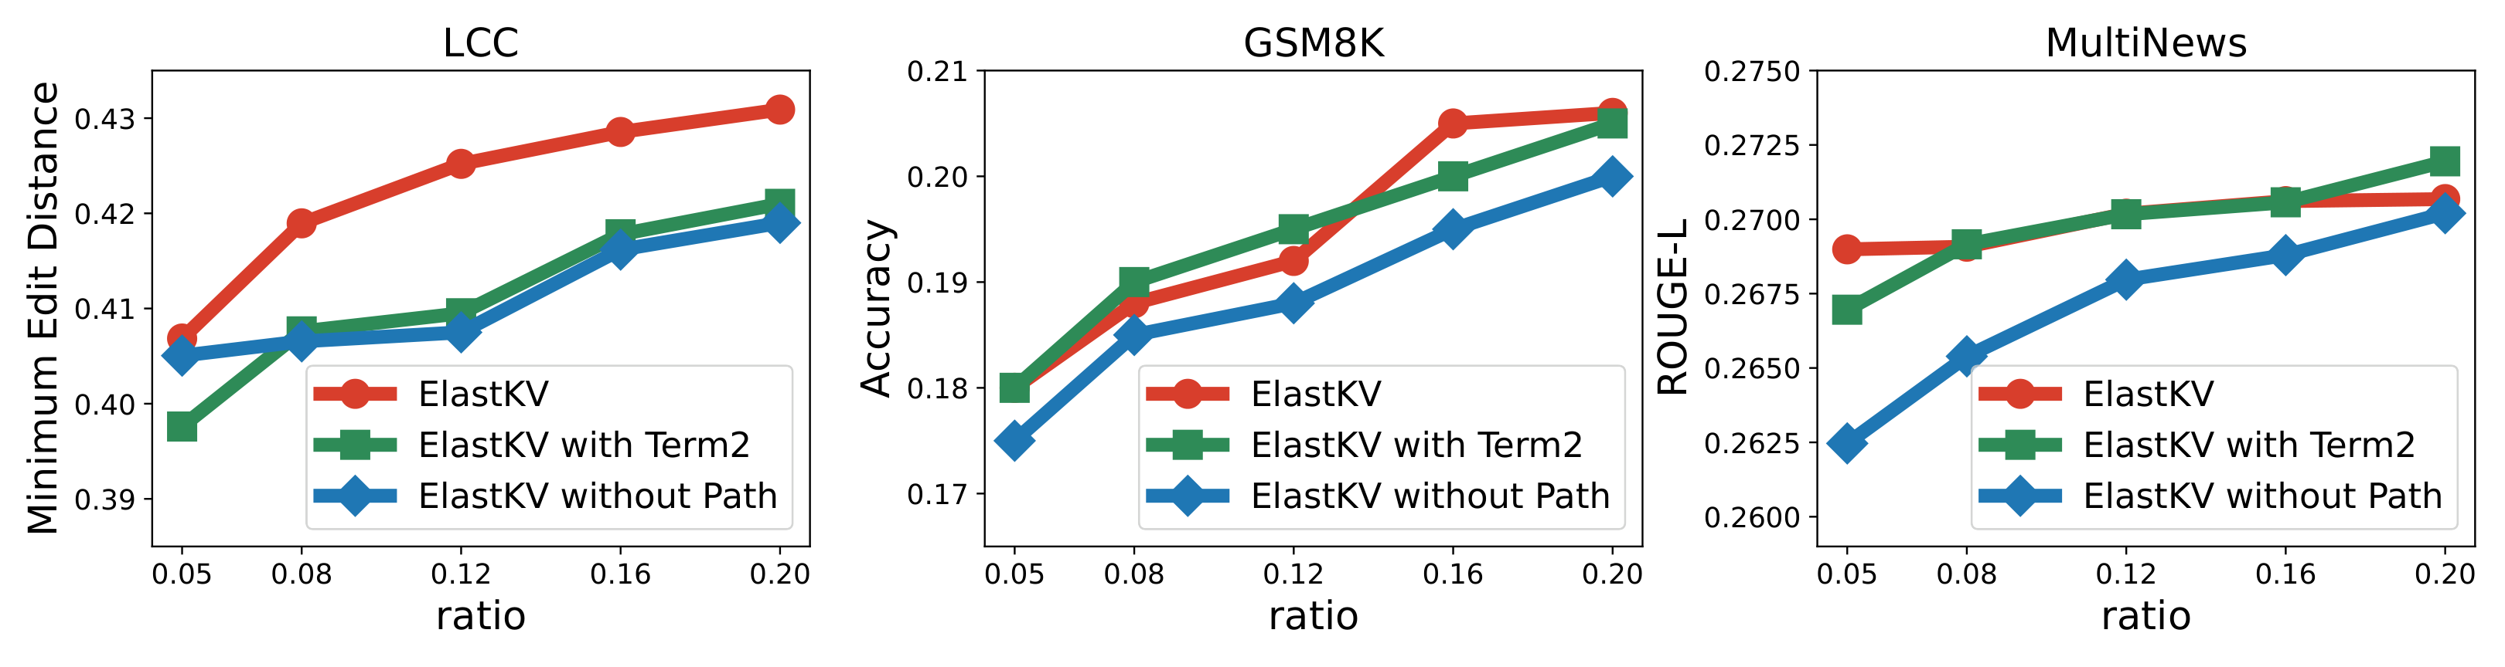
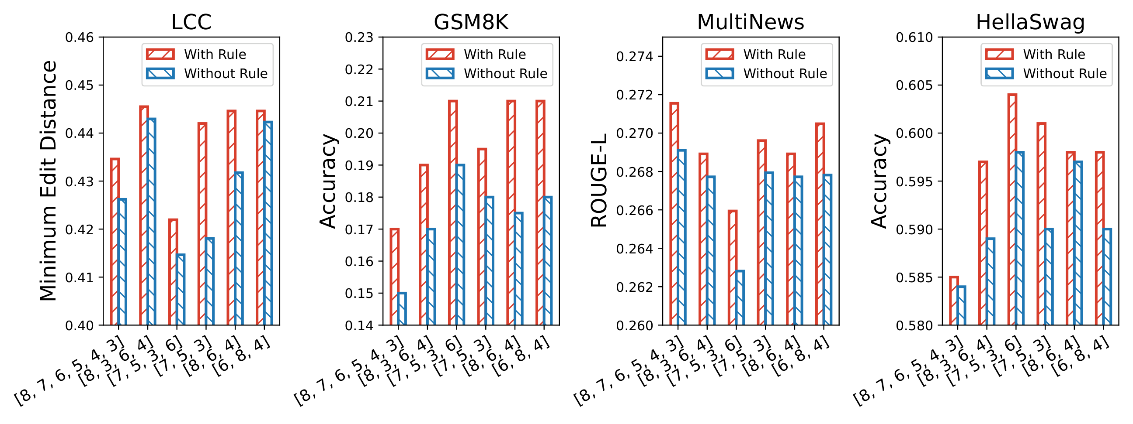
Ablation Study
Using the second term of the Taylor expansion & Without Considering Influence Paths.
Influence path: removes → performance drops
Term2: Very few improvements
Disabling the Recomputation Rule.
Without rule: degrades on high-bit KV
With rule: prevents unnecessary degradation
Notes:
This slide verifies each component's contribution.
The top part compares two design choices. Removing influence paths causes a clear performance drop. Adding the second Taylor term brings little to no improvement(, which supports our design).
The bottom part shows that, without recomputation rule, performance degrades (because low-precision models can overwrite high-precision KV entries)

Slide 21
Conclusion
Notes:
17.5-18min
Let me draw a few conclusions.

Slide 22
Conclusion
ElastKV: first work to address KV cache reuse from mixed-precision models for elastic LLM inference on edge devices
Recomputation Rule: only recompute when current model precision > cached KV precision
Token Priority Estimation: Taylor approximation + influence-path propagation
Results: ≤2% accuracy loss + ~3× speedup; better trade-off than all SOTA methods
ElastKV enables practical on-device LLM serving under dynamic resource constraints.
Notes:
To summarize, ElastKV enables mixed-precision KV cache reuse on edge devices. It introduces a recomputation rule and a token priority estimation( that combines local deviation with influence propagation). Results show less than two-percent accuracy loss and about three-times speedup. Overall, ElastKV makes on-device LLM serving practical under dynamic constraints.

Slide 23
Thanks for Your Attention!
KV Cache Reuse for Elastic LLM Inference on Edge Devices
Peishuo Wang, Zhenzhe Zheng, Xiaoyao Huang, Jie Wu, Fan Wu, Guihai Chen
Shanghai Jiao Tong University & China Telecom & Temple University
IEEE ICDCS 2026, Seoul, South Korea
2026-6-22
Notes:
Thank you for your attention. I am now happy to answer any questions.
During the prefill stage, the output tokens are not available, so we must estimate. In transformer, the model produces output at every input position. The output at a token position can be seen as the first token of model’s output after seeing the input prefix up to that token. Longer prefix contains more complete question, so output at last position represents output better. That’s why we use the last few tokens in query as a proxy.
Thank you for the question.
There are many methods for model lightweighting. I will first explain why we use quantization rather than pruning. Pruning can change the KV dimension, making KV reuse difficult.
As for quantization, on edge devices, the quantization method should support low-overhead switching. The quantization method we use is adopted from AnyprecisionLLM, whose storage design supports efficient switching across different bit-widths.
Additionally, our method relies on estimating the output deviation caused by KV deviation, rather than assuming a particular quantization error distribution.

