Slide 1
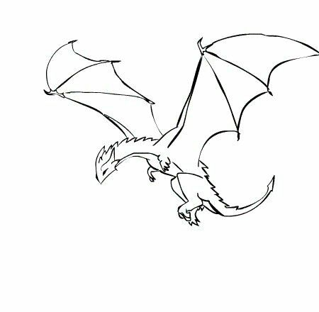



DRAGON: Enhancing On-Device Model Performance with Distributed Retrieval-Augmented Generation
Shangyu Liu, Zhenzhe Zheng, Xiaoyao Huang†, Fan Wu, Guihai Chen, Jie Wu†*
Shanghai Jiao Tong University, † China Telecom Cloud Computing Research Institute, *Temple University
Oct. 27th, 2025
ACM MobiHoc 2025, Houston, USA

Slide 2
Content
Background & Motivation
Why We Need On-Device Language Models?
Why We Need Distributed Knowledge Database?
Distributed Retrieval and the Dilemma
Design
Experiments
A Rough Solution
Implementation
Problem Formulation
Evaluation
Speculative Aggregation
Greedy Scheduling
Theoretical Analysis
Conlusion
System Design

Slide 3
Background & Motivation

Slide 4





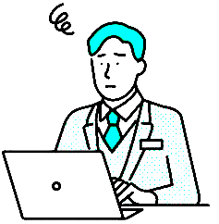
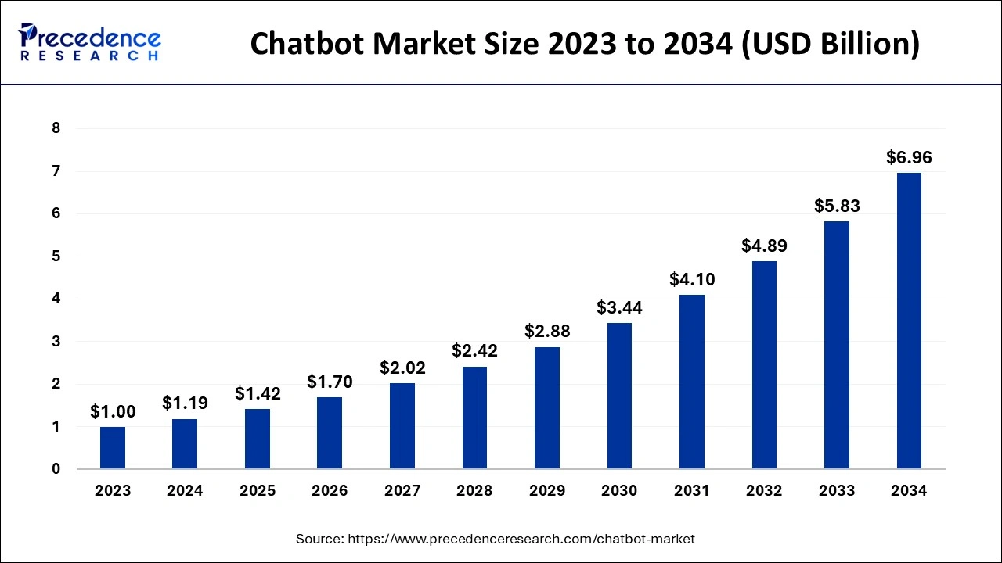





Background: Why We Need On-Device Language Models?
In LLM-based chatbot applications, some queries require integrating both personalized user data and general knowledge.
DeepSeek V3.2
GPT 5
Grok 4 Heavy
Gemini 2.5 Pro
Claude Sonnet 4.5
Kimi K2 Instruct
What to cook today?
Large language models
personalized data
general knowledge
Stock in Smart Fridge
bell pepper, brocoli, carrot
History Orders
2025-10-20, Mexican Cuisine
Chat Records
… I’m allergic to peanuts …
chatbots growing in popularity rapidly

Slide 5
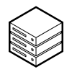





Background: Why We Need On-Device Language Models?
…
Cloud-hosted Large Language Models (LLMs)
DeepSeek V3.2
GPT 4.5
Claude Sonnet 4.5
What to cook today?
w/o user data
upload user data
w/o user data
– lack of personalization
Stock in Smart Fridge
bell pepper, brocoli, carrot
upload user data
– raising privacy concerns
History Orders
2025-10-20, Mexican Cuisine
Personalized Data
Chat Records
… I’m allergic to peanuts …
On-device Small Language Models (SLMs)
popular dishes you dislike

Slide 6



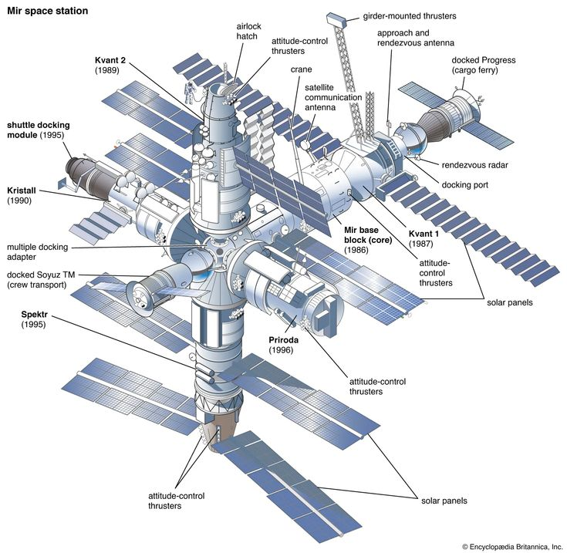
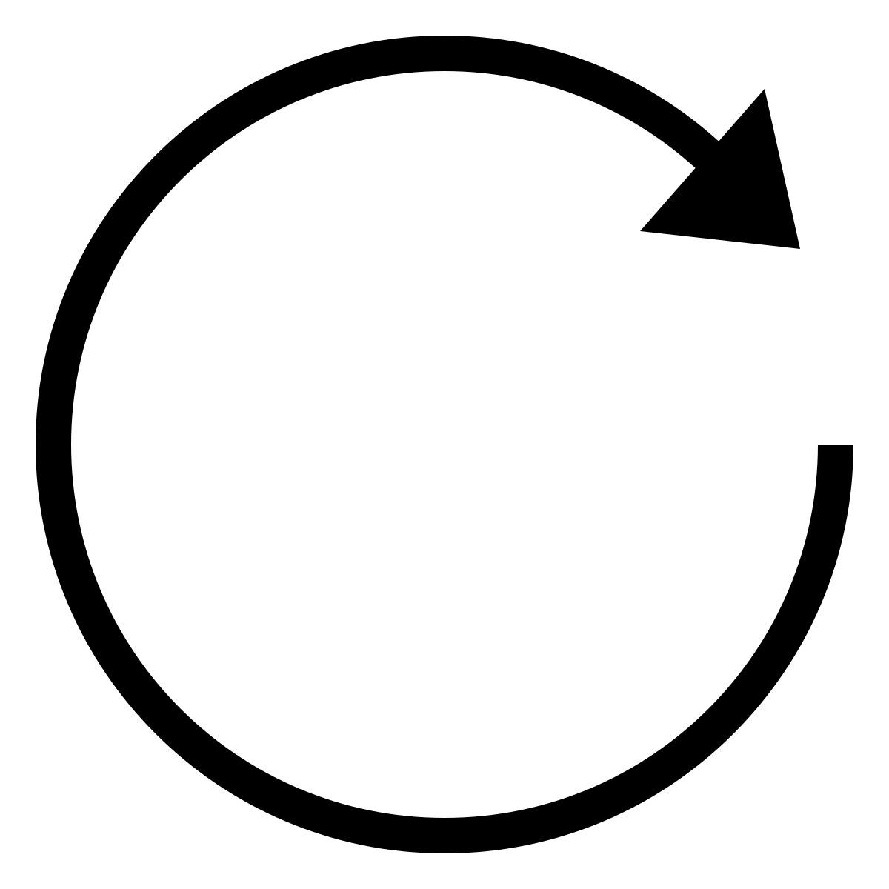


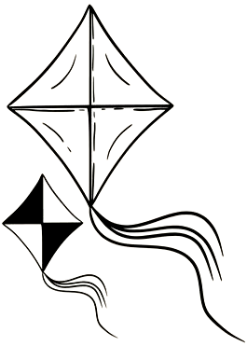
Background: Why We Need Distributed Knowledge Database?
What to cook today?
On-Device Small Language Models (SLMs)
Qwen2.5
Phi-4 mini
Llama 3.2
…
hardly support on-device supervised fine-tuning (SFT)
Data evolves continuously
– cannot afford training
0.5 ~ 1 T params
LLM is like a space station
Stock in Smart Fridge
bell pepper, brocoli, carrot
Reduced model parameters
– performance degradation
Daily updates of personalized user data
Performance gap
History Orders
2025-10-20, Mexican Cuisine
Chat Records
… I’m allergic to peanuts …
Retrieval-Augmented Generation (RAG)
1 ~ 4 B params
SLMs is like a kite

Slide 7





Background: Why We Need Distributed Knowledge Database?
Retrieval-Augmented Generation (RAG)
Documents
concatenate
Model
Question with
Enlarged context
+
Documents:
(1) ; (2) ; (3) …
Please answer the following questions based on the above documents:
What to cook today?
[text]
[text]
Database
RAG scaling law^{[1]}
retrieval
generation quality improves consistently with the scale of the retrieval database^{[1]} (require a large database to enhance performance)
the database supports convenient updates (require a private database that updates frequently)
What to cook today?
Overview of the RAG workflow
[1] Shao, Rulin, et al. "Scaling retrieval-based language models with a trillion-token datastore." Advances in Neural Information Processing Systems 37 (2024): 91260-91299.

Slide 8
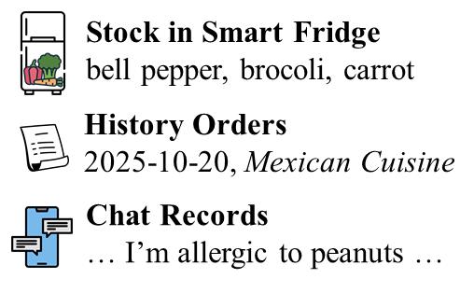
Background: Distributed Retrieval and the Dilemma
Distributed RAG (DRAG)
A Dilemma
Distributed Retrieval
KV-Cache is widely employed in Transformers
KV-Cache is commonly >1000,000 times larger than the raw text input
Cloud-side
Database
Case 1:
Download pre-built KV
Database
cloud
+
Data transmission latency
or [text]
device
Device-side
Database
Model
y₁
y₂
Case 2:
Download text + recompute KV
What to cook today?
KV
KV
KV
KV
KV
KV
KV
KV
…
Computing latency
Centralized Generation
Query
Database
How to resolve this dilemma?

Slide 9
Design of DRAGON

Slide 10
Design: A Rough Solution
Vanilla DRAG (VDRAG) – Workflow Decomposition
for d
probability to
retrieve document d
given current context
Cloud-side
Database
cloud-only RAG workflow
=
=
+
predict next-token
using current context
predict next-token
using enlarged context
for d
Device-side
Database
device-only RAG workflow
DRAG transformed into output aggregations between cloud-side RAG and device-side RAG

Slide 11

Design: A Rough Solution
Vanilla DRAG (VDRAG) – Workflow Decomposition
Predicting current token requires waiting for both output distributions to be generated, collected, and aggregated
KV
KV
KV
KV
KV
KV
Cloud-side
Database
What to cook today?
Due to small data packet size, transmission time is often dominated by data-independent factors^{[1]}, like RTT
...
KV
KV
KV
KV
KV
KV
Device-side
Database
High-frequency synchronization reulted in unacceptable transmission latency
What to cook today?
Aggregation of
output distributions
[1] Neal Cardwell, Yuchung Cheng, C Stephen Gunn, Soheil Hassas Yeganeh, and Van Jacobson. 2016. BBR: Congestion-Based Congestion Control: Measuring bottleneck bandwidth and round-trip propagation time. Queue 14 (2016), 20–53.

Slide 12
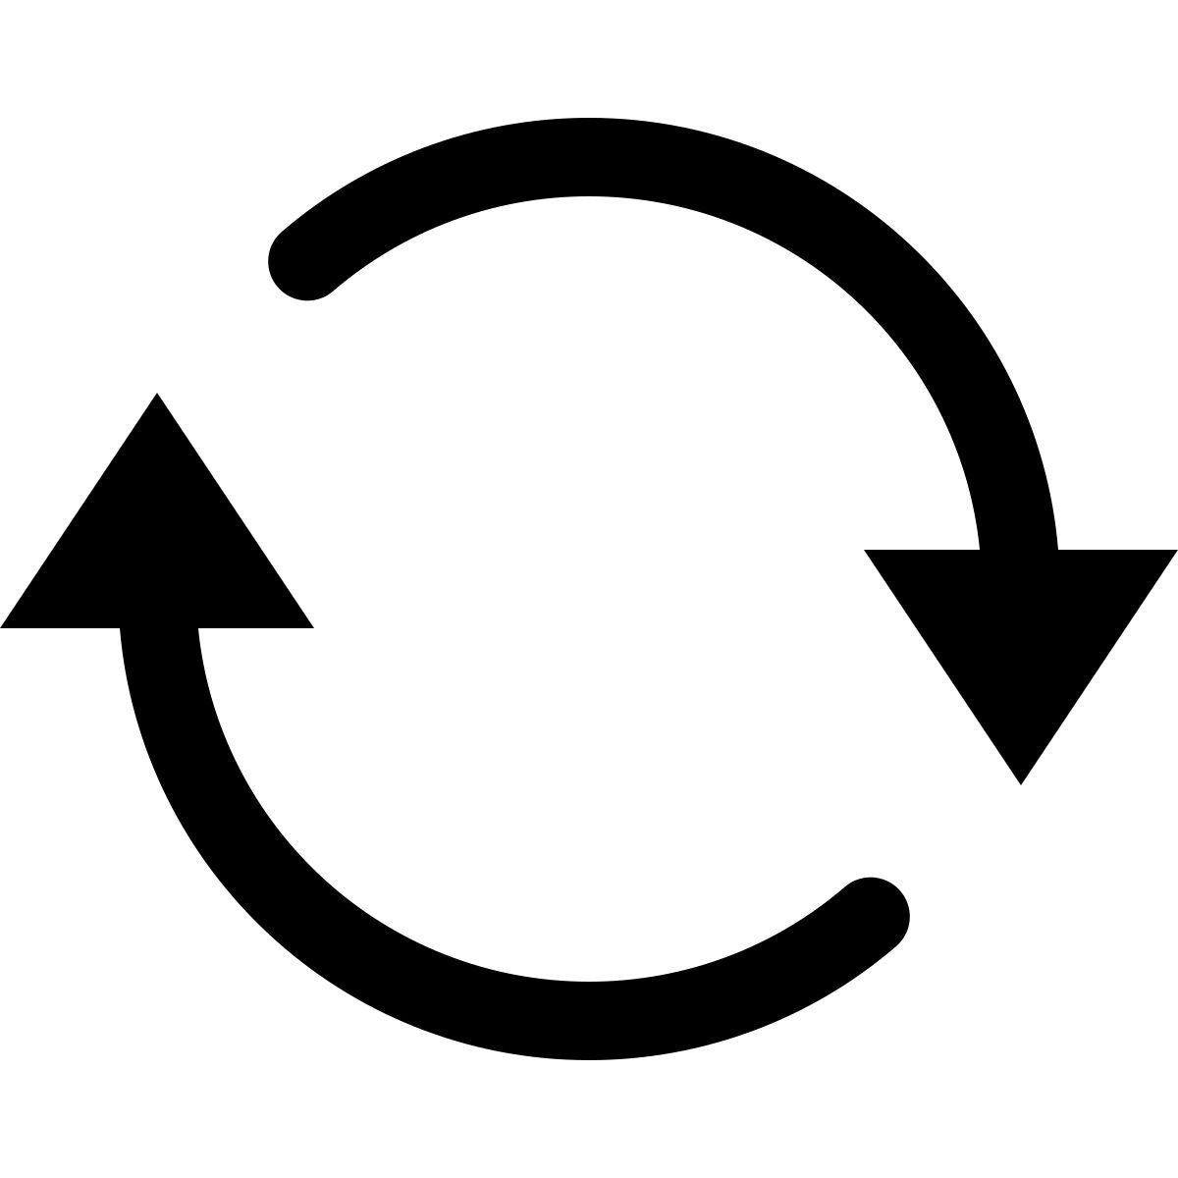


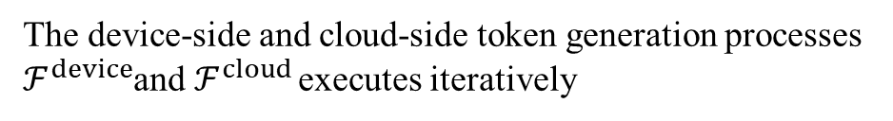
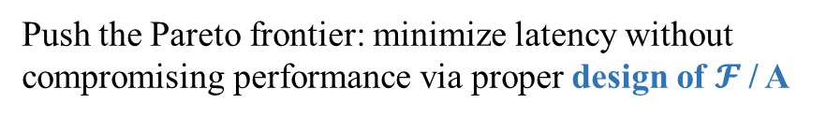
Design: Problem Formulation
System Model
Objective Function
The device-side and cloud-side token generation processes
$ℱ^{device}$and $ℱ^{cloud}$ executes iteratively
t ← t+1
cross-entropy loss
Latency
Performance
Vanilla-DRAG
Device-Only
Auxiliary Information
Database
0
Latency
Output Distribution
Current Sequence
Push the Pareto frontier: minimize latency without compromising performance via proper design of $𝓕$/ A
Small Language Model

Slide 13


Design: Speculative Aggregation
Speculative Sampling
Speculative Aggregation
Draft-then-verify
Paralleled decoding
Reduce the number of calls
Break the sequential dependence in VDRAG
Reduce the number of aggregations between two sides.
Insight
Insight
Some tokens can be speculated by a lightweight draft model
context-independent tokens should be similar across the device and the cloud
❷
KV
KV
KV
KV
Target Model
verifies draft tokens in parallel
…
…
❶
Draft Model
generates multiple tokens
…
KV
KV
KV
KV
…

Slide 14












Design: Speculative Aggregation
Overall Workflow of Speculative Aggregation
receive
signal and
rollback
$$p_{0}^{cloud}$$
$$p_{1}^{cloud}$$
$$p_{2}^{cloud}$$
$$p_{3}^{cloud}$$
$$p_{3}^{cloud}$$
$$p_{4}^{cloud}$$
KV
KV
KV
KV
KV
KV
KV
KV
KV
KV
Decoding
continuously
Cloud-side
Database
…
What to cook today?
aggregating
asynchronously
…
KV
KV
KV
KV
KV
KV
KV
KV
KV
KV
…
Device-side
Database
Keep decoding
if not rejected, otherwise rollback
$$p_{0}^{device}$$
$$p_{1}^{device}$$
$$p_{2}^{device}$$
$$p_{3}^{device}$$
$$p_{4}^{device}$$
$$p_{4}^{device}$$
What to cook today?
Aggregation of
output distributions
reject signal
target token

Slide 15





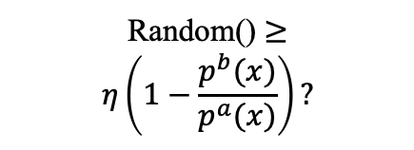
















Design: Speculative Aggregation
Aggregation Strategy
Draft token $x$
$$p^{a}$$
$$p^{b}$$
$$η$$
(the relevance of docs from b-side)
$$x_{t}^{l}$$
$$p_{t}^{l}$$
$$p_{t}^{r}$$
$$η_{t}^{r}$$
$$x_{t}^{r}$$
$$p_{t}^{r}$$
$$p_{t}^{l}$$
$$η_{t}^{l}$$
$$p^{a}\left(x\right)≤p^{b}\left(x\right) ?$$
Sample
Sample
Sample
yes
no
$${\tilde{x}}_{t}^{l}$$
$${\tilde{x}}_{t}^{r}$$
Random() $≥$
$$η\left(1−\frac{p^{b}(x)}{p^{a}(x)}\right)?$$
Random Selection
yes
no
$${\tilde{x}}_{t}$$
Accept:$\tilde{x}=x$
normalize
Theorem 1
Target tokens produced by the speculative aggregation follows a distribution identical to that output by VDRAG.
$p′$=$max⁡(0, p^{b}−p^{a})$
$$p^{′}=p^{′}/sum(p′)$$
Reject: ${\tilde{x}=x}^{′}\sim { p}^{′}$
$$\tilde{x}$$

Slide 16
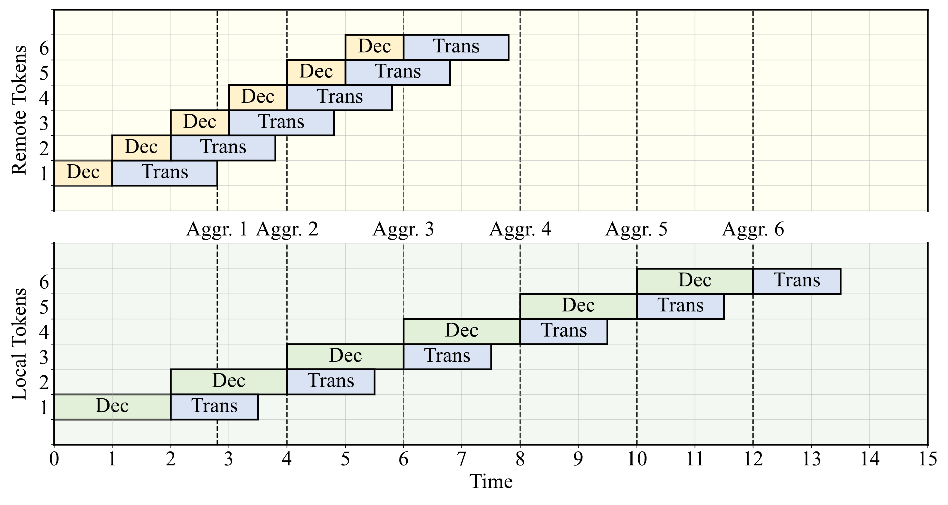
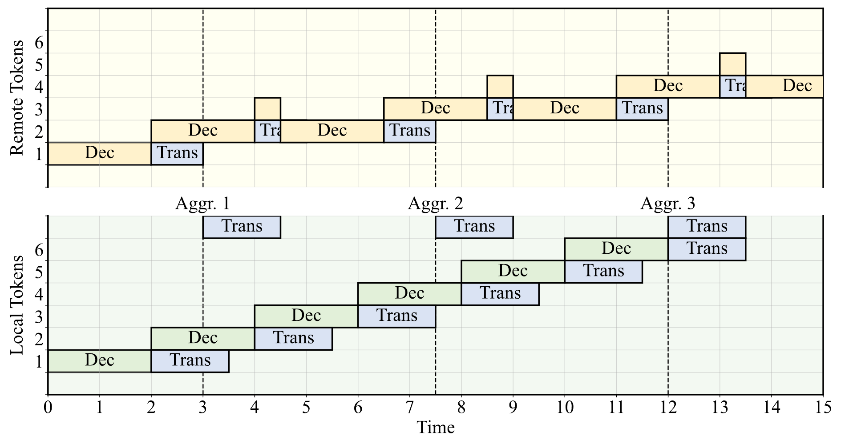
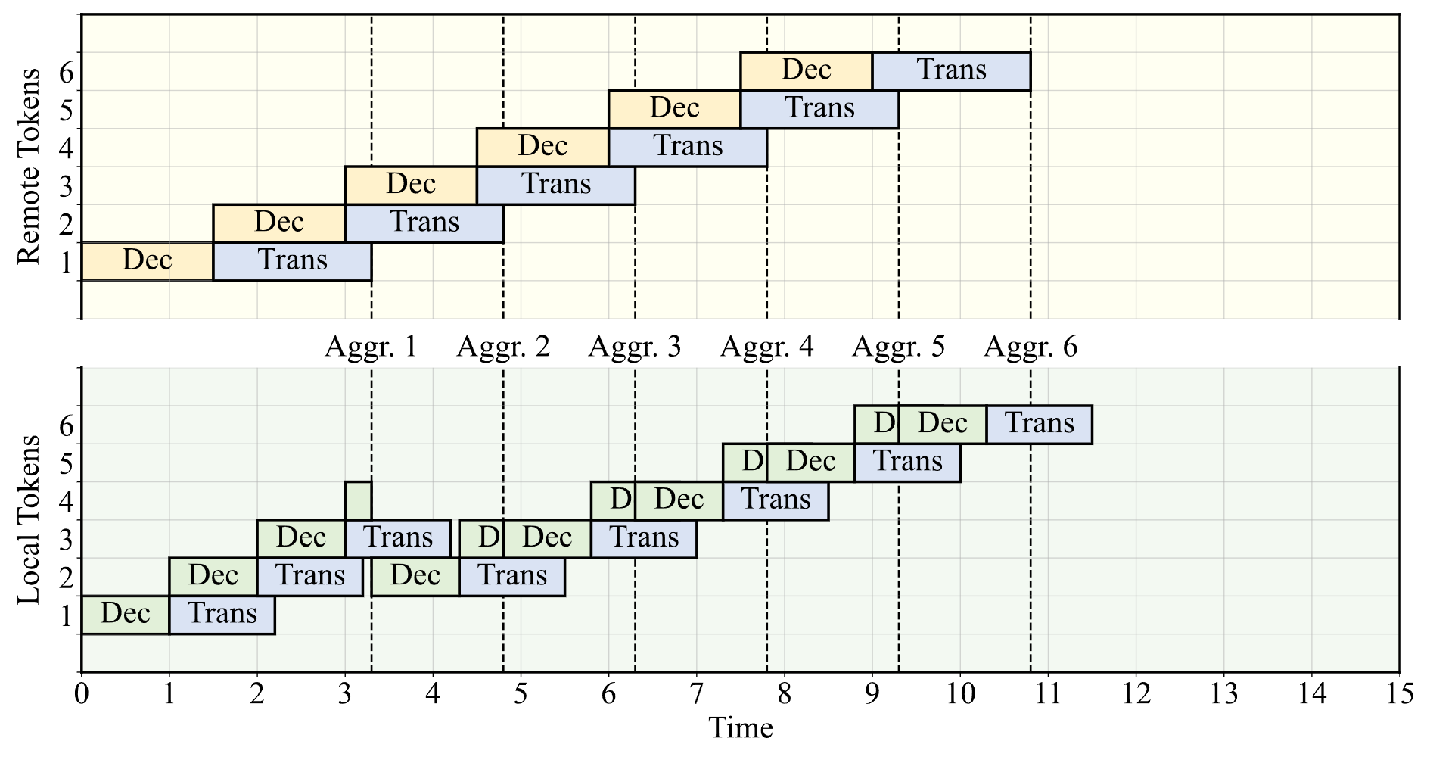
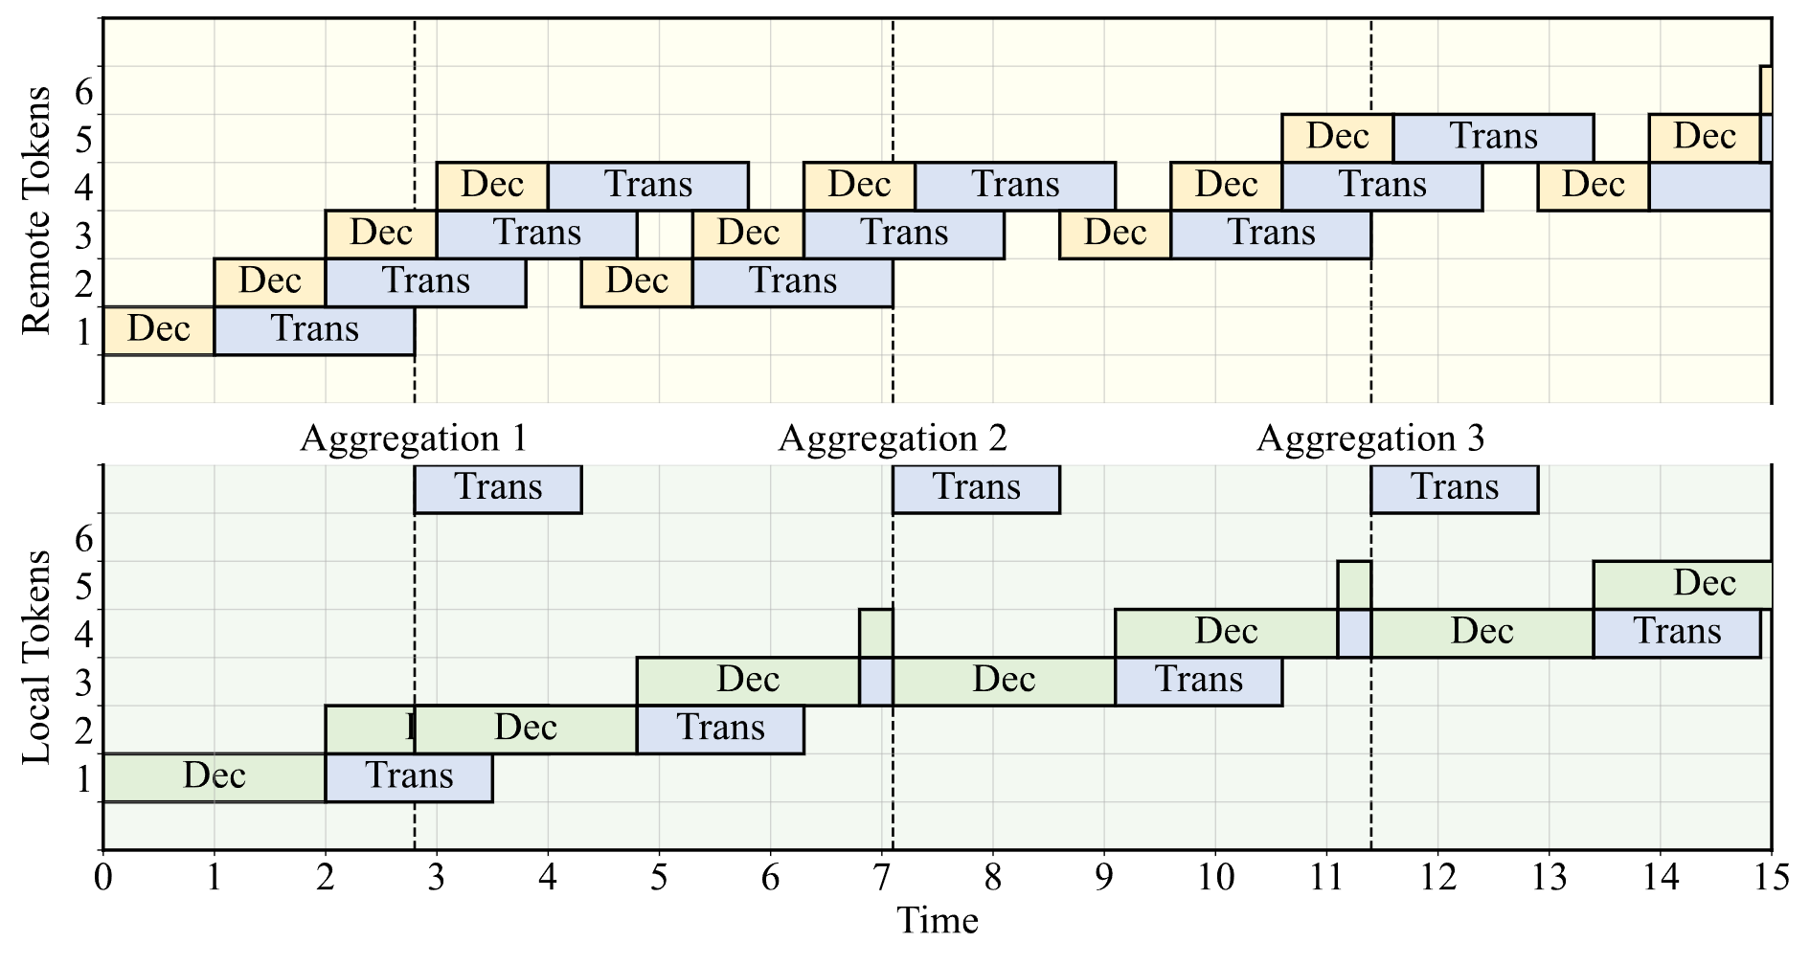



Design: Greedy Scheduling
To maximize the overlap between decoding and transmission processes, adaptively schedule which side performs the next aggregation
Enumerate each acceptance scenario by assuming it repeats continuously
Dynamic Factors
$$α$$
Acceptance Rates
Decoding Latency
Transmission Latency
$$c_{dec}$$
accept both
accept local, reject remote
$$c_{trans}$$
Estimation Model
We employ a greedy strategy, where at each step, we minimize the expected latency per token based on current observations
reject local, accept remote
reject both

Slide 17
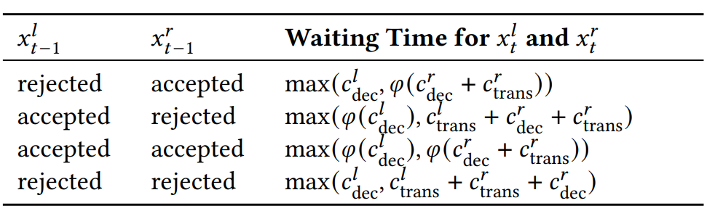
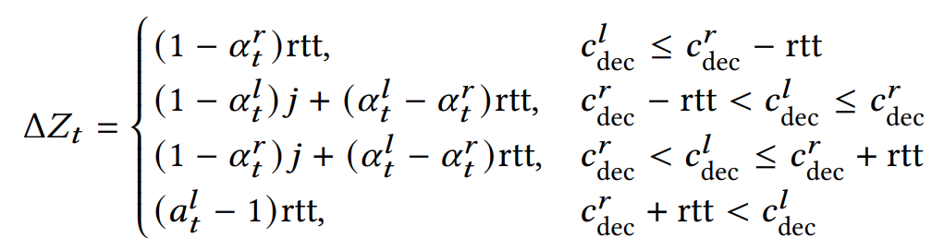
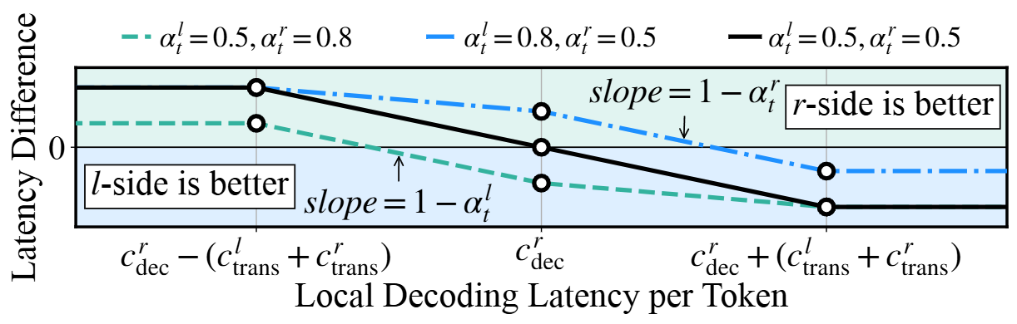
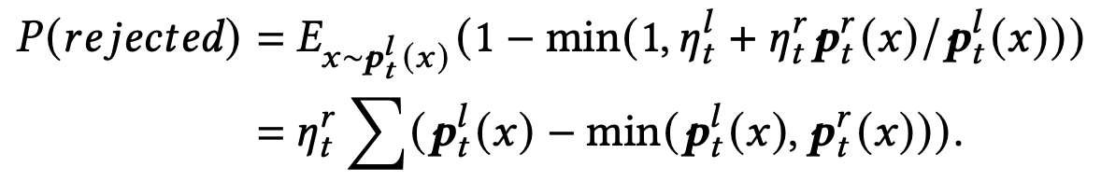
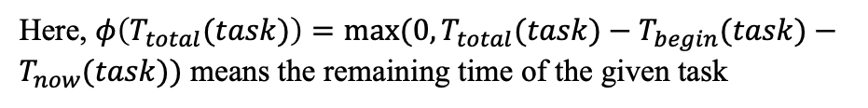
Design: Greedy Scheduling
Waiting time for each case
Extra waiting time after switching aggregation side
Here, $φ\left(T_{total}(task)\right)=max⁡(0,T_{total}(task)−T_{begin}(task)−T_{now}(task))$ means the remaining time of the given task
Probability of each case
We assume each case occurs with an expected probability given by the acceptance rate, e.g.,
Scheduling Strategy
Switch the aggregation to the other side once $ΔZ_{t}>0$
Expected waiting time
Z =

Slide 18
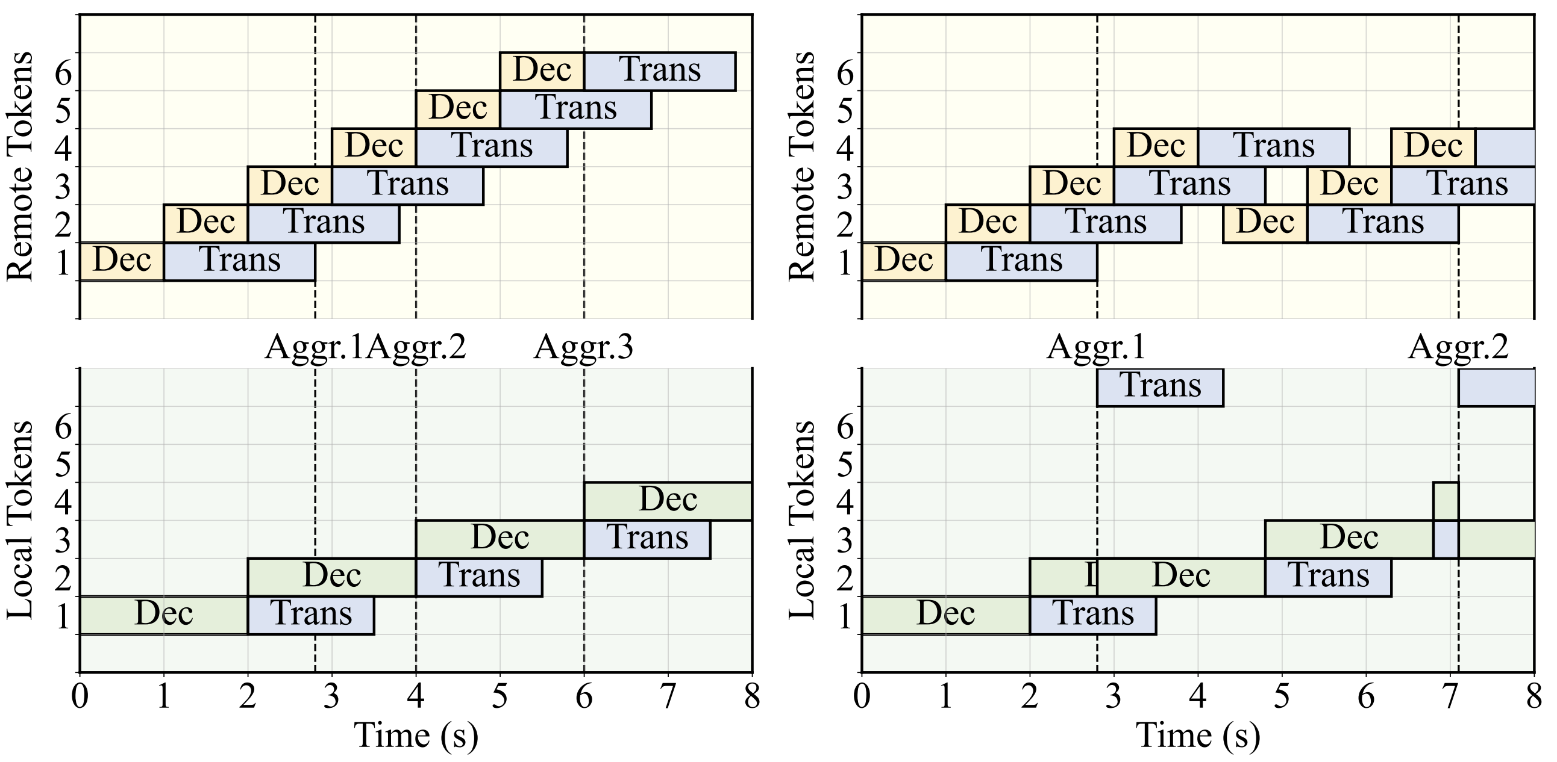
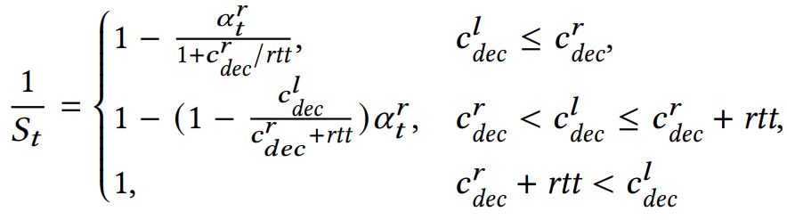
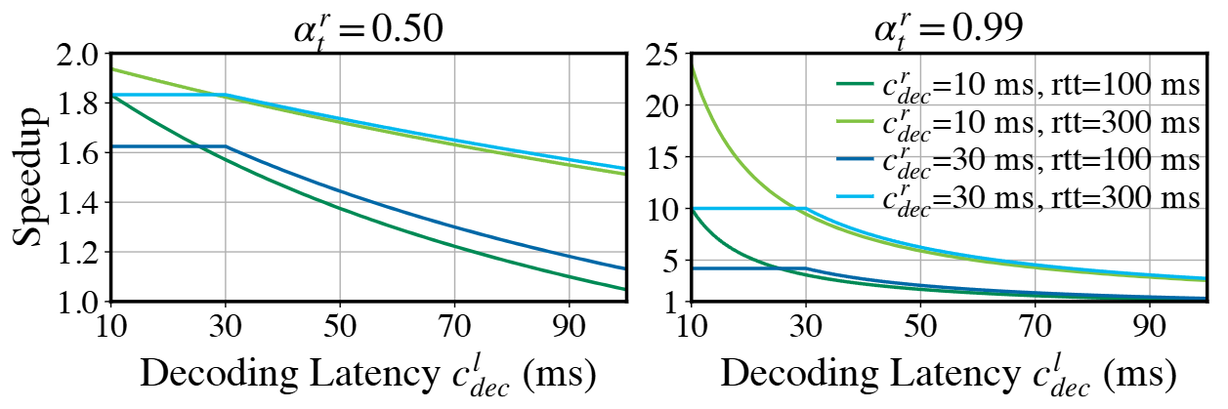
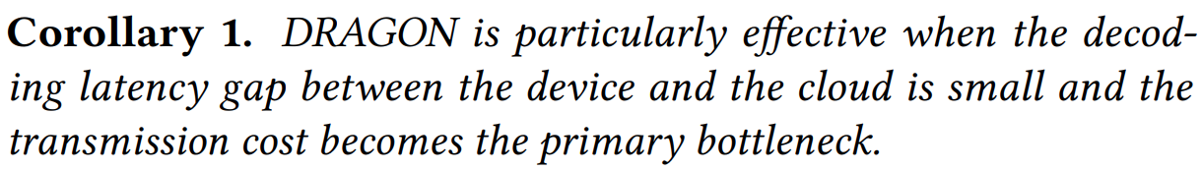
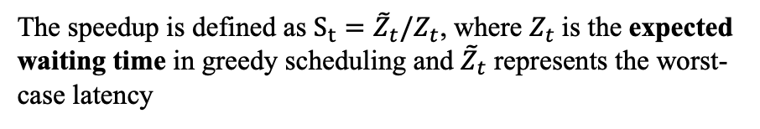
Design: Theoretical Analysis
The speedup is defined as $S_{t}={\tilde{Z}}_{t}/Z_{t}$, where $Z_{t}$is the expected waiting time in greedy scheduling and ${\tilde{Z}}_{t}$ represents the worst-case latency
best case
Always accept
period
vs.
worst case
Always reject
period

Slide 19





Design: System Design
Cloud
Overview of DRAGON
Decoder
Draft & Target Queues
Transmission Bus
We propose DRAGON, a device-cloud distributed RAG framework.
We deploy Decoders, Queues, and Schedulers on both sides and an Aggregator module on either side
Draft Queues
“.”
+
+
decode()
“science”
“and”
“technology”
Decoder
Decoder
“science”
“games”
“games”
“.”
“games”
Aggregator
Aggregator
Target Queue
Scheduler
“I”
“love”
“computer”
Device
Query
Target token
Acceptance status
Draft tokens and output distributions

Slide 20
Design: System Design
Cloud
Overview of DRAGON
Decoder
Draft & Target Queues
Transmission Bus
Step
❶
❶
Draft Queues
The Decoder module serves as a token producer, and on each side it decodes draft tokens independently based on local output distributions using the retrieved local documents only
“.”
+
+
decode()
“science”
“and”
“technology”
Decoder
Decoder
“science”
“games”
“games”
“.”
“games”
Aggregator
Aggregator
Target Queue
Scheduler
“I”
“love”
“computer”
Device
Query
Target token
Acceptance status
Draft tokens and output distributions

Slide 21
Design: System Design
Cloud
Overview of DRAGON
Decoder
Draft & Target Queues
Transmission Bus
Step
❷
❶
Draft Queues
❷
The draft tokens and their corresponding distribution vectors are broadcast to the other side. On each side, we enqueue into Draft Queues
“.”
+
+
decode()
“science”
“and”
“technology”
Decoder
Decoder
“science”
“games”
“games”
“.”
“games”
Aggregator
Aggregator
Target Queue
Target Queue
Scheduler
“I”
“love”
“computer”
Device
Query
Target token
Acceptance status
Draft tokens and output distributions

Slide 22
Design: System Design
Cloud
Overview of DRAGON
Decoder
Draft & Target Queues
Transmission Bus
Step
❸
❶
Draft Queues
❷
The Aggregator module, as a consumer, continuously consumes draft tokens from the front of local queues and performs aggregation process
“.”
+
+
decode()
“science”
“and”
“technology”
Decoder
Decoder
“science”
“games”
“games”
“.”
“games”
❸
Aggregator
Target Queue
Target Queue
Scheduler
“I”
“love”
“computer”
Device
Query
Target token
Acceptance status
Draft tokens and output distributions

Slide 23
Design: System Design
Cloud
Overview of DRAGON
Decoder
Draft & Target Queues
Transmission Bus
Step
❹
❶
❹
Draft Queues
❷
❹
The aggregation results of the draft token are broadcast to Draft Queues on both sides.
For each queue, the first token is dequeued if accepted, or the entire queue is cleared if rejected. The final target token output by Aggregator is enqueued into Target Queue on both sides
“.”
+
+
decode()
“science”
“and”
“technology”
Decoder
“science”
“games”
“games”
“.”
“games”
❸
Aggregator
Target Queue
Scheduler
“I”
“love”
“computer”
Device
Query
Target token
Acceptance status
Draft tokens and output distributions

Slide 24
Experiments

Slide 25
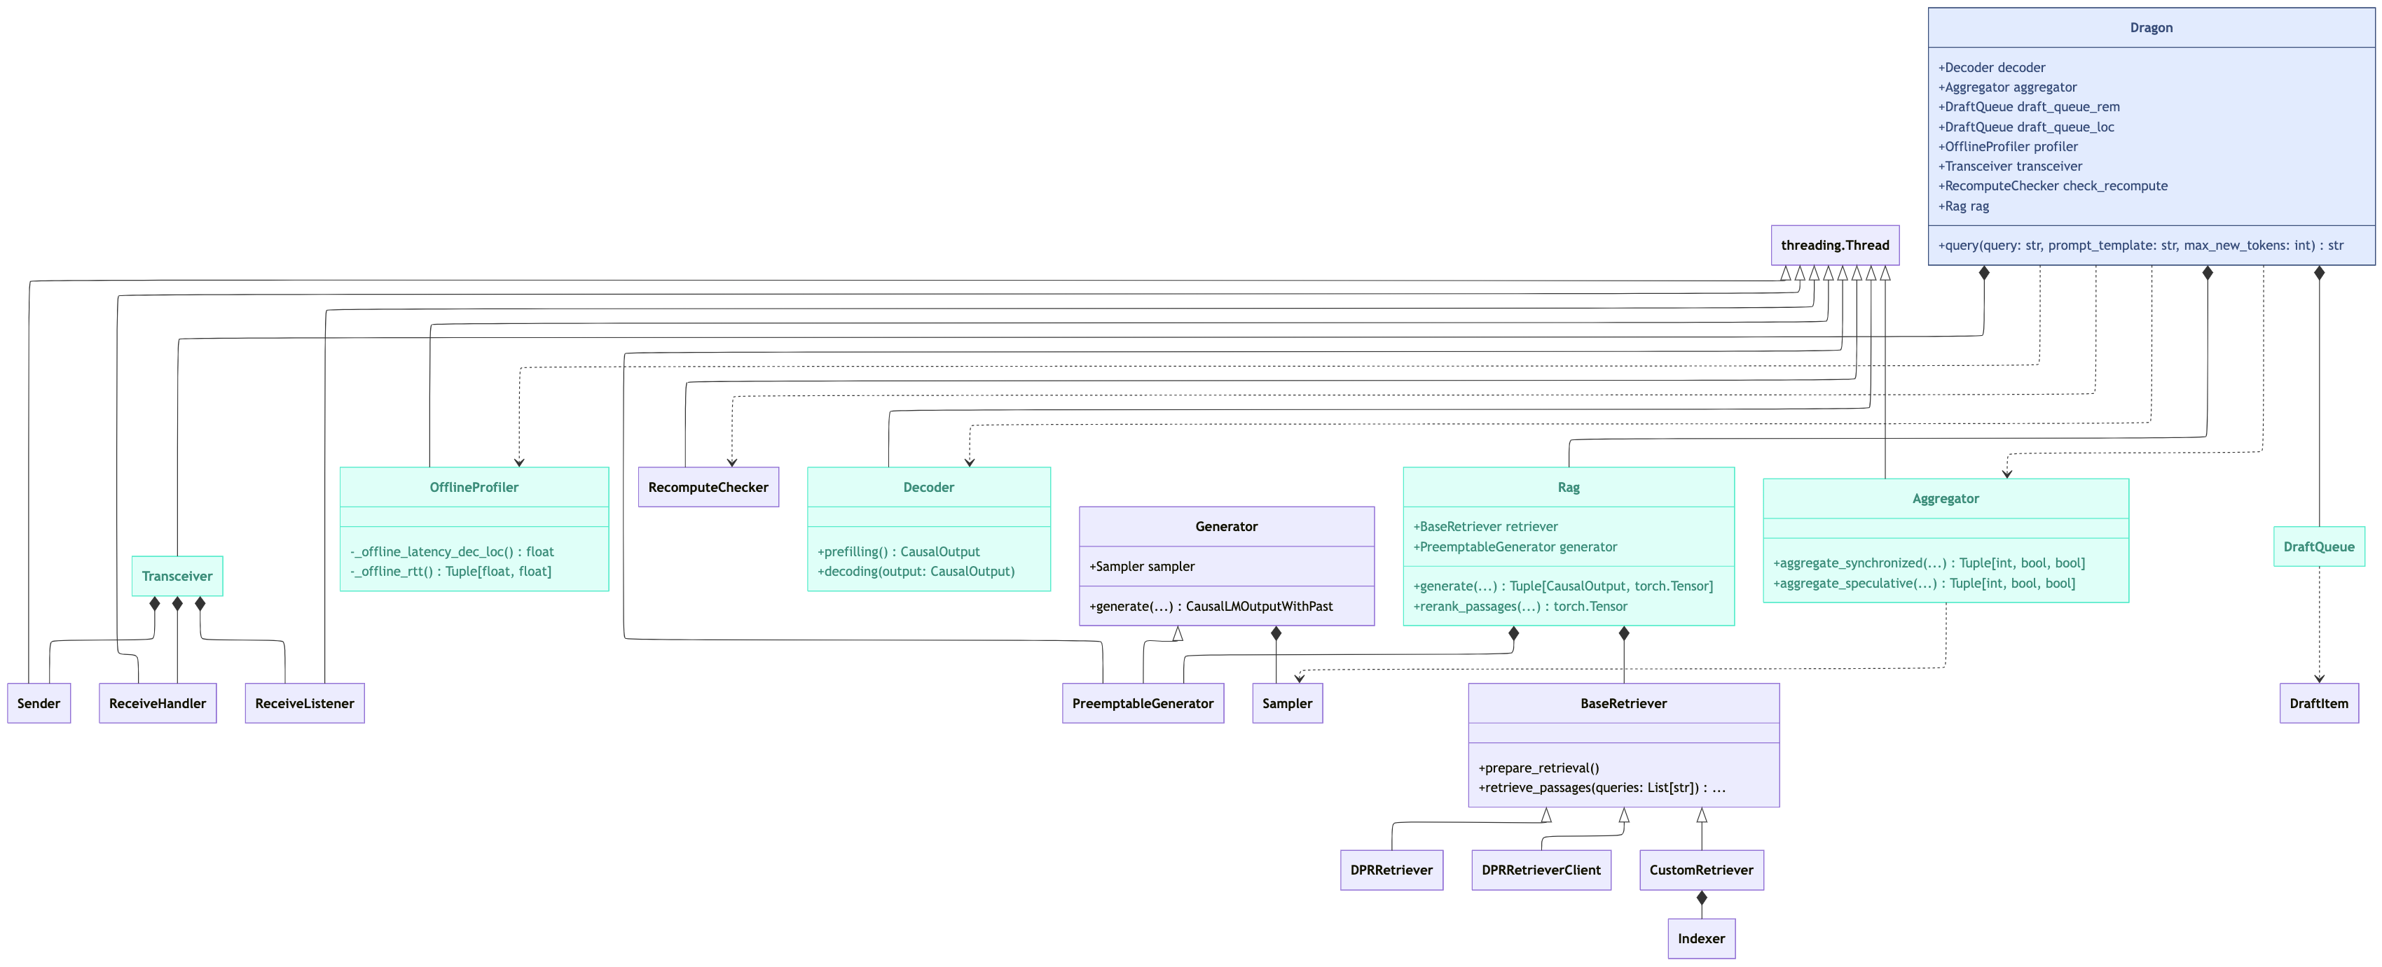
Experiments: Implementation
We implemented DRAGON for distributed RAG workflow comprising ~3,000 lines of Python code: https://github.com/ThomasAtlantis/DRAGON
Two symmetric processes, the device-side and cloud-side ones, each utilizing 8 threads for core functionalities, a memory-resident service process for document retrieval.
multi-producer, multi-consumer queues for synchronization between threads, and socket-based communication between processes.

Slide 26
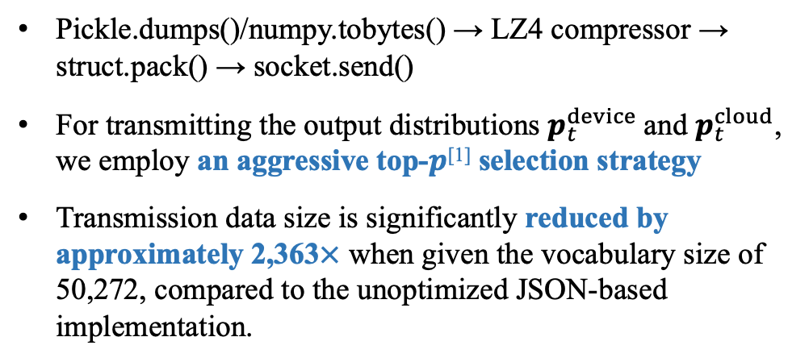
Experiments: Implementation
Efficient transmission
Preemptible generation
Pickle.dumps()/numpy.tobytes() → LZ4 compressor → struct.pack() → socket.send()
For transmitting the output distributions $p_{t}^{device}$and $p_{t}^{cloud}$, we employ an aggressive top-$p$^{[1]} selection strategy
Transmission data size is significantly reduced by approximately 2,363$×$ when given the vocabulary size of 50,272, compared to the unoptimized JSON-based implementation.
We implemented a hook function to enable layer-wise interruption of draft decoding.
When interrupted, it rolls back the KV-cache and attention masks based on the number of generated target tokens so far and feeds the latest target token as input to trigger re-computation.
[1] Ari Holtzman, Jan Buys, Li Du, Maxwell Forbes, Yejin Choi: The Curious Case of Neural Text Degeneration. ICLR 2020

Slide 27

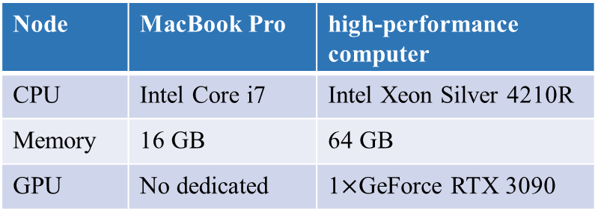
Experiments: Evaluation
Experiment Setups
Testbed
2.4 GHz Wi-Fi local-area network
Latency=2ms, Jitter=6ms
Datasets and metrics
Performance: we test language modeling on WikiText^{[1]} (>100M tokens, two different-scale versions, WikiText2 / WikiText103) using perplexity (i.e. exp cross-entropy).
Efficiency: we measure the time to first token (TTFT) and per-token latency. We used the retrieval corpus and index pre-built by Facebook from a Wikipedia dump dated December 20, 2018, which contains 21 million documents.
Node | MacBook Pro | high-performance computer
CPU | Intel Core i7 | Intel Xeon Silver 4210R
Memory | 16 GB | 64 GB
GPU | No dedicated | 1$×$GeForce RTX 3090
We use the traffic control tool, tc, to simulate network jitter
[1] Stephen Merity, Caiming Xiong, James Bradbury, and Richard Socher. 2017. Pointer Sentinel Mixture Models. In ICLR.
[2] Susan Zhang, Stephen Roller, Naman Goyal, Mikel Artetxe, Moya Chen, et al. 2022. OPT: Open Pre-trained Transformer Language Models. arXiv:2205.01068 [cs.CL]
[3] Qwen Team. 2024. Qwen2.5 Technical Report. arXiv:2412.15115
[4] Gautier Izacard, Mathilde Caron, Lucas Hosseini, Sebastian Riedel, Piotr Bojanowski, et al. 2021. Unsupervised Dense Information Retrieval with Contrastive Learning.
[5] Vladimir Karpukhin, Barlas Oguz, Sewon Min, Patrick Lewis, Ledell Wu, et al. 2020. Dense Passage Retrieval for OpenDomain Question Answering. In EMNLP. 6769–6781.
[6] Nils Reimers and Iryna Gurevych. 2019. Sentence-BERT: Sentence Embeddings
using Siamese BERT-Networks. In EMNLP. 3980–3990.
Models
SLMs: OPT-1.3B^{[2]} and Qwen2.5-1.5^{[3]}
Retriever: Contriever^{[4]} (for Language Modeling) and DPR^{[5]} (for latency measurement)
Re-ranker: ms-marco-MiniLM-L6-v2^{[6]}

Slide 28
Experiments: Evaluation
Experiment Setups
Baselines
We compare DRAGON with four baseline methods:
CRCG, centralized generation augmented with centralized retrieval (most existing RAG methods)
DRCG, on-device centralized generation augmented with distributed retrieval
DRDG/TW, distributed RAG using token-wise synchronization (VDRAG)
DRDG/SW, distributed RAG using sequence-wise synchronization, i.e., one-time aggregation of the independently generated output sequences ^{[1][2]}
To study the overhead of DRCG, we evaluate two variants:
DRCG/Text retrieves raw text and prefill KV cache from scratch
DRCG/KV retrieves and reuses the KV cache of documents directly
[1] Weijia Shi, Sewon Min, Michihiro Yasunaga, Minjoon Seo, Rich James, Mike Lewis, Luke Zettlemoyer, and Wen-tau Yih. 2024. REPLUG: Retrieval-Augmented Black-Box Language Models. In NAACL. 8371–8384.
[2] Patrick Lewis, Ethan Perez, Aleksandra Piktus, Fabio Petroni, Vladimir Karpukhin, Naman Goyal, Heinrich Küttler, Mike Lewis, Wen-tau Yih, Tim Rocktäschel, et al. 2020. Retrieval-Augmented Generation for Knowledge-Intensive NLP Tasks. In NIPS. 9459–9474.

Slide 29
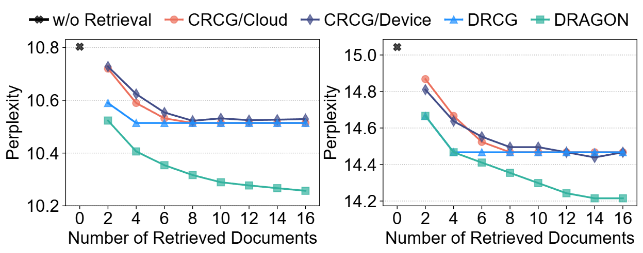
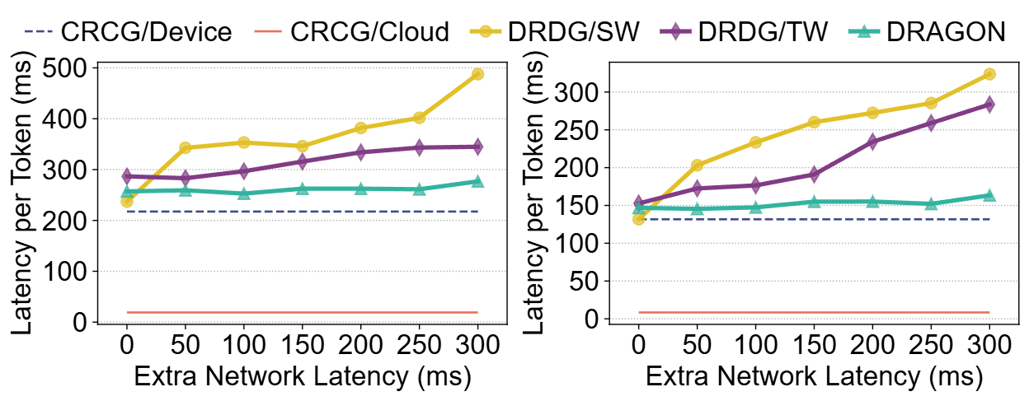
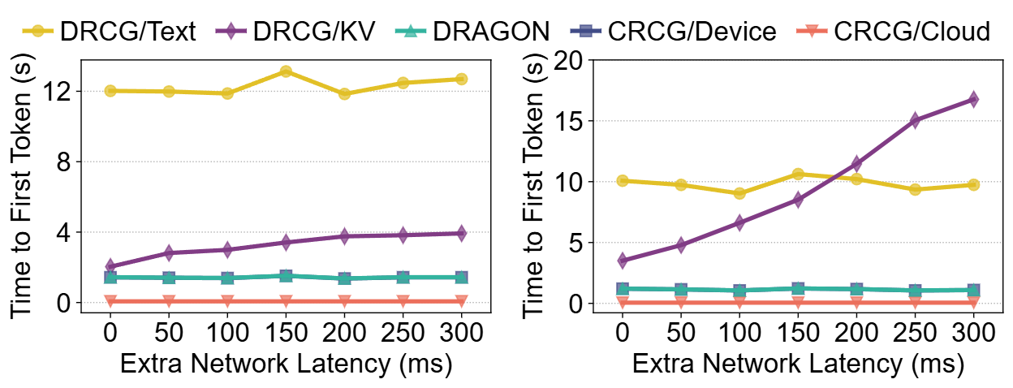


Experiments: Evaluation
Overall Performance
Overall Efficiency
1.9$×$
1.4$×$
(a) Qwen2.5-1.5B/WikiText2 (b) OPT-1.3B/WikiText103
Performance on WikiText.
(a) Qwen2.5-1.5B (b) OPT-1.3B
Per-token latency in various network conditions.
DRAGON matches or outperforms all baseline methods across all settings.
The performance gain increases as more documents are integrated.
DRAGON shows strong robustness under different network conditions compared to distributed baselines
(a) Qwen2.5-1.5B (b) OPT-1.3B
Time-to-First-Token in various network conditions.

Slide 30
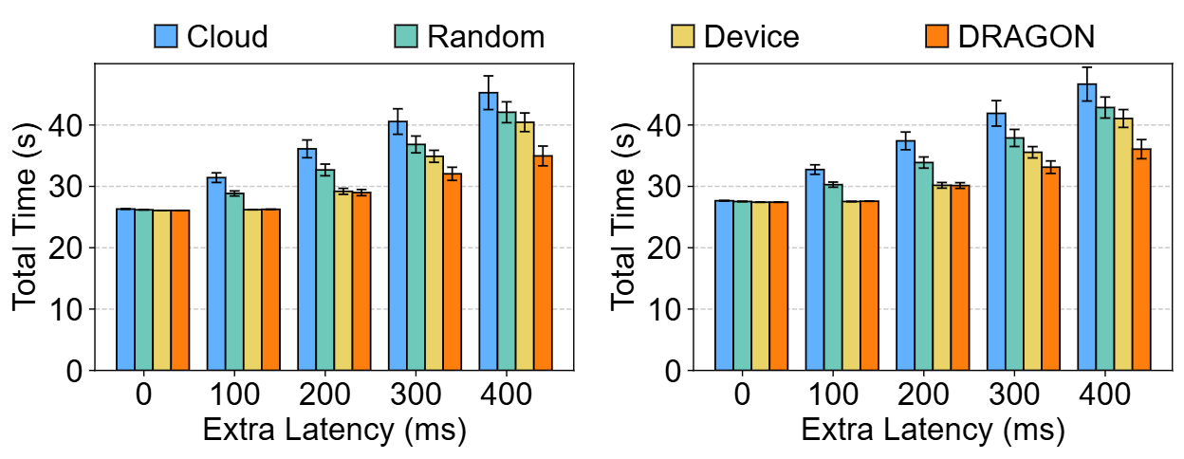
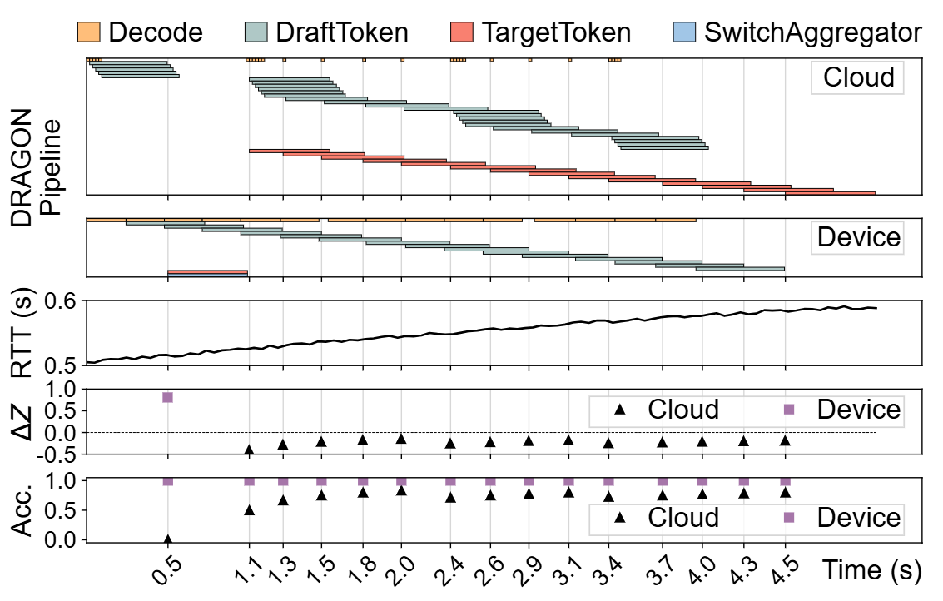

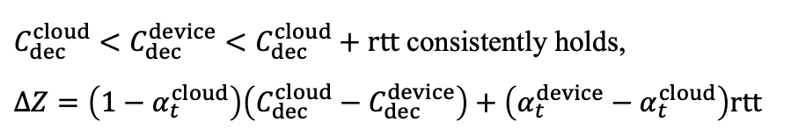
Experiments: Evaluation
Effectiveness of Scheduling
$C_{dec}^{cloud}<C_{dec}^{device}<C_{dec}^{cloud}+rtt$ consistently holds,
$ΔZ=\left(1−α_{t}^{cloud}\right)\left(C_{dec}^{cloud}−C_{dec}^{device}\right)+\left(α_{t}^{device}−α_{t}^{cloud}\right)rtt$
A
B
T=0, by default
Aggregate
on the device side
(a) Qwen2.5-1.5B
T$≥$0.5, B dominates
Switch to aggregate
on the cloud side
(b) OPT-1.3B

Slide 31
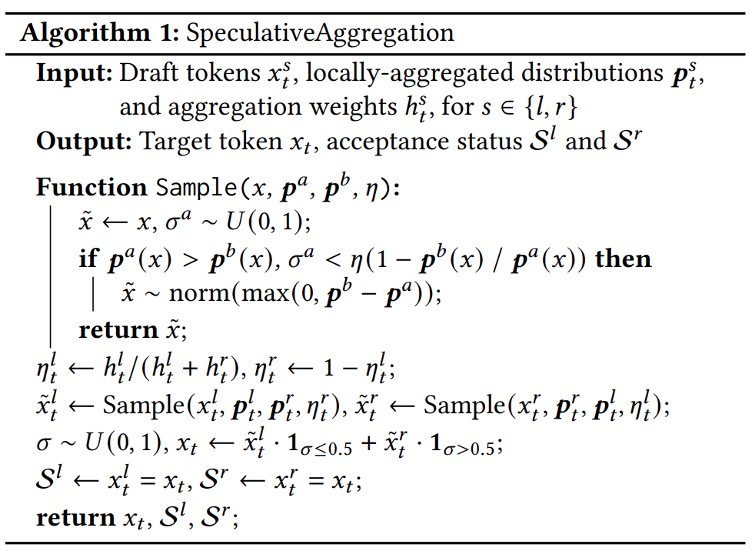
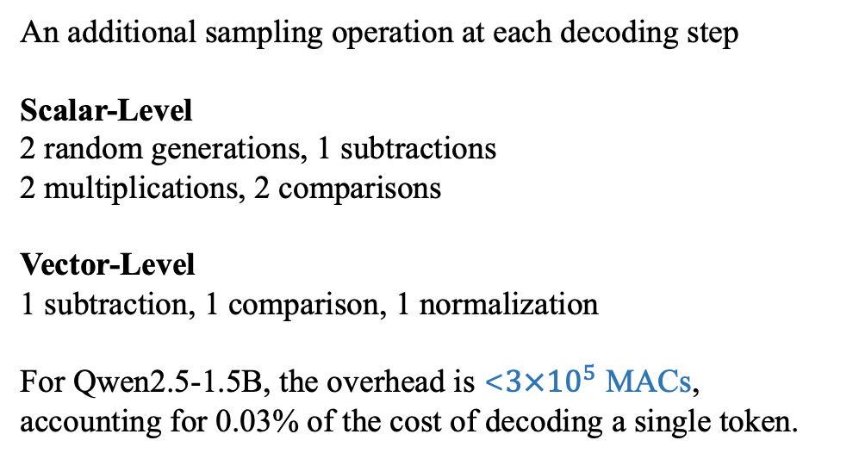
Experiments: Evaluation
Overhead Analysis
Computational Overhead
An additional sampling operation at each decoding step
Scalar-Level
2 random generations, 1 subtractions
2 multiplications, 2 comparisons
Vector-Level
1 subtraction, 1 comparison, 1 normalization
For Qwen2.5-1.5B, the overhead is <$3×{10}^{5}$ MACs, accounting for 0.03% of the cost of decoding a single token.
Communication Overhead
Transmitting the output distributions incurs less than 0.5 KB of extra data per token. Under a 100 Mbps local-area Wi-Fi network, this translates to <40 us of latency.

Slide 32
Conclusion

Slide 33
Conclusion
DRAGON is a distributed RAG framework that enhances on-device SLMs using both personal and general knowledge without raw document transmission.
DRAGON partitions the RAG workflow across device and cloud, using Speculative Aggregation to minimize output synchronization overhead.
Experimental results show that DRAGON notably improves generation quality while maintaining low latency.
Designed for peer-to-peer computing nodes, also applicable for multi-node systems

Slide 34
DRAGON: Enhancing On-Device Model Performance with Distributed Retrieval-Augmented Generation
Thanks for ​​your attention！(Q&A)
Oct. 27th, 2025
ACM MobiHoc 2025, Houston, USA

Slide 35
Q&A: Why KV-Cache is employed in Transformer-based LLMs?
One step in
Transformer
The relationship of self-attention is a complete graph, which results in a quadratic increase in time complexity as context length grows
Simplicity
is
not
a
simple
thing.
Simplicity
is
not
a
simple
thing.
$$x→x⊙w/\sqrt{sum_{i} x_{i}^{2}/d+eps}$$
$$x→x⊙w/\sqrt{sum_{i} x_{i}^{2}/d+eps}$$
Matmul $W_{Q}$
Matmul $W_{K}$
Matmul $W_{V}$
Matmul $W_{1}$
SiLU
Mul
Matmul $W_{3}$
$$O(ndd_{f})$$
$$O(nd^{2})$$
Reshape
Reshape
Matmul $W_{2}$
Matmul $R_{t}$
Matmul $R_{t}$
n Copies
n Copies
Add
Time complexity further exacerbated due to the enormous hidden dimension and the number of layers
Transpose
One-step in Recurrent NN
$$Q$$
$$×$$
$$K^{⊤}$$
Causal
Mask
$$O(n^{2}d_{k}\frac{d}{d_{k}})$$
+
$$x_{t}$$
$$×$$
$$V$$
$$O(md)$$
$$\sqrt{d_{k}}$$
Softmax
Matmul $U_{h}$
Concatenate & Reshape
$$h_{t−1}$$
Matmul $V_{h}$
Tanh
$$h_{t}$$
$$O(d^{2})$$
$$O(nd^{2})$$
Matmul $W_{o}$
$$O_{t}$$
$$O(d^{2})$$
Add
Matmul $W_{y}$
$$y_{t}$$
3

Slide 36
KV Cache: Trade Space for Time
Simplicity
is
not
a
simple
thing.
Softmax
$$Q$$
$$×$$
$$K^{⊤}$$
Causal
Mask
$$×$$
$$V$$
$$=$$
+
$$x→x⊙w/\sqrt{sum_{i} x_{i}^{2}/d+eps}$$
$$/\sqrt{d_{k}}$$
Caching K
Caching V
Step 0
Matmul $W_{Q}$
Matmul $W_{K}$
Matmul $W_{V}$
Reshape
Reshape
Cache Memory
Matmul $R_{t}$
Matmul $R_{t}$
Restoring K
Restoring V
Step 1
n Copies
n Copies
Self-Attention
Softmax
Transpose
$$Q$$
$$×$$
$$K^{⊤}$$
Causal
Mask
+
$$Q$$
$$×$$
Causal
Mask
$$×$$
$$V$$
$$=$$
$$×$$
$$V$$
$$K^{⊤}$$
+
$$\sqrt{d_{k}}$$
Softmax
$$/\sqrt{d_{k}}$$
Concatenate & Reshape
History
Cached
To Compute
Matmul $W_{o}$
Each decoding step now operates with a time complexity of $O\left(nd+d^{2}\right)$
However, it incurs a space complexity of $O(nd)$.
Add
4

