Slide 1
Distributed Rerouting For Multiple Sessions in Cognitive Radio Networks
Ying Dai and Jie Wu
Department of Computer and Information Sciences
Temple University

Slide 2
Motivation
In cognitive radio networks (CRNs):
Rerouting Path
Two nodes can talk if both on the same channel.
CH1
CH1
CH1
v
CH1
u
CH2
CH2
CH1
CH1
CH3
CH3
What if multiple nodes in a close area need rerouting together?

Slide 3
Motivation
u₁ and u₂ both choose v for rerouting;
Delay for u₁ or u₂ increases since v can only serve one at each time
u₁
Make use of the RREP?
RREP
v
u₂
RREP
RREP: pass some delay predictions for u₁ and u₂ to decide whether to choose v for rerouting

Slide 4
Model
Consider in a CRN, when multiple nodes in a close geographical area need rerouting together
  Our objective: reduce the overall rerouting delay for them.
  Each node selects rerouting path considering the choices of other nodes in the neighborhood.
u₁
v₁
u₂
v₂

Slide 5
Model
To build the rerouting paths, we are facing several challenges:
  The set of nodes that need rerouting together in the neighborhood is unknown;
  The choices of other nodes are unknown or undetermined.
Need some predictions about the probability of a node to be chosen for rerouting…

Slide 6
Solution
Each node maintains two queues:
  QN: a queue of confirmed nodes that use it to transmit and nodes that may possibly use it
  QP: the probabilities of nodes in QN choosing this node for rerouting.
    The positions of the same node in two queues are the same.

Slide 7

Solution
Delay prediction:
  Assume each session takes the same time to transmit (can also be different):
The content of RREPs:
  D_{v}^{u}: Predicted delay if u chooses v
  M_{v},QL_{v}: for other nodes to overhear

Slide 8
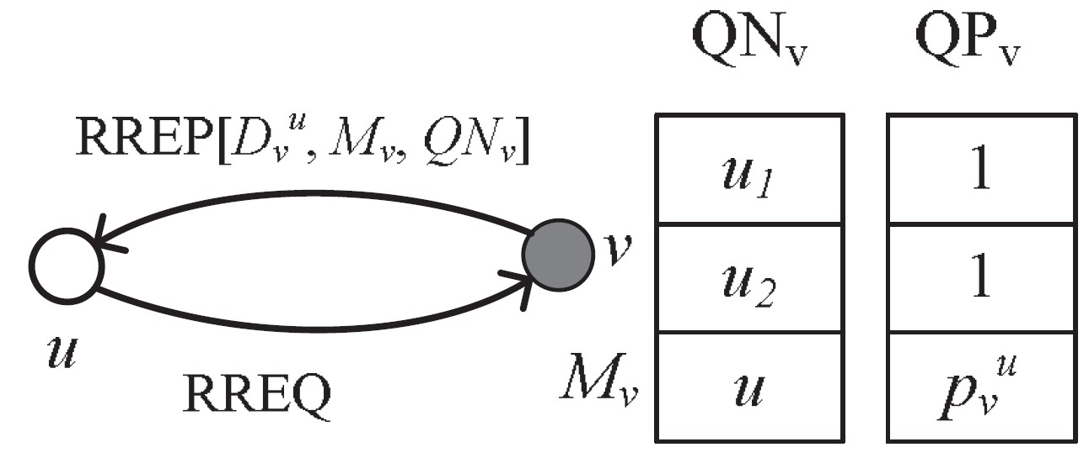
Solution
The values in QP:
  For nodes that are confirmed to choose this node: 1;
  For nodes that are possible to choose this node: predict the probabilities.
How to predict?

Slide 9
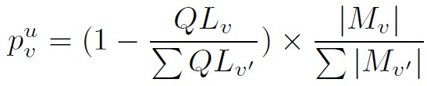
Solution
For node v, to predict the probability of it being chosen for rerouting:
v'
RREP
u
v

Slide 10
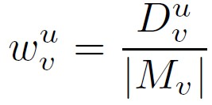
Solution
Path construction
  Assign weights to each link:
  Greedy algorithm
    Based on the weights on links

Slide 11
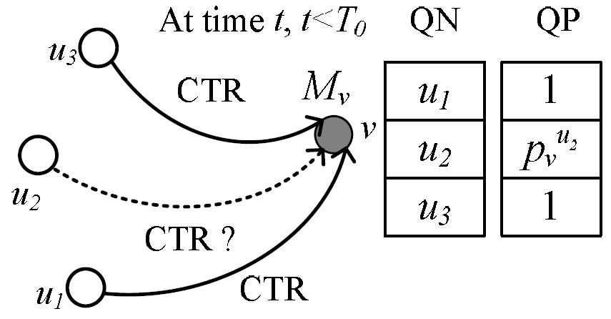
Issues
Possible conflicts:

Slide 12
Issues
Conflict resolutions
  Reserve-based Conflict Resolution Approach
    Define valid time period: T₀
    Reserve the position before T₀ expires
    After T₀ expires, remove the node without CTR from both queues

Slide 13
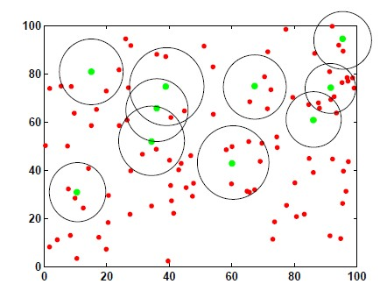

Simulations
Rerouting nodes
Base searching range

Slide 14
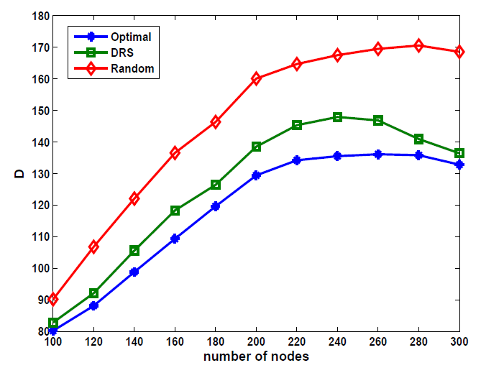
Simulations
D: the sum of the delay for all nodes that need rerouting
Achieves more than 80% of the optimal results.

Slide 15
Conclusions
We provide a distributed rerouting scheme for multiple sessions in CRNs.
Each node maintains two queues for delay estimation and sends back with RREP.
We consider the possible conflict issues and give a solution.

Slide 16
Thank you!
Q&A

