Slide 1


DiVE: Differential Video Encoding for Online Edge-assisted Video Analytics on Mobile Agents
Jiangang Shen¹, Hongzi Zhu¹, Liang Zhang², Yunzhe Li¹, Shan Chang², Jie Wu³, and Minyi Guo¹
¹Shanghai Jiao Tong University, China
²Donghua University, China
³Cloud Computing Research Institute China Telecom, China

Slide 2
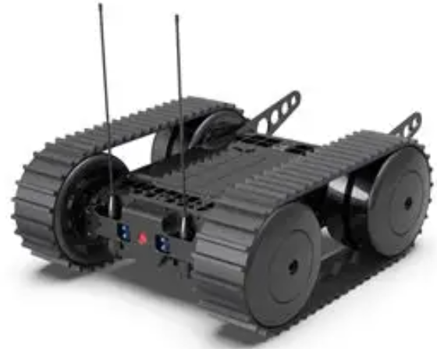
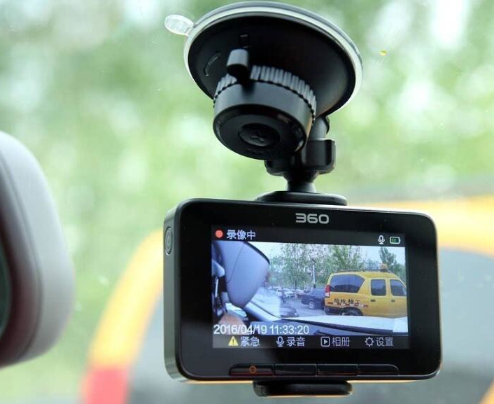
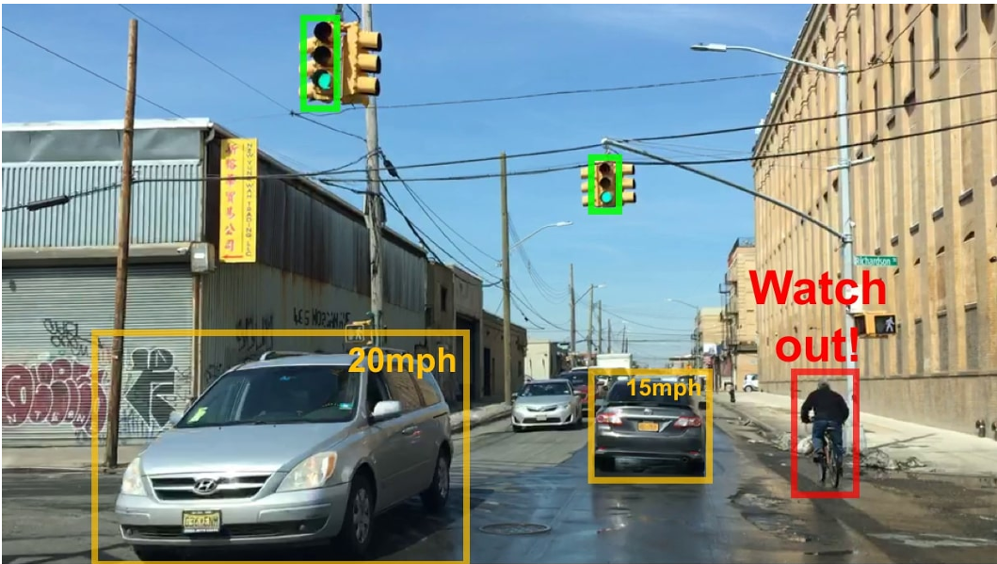
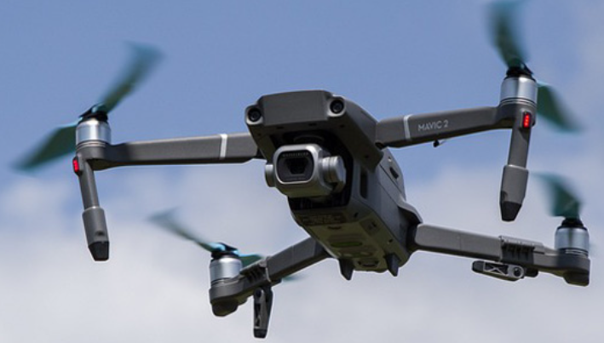
Background
Offloading video analytic task to edge server for mobile agents can be of great interest.
Mobile Agents are resource-constrained.
Online video analytics is important.

Slide 3
Existing work
Key frame filtering at camera side.
Perform poorly in highly dynamic scenarios!
Video compressing based on server feedback.
Depend on guidance from the edge, leading to huge latency!
Local compressed model assisted video analytics.
Require significant computing power!

Slide 4

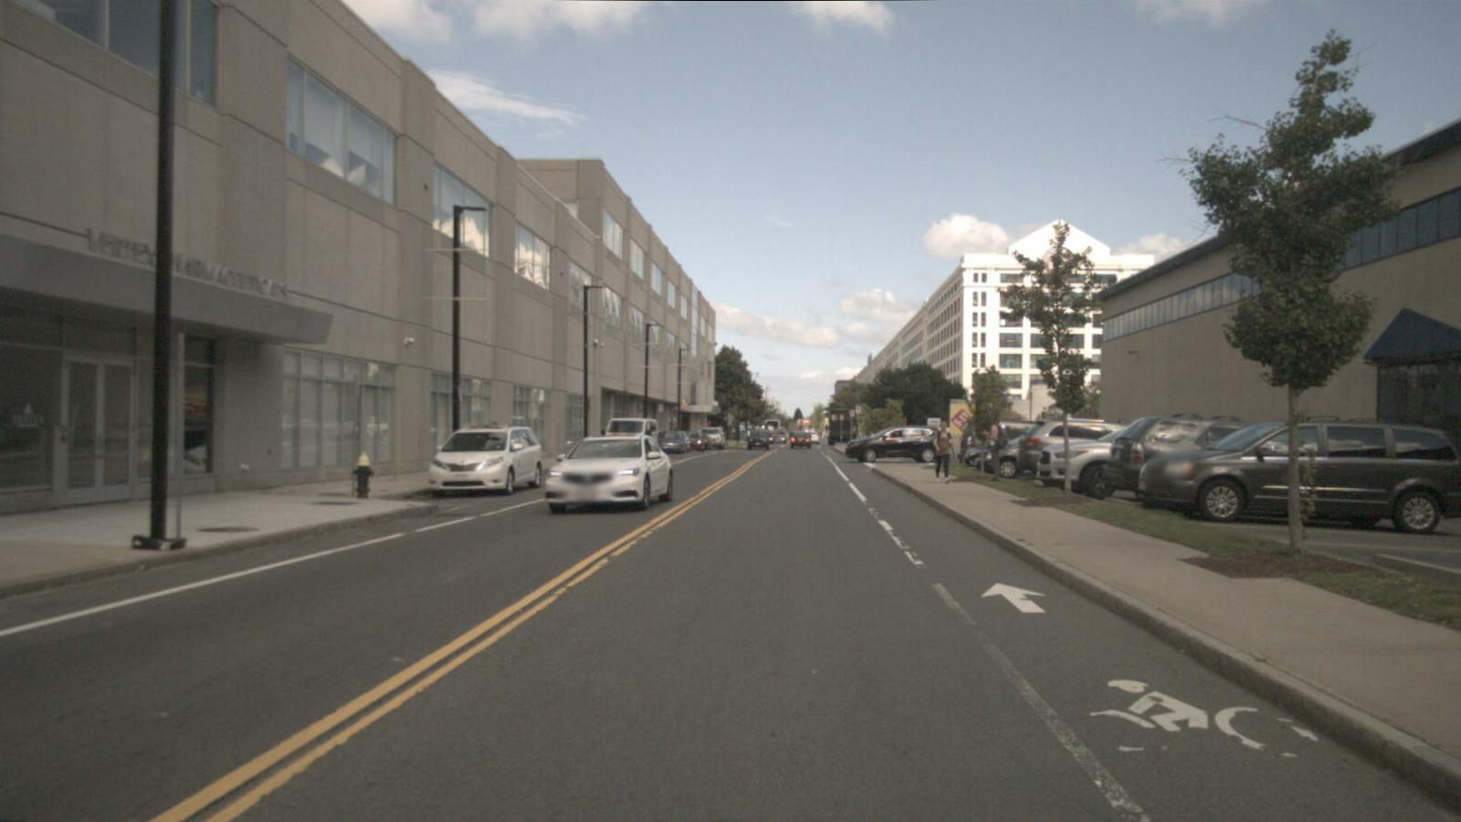


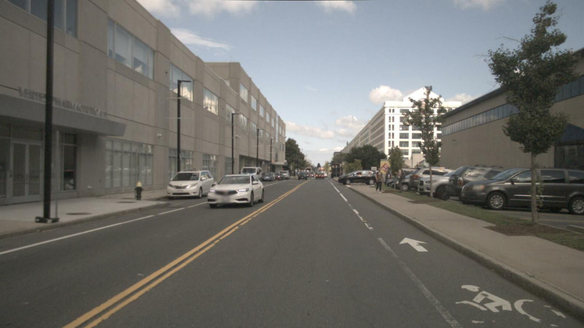
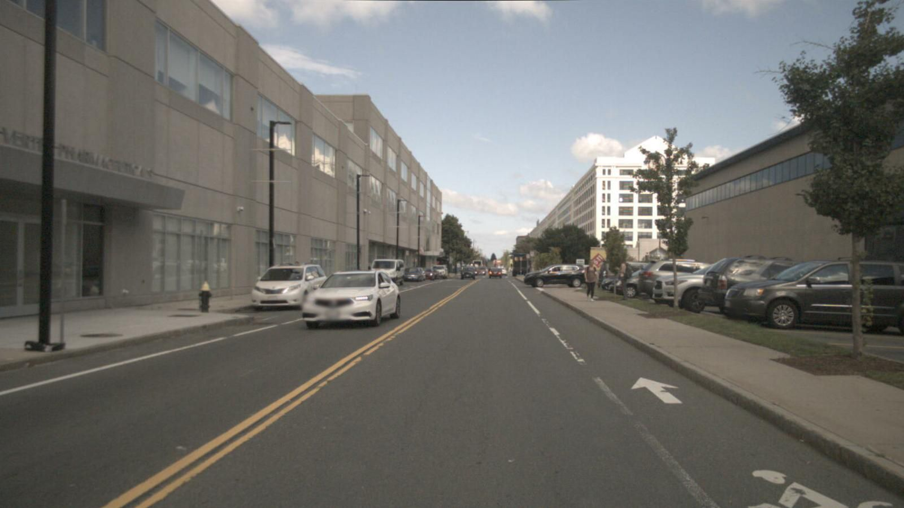


System Model & Design Goals
System Model
Mobile Agents:
Demanding video analytics like object detection.
Basic computility for video encoding such as H.264.
Edge Server:
Computility for video decoding and online model inference.
Returning inference results to mobile agents.
Encoder
Decoder
Mobile Agents
Edge Server

Slide 5
System Model & Design Goals
Design Goals
High Inference Accuracy.
Low End-to-end Latency.
Limited computational power Requirement.
Encoder
Decoder
Mobile Agents
Edge Server

Slide 6
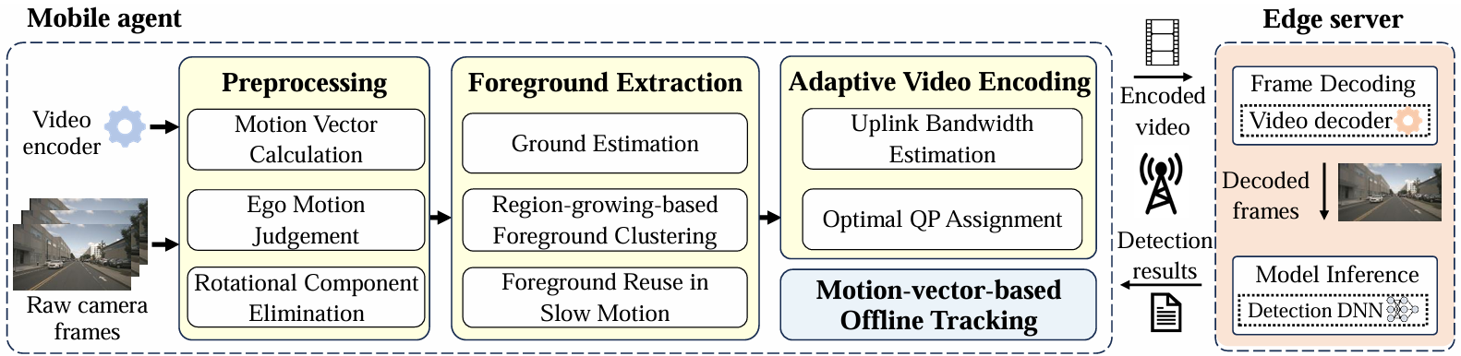
Core Idea of DiVE
Mobile agent leverages motion vectors output by the video codec to identify foreground objects in each frame.
Mobile agent adaptively chooses different compression ratios between the foreground and the rest of a frame based on current uplink bandwidth.
Arhcitecture of DiVE

Slide 7
Challenges
Challenge 1：Motion vectors are very coarse and vulnerable to image noise and rotation of the camera.
Challenge 2：Foreground objects may have distinct motion and different image textures.

Slide 8
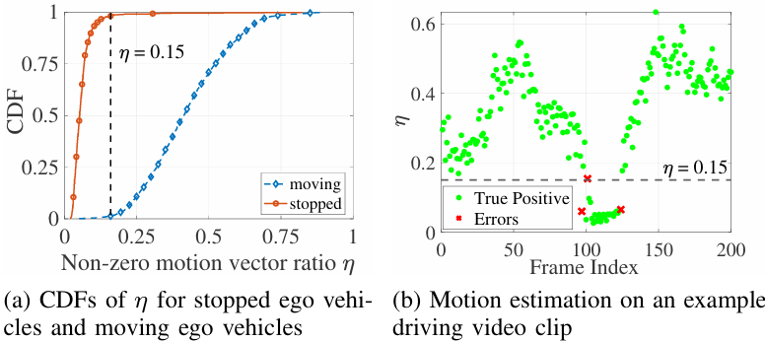
Challenge 1: Process coarse motion vectors
Ego Motion Judgement
Judge ego motion state with non-zero motion vector ratio η.
Ego agent is moving if η > threshold, otherwise ego agent is static.

Slide 9
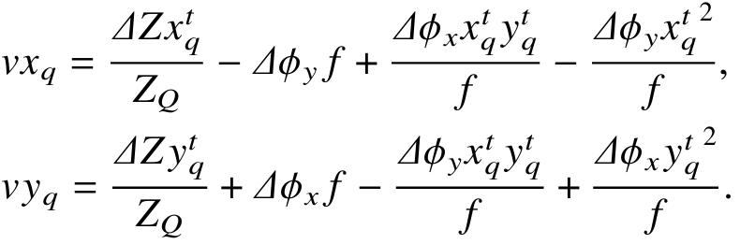
Challenge 1: Process coarse motion vectors
Rotational Component Elimination
When ego agent is turning, the motion vector along x-axis and y-axis can be written as:

Slide 10
Challenge 1: Process coarse motion vectors
Rotational Component Elimination
When ego agent is turning, the motion vector along x-axis and y-axis can be written as:
translation components
rotation components

Slide 11
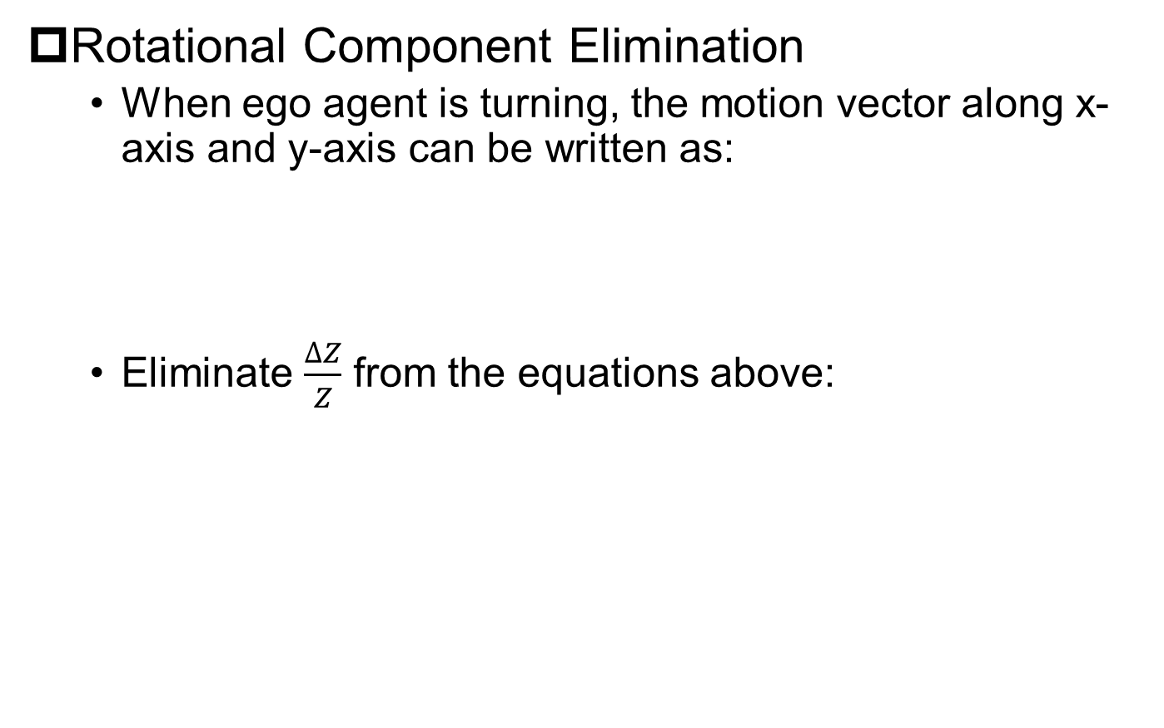
Challenge 1: Process coarse motion vectors
Rotational Component Elimination
When ego agent is turning, the motion vector along x-axis and y-axis can be written as:
Eliminate $\frac{∆Z}{Z}$ from the equations above:

Slide 12
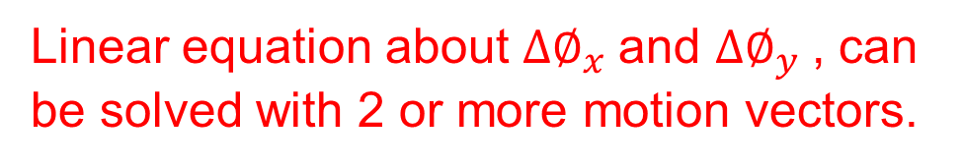
Challenge 1: Process coarse motion vectors
Rotational Component Elimination
When ego agent is turning, the motion vector along x-axis and y-axis can be written as:
Eliminate $\frac{∆Z}{Z}$ from the equations above:
Linear equation about $∆∅_{x}$and $∆∅_{y}$, can be solved with 2 or more motion vectors.

Slide 13
Challenge 1: Process coarse motion vectors
Rotational Component Elimination
How to choose motion vectors to efficiently solve the linear equations?

Slide 14
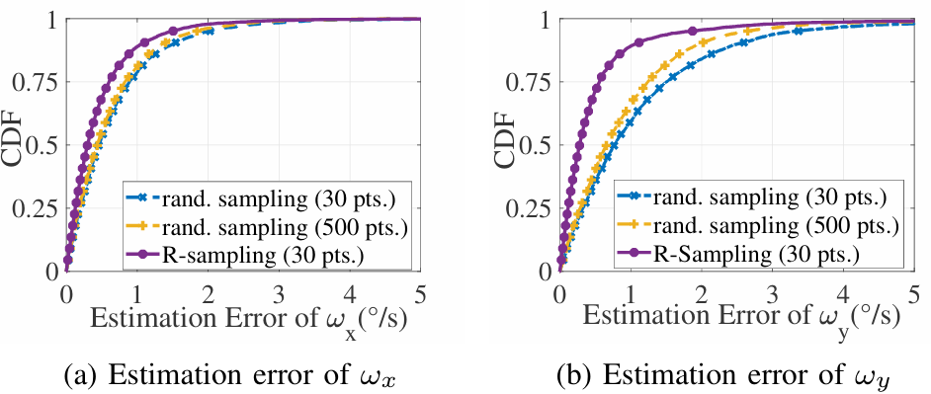
Challenge 1: Process coarse motion vectors
Rotational Component Elimination
How to choose motion vectors to efficiently solve the linear equations?
R-sampling: choosing k motion vectors nearest to Focus of Expansion (FOE).

Slide 15
Challenge 2: Extract foregrounds
Key Observations:
All foreground objects stand on the ground.
Motion vectors on the same object are similar.
Core idea:
First utilize a unique feature of motion vectors to estimate the ground region in each frame.
Then identify objects by clustering similar motion vectors starting from the ground region.

Slide 16

Challenge 2: Extract foregrounds
Ground Estimation
Normalize the preprocessed motion vectors:
$$v_norm=\frac{∆Z}{fY}$$

Slide 17
Challenge 2: Extract foregrounds
Ground Estimation
Normalize the preprocessed motion vectors:
$$v_norm=\frac{∆Z}{fY}$$
Magnitude of the normalized motion vector is only related to height of object point Y！

Slide 18
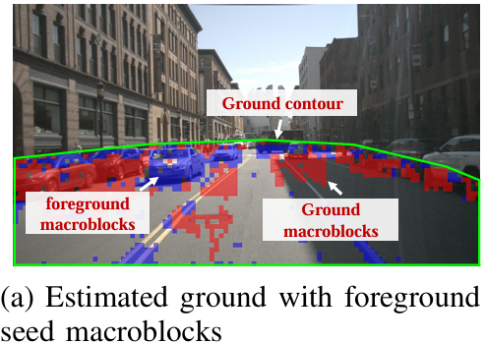
Challenge 2: Extract foregrounds
Ground Estimation
Normalize the preprocessed motion vectors:
Motion vectors with the smallest normalized magnitude belongs to ground, statistic method is utilized for calculating the threshold.
$$v_norm=\frac{∆Z}{fY}$$

Slide 19
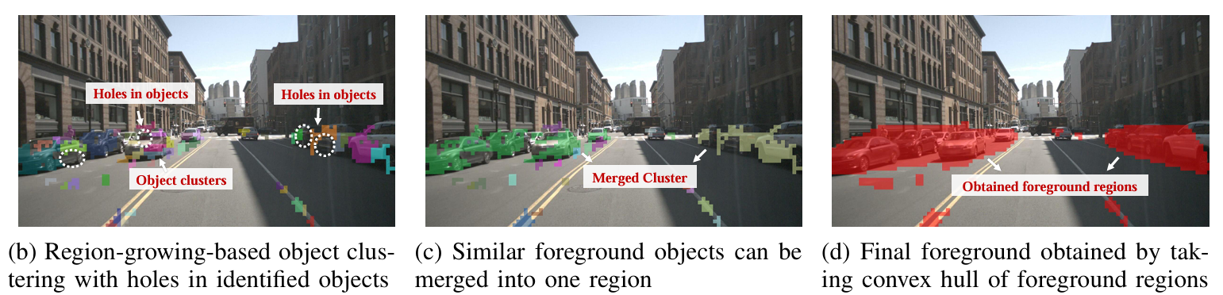
Challenge 2: Extract foregrounds
Region-growing-basd Foreground Clustering
Non-ground macroblocks inside ground contour are foreground seeds.
BFS-based clustering are utilized to cluster similar motion vectors.
Object clusters with similar motion vectors are merged as final foregrounds.

Slide 20
Adaptive video encoding
Uplink bandwidth is estimated with slicing window of 2ms length.
Optimal QP Assignment
Observation: Larger extracted foregrounds are more likely to cover more real foregrounds.
QP offset value δ=c*size(FG)
Motion-vector-based offline tracking is enabled when uplink is interrupted.

Slide 21
Performance Evaluation
Settings
Datasets: nuScenes, RobotCar
Video analytics task: object detection (Car + Pedestrian)
Metrics
Average Precision (AP)
Response Time
Compared Methods
O³ (INFOCOM’ 21)
EAAR (MobiCOM’ 19)
DDS (SIGCOMM’ 20)

Slide 22
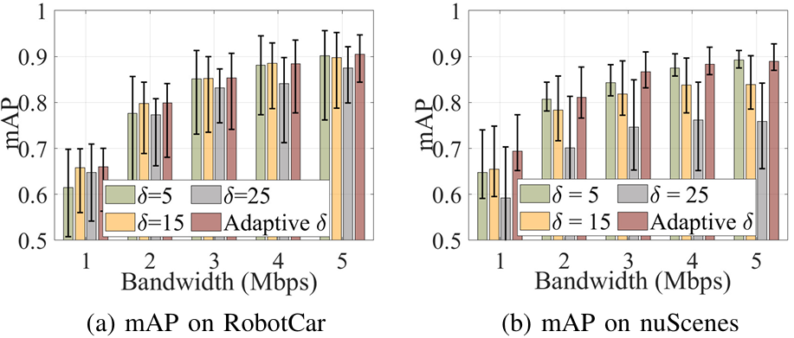
Effectiveness of Optimal QP Assignment
Vary δ from 5 to 25 with an interval of 10, along with adaptive δ in DiVE.
Adaptive δ achieves the highest mAP under most settings.

Slide 23
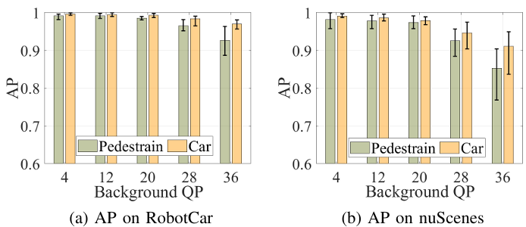
Effectiveness of Foreground Extraction
Fix the QP value of foregrounds to 0, vary QP value of backgrounds from 4 to 36 with an interval of 8.
AP of the pedestrian and car is larger than 0.97 on both datasets when QP=20.

Slide 24
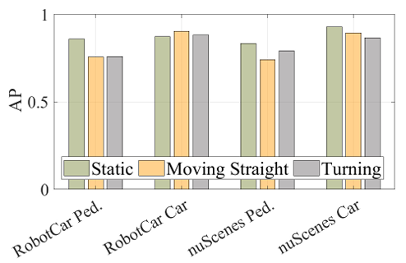
Impact of Different Motion State
Manually divide RobotCar and nuScenes into static, moving straight and turning.
DiVE consistently achieves car detection AP exceeding 0.8 across both datasets.

Slide 25
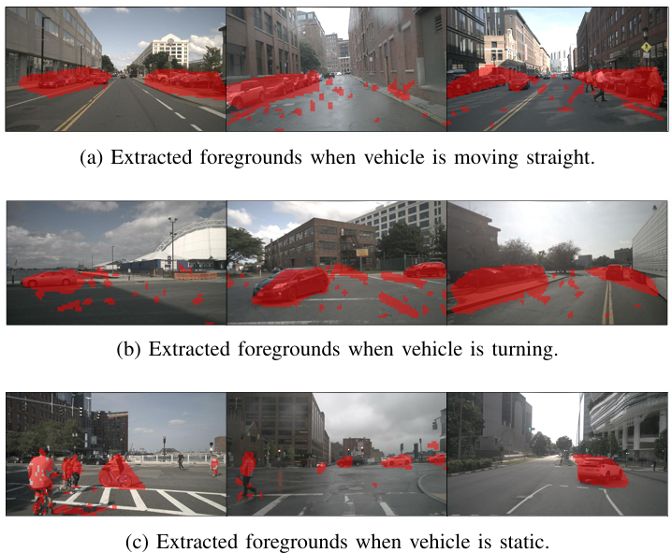
Impact of Different Motion State
Samples of foregrounds extracted by DiVE.

Slide 26
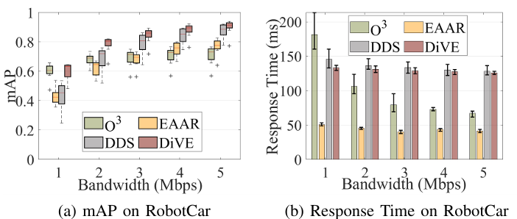
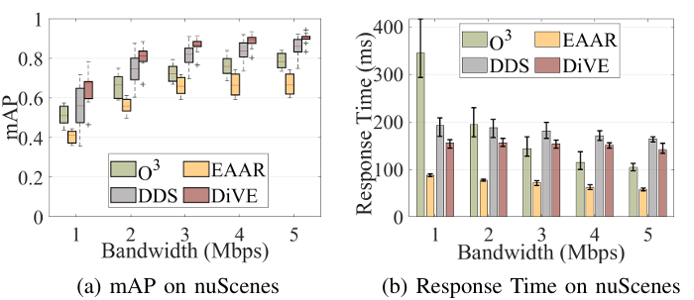
End-to-end Performance Evaluation
Varying netwok bandwidth from 1Mbps to 5Mbps with an interval of 1Mbps.
DiVE improves mAP by 39.1% and reduce response time by 19.1% at most compared to DDS.

Slide 27
Conclusion
We propose a light-weight video analytics system designed for mobile agents called DiVE.
In DiVE, mobile agent extracts interested foregrounds based on low-cost motion vectors for differential encoding.
We conduct extensive experiments to demonstrate the efficiency of DiVE.

Slide 28

Thanks！
Q & A
Notes:
我的汇报到此结束，请各位专家批评指正。

