Slide 1

Cooperative Trajectory-based Map Construction
IEEE TrustCom 2012, June, Liverpool, UK
Wei Chang, Jie Wu, and Chiu C. Tan
Temple University, USA

Slide 2

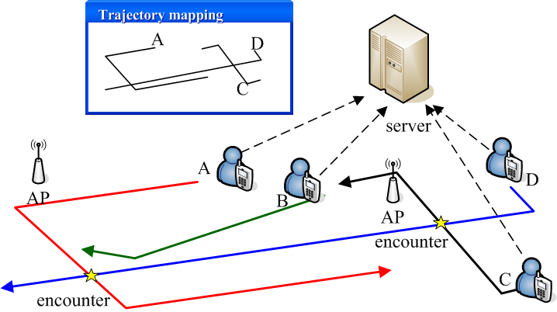



Introduction
Why? Navigation to a friend in an unfamiliar region.
Traditional ways of map construction:
GPS-based: indoor
Multi-sensors (MobiCom 2010)
Accelerometer + compass + Encounter sensor
Notes:
With the development of GPS, there is a new type of service, called Location-based service. Unlike the traditional online services, location-based service uses users’ instant location information. For example, friend locator is application. When a group of users enters into an unfamiliar region, they need some kind of service to help them navigating to their friend. However, here are some challenges:
This group of users do not have the map of this unfamiliar region.
During navigation, we need to know the instant location of each user.
So, for this group of users, they need to cooperatively construct a map.
Traditional ways of map construction is to use GPS (left down figure): users periodically reports their GPS readings to a central server. By recording the reported locations of users, the server can obtain both the shape of each and the location of users. However, here are some limitations for using GPS:
The unavailability of GPS signals in indoors
High energy consumption
Lots of sampling data
In 2010 mobicom, a group from Duke university proposed another way for map construction by using Multi-sensors (right down figure):
Multi-sensors embedded in smartphones:
Accelerometer (can calculate the moving distance from one place to another)
Electronic compass (finding the moving direction)
Encounter sensor (detect the physical encounter of users)
For example, in right down figure, the path of user A is represented by red solid line. By using multiple sensors, the shape of A’s can be recorded as “move west for 1 mile, then turn to south and continue walking for 1 mile with an encounter with user D at the star point. And then, turn to east and walks 2 miles.”
Clearly, the multiple sensors system also records the shape of each road. However, if the roads contain a lot of curves, each users still need to report plenty of data to the central server (next page, upper figure)

Slide 3
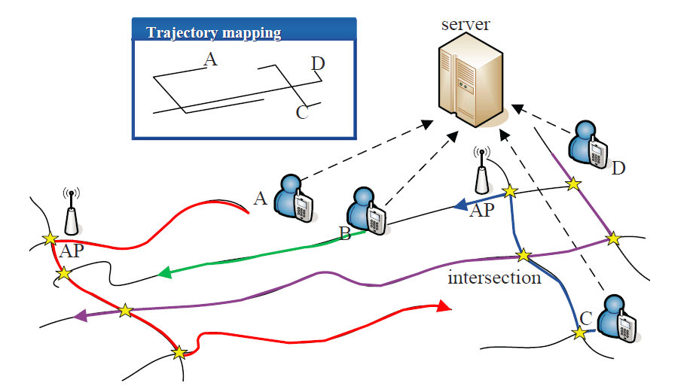
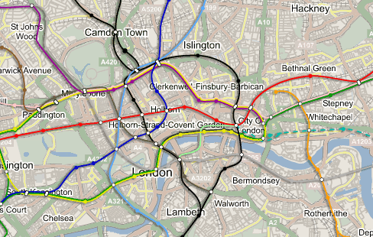
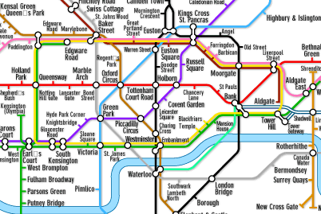
System model
Notes:
Our Basic idea for map construction comes from subway map. (down figure) these two maps are London subway map. Although the shape of tube (left down figure) is curve, we still can use direct line to join the different stations. For a walking path map, we only need to preserve two types of information: connectivity of intersections and the distance between them. So, if each intersection can be associated with unique features, instead of recording the shapes of paths, the trajectories can be represented as the combination of intersections features and the walking distance between intersections.
The map construction problem can be transformed into trajectory mapping problem.
(the below part is option)
Here is the system model.
central server: There is a central server, which collects data and constructs the map.
Users: In the graph, we have 4 users, named A, B, C and D. Each user has three sensors embedded in their Smartphone. The arrows represent users moving directions. The stars represent the happening of physical encounters. The users also record the timestamps of each encounter and the id of the other encounter.
Landmark (such as wifi access points): The towers in the graph mean access points (APs). Each access point also has a unique id. The AP can be used as some fixed land-mark; when a user pass by an AP, the user will record it as a special encounter. The exact location of each AP is unknown, and we only know the identities of them. The trajectories of users are join together at the places where physical encounter happened.
The system works as follow:
All the data, including displacement, direction, and encounter, are sent to a server at each turning place. Because the server records the relative positions of users, if a user does not have any physical encounter with others, his trajectory will not be added at the final map. For example, user B never met any one else, at the final map which is shown in blue frame, we cannot find his corresponding trajectory.

Slide 4
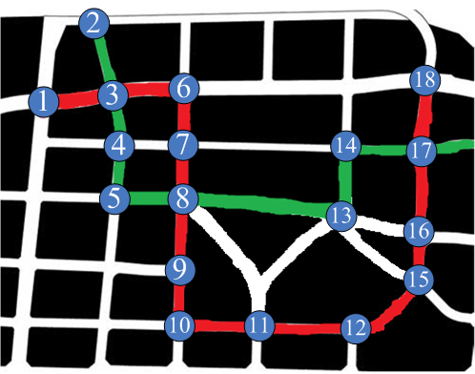
Problem formulation
R: 1-3-6-7-8-9-…-16-17-18
| | |
G: 2-3-4-5-8- 13-14 -17
Notes:
PART I : MAP CONSTRUCTION BY INTERSECTION FEATURES

Slide 5
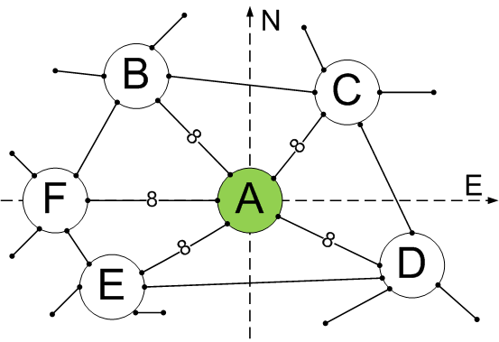

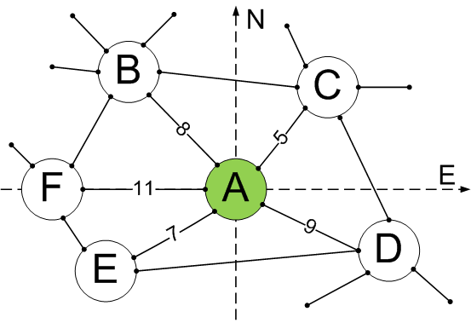
Three basic conditions
Uniqueness (node degree; length of paths)
Opportunistic use of Landmarks
Direction of entering and leaving
Notes:
There are several features can be used for matching intersections.
Node degree represents the number of paths connected with an intersection. For example, intersection A can be discriminated with other intersections based on its unique node degree and the length of connected paths.
However, for the map like right below, most of their node degree and the length of connected paths are the same. It is hard for discriminating these intersections. If we can find some landmarks at some intersections(down right figure, the red points), then, based on the identities of these landmarks, we can discriminate these intersections. But, the using landmarks is only an option since at some intersections, we cannot find any landmark.
Click mouse
Consider that once we can uniquely identify one intersection then we can discriminate its neighbors by the leaving and entering directions. For example, we know that user currently locates at intersection A. Although all of its neighbors have the same node degrees and the distances between A and others are the same, we still can using the moving directions to discriminate them.

Slide 6
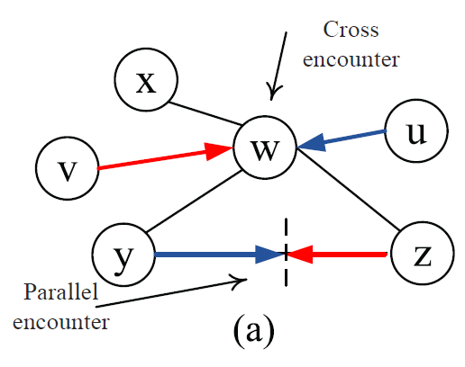
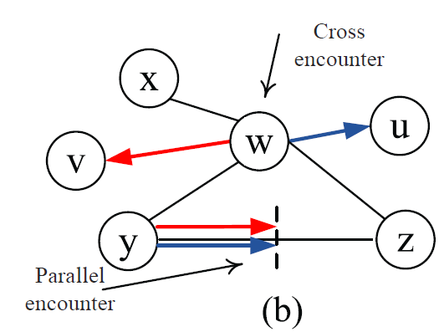
Encounters
Notes:
There are two types of encounters:
Cross encounter: should use node matching
Parallel encounter: should use edge matching

Slide 7
Our scheme
Map can be gradually constructed.
Phase I: Map construction by Landmarks and intersection node degree.
Phase II: Based on the server’s feedback, when users enter an unclear region, they should report entering and leaving directions at each intersection (map construction by directions).
Notes:
Basic idea:
First use the easiest obtained features to construct the map;
For the intersections in unclear regions, gradually add more features to make them being discriminable.

Slide 8
Extension: against malicious users
Assumption
Attacks
Two key features
Defense: Each user is assigned with an honest degree. Once the server discovers an inconsistency, some penalty will be given to the corresponding users.
Notes:
Assumption: malicious users do not collude.
Attacks: they may modify some information, like node degree or passing distance, such that the map cannot be constructed correctly.
Two key features of cooperative trajectory mapping:
when users encounter with each other, they independently report encountering to the server;
any path can be passed by any user.
Defense: Each user is assigned with an honest degree. Once the server finds out an inconsistency, some penalty will be given to the corresponding users.

Slide 9
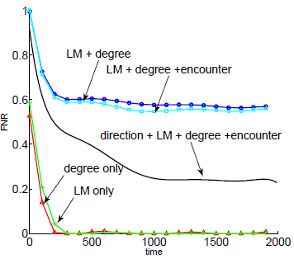
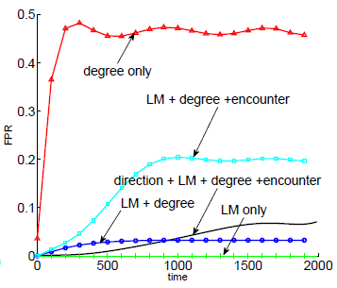
Performance analysis and evaluation
The accuracy of constructed map increases with more information at intersections.
(L) False negative rate: # of missing edges / # of total edge
(R) False positive rate: # of extra false edges / # of total edge
Notes:
In our simulation, we first generate a 10 by 10 grid map (like a mesh). Then, we use different information to construct the map.
LM + degree: using optional landmarks and node degree of each intersection
LM + degree + encounter: using optional landmarks, node degree of each intersection, and the physical encounters among users
Direction + LM + degree + encounter: using entering and leaving directions, optional landmarks, node degree of each intersection, and the physical encounters among users
Degree only: construct the map by only using node degree of each intersection
LM only: assume that each intersection has an unique landmark.
We compared our constructed map with the original grid map. if two intersections connect with each other (also means having a path between them) in the original map, but there is no corresponding edge in the constructed map, then we call it as false negative;
Similarly, if two intersections do not share an edge in the original map, but there is an false edge connecting them in the constructed map, then we call it as false positive.
From the above graphs, we can see that by using more information the accuracy of constructed map increases.

Slide 10
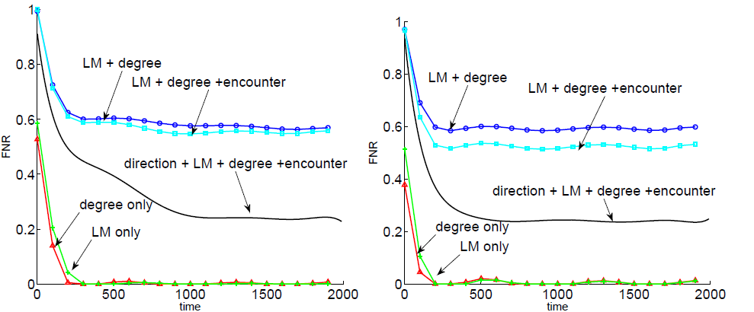
Performance analysis and evaluation
The process of map construction can be accelerated
by having more participants.
10 users (b) 15 users
Notes:
These images show the impacts of the number of users. Clearly, our scheme (black solid line) converges faster when having more participants.
We also have other simulation results. But considering the time limitation, we cannot present all of them.

Slide 11
Conclusion
In this paper, we consider the problem of map construction in cooperative trajectory mapping.
We propose a server feedback-based map construction algorithm, which gradually constructs a map by using multiple sensors and intersection features.
Our scheme can also be applied in localization problems and can also defend against some malicious users.

Slide 12
Thank you!

