Slide 1
Edge-Cloud Networks for Efficient AI/ML Implementations
Jie Wu
Dept. of Computer and Information Sciences
Temple University, USA

Slide 2
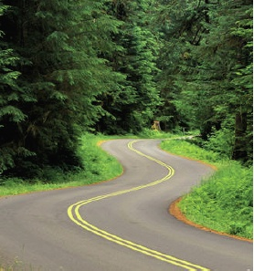
Roadmap
  Edge-Cloud Networks
  Parallelism: model vs. data
  Model: Collaborative Edge-Cloud
  Data: Decentralized Federated Learning
  Some Final Thoughts

Slide 3
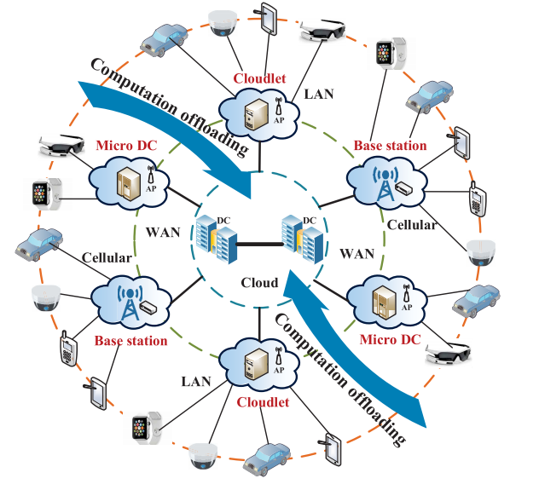
1. Edge-Cloud Networks
50 billion IoTs: connected intelligence
Edge: End IoTs + Edge
  Application-driven: AR/VR and LLM (ChatGPT, GPT4)
  Key indicators: latency, accuracy, energy, and privacy
  Latency-sensitive
    How edge contributes to AI/ML ?
    How to use rich resources in cloud ?
  Collaboration
    Edge-Cloud
    Within Cloud
TX
Notes:
Smartphones, wearable devices (google glass and apple watch), cameras, vehicles, 850 ZB data in 2021, DC 20.6 ZB data_6G in 2030, space-air-ground-sea networks

Slide 4
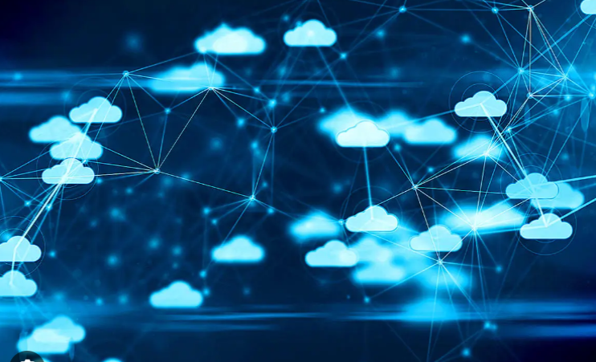
Efficient AI/ML Implementation
Work hard
  Faster processing, e.g., GPU accelerator
Work smart
  Partition AI/ML model and map parts to edge-cloud
AI/ML model and optimization
  Deep neural networks (DNN)
  Stochastic gradient descent (SGD)
TX
Notes:
Smartphones, wearable devices (google glass and apple watch), cameras, vehicles_

Slide 5
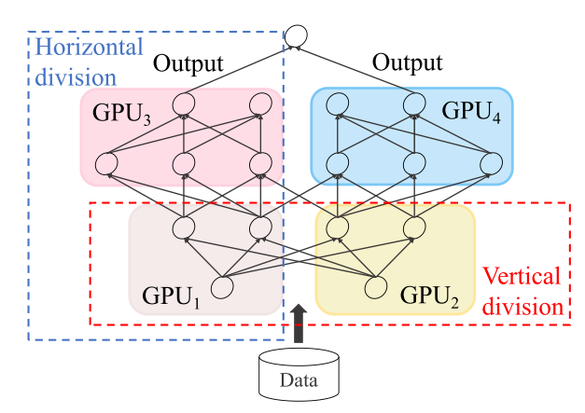
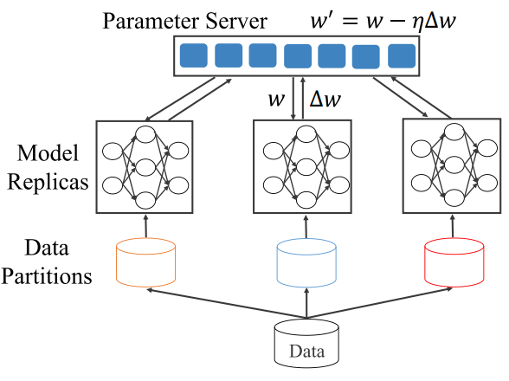
2. Parallelism
Model (task) parallelism: Edge-cloud collaboration
Data parallelism: Federated Learning (FL)
Collaborative edge-cloud Decentralized federated learning
Wu, Parallel Processing: Past, Present, and Future, early 90s
TX
Notes:
Smartphones, wearable devices (google glass and apple watch), cameras, vehicles_

Slide 6
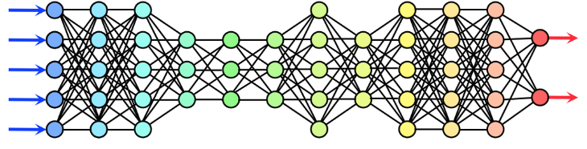

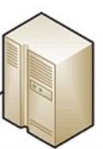
3. Model: Collaborative Edge-Cloud
Three-stage collaborative pipeline and offloading
  Local, communication, remote (Cloud)
Three models
  Device/edge-only
  Cloud-only offloading
  Mixed-mode offloading
cut
offloading
TX

Slide 7
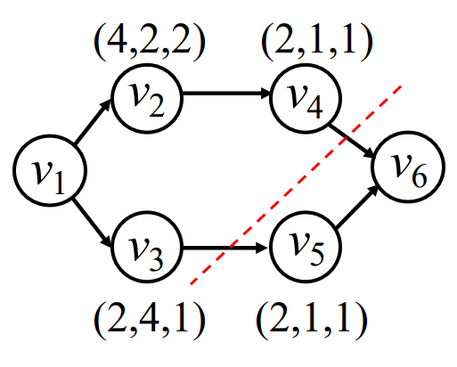
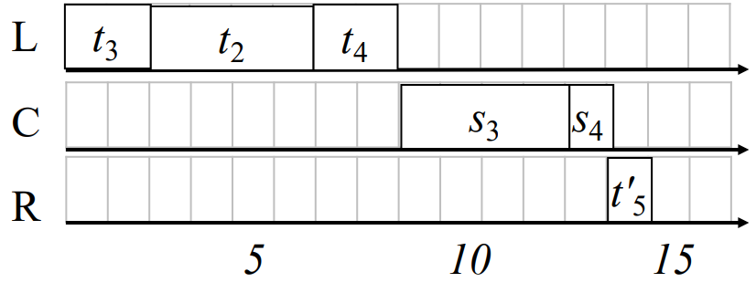
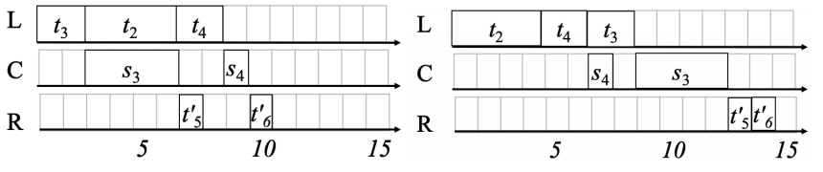
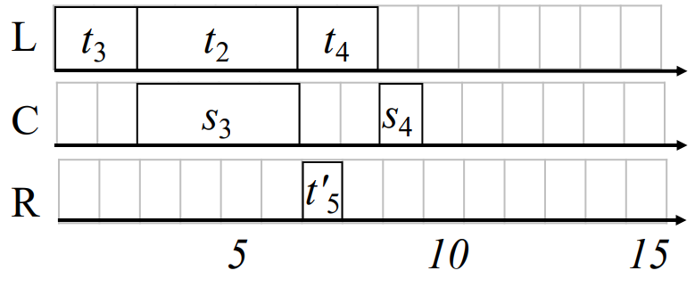
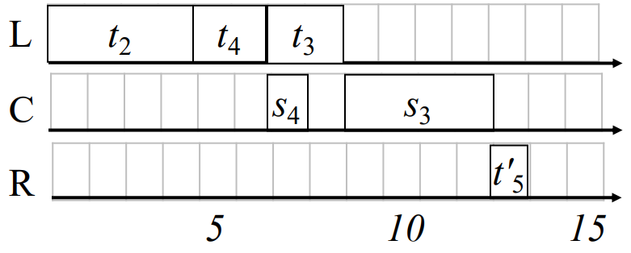
Offloading Sample: Multiple Paths
Given a partition (i.e., cut)
  Fine-grained pipeline: path-based (rather than phase-based)
  Extended Johnson’s solution with approximation ratio
TX
Notes:
(first, second): local and communication

Slide 8
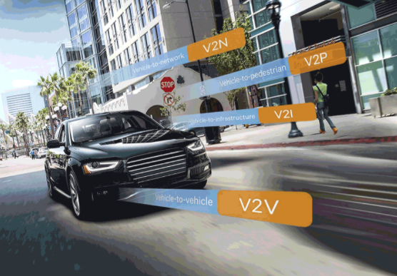
Multiple DNNs Offloading
Internet of Vehicles: smart city
Autonomous driving systems: perception is a key
Multiple cameras/sensors: multiple (identical) DNNs
V2X: V (vehicle); X for I (infrastructure), N (network), P (pedestrian)
Notes:
200 sensors: Radar, Light Detection and Ranging sensors, Sonar, Global Navigation Satellite Systems (GNSS)

Slide 9
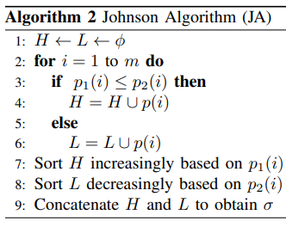
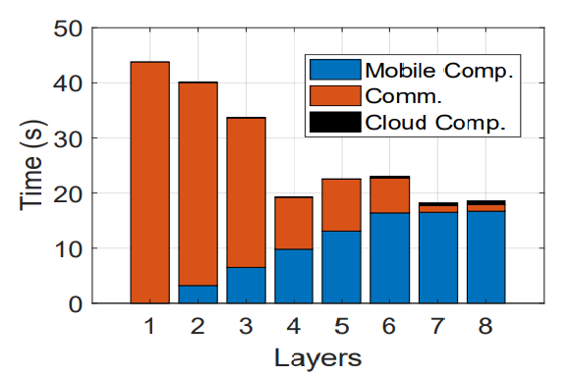
Johnson Algorithm: Multiple Lines
Computation at cloud can be neglected
JA for optimal schedule
  2-stage pipeline with given partitions
AlexNet
TX

Slide 10
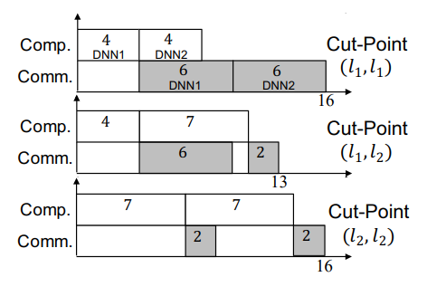
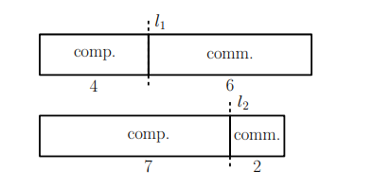
Partition and Scheduling
Partition and scheduling of 2-stage pipeline
  Brute force: O(k^{n})
  n: # of copies, k: # of layers
Existence of a better solution?
  Exploring special properties
Notes:
Gap in the first and last pairs. Two parallel bars:

Slide 11
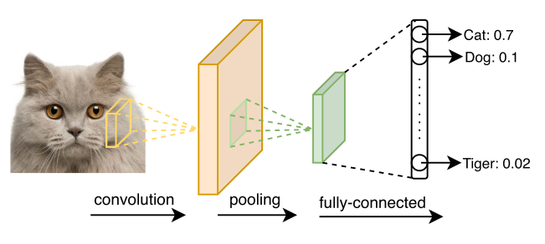
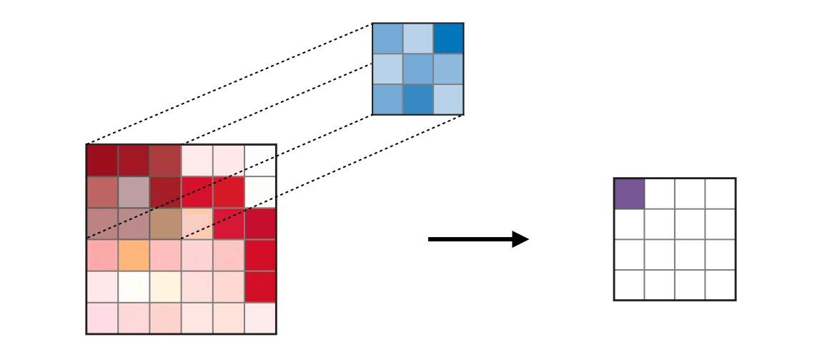
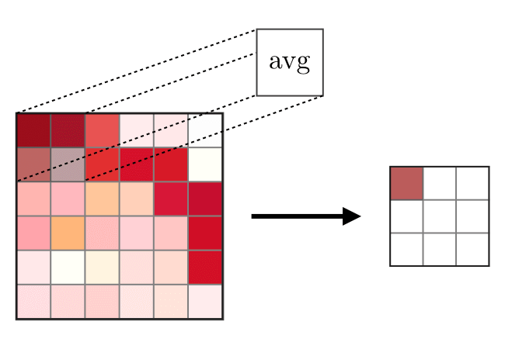
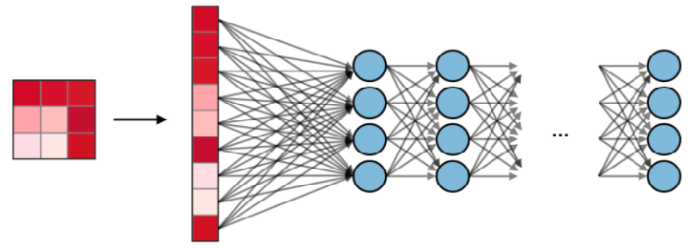
Convolution NNs
CNNs (image classification)
convolution (filtering), pooling (max/avg), fully-connected (neurons)
TX
Notes:
The convolution layer (CONV) uses filters that perform convolution operations as it is scanning the input II with respect to its dimensions. Its hyperparameters include the filter size FF and stride SS. The resulting output OO is called feature map or activation map. 200 layers, 60M parameters, LLM: 1.7 trillion parameters
卷积, 汇集

Slide 12
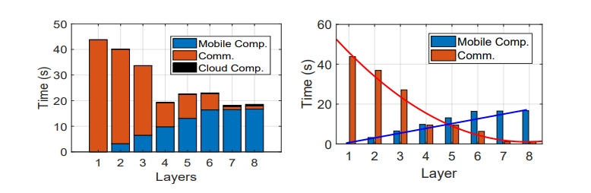
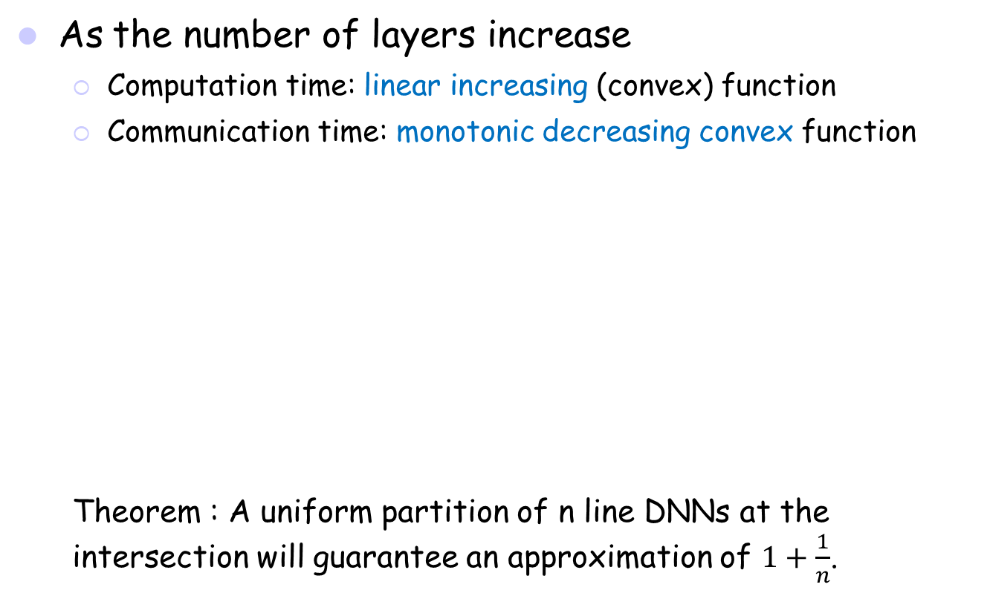
Special Application Property
As the number of layers increase
  Computation time: linear increasing (convex) function
  Communication time: monotonic decreasing convex function
  Theorem : A uniform partition of n line DNNs at the intersection will guarantee an approximation of $1+\frac{1}{n}$.

Slide 13
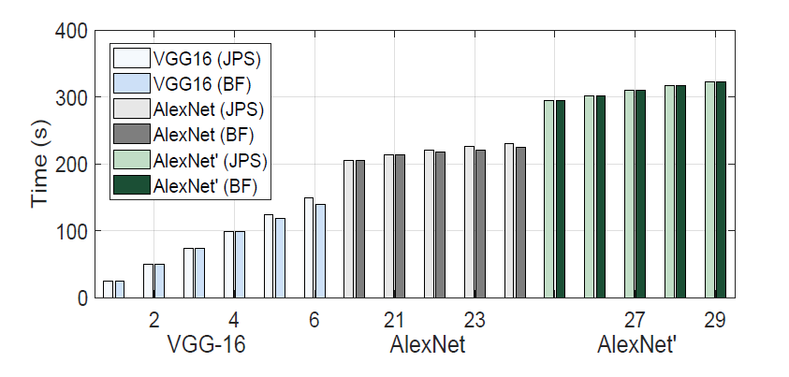
Simulation
Partition methods
  Joint Partition and Scheduling: JPS, Brute Force: BF
Applications
  VGG-16, AlexNet, and AlexNet’ (curve fitting) with n = 1, …, 29
Notes:
Approximate convex: AlexNet’. Copy numbers.

Slide 14
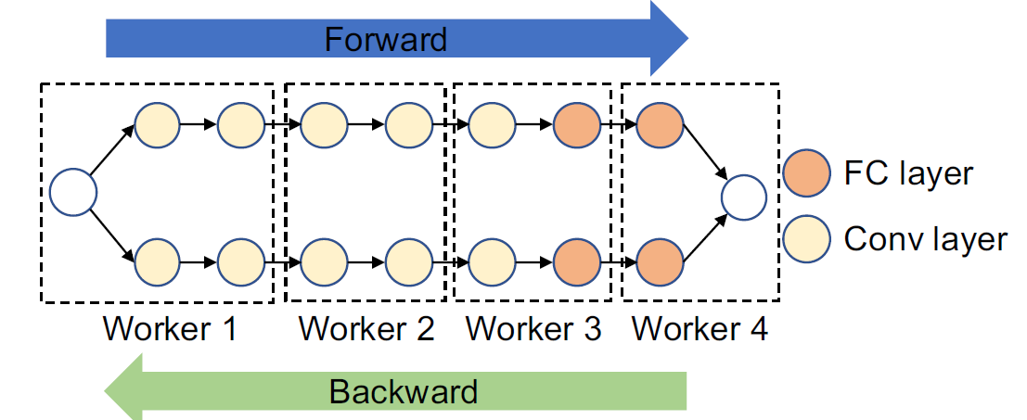
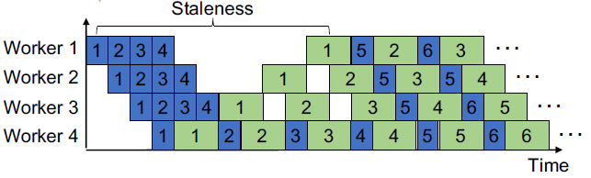

Extension: Training
  Inference forward pass/training backward pass
  Reduce resource idle time by adjusting the ratio of resources
Aligning Pipeline with Resource Allocation
  Combine forward/backward passes (insert 1’ after 1 to fill up space)
Duan and Wu, Optimizing Job Offloading Schedule for Collaborative
DNN Inference, IEEE TMC, 2023.
Bubble Slots
Idle Time (Bubble)
TX

Slide 15
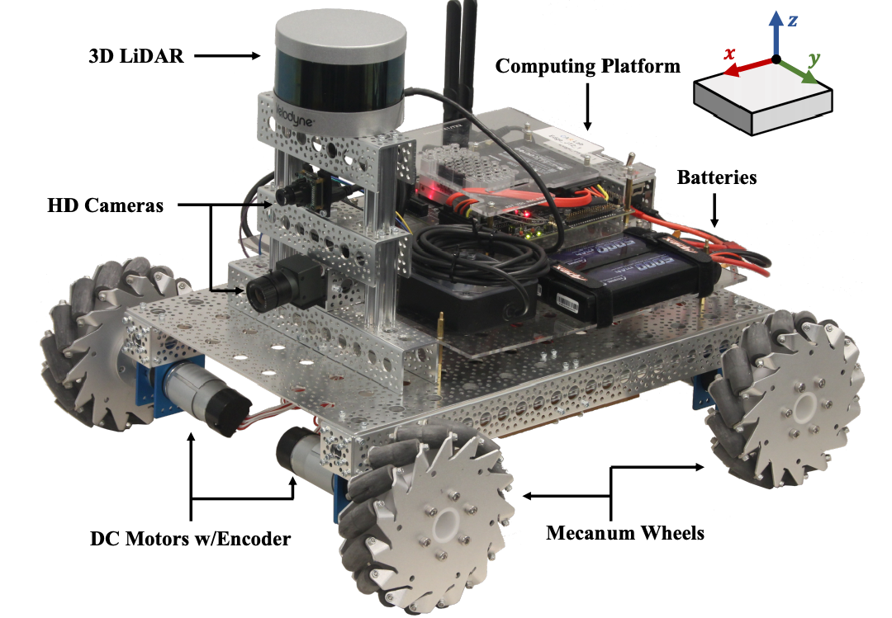
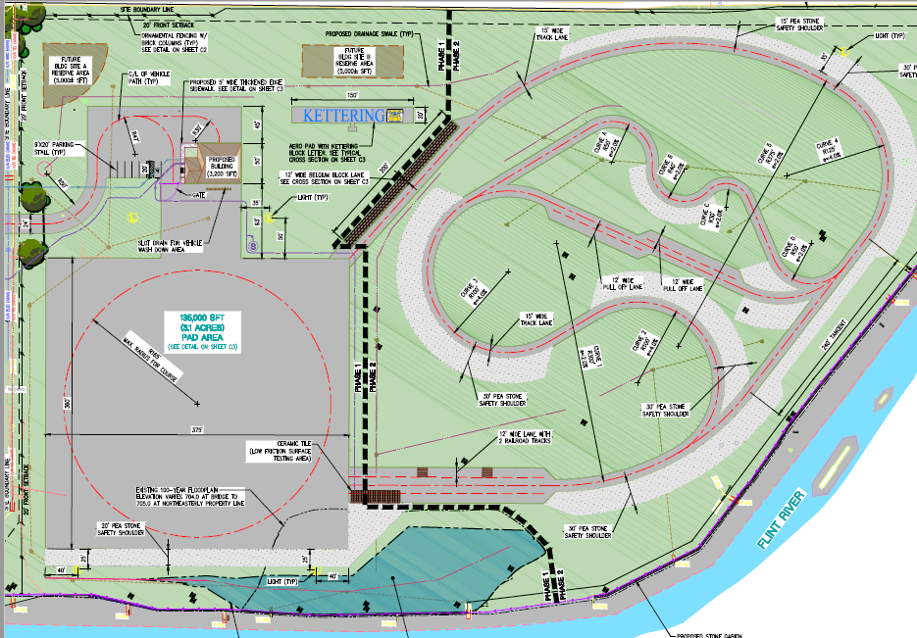
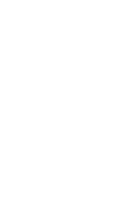
An Ongoing Project
Extension to DNN training
  Data compression
Testbed implementation
  Visual detection & tracking
Field test
  KUSARA at Kettering University
  NSF CNS Medium: Cooperative AI Inference in Vehicular Edge Networks for Advanced Driver-Assistance Systems (PI, 2021-2024)
  (Temple, Stony Brook, Rowan, and Kettering)

Slide 16
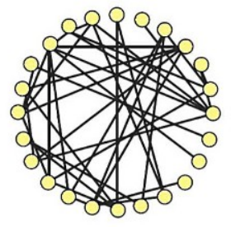
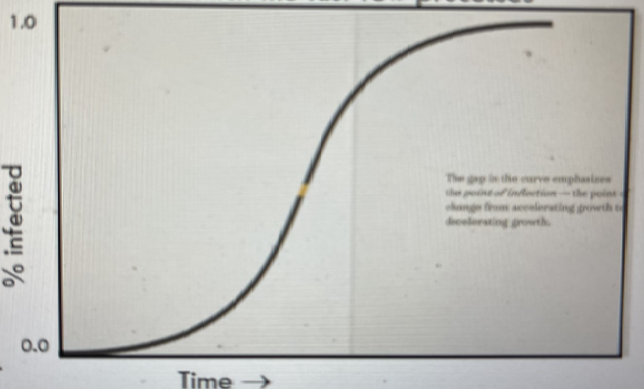
4. Data: Decentralized Federated Learning
DFL
  CFL shortcoming: central failure
  Nodes coordinate themselves to obtain the global model
Gossip learning
  Exchange/aggregate models
  Random perfect pairing
  Comparable performance to CFL
Merits and drawbacks
  Easy to use, robust, and robust
  Drawbacks: long-tail
TX
Notes:
Smartphones, wearable devices (google glass and apple watch), cameras, vehicles_

Slide 17
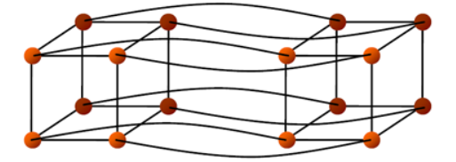
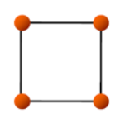
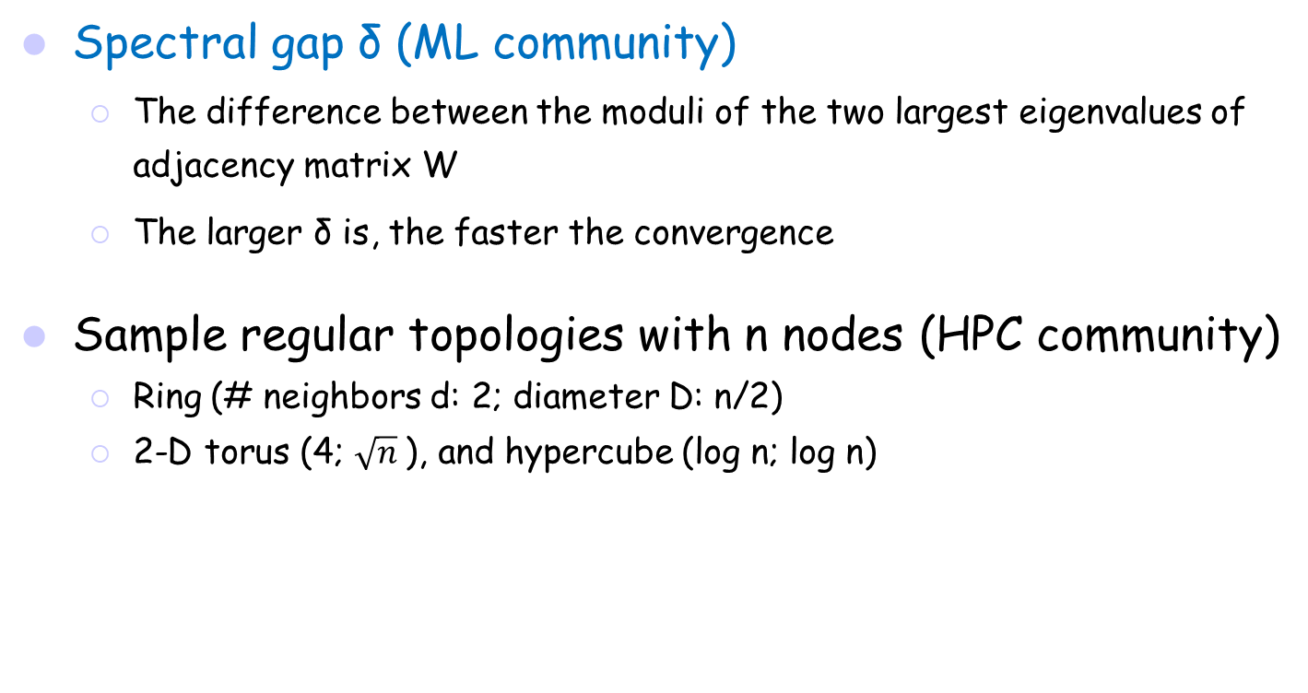
Structured Peer-to-Peer (P2P)
Spectral gap δ (ML community)
  The difference between the moduli of the two largest eigenvalues of adjacency matrix W
  The larger δ is, the faster the convergence
Sample regular topologies with n nodes (HPC community)
  Ring (# neighbors d: 2; diameter D: n/2)
  2-D torus (4; $\sqrt{n}$), and hypercube (log n; log n)
TX
Notes:
Smartphones, wearable devices (google glass and apple watch), cameras, vehicles_

Slide 18
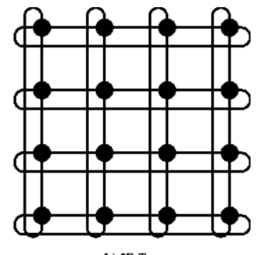
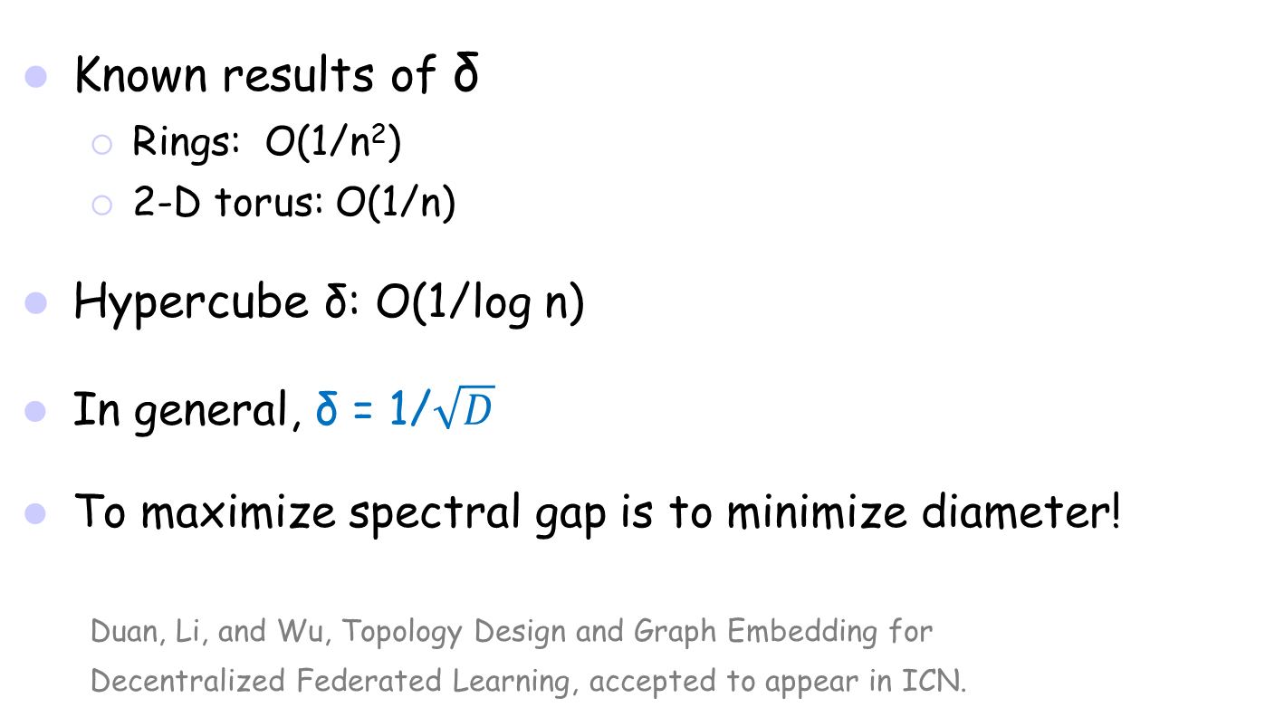
Relationship between δ and D
Known results of δ
  Rings: O(1/n²)
  2-D torus: O(1/n)
Hypercube δ: O(1/log n)
In general, δ = 1/$\sqrt{D}$
To maximize spectral gap is to minimize diameter!
  Duan, Li, and Wu, Topology Design and Graph Embedding for
  Decentralized Federated Learning, accepted to appear in ICN.

Slide 19
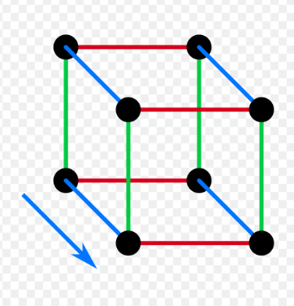
Graph Embedding based on Similarity
Select neighbors with max-similarity
  Maximize total neighbor similarity (product of feature vectors)
  Similar to a graph embedding in a complete graph
NP-hard problem: max-similarity for a ring
Heuristic polynomial algorithms
  2-D torus and hypercube
  1/log n approximation ratio for hypercube
Reducing communication frequency
  Scan dimensions in sequence

Slide 20
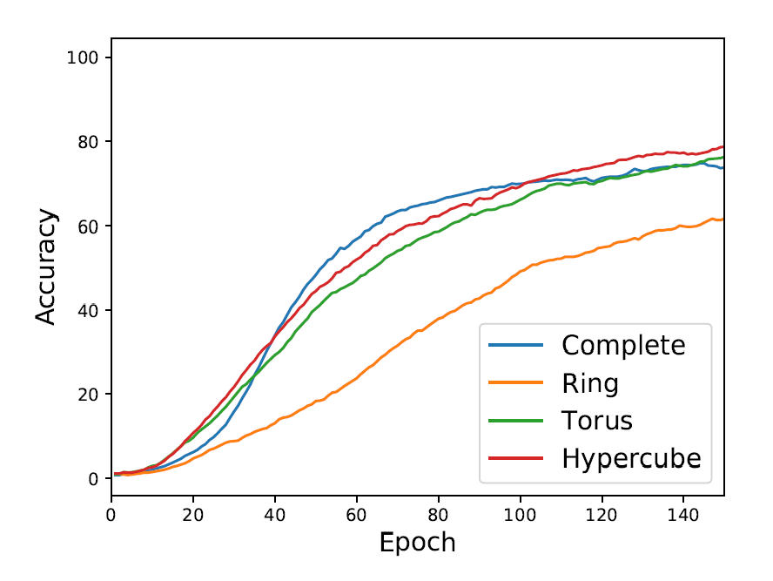
Simulation Results
Roles of topology on convergence and accuracy
ResNet-50 on CIFAR-100 with 64 workers
Cluster: 8 NVIDIA Tesla V100 GPUs (448 GB RAM, 5.9 TB)
PyTorch and OpenMPI
Data: CIFAR-10 and CIFAR-100

Slide 21
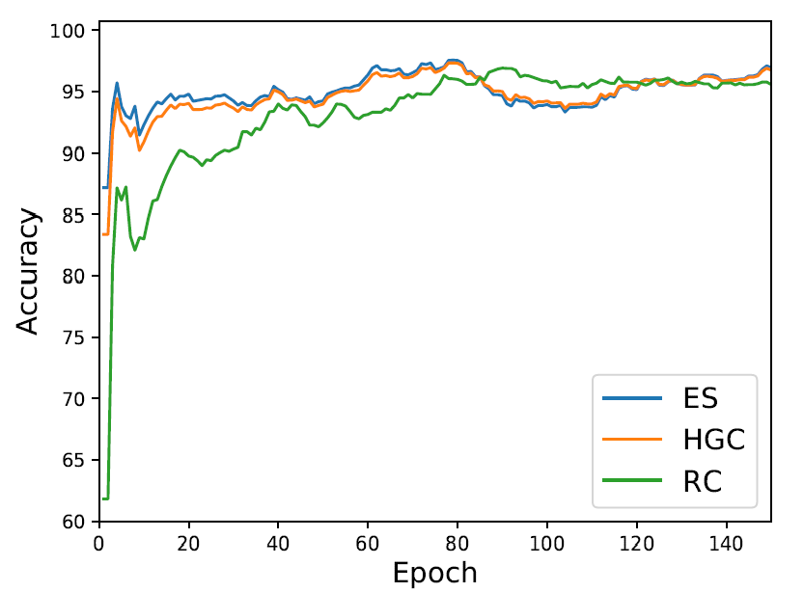
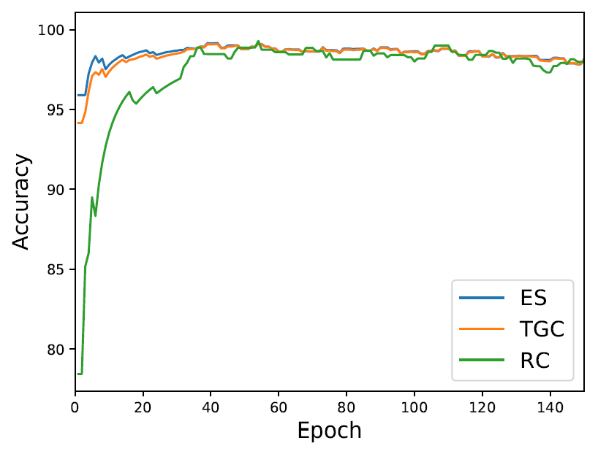
Simulation Results (Cont’d)
Roles of graph embedding based on data similarity
ResNet-50, HGC/TGC: hypercube/torus, ES: optimal, and RC: random

Slide 22
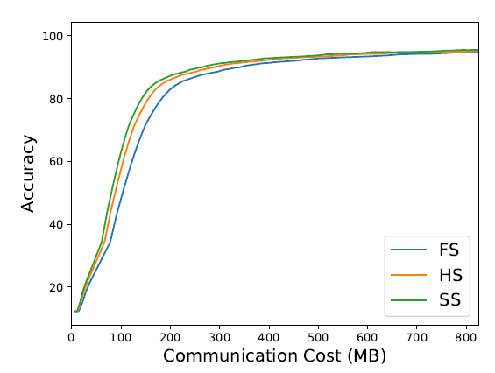
Simulation Results (Cont’d)
Roles of communication orchestration on hypercubes
Reaching 80% accuracy for CIFAR-10, SS has 19% lower cost compared to FS (FS: parallel, HS, half-parallel, and SS: sequential)

Slide 23

Overlay Networks
Tunneling
  For fast convergence
  Emulation of any topology (e.g.,
  all-to-all comm.), but network congestion
Measurement: load, dilation, and congestion
TX
Notes:
Smartphones, wearable devices (google glass and apple watch), cameras, vehicles_

Slide 24
5. Some Final Thoughts
Offloading: dynamic comm. channel conditions
  Dynamic cut, compression, link pruning, and phase freezing
  AUTO-SPLIT for offloading in Huawei Cloud
DFL: random vs. symmetric graphs
  Flexibility (on the number of nodes)
  Congestion (at the network level)
Resource allocation and elastic computation
  Resource allocation based on data distribution
  Data distribution under constraints
Niknami, Sawwan, and Wu, SmartPipe: Intelligently Freezing Layers in Pipeline Parallelism for Distributed DNN Training,"ICPADS, 2023
TX
Notes:
Smartphones, wearable devices (google glass and apple watch), cameras, vehicles_

Slide 25
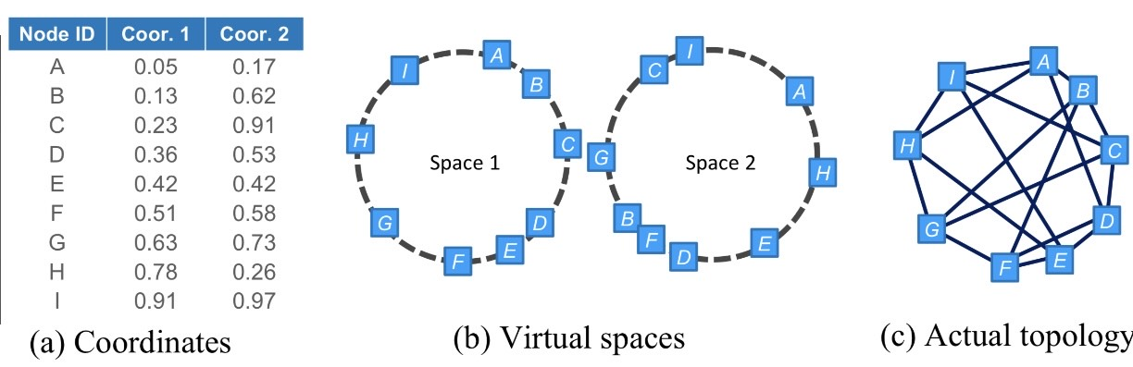
Random Graphs
Works for any number of nodes
Controlled random graph
e.g., d-regular graph
l (=d/2) virtual random space/rings, approaching toward a
Ramanujan graph (with a large spectral gap)
https://arxiv.org/abs/2112.15486

Slide 26
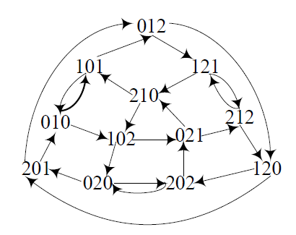
Symmetric Graphs
Moore bound
  max n, given diameter D and node degree d
  n = d^{D}+d^{D-1} +...+d¹
Symmetric graphs
  Moore bound has not been reached
Kautz digraph
  n = d^{D}+d^{D-1} i.e., D = O(log n) for const. d,
  symmetric, and c-congestion-free
  Simulate all-to-all comm. with c congestion
  Li, Lu, and Wu, FISSIONE: A Scalable Constant Degree and Low
  Congestion DHT Scheme Based on Kautz Graphs, INFOCOM 2005
TX
Notes:
Smartphones, wearable devices (google glass and apple watch), cameras, vehicles_

Slide 27

Other learning models
  Other FL models
    CFL, DFL, and HFL (multi-tier)
    Federated reinforcement/graph learning
  Time-varying graphs
    Learning rates and topology selections
  Beyond P2P: multi-models
    Local (fast) and global (slow) models
  Information sharing
    Push, Pull, and hybrid
D. Kahneman: Thinking, Fast and Slow, 2011
2-hop local views in graph learning
Notes:
Instinctive and emotional, deliberate and logical

Slide 28
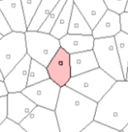
Resource Allocation
  Site and data locations are fixed
  Resource assignment based on data
    Voronoi diagram to min. data-movement distance
  Data assignment based on resource
    based on site and network capacity
    Elasticity: offering maximum future growth under the gossip model
Wu, Lu, and Zheng, On Maximum Elastic Scheduling of Virtual
Machines for Cloud-based Data Center Networks, ICC, 2018.
of

Slide 29
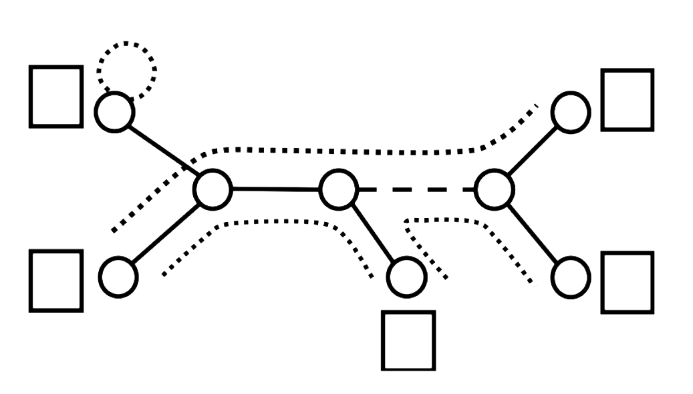
Maximum Elastic Scheduling
  Given a cable connection in a graph, each household has an occupancy limit and each cable section has bandwidth limit.
  What is the maximum total occupancy that can support all possible simultaneous pairwise telephone conversations (hose model)?
  What is the schedule with the maximum elasticity (i.e., maximum uniform growth in occupancy)?
2
1
2
1
2
hose model: statistical multiplexing. topology: tree and general graph

Slide 30

Questions

