Slide 1
User-based CPU Verification Scheme for Public Cloud Computing
Huanyang Zheng, Kangkang Li, Chiu C. Tan, Jie Wu
CIS, Temple University

Slide 2
Outline
Motivation
Monitoring Architecture
Algorithm Details
Evaluation

Slide 3
Motivation
CPU Verification in the cloud system is difficult,
but necessary for the users.
A malicious cloud allocates overfull VMs to a PM, as to save the operation costs of additional VMs.
Errors in the VM migration code or algorithm, and the heterogeneity of hardware also result in the fluctuation of the CPUs.

Slide 4
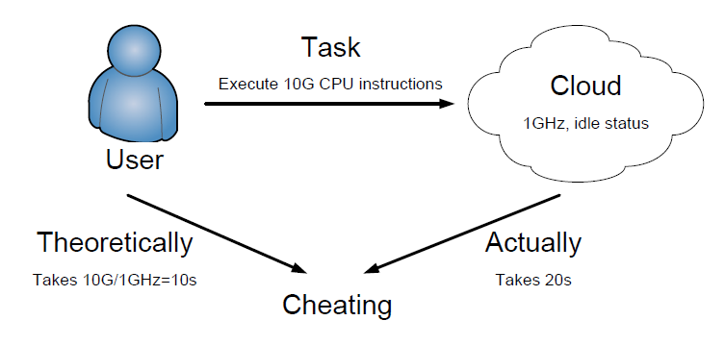
Monitoring Architecture
Assign a predefined task for the cloud, and check
the difference between the theoretical execution
time and the actual execution time.

Slide 5
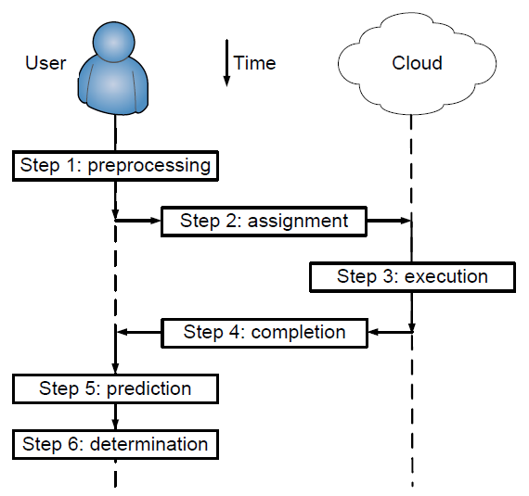
Monitoring Architecture
Assumptions:
The cloud is as smart as humans in doing any possible anti-detection action.
The user has a reliable local PC and a timer for the detection assist.
Small interferences, such as network delay, are neglected.

Slide 6
Algorithm Details
The predefined task for cloud execution:
Guarantee the execution of certain CPU instructions. For example, if the task is to calculate x=x+1 for 1000 times, the cloud can calculate x=x+1000 for one time instead, as to save calculation time.

Slide 7
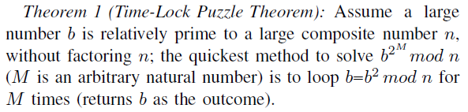
Algorithm Details
The predefined task for cloud execution:
Use a time-lock puzzle to guarantee execution.
Essentially it is like an encryption process.

Slide 8
Algorithm Details
Theoretical task execution time:
Stop everything and decide that the cheating detection is not rational, since the users buy the cloud for temporal computation, rather than doing cheating detection.

Slide 9
Algorithm Details
Theoretical task execution time:
If our cheating detection program takes 40% CPU when running alone, and currently 80% CPU of the VM is taken off, then how much CPU would the detection program take ?
Depends on the OS schedule. But in most OSs, it would take 40%/(40%+80%) = 1/3 CPU.

Slide 10
Algorithm Details
Cheating determination:
The difference between the theoretical execution time and the actual execution time is larger than a certain threshold.

Slide 11
Algorithm Details
Small execution task vs. Large execution task
The resources for cheating detection are limited.
A smaller task means less precision in one round of cheating detection, but more rounds.
A larger task means higher precision in one round of cheating detection, but fewer rounds.

Slide 12
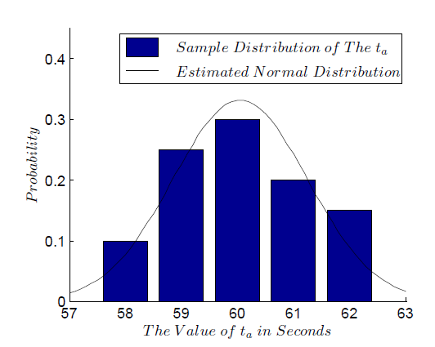
Algorithm Details
Small execution task vs. Large execution task
Experiments show that the actual task execution time is submitted to normal distribution.

Slide 13
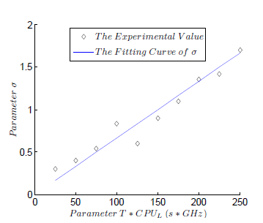
Algorithm Details
Small execution task vs. Large execution task
The distribution variance is linearly proportional to the total CPU instructions of the task.

Slide 14
Algorithm Details
Small execution task vs. Large execution task
Theoretical model shows that a smaller task and more detection rounds are better.
However, the task cannot be infinitely small, since the interferences are no longer negligible.

Slide 15
Evaluation
System setup
Based on Oracle VM VirtualBox, version 4.1.22.
The virtualization technology is essentially the same as what it is in the cloud system.

Slide 16
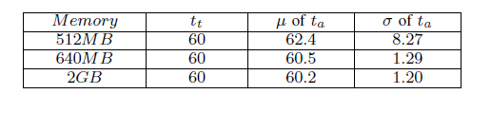
Evaluation
Memory-intensive test
Our detection method requires very small memory.

Slide 17
Thank you !
Q & A

