Slide 1
Cyber Security Defense:
From Moving Target Defense to Cyber Deception
Jie Wu
Temple University

Slide 2
Outline
  Offense vs. Defense
  Cyber Deception in Offense
  Deep Fake
  Cyber Deception in Defense
  Moving Target Defense
  Challenges of Cyber Deception
  Conclusions

Slide 3
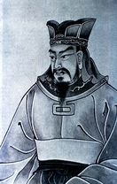
1. Offense vs. Defense
  The Art of War
    All warfare is based on deception
  Offense vs. Defense
    Attack is the secret of defense
    Defense is the planning of an attack
  Cyber Deception
    Both attacker and defender

Slide 4

2. Cyber Deception in Offense
New York Times (12/28/2020)
Designed to Deceive
Website Generated.Photos
“unique, worry-free” fake person for $2.99

Slide 5
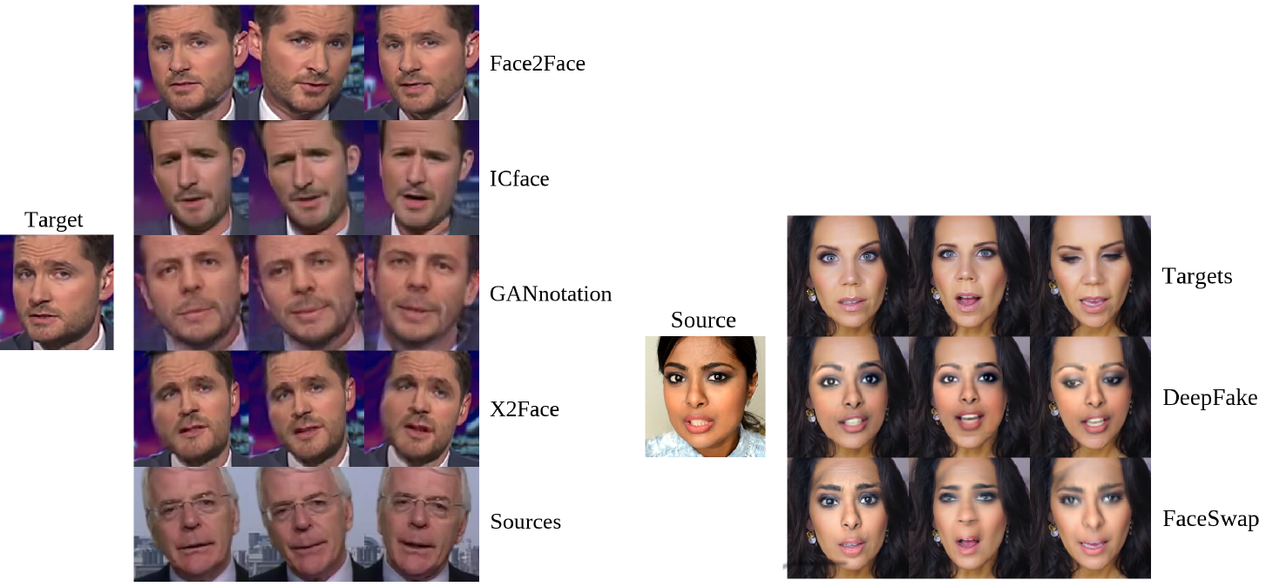
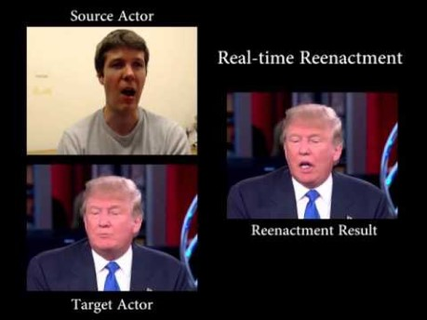
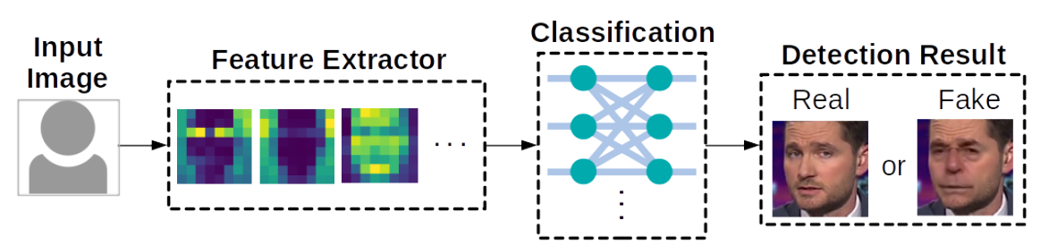
3. Deep Fake
  Defend against facial forgery
Face reenactment
Face swapping
Face2Face, CVPR 2016
Architecture of deepfake defense systems
Notes:
Asymmetric advantage over attackers: defenders know more!

Slide 6
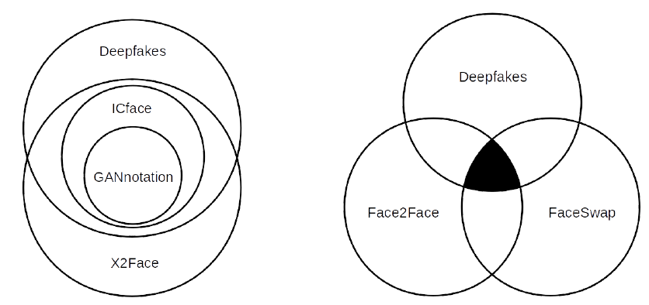
Deep Fake Detection
  Limitation of current defense systems
    Cannot defend against unseen attack methods
    Features of different attack methods can be independent
Feature overlap among existing facial forgery techniques ^{[1]} (tested on MesoNet)
[1] J. Brockschmidt, J. Shang, and J. Wu., “On the Generality of Facial Forgery Detection”,
Proc of REUNS 2019 (Best Paper)
Notes:
Asymmetric advantage over attackers: defenders know more!

Slide 7
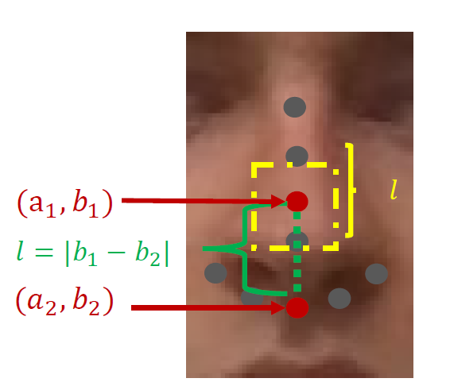
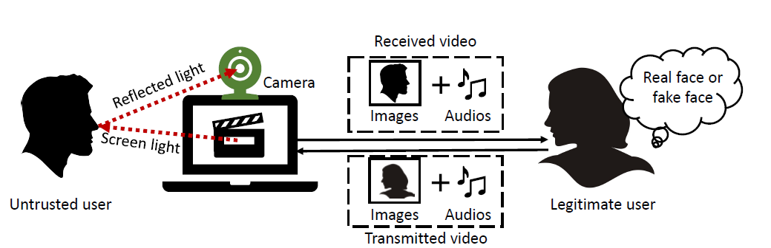
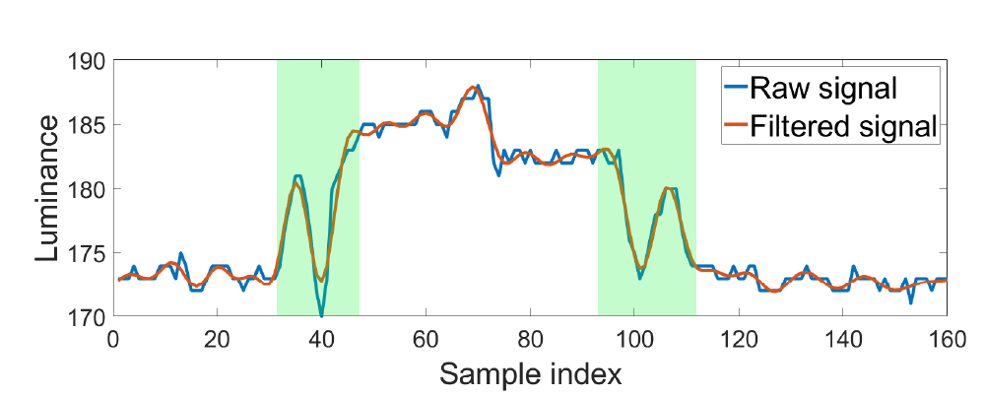
Deep Fake Detection (Cont’d)
  Detection using side-channel information ^{[2]}
    The screen light reflected off human faces
$$C=0.2126R+0.7152G+0.722B$$
[2] J. Shang and J. Wu, “Protecting Real-time Video Chat against Fake Facial Videos Generated by Face Reenactment”, Proc of ICDCS 2020
Notes:
where $C$ is the luminance value calculated using linear Red Green Blue (RGB) values. The coefficient of each color is assigned based on the human visual perception of brightness.

Slide 8


2. Cyber Deception in Defense
  Cyber deception
  Planned actions to mislead/confuse (i.e. trap) attackers
Goals
  Complement detection, enhance prevention, and mitigate successful attacks
Unit and layer
  Parameter, file, account, profile, …
  Network, system, application, data, …
  Life cycle of cyber deception
  Collect knowledge of attacker
  Implement deception schemes
Notes:
Concealment, camouflage, false and planted information, lies, displays, ruses, demonstrations, feints and insight
Masking, repacking and dazzling for dissimulation
Mimicking, inventing and decoying for simulation

Slide 9
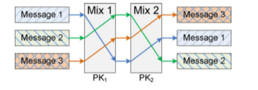
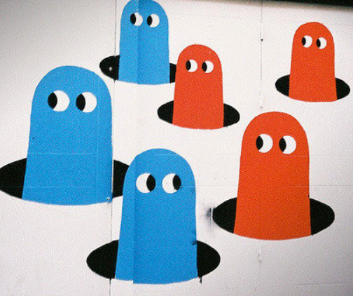
Types of Deception
  Perturbation
    Perturb sensitive data with noises
  Mixing
    Prevent linkability (mixing zone)
  Obfuscation
    Decoy targets and/or reveal useless info
  Honey-X
    Disguise honeypots as real systems
  Moving target defense (MTD)
    Change attack surfaces to increase
    uncertainty and complexity for attackers

Slide 10

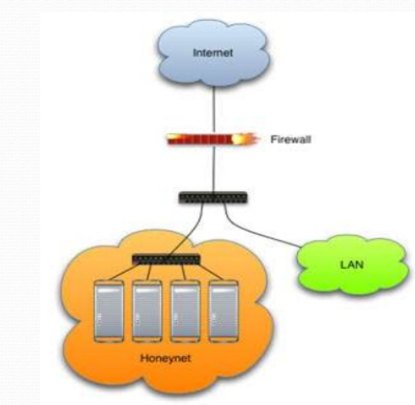

Honeypots and Honey-X
  Honeypots
    Bears: honey eaters
    Traps
Honey-X
  Honeynet: two ore more honeypots on a network
  Honeyfile, honeyword, …

Slide 11
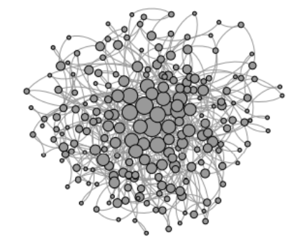
5. Moving Target Defense
Hierarchical military command chains
Network hierarchy
  SDN controllers: load balance and fault tolerance

Slide 12

Self-Organizing Solutions
Local decision
P2P and simple interaction (mostly local and without sequential propagation)
Global functionality
Adaptive, robust, and scalable
Principles
P₁: Local interactions with global properties (scalability)
P₂: Minimization of maintained state (usability)
P₃: Adaptive to changes (self-healing)
P₄: Implicit coordination (efficiency)
Agility

Slide 13
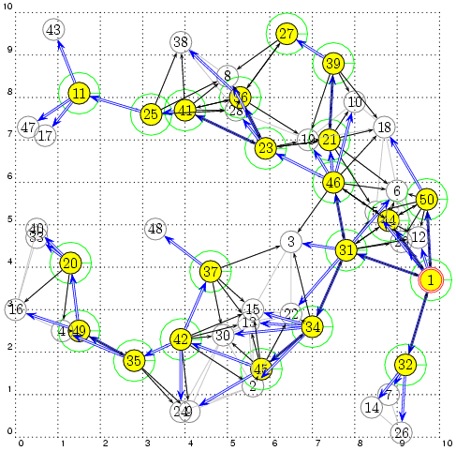
MTD Applications
Connected Dominating Set (CDS)
Local decision:
backbone nodes
based on node priority (ID, degree, …)
Global properties:
Connectivity
Coverage

Slide 14
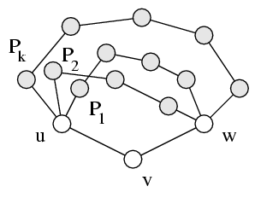
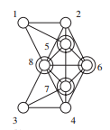
Application: Resiliency and Rotation
Redundancy: K-connected & K-dominated
  Non-backbone node: K node-disjointed paths for any neighbor pairs (for multiple CDS)
Moving target defense: CDS rotation
Self Healing: How can we deal with the complexity of building a structure along with a change of topology ^{[3]}?
  [3] J. Wu, “Uncovering the Useful Structures of Complex Networks in Socially-Rich and Dynamic Environments”, Proc. of IEEE ICDCS, 2017
Notes:
CIAA: Confidentiality, Integrity, Authentication, and Availability

Slide 15

4. Challenges of Cyber Deceptions
  Limited Applications
    Projected market to be $1B by 2020
  Effectiveness
    How to measure?
  Game Theory and Learning
    Ability of both attackers & defender

Slide 16
Limited Applications in Defense
  Still limited in cyber deception, why?
  Differences: cyber deception vs. deceptions in warfare
    Domain: cyber vs. physical, social, …
    Time: different scales, logical clock vs. physical clock (i.e., real time)
    Space: virtual space vs. physical space
    Speed: speed of light vs. physical space laws (e.g., movement of a tank)
  Do not understand the attackers well: known vs. unknown
    Know your enemies and know yourself
  How to attract attackers to interact with them in cyberspace?
    It is relatively easy to engage your enemies in a battle field

Slide 17
Effectiveness
  Effectiveness measurement for attackers
  Rate frustration in time and cost
Effectiveness measurement for systems
  Time and place of attacker’s action
  How much attacker’s resources are wasted (e.g. num. of packets)
  How long before attacker break the system/ stop acting
  How much valuable data are breached
  And more…

Slide 18


Measurement
Lord Kelvin: If you cannot measure it, then we cannot improve it
Extended dependability that includes security
  Mean time between security incidents (MTBSI)
  Mean time to incident discovery (MTTID)
  Mean time to incident recovery (MTTIR)
Performability: work completed before the next security breach
Degradation
  B₁: Level 1 breach, 1,000 hrs
  B₂: Level 4 breach, 5 hrs

Slide 19


Game Theory and Learning
Markov chain (MC)
  Basic MC: transition probability
  Semi MC: time and budget limit
  Hidden MC: partially observable state (attacker/defense)
Stochastic repeated game
  Learn the behavior of the attacker: learning theory
(0: healthy, 1: slightly damaged, 2: heavily damaged, 3: disabled)
Attacker
$$λ$$
0
1
2
3
Defender
$$μ$$

Slide 20

Learning: Cognitive Biases
Deception is strongly relied
on human psychology
  Cognitive biases
Cultural biases
  Power Distance Index (PDI)
  Uncertainty Avoidance (UAI)

Slide 21
Final Thoughts
Cyber-deception: friend or foe?
Misinformation vs. disinformation
  Disinformation is information that is deliberately false or misleading
  Recent events in the world
Challenges
  Identifying disinformation is not merely about the truth, but about referring the intent (to mislead)

Slide 22
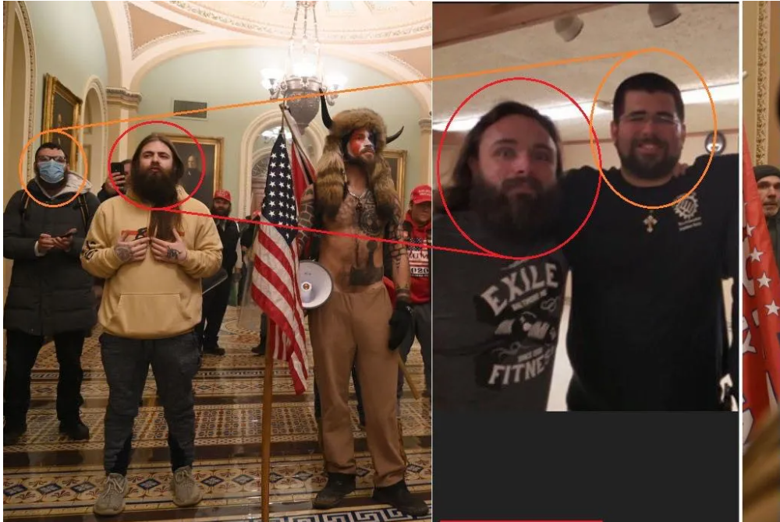
QAnon or Antifa?
An article in WeChat
  US Capital Hill, 01/06/2021

Slide 23

Smarter Than You Think
Who is Smarter
  Human or Computer?
Homo Dues: Man God
  AI-designed software/media
  Controls Homo Sapiens
  Replaces human beings

Slide 24
5. Conclusions
Importance of cyber deception
  Compliment to the existing security methods
Self-organized design for agility
  Basic principles and challenges
Future
  A better learning model for attackers/defenders
    Security vs. ML
    Game theoretical models
  Science of security (S & P 2017)

