Slide 1

Enhancing Load Balancing by Intrusion Detection System Chain on SDN Data Plane
Nadia Niknami and Jie Wu
Temple University
IEEE CNS 2022

Slide 2
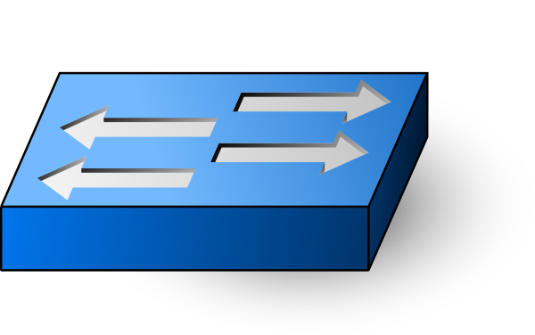
Software-Defined Networks
Control
App
Control
App
Control
App
. . .
Control
App
Controller
Global
Network
Map
Routing Table
(RIB)
Control Plane
Flow Rules
Data Plane
Forwarding Table
(FIB)
IEEE CNS 2022

Slide 3
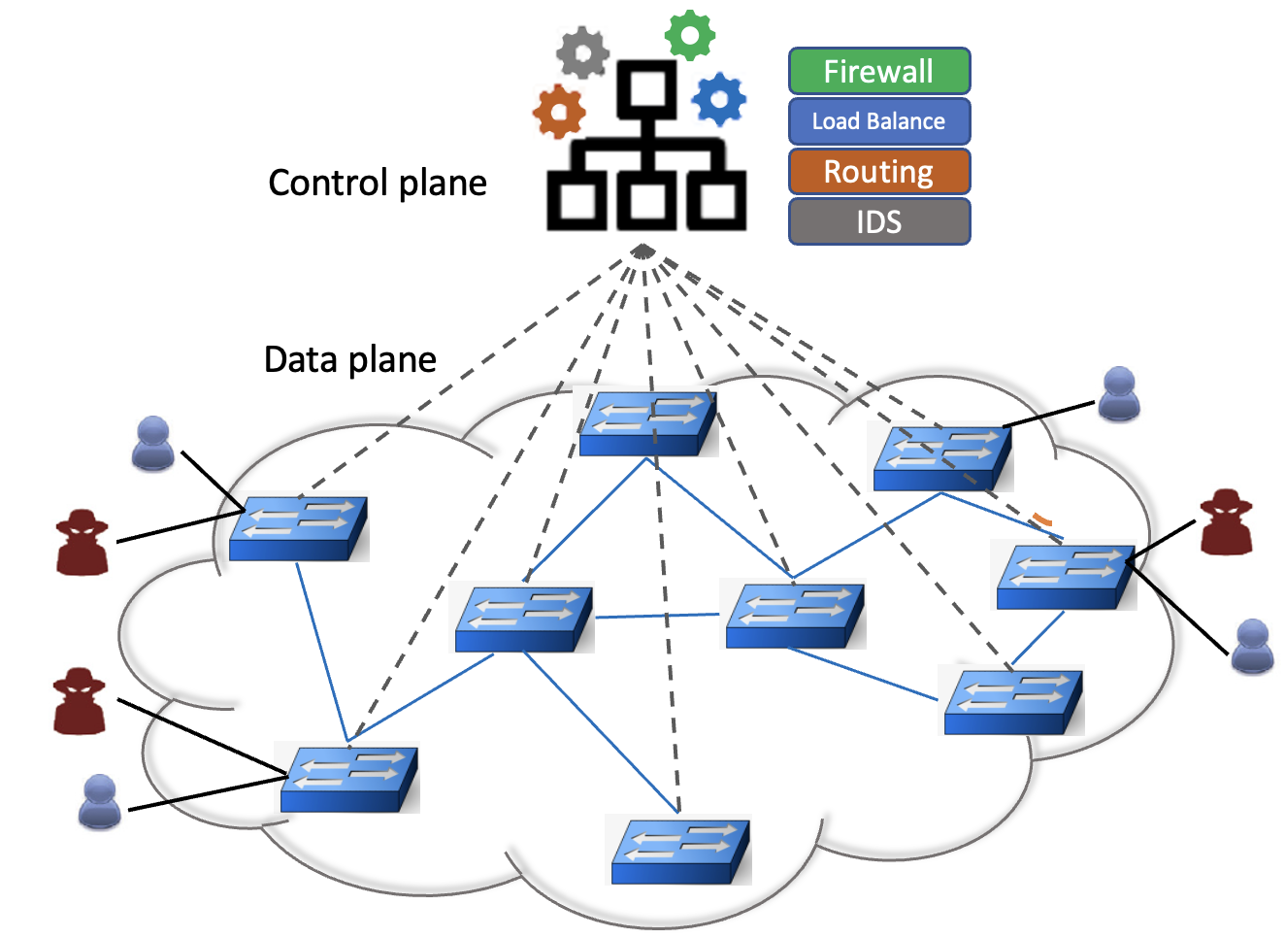
Intrusion Detection System Application
Detect anomalies
Drop flows
Redirect flows
IDS
IEEE CNS 2022

Slide 4
Centralized Intrusion Detection System in Data Plane
Limited Capacity
Overloading
Delay
Anomaly Detection Report
IDS
IEEE CNS 2022

Slide 5

Intrusion Detection System for Switches in Data Plane
Cost of installation
Missing rate
Limited Capacity
IEEE CNS 2022

Slide 6
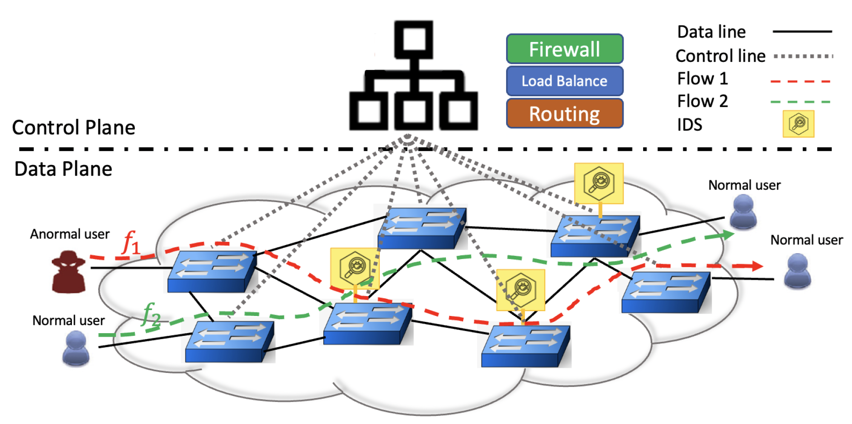
Chain of Intrusion Detection System in Data Plane
IEEE CNS 2022

Slide 7
IDS has limited hardware resources in terms of CPU power, memory access speed, and storage capacity. IDS applications are unable to achieve an acceptable detection rate.
Chains of IDSs may provide a solution to this problem. How can multiple IDSs be implemented on the SDN?
Implementing an IDS chain can improve detection rates. Due to installation costs and flow table capacity limitations, IDS cannot be installed on all switches. Therefore, there are a limited number of IDSs. As incoming traffic is grouped, there is no need for many IDSs.
Which method is the best for grouping flows?
Grouping flows and IDS assigning techniques can have a significant impact on performance measurements, such as dropping rates under high load and transmission delays caused by non-shortest path routing.
How can we maintain balanced flow groups? How can flow groups be matched with IDS chains?

Slide 8
Proposed Method
Provide chains of IDSs on the data plane to increase the rate of intrusion detection and reduce the dropping rate.
1
Introduce a creative centroid-based (modified K-means clustering method) to group the incoming flows.
2
Introduce two models for matching flow groups to IDS chain: minimum cost 2-D matching and minimum cost 3-D matching.
3
Evaluate the performance of our approach on a real test bed under different measurements.
4
IEEE CNS 2022

Slide 9
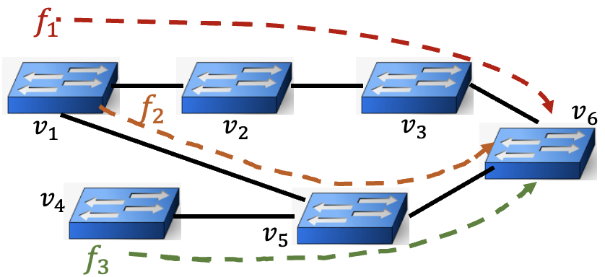
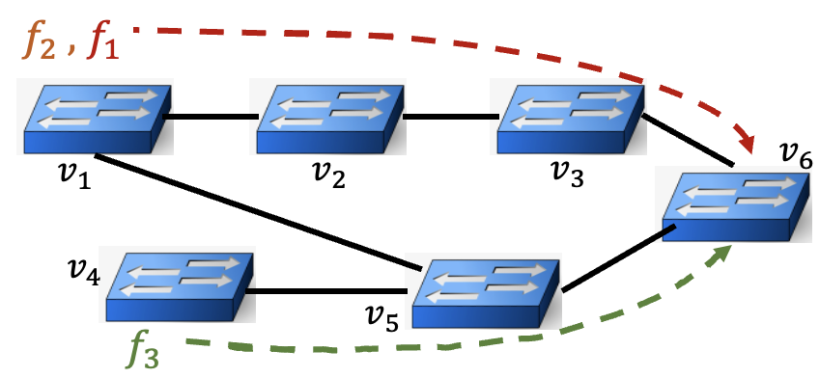
Grouping the Flows
IEEE CNS 2022

Slide 10
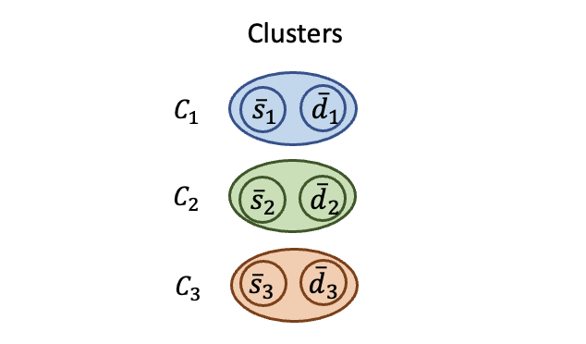
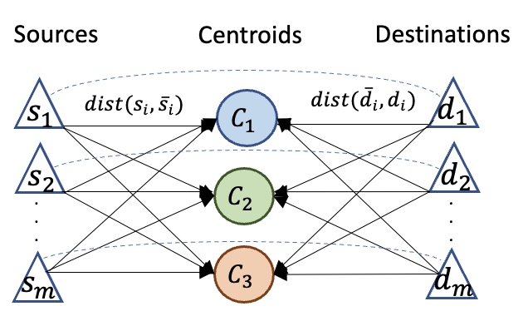
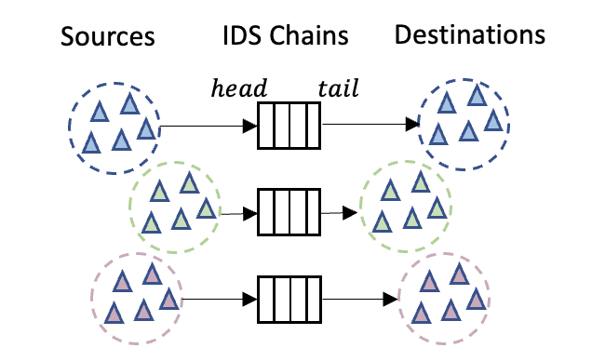

Grouping the Flows
Virtual centroid
Grouping
Matching
$$dis\left(s_{i},{\overline{s}}_{i}\right)+dis({\overline{d}}_{i}{,d}_{i})$$
IEEE CNS 2022

Slide 11
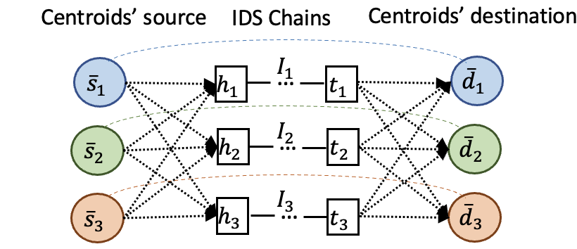
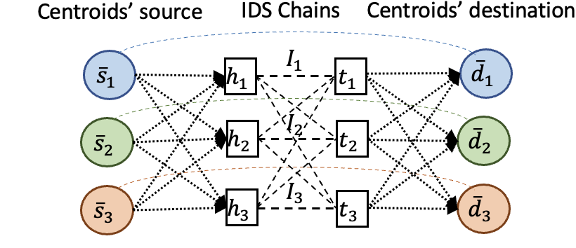
Matching Flow Groups to IDS chain
IEEE CNS 2022

Slide 12
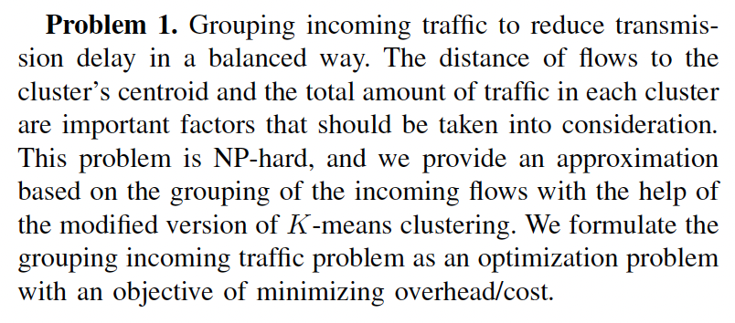
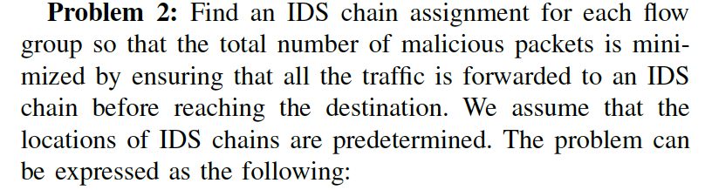
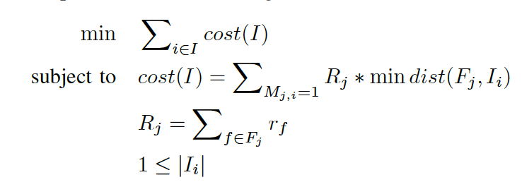
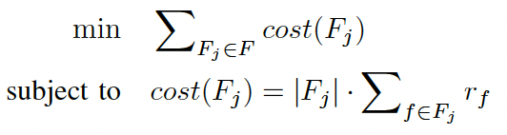
IEEE CNS 2022

Slide 13
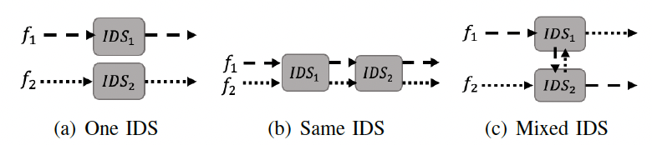
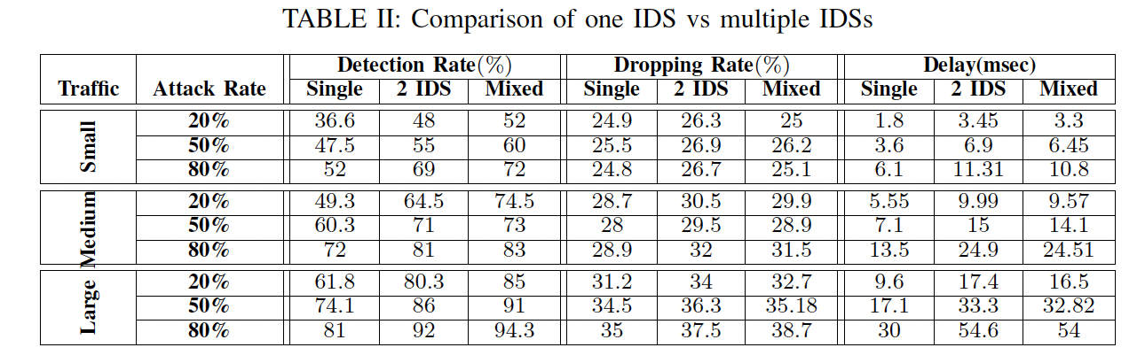
Evaluation
The rate of blocked malicious packets can be displayed by the detection rate!
The rate of dropped malicious and legitimate packets can be displayed by the dropping rate!
IEEE CNS 2022

Slide 14
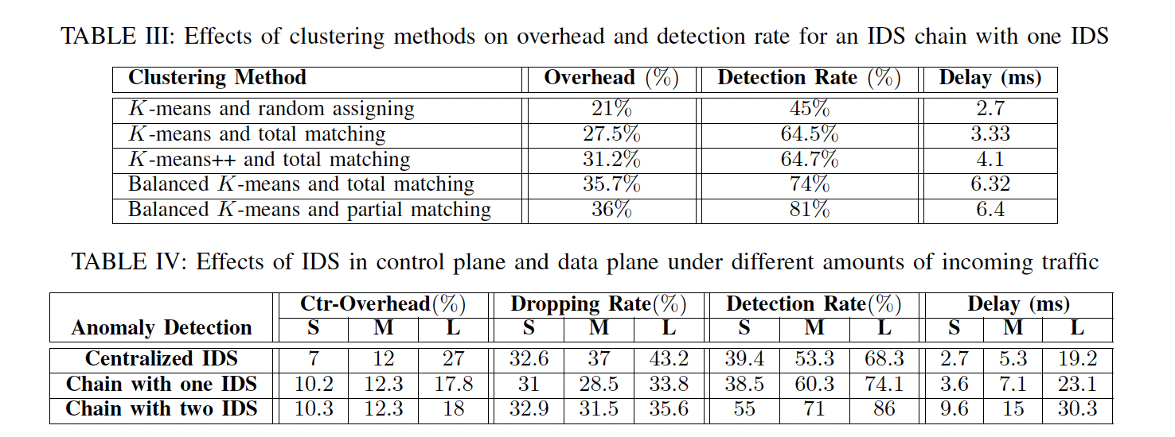
IEEE CNS 2022

Slide 15
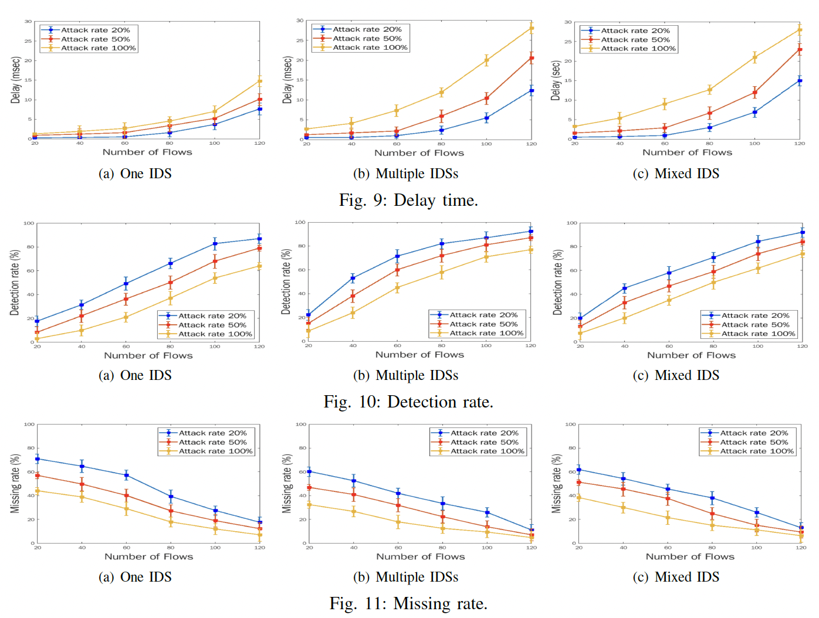
IEEE CNS 2022

Slide 16
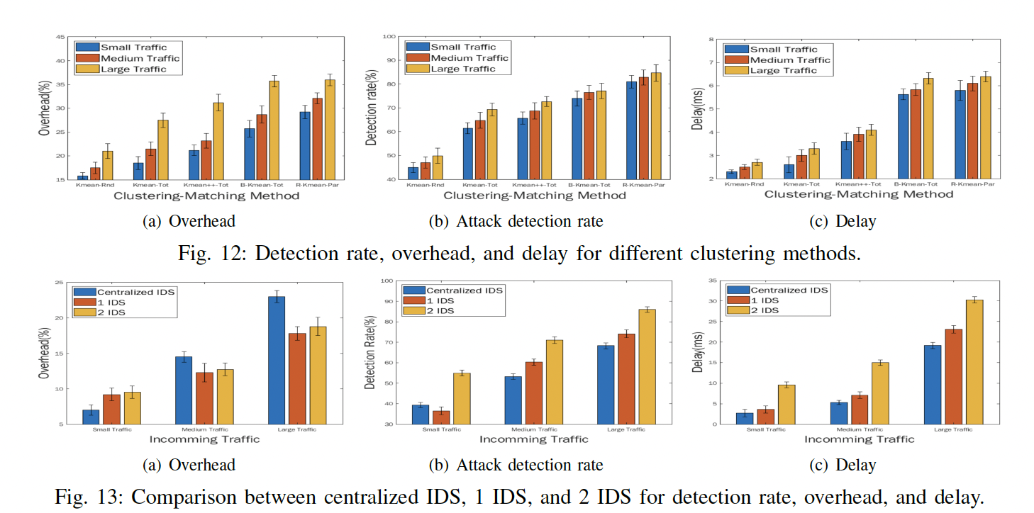
IEEE CNS 2022

Slide 17

Summary
Since deploying a single IDS in network cannot handle the traffic with fast rate on time we proposed a mechanism to deploy multiple IDSs in network and separate the incoming traffic to multiple route paths.
With this process, traffic is load-balanced and IDS is capable to detect fewer packets to increase detection efficiency.
We tried to minimize the cost (the overhead of SDN controller) by grouping flows (separate flows to different paths) and improve IDS detection capability
We performed experiments to explore different patterns of IDS deployment and evaluated several factors such as detection rate, dropping rate, and delay time
IEEE CNS 2022

