Slide 1




The IEEE International Conference on Cluster Computing (CLUSTER 2025)
SoCL: Scalable and Latency-Optimized Microservices
in Serverless Edge Computing
Shuaibing Lu, Bojin Xiang, Ziyu You
College of Computer Science
Beijing University of Technology
Beijing, China
Jie Wu
China Telecom Cloud Computing Research Institute
Center for Networked Computing
Temple University
Philadelphia, USA
Wentong Cai
College of Computing and Data Science
Nanyang Technological University
Singapore
Notes:
Hello everyone, today is my honor to be here. I’m Bojin from Beijing University of Technology, and I’m here to present our work “SoCL: Scalable and Latency-Optimized Microservices in Serverless Edge Computing”

Slide 2
1
Introduction
2
Model and Formulation
CONTENTS
3
Algorithm Design
4
Experiment and Results
Notes:
Here is the outline of my presentation. I will first give the background.

Slide 3



Emerging serverless edge computing
  Serverless edge computing deploys lightweight functions to the network edge.
  User mobility causes frequent and unpredictable shifts in request patterns.
  Random request dependency leads to path conflicts and network contention.
Drone Control ^{[dji.com]}
Automated Driving ^{[xiaomiev.com]}
Mobile Applications ^{[huawei.com]}
Notes:
The emergence of serverless edge computing reduces reliance on centralized cloud services by deploying lightweight functions to the network edge.
It can support a wide range of time-sensitive applications, such as outdoor drone control.
However, the user mobility and random request dependency chain make the provisioning process complicated in large-scale dynamic environment.

Slide 4
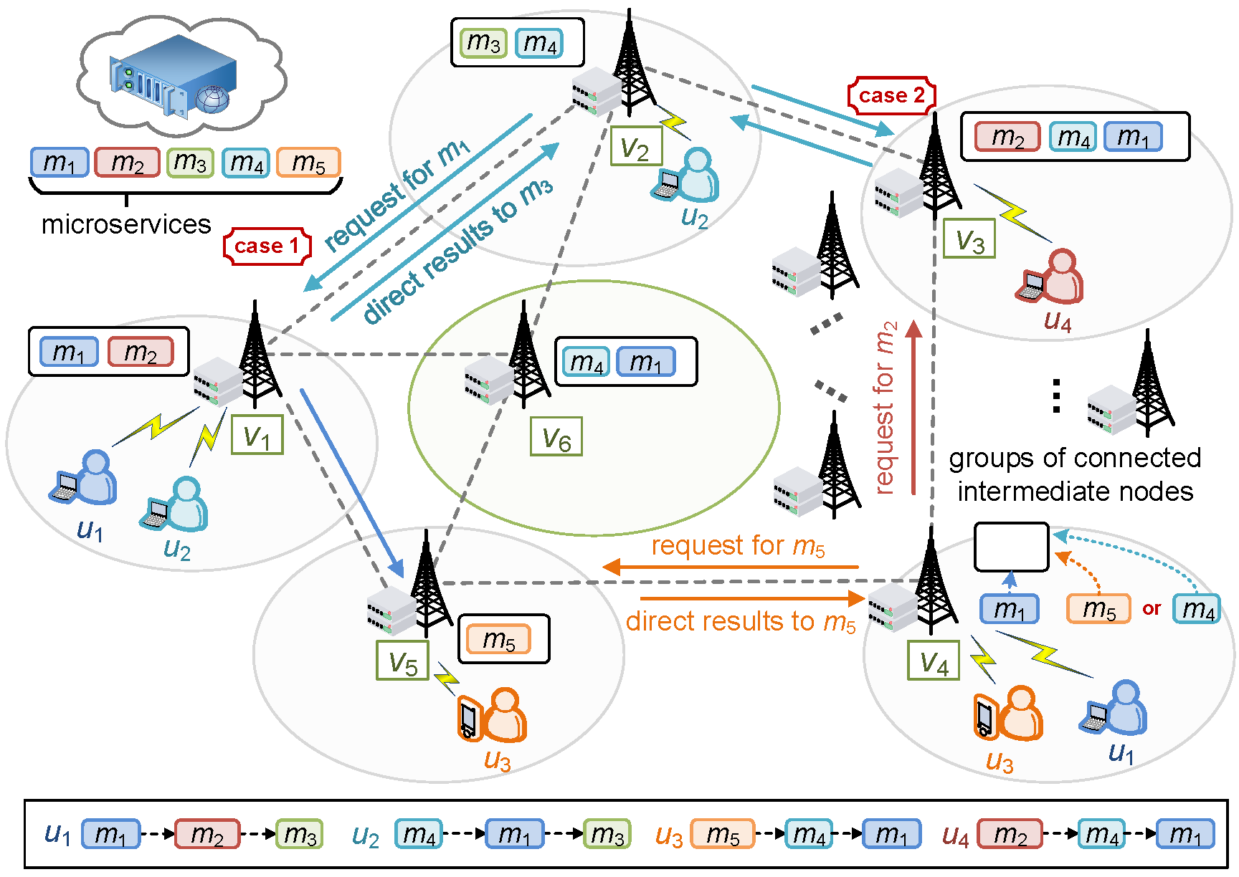
An example - scenario
Edge: constrained resources
deployed near base station;
accommodate limited microservices;
User: diverse requests
high mobility;
random request dependency;
back-and-forth data transmission
Notes:
Here is an example of the scenario.
The cloud server have every microservices.
The edge servers are deployed near the base station infrastructures with constrained resources.
The users have high mobility with diverse requests.
Since the different request dependency, it is hard to find an optimal provisioning decision.
In case1, the user2 at edge2 need to forward his request to edge1 to obtain access of microservice1.
In case2, the user4 can simply wait on edge3 locally.
（动画）Also, an improper microservice placement may cause back-and-forth data transmission.

Slide 5
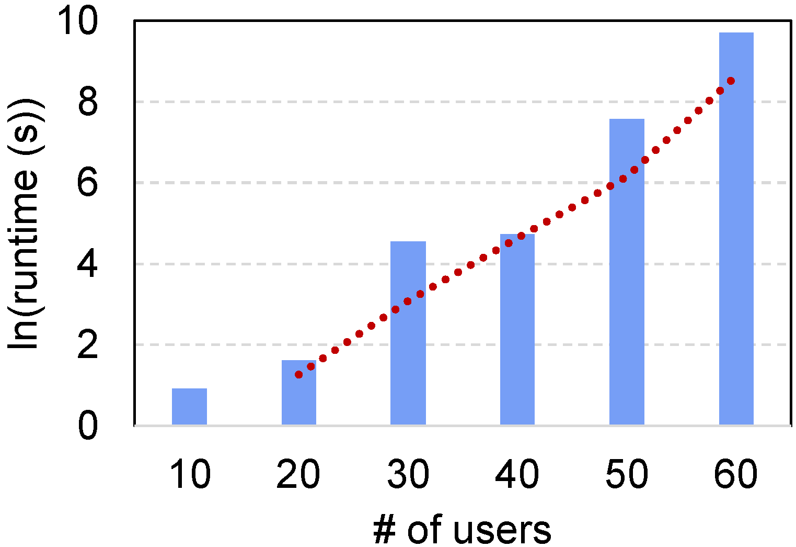
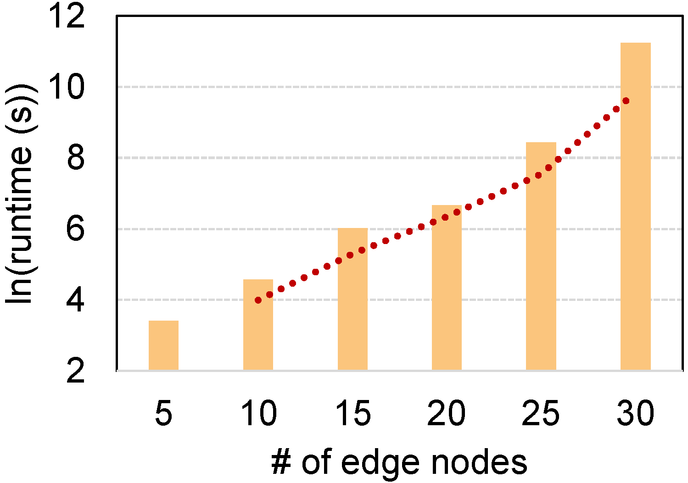
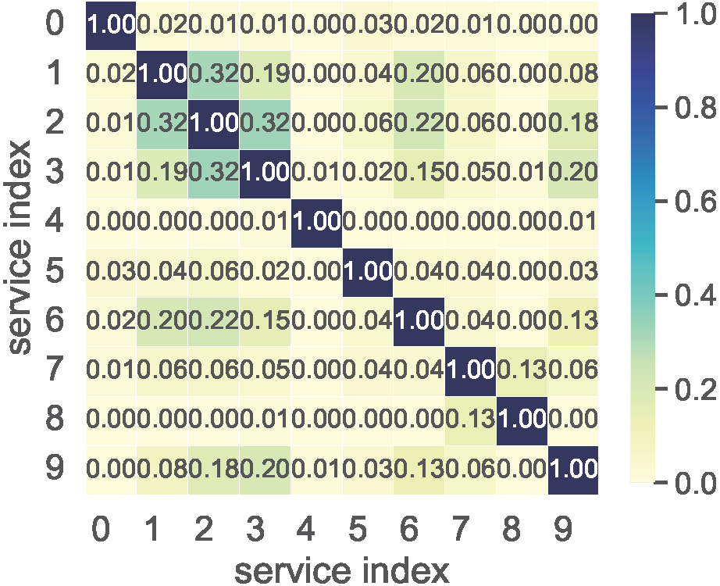
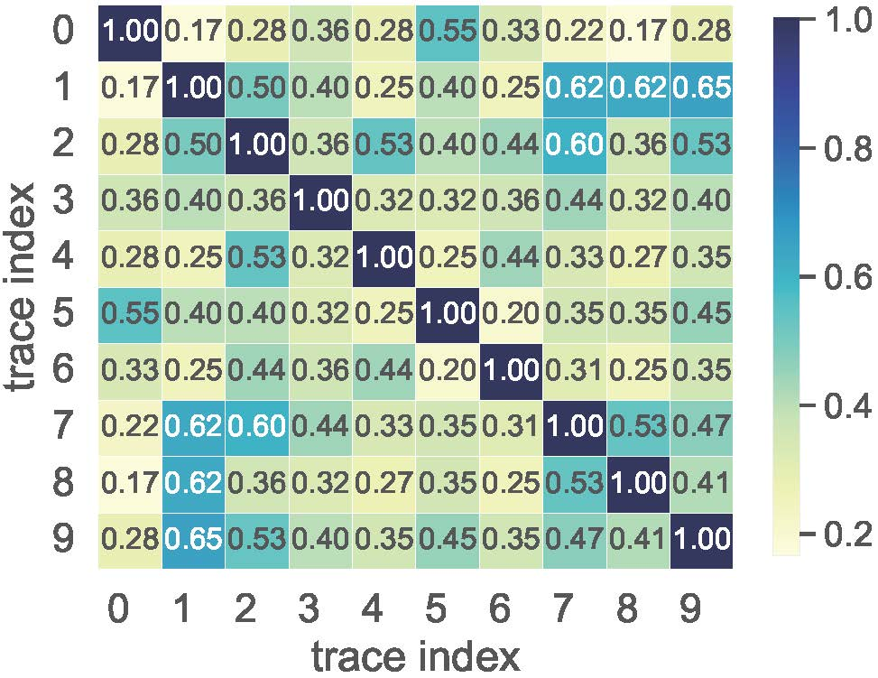
Challenges
High complexity: high dimensional
a Gurobi-based decisioning prototype.
Runtime increased exponentially as the number of users / of edge nodes grew.
logarithmic
Dynamic environment: time-varying
analysis of Alibaba Cluster traces
select top-10 frequently recorded services.
Similarity varies across different services and dependency chains, indicating a highly dynamic and heterogeneous service landscape.
Notes:
Under complexity analysis and cluster trace data analysis, we identify several challenges on designing serverless edge computing microservice provisioning framework:
As shown in the right figure, experiments using Gurobi with various numbers of user and edge server shows that the provisioning runtime increased exponentially over tenfold, showing the complexity of the optimization problem.
We analyzed microservice traces from the Alibaba Cluster Trace Program by selecting the 10 most frequently recorded services on a one-hour trace, to analyze similarity distributions across files. As shown in the left figure, the similarity values vary significantly across files, indicating a highly dynamic and heterogeneous service landscape.

Slide 6
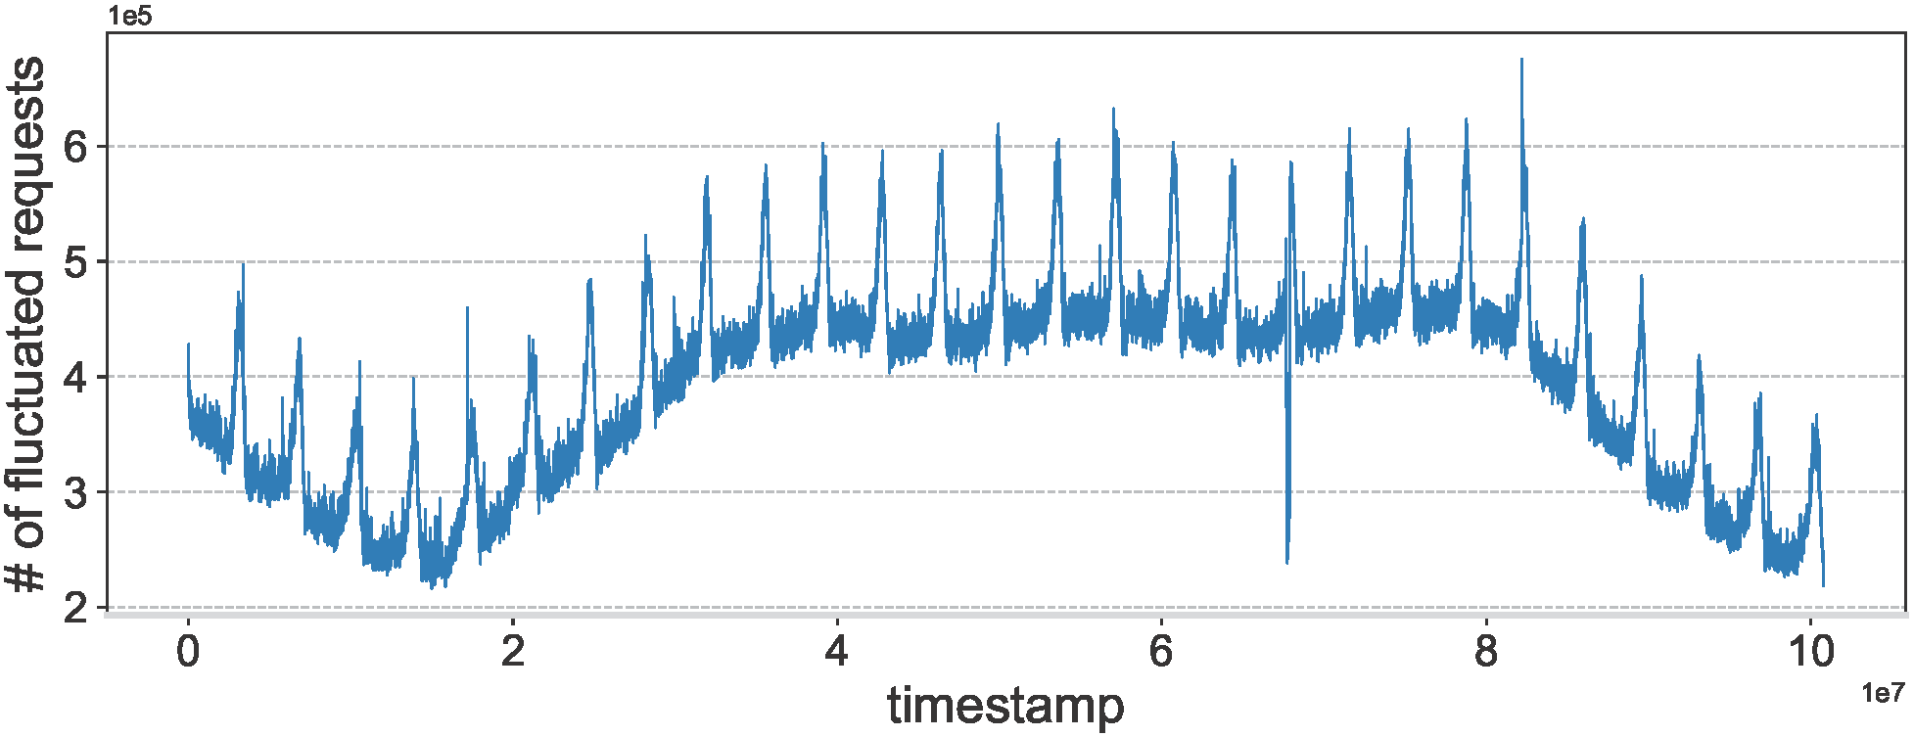
Challenges
Unpredictable workload: fluctuate requests
a 10-hour request trace across time intervals.
request rates—significant temporal fluctuations and recurring peaks
time-varying workload—make optimization complicate
Limited resource: stringent memory
edge servers from Alibaba—8GB to 128GB
Difficult in arranging microservice instances
demanding a lightweight algorithm to perform in a memory limited edge.
Notes:
As shown in the figure, the request rates significantly fluctuate with recurring peaks, reflecting the unpredictable nature of demands. This time-varying workload complicates the resource provisioning problem and calls for adaptive, load-aware strategies to maintain performance and cost-efficiency.
Also, edge servers are operated under stringent resource constraints, particularly in memory: edge servers from Alibaba have only 8 to 128GB memory size, which is way more less than the cloud servers. Limited memory capacity on edge nodes not only causes difficulty in arranging microservice instances, but also demand a lightweight algorithm to perform in a memory limited edge.

Slide 7
Enabling features
  One-shot decision-making: reacts promptly; continuously responds to real-time environment
  Dependency-based filtering: figure out intrinsic dependency pattern; avoid detoured routing
  Optimized for routing: heuristic grouping; ensure each edge group has at least one instance
  Flexible storage planning: storage and provisioning trade-off; allow more warm instances to stay nearby
Notes:
The SoCL framework aims to address the above challenges through the following key features:
First is the One-shot decision-making: The SoCL framework reacts promptly to mobility-induced changes, continuously responds to real-time user distributions and requests.
Second is the Dependency-based filtering: The filtering mechanism can figure out the intrinsic dependencies inside the user requests and avoid detoured routing.
Third, it is Optimized for routing: The partitioning method ensures each connectivity-based group has at least one instance, increasing the probability of finding a nearby edge server.
And last, it has Flexible storage planning: The storage planning mechanism performs a deployment trade-off by instance priority, allowing more warm instances in the nearby area.

Slide 8
1
Introduction
2
Model and Formulation
CONTENTS
3
Algorithm Design
4
Experiment and Results
Notes:
Here we introduce the models and formulation.

Slide 9
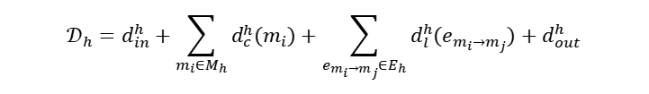

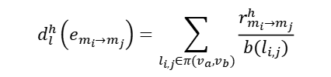



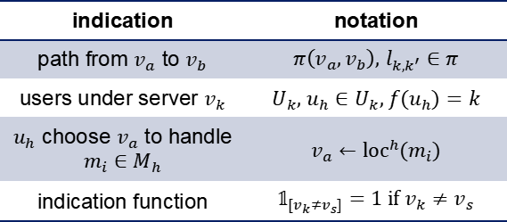
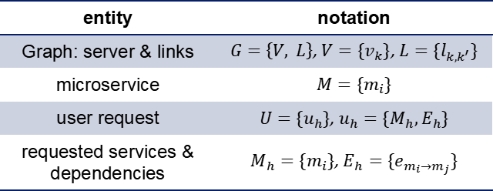
Model and Formulation
  System Model
entity | notation
Graph: server & links | $G=\left\{V, L\right\}$, $V=\{v_{k}\}$, $L=\{l_{k,k^{′}}\}$
microservice | $$M=\{m_{i}\}$$
user request | $U=\{u_{h}\}$, $u_{h}=\{M_{h},E_{h}\}$
requested services & dependencies | $M_{h}=\{m_{i}\}$, $E_{h}=\{e_{m_{i}→m_{j}}\}$
indication | notation
path from $v_{a}$ to $v_{b}$ | $π\left(v_{a},v_{b}\right)$, $l_{k,k^{′}}∈π$
users under server $v_{k}$ | $U_{k}$, ${u_{h}∈U}_{k}$, $f(u_{h})=k$
$u_{h}$ choose $v_{a}$ to handle $m_{i}∈M_{h}$ | $$v_{a}←{\text{loc}}^{h}(m_{i})$$
indication function | $𝟙_{[v_{k}≠v_{s}]}=1$ if $v_{k}≠v_{s}$
  Cost Model
  Completion Time Model
    deploy cost on server $v_{k}$:
    completion time for a user request $u_{h}$:
decision variable
    $$𝒦_{k}=\sum_{m_{i}∈M}{κ}(m_{i})∙x(i,k)$$
    $$𝒟_{h}=d_{in}^{h}+\sum_{m_{i}∈M_{h}}{d_{c}^{h}(m_{i})}+\sum_{e_{m_{i}→m_{j}}∈E_{h}}{d_{l}^{h}(e_{m_{i}→m_{j}})}+d_{out}^{h}$$
deploy cost of $m_{i}$
$$d_{in}^{h}=𝟙_{[v_{k}≠v_{s}]}∙\sum_{l_{i,j}∈π(v_{k},v_{s})}{\frac{r_{in}^{h}}{b(l_{i,j})}}$$
$$d_{c}^{h}\left(m_{i}\right)=\frac{q\left(m_{i}\right)}{c(v_{k})}$$
$$d_{l}^{h}\left(e_{m_{i}→m_{j}}\right)=\sum_{l_{i,j}∈π(v_{a},v_{b})}{\frac{r_{m_{i}→m_{j}}^{h}}{b(l_{i,j})}}$$
    where
bandwidth
computation capacity
Notes:
For the system model, we got the entities at the left part, and some indications at the right part.
Here is the cost model for each edge server, where the x is a provisioning decision variable to indicate whether microservice $m_{i}$ is placed on $v_{k}$ .
The completion time of each request consists of 4 terms, only the $d_{c}^{h}\left(m_{i}\right)$ is the computation delay, and the others are the transmission delays at different stage.

Slide 10
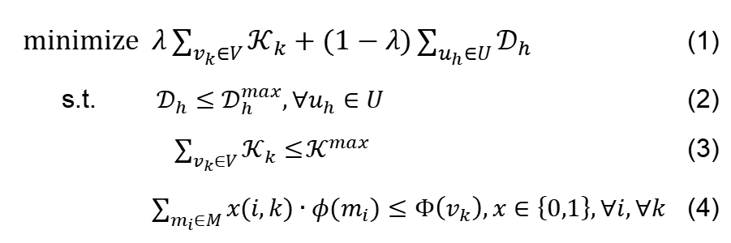
Model and Formulation
  Formulation
objective function
$\text{minimize} λ\sum_{v_{k}∈V}{𝒦_{k}}+(1−λ)\sum_{u_{h}∈U}{𝒟_{h}}$ (1)
s.t. $𝒟_{h}≤𝒟_{h}^{max},∀u_{h}∈U$ (2)
$\sum_{v_{k}∈V}{𝒦_{k}}≤$ $𝒦^{max}$ (3)
$\sum_{m_{i}∈M}{x(i,k)∙φ(m_{i})}≤Φ\left(v_{k}\right),x∈\left\{0,1\right\},∀i,∀k$ (4)
QoS maintain
constraints
memory capacity
constraint
Objective: find a provisioning strategy for microservices to minimize cost and delay under the QoS and memory constraints.
Notes:
The provisioning cost and the request completion time together form the objective, where the constraints (2) and (3) guarantee QoS, and the constraint (4) ensures each edge server will not run out of memory.
Our objective is to find a provisioning strategy for microservices to minimize cost and delay under the QoS and memory constraints.

Slide 11
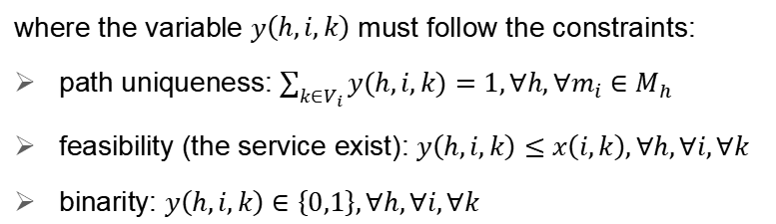
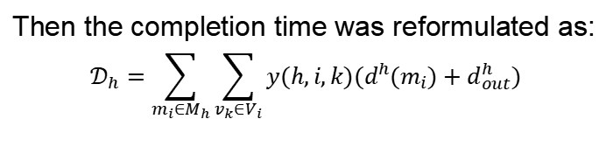
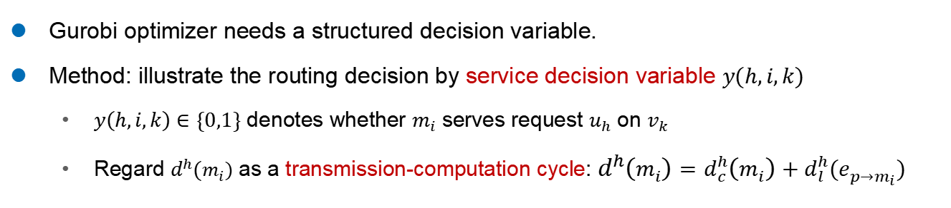
Model and Formulation
  Reformulation
    Gurobi optimizer needs a structured decision variable.
    Method: illustrate the routing decision by service decision variable $y(h,i,k)$
      $y\left(h,i,k\right)∈\{0,1\}$ denotes whether $m_{i}$ serves request $u_{h}$ on $v_{k}$
      Regard $d^{h}(m_{i})$ as a transmission-computation cycle: $d^{h}\left(m_{i}\right)=d_{c}^{h}\left(m_{i}\right)+d_{l}^{h}(e_{p→m_{i}})$
    Then the completion time was reformulated as:
    $$𝒟_{h}=\sum_{m_{i}∈M_{h}}{\sum_{v_{k}∈V_{i}}{y(h,i,k)(d^{h}(m_{i})+d_{out}^{h})}}$$
    where the variable $y\left(h,i,k\right)$ must follow the constraints:
    path uniqueness: $\sum_{k∈V_{i}}{y(h,i,k)}=1,∀h,∀m_{i}∈M_{h}$
    feasibility (the service exist): $y\left(h,i,k\right)≤x\left(i,k\right),∀h,∀i,∀k$
    binarity: $y\left(h,i,k\right)∈\left\{0,1\right\},∀h,∀i,∀k$
Notes:
To better address the routing problem to Gurobi optimizer, we reformulate the problem by introducing structured decision variables that normalize relationships among user requests.
We illustrate the routing decision by introducing the service decision variable $y(h,i,k)$, which denotes whether the microservice $m_{i}$ serves request $u_{h}$ on edge server $v_{k}$.
Since the completion process repeatedly switch between computation and transmission stages, we further regard $d^{h}(m_{i})$ as a transmission-computation cycle.
Then the completion time was reformulated as this new form, where the variable $y\left(h,i,k\right)$ must follow the constraints to keep path uniqueness, feasibility and binarity.
---
Path uniqueness, that only one instance of each specific microservice was chosen in a particular request chain;
Feasibility, that the microservice instance must alive in the edge server to be chosen;
And binarity.

Slide 12
1
Introduction
2
Background
CONTENTS
3
Algorithm Design
4
Experiment and Results
Notes:
Here we introduce our proposed approach.

Slide 13
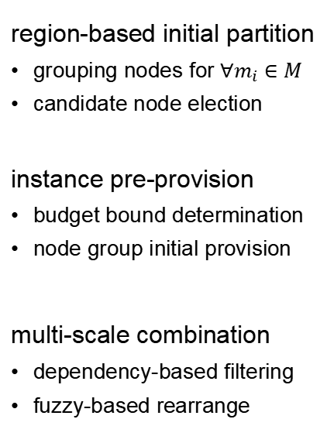
SoCL framework overview
Scalable optimization framework with Cost-efficiency and Latency reduction
region-based initial partition
grouping nodes for $∀m_{i}∈M$
candidate node election
instance pre-provision
budget bound determination
node group initial provision
multi-scale combination
dependency-based filtering
fuzzy-based rearrange
Notes:
The proposed SoCL framework, as shown in this figure, was performed under 3 steps: a region-based initial partition that organizes virtual groups under each microservices’ perspective; an instance pre-provision that provision microservice instances based on cost budget of each group; a multi-scale combination that parallel combine instances during large scale and serial combine instance during small scale.
The initial partition step and the budget-based upper bound together narrows the solution space and providing a basis for efficient provisioning in the subsequent optimization phase.

Slide 14
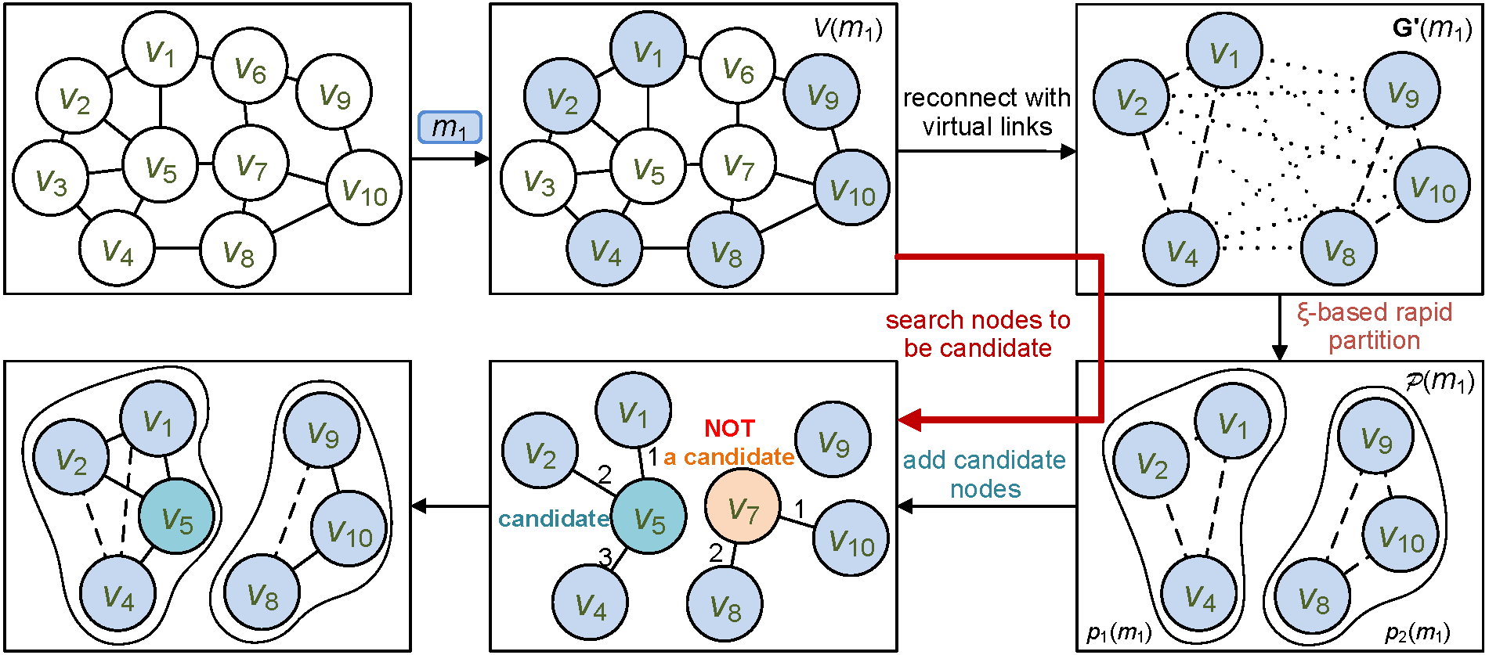
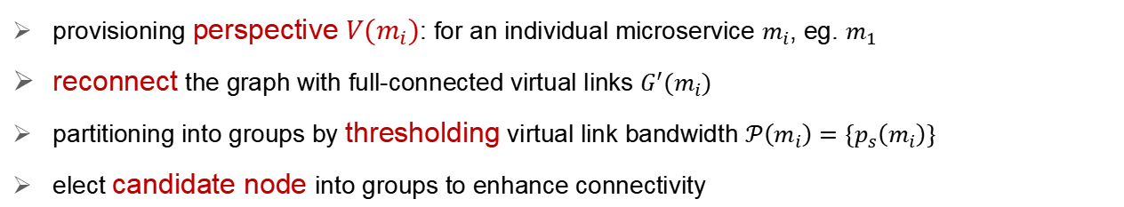
Region-based initial partition
    provisioning perspective $V(m_{i})$: for an individual microservice $m_{i}$, eg. $m_{1}$
    reconnect the graph with full-connected virtual links $G^{′}(m_{i})$
    partitioning into groups by thresholding virtual link bandwidth $𝒫\left(m_{i}\right)=\{p_{s}\left(m_{i}\right)\}$
    elect candidate node into groups to enhance connectivity
Notes:
In the region-based initial partion, we first construct a graph based on the physical topology of edge servers.
We start by identifying those edge servers $v_{k}$ that hosting requests for $m_{i}$ , and collecting these nodes into $V(m_{i})$, forming a subgraph $G\left(m_{i}\right)$ .
Since they are not fully connected, we use virtual links that select the shortest path and regard the harmonic mean of each link speed as the virtual link speed, reconnected into a new graph $G^{′}(m_{i})$ (G prime).
Then we use a bandwidth threshold to filter out low-bandwidth links, forming high-connectivity groups that nodes inside a same group can collaborate together.
Finally, a proactive factor was calculated to figure out which node could be a candidate that helps improving the connectivity.

Slide 15
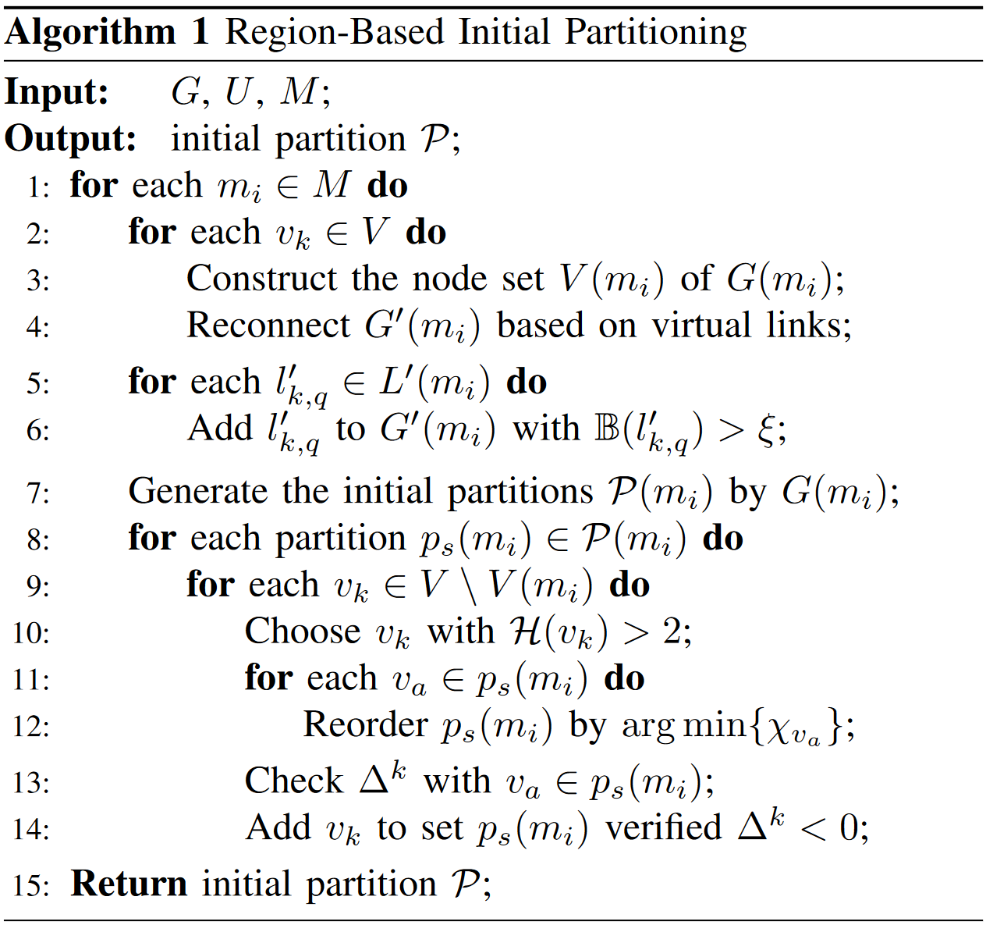
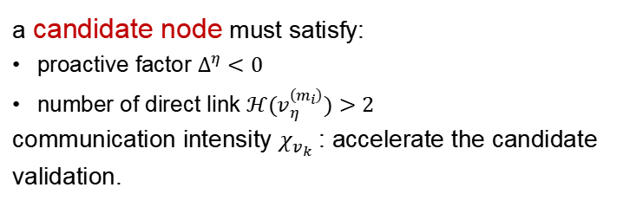
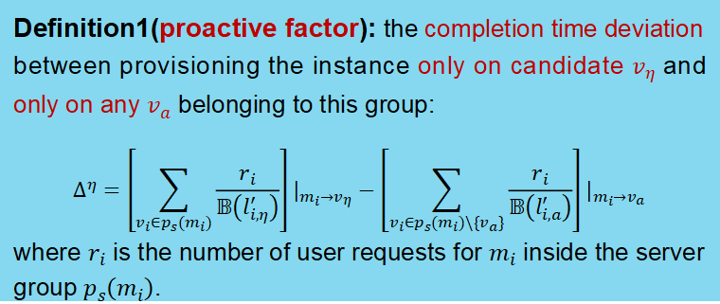
Region-based initial partition
Definition1(proactive factor): the completion time deviation between provisioning the instance only on candidate $v_{η}$ and only on any $v_{a}$ belonging to this group:
$$Δ^{η}=\left[\sum_{v_{i}∈p_{s}\left(m_{i}\right)}{\frac{r_{i}}{𝔹\left(l_{i,η}^{′}\right)}}\right]|_{m_{i}→v_{η}}−\left[\sum_{v_{i}∈p_{s}\left(m_{i}\right)\backslash \{v_{a}\}}{\frac{r_{i}}{𝔹\left(l_{i,a}^{′}\right)}}\right]|_{m_{i}→v_{a}}$$
where $r_{i}$ is the number of user requests for $m_{i}$ inside the server group $p_{s}\left(m_{i}\right)$.
a candidate node must satisfy:
proactive factor $Δ^{η}<0$
number of direct link $ℋ(v_{η}^{\left(m_{i}\right)})>2$
communication intensity $χ_{v_{k}}$: accelerate the candidate validation.
Theorem1: a node $v_{η}^{\left(m_{i}\right)}$ must satisfy $ℋ(v_{η}^{\left(m_{i}\right)})>2$ to provide sufficient connectivity as a candidate.
Notes:
The proactive factor was defined as the completion time deviation between provisioning the instance only on candidate $v_{η}$ (v eta) and only on any $v_{a}$ belonging to this group, and $r_{i}$ represents the total number of user requests for $m_{i}$ on edge server $v_{i}$ inside the server group $p_{s}\left(m_{i}\right)$.
Having the proactive factor, a node can become a candidate node when its proactive factor below 0, and it has more than 2 direct links into any server node inside the group.
Also, a “communication intensity” $χ_{v_{k}}$ (chi vk) was pre-calculated in ascending order to accelerate the candidate validation.
The link number demand of a candidate node was proved in theorem 1

Slide 16
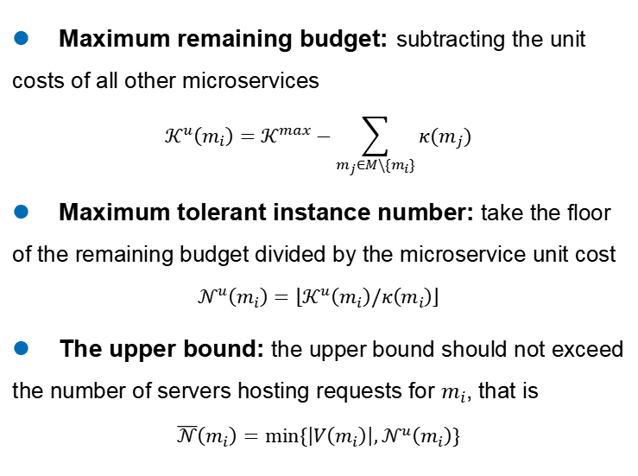
Instance pre-provision
    Maximum remaining budget: subtracting the unit costs of all other microservices
    $$𝒦^{u}\left(m_{i}\right)=𝒦^{max}−\sum_{m_{j}∈M\backslash \{m_{i}\}}{κ(m_{j})}$$
    Maximum tolerant instance number: take the floor of the remaining budget divided by the microservice unit cost
    $$𝒩^{u}\left(m_{i}\right)=\left\lfloor 𝒦^{u}\left(m_{i}\right)/κ\left(m_{i}\right)\right\rfloor$$
    The upper bound: the upper bound should not exceed the number of servers hosting requests for $m_{i}$, that is
    $$\overline{𝒩}\left(m_{i}\right)=min⁡\{\left|V\left(m_{i}\right)\right|,𝒩^{u}\left(m_{i}\right)\}$$
Notes:
The pre-provisioning step uses budget-based constraints to optimize the provisioning process. The upper bound on the number of each microservice instance is determined based on the maximum budget to ensure the cost constraint was guaranteed, while the lower bound keeps a constant 1.
We first obtain the maximum remaining budget of $m_{i}$ by subtracting the unit costs of all other microservices from the total budget.
Based on that, we determine the maximum tolerant instance number of $m_{i}$ by taking the floor of the remaining budget divided by the unit cost of microservice $m_{i}$ .
Since the best situation is to provision $m_{i}$ on every server hosting requests for $m_{i}$ , the upper bound for $m_{i}$ should be the minimum between such server number and the maximum tolerant instance number .
Then as shown in the figure, each microservice will have a maximum and minimum bound restricting its instance number.

Slide 17
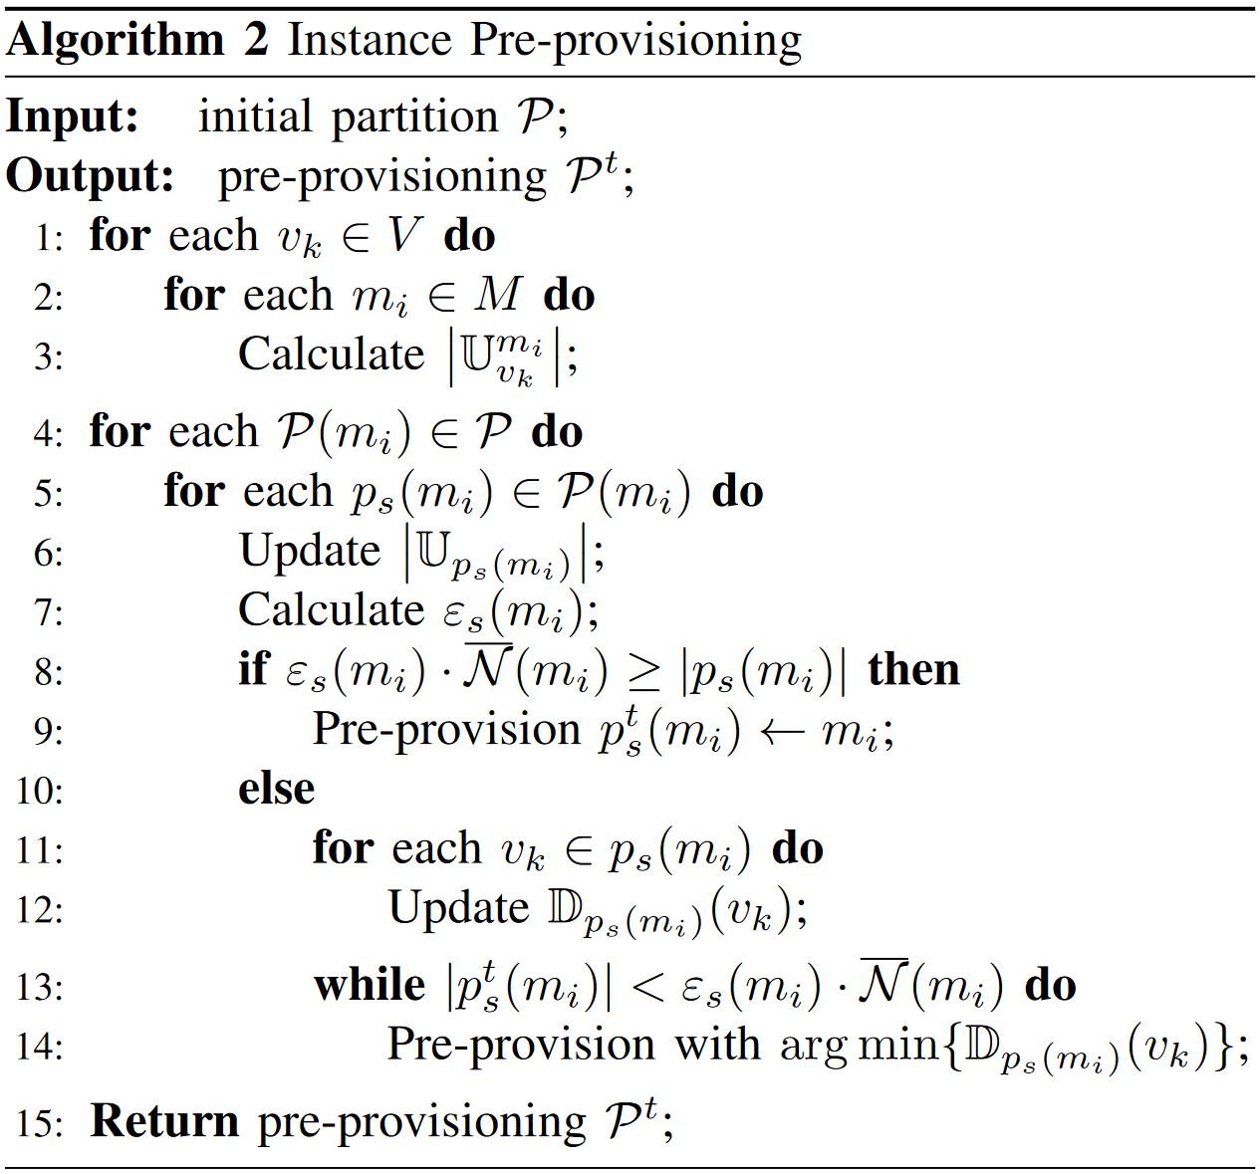
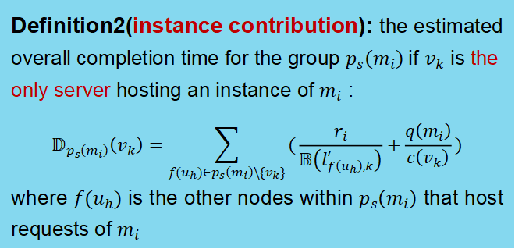
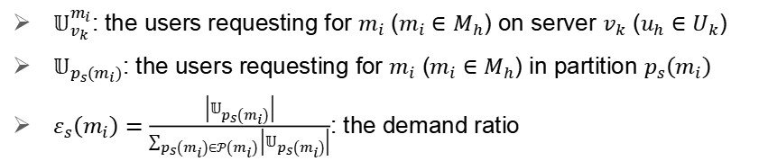
Instance pre-provision
    $𝕌_{v_{k}}^{m_{i}}$: the users requesting for $m_{i}$ ($m_{i}∈M_{h}$) on server $v_{k}$ (${u_{h}∈U}_{k}$)
    $𝕌_{p_{s}\left(m_{i}\right)}$: the users requesting for $m_{i}$ ($m_{i}∈M_{h}$) in partition $p_{s}\left(m_{i}\right)$
    $ε_{s}\left(m_{i}\right)=\frac{\left|𝕌_{p_{s}\left(m_{i}\right)}\right|}{\sum_{p_{s}\left(m_{i}\right)∈𝒫\left(m_{i}\right)}{\left|𝕌_{p_{s}\left(m_{i}\right)}\right|}}$: the demand ratio
the allocated quota is sufficient
Definition2(instance contribution): the estimated overall completion time for the group $p_{s}\left(m_{i}\right)$if $v_{k}$ is the only server hosting an instance of $m_{i}$ :
$$𝔻_{p_{s}\left(m_{i}\right)}\left(v_{k}\right)=\sum_{f(u_{h})∈p_{s}\left(m_{i}\right)\backslash \{v_{k}\}}{(\frac{r_{i}}{𝔹\left(l_{f\left(u_{h}\right),k}^{′}\right)}+\frac{q\left(m_{i}\right)}{c\left(v_{k}\right)})}$$
where $f(u_{h})$ is the other nodes within $p_{s}\left(m_{i}\right)$ that host requests of $m_{i}$
Notes:
With the budget bounds obtained just now, we assign the estimated number of instances to each partition. The server locations and user demand patterns are considered to ensure the budget allocation within each partition is both balanced and meets the practical requirements of microservice delivery.
We begin with counting the request rate of each microservice $m_{i}$ on each server $v_{k}$, further deducing the request rate on each partition group. Then a quota allocation strategy was introduced to allocate the budget by group demand ratio. If the allocated quota is sufficient to every server inside the group, just simply pre-provision instance to all servers inside this group; otherwise, a selective provisioning guided by instance contribution was performed to determine the provision priority, where the instance contribution was defined as the estimated overall completion time for the group $p_{s}\left(m_{i}\right)$if $v_{k}$ is the only server hosting an instance of $m_{i}$ .

Slide 18
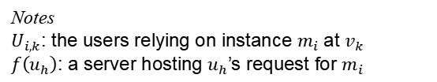
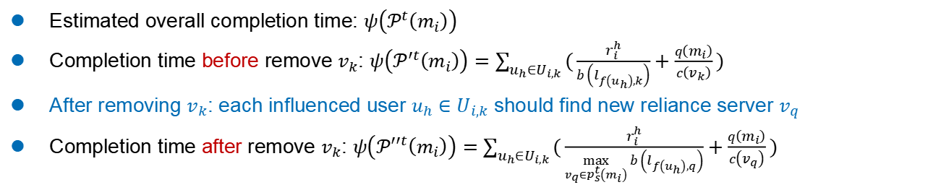
Notes
$U_{i,k}$: the users relying on instance $m_{i}$ at $v_{k}$
$f\left(u_{h}\right)$: a server hosting $u_{h}$’s request for $m_{i}$
Multi-scale combination
    Estimated overall completion time: $ψ\left(𝒫^{t}\left(m_{i}\right)\right)$
    Completion time before remove $v_{k}$: $ψ\left(𝒫^{′t}\left(m_{i}\right)\right)=\sum_{u_{h}∈U_{i,k}}{(\frac{r_{i}^{h}}{b\left(l_{f\left(u_{h}\right),k}\right)}+\frac{q\left(m_{i}\right)}{c\left(v_{k}\right)})}$
    After removing $v_{k}$: each influenced user $u_{h}∈U_{i,k}$ should find new reliance server $v_{q}$
    Completion time after remove $v_{k}$: $ψ\left(𝒫^{′′t}\left(m_{i}\right)\right)=\sum_{u_{h}∈U_{i,k}}{(\frac{r_{i}^{h}}{\max_{v_{q}∈p_{s}^{t}\left(m_{i}\right)}{b\left(l_{f\left(u_{h}\right),q}\right)}}+\frac{q\left(m_{i}\right)}{c\left(v_{q}\right)})}$
Definition3(latency loss): the estimated completion time increase after the removal of $v_{k}$:
$$ζ_{i,k}=ψ\left(𝒫^{′′t}\left(m_{i}\right)\right)−ψ\left(𝒫^{′t}\left(m_{i}\right)\right)$$
Notes:
An instance combination involves merging two instances of the same microservice into a single consolidated instance to reduce provisioning costs. The multi-scale combination step aims to minimize the objective function by combining instances with two granularities: the large-scale gradient descent merges multiple instances simultaneously, while the small-scale gradient descent combines instances individually to identify the optimal trade-off.
The combination process will definitely increase the overall completion time; thus, we monitor the provision update and use $ψ\left(𝒫^{t}\left(m_{i}\right)\right)$(Psi) to represent the estimated completion time under current provisioning strategy.
In order to estimate the completion time change, we define $ψ\left(𝒫^{′t}\left(m_{i}\right)\right)$ (Psi P prime t m i) as the completion time before removing $v_{k}$ , and the $ψ\left(𝒫^{′′t}\left(m_{i}\right)\right)$ (Psi P double prime t m i) after removing $v_{k}$ .

Slide 19
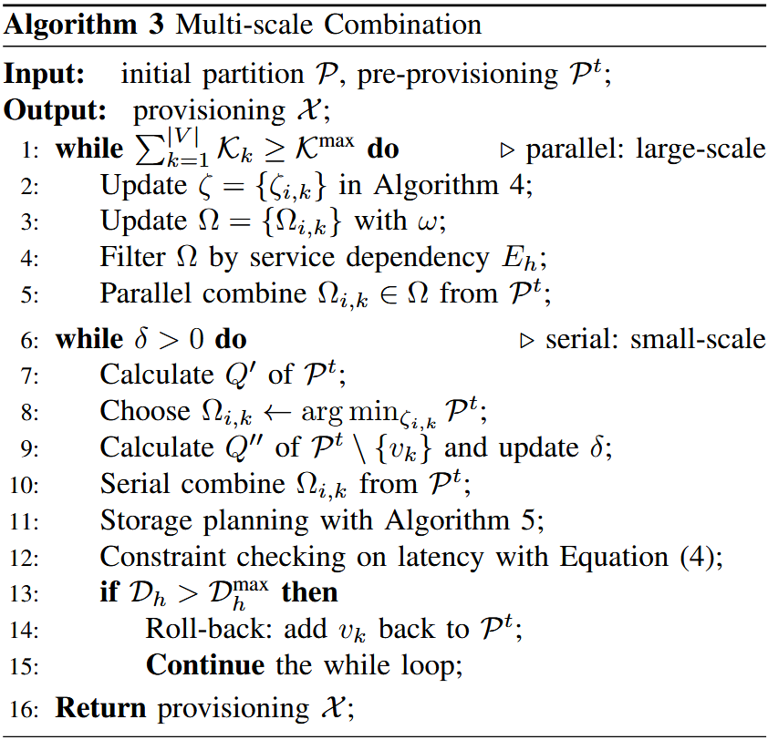
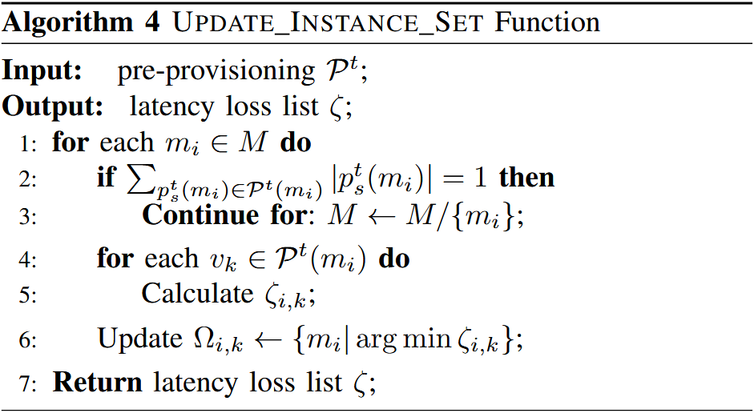
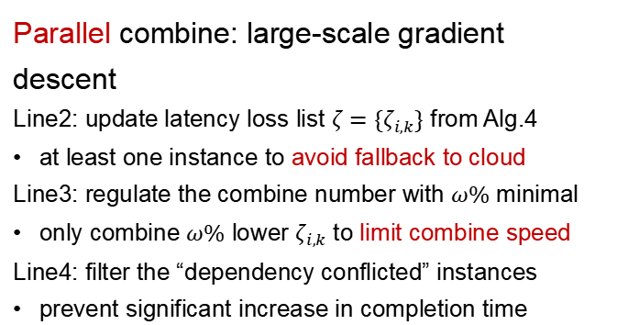
Multi-scale combination
Parallel combine: large-scale gradient descent
Line2: update latency loss list $ζ=\{ζ_{i,k}\}$ from Alg.4
at least one instance to avoid fallback to cloud
Line3: regulate the combine number with $ω\%$ minimal
only combine $ω\%$ lower $ζ_{i,k}$ to limit combine speed
Line4: filter the “dependency conflicted” instances
prevent significant increase in completion time
Notes:
The two-scale gradient descent combination is outlined in Algorithm 3. During the large-scale gradient descent in lines 1-5, we combine the microservice instances in parallel.
In line 2, the latency loss list was deduced by selecting instance with the lowest latency loss. As line 2 referring to the Algorithm 4, each microservice type will have one instance selected and ready for the removal, unless there was only one instance remaining in the edge environment, avoiding the service fallback to the cloud.
Let’s back to the Algorithm 3, in line 3, a hyperparameter $ω$ (omega) was proposed to regulate the number of parallel combinations, which limits the speed of parallel gradient descent by only taking the $ω$ (omega) minimal percentage of instances to be combined.
Further in line 4, we regard the frequently recurring dependency patterns in user requests as “dependency conflicted” and avoid combining them simultaneously to prevent significant increase in completion time of individual requests.

Slide 20
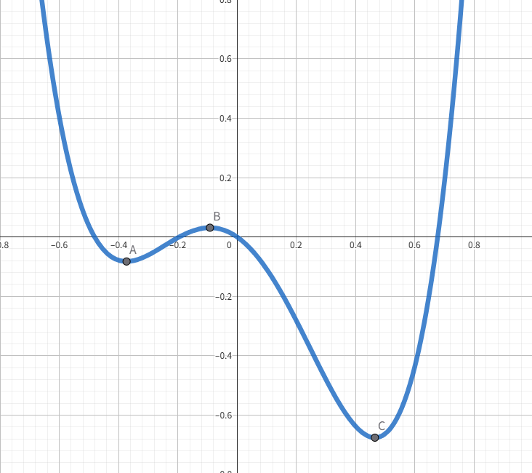
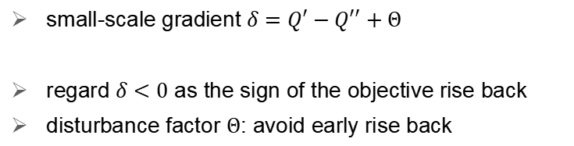
Multi-scale combination
estimated objective before combination
estimated objective after combination
    small-scale gradient $δ=Q^{′}−Q^{′′}+Θ$
    regard $δ<0$ as the sign of the objective rise back
    disturbance factor $Θ$: avoid early rise back
disturbance factor
early rise back
combination
process
rise back
Notes:
After the deployment cost fall into the maximum budget constraint, the combination process switch into the small-scale serial gradient decent. The main concern changes from the budget feasibility to the trade-off between deployment cost and completion time. The calculation method of the latency loss remains the same in line 8, but the instances are combined one by one in line 10 to implement a more granular adjustments.
In line 7 and 9, we estimate the objective with current deployment cost and the estimated completion time. Having the objective before and after serial combine, we give the small-scale gradient $δ=Q^{′}−Q^{′′}+Θ$ (delta equals Q prime minus Q double prime plus Theta) and regard $δ<0$ (delta less-than 0) as the sign that the objective value starts to rise back, where $Θ$ (Theta) is a positive disturbance factor to prevent a small rise back stopping the whole progress.
The provisioning solution from each serial combine round may violate the storage constraint or completion time constraint. A storage planning process is applied in line 11 to avoid storage violation, followed by a roll-back mechanism in lines 12 to 15 to ensure the maximum completion time.

Slide 21
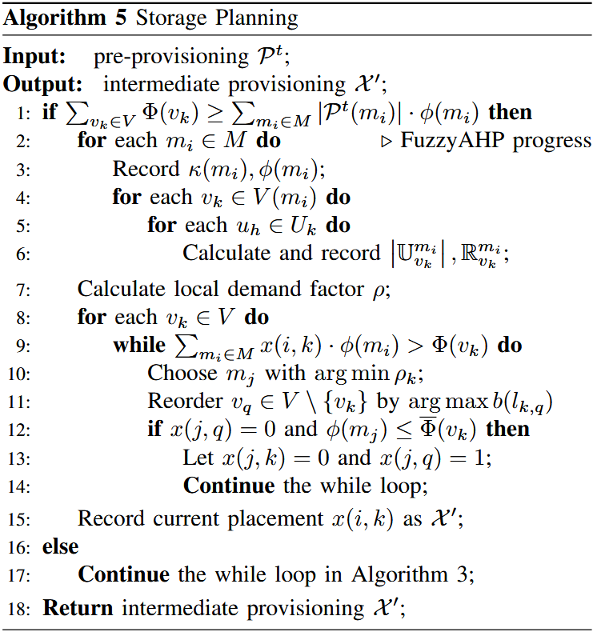
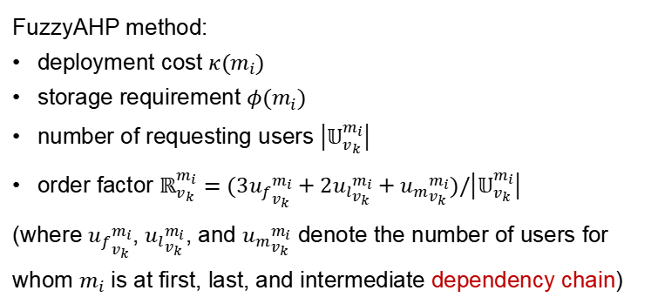
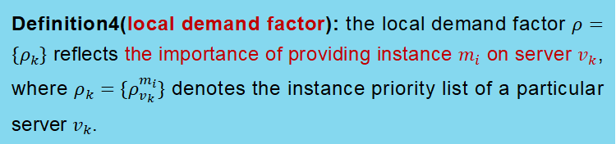
Multi-scale combination
Definition4(local demand factor): the local demand factor $ρ=\{ρ_{k}\}$ reflects the importance of providing instance $m_{i}$ on server $v_{k}$, where $ρ_{k}=\{ρ_{v_{k}}^{m_{i}}\}$ denotes the instance priority list of a particular server $v_{k}$.
FuzzyAHP method:
deployment cost $κ(m_{i})$
storage requirement $φ(m_{i})$
number of requesting users $\left|𝕌_{v_{k}}^{m_{i}}\right|$
order factor $ℝ_{v_{k}}^{m_{i}}=(3{u_{f}}_{v_{k}}^{m_{i}}+2{u_{l}}_{v_{k}}^{m_{i}}+{u_{m}}_{v_{k}}^{m_{i}})/\left|𝕌_{v_{k}}^{m_{i}}\right|$
(where ${u_{f}}_{v_{k}}^{m_{i}}$, ${u_{l}}_{v_{k}}^{m_{i}}$, and ${u_{m}}_{v_{k}}^{m_{i}}$ denote the number of users for whom $m_{i}$ is at first, last, and intermediate dependency chain)
Notes:
The storage planning process identifies less critical microservices on each server based on the FuzzyAHP method. Once the total memory of every edge server can accommodate every provisioned instances, the FuzzyAHP method will calculate the local demand factor to guide the storage planning.
As shown in definition 4, the local demand factor reflects the importance of providing instance $m_{i}$ on server $v_{k}$ . The fuzzy properties of microservice $m_{i}$ on server $v_{k}$ are the deployment cost of $m_{i}$ , the storage requirement of $m_{i}$ , the number of users requesting for $m_{i}$ on server $v_{k}$ , and an order factor considering $m_{i}$’s position in different user request dependency chain.

Slide 22
1
Introduction
2
Model and Formulation
CONTENTS
3
Algorithm Design
4
Experiment and Results
Notes:
At last, let me show some experimental results.

Slide 23
Experiment and Results
  Basic Setting
    Hardware: Windows 10 with an Intel(R) Xeon(R) Silver 4210R CPU @ 2.40GHz, NVIDIA RTX5000 GPU, and 128GB RAM.
    Dataset: Microservices (Version 1.0)^{[1]} .
    Project: eShopOnContainers
  Comparison
    Random Provisioning (RP).
    Joint Deployment and Routing (JDR)^{[2]}.
    Greedy Combine with Objective Gradient (GC-OG)
[1] Imranur, M., Panichella, S., & Taibi, D. (2019). A curated dataset of microservices-based systems. Joint Proceedings of the Summer School on Software Maintenance and Evolution (CEUR-WS), Tampere, Finland.
[2] Peng, K., Wang, L., He, J., Cai, C., & Hu, M. (2024). Joint optimization of service deployment and request routing for microservices in mobile edge computing. IEEE Transactions on Services Computing.
Notes:
Here is the basic setting.
We use the Microservices dataset that includes dependency analyses for 20 microservice-based projects.
And the eShopOnContainers project, configuring microservices with processing capabilities from 1G to 3 GFLOPs and data flows from 1 to 80 GB/s.
Edge Servers have 5 to 20 GFLOPs computing power, with 4 to 8 storage units, and 20 to 80 GB/s bandwidth.
We choose these following methods as comparison.

Slide 24
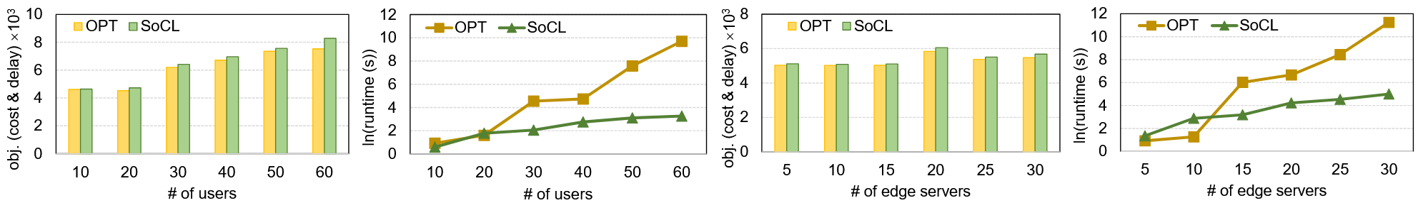
Experiment and Results
  Comparison with Gurobi Optimizer
    Gurobi achieves slightly better objective values, but the differences are minimal.
    SoCL outperforms Gurobi in runtime as the user scale and server scale increases.
    SoCL can deliver near-optimal solutions with significantly higher efficiency.
(a) # of users (obj).
(b) # of users (runtime).
(c) # of edge servers (obj).
(d) # of edge servers (runtime).
Notes:
We compared the performance of the Gurobi optimizer and SoCL at various user scales and server scales, focusing on objective and runtime. The result shows that although Gurobi achieves slightly better objective values, the differences are minimal.
However, SoCL significantly outperforms Gurobi in terms of runtime, especially as the user scale and server scale increases.
These results underscore SoCL’s ability to deliver near-optimal solutions with significantly higher computational efficiency and demonstrate its scalability and practicality for large-scale scenarios, where Gurobi’s performance is no longer feasible.

Slide 25
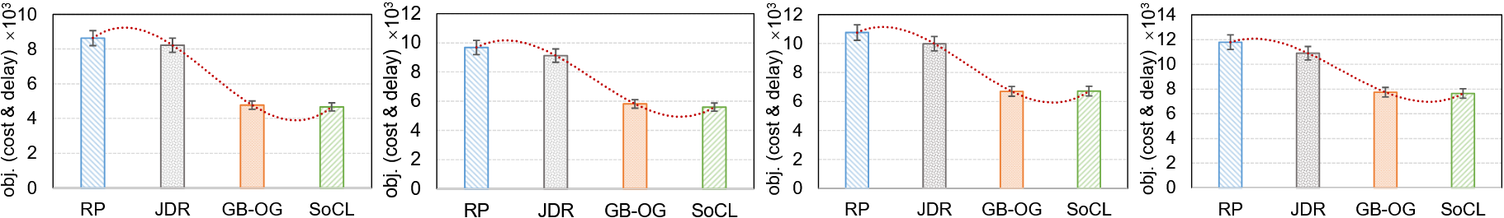
Experiment and Results
  Comparison on Baselines
    SoCL achieved the lowest objective values across all user scales.
    The difference in performance became clearer as the user scale increased.
    SoCL’s efficient search and provisioning strategy effectively avoids resource redundancy and search inefficiency.
(a) # of users 80.
(b) # of users 120.
(c) # of users 160.
(d) # of users 200.
Notes:
We compared the performance of four methods under user scales of 80, 120, 160, and 200, and conducted an in-depth analysis of the results.
The result shows that SoCL achieved the lowest objective values across all user scales, demonstrating superior optimization capability and computational efficiency. The difference in performance between the methods became clearer as the user scale increased.
These results exhibited that SoCL’s efficient search and microservice provisioning strategy can effectively avoids resource redundancy and search inefficiency, ensuring a balanced optimization of deployment cost and latency.

Slide 26
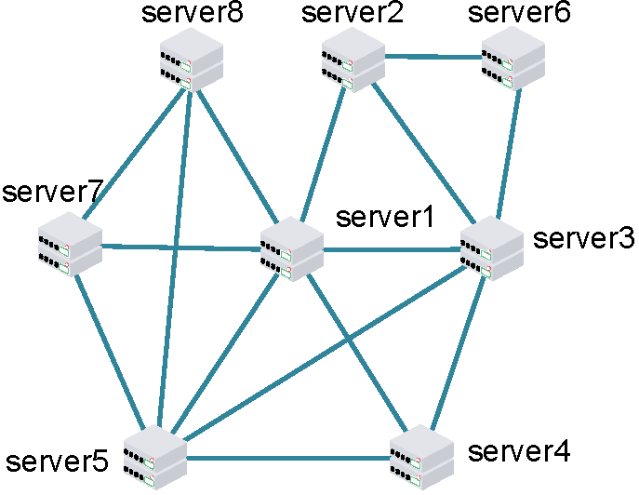
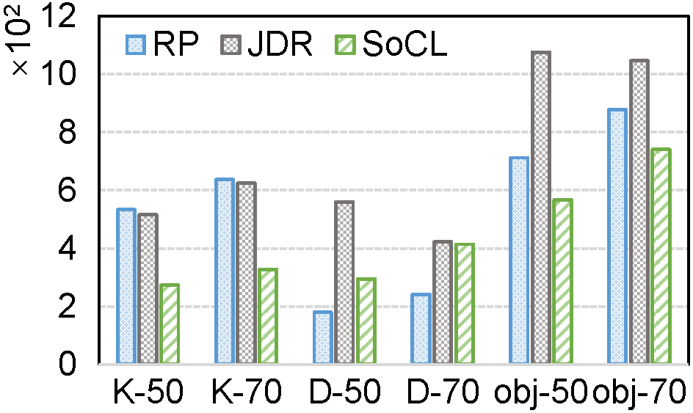
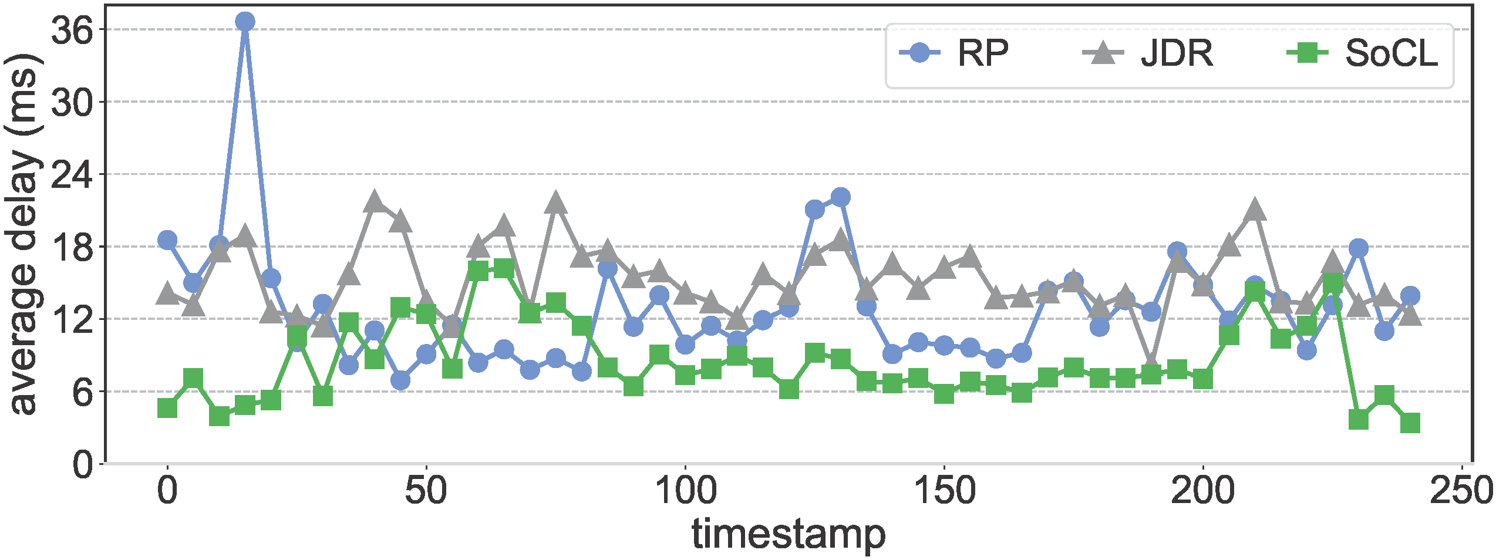
Experiment and Results
  Evaluation on Kubernetes
      Testbed Results
    SoCL can balance the deployment cost with the users’ requirements and place the instances in a proper place.
    SoCL consistently achieved the lowest average delay during the latency trace.
Objectives with 8 servers
Avg delay trace with 16 edge servers
Notes:
During the objective evaluation under 50 and 70 users with 8 servers, we found that although the RP and JDR methods achieve a low completion time, this result depends on a full utilization of the maximum deployment budget, which increases the total deployment cost and negatively affects the objective. Instead, the proposed SoCL method can balance the cost of deploying instances with the users’ requirements and place the instances in a proper place to increase the benefit.
We also conducted a 4-hour trace experiment on Kubernetes, where 50 users randomly moved among edge nodes and issued requests every 5 minutes with stochastic service dependencies. The result shows that SoCL consistently achieved the lowest average delay, around 8.50 ms per timestamp, outperforming RP and JDR.

Slide 27
Conclusion
SoCL: a scalable framework for efficient microservice provisioning, which optimally positions microservice instances to balance cost and latency based on user demands.
Experiments: SoCL consistently outperforms baselines, handling large-scale user requests and network expansions effectively.
Compared to Gurobi: SoCL achieves significant reductions in cost and latency while delivering execution times up to one order of magnitude faster.
Future work: incorporate user behavior modeling and preference integration to support context-aware resource management.
Notes:
In conclusion, we proposed SoCL, a scalable framework for efficient microservice provisioning, which optimally positions microservice instances to balance cost and latency based on user demands.
Extensive experiments, including simulations and containerized deployments on Kubernetes, demonstrate that SoCL consistently outperforms baselines, handling large-scale user requests and network expansions effectively.
Compared to the state-of-the art ILP optimizer Gurobi, SoCL achieves significant reductions in cost and latency while delivering execution times up to one order of magnitude faster.
As future work, we plan to incorporate user behavior modeling and preference integration to support context-aware resource management. This advancement aims to address broader QoS challenges in edge networks and facilitate the development of more generalized and adaptive resource management solutions.

Slide 28
THANK YOU
Notes:
Thank you for your attention. Please feel free to ask any questions.
可能的提问：
关于microservice和function：they are all computation tasks: a serverless function is more fine-grained comparing with microservice, it may start in need and destroy after use, while microservice keeps alive in a certain container or virtual machine

