Slide 1
Algorithmic Solutions for Re-Balancing in Bike Sharing:
Challenges and Opportunities
Jie Wu
Center for Networked Computing
Temple University
Notes:
1

Slide 2
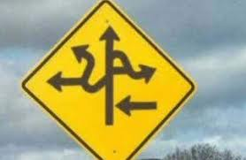
Road Map
  1. Introduction
  2. Four System Components
  3. Re-balancing Through Trucks
  4. Re-balancing Through Workers
  5. Spatial and Temporal Complexity
  6. Challenges and Opportunities
  7. Conclusion

Slide 3
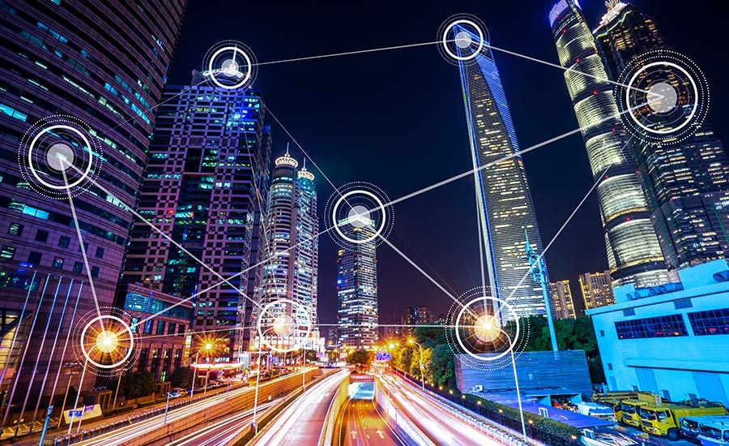
1. Introduction
  Smart City
    Collection of data
    Management of assets, resources, and services
  Scope
    Transportation
    Power plants
    Utilities
    Water supply
    Crime detection
    School
    Libraries
    Hospitals
    …
Notes:
Data buckets for TeraSort

Slide 4
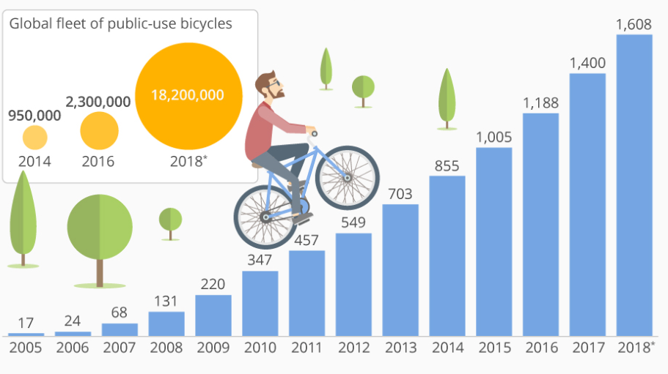
Bike Sharing System (BSS)
  BSS
    First/last mile connection
    Rent-Ride-Return
    > 1600 BSSs in > 50 countries
  Benefits
    Healthy lifestyle
    Green transportation
    40% of BSS users drive less
Notes:
Data buckets for TeraSort

Slide 5
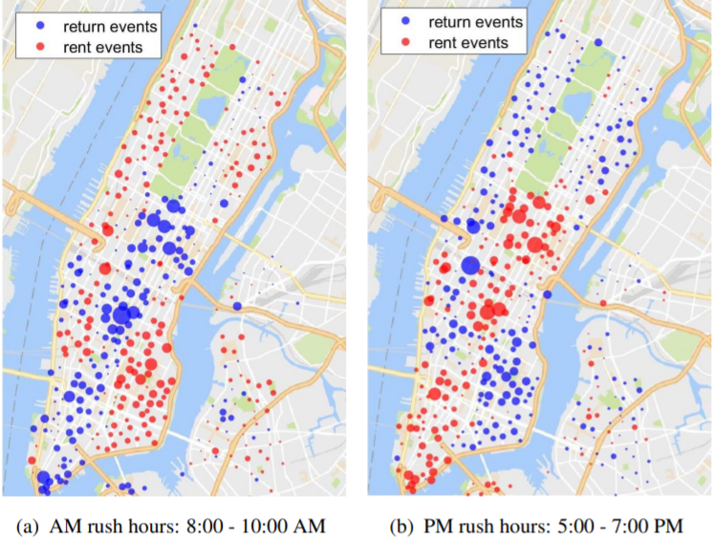
Unbalanced Usage in BSS
  Unbalanced usage
    Time
    Space
  Capacity
    Underflow (empty)
    Overflow (full)
Notes:
Data buckets for TeraSort

Slide 6
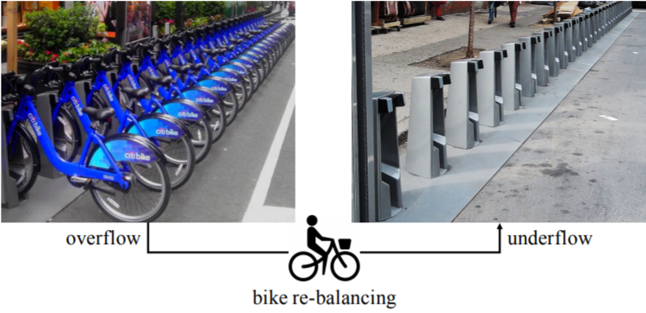
Re-Balancing in BSS
Dock BSS
Citi Bike (NYC), Indego (Philly),
and GoBike (Bay Area)
BikeMi (Milan), Bubi (Budapest)
Dock-less BSS
ofo and Mobike (China)
U-Bicycle and OV-fiets (Europe)
LimeBike and JUMP (US)
Re-balancing (repositioning)
Via trucks (not eco-friendly)
Via workers (through crowdsourcing)
Notes:
China’s new 4 invention

Slide 7
2. Four System Components
1. System design
Station number, location,
capacity, and bike number
Facility location problem: area
best for placing a station?
2. System prediction
Mobility modeling
Demand prediction
3. System balancing
Dedicated truck service
Incentive-based worker
recruitment
Route planning and scheduling
4. Trip advisor
User guidance
Re-balance via suggestions

Slide 8
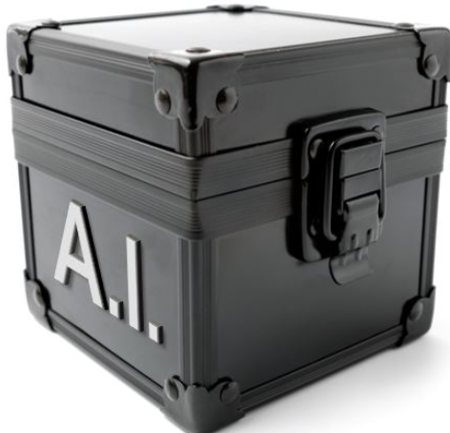
AI Take-off
X – AI convergence
  AI blackbox
However, DARPA: Explainable AI
  Produce more explainable models
  Enable human users to understand
Back to fundamentals
  Direct algorithmic/combinatoric solutions
  Mixed with AI/ML solutions

Slide 9
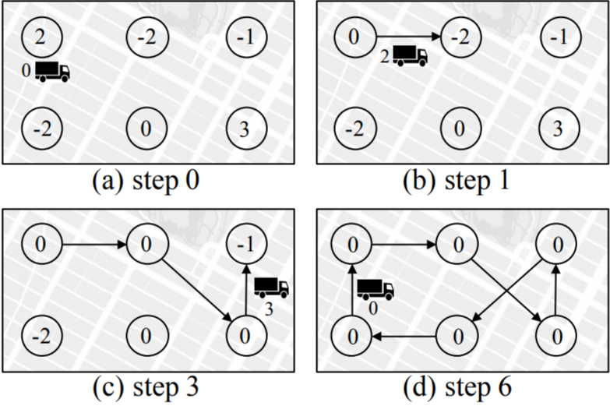
3. Re-balancing Through Trucks
Hamiltonian circle (for TSP)
Trucks move around stations
to pick-up/drop-off bikes
Notation
+m: overflow by m
-m: underflow by m
l: truck capacity
Legitimate circle
Alternating positive pieces and
negative pieces s.t. capacity l

Slide 10
MATCH Method
Assumptions
Predefined Hamiltonian cycle
Piece length limit: l’
MATCH method
l’: l/2, complexity: O(n³), bound: 6.5
Min-weight perfect matching:
pos (l’)., neg (l’)., and zero pieces
Visit each pair following the
cycle clock-wise (random point)
Cyclic-shift the sequence (real start)
+ and – initially balanced
l=6, l’=3, (3, 7, 8, 4, 5, 6, 9, 2, 10, 1)
Cyclic-shift: (1, 3, 7, 8, 4, 5, 6, 9, 2, 10)

Slide 11
GREED Method
Assumptions
Predefined Hamiltonian cycle
Piece length limit: l’
GREED method
l’: l, complexity: O(n²)
Alternating pos. and neg.
following the cycle clock-wise
(1, 2, 5, 6, 7, 8, 3, 4, 9, 10, 1)

Slide 12
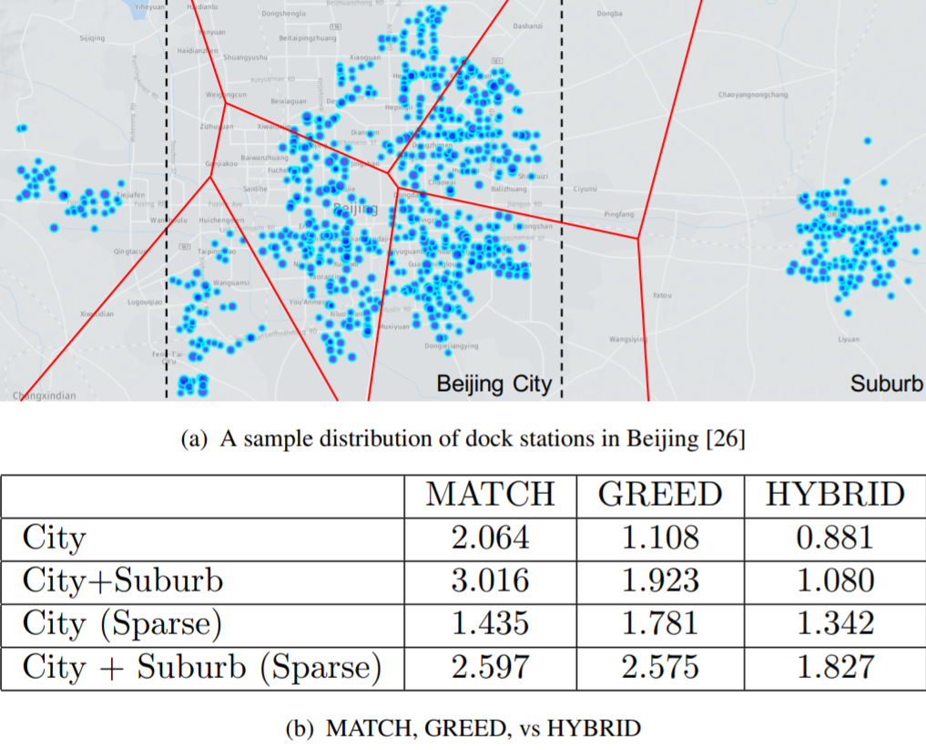
HYBRID Method
MATCH
Sparse mode (primary)
Small geo-area (secondary)
GREED
Dense model (primary)
Large geo area (secondary)
HYBRID
Two-level hierarchy
MATCH for intra-cluster
GREED for inter-cluster
(Average per bike repositioning distance in km)
M. Charikar et al, Algorithms for capacitated vehicle routing, SIAM, 2001
Y. Duan, J. Wu, and H. Zheng, A greedy approach for vehicle routing, GLOBECOM, 2018
Notes:
7 pieces using k means

Slide 13
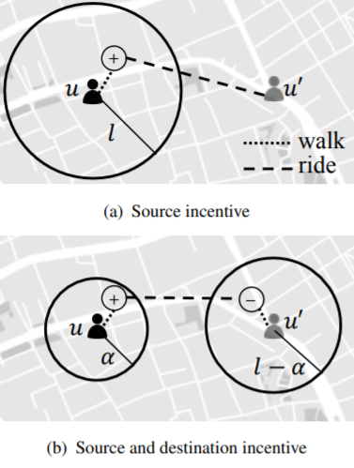
4. Re-balancing Through Workers
Through incentive
Workers are BSS users
Overflow: + and underflow: -
Monetary award prop.to distance
Reinforcement learning on
setting the price
Dock-less incentive
Source detour bounded by l
Extensions with detour at both
source and destination
L. Pan et al, A Deeep Reinforcement Learning Framework for Rebalancing Dockless Bikesharing Systems, AAAI, 2019
Y. Duan and J. Wu, Optimizing Rebalance Scheme for Dockless Bike Sharing Systems with Adaptive Incentive, MDM, 2019

Slide 14
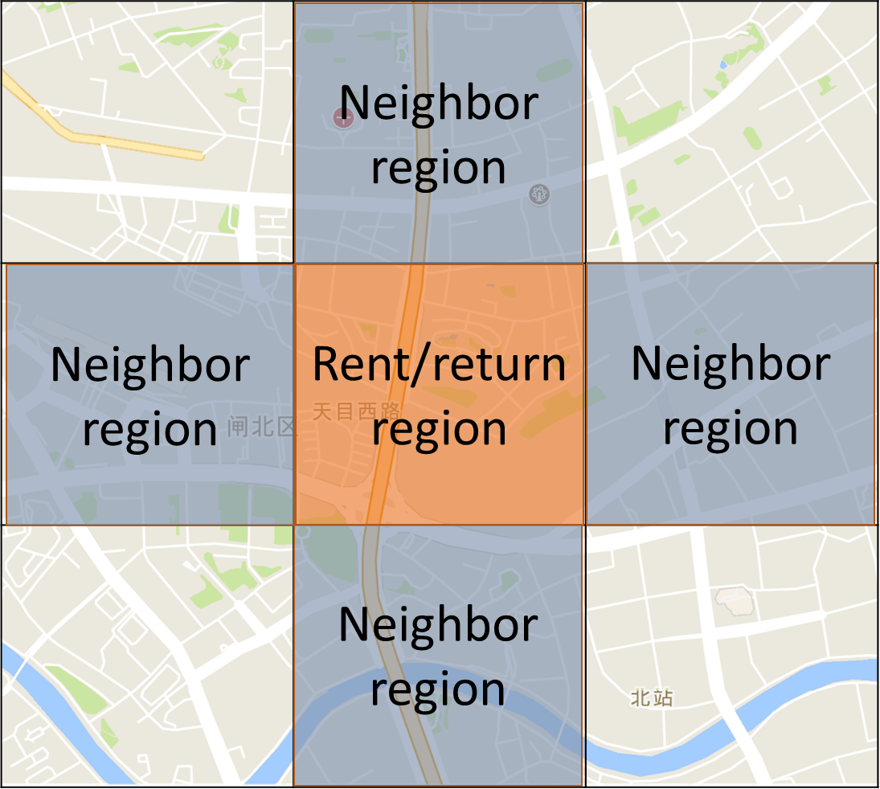
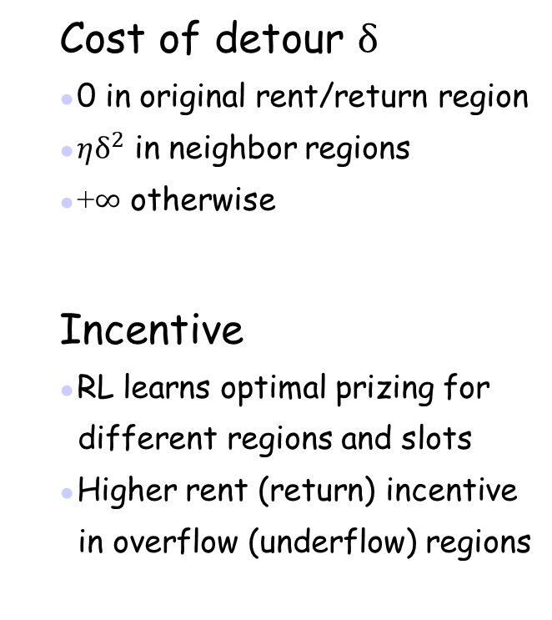
Incentive Simulation
Cost of detour $δ$
0 in original rent/return region
$ηδ^{2}$ in neighbor regions
    +$∞$ otherwise
Incentive
RL learns optimal prizing for
different regions and slots
Higher rent (return) incentive
in overflow (underflow) regions
Mobike Shanghai trace data
Notes:
Size of each neighbor

Slide 15





A Global Incentive Approach
Incentive
For both dock and dock-less
Deal with multiple workers
Two rounds of perfect matching
  Match overflow stations with
  underflow stations
  Match users with station pairs
$$+$$
$$−$$
o
u
s
d
$$+$$
$$−$$
o'
u'
Y. Duan and J. Wu, Optimizing the crowdsourcing-based bike rebalancing scheme, IEEE ICDCS, 2019

Slide 16
  Approximation
3-approximation
Proof sketch:
Optimality of the two rounds of matching
Triangle inequality
Combining
Yellow: Optimal, Blue: 2-Round

Slide 17
5. Spatial and Temporal Complexity
Traffic dynamic: NYC Citi Bike dataset
Static vs. dynamic repositioning
weekdays
weekends
Notes:
Equal-cost multi-path routing (ECMP)

Slide 18

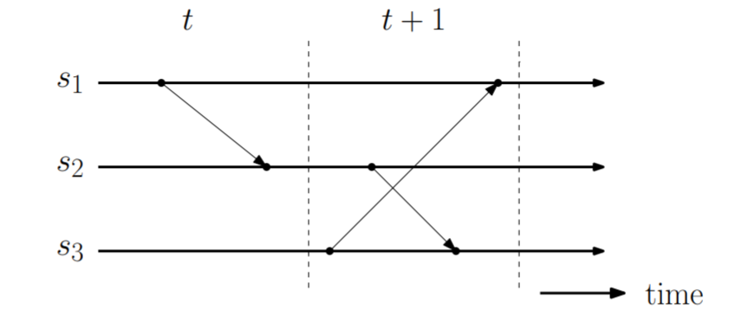
Time-Space View
Global state
Local state
Transition state
View
Horizontal line
  Status of local station
Vertical dotted line (slot)
  Time period between two
  slots
Slanted arrow
  Re-balancing event
Cut: a re-balancing event goes
across two slots

Slide 19
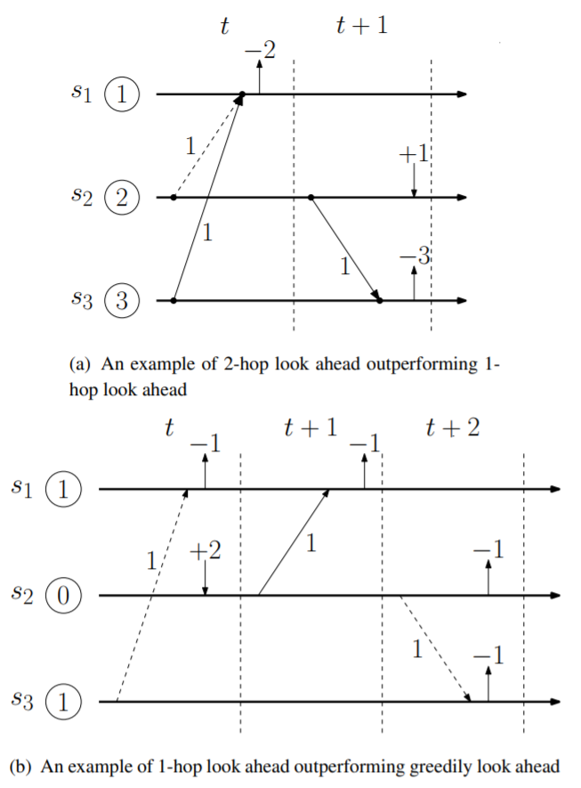
Frequency Reduction via Look-Ahead
K-hop look ahead
Make minimum move in the current
slot so that it can last at least k hops
Reschedule after k slots
Greedily look ahead
Make move in the current slot
so that it can last the longest (L)
Reschedule after L slots
(a) and (b): solid lines for 1-hop
Notes:
Average view: 2.61

Slide 20
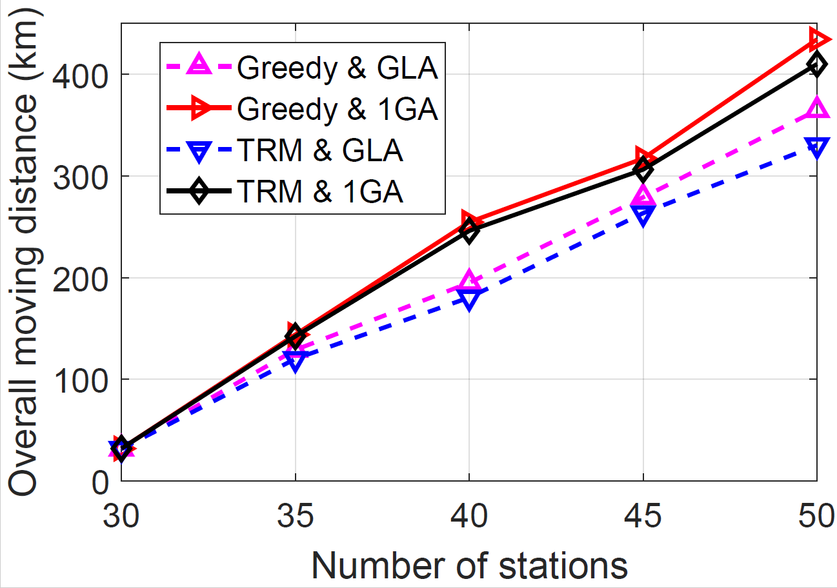
Spatial and Temporal Domain Simulation
Spatial domain
On a single time slot
Given rebalance targets
Minimize worker detour
(BB: Branch & Bound , LS: Local Search, TRM: 2-Round Matching, Greedy: closest NYC Citi Bike)
Temporal domain
Over multiple time slots
Minimize bike repositioning dis.
(1-LA: 1-hop, 2-LA: 2-hop, GLA: Greedily)

Slide 21
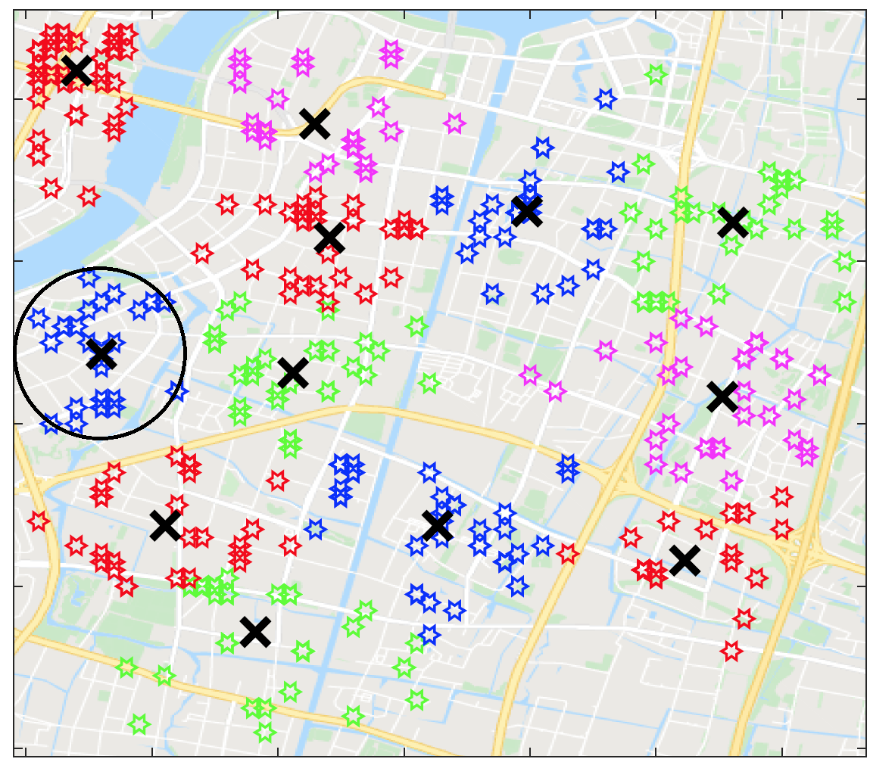
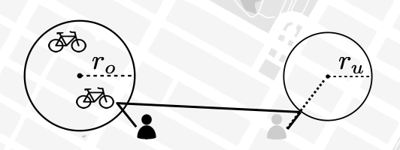
Extension to Dock-less Scenario
Virtual stations (VS)
Mesh grid
K-means
Density-based clustering
Rebalancing VS
Pick-up
  nearest in starting VS
Drop-off
  nearest in destination VS
Mobike Shanghai Dataset (08/01/16-08/31/16)
Y. Duan and J. Wu, Spatial-Temporal Inventory Rebalancing for Bike Sharing Systems with
Worker Recruitment, accepted to appear in IEEE Transactions on Mobile Computing, 2020

Slide 22
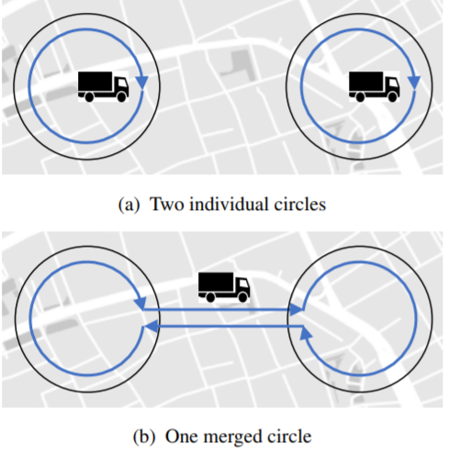
6. Challenges and Opportunities
Model extensions
Models with “cut”
Repositioning spanning over one slot
Scalable design
Geometric partitioning
Clustering (k-means or density-based)
Number of trucks used
Scheduling of trucks
J. Wu, Collaborative Mobile Charging and Coverage, JCST 2014
H. Zheng, N. Wang, and J. Wu, Minimizing Deep Sea Data Collection Delay With Autonomous Underwater Vehicles, Journal of Parallel and Distributed Computing, 2017

Slide 23
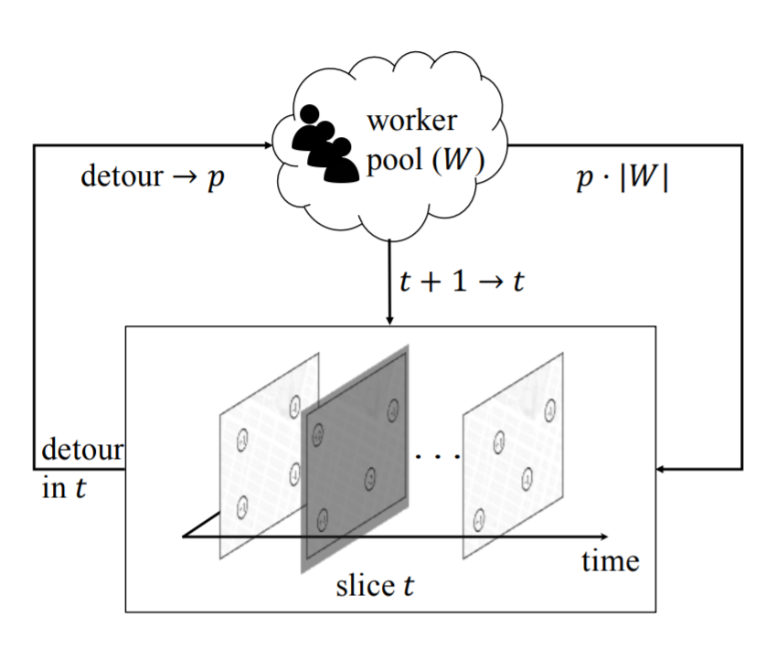
Challenges and Opportunities (Cont’d)
Other models
Bike recycling (and usage balance)
Robust solution (under data uncertainty)
Economic models (mechanism design)
Gaming and incentive
Stakelberg and Nash games
  Among BBS operators and workers
Incentive
  Reinforcement incentive

Slide 24
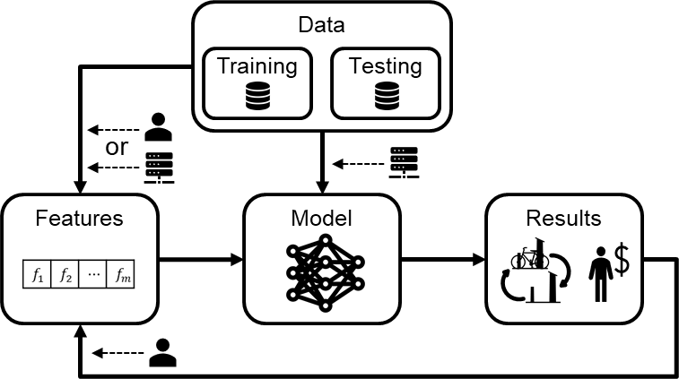
Challenges and Opportunities (Cont’d)
Machine Learning (ML)
Effectiveness
  Learning from a large data set
  Challenges: biased samples,
  data sparsity, data missing
Robustness
  Performance deviation due
  to the data perturbation
Explainable AI
  Hybrid approach

Slide 25
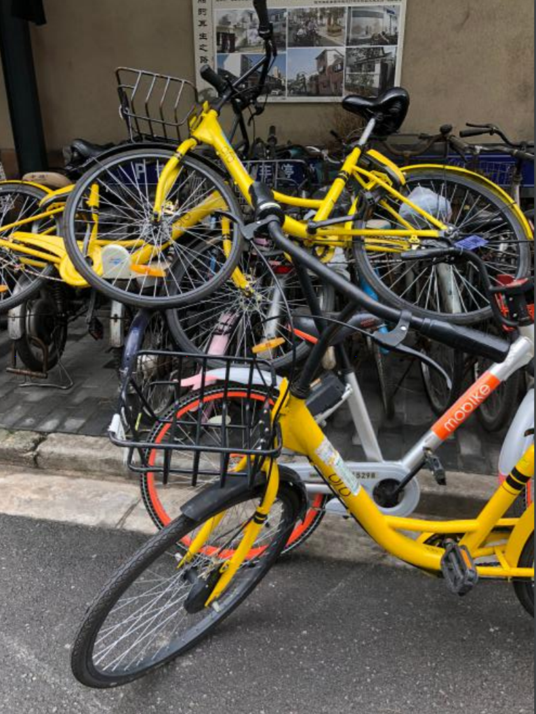
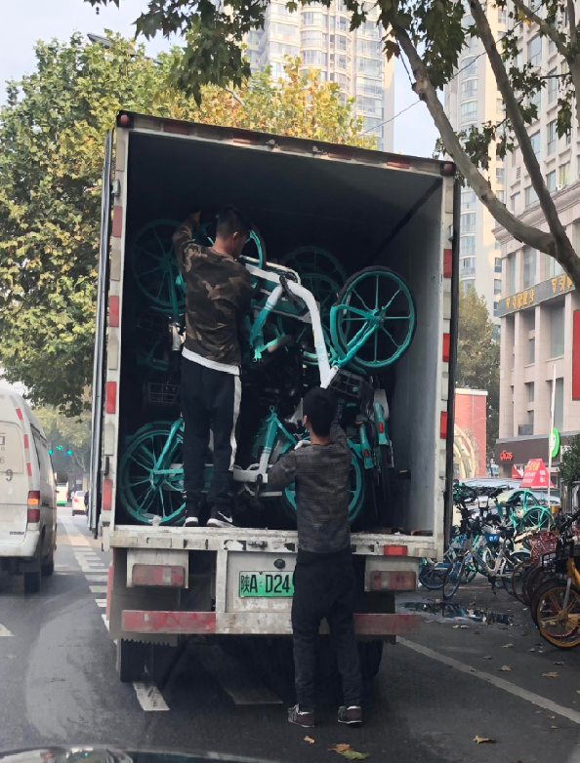
Challenges and Opportunities (Cont’d)
  Dock vs. dock-less BSS
  Flexibility
  Manageability
Trends
  Dock-less BSSs have disappeared largely in US, JUMP from Uber
  Ofo, the largest dock-less BSS in China, suffered financially

Slide 26
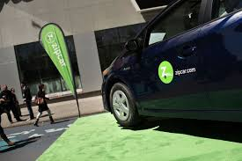
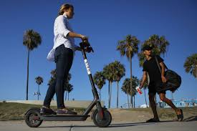
A Bigger Picture: Classification
Active transportation
Fixed (subway, bus, auto-shuttle)
On-demand (taxi, Uber, DiDi, Lift)
Hybrid (restricted on-demand)
Passive transportation
ZipCar (first/last ten-mile)
Bike/e-bike (first/last mile)
Scooter/e-scooter (first/last mile)
J. Wu et al, Logarithmic Store-Carry-Forward Routing in MANETs, IEEE Trans.
on Parallel and Distributed Computing, Aug. 2007..

Slide 27
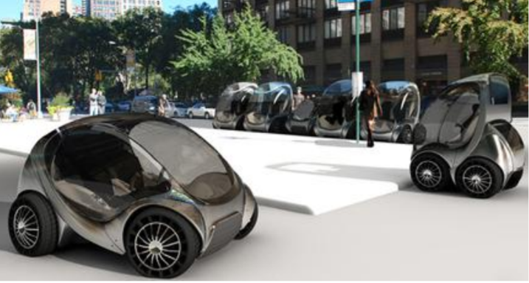
A Bigger Picture: Future of BSSs
Future
E-bike
Two-wheeled e-scooters
Policy
Shared responsibility
  Credit systems
Safety and regulation
  Sidewalk, bike lanes, and car lanes
  Scooter: sidewalk or bike lane?
  How about folded-mini cars
  (MIT’s CityCar Project)?
  Regulation to enhance rebalancing?

Slide 28
7. Conclusions
Bike Sharing Systems (BSSs)
  Bike re-balancing issue
Solutions
  Algorithmic solutions
  ML solutions with data analytics
Future of BSSs
  Policies and regulations
  Role in a smart-city ecosystem

Slide 29

Questions
J. Wu, Challenges and Opportunities in Algorithmic Solutions for Re-balancing
in Bike-Sharing Systems, Tsinghua Science and Technology, 2020.

