Slide 1
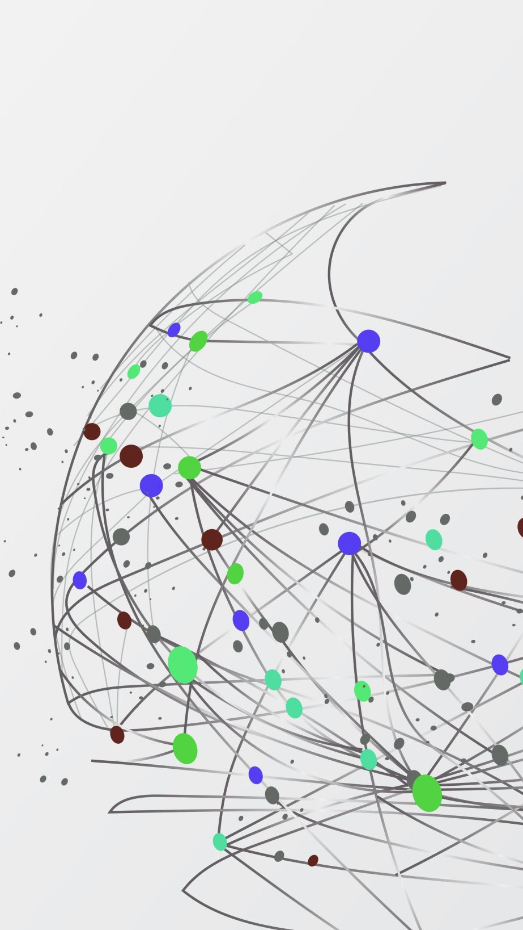
Beyond the Teacher–Student Paradigm: The Role of Network Structure in Knowledge Distillation
Nasif Fahmid Prangon and Jie Wu
Department of Computer and Information Sciences
Temple University, USA
International Conference on Computing, Networking and Communications (ICNC 2026)
Notes:
Today I’ll present our work on topology-aware knowledge distillation.
This work addresses a fundamental limitation in how traditional knowledge distillation is designed.
It assumes a static, one-shot teacher–student interaction.
But in distributed environments, learning does not happen in isolation.
It happens over networks — and network structure fundamentally shapes how knowledge spreads.

Slide 2
Outline
• Motivation and Problem Setting
• From Static KD to Networked Distillation
• Topology-Aware Learning Framework
• Dynamic Reinforcement Strategy
• Theoretical Insights on Diffusion
• Experimental Evaluation
• Conclusions and Future Directions
Notes:
I’ll first motivate the problem and explain why traditional knowledge distillation is limited in distributed settings.
Then I’ll introduce our topology-aware framework and dynamic reinforcement strategy.
After that, I’ll briefly discuss the theoretical intuition behind diffusion in networks.
Finally, I’ll show experimental results and conclude.

Slide 3
Motivation: The Limitation of Traditional KD
Traditional Knowledge Distillation
• Single teacher → single student
• One-shot interaction
• Static supervision
• Assumes continuous teacher availability
But Real Systems Are Different
• Teacher may be intermittently available
• Students operate in distributed environments
• Communication happens over structured networks
• Learning must continue even without the teacher
Notes:
Knowledge distillation is traditionally designed as a simple teacher–student interaction.
This works well when the teacher is continuously available and communication is centralized.
But in distributed and edge systems, the teacher may not always be reachable.
Students are connected through a communication network.
So we must ask:
How can learning continue efficiently when supervision is limited?

Slide 4
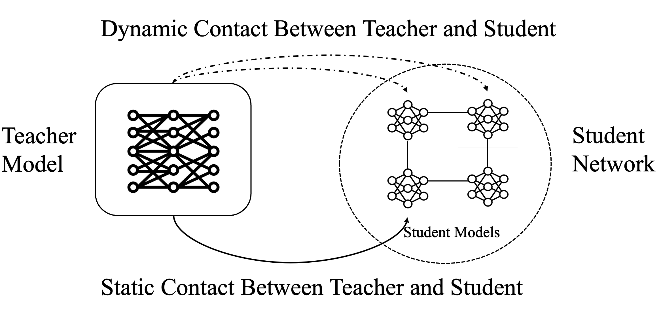
From Static Contact to Dynamic, Networked Distillation
• Static KD relies on one-shot supervision.
• Learning halts when teacher access is limited.
• We introduce multi-round dynamic reinforcement.
• Knowledge propagates through the student network in the form of peer-to-peer distillation.
Notes:
We just discussed why static knowledge distillation becomes problematic in distributed environments.
In traditional knowledge distillation, the teacher supervises the student directly, typically in a single interaction. This is what we refer to as static contact.
This approach assumes that the teacher is continuously available and that communication is centralized.
However, in distributed or edge systems, the teacher may not always be reachable due to bandwidth, power, or computational constraints.
To address this limitation, we introduce dynamic contact. Instead of relying on one-shot supervision, the teacher selectively reinforces certain students over multiple rounds.
Once reinforced, knowledge propagates through peer-to-peer interactions across the student network.
This allows learning to continue even when direct teacher supervision is limited.
However, once we introduce a network structure, the speed and uniformity of knowledge propagation depend on the topology itself.
So the next question becomes: how does network structure affect distillation dynamics?

Slide 5
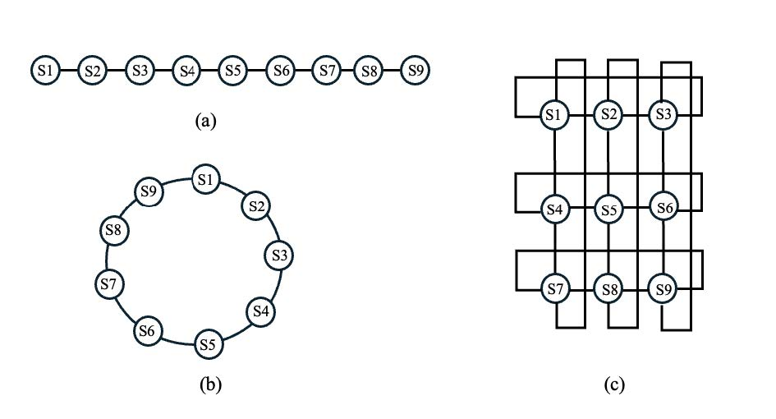
How Does Network Structure Affect Knowledge Diffusion?
• Knowledge spreads hop-by-hop across the graph
• Diffusion speed depends on shortest-path distances
• Diameter upper-bounds full network propagation
• Lower diameter → Faster and more uniform convergence
• (a) Line topology — large diameter, long propagation paths
• (b) Ring topology — reduced diameter, bidirectional flow
• (c) Torus topology — minimal diameter, high connectivity
Notes:
Once we introduce a student network, knowledge propagates hop by hop.
This means the time required for information to reach all students depends on the shortest-path distances in the graph.
One key metric is the diameter, which is the longest shortest path between any two nodes.
In a line topology, information must travel across many hops.
In a ring, the distance is reduced.
In a torus, every node is within two hops, enabling much faster diffusion.
So lower diameter leads to faster and more uniform convergence across students.
This shows that topology is not just a communication structure — it directly shapes learning dynamics.

Slide 6
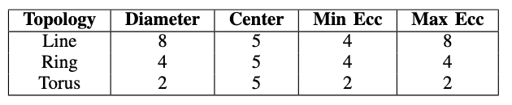
Topology and Graph Metrics
• Diameter bounds worst-case diffusion time
• Eccentricity determines node-level influence radius
• Line topology is structurally imbalanced and reinforcement-sensitive
• Ring topology is symmetric and more robust
• Torus topology minimizes both diameter and eccentricity
• Compact topologies enable faster and more uniform convergence
Notes:
In our framework, students are connected through a predefined topology.
We analyze several graph-theoretic metrics to characterize how knowledge diffuses.
The diameter represents the longest shortest-path distance in the network.
The eccentricity of a node measures how far that node is from the farthest student.
From the table, we see that the line has diameter 8, the ring reduces it to 4, and the torus reduces it to 2.
This structural difference directly bounds diffusion speed.
These metrics allow us to reason formally about convergence behavior.

Slide 7

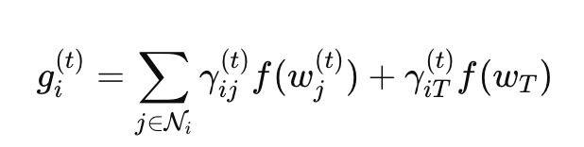


Problem Formulation
Student Objective
Where:
First term: supervised learning
Second term: distillation from peers + teacher
$α$: trade-off parameter
Distillation Target
Where:
• $𝒩_{i}$: neighbors of student $i$
• $γ$: topology-aware weighting
• Teacher influence is selective
Notes:
We now formalize the learning objective.
Each student minimizes a combination of supervised and distillation loss.
The first term is the standard cross-entropy loss with ground-truth labels.
The second term is a KL divergence that aligns the student with its distillation target.
The key difference in our framework lies in how we define that target.
Instead of distilling only from the teacher, each student aggregates outputs from its neighbors and, if selected, from the teacher.
The aggregation weights are topology-aware and sum to one.
This formulation embeds the network structure directly into the learning dynamics.

Slide 8
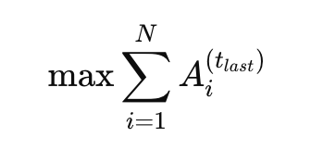
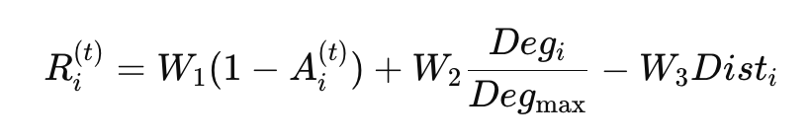
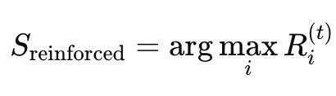
Reinforcement Strategy and Optimization Objective
Global Objective
Maximize final student accuracy
Selection Rule
• Reinforce highest-scoring student each round
Reinforcement Score
• First term: improvement potential
• Second term: structural influence (degree / centrality)
• Third term: communication cost based on eccentricity
Notes:
Now we define how the teacher selects which student to reinforce.
Our objective is to maximize the total final accuracy across all students.
Since teacher supervision is limited, we compute a reinforcement score.
The first component favors students with lower accuracy — meaning higher improvement potential.
The second component favors structurally influential nodes.
The third component penalizes communication cost.
The student with the highest reinforcement score is selected.
This creates a dynamic and topology-aware reinforcement process.

Slide 9
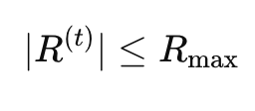
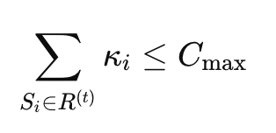
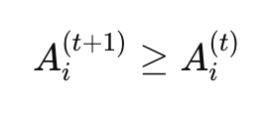
Global Optimization Objective and Constraints
Reinforcement Budget Constraint
Limited teacher supervision per round
Communication Constraint
Total reinforcement cost must respect communication budget
Monotonic Learning Assumption
Learning should be non-decreasing over rounds
Global Objective
Maximize final student accuracy
Notes:
We now define the system-level objective.
Our goal is to maximize the total final accuracy of all students.
However, teacher reinforcement is limited.
At each round, only a small subset of students can be reinforced.
Additionally, reinforcement incurs communication cost, which must respect a budget.
Thus, reinforcement becomes a constrained optimization problem.
This formalizes the dynamic and resource-aware nature of our framework.

Slide 10
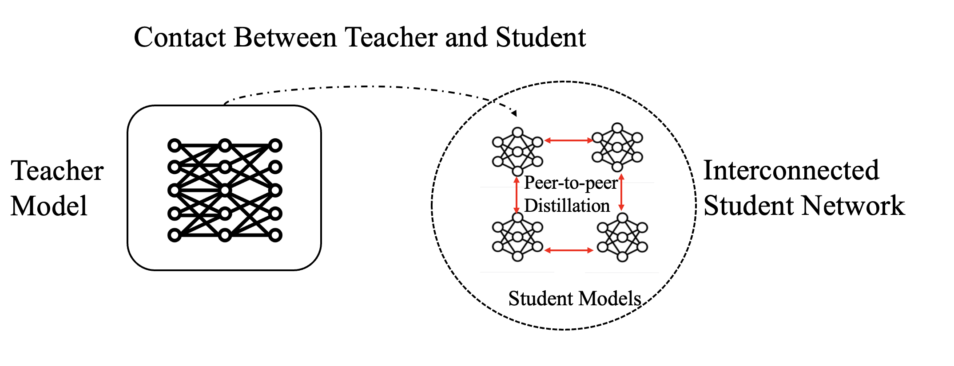
Peer-to-Peer Propagation Mechanism
• Teacher reinforces one student
• Reinforced node updates with teacher supervision
• Knowledge spreads hop-by-hop
• Each round propagates one structural layer outward
Notes:
After reinforcement, knowledge does not instantly reach all students.
Instead, propagation occurs locally.
Each student aggregates outputs from its neighbors.
So if a reinforced node updates at round t, its neighbors benefit at round t+1.
Their neighbors benefit at round t+2.
Thus, diffusion occurs hop-by-hop across the topology.
This means the number of rounds required for full diffusion depends on structural distance.
So topology directly controls propagation dynamics.

Slide 11



Theoretical Diffusion Properties
Property 1
Knowledge propagates one hop per round
Property 2
Full diffusion time equals eccentricity of reinforced node
Theorem 1
Eccentricity upper-bounded by diameter
Notes:
Since propagation occurs hop-by-hop, a student that is k hops away from the reinforced node requires at least k rounds to receive updated knowledge.
Therefore, the number of rounds required for full diffusion equals the eccentricity of the reinforced node.
Because eccentricity is upper-bounded by the graph diameter, we obtain:
The total diffusion time is bounded by the diameter.
This formally explains why lower-diameter topologies converge faster.

Slide 12
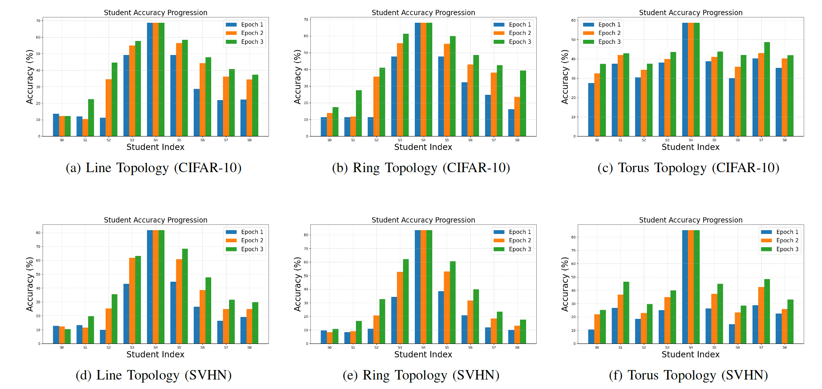
Simulation Results
Student accuracy progression across epochs for different topologies
Notes:
We evaluate our framework on CIFAR-10 and SVHN.
We use a ResNet-50 as the teacher and multiple ResNet-18 students.
Students are arranged in structured topologies: line, ring, and torus.
At each round, one student is reinforced using our score-based selection strategy.

Slide 13
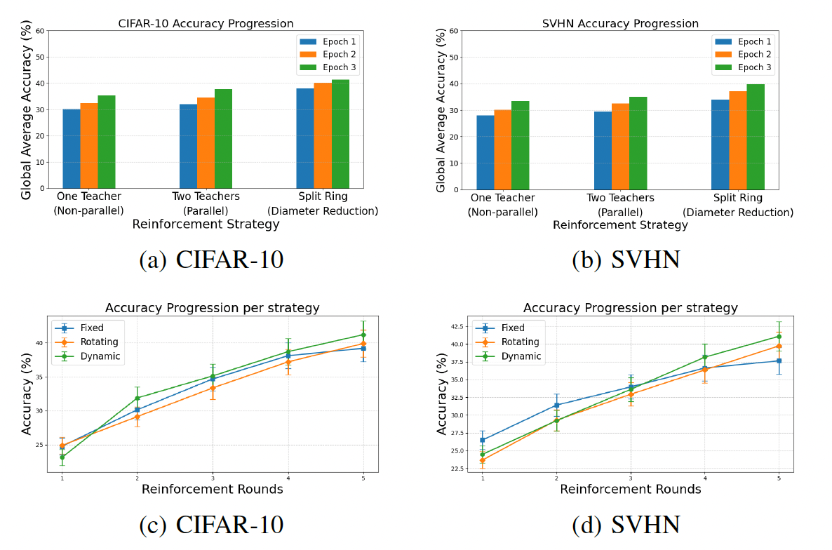
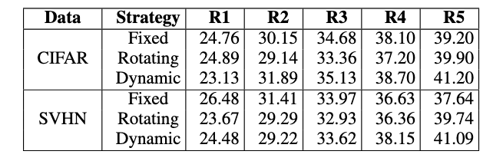
Simulation Results
Global Accuracy per Round Across Strategies
Accuracy trends: (a–b) show the effect of decreasing diameter on ring topology;
(c–d) compare fixed, rotating, and dynamic reinforcement on a line topology.
Notes:
We evaluate our framework on CIFAR-10 and SVHN.
We use a ResNet-50 as the teacher and multiple ResNet-18 students.
Students are arranged in structured topologies: line, ring, and torus.
At each round, one student is reinforced using our score-based selection strategy.

Slide 14
Key Experimental Insights
• Convergence speed strongly correlates with graph diameter
• Torus topology (D = 2) achieves fastest and most uniform diffusion
• Parallel reinforcement reduces effective propagation distance
• Dynamic reinforcement consistently yields highest global accuracy
• Results are consistent across CIFAR-10 and SVHN
Notes:
Across all experiments, we observe a consistent structural pattern.
Lower-diameter topologies converge faster and more uniformly.
The torus topology, with the smallest diameter, consistently outperforms line and ring.
Parallel reinforcement reduces propagation distance, accelerating diffusion.
Most importantly, dynamic reinforcement achieves the best global performance.
These results align directly with our theoretical diffusion bounds.

Slide 15
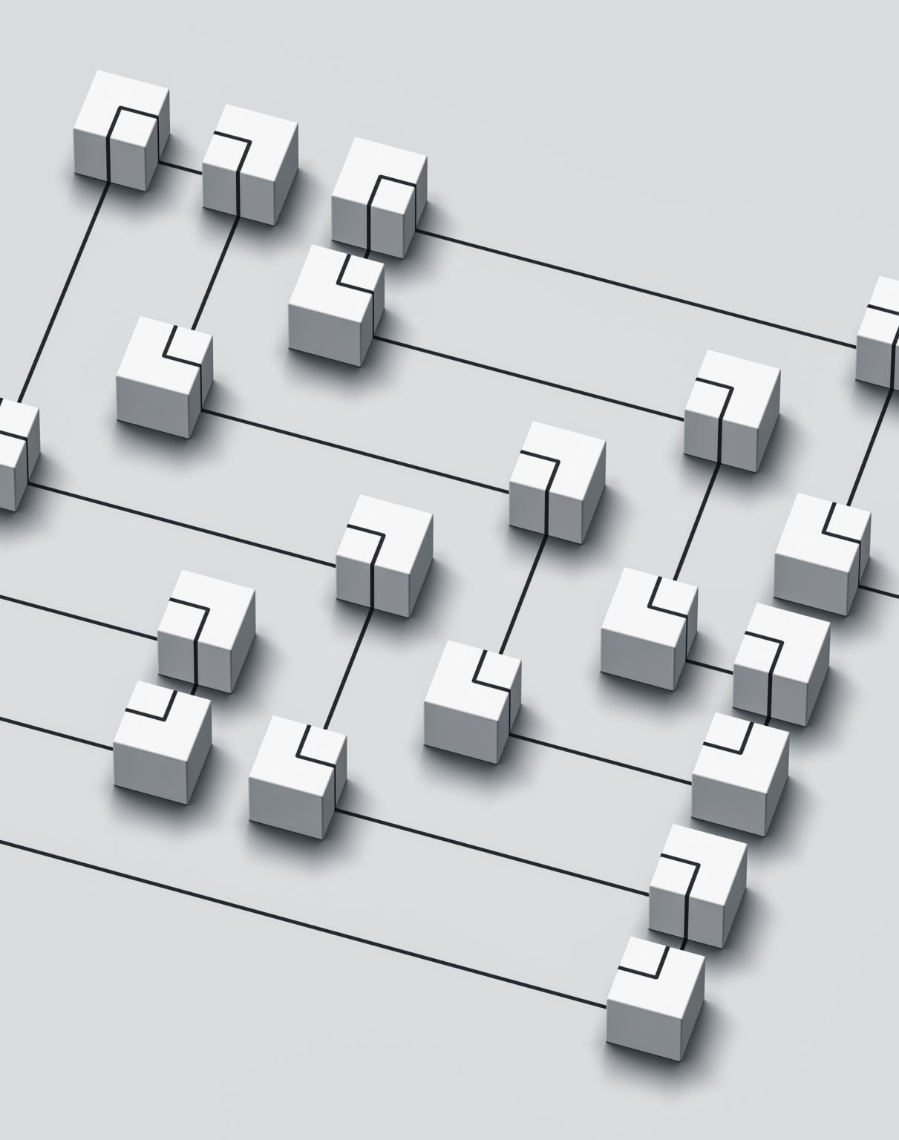
Conclusion & Future Work
Conclusion
• Knowledge distillation is topology-dependent
• Diffusion time is bounded by diameter
• Reinforcement effectiveness depends on node position
• Topology-aware weighting improves convergence efficiency
Future Directions
• Larger and irregular network structures
• Stochastic or unreliable communication links
• Application to federated / edge systems
• Adaptive topology reconfiguration
Notes:
This work shows that knowledge distillation is fundamentally a network diffusion process.
We prove that diffusion time is bounded by graph diameter.
We demonstrate that reinforcement effectiveness depends on node position in the graph.
By incorporating topology-aware weighting, we improve convergence efficiency.
Looking forward, this framework can be extended to larger, irregular, and dynamic networks, and applied to federated and edge learning systems.
Ultimately, topology becomes a design parameter for distributed intelligence.

Slide 16
Thank you!

