Slide 1


ArrayPipe: Introducing Job-Array Pipeline Parallelism for High Throughput Model Exploration
Presenter: Hongliang Li
Hairui Zhao¹, Hongliang Li^{1,2}, Qi Tian¹, Jie Wu³, Meng Zhang¹, Zhewen Xu¹, Xiang Li¹, Haixiao Xu⁴
1 College of Computer Science and Technology, Jilin University, Qianjin street 2699, Changchun, 130012, China
2 Key Laboratory of Symbolic Computation and Knowledge Engineering of the Ministry of Education, Changchun, China
3 Department of Computer and Information Sciences, Temple University, Philadelphia, PA, USA
4 High Performance Computing Center, Jilin University, China

Slide 2
Outline
Background and Motivation
Job Array Pipeline Parallelism and ArrayPipe Framework
Evaluations

Slide 3
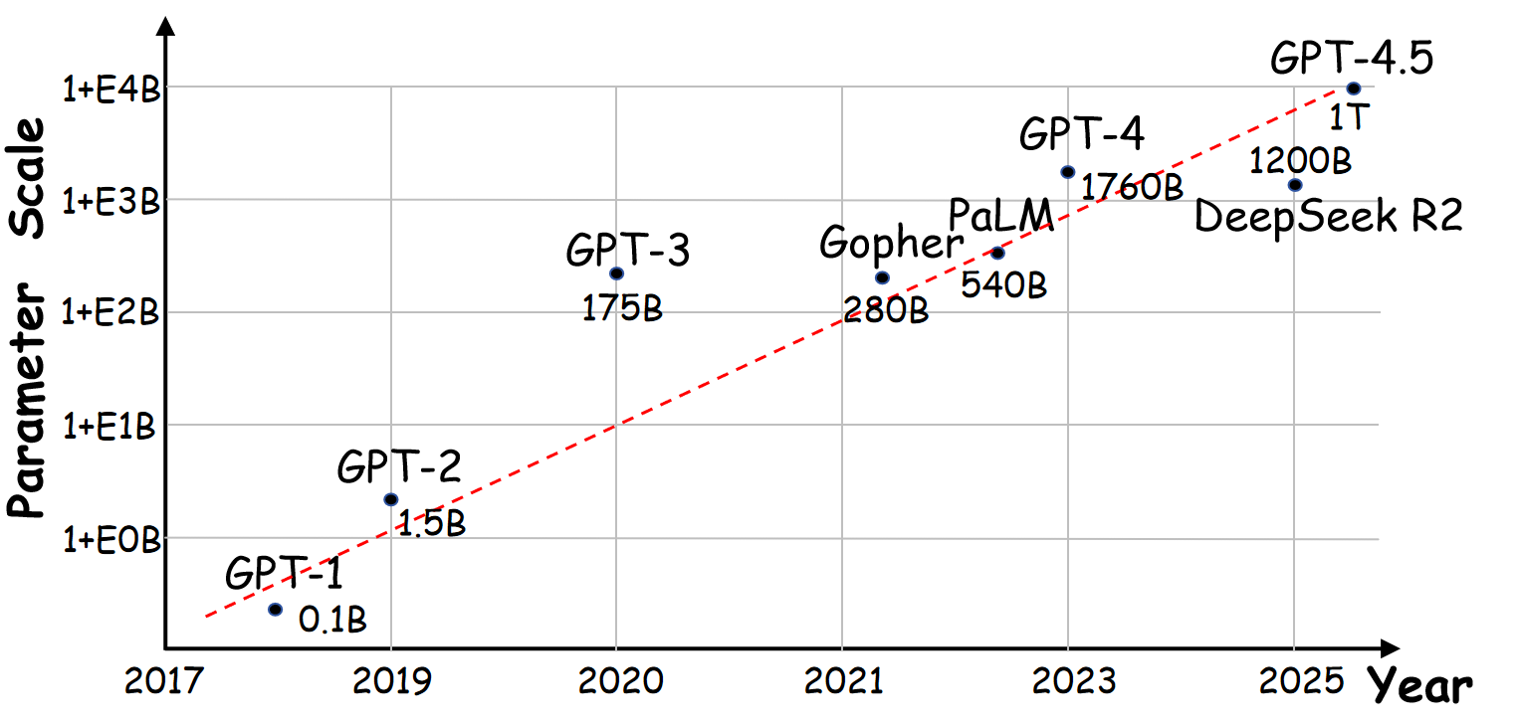
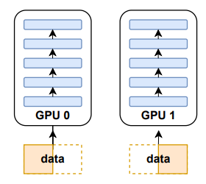
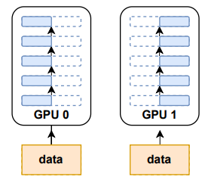
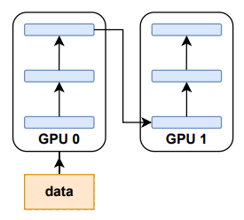
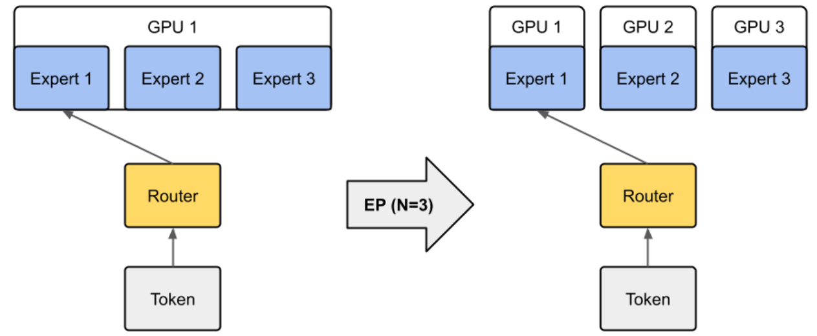
Background (1)
Parallel schemes to accelerate individual DL model training
Data Parallel
Tensor Parallel
Scaling law: bigger model, more data, better result
Dramatic growth in both data volume and model complexity.
Training DeepseekV3 requires 2048 H100 GPUs using 55 days.
Pipeline Parallel
MoE Parallel
[1] Alex Black、Vyacheslav Kokorin. Distributed Deep Learning, Part 1: An Introduction to Distributed Training of Neural Networks

Slide 4
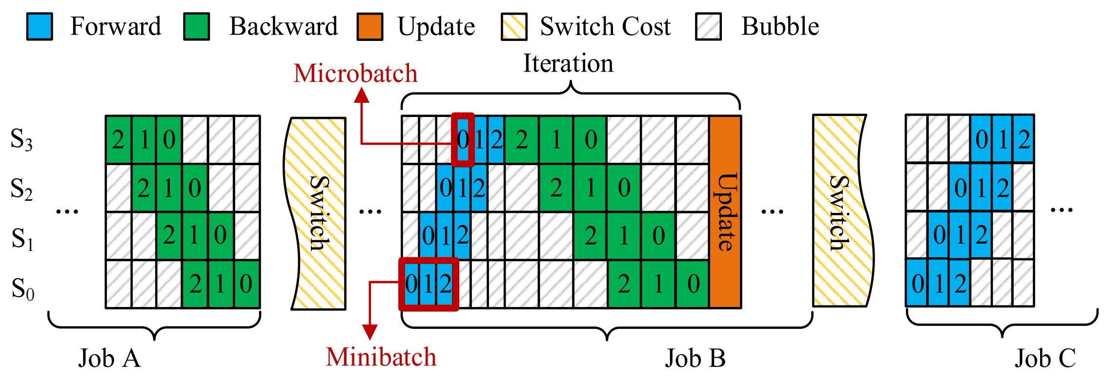
Background (2)
Training jobs are not always independent
The search space for optimal hyperparameter settings can be large (5 hyperparameters with 5 possible values each leads to 3125 configurations).
Babysitting: trying out one setting at a time (one environment)
Batching: Explore multiple settings in parallel (multiple sets of environment)
Idea
Code
Experiment
Circle of model exploration
(Explore hyperparameter settings)
How to accelerate the model exploration process as a whole?
[1] https://xgboosting.com/optimal-order-for-tuning-xgboost-hyperparameters/?utm_source=chatgpt.com

Slide 5
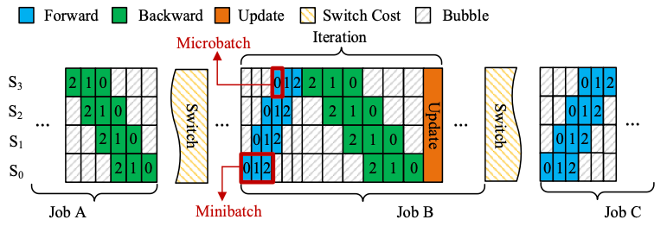
Motivations (1)
How to increase the resource utilization in trainings?
Reducing “bubbles”: divide minibatch to microbatches, pipeline scheduling
Overlapping communication with computation
Context switching in between jobs (100x the duration of an iteration [1])
[1] Z. Bai, et al.,“Pipeswitch: Fast pipelined context switching for deep learning applications,” in USENIX OSDI, 2020
5

Slide 6
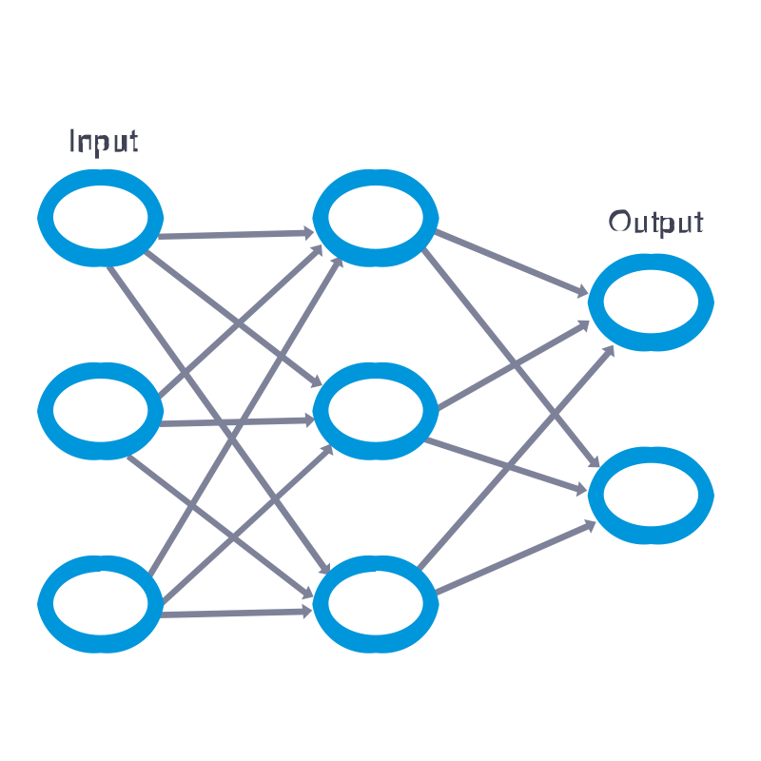
Motivations (2)
Searching hyperparameter involves trail-and-error sibling jobs
share the same core (i.e. model stucture, CUDA Context structure)
vary in hyperparameter configuration (e.g., batch_size, learning_rate, weight_decay...)
Opportunity to pack sibling jobs into a batch (job-array)
Job-Array: a set of Sibling Jobs
Same Model Structure
Different Hyper-Parameter
S₀
S₁
S₂
Job 1
Job N
(512, 0.01
, 0.0005, …)
…
(256, 0.01
, 0.0005, …)
…
…
…
(batch_size, learning_rate,
weight_decay, …)
Job-Array: train concurrently, instead of sequentially
How to seamlessly switch between sibling jobs?
How to efficiently schedule multiple jobs in one pipeline?
6

Slide 7
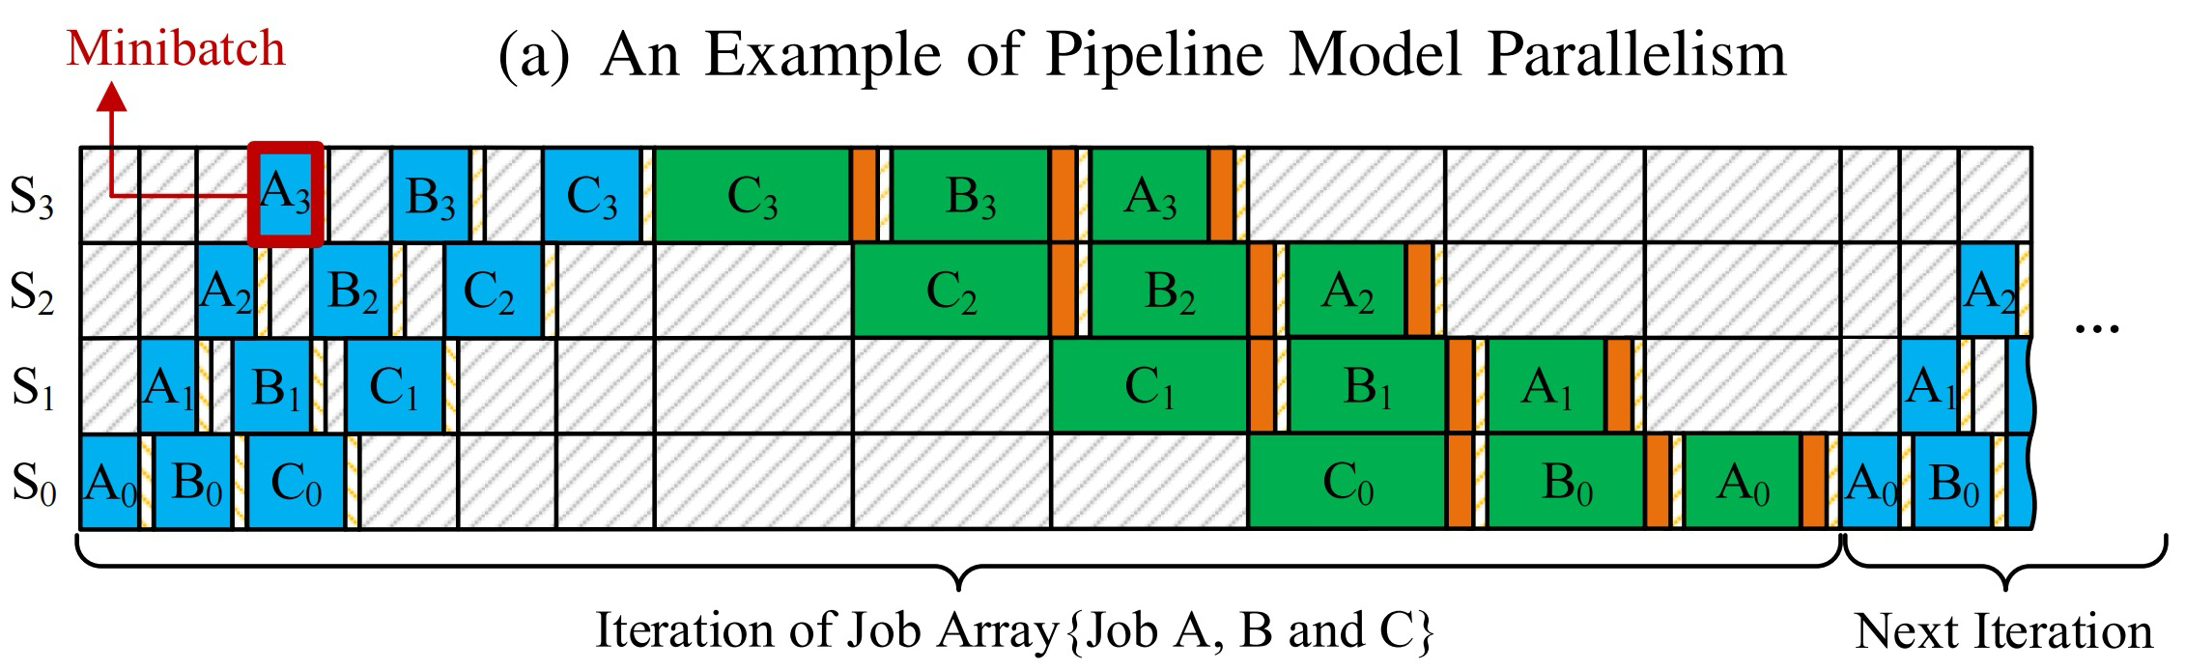
Job-Array Pipeline (JAP) Parallelism
Job-level parallelism for high throughput model exploration
Given a job-array J and a cluster of servers H, JAP is a pipeline parallelism that supports the stages of different jobs in J execute concurrently rather than consecutively.

Slide 8
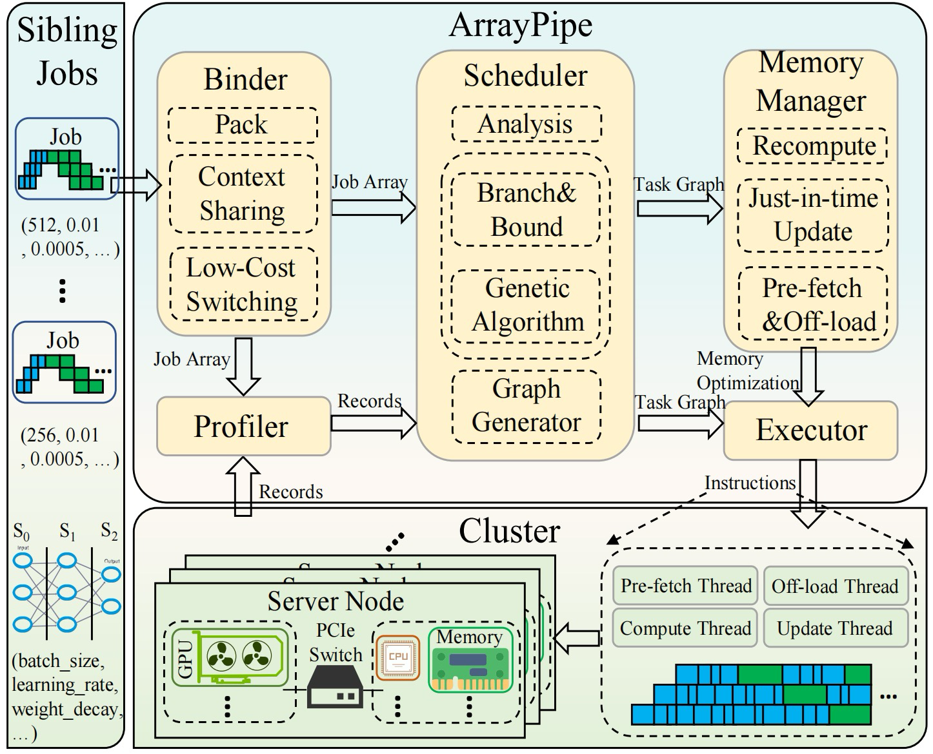
ArrayPipe Framework Overview
Binder regards a batch of sibling jobs as a whole and packs them as a job-array supported by Low-Cost Context Switching (LCS).
Scheduler integrates two algorithms (B&B and Genetic algorithm) to generate the pipeline plans a job-array.
Memory Manager mitigates the memory pressure via re-computation, just in-time updates, memory virtualization, and a dedicated buffer to pre-load model parameters.

Slide 9
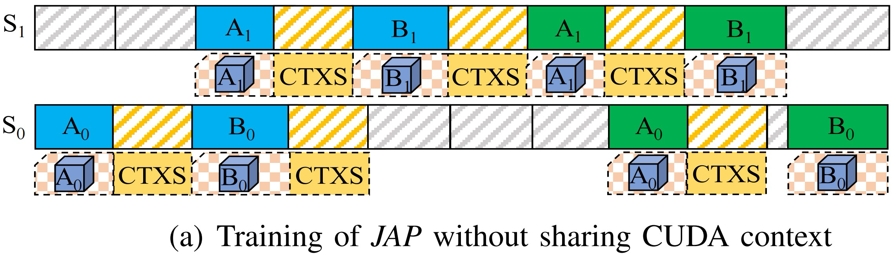
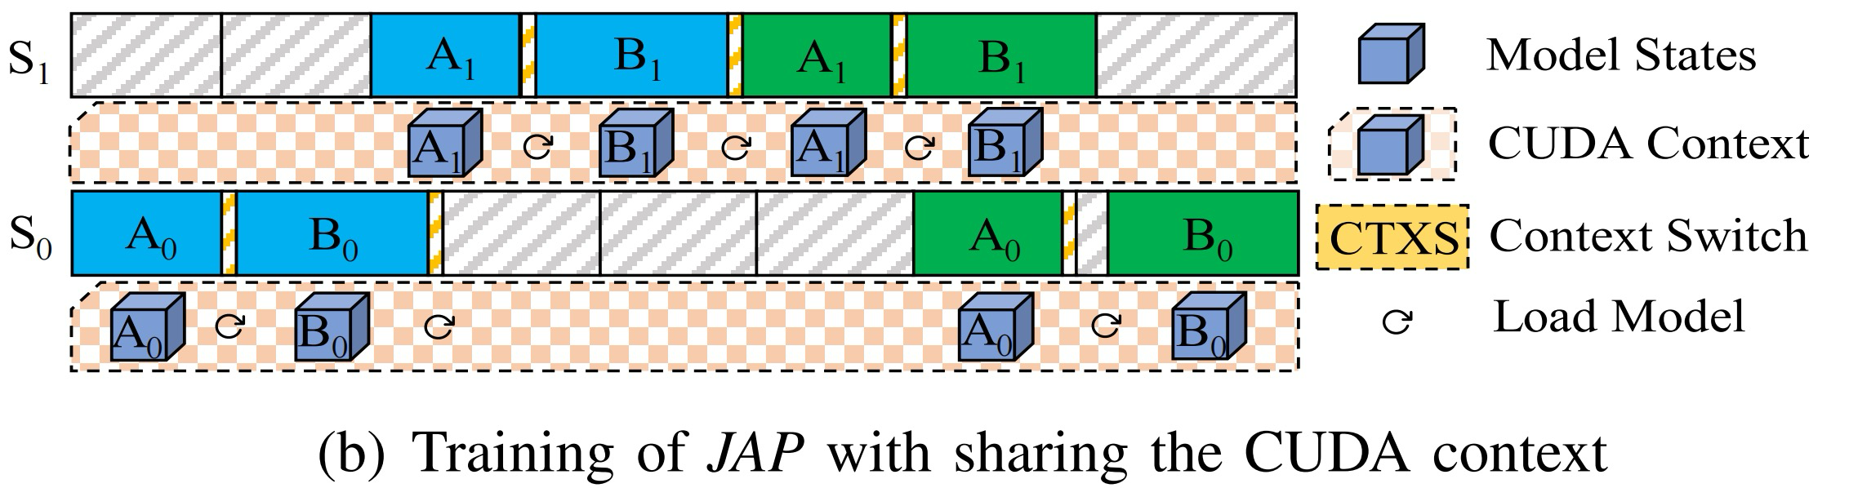
Binder
Challenge 1: How to support low-cost context switching between sibling jobs?
Switching context:
model states
activations
gradients
Training with Binder supported by Low-Cost Context Switching (LCS).
Switching states:
parameter
optimizer

Slide 10
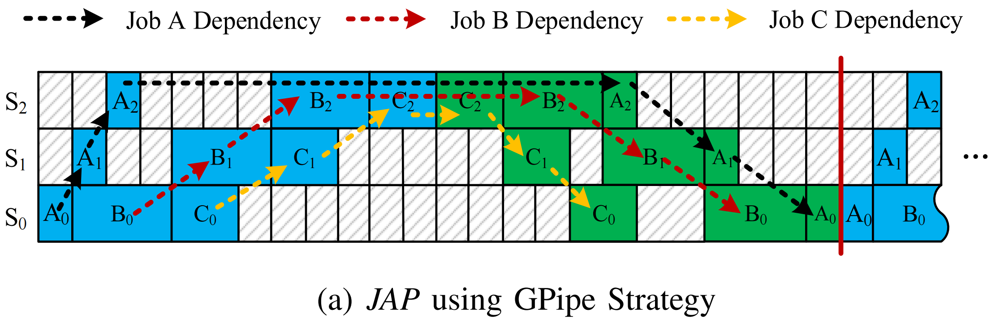
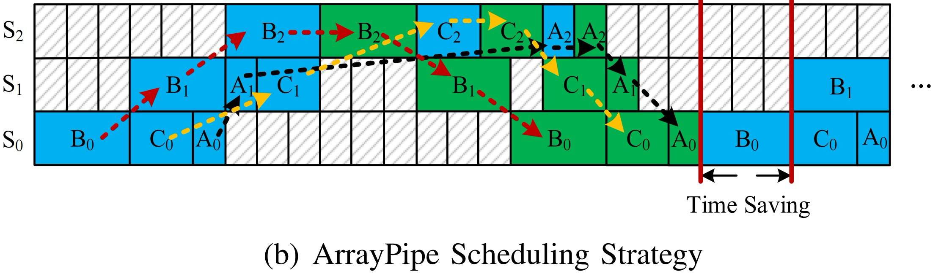
Scheduler
Challenge 2: How to ensure an efficient scheduling when sibling jobs have different mini-batch execution durations and their own stage dependencies?
Sophisticated scheduling algorithms are needed.

Slide 11
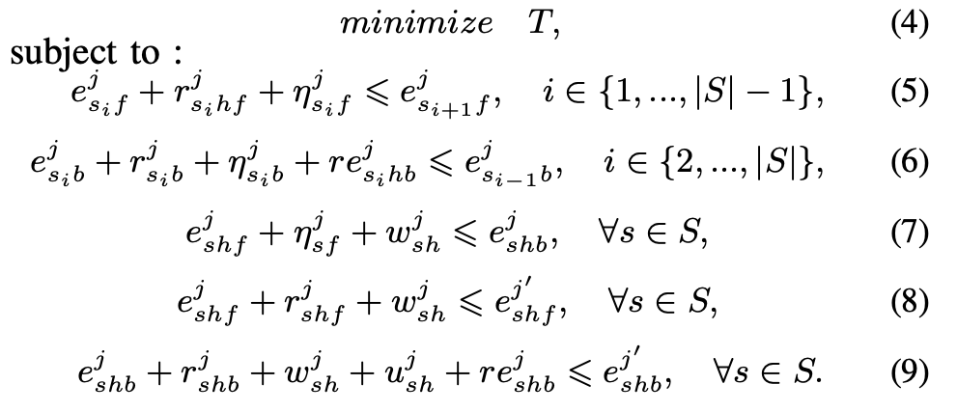
JAP Scheduling Problem
Given a job-array of DL training jobs J, and a cluster of servers H, the JAPSP seeks a schedule of all stages for J on H, with the minimum per-iteration time T, as:

Slide 12
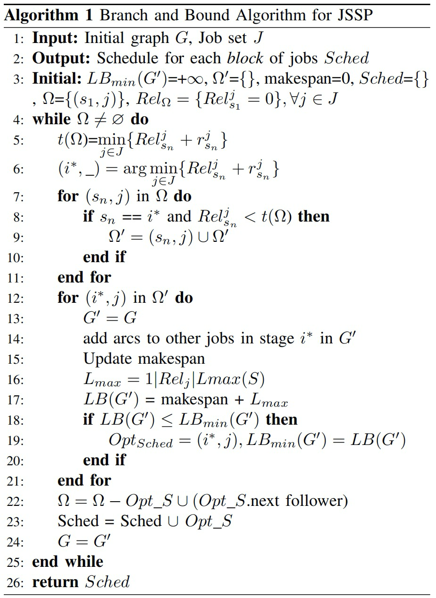
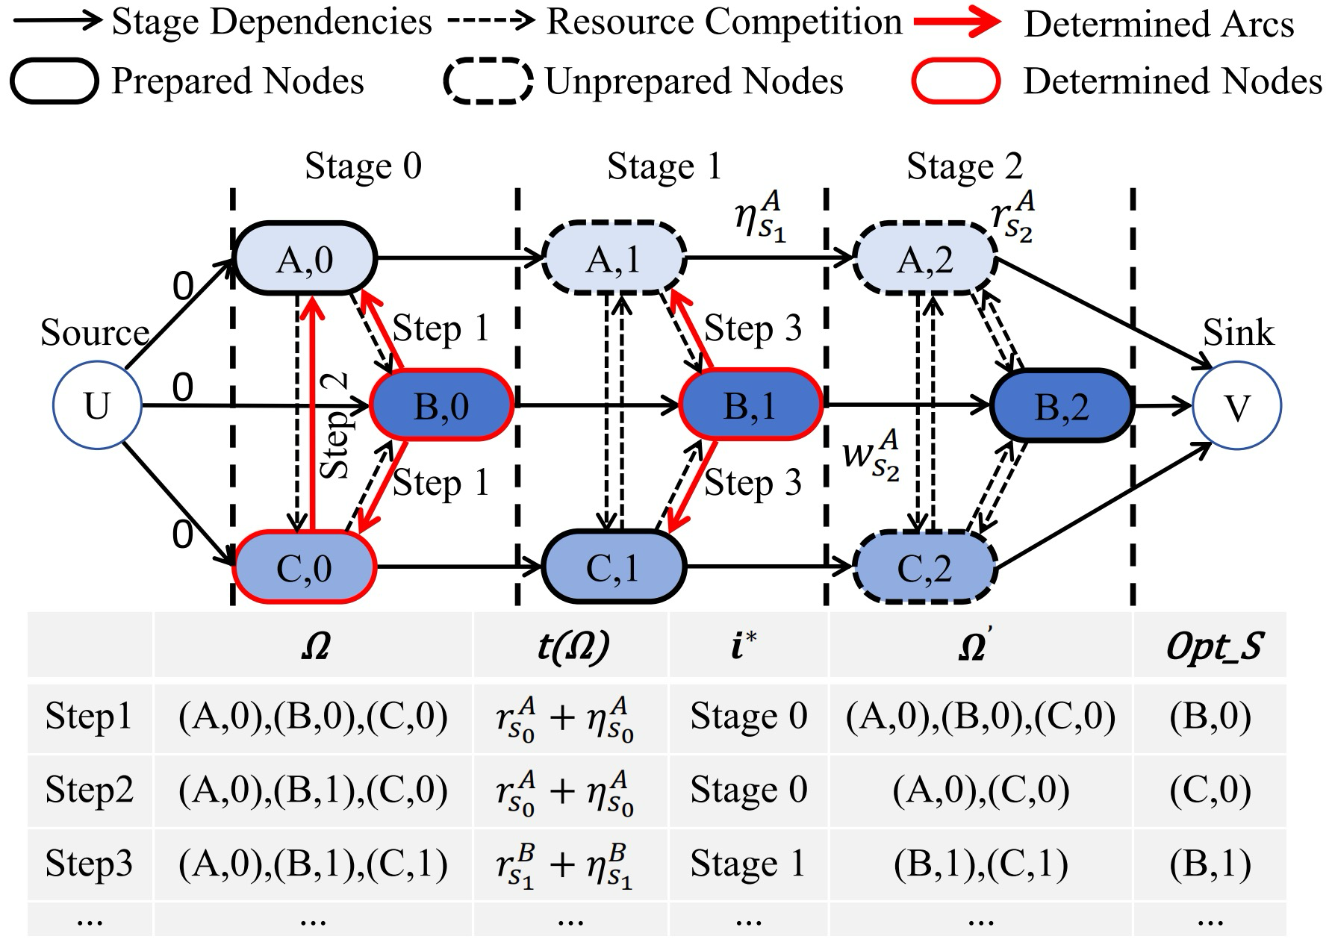
Solving JAPSP
A variant of the Job Shop Scheduling Problem (JSSP), with extra dependencies between model stages
A Branch-and-bound Algorithm and a Genetic Algorithm

Slide 13
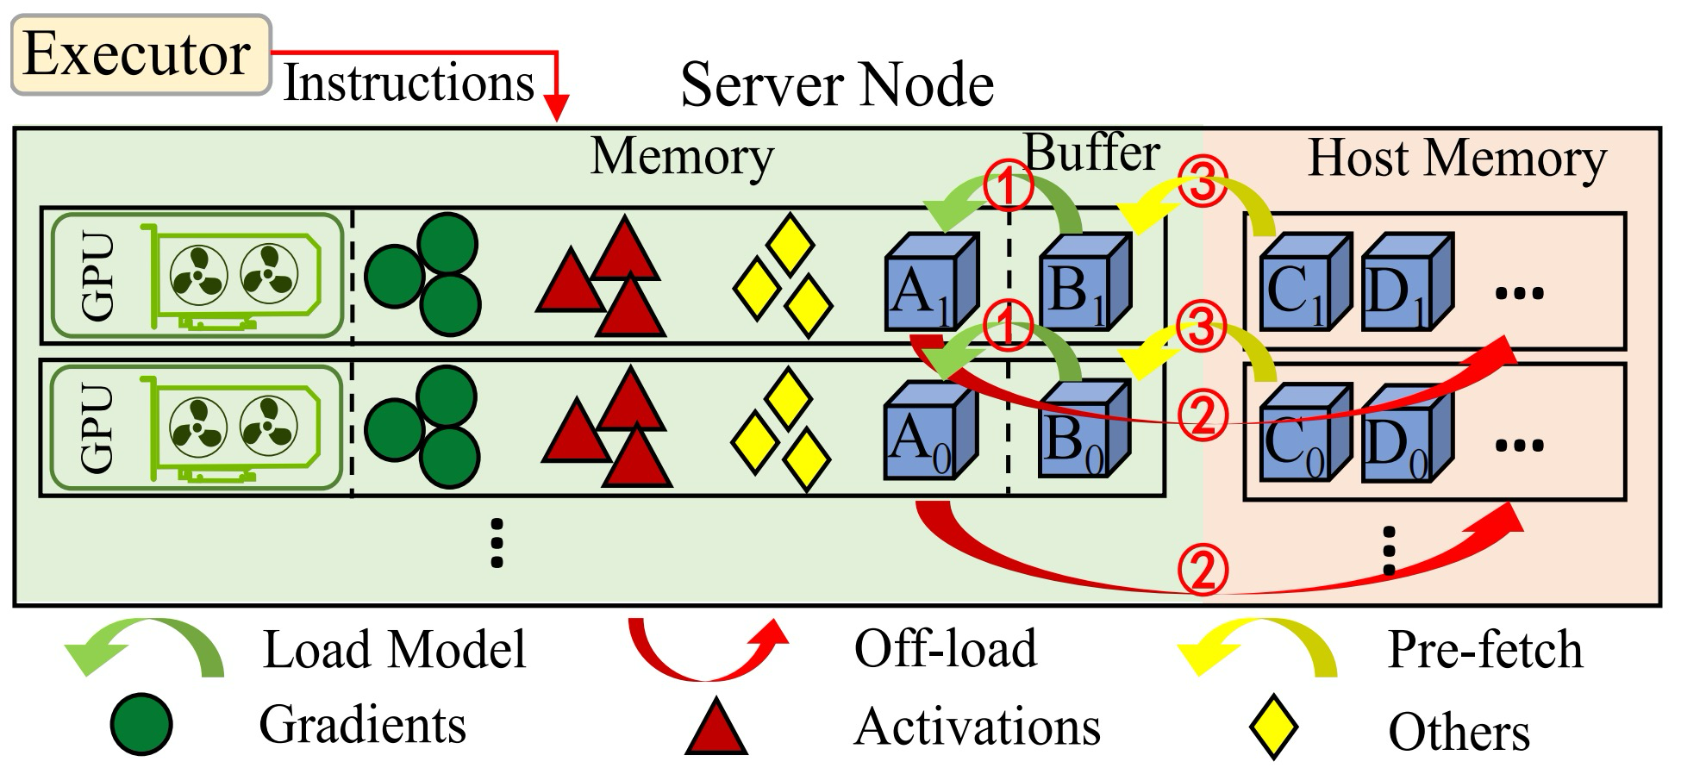
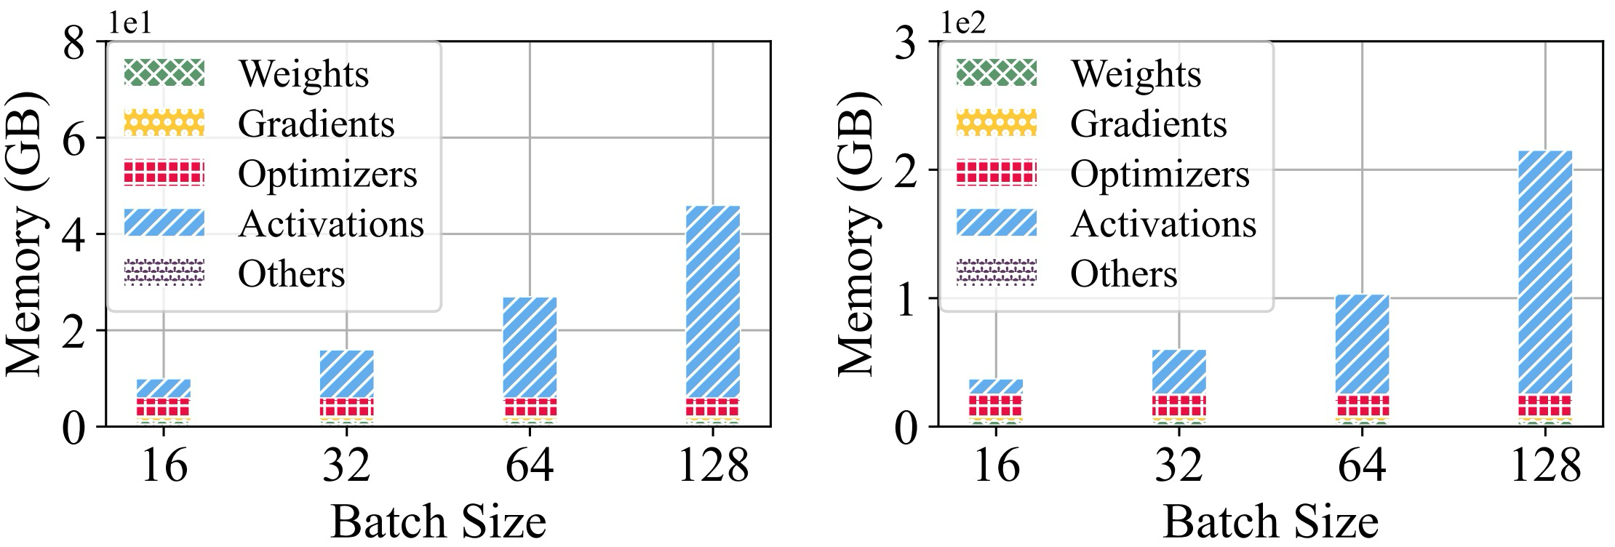
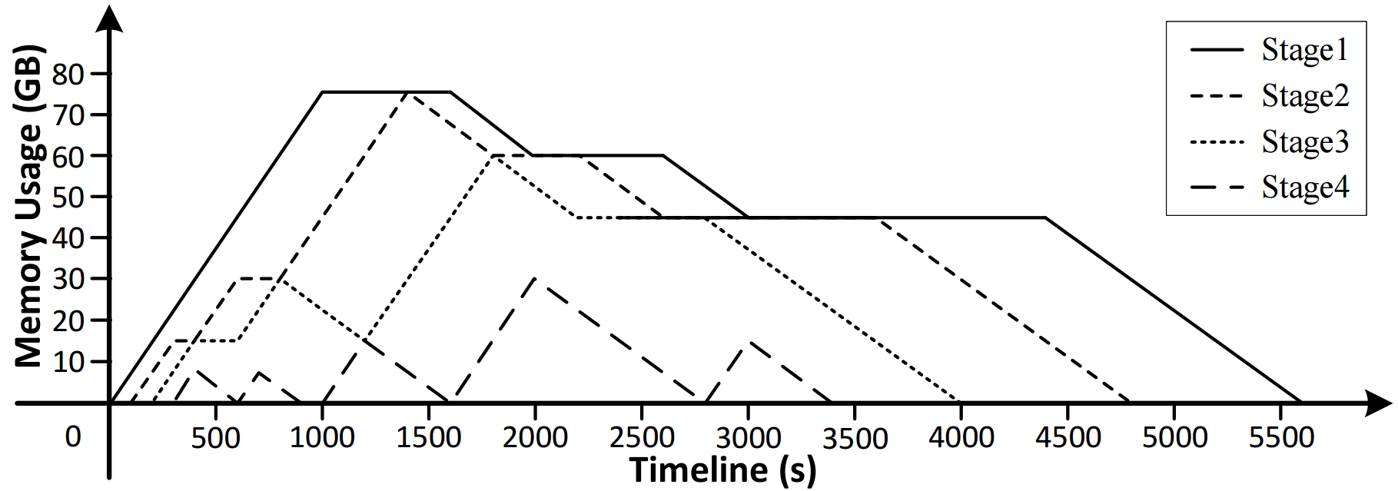
Memory Manager
Challenge 3: How to avoid Out Of Memory (OOM) in JAP when too many sibling jobs are sharing resources?
BERT
GPT-2
Activation memory usage (GPT-2)
Activation account of nearly 60% of the memory footprint
Re-materialization: Eliminate and recompute

Slide 14
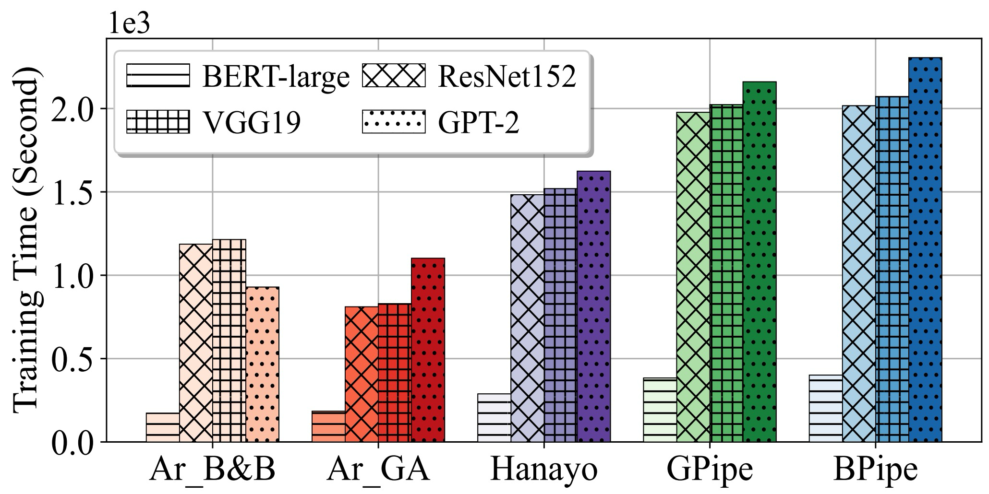
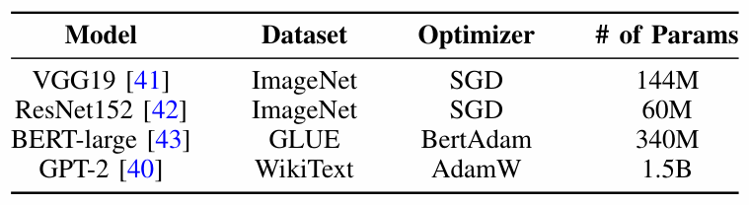
Evaluations
Testbed: NVIDIA SXM4 server with 8 A100 (80GB), NVLink (300GB/s), PCIe4.0 (64GB/s).
Baselines: GPipe, BPipe, Hanayo
DNN Models:
Training Time Comparisons.
ArrayPipe achieves 1.46× training throughput, comparing with State-Of-The-Art (SOTA) PPs, on average.

Slide 15
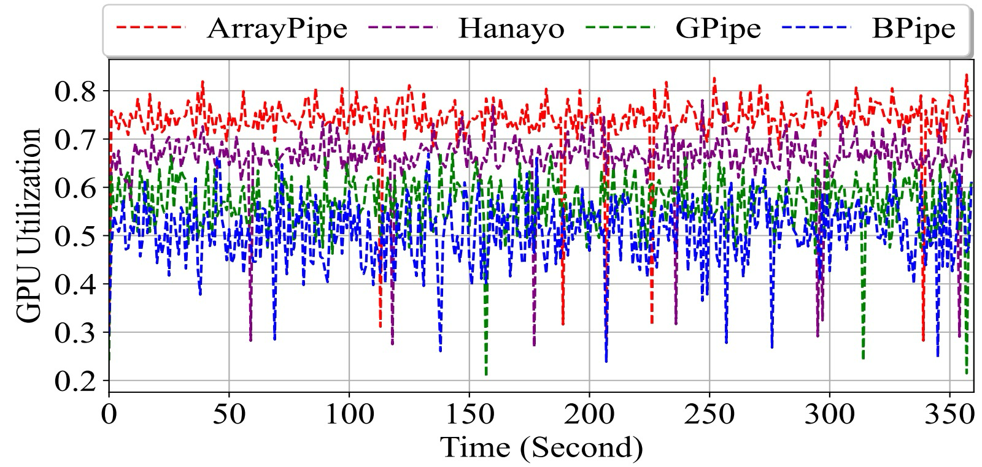
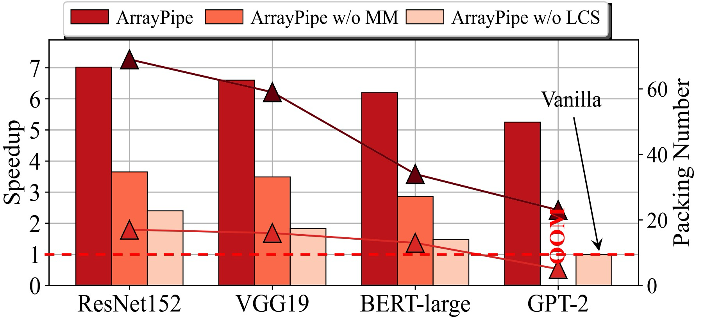
Evaluations
Comparison between whether to use LCS and MM in ArrayPipe.
GPU Utilization.
ArrayPipe achieves high GPU utilization. As more jobs are packed into a job-array, the overall throughput improves.

Slide 16
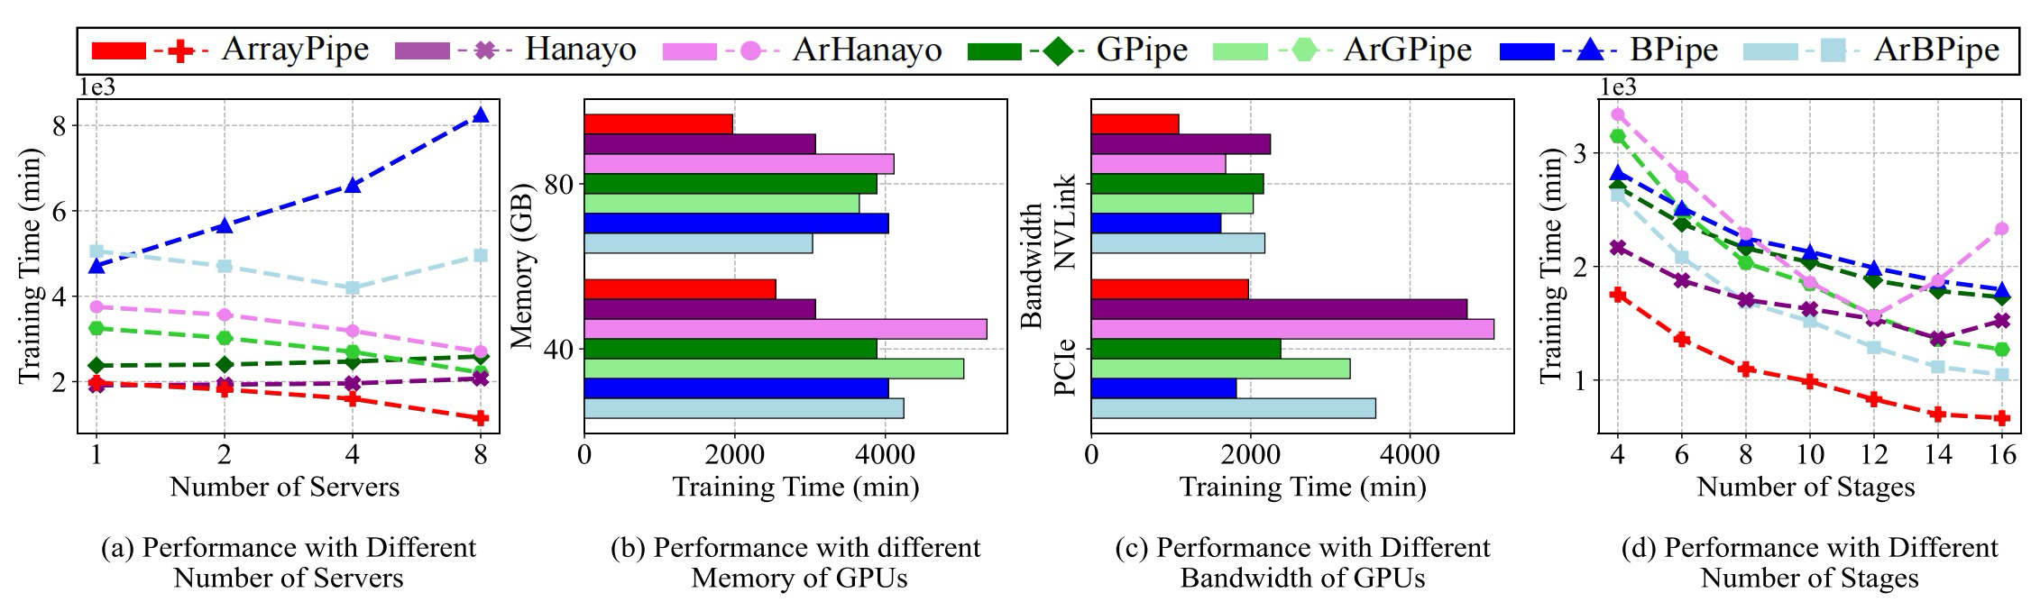
Large-scale Simulation
ArrayPipe is more suitable for environments with larger GPU memory capacity, higher intra-node bandwidth, aligning with the developing trends and application patterns.

Slide 17
Conclusion and Future Work
Conclusion
A novel parallel scheme (JAP) is introduced to enable a batch of sibling jobs to form a concurrent job-array and to execute concurrently, targeting high throughput model exploration.
We design ArrayPipe, a framework to support JAP with low-cost job context switching within a job-array and a GPU-Host memory manager for higher training concurrency.
We propose a novel scheduling problem JAPSP that seeks to minimize the per-iteration time of a job-array, along with two algorithms for different scales of job-arrays.
Extensive testbed experiments and trace-driven simulations are conducted to evaluate the efﬁciency of ArrayPipe.
Future Work
How can ArrayPipe handle exploratory job workflows that frequently terminate and resubmit?
Models with different hyperparameters may benefit from different degrees of parallelism. Fine-grained (layer-wise) LCS and migration is a possible direction.

Slide 18
Thank you
Presenter: Hongliang Li
lihongliang@jlu.edu.cn
College of Computer Science and Technology, Jilin University, Changchun, China, 130012

