Slide 1

Algorithmic Crowdsourcing:
Current State and Future Perspective
Jie Wu
Dept. of Computer and Info. Sciences
Temple University

Slide 2
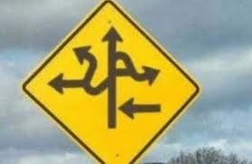
Road Map
  Introduction and Motivation
  Mechanical Turk
  Applications
  Paradigms
  Challenges and Opportunities
  Social Crowdsourcing
  Conclusion

Slide 3
INTRODUCTION
What
Why
Basic components
Motivation examples

Slide 4

Big Data is Everywhere!
Lots of data is being collected:
Volume, Variety, Velocity
  Web data, e-commerce
  Purchases
  Bank/credit card transactions
  Video and images
  Social networks

Slide 5
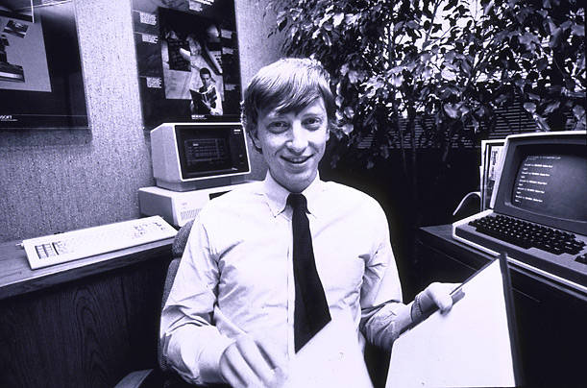
How Much Data?
Google processes 100 PB a day
Wayback Machine has 3 PB + 100 TB/month (3/2009)
WeChat has 600 M users and 20 B message per day
Facebook has 2.5 PB of user data + 15 TB/day (4/2009)
eBay has 6.5 PB of user data + 50 TB/day (5/2009)
640K ought to be enough for anybody.

Slide 6

Big Data Era
“In information technology, big data consists of datasets that grow so large that they become awkward to work with using on-hand database management tools.”
Computers are not efficient in processing certain data (e.g., image processing)

Slide 7

What is Crowdsourcing?
Coordinating a crowd (a large group of people online) to do micro-work (small jobs) that solves problems (that software or one user cannot easily do)
Notes:
The reasons for participating in crowdsourcing:
For fun: game style– put task in certain form of games
For money: tiny dollar, such as Amazon Mturk
based on the quality of results
based on the working time or completed amount

Slide 8
The Benefits of Crowdsourcing
Performance
  Inexpensive
  Fast
Human Processing Unit (HPU)
  More effective than CPU (for some apps)
    Image labeling
    Language translation
    Social network survey
    …
Notes:
CACM Gaining Wisdom from Crowds: (1) 57,000-plus players to discovery the structure of a protein. (2) Wiki Spanish version in just 80 hours by 1M people.

Slide 9
Basic Components
Requester
  People submit jobs
  Human Intelligence Tasks (HITs)
Worker
  People work on jobs
Platform
  Job management
  Amazon Mechanical Turk (MTurk)
Notes:
Requester: work owner; submit work onto a crowdsourcing platform
Workers: a undefined group of users
Platform: usually websites or apps
provides places for publishing work and finding workers
provide payment approach
but get service fee from both requester and workers

Slide 10

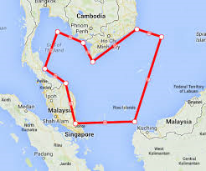
Malaysia Airlines Flight MH 370
DigitalGlobe
  Crowdsourcing volunteers comb satellite photos for Malaysia Airlines jet
March 11 (from a CSU prof. email)
I just saw on our local Denver Fox news (KDVR.com) that a local company, DigitalGlobe, has reoriented their satellites to take high-res images in the area where the plane may have crashed. Crowdsourcing efforts are on to have people scan these images and find signs of debris. I was reminded of Jie Wu's talk earlier this month.
Notes:
In current crowdsourcing platforms, 100,000 tasks can be completed in about 2 days.
We can use satellite image to find and locate the missing boat.
Accuracy: human intelligence
Fast: multiple workers; works in parallel

Slide 11
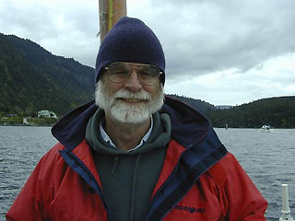
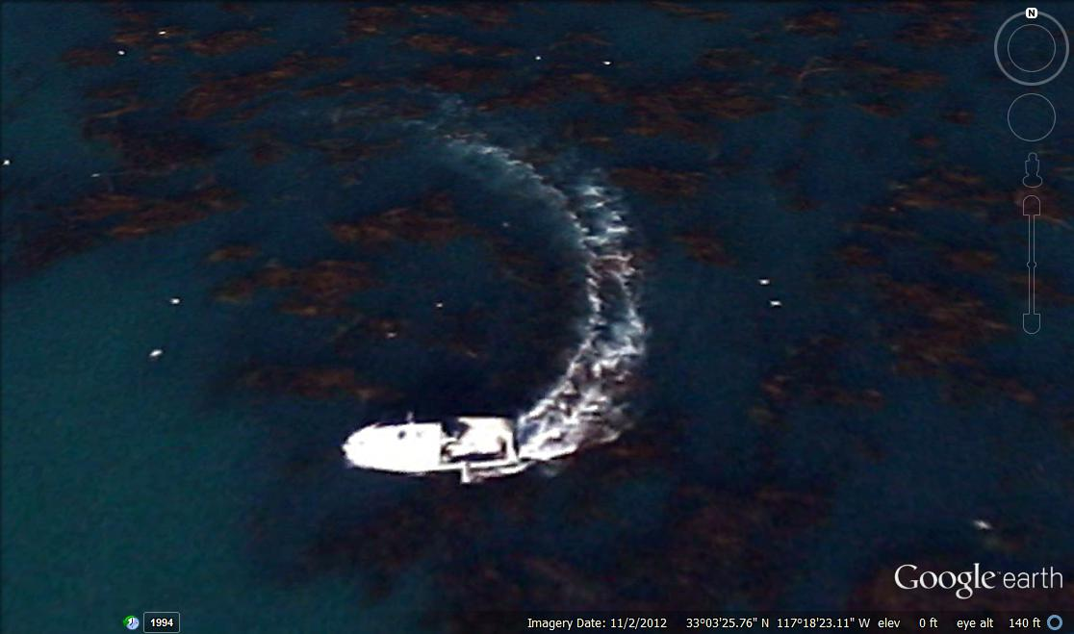
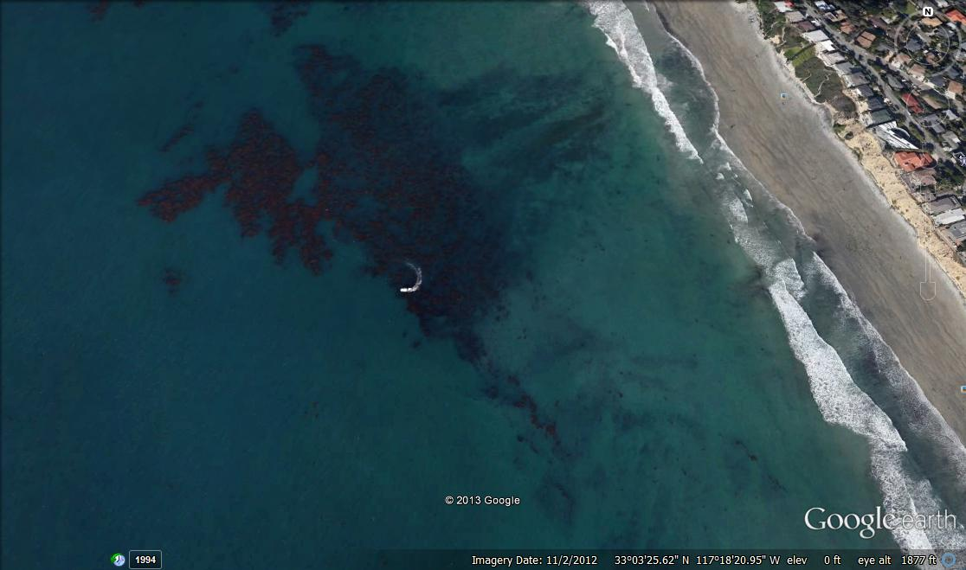
Help Find Jim Gray
Jim Gray, Turing Award winner, went missing with his sailboat outside San Francisco Bay in January 2007.
Use satellite image to search for his sailboat.
Notes:
In current crowdsourcing platforms, 100,000 tasks can be completed in about 2 days.
We can use satellite image to find and locate the missing boat.
Accuracy: human intelligence
Fast: multiple workers; works in parallel

Slide 12
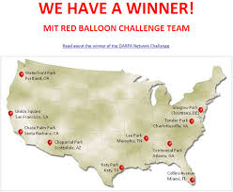

DARPA Network Challenges
Problem (2009): $40,000 challenge award for the first team to find 10 balloons.
MIT team won under 9 hours.
Winning strategy
  $2,000 per balloon to the first person to send the correct location
  $1,000 to the person who invited the winner
  $500 to whoever invited the inviter
  … (or to charity) …
Notes:
Special point: how to design the rewarding scheme

Slide 13
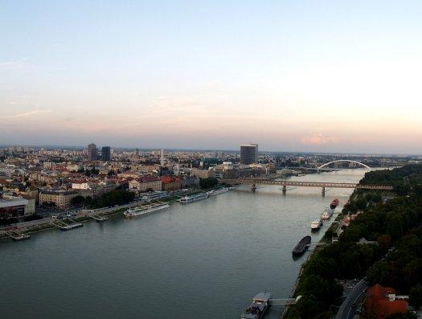
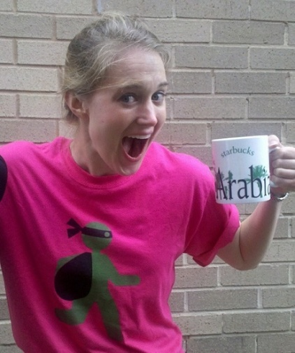
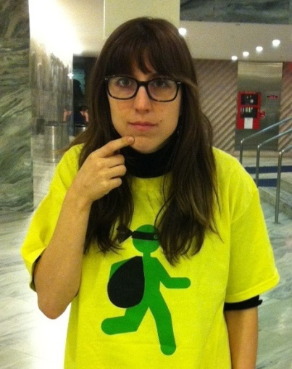
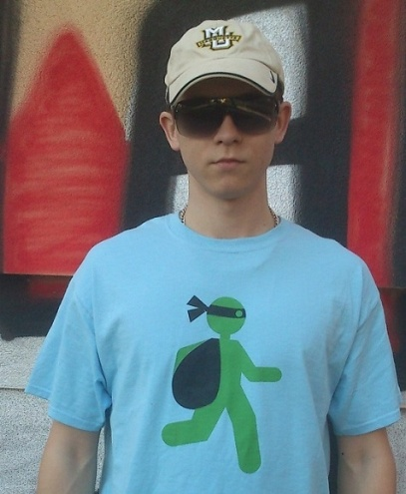
Tag Challenges
Problem (March 31, 2012): Find five suspects in Washington, D.C., New York, London, Stockholm, and Bratislava.
Winner from UCSD CrowdScanner: located 3 of the 5 suspects.
Winning strategy: same as MIT. Also, recruiters of the first 2,000 get $1.
Washington DC
New York City
Bratislava

Slide 14
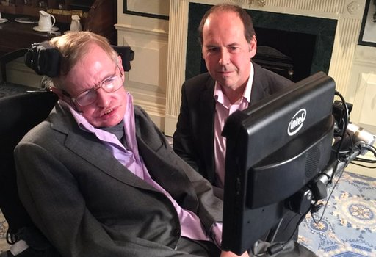



AI Could End Human Race (Stephen Hawking)
Stephen Hawking
  "Humans, who are limited by slow biological evolution, couldn't compete, and would be superseded.“
Recent movies
  Her (2014) & Ex-Machina (2015)

Slide 15
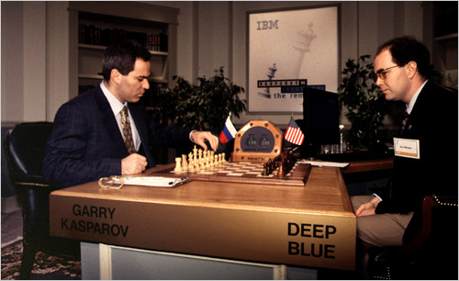
Smarter Than You Think
1997 (Chess)
  Kasparov vs. Deep Blue
1998
  Kasparov vs. Topalov: 4:0
  Kasparov + machine vs.
  Topalov + machine: 3:3
2005 (freestyle tournament)
  Grand-master (>2,500)
  Machine (Hydra)
  Grand-master + machine
  Amateurs (>1,500) + machine *
2016 (Go game)
  AlphaGo vs. Lee Sedol: 4:1
Who is smarter
  Human or computer?
AI will redefine
  What it means to be human
  Our Machine Masters
  NY Times, Oct. 31, 2014
Notes:
Special point: how to design the rewarding scheme

Slide 16
MECHANICAL TURK
Worker
HIT
Dashboard
Requester

Slide 17
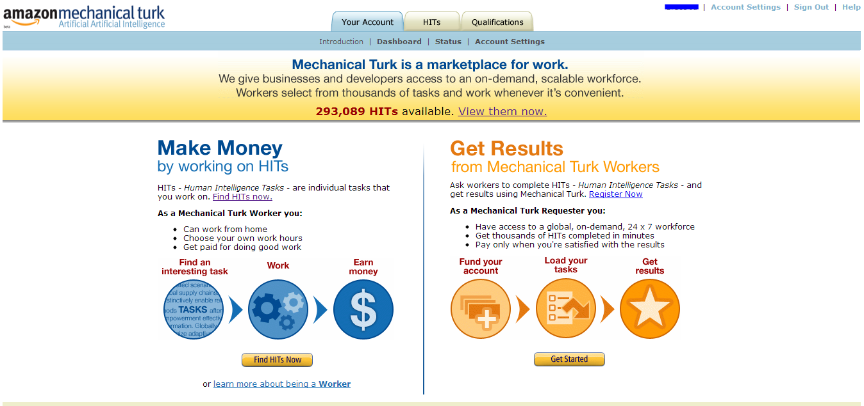
Name
As a worker, make an average of $0.03 per task
Paid directly to Amazon account
As requester, set up simple tasks for workers to complete
Quality control is possible through MTurk services
Notes:
General information about Amazon Mturk:
Cheap: $0.03 per task
Platform for requester and workers
Supporting functions for both sides: the successive rate in history; work speed; quality;

Slide 18
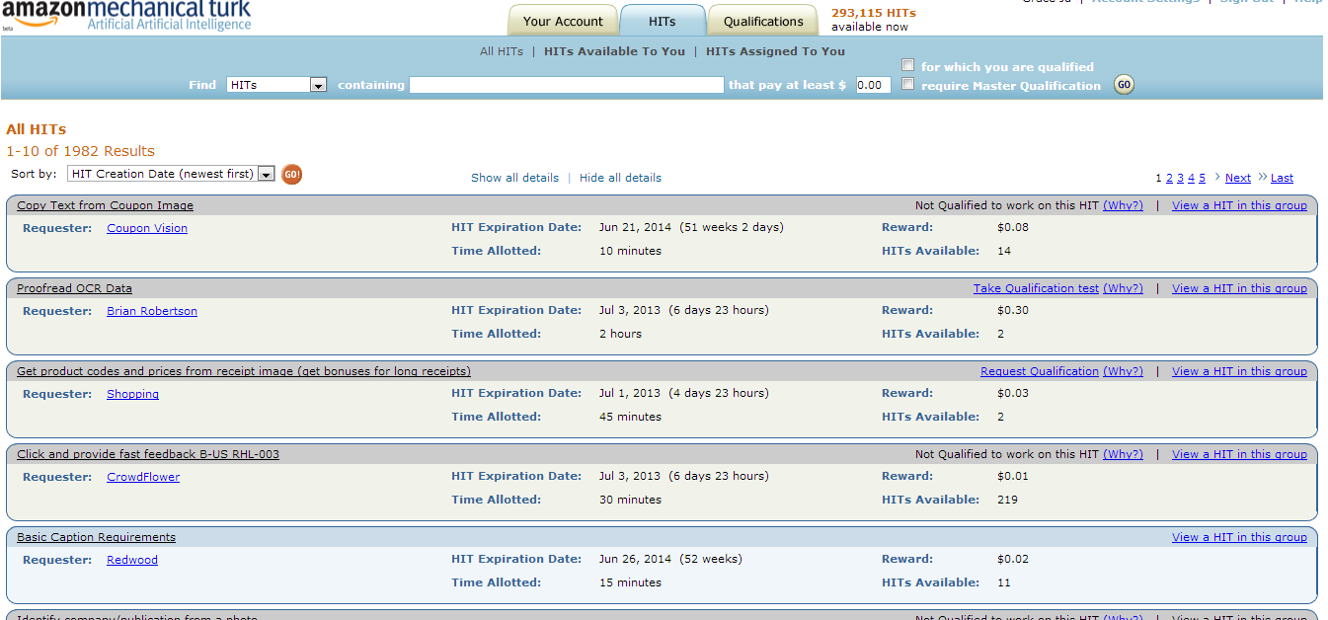
Worker: Contract for a HIT
Select a HIT
  By creation date, payment amount, time allotment
Notes:
Interface for workers: pickup any work that you want to
You can see the general information about the available tasks, such as time, money, and owners

Slide 19
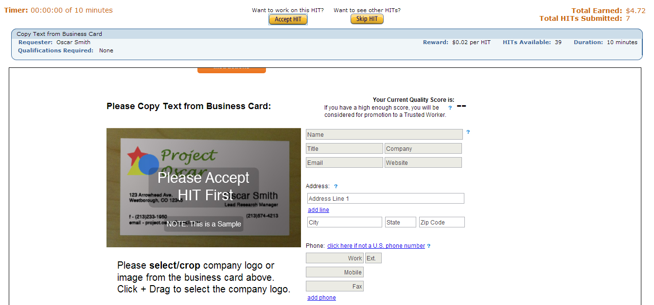
Worker: Reviewing a HIT
Review the HIT before accepting
  Shown full task, allotted time (10 minutes), reward amount ($0.02)
Notes:
Worker can further check the details about the task before accepting the task

Slide 20

Worker: Completing a HIT
Confirmation message in green
Automatically shows the next HIT submitted by the same requester
Check Dashboard to see if HIT is accepted

Slide 21
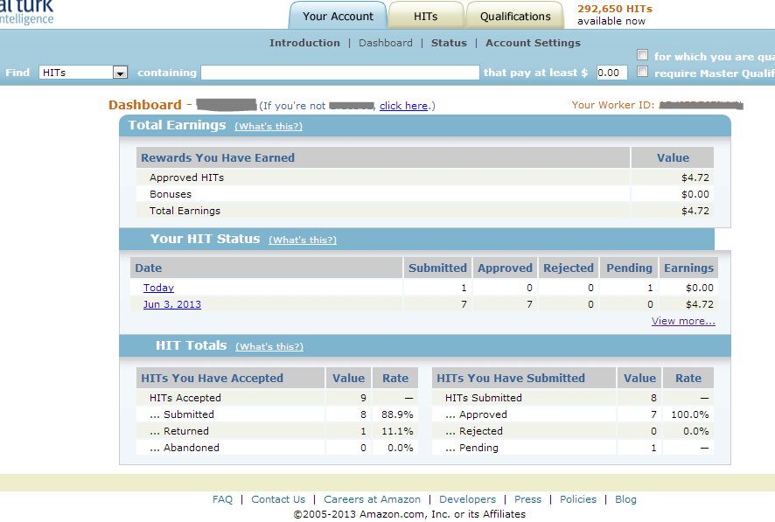
Worker: Sample Dashboard
Name
Name
Notes:
Statistic information about users

Slide 22
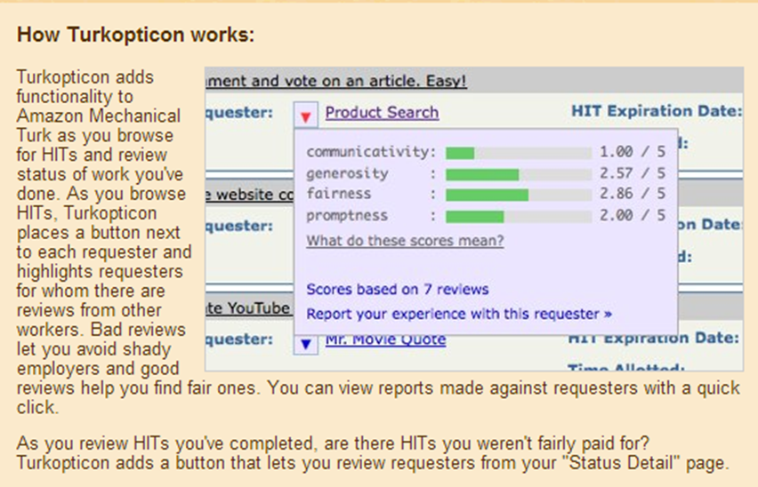
Avoid Shady Requester
Notes:
There is a browser-based plugin, which can provide the reputation about a job owner
If the owner always rejects workers’ results, soon or later, no worker will take his project (HITs) any more.

Slide 23
APPS: Image Processing
EteRNA
Galaxy Zoo
Fine-grained Recognition

Slide 24
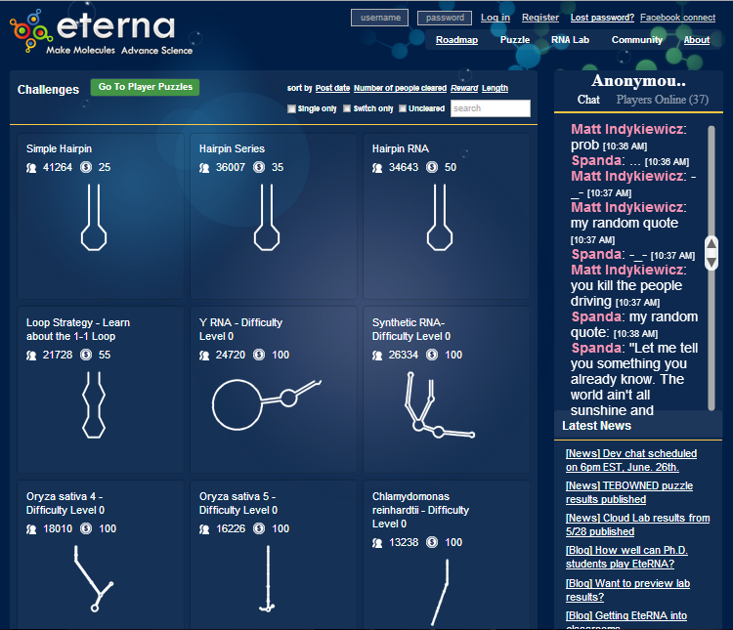
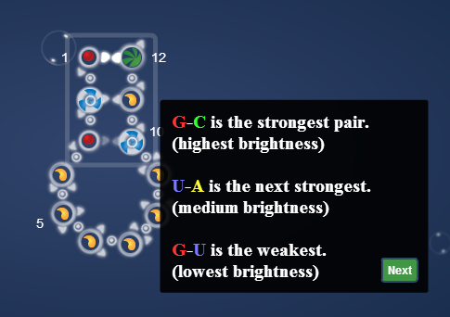
Biology: EteRNA: CMU, Stanford
Aim: to gain mastery over the way RNA molecules folds.
Notes:
The most basic rules for folding RNA are similar to the famous rules for the DNA double helix that were figured out by Watson and Crick. There is a natural tendency for A, to stick to U, and for C, to stick to G. So when an RNA is synthesized, it doesn't just appear as a straight chain. It typically doubles back on itself to form helices that allow bases to pair up.
A-U pair and C-G pair
Four RNA nucleotides:
A: adenine
U: uracil
C: cytosine
G: guanosine
Example: a chain with 12 positions: o-o-o-…..o-o
If we only use u*12 to fill them, it only presents a chain structure
If we put A*3 in the first 3 positions, followed by 6 C, and end with 3*U, then we can get a bottle shaped RNA

Slide 25

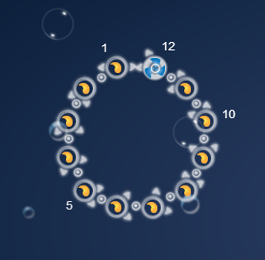
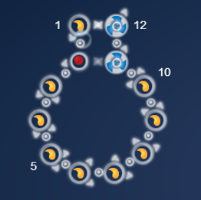
EteRNA: CMU, Stanford
By assigning different colors (RNA nucleotides), a RNA chain will fold into different structure
Notes:
By assigning different colors (RNA nucleotides), a RNA chain will fold into different structure

Slide 26
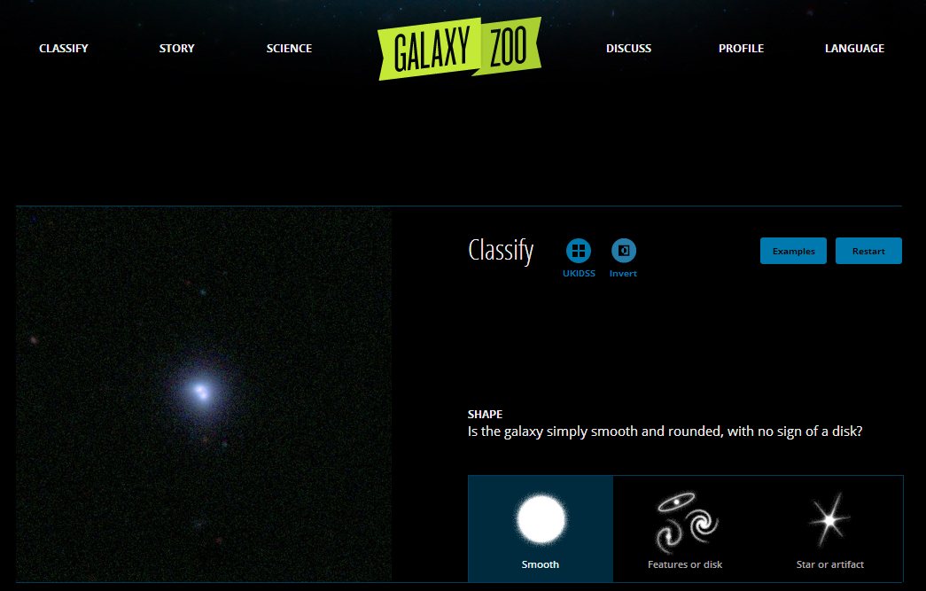
GalaxyZoo: Zooniverse
Notes:
Satellite images of galaxies, with labeling instructions.
Given a galaxy image (left), choose a label from right side
There are 3 types:
Smooth
Features or disks
Star or artifact

Slide 27
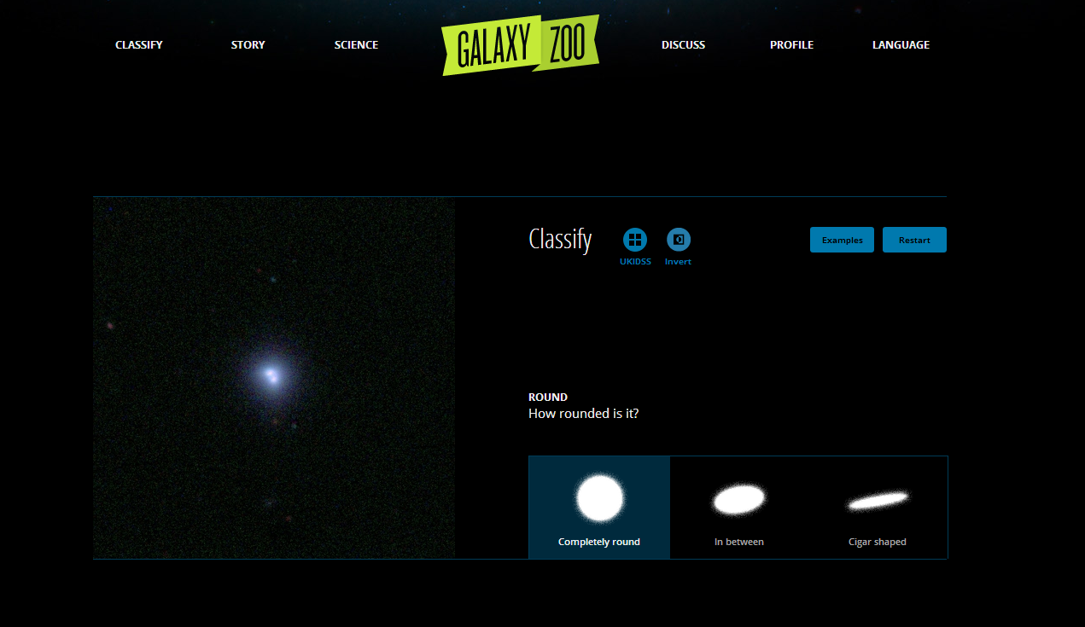
GalaxyZoo: Zooniverse
Notes:
Satellite images of galaxies, with labeling instructions.
Given a galaxy image (left), choose a label from right side
There are 3 types:
Smooth
Features or disks
Star or artifact

Slide 28
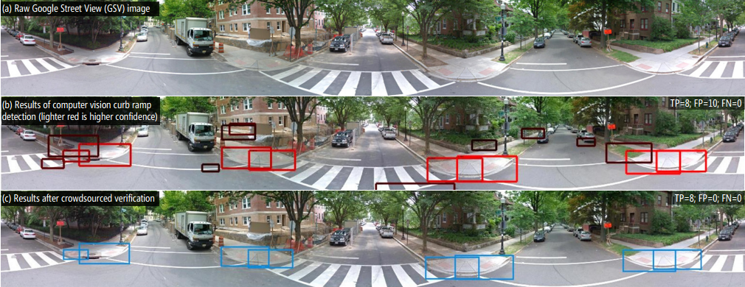
Fine-Grained Recognition: Tohme
K. Hara et al, “Tohme: Detecting Curb Ramps in Google Street View Using Crowdsourcing, Computer Vision, and Machine Learning,” UIST 2014
Notes:
Label image for training research dataset

Slide 29
APPS: Commonsense Knowledge
GWAP.com
OnToGalaxy
reCAPTCHA
ChaCha
Crowrdsourcing

Slide 30
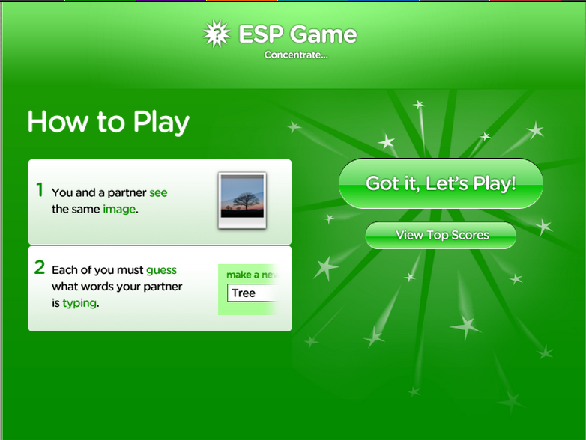
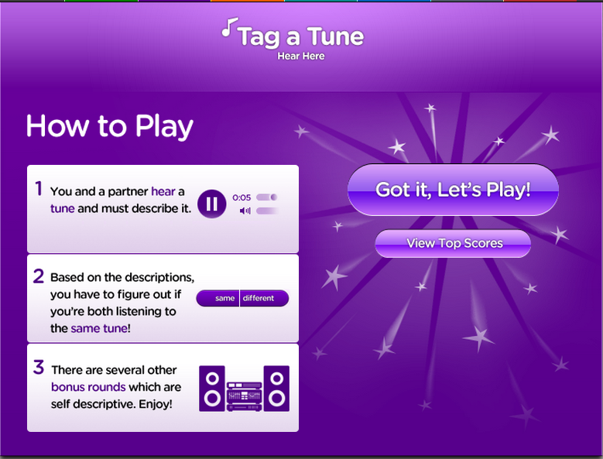
GWAP.com: CMU
ESP Game
Tag a Tune
Labeling images
Labeling tunes
Notes:
Simple labeling games
Left: label pic
Right: label music

Slide 31
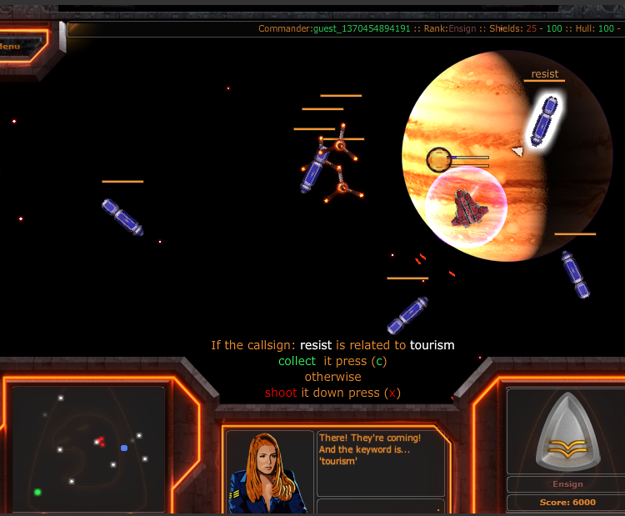
OnToGalaxy: University of Bremen
Given a keyword
  e.g., “tourism”
Collect pods with words related to keyword
  e.g., “voyage”
Shoot down pods with unrelated words
  e.g., “resist”
An experimental game platform
Notes:
Example: given the keyword: tourism
Try to capture the objects that contain the words related with the keywords, like voyage
Kill (discard) the irrelevant words, such as resist

Slide 32
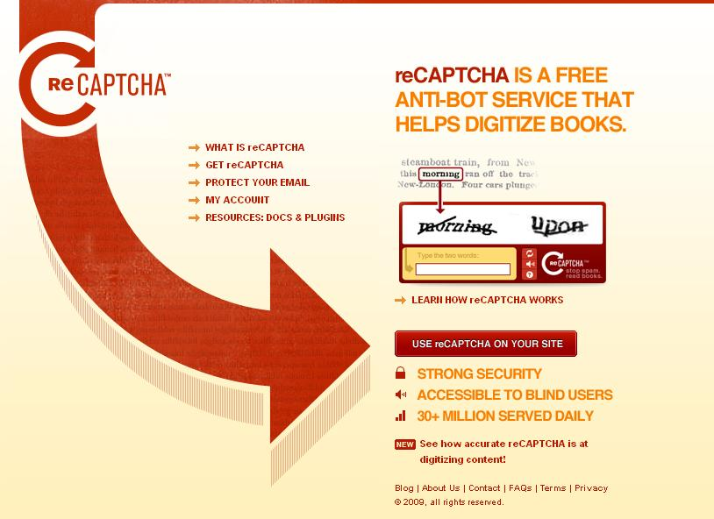
reCAPTCHA: CMU
Notes:
One word is correct; one word is wrong. http://www.google.com/recaptcha/learnmore
Scan old newspaper into image, then transcribe into electronic records
USENIX: CAPTCHA attack to break security through crowdsourcing

Slide 33
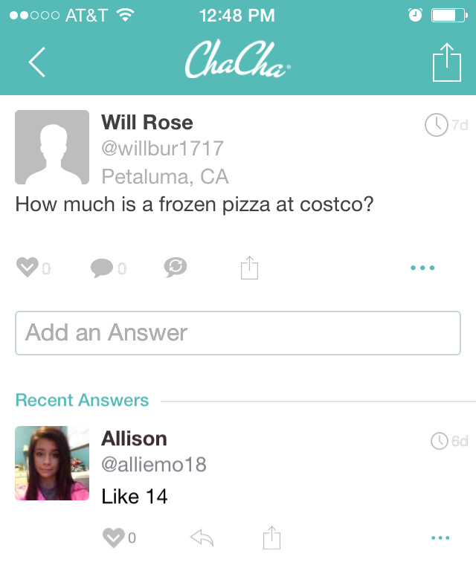
ChaCha Search Engine: powered by people
ChaCha is a human-guided search engine.
Questions are answered real-time in an “ask a smart friend” format.
One can access ChaCha via its website, text message, or mobile apps.
Notes:
The reasons for participating in crowdsourcing:
For fun: game style– put task in certain form of games
For money: tiny dollar, such as Amazon Mturk
based on the quality of results
based on the working time or completed amount

Slide 34
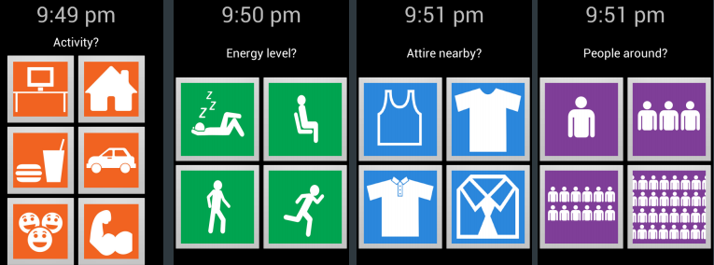
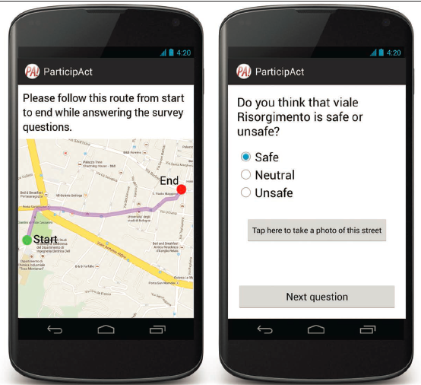
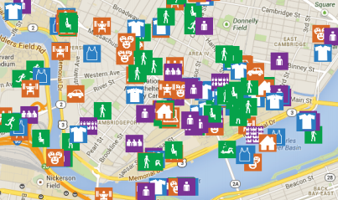
Crowdsensing: Smart City
Traveling safety
Activity census
  G. Cardone et al, “The ParticipAct Mobile Crowd Sensing Living lab: The Testbed for Smart Cities,” IEEE Communications Magazine 2014
  R. Vaish et al, “Twitch Crowdsourcing: Crowd Contributions in Short Bursts of Time,” CHI 2014
Notes:
http://stanfordhci.github.io/twitchcrowdsourcing/
Twitch uses available network connections to tell you what others nearby have said in similar situations.
http://www.smart-cities.eu/
http://cities.media.mit.edu/
http://www.newcitiesfoundation.org/combining-big-data-crowdsourcing-build-smart-city/

Slide 35
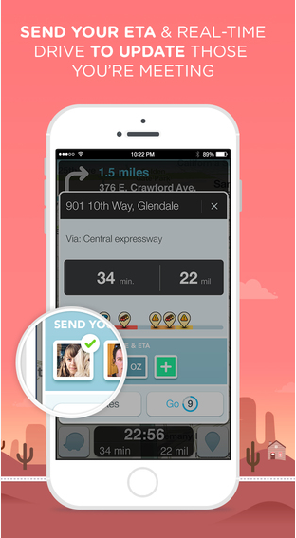
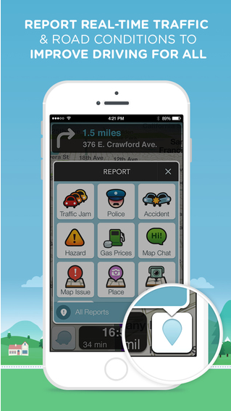
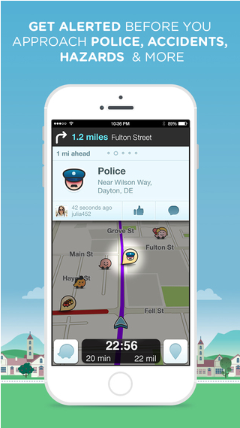
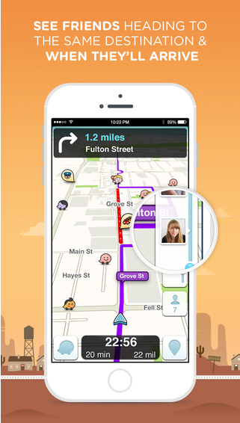
Waze Social GPS, Maps & Traffic
Waze is the world's largest community-based traffic and navigation app.

Slide 36
Smartphone-based Crowdsensing
Smart city
  Personalized recommendation
  P. Organisciak et al, “A Crowd of Your Own: Crowdsourcing for On-demand Personalization,” AAAI 2014
  Public transportation
  Z. He et al, “High Quality Participant Recruitment in Vehicle-based Crowdsourcing using Predicatable Mobility,” INFOCOM 2015
  Indoor map construction
  X. Guo et al, “ShopProfiler: Profiling Shops with Crowdsourcing Data,” INFOCOM 2014
  Speaker counting
  C. Xu et al, “Crowdsensing the Speaker Count in The Wild: Implications and Applications,” IEEE communications magazine 2014
Some challenges
  GPS-less (energy efficient)
  X. Sheng et al, “Leveraging GPS-less sensing Scheduling for Green Mobile Crowd Sensing,” JIoT 2014
  Trustfulness & Game
  Z. Feng et al, “TRAC: Truthful Auction for Location-aware Collaborative Sensing in Mobile Crowdsourcing,” INFOCOM 2014
  T. Luo et al, “Crowdsourcing with Tullock Contests: a New Perspective,” INFOCOM 2015
  Coverage
  M. Karliopoulos et al, “User Recruitment for Mobile Crowdsensing over Opportunistic Networks,” INFOCOM 2015
  Privacy
  L. Pournajaf et al, “Spatial Task Assignment for Crowd Sensing with Cloaked Locations,” MDM 2014
Notes:
4W1H: what/when/where/who/how

Slide 37
Paradigms
Sequential
Iterative and Parallel
Divide-and-Conquer and Aggregate
Map and Reduce: a Special Case
Publish/Subscribe

Slide 38
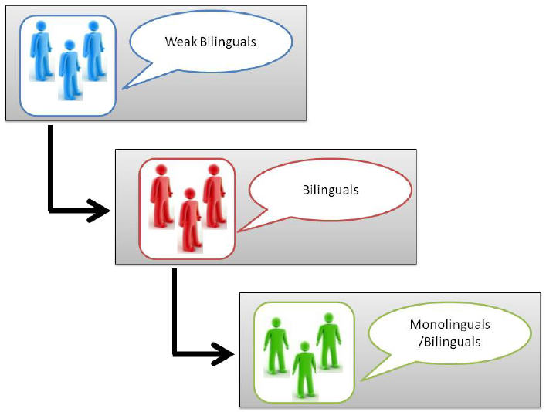
Sequential: Collaborative Workflow
Lexical translation
(weak bilinguals or machine)
Assistive translation
(strong bilinguals)
Refine sentence
(monolinguals)
V. Ambati et al, “Collaborative Workflow for Crowdsourcing Translation,” CSCW 2012
Notes:
There are 3 phases for collaboratively translating:
Lexical translation (weak bilinguals or machine)
Assistive translation (strong bilinguals)
Refine sentence (monolinguals)

Slide 39
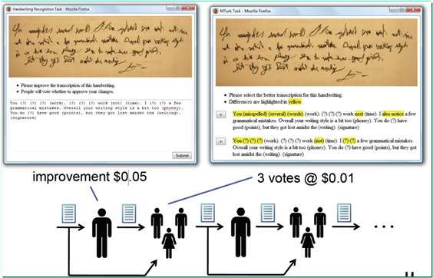
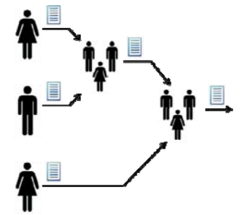
Iterative and Parallel
Iterative improve and vote
Greg Little et al. “Exploring iterative and parallel human computation
processes.” HCOMP 2010.
G. Little et al, “Exploring Iterative and Parallel Human Computation Processes,” HCOMP 2010
Notes:
Left: iterative improve: use previous worker’s results as the inputs of the next work
Right: multiple workers work on their own. Select the best one from them.
The iterative scheme takes more time but has more accuracy.

Slide 40
Divide-and-Conquer and Aggregate
Divide-and-Conquer and Aggregate
  Decompose a problem statement and aggregate the results
Two special aggregates
  Merge
  Reduce
  P. Minder et al, “Crowdlang - First Steps Towards Programmable
  Human Computers for General Computation,” AAAI 2011.
Notes:
By using the concept of Map-reduce, a complex work can be done via the combinations of three operations: partition(design sub-problems) , map (collecting information), and reduce (summary information and write a related article).
Example: writing a tourist book
Two types of aggregation:
1.merge:
2.reduce: have certain reduce rules

Slide 41
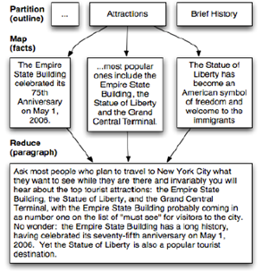
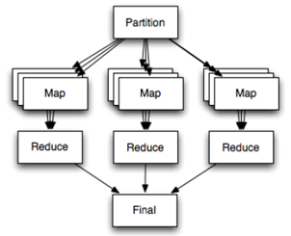
Map and Reduce: A Special Case
A. Kittur et al, “Crowdforge: Crowdsourcing Complex Work,” UIST 2011
Notes:
Example: writing a tourist book about new York
Divide: sub-problems: food, culture, attractions
Map: finding workers and let them provide contents for each topic
Reduce: collect all contents and trim into a book

Slide 42
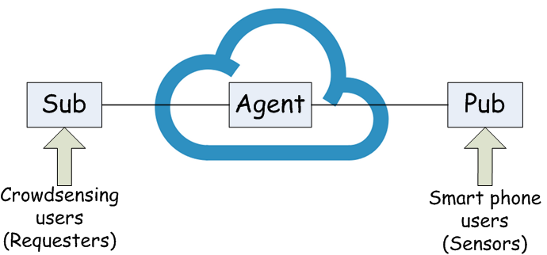
Publish and Subscribe
Pub/Sub middleware-based task assignments
I. Zarko et al, “IoT Data Management Methods and Optimization Algorithms for Mobile Publish/Subscribe Services in Cloud Environments,” EU FP 7 OpenIoT Project 2013
Notes:
Middleware acts as an integrator of domain silos from a data perspective.
Task: type of sensing + locations needed to be sensed
Sensor: sensing types being able to generate + location

Slide 43
Challenges and Opportunities
Challenges
Opportunities

Slide 44
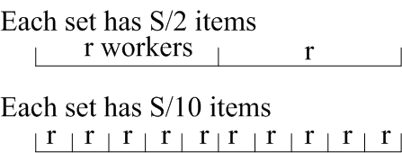
Challenges
Trade-offs: time, cost, and quality
  Max algorithm with human error (with a probability)
  Maximize quality (via redundancy) subject to cost and time
  P. Venetis et al, “Max Algorithms in Crowdsourcing Environments,” WWW 2012
  R. Kawajiri et al. “Steered Crowdsensing: Incentive Design Towards Quality-oriented Place-centric Crowdsensing”, UBICOMP 2014
Incentive: money, glory, and love
  Platform-centric: a Stackelberg game
  User-centric: auction-based incentive mechanism
  D. Yang et al, “Crowdsourcing to Smartphones: Incentive Mechanism Design for Mobile Phone Sensing,” MobiCom 2012.
Notes:
Trade-off:
Max algorithm: for instance, select the best Facebook profile that matches a given person or the best photo that describes a given restaurant.
r: the number of workers for each work set
S: the number of items in each work set
More worker, smaller size of work size ➔ high quality but high cost
Larger work set, less worker ➔ low quality and low cost
Cite 2: for game theory in Crowdsourcing, the incentive should not be simply increasing the number of workers; it should be increase the quality of the results.
L. Thanh et al, “BudgetFix: Budget Limited Crowdsourcing for Interdependent Task Allocation with Quality Guarantees,” AAMAS 2014
Above Cite: a job is consist of several phases. Fixed budget, selecting which workers (quality vs cost) at which phase?
Incentive: two types of games
1: the owner give a total reward R onto platform, multiple workers divide the rewords. The owner acts as a leader in the Stackelberg game since the owner proposed the reward first;
2. Bid game: workers provide a bid and the amount of work that they can provide. There is no upper bound on the total rewards.

Slide 45
Challenges: HPU + CPU
CrowdDB:
  M. Franklin et al, “CrowdDB: Answering Queries with Crowdsourcing,” SIGMOD 2011
Notes:
A crowd of your own:
Two techniques to predict ratings of a requester.
In taste-matching, workers rate according to their own preferences; Worker I is most similar to the requestor and thus influences the prediction.
In taste-grokking, workers see the requester’s prior ratings and make predictions.
CrowdDB:
Divide Database into two parts:
CPU solves traditional problem
Human intelligence solves the problems that a computer cannot.

Slide 46
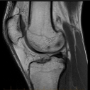
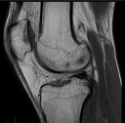
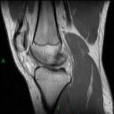
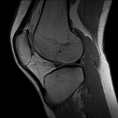
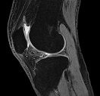
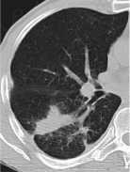
CPU-assisted HPU
Entity Matching
e.g. JHU matches John Hopkins Univ.
Radiology
  Filter
  Diagnose
HPU:
CPU:
tuberculosis
CPU
HPU
tuberculosis
  C. Gokhale etal, “Corleone: Hands-off Crowdsourcing for Entity Matching,” SIGMOD 2014
Notes:
Entity matching:
Traditional approach: expert generate matching rule→ matching results → crowd verification
HPC assisted: CPU use random forest to generate plenty of rules →apply rule and get result → crowd verify results matching or not → pruning the rule

Slide 47

Challenges: Collaborative Workflows
Turkomatic
Complex works require careful and accurate design workflow
Problems:
  Loop subtasks
  Task starvation
  Multi-stage task with limited budget
Kulkarni et al, “Collaboratively Crowdsourcing Workflows with Turkomatic,” CSCW 2012
C. Fofi et al, “Design Patterns for Hybrid Algorithmic-Crowdsourcing Workflows,” CBI 2014
Notes:
The task-owner should monitor how a task been partitioned (reduced into several smaller problems).
Subworkers, who partition the task, may misunderstand the question, and therefore, causes wrong partitioning.
Subworkers, who partition the task at different level, may cause loop.
Second paper gives 5 types of HPU and CPU combinations

Slide 48

Challenges: Multi-dimensional Data
Multi-dimension
Integrate all context
Personal activity data:
  Eating hobby
  Shopping preferences
  Incomes
  Emotional state
Social data:
  Close friends
  Similar users
Environmental data:
  Locations
  Climates
X. Hu et al, “Multidimensional Context-aware Social Network Architecture for Mobile Crowdsensing,” IEEE Communications magazine 2014
Notes:
Integrate all kinds of data into crowdsensing services:
Shopping recommendation
Eating etc.

Slide 49
Opportunities
Beyond simple workflows
  Graph search
  Graph match
Beyond simple worker selection
  Dynamic procurement
Beyond independent workers
  Social networks

Slide 50
Beyond Simple Workflows
Graph search
  Human-assisted graph search
  Best sequence of questions with simple Y/N answers
  A. Parameswaran et al, “Human-Assisted Graph Search: It’s Okay to Ask Questions,” VLDB 2010
Graph match
  People graph (who knows and/or communicates with whom)
  Puzzle graph (ideas are compatible and can merge)
  Natural dynamic for people to merge their compatible ideas
  C. Brummitt et al, “Jigsaw Percolation: What Social Networks Can Collaboratively Solve a Puzzle,” 2012
Notes:
Graph search:
Given a set of labels, such as car, nissan, audi, sentra, altima, and a set of car images, find the best label for the images. The task can be done by asking a serials of y/n questions. However, each question may related with payments to workers. The goal is to design the optimal strategy such that the total number of questions is minimum.

Slide 51

Beyond Simple Worker Selection
Dynamic Procurement
(multi-armed bandit)
A gambler facing a row of slot machines
Which one to play, how many times, and in which order
Each machine having a random reward from a fixed distribution
Objective: maximizing the sum of rewards earned through a sequence of lever pulls
A. Badanidiyuru et al, “Bandits with Knapsacks: Dynamic Procurement for Crowdsourcing,” 2013
Beyond independent workers
Notes:
Model the crowdsourcing problem by multi-armed bandit problem with budget constraint.
A serials of workers u1, u2, …, uk, …., each one associated with a payment p1, p2, …, pk, … and the contributes that the user can give r1, r2,…, rk, … The features follow a certain hidden distribution, which is unknown.
Given total budget B, how to hire the workers such that the total contributions is maximized.

Slide 52

Beyond Independent Workers
Social network of workers
Iterative recruitment of workers through social ties
Challenges
  Graph searching
  Timeliness of responses
  Stoppage condition

Slide 53
Social Crowdsourcing
Computational Surplus Around
QQ Example

Slide 54

Computational Surplus Around
S. Zhang et al, “Minimum Makespan Workload Dissemination in DTNs: Making Full Utilization of Computational Surplus Around ,” MobiHoc 2013
Friends help friends
  Fixed individual capability
  Probabilistic friends’ capability
Makes dissemination decisions
    Based on the estimations of the fixed and potential computational capacities

Slide 55


Water Filling Schedule
d_{i}: response + reply
Response delay
Computation (by a friend)
Reply delay
Scheduling across time: assign jobs to workers
M. Xiao et al, “Multi-task Assignment for Crowdsensing in Mobile Social Networks,” INFOCOM 2015
J. Bragg et al, “Parallel Task Routing for Crowdsourcing,” AAAI 2014

Slide 56

QQ Example
Tencent QQ, or QQ
  Instant messaging
As of March 2013
  798.2 million active QQ accounts
  Peak of 176.4 million simultaneous online users
QQ experiment
  Exploring social status of QQ users by responses

Slide 57
Recursive Doubling (reduce)
Initial label is L = "2" (subtract L by 1 when forwarding this request to QQ friends)
When L = 0, return the
total number of QQ friends
When L > 0, do the following:
  Forward this request to all QQ friends
  After receiving the first 10 replies, compute the average number of friends, and send them back to me

Slide 58
Recursive Doubling (merge)
Initial label is L = "2" (subtract L by 1 when forwarding this request to QQ friends)
When L = 0, return the following:
  Basic information (B)
  Number of friends (N)
  Timestamps (T)
When L > 0, do the following:
  Forward this request to all QQ friends
  Pack the first 10 replies, together with your own information (B, N, T), and send them back to me

Slide 59
Conclusion
Summary
Acknowledgements

Slide 60
Summary
HPU as a new paradigm to compliment the traditional CPU-based computing for big data
Many unexplored algorithmic problems
  Worker selection
  Social connections of workers
  Workflow design
  Cost-time-quality trade-offs
  Incentive mechanisms

Slide 61

Acknowledgements
  Wei Chang
Temple University
  Grace Ju
Carnegie Mellon University
  Wenjun Jiang and Ying Dai
Hunan University and LinkedIn

