Slide 1

Balancing Teaching, Research, Service, and Administration
Jie Wu
Dept. of Computer and Info. Sciences
Temple University
Notes:
1

Slide 2
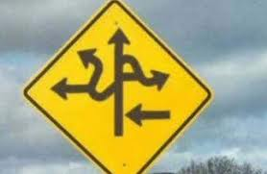
Road Map
  Introduction
  Personal Experience
  Teaching
  Research
  Service
  Administration
  Conclusion

Slide 3
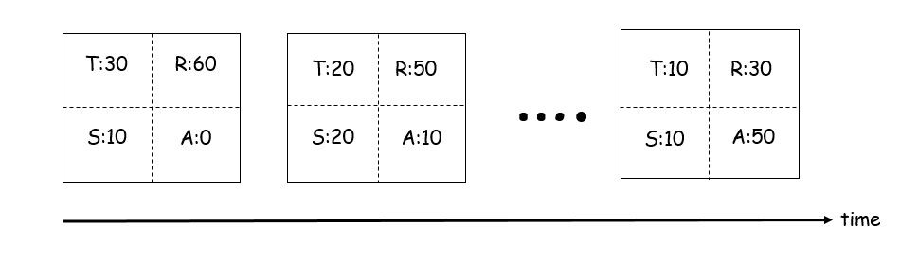
Introduction
Teaching (T), Research (R), Service (S), and Administration (A)
  What is expected of you
  Reevaluate periodically (e.g., yearly)
Time allocation in career path
SIAT

Slide 4
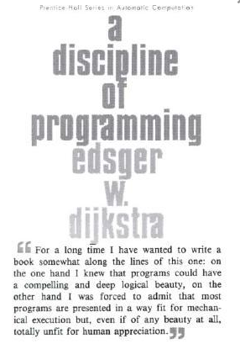
Personal Experience
“Poor” education
  3 years of middle school (1975-78)
  BS/MS, Shanghai U. of Sci. & Tech. (SUST), 1982/1985
  PhD, Florida Atlantic University (FAU), 1989
“Small” school experience
  SUST (1985), FAU (1989), Temple U. (2009)
“First”
  Programming language: Algol 60 (1976)
  English book: A Discipline of Programming (1982)
  Class taught: Pascal (1985)

Slide 5

Teaching
High-quality learning experience
  Professor
  Students
Depth and breadth
  Research areas
  General topics
Teaching and research relationship
  Start teaching early in your career

Slide 6

Teaching Can Be Fun
Algorithm: seating problem
  Several couples are seated in a
  round table. Each neighbor of
  person A should be of the same
  gender of A or the spouse of A.
  hhhhwwww, hhwwhhww, hwwhwwhh, hwhwhwhw
Write a program that can quickly generate all “legal” streams
Results in a paper and an international research collaboration

Slide 7
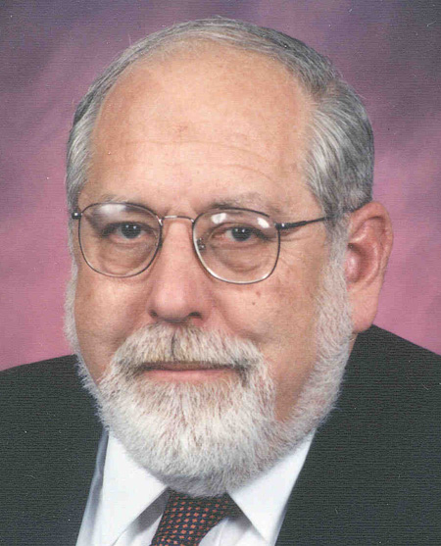
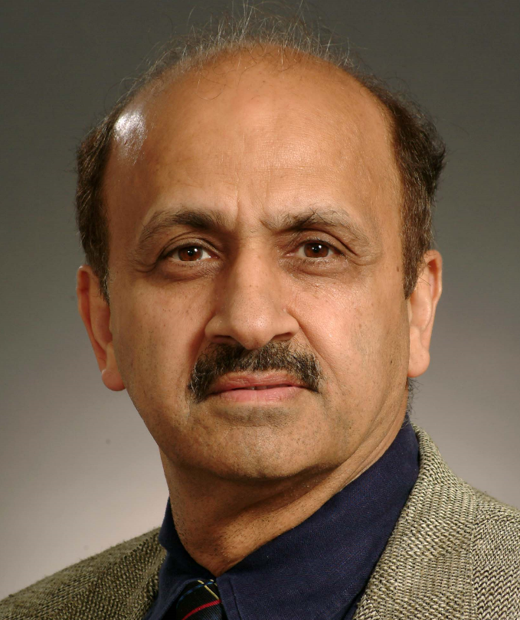
Scholar: A Serious Teacher
Ken Batcher
Sartaj Sahni

Slide 8
Research
Important decisions
  Publication vs. grant
  Individual research vs. collaborative research
  Quantity vs. quality
CRA recommendation: quality and impact
  Top 3 to 5 publications
  Extended h-index?
  How to measure intangible quality?
Quality comes from quantity
  Analogy: leaves and flowers
  Mozart and Beethoven: high quan. & high qual.
  Orff (Carmina Burana) and Holst (Planets): low quan. & high qual.

Slide 9
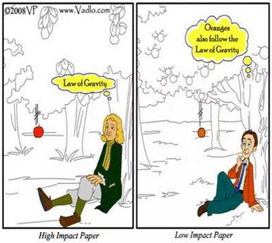
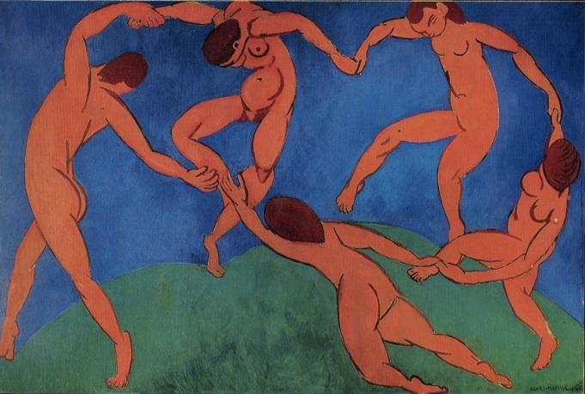
Research Quality
Originality
  Balancing reading literature and writing your own paper(s)
Learn from artists
  Abstraction + imagination

Slide 10
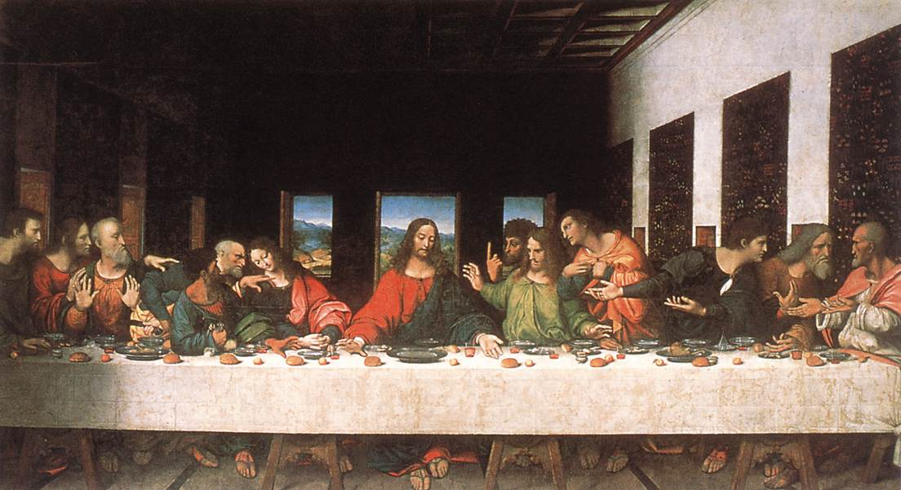
Abstraction and Imagination
Fibonacci seq. (F_{i} = F_{i-1} + F_{i-2}, 1, 2, 3, 5, 8, 13,…)
  2, 4, 6, 10, 16, 26, 42,…
  4, 8, 12, 20, 32, 54, 86,…
  8, 16, 24, 40, 64, 104, 168, …
Fibonacci seq. in Last Supper

Slide 11
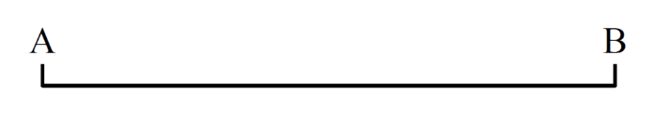
Research Can Be Fun
Mobile computing: cost optimization
  Problem: The Washington, DC subway system charges fees based on travelling distance. For example, a passenger enters station A, stays there for X (say, 10) hours, and exits station B. The charge is proportional to the distance between A and B and is irrelevant to X.
  What are the potential flaws? Provide possible solutions.
  What happen if X is limited to 4 hours as in Nanjing, P. R. China?
A B
1, 2 (in)
2 (out)
2 (in)
1 (out)
1 (in)
2 (out)
2 (in)
1 (out)
1 (in)

Slide 12
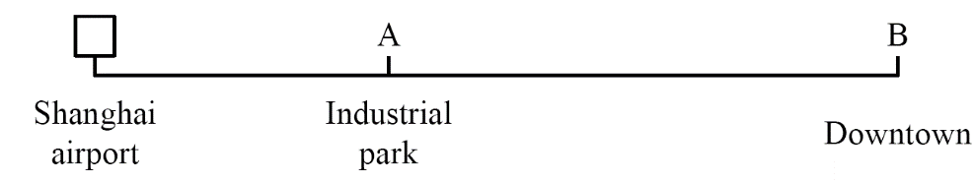
Research Can Be Fun (con’t)
  Problem: At the Shanghai int’l airport, taxi drivers have to wait for at least 4 hours. It is unfair to a driver if a passenger’s destination is the Industrial Park, which is about 20 minutes away. Others will go to downtown, which is 50 minutes away.
  Find a solution so that the interests of both the drivers and the customers are protected.
  Find potential flaws with the current solution at the Shanghai International Airport.

Slide 13
Service
Internal vs. external
  Department, college, university
  Reviewer, TPC, panelist, editor, invited speaker
External larger role
  Conference GC and PC
  Journal EIC
  PDs in various agencies
  Major roles in IEEE/ACM
How to choose?
  Personal taste/judgement
General rule
  Assis. professor (<35): department and limited external
  Asso. professor (<40):
  college and external
  Full professor (>40):
  university and larger role

Slide 14
Service Can Be Fun
IEEE HPCA ’99
  Hotel selection
NSF NeTS PI meeting ’07
  Effective program
IEEE IPDPS ’08
  Keynote selection
IEEE INFOCOM ’11
  Devils in details
IEEE ICDCS ’13
  Dealing with the hotel
ACM MobiHoc ’14
  Restaurant selection
NSF PD
  Task/time management
  Mobilizing the community
  Teamwork
GC and TC
  Optimal resource allocation
  Best service with limited resources
  Balancing quality (paper) and quantity (revenue)
  Coordinating various chairs

Slide 15
Administration
Graduate PD
Assoc/Vice Chair
Chair
Assis/Assoc/Vice Dean
Dean
  College, Graduate, Undergraduate, …
Assis/Assoc/Vice Provost and President
  Research, Faculty Affairs, CIO, Int’l Affairs, …
Provost
President
Faculty vs. Administration
  Most faculty felt that relationships are fair or poor
  Less than 5% of faculty felt that they were influential

Slide 16
Administration (con’t)
Importance of being a chair
  Shape-up department direction
  General starts from a solider (e.g., chair)
Most important function of a chair
  Faculty recruitment
  Secure resources
Qualities
  Vision
  Knowledge
  Commitment
  Grit
  Responsiveness
  Fairness
  Efficiency
  Communication
  Priority setting
  Judgment
  …

Slide 17
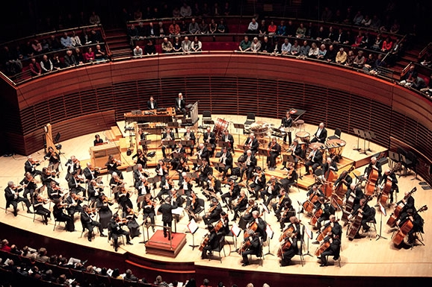
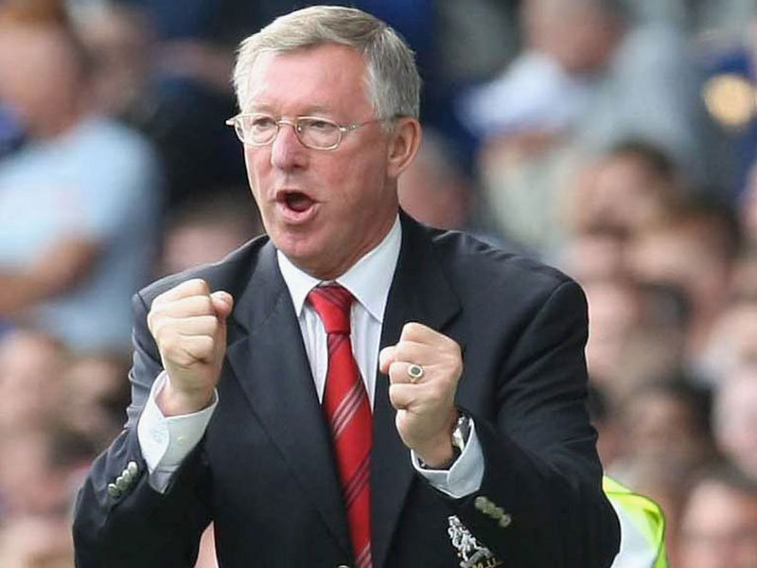
Becoming A Good Administrator
Music director in an orchestra
  Sum of all its musicians
Manager of a football team
  Former MU manager: Sir Alex Ferguson

Slide 18
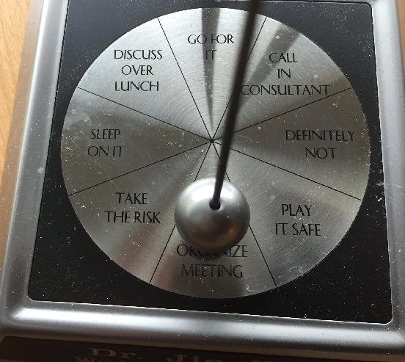
Administration Can Be Fun
Best approximation
(in impossible crises)
  Judgment
  Timing
Case: Trust management
  Direct trust
  Indirect trust
Mechanism design
  Tie-in individual interests with societal (departmental) interests
Case: TA assignment
  Matching with a credit system and a slide window

Slide 19
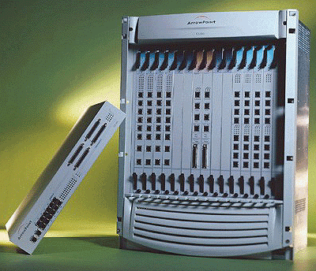
Additional Note
Nothing can replace
  Hard work
Dealing with new “task/opportunity”
  Prioritize tasks
  Leave some room
  Important vs. emergent
  Optimize online/offline schedule
How to get more time
  Less sleep
    More exercise
  Parallelism
    Quick content switch

Slide 20

Balancing the Big Picture
Success
        Outer achievements
    Inner satisfaction/fulfillment
Science and humanism
    Case: Attending a conference
  Experience local culture (e.g. food) and shopping
  Visit museums and attend a concert or sporting event
Case: Attending conference
  Experience local culture (e.g. food) and shopping.
  Visit museum and attend a concert or sport event.

Slide 21

Success vs. Happiness
Success ≠ Happiness
        Meaningful work, love, and good health
Levels of happiness
Momentary (avoiding happiness dream)
Overall (be aware of expectation gap)
Spiritual (serving a purpose larger than yourself)
Case: Attending conference
  Experience local culture (e.g. food) and shopping.
  Visit museum and attend a concert or sport event.

Slide 22


Conclusion
Assistant professor
  T + R + S
Associate professor
  T + R + S
Full professor
  T + R + S + A
Chair
  T + R + S + A
Dean (and up)
  S + A
Case: Attending conference
  Experience local culture (e.g. food) and shopping.
  Visit museum and attend a concert or sport event.

Slide 23

Conclusion (cont’d)
Quality, style, and taste
  Show passion and enjoy what you do
  Do not cut corners
    “You can fool all the people some of the time; you fool some of the people all the time; but you can’t fool all the people all the time.”
Balancing the big picture
  Career, family, and health

Slide 24
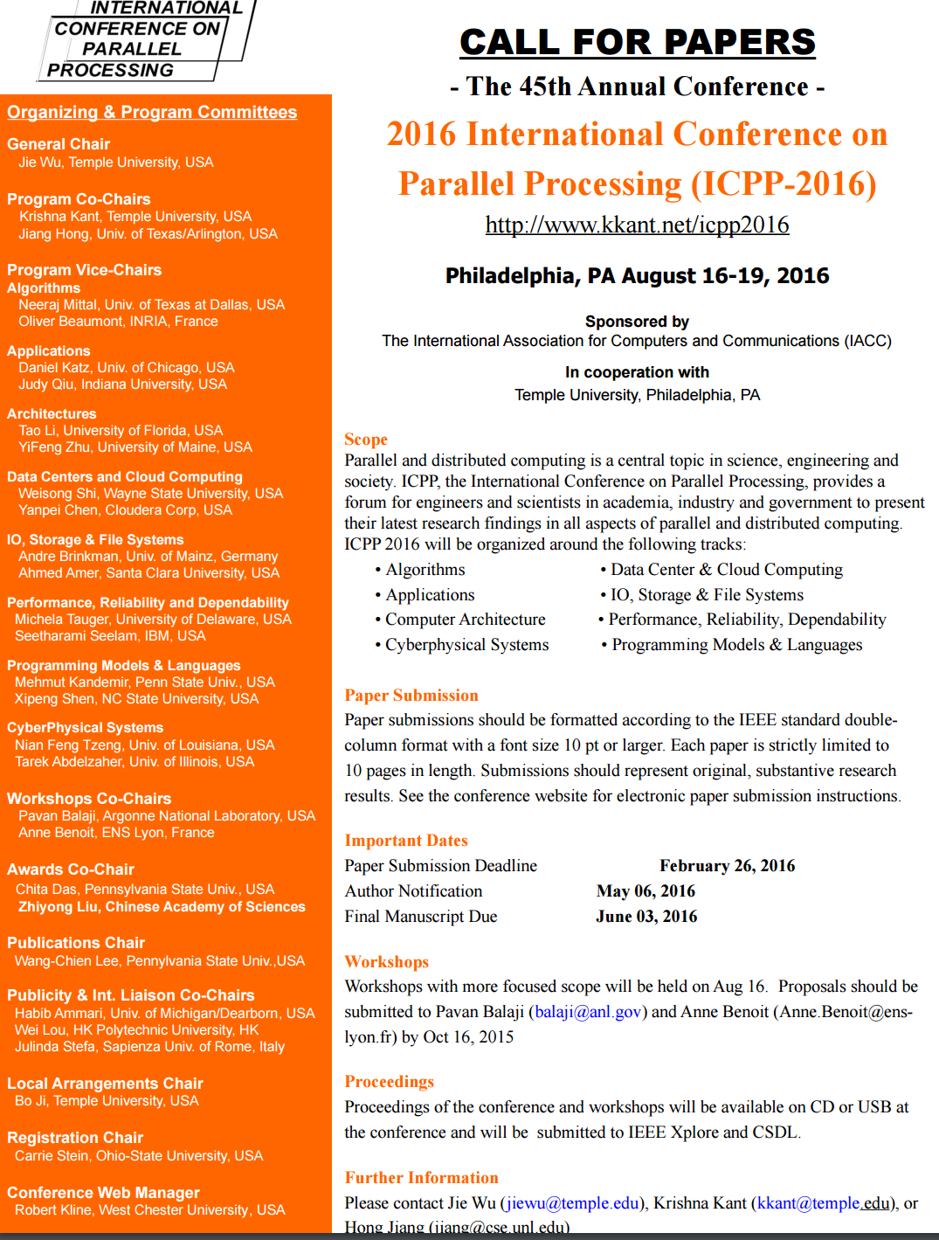

Future Events in Philadelphia
Case: Attending conference
  Experience local culture (e.g. food) and shopping.
  Visit museum and attend a concert or sport event.

