Slide 1


Bridge: A Cross-Modal Learning Framework for
Unified Semantic Representation in Noisy Communication
Liang Chen, Yanze Huang, Limei Lin*, Xiaoding Wang, Wei Lou,
Jie Wu and Sun-Yuan Hsieh
IJCAI–ECAI 2026
15-21 August 2026 Bremen,Germany
Notes:
Hello everyone.
Today, I’m pleased to present our work: Bridge: A Cross-Modal Learning Framework for Unified Semantic Representation in Noisy Communication.

Slide 2

CONTENTS
1
Background & Motivation
2
Bridge Framework Design
3
Experiments & Results
4
Conclusion & Future Work
Notes:
My presentation is divided into the following four parts.

Slide 3

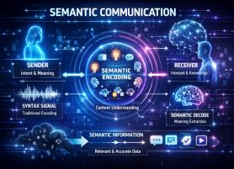





Semantic Communication: From Bits to Meaning
Why Semantic Communication?
Traditional communication transmits raw bits, causing high redundancy.
Semantic communication focuses on meaning, improving transmission efficiency.
选题的介绍
项目团队介绍
Why Multimodal Semantic Communication?
Complementary semantics from text, audio, and video.
Richer understanding through cross-modal information.
Robust communication in complex real-world scenarios.
选题研究实施
研究目标成果
Typical Application Scenarios：
Intelligent
Web Services
Telemedicine
Internet of
Things
Vehicle-to-Everything
Digital Twins
& Smart Sensing
Notes:
Let me first introduce the background.
Traditional communication mainly focuses on transmitting raw bits accurately, which can lead to large redundancy, especially when bandwidth is limited. Semantic communication changes this goal: instead of reproducing every bit, it tries to preserve the intended meaning, making transmission more efficient and task-oriented.
In many real-world applications, information is naturally multimodal. Text, audio, and video provide complementary semantic cues, so jointly modeling them can support richer understanding and more robust communication in complex scenarios such as intelligent services, healthcare, and connected vehicles.

Slide 4

Motivation
Challenges in Multimodal Semantic Communication:
Heterogeneous modalities exhibit large distribution and semantic gaps.
Channel noise and fading may cause semantic drift and misalignment.
Accurate alignment and robust transmission remain difficult under bandwidth constraints.
选题的介绍
项目团队介绍
Limitations of Existing Methods:
Existing methods often struggle with cross-modal alignment.
Shared semantics can be mixed with modality-specific information.
Most alignment methods assume relatively stable communication conditions.
选题研究实施
研究目标成果
Motivation for this research:
How can we learn a unified semantic representation that remains consistent across modalities
and robust under noisy channels?
Notes:
However, multimodal semantic communication still faces several challenges.
Different modalities have different distributions, granularities, and semantic structures, which creates a significant modality gap. Meanwhile, channel noise and fading can further distort transmitted features and cause semantic drift or cross-modal misalignment.
Existing methods often struggle to separate truly shared semantics from modality-specific information, and many alignment strategies are designed under relatively stable conditions. Therefore, when the channel becomes noisy, the learned shared space may become unreliable.
This motivates our main question: how can we learn a unified representation that remains consistent across modalities and robust under noisy channels?

Slide 5
Key Contributions of the Paper
Bridge Framework:
We propose Bridge, a unified cross-modal framework for robust semantic communication across text, audio, and video.
Disentangled Representation Learning:
Bridge separates modality-specific and modality-invariant features to preserve unique information while learning cleaner shared semantics.
Adaptive Cross-Modal Alignment:
A modality-aware alignment mechanism maps heterogeneous features into a shared semantic space and improves robustness under noise and fading.
Experimental Results:
Experiments on multiple multimodal benchmarks demonstrate strong robustness, especially under low-SNR conditions, with about 16.3% improvement in image reconstruction.
Notes:
Our work makes four main contributions.
First, we propose Bridge, a unified framework for semantic communication across text, audio, and video.
Second, we disentangle modality-specific and modality-invariant features to obtain cleaner shared semantics.
Third, we introduce modality-aware cross-modal alignment to improve robustness under noise and fading.
Finally, extensive experiments show strong performance across multiple benchmarks, especially in low-SNR conditions.

Slide 6
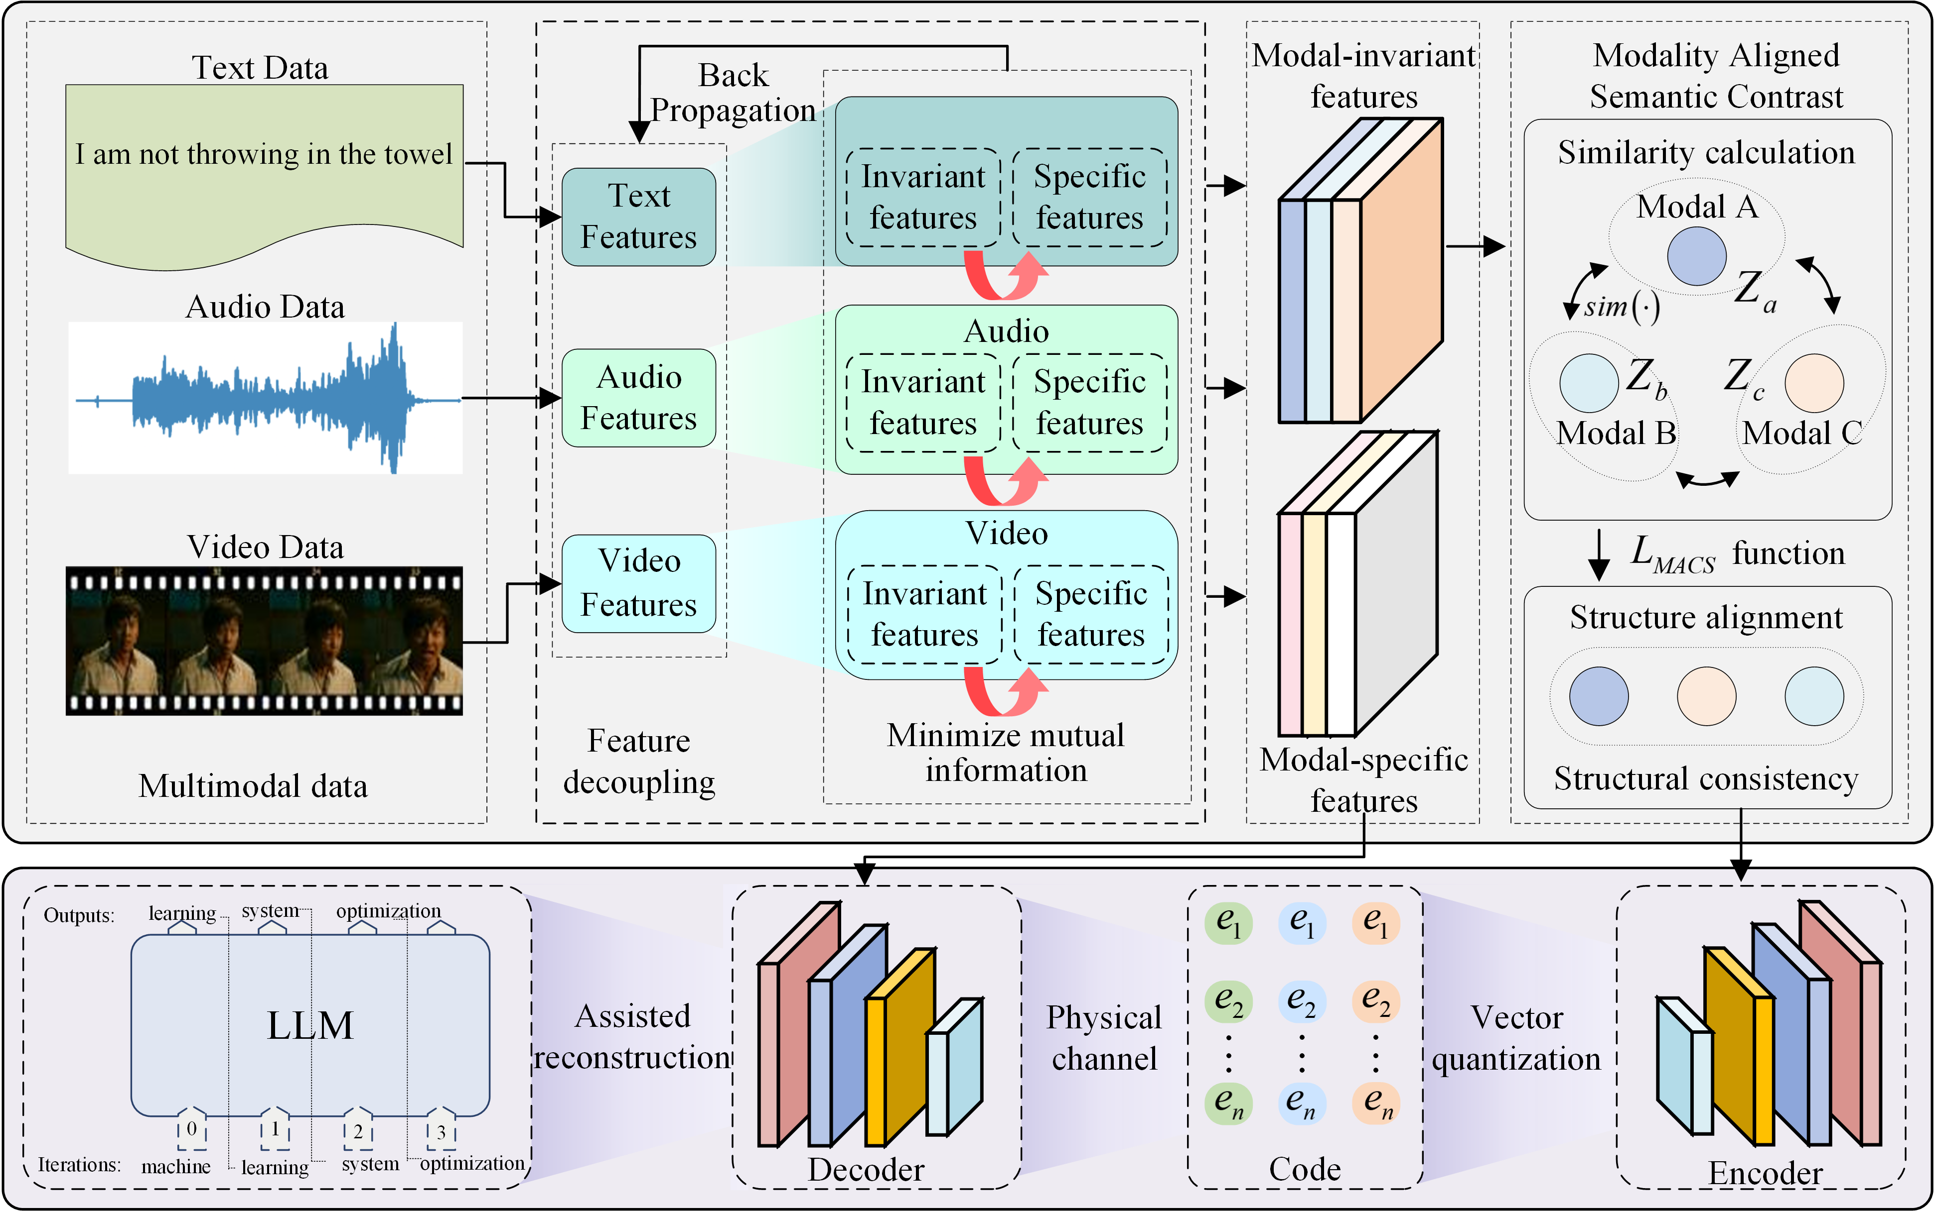
Overview of the Bridge Framework
We propose Bridge, a unified cross-modal learning framework for semantic communication that integrates text, audio, and video into a shared semantic space while preserving modality-specific information.
Bridge disentangles modality-specific and modality-invariant features, aligns shared semantics through MACS, and employs vector quantization for compact and robust transmission over noisy channels.
The figure illustrates the key components: SDMI, MACS, vector quantization, and foundation-model-assisted reconstruction.
Notes:
This slide gives an overview of Bridge.
Starting from text, audio, and video, we first use modality-specific feature extractors and separate the representations into two parts: modality-specific information and modality-invariant semantics.
The invariant features are then aligned in a shared semantic space through MACS, while the specific branch preserves information unique to each modality. Next, the shared representations are quantized into compact discrete codes for transmission over the physical channel.
At the receiver, lightweight modality-specific decoders reconstruct the signals, and foundation models are used to further verify and enhance semantic consistency.
In this way, Bridge combines feature disentanglement, cross-modal alignment, compact coding, noisy-channel transmission, and semantic reconstruction in a unified end-to-end pipeline.

Slide 7

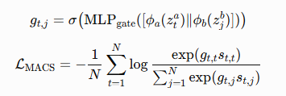
Method
1. Specific-Invariant Dependency Minimization (SDMI)
Disentangle each modality into specific and invariant features, and minimize their dependency to obtain purified shared semantics.
2. Modality-Aware Cross-Modal Semantics (MACS)
Perform pairwise-gated contrastive alignment to emphasize reliable matches and suppress noisy cross-modal pairs.
Key idea: SDMI purifies shared semantics, while MACS enables robust cross-modal alignment.
Notes:
The core of Bridge contains two modules.
The first is r SDMI. For each modality, we learn specific and invariant representations through separate branches, and then minimize the dependency between them. The goal is to reduce redundant modality-specific information in the shared representation and obtain cleaner invariant semantics.
The second module is MACS. It uses pairwise-gated contrastive learning. Instead of treating all cross-modal pairs equally, a learnable gate assigns different importance to different pairs. Reliable matches receive stronger alignment, while noisy or weak pairs are suppressed.
So the key idea is simple: SDMI purifies the shared semantics, and MACS makes cross-modal alignment more adaptive and robust.

Slide 8
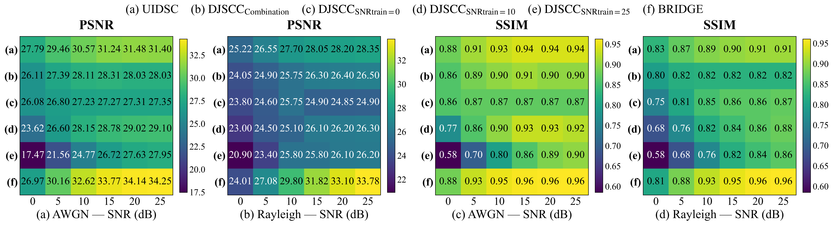
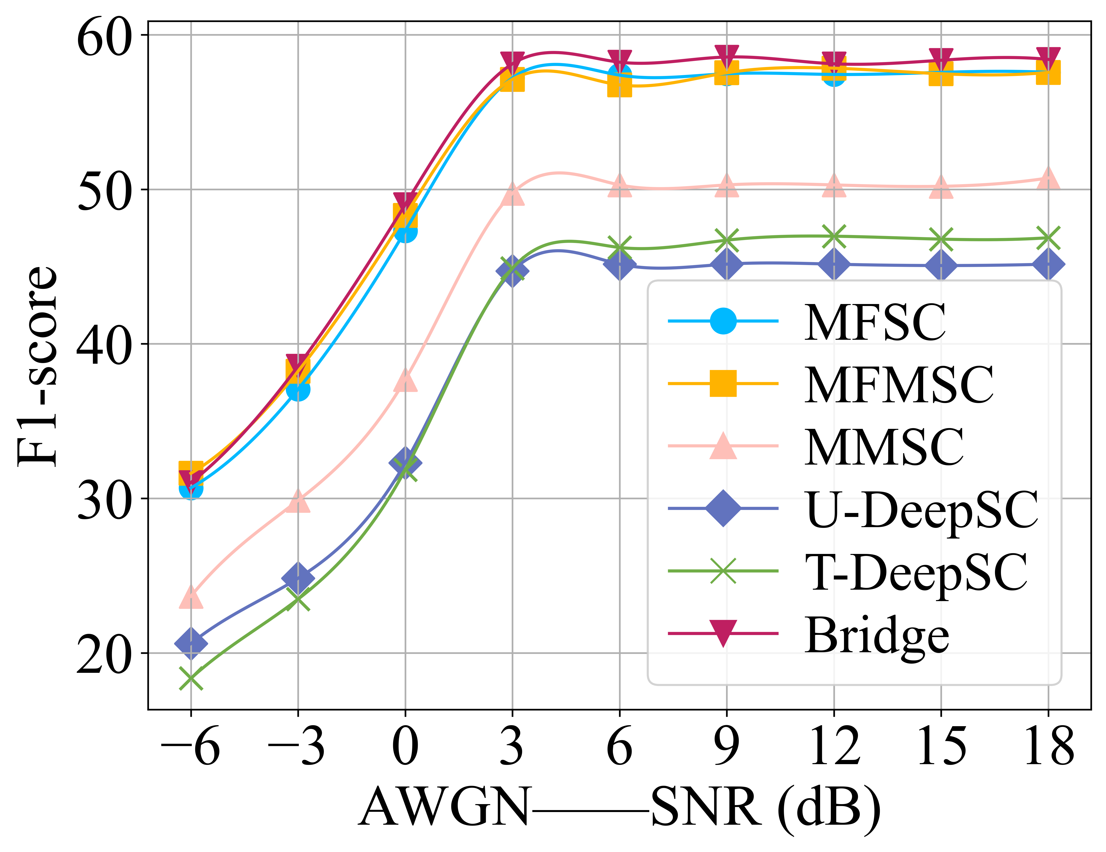
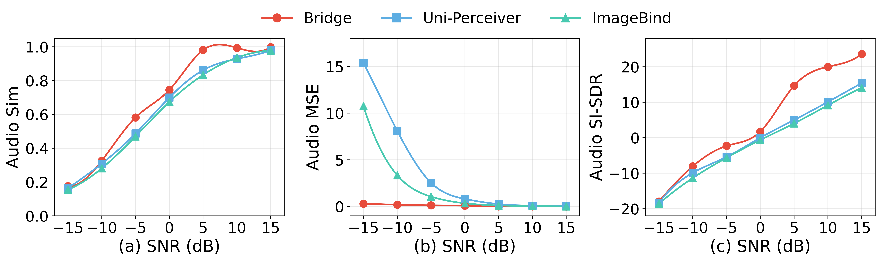
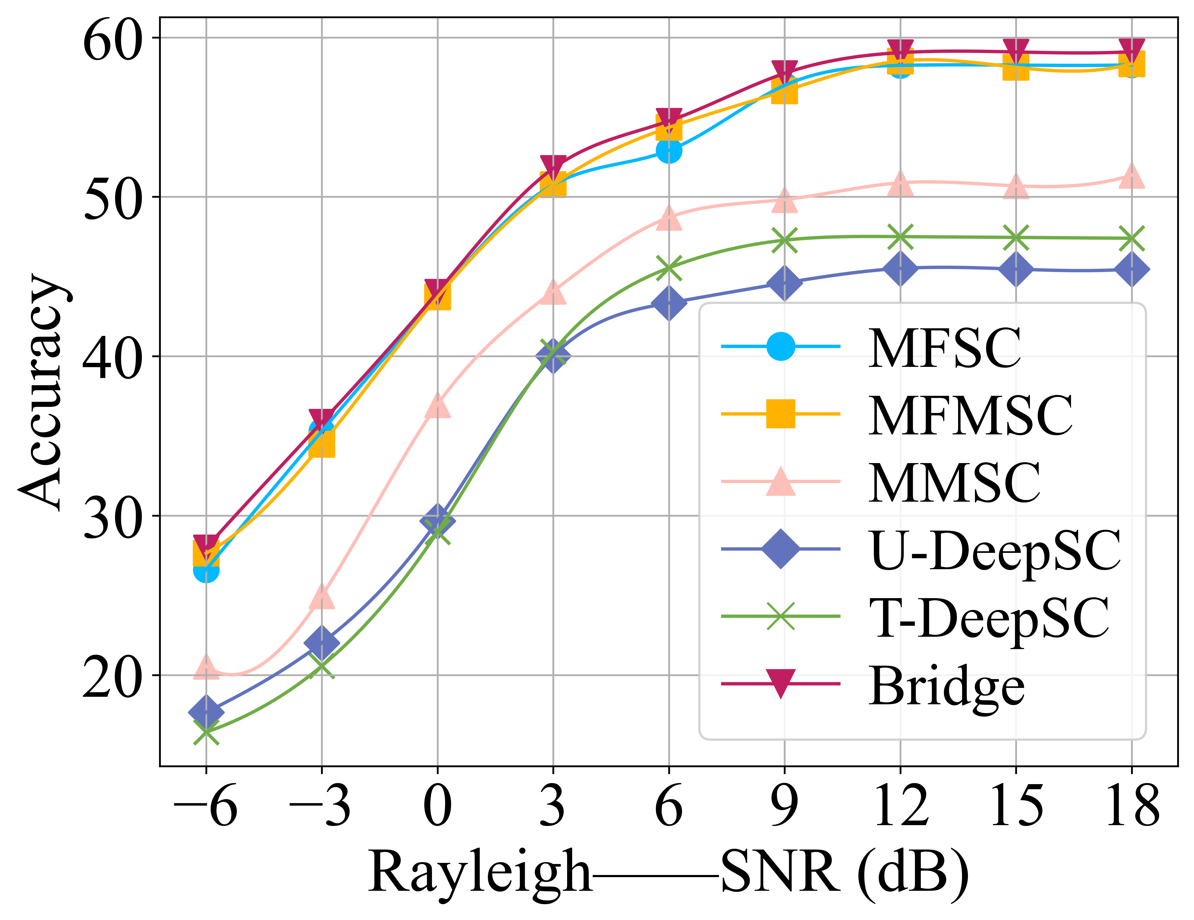
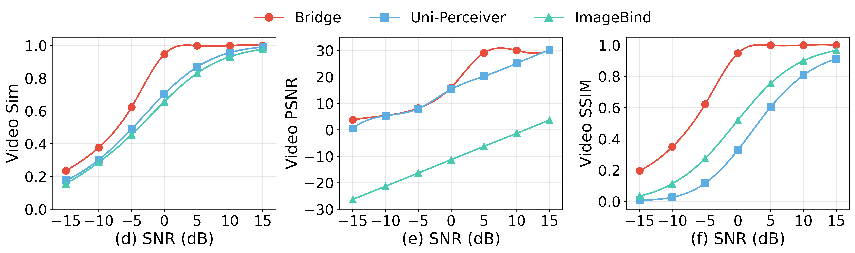
Experiments & Results
Notes:
We evaluate Bridge on multiple multimodal benchmarks under both AWGN and Rayleigh channels.
As shown in the results, Bridge consistently achieves better reconstruction and downstream-task performance than existing methods.
The advantage is especially clear under low-SNR conditions, demonstrating stronger robustness to channel noise and fading.

Slide 9
Conclusion
We propose Bridge, a unified cross-modal framework that learns shared semantic representations across text, audio, and video.
Bridge combines specific-invariant disentanglement and modality-aware alignment to preserve semantic consistency under noisy channels.
Extensive experiments demonstrate superior reconstruction quality, task performance, and robustness, especially in low-SNR conditions.
选题的景
选题的背景
请替换输入您的正式研究选题文字内容，也可以直接复制您的文字内容到此，根据需要调整文字的大小。
请替换输入您的正式研究选题文字内容，也可以直接复制您的文字内容到此，根据需要调整文字的大小。
选题的背景
Future Work
请替换输入您的正式研究选题文字内容，也可以直接复制您的文字内容到此，根据需要调整文字的大小。
Extend Bridge to more heterogeneous modalities and complex real-world communication scenarios.
Explore more efficient and adaptive semantic transmission under dynamic channel conditions.
Notes:
To conclude, Bridge provides a unified semantic representation for text, audio, and video.
By combining specific-invariant disentanglement with modality-aware alignment, it preserves semantic consistency under noisy channels.
Experiments confirm strong reconstruction quality, downstream task performance, and low-SNR robustness.
In future work, we plan to extend Bridge to more heterogeneous modalities and investigate more efficient and adaptive transmission under dynamic channel conditions.

Slide 10
Thanks!
IJCAI–ECAI 2026
15-21 August 2026 Bremen,Germany
Notes:
That is all for my presentation. Thank you very much for your attention.

