Slide 1

EduCode: An Authenticity-Ensuring Algorithm for AI-Mediated Education
Lei Shi-CIS 5603
Collaborator: Tangrui Li

Slide 2

Background and Motivation
The boundary between student thinking and AI output.
Banning AI or using AI-detectors fails: unreliable, restrictive, and unsustainable.
The core problem: instructors cannot see whether it reflects genuine understanding.

Slide 3

We need transparent, structured protocols that preserve learning integrity while allowing guided AI use

Slide 4
Learning Process
Started with CAP(Cognitive Authorship Protocol )
Ensures cognitive ownership
Challenges: NLP prompt generation, reflection comparison, UI/flow complexity
Takes more efforts to implement
Pivot to EduCode as a practical, system-level authenticity mechanism

Slide 5
EduCode Overview
Tracks how students work:
copy, paste, type, interact with AI
Prevents raw text from leaving system (private Unicode + encryption)
All copy/paste converted into structured, encrypted payloads
Produces a history graph of the entire writing process
Supports transparent, guided AI use (via regulated LLM endpoint)

Slide 6
EduCode Architecture
Three endpoints:
Each endpoint has a unique encryption key
Copy = encrypted payload (not text)
Paste = decrypt + create new Node
Each Node stores:
parents (origin trace)
payload digest (content fingerprint)
metadata
Nodes form a directed acyclic graph (DAG) representing the writing history
EDU
DRAFT
LLM

Slide 7

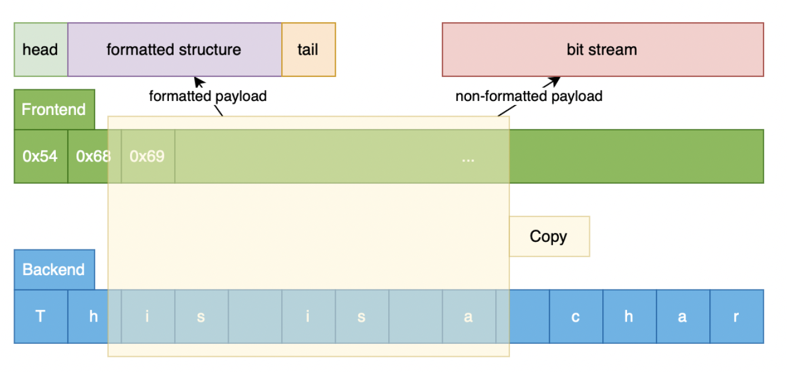
EduCode Copy/Paste Encoding
EduCode never moves raw text between endpoints
Copy operations generate formatted, structured payloads (head + data + tail)
Paste operations validate and decode the payload
Any external or invalid copying produces unreadable bit streams

Slide 8
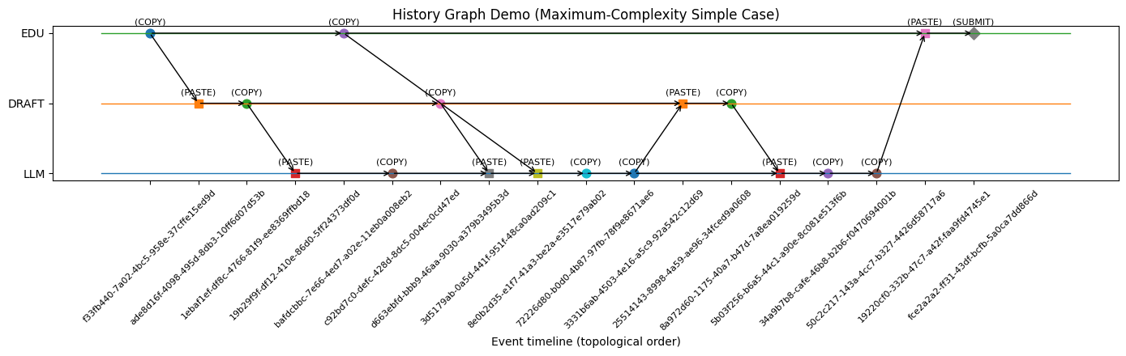
History Graph–An Example
Represents the full trace of one assignment
Each Node = an action (copy, paste, type, submit)
Parents = where the content came from
Digests = verify consistency without revealing text
Enables process transparency without exposing student text

Slide 9
Scalable Analysis to the History Graph
Treat the EduCode history as a DAG over actions (COPY / PASTE / SUBMIT across EDU, DRAFT, LLM)
Assign source weights at root nodes (LLM = AI, DRAFT = human, EDU = prompt) and propagate them forward through the graph
For each submission node, compute an approximate AI / human / prompt contribution vector
AI-derived contribution: 58.3%
Human-typed contribution: 30.6%
Prompt/instruction reuse: 11.1%
Overall tag: Moderate AI assistance

Slide 10
Conclusion
Introduced a protocol-level approach, based on endpoint-specific encryption and structured payloads rather than text detectors
EduCode encodes student activity as a history DAG over EDU / DRAFT / LLM endpoints
Implemented an initial authorship analysis module that propagates source weights (AI / human / prompt)
Overall: points toward process-aware, provenance-based assessment pipelines that can achieve scalable, AI-compatible evaluation

Slide 11
Thanks
Lei Shi-CIS 5603
Collaborator: Tangrui Li

