Slide 1

A Pipeline for Automated Analysis of Factual Claims in YouTube Transcripts
Team: Farnoush Nilizadeh, Ali Ansari, Sanobar Rustamova, Abhudaya Shrivastava

Slide 2
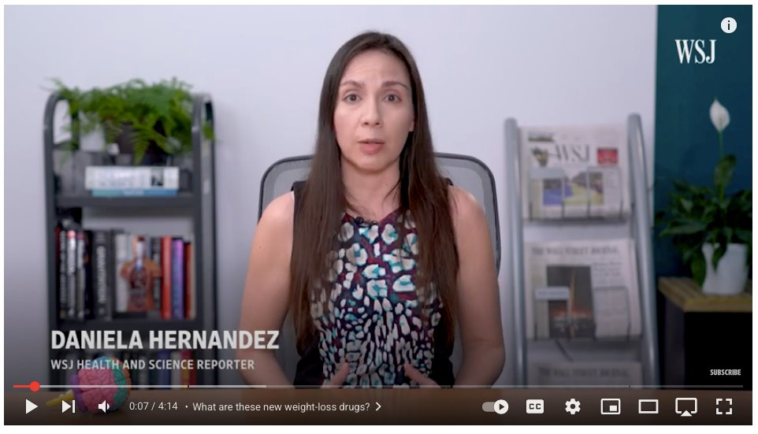
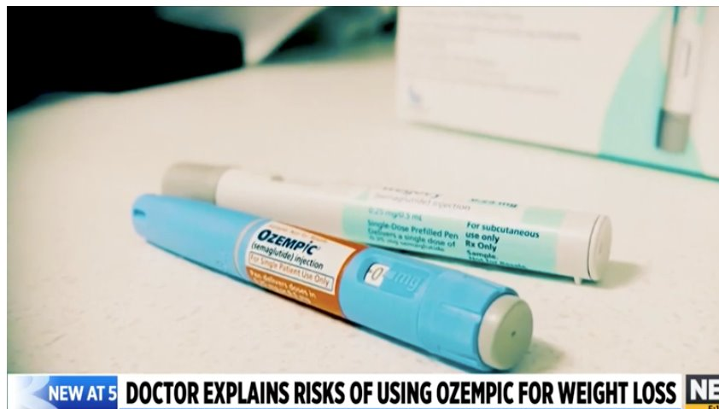
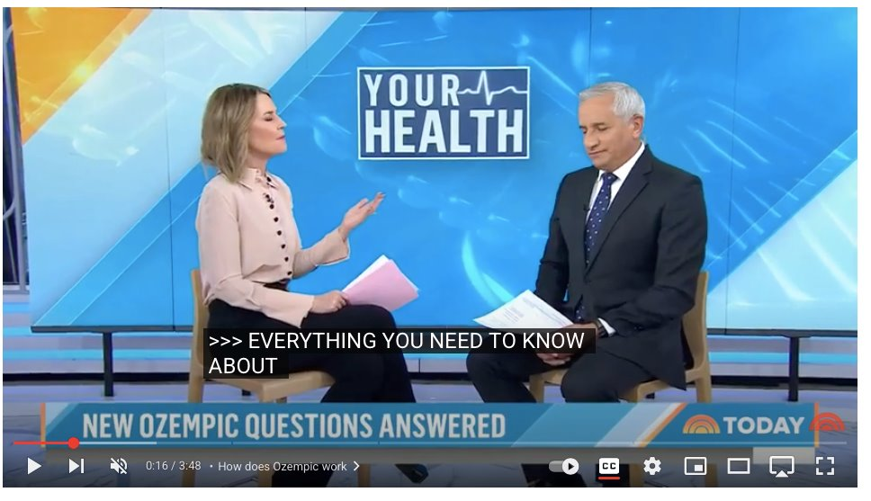
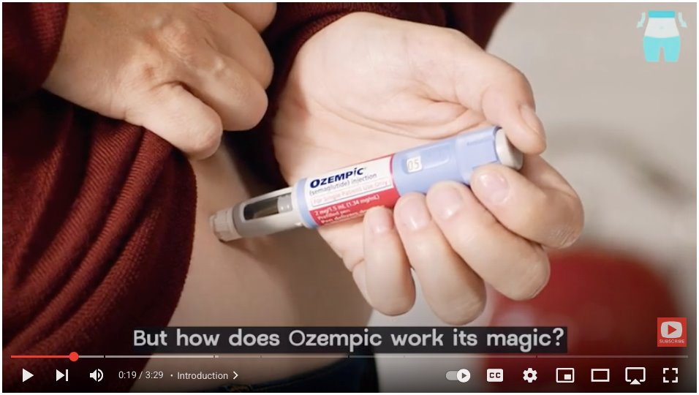
Topic & Motivation
•
Topic: GLP-1 Agonists (Ozempic/Wegovy) on YouTube.
•
The Problem:
•
Proliferation of information makes manual tracking impossible.
•
Content is noisy, machine-generated, and anecdotal.
•
Goal: To automatically process transcripts and analyze factual claims and their logical relationships.
10,000+ Hours of Unstructured Video Data

Slide 3
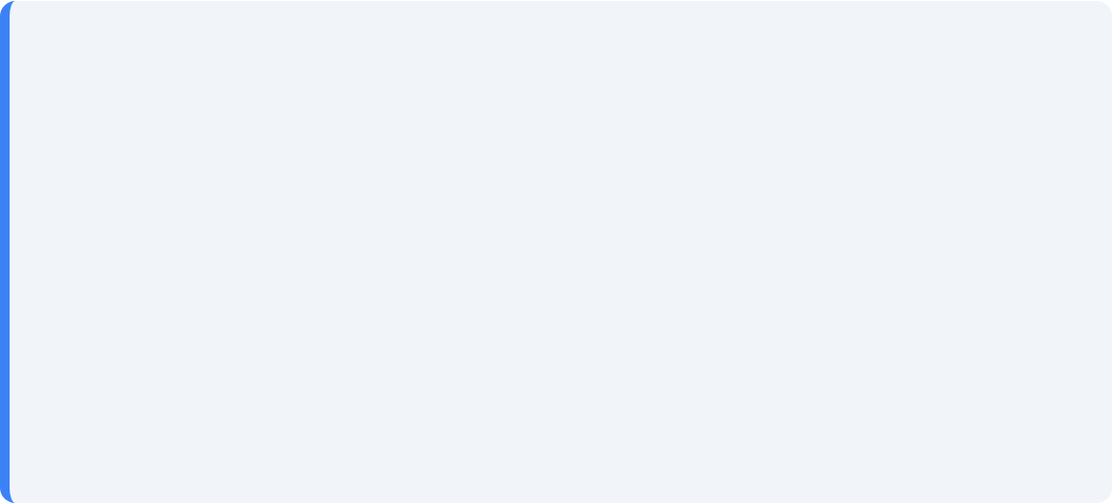
Primary Objective
Our Engineering Goal
"To build a machine that could take a raw, messy video and output a structured list of atomic, factual claims."
•
Classification by Stance (Positive/Negative)
•
Classification by Aspect
•
Identification of Semantic Relationships

Slide 4
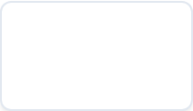
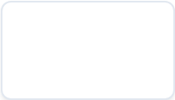
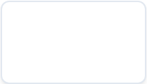
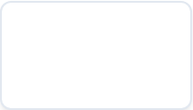
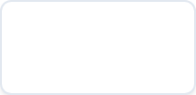




The 5-Phase Pipeline
Data Collection
Transcription
Smart Triage
Extraction
Classification
YouTube API & Metadata
Local Whisper Implementation
Branching Logic & Denoising
Context-Aware Decomposition
13-Aspect Taxonomy

Slide 5



Phase 1: Data Collection & Preparation
Output: Central Database
Goal: Gathering raw materials for analysis.
File:
•
Input:
Columns: id, title, description, view_count, like_count, comment_count.
•
Process: Python script calls YouTube Data API.
Result: Central database established.

Slide 6

Phase 2: Transcription Extraction
Challenges
•
Bot Detection: Solved by Using `yt-dlp` with browser cookie injection to authenticate as a real user.
•
Tools: yt-dlp (Audio) + Whisper (Text).
•
Process: Transcribe every video in master CSV.
•
CSV Corruption: Hidden characters broke file structure (Solved by building a custom text-cleaning protocol.
).
•
Output: Fills transcript column.

Slide 7






Phase 3: Deep Video-Level Analysis
Goal: High-level analysis of content, style, and intent using LLMs.
1. Triage
2. Analysis
3. Entities
Filter English & Relevance.
Stance, Rhetoric, Content Type.
Drugs, Conditions, Side Effects.

Slide 8

Phase 3: Output & Storage
Key Metadata Captured
Data Structure
•
Stance: Pro / Neutral / Anti
Results from all 3 prompts are combined into a single JSON object.
•
Speaker Type: Doctor / Patient / Influencer
Storage: New column in master CSV.
•
Evidence Level: Anecdotal vs Cited Research

Slide 9


Methodology: Validation Protocol
To ensure high-quality data, we established a human-verified benchmark before running scale processing.
1. Ground Truth Creation
2. Optimization Loop
•
14 Videos selected for manual review.
•
We tested multiple prompt architectures against this Gold Standard.
•
Dual Annotation: Two researchers (Farnoush & Elham) extracted claims independently.
•
Calculated F1-Score (Semantic Match) for each attempt.
•
Consensus: Meetings to resolve disagreements and finalize the "Gold Standard."
•
Refined prompts iteratively until performance was maximized.

Slide 10
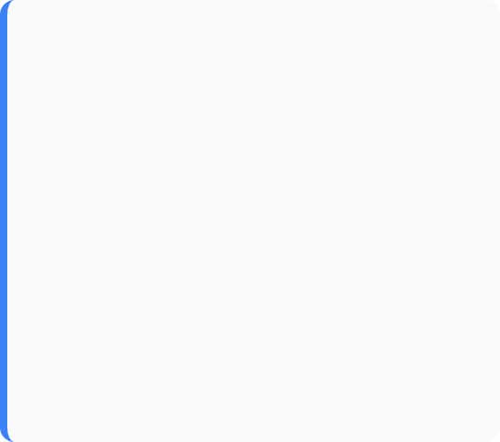
Phase 4: Claim Extraction
Method: The "Extract and Decompose" Strategy.
Step 1: The extractor
Goal: Identifying Relevant Sentences
0.94
The first step is finding the sentences that matter within a 5,000-word transcript.
F1-Score
Precision: 0.94 | Recall: 0.94
We optimized the "Extractor" prompt to find relevant content while ignoring fluff.

Slide 11
Phase 4: Claim Extraction
Step 2: The Decomposer
•
More powerful analysis on specific sentences.
0.87
•
Breaks complex sentences into atomic sub-claims.
F1-Score
Precision: 0.86 | Recall: 0.89

Slide 12

Phase 5: Inter-Claim Analysis
Goal: Analyze relationships across ALL videos.
•
Clustering: Group claims based on our 13 defined Aspects.
•
From Local Lists to Global Graph
NLI: Find contradictions and consensus.

Slide 13
Phase 5: Grouping & Analysing
Aspect extraction
0.00
we came up with 13 Aspects in the topic and clustered the claims into them.
F1-Score
Precision: 0.0 | Recall: 0.0

Slide 14






Aspect Taxonomy
We classify claims into 13 Aspects, including:

Slide 15

Current Project Status
•
Ground Truth Created: Manually annotated statements, claims, Aspects, and Stance.
•
Transcripts Ready: Phase 2 is complete.
•
Prompts Validated: Iterated on Phase 3 & 4.
•
Taxonomy Defined: 13 Aspects.

Slide 16
Plan for the Final Week
•
Execution: Apply the validated prompts to the full dataset.
•
Clustering: Group the extracted claims using our Aspect taxonomy.
•
Analysis: Generate final insights from the clustered data.
•
Reporting: Compile the findings for the final report.

Slide 17

Conclusion
Summary
•
Engineered a robust NLP pipeline for health discourse.
PhD Context
•
Addressed real-world data issues (ASR noise, corruption).
This project establishes the technical foundation for future publication.
•
Validated architecture against human ground truth.

Slide 18


Thank You for your attention!

