Slide 1
SINDy+Reinforcement Learning
CIS5603 Project
Presenter: Hirsa Kia

Slide 2
What is RL?
In RL, we train an agent to learn a policy to maximize cumulative reward
Two main paradigms:
Model-Free RL: Learn what you care about the most (Q-learning, Policy Gradient)
No model needed
Low sample efficiency (lots of interactions needed)
Model-Based RL: Learn environment model
High sample efficiency
Learn once, reuse model for different objectives
Modeling of the environment could be harder

Slide 3
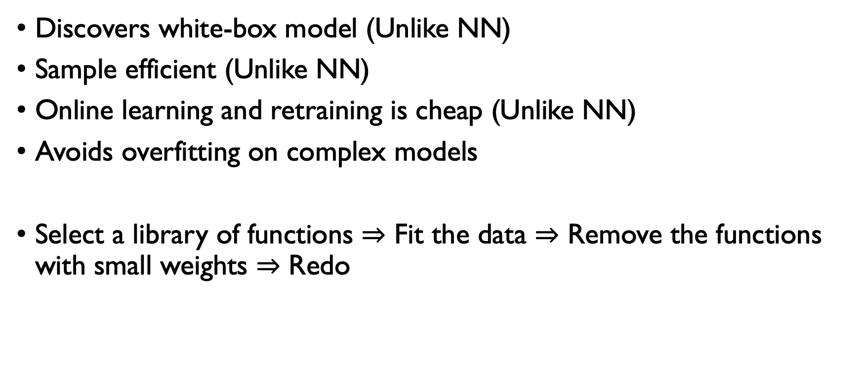
Why Sparce Identification of Nonlinear Dynamics?
Discovers white-box model (Unlike NN)
Sample efficient (Unlike NN)
Online learning and retraining is cheap (Unlike NN)
Avoids overfitting on complex models
Select a library of functions $⇒$ Fit the data $⇒$ Remove the functions with small weights $⇒$ Redo

Slide 4
SINDy+RL Agent
Retraining
Library of Candidates
Suggested actions
Model Parameters
Storage
Sequentially Thresholded Least Squares Problem
Sparse Dynamics Model
Rollouts
RL
Trajectory Data
Unknown Dynamics
Actions

Slide 5
Scenarios
Pendulum Swing-up
Offline and Noisy Online
Non-stationary Oscillator
Model parameters change over time
Compare Model-based vs. Model-free
DQN
NN
SINDy

Slide 6
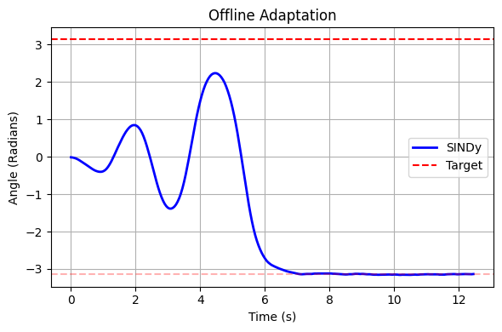
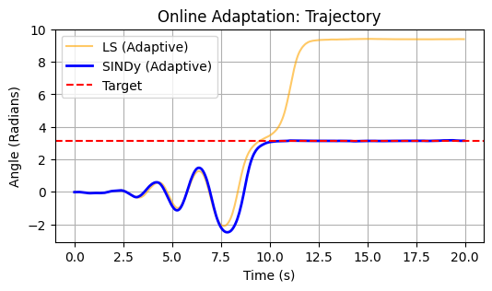
Scenario 1: Pendulum Swing-Up

Slide 7
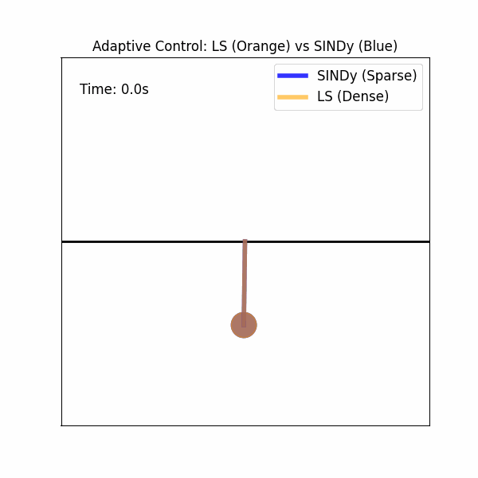
Scenario 1: Pendulum Swing-Up

Slide 8
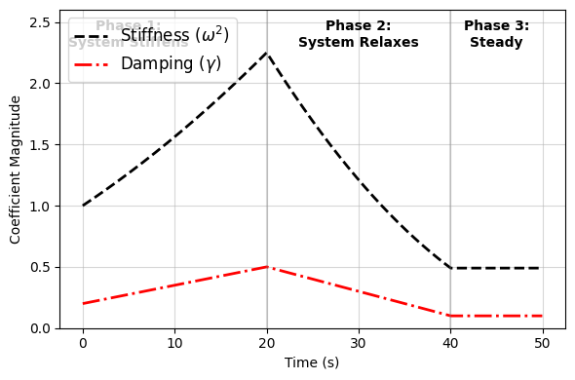
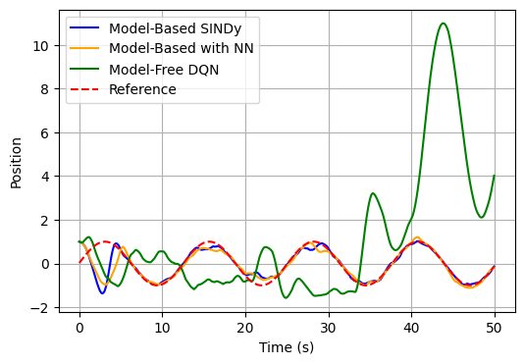
Scenario I1: Non-stationary Oscillator

Slide 9
Conclusions
Model-based can be better than Model-free, if modeling makes sense
NN could be used since it provides a rich function space
Large function space could lead to expensive training and overfitting
SINDy can make a lot of sense in non-stationary cases

