Slide 1
Connect 4 AI
Deep Q-Network Reinforcement Learning
Donye Wakefield and Calvin Kang
2025
Notes:
Hi everyone, today we're presenting our course project:
Connect 4 AI using Deep Q-Network Reinforcement Learning.
The goal of this project is to build an AI that can learn
to play Connect 4 completely on its own - no hardcoded rules,
no human strategies. It learns purely by playing thousands
of games and figuring out what works.
Let's start by explaining what Connect 4 is and why we
chose reinforcement learning for this problem.

Slide 2
What is Connect 4?
GAME RULES
Two players take turns dropping pieces
6 rows × 7 columns board
First to connect 4 in a row wins
Horizontal, vertical, or diagonal
WHY REINFORCEMENT LEARNING?
AI learns through trial and error
No hardcoded strategies needed
Improves over time with training
6×7 Game Board
Notes:
So what is Connect 4? It's a two-player game on a 6 by 7 board. Players take turns dropping pieces into columns, and the pieces fall to the lowest available spot. The first player to connect 4 pieces in a row wins - either horizontally, vertically, or diagonally. Why did we choose reinforcement learning for this? Because we wanted the AI to learn by itself. Instead of programming specific strategies like "block the opponent" or "try to build lines", we let the AI play thousands of games, make mistakes, and gradually figure out what moves lead to winning. That's the power of reinforcement learning - it learns through trial and error.

Slide 3
What is DQN?
CORE IDEA
DQN = Deep Neural Network + Q-Learning
Replay Buffer
Q-Learning
Neural Network
Stores past experiences
Random sampling for training
Breaks correlation in data
Learn action values Q(s, a)
Choose action with max Q
Update based on rewards
Approximates Q function
Handles large state spaces
Learns patterns from data
ε-GREEDY:
Balance exploration (random moves) vs exploitation (best known moves)
Notes:
Now let's explain what DQN is. DQN stands for Deep Q-Network.
It combines two things: Q-Learning and Deep Neural Networks.
Q-Learning is a classic reinforcement learning algorithm. The idea is simple: for every state of the game, we want to learn a Q-value for each possible action.
The Q-value tells us how good that action is. So the AI just picks the action with the highest Q-value.
But Connect 4 has billions of possible board states - we can't store Q-values for all of them. That's where the neural network comes in.
Instead of storing a giant table, we train a neural network to predict Q-values for any board state. We also use a Replay Buffer - it stores past experiences and we randomly sample from it during training. This helps the network learn more efficiently. Early in training, the AI makes mostly random moves to explore different strategies. As training progresses, it relies more on what it has learned.

Slide 4
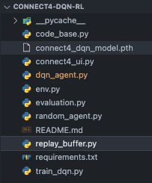
Project Architecture
FILE STRUCTURE
TRAINING FLOW
Agent plays game
Uses ε-greedy to choose actions
Store experience
(state, action, reward, next_state) → Buffer
Sample & train
Random batch of 64 → Update CNN weights
Repeat & improve
Thousands of games → Better strategy
Notes:
Let me walk you through our project structure. On the left, you can see our file organization.
We have several Python files: - env.py is the game environment - it handles the board, making moves, and checking for winners.
- dqn_agent.py contains our CNN model and the DQN agent.
- replay_buffer.py stores all the experiences for training.
- train_dqn.py is the main training loop.
- evaluation.py tests how well our trained model performs.
- connect4_ui.py is a graphical interface where you can play against the AI.
- random_agent.py is a simple agent that makes random moves - we use it as the opponent during training.
- And connect4_dqn_model.pth is our saved trained model.
On the right is our training flow - it's a 4-step loop:
Step 1: The agent plays the game, using epsilon-greedy to choose actions.
Step 2: After each move, we store the experience into the buffer.
Step 3: We randomly sample a batch of 64 experiences and update the CNN weights.
Step 4: We repeat this for thousands of games, and the agent gradually gets better.

Slide 5
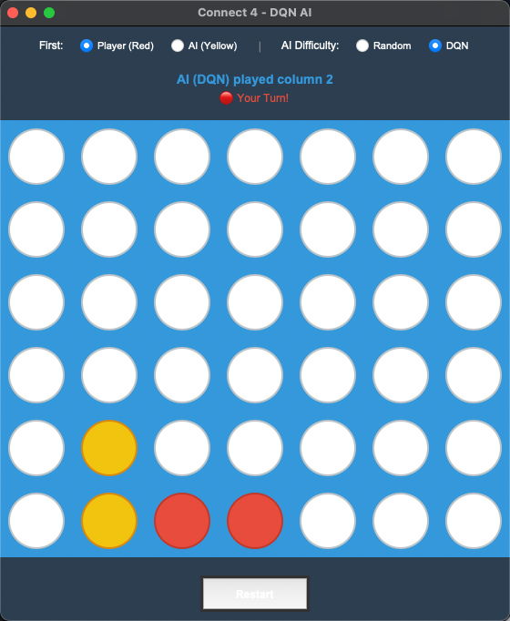
Live Demo
UI FEATURES
Choose First Player
Player or AI can go first
Select AI Difficulty
Random or trained DQN model
Turn Indicator
Shows whose turn it is
Auto Restart
New game after win/lose/draw
Notes:
Now let me show you our game interface.
This is the UI we built using Python's Tkinter library.
You can see the Connect 4 board in the middle - the blue
grid with red and yellow pieces.
At the top, we have two options:
First, you can choose who goes first - either the player
or the AI.
Second, you can select the AI difficulty. You can play
against a Random agent, which just picks random moves,
or you can play against our trained DQN model.
The interface also shows whose turn it is - "Your Turn"
or "AI Thinking".
And after each game ends, it automatically restarts
so you can play again.
Let me give you a quick demo...

Slide 6
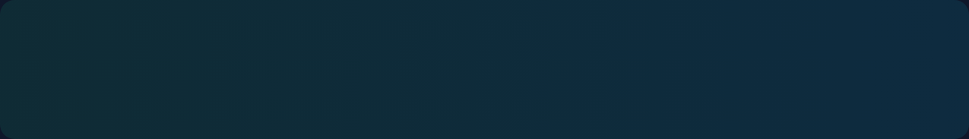
Evaluation Results
DQN vs RANDOM AGENT (100 games)
Wins
~70%
Losses
~25%
Draws
~5%
TRAINING CONFIG
Episodes
Batch Size
Platform
2,000+
64
Google Colab GPU
Key Insight: DQN significantly outperforms random play after training
Notes:
So how well does our trained DQN agent perform?
We evaluated it by playing 100 games against a random agent.
As you can see from the results:
- Our DQN agent wins about 70% of the games
- It loses around 25%
- And about 5% end in draws
Compared to a random agent, which would win about 50%
against another random agent, our DQN is significantly better.
For training, we ran over 10,000 episodes with a batch size
of 64. We used Google Colab with a Tesla T4 GPU to speed up
the training process.
The key insight here is that DQN can learn effective
strategies just by playing games - no human knowledge required.
The more we train, the better it gets.

Slide 7
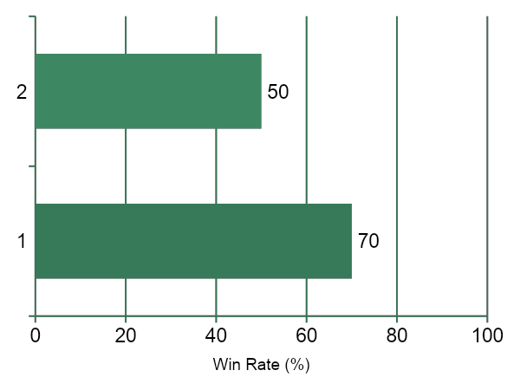
WIN RATE COMPARISON

Slide 8
Conclusion & Future Work
WHAT WE LEARNED
FUTURE IMPROVEMENTS
DQN can learn game strategies through self-play without explicit rules
Self-Play Training
Train against itself instead of random agent for stronger play
CNN architecture effectively captures spatial patterns on the board
Better Reward Shaping
Reward blocking opponent's winning moves and creating threats
More training episodes = Better performance against random opponents
Double DQN / Dueling DQN
Advanced DQN variants for more stable learning
GPU training (Colab) significantly speeds up the learning process
Monte Carlo Tree Search
Combine with MCTS for even stronger decision making
Notes:
So what did we learn from this project? First, DQN can learn game strategies through self-play without us programming any explicit rules. The AI figured out on its own how to win. Second, CNN architecture works well for this problem because it can detect spatial patterns on the board - like lines and potential threats. Third, more training means better performance. We saw the win rate improve as we trained for more episodes. And fourth, using GPU on Google Colab made training much faster compared to running on our local computers. For future improvements, there are several things we could do: Self-play training - instead of training against a random agent, have the AI play against itself. This would make it much stronger. Better reward shaping - give rewards for blocking opponent's winning moves or creating threats, not just for winning. We could also try advanced DQN variants like Double DQN or Dueling DQN for more stable learning. And finally, we could combine DQN with Monte Carlo Tree Search, which is what AlphaGo uses, for even better performance.

