Slide 1

Graph Retrievers based on LLM
Aayush Acharya

Slide 2
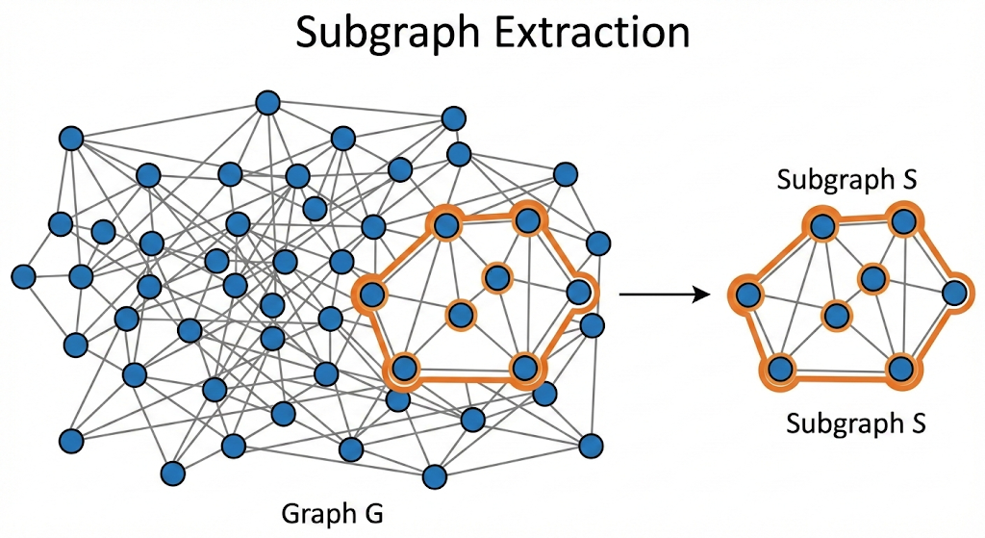
Background: Graph retriever
Identifies and extracts the most relevant subgraph from a large Knowledge Graph (KG) to answer a user query.
Instead of retrieving entire graphs, it focuses on precise, query-specific nodes and relations.
Acts as a bridge between Natural Language Queries and structured KG data, ensuring downstream models work on the right context.
Supports applications in Knowledge Graph Question Answering (KGQA), fact verification, and graph-augmented LLMs.

Slide 3
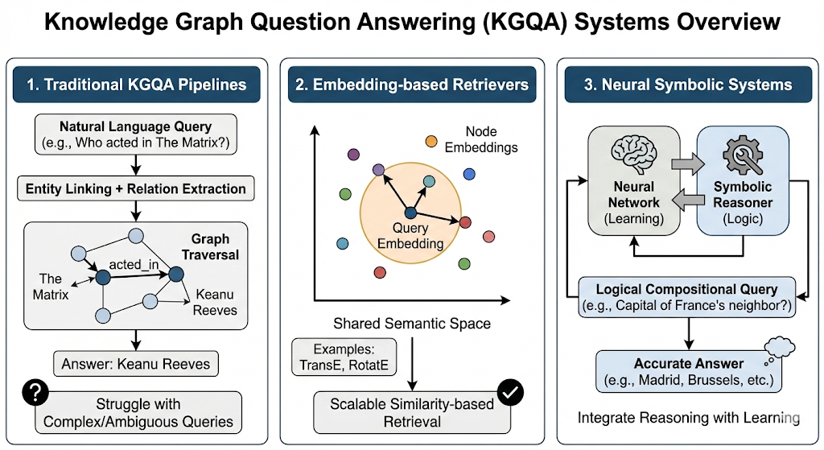
Literature review
Traditional KGQA pipelines rely on entity linking + relation extraction followed by graph traversal, but struggle with complex multi-hop or ambiguous queries.
Embedding-based retrievers map queries and nodes into a shared semantic space, enabling scalable similarity-based retrieval (e.g., TransE, RotatE).
Neural symbolic systems integrate reasoning with learning, improving retrieval accuracy for logical compositional queries.

Slide 4
Dataset: GrailQA
A large-scale KGQA benchmark built on Freebase (~64K questions).
Each question includes logical-form annotations for precise evaluation.
Designed to test generalization with three settings:
i.i.d., compositional, and zero-shot splits.
Covers diverse multi-hop and semantic reasoning challenges.
Evaluates both retrieval accuracy and downstream question answering.
Widely used to benchmark graph retrievers and KGQA models.

Slide 5
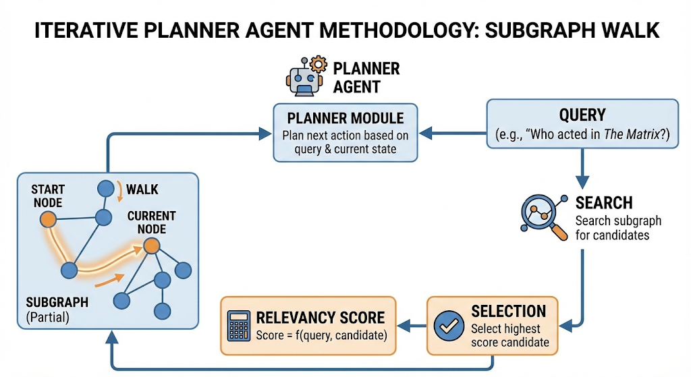
Methodology

Slide 6
Future tasks
Running the experiments and evaluation pipeline.
See how the baseline model fares with proposed model in the leaderboard.

Slide 7

Any questions?

