Slide 1

Project
Neural network and reinforcement learning approach to optimize
compressive measurement matrix in a massive MIMO system
Md Saidur Rahman Pavel
Nazia Rahman

Slide 2
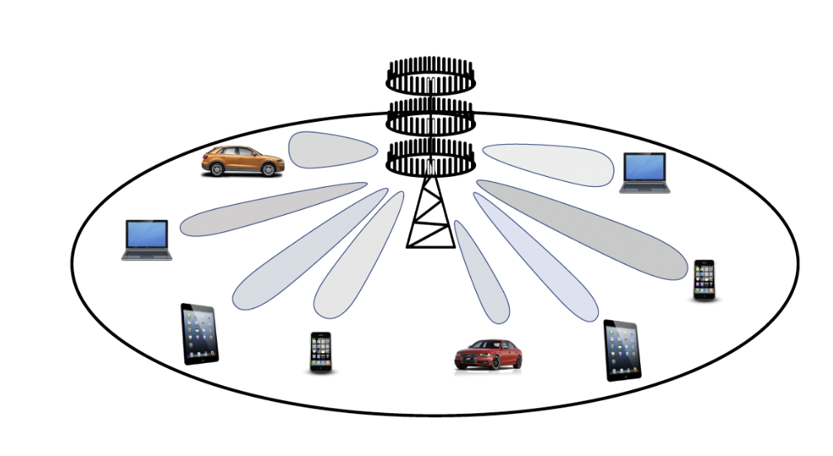
Massive MIMO system and beamforming
One of the key enablers of the Beyond 5G and 6G wireless communication technologies.
A very large number of antennas in the Base station.
Enhance system capacity, energy efficiency, and robustness.
Ensure higher data rates and greater spectrum efficiency.
Highly directional beamforming is required.
Accurate estimation of channel state information is essential, for which accurate direction of arrival estimation (DOA) is important.
A massive MIMO system

Slide 3
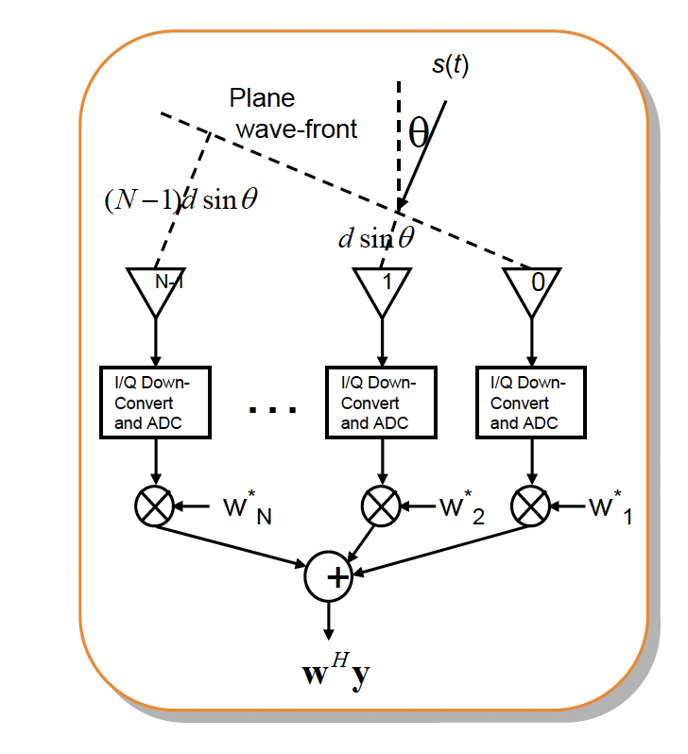
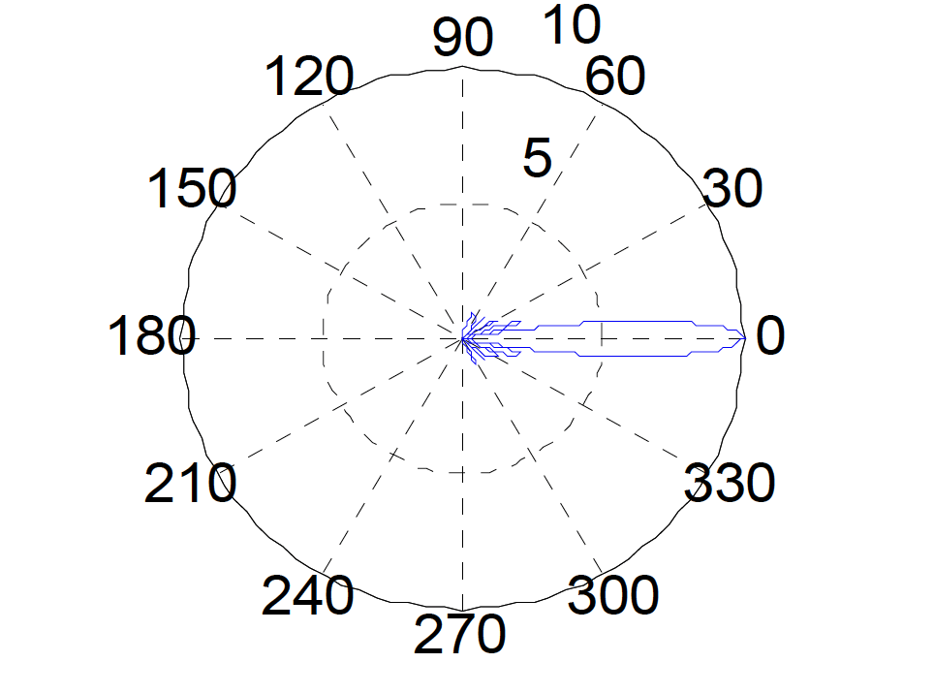
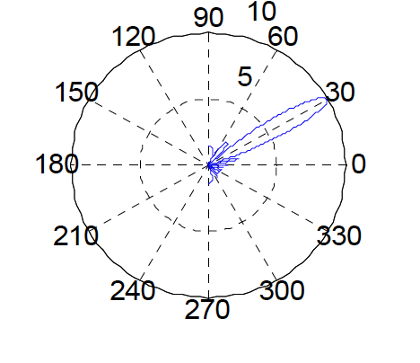






Beamforming overview
$$w={\left[1,1, ⋯,1\right]}^{T}=a^{∗}(0°)$$
$$w={\left[1,e^{−\frac{jπ}{2}}, ⋯,e^{−jπ}\right]}^{T}=a^{∗}\left(30°\right)$$
$$x_{N}$$
$$x_{2}$$
$$x_{1}$$
$$w^{H}x$$
Adjusting the weights, it is possible to steer the beam in different directions.
The wights depends on the direction of arrivals (DOAs)

Slide 4
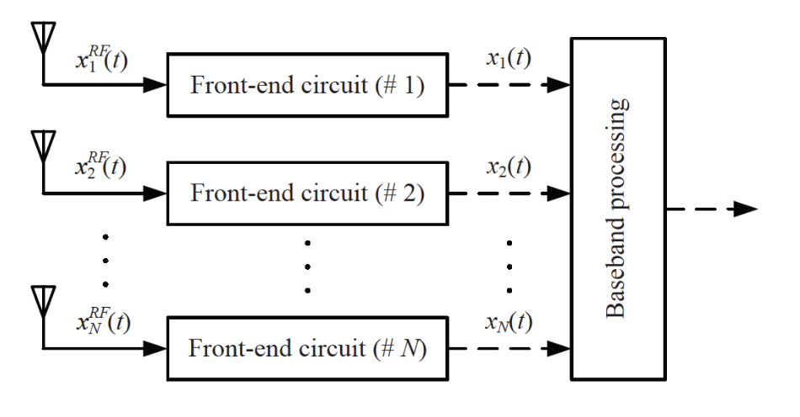
Full digital beamforming
Separate RF chains (Front-end circuits) are required.
An RF front-end chain typically consists of a band-pass filter, a low-noise amplifier, a mixer, a low-pass filter, and a high
resolution ADC.
More costly than Antenna elements.
The most limiting factor from the perspective of cost and power consumption for implementing a massive MIMO system.

Slide 5
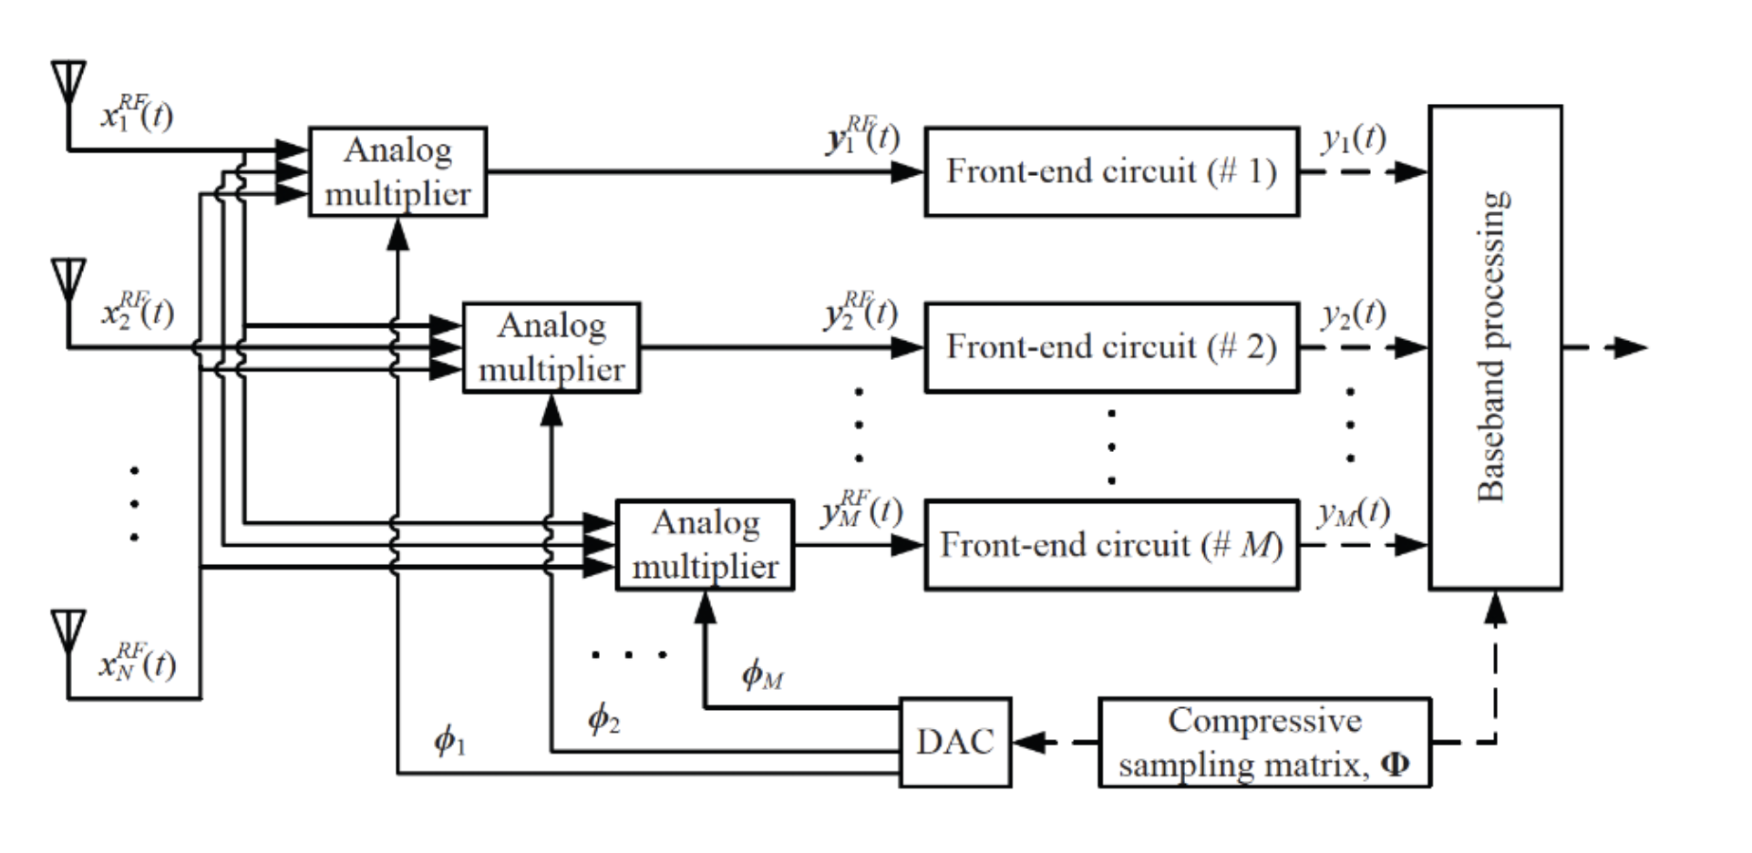
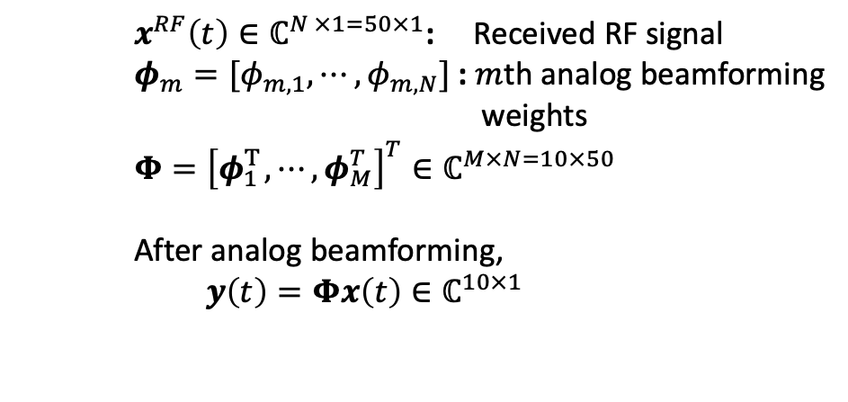
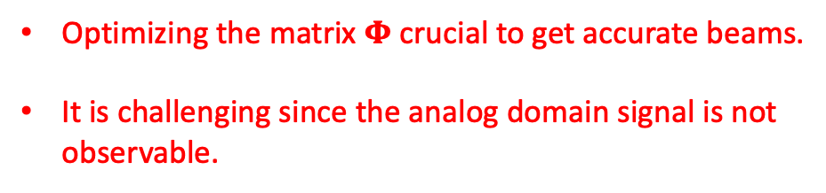
Hybrid beamforming
Hybrid analog-digital beamforming is a practical choice.
Compress the high-dimensional received signal into a lower-dimensional space (Analog beamforming)
before digitization.
The analog version of the received signal is not observable; we can only observe it once it is digitized.
$x^{RF}\left(t\right)∈ℂ^{N ×1=50×1}$: Received RF signal
$φ_{m}=[φ_{m,1}, ⋯,φ_{m,N}]$: $m$th analog beamforming
weights
$$Φ={\left[φ_{1 }^{T}, ⋯,φ_{M}^{T}\right]}^{T}∈ℂ^{M×N=10×50}$$
After analog beamforming,
$$y\left(t\right)=Φx\left(t\right)∈ℂ^{10×1}$$
Optimizing the matrix $Φ$ crucial to get accurate beams.
It is challenging since the analog domain signal is not
observable.
Hybrid analog-digital beamforming from

Slide 6
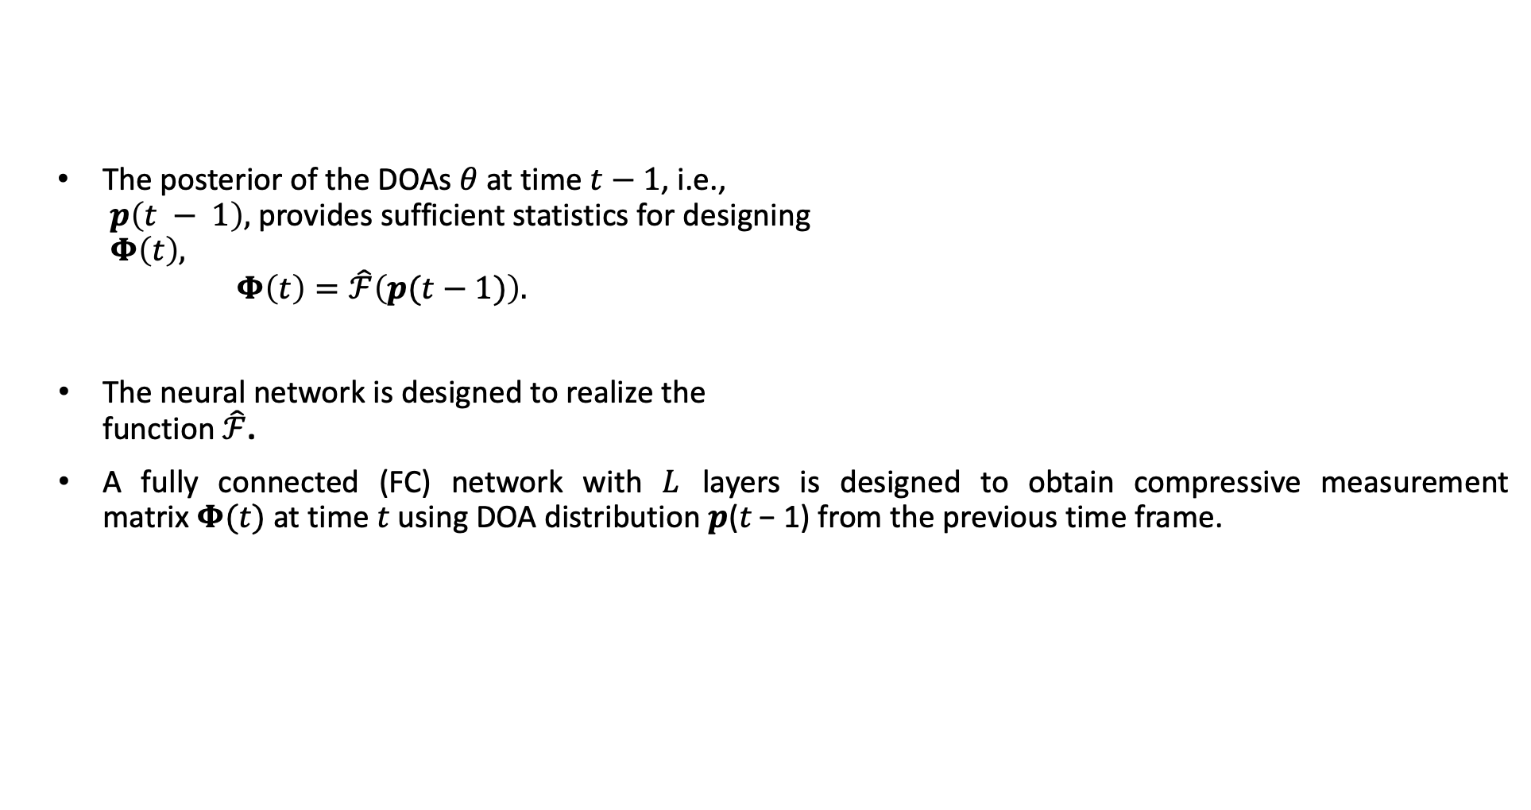

Neural network-based optimization of $Φ$
The posterior of the DOAs $θ$at time $t−1$, i.e.,
$p\left(t − 1\right),$provides sufficient statistics for designing
$Φ\left(t\right),$
$Φ\left(t\right)=\hat{ℱ}\left(p(t−1)\right).$
The neural network is designed to realize the
function $\hat{ℱ}$.
A fully connected (FC) network with $L$ layers is designed to obtain compressive measurement
matrix $Φ(t)$at time 𝑡 using DOA distribution 𝒑(𝑡 − 1) from the previous time frame.
Fig 3:Neural network framework for optimizing $Φ$

Slide 7
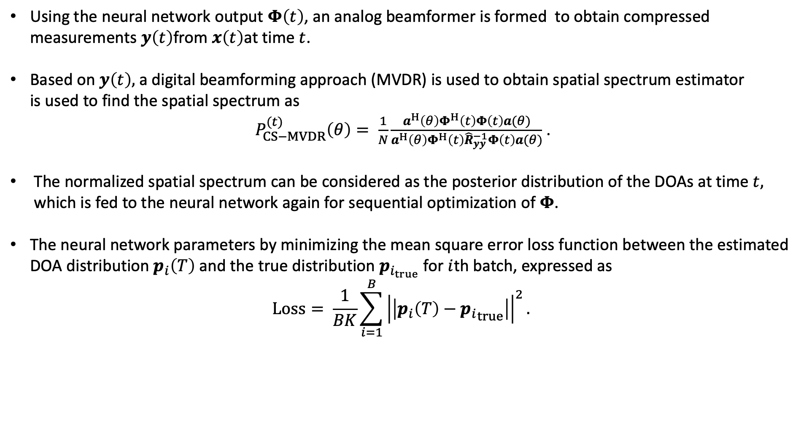
Neural network-based optimization of $Φ$
Using the neural network output $Φ\left(t\right)$, an analog beamformer is formed to obtain compressed
measurements $y\left(t\right)$from $x\left(t\right)$at time $t$.
Based on $y\left(t\right),$a digital beamforming approach (MVDR) is used to obtain spatial spectrum estimator
is used to find the spatial spectrum as
$P_{CS−MVDR}^{(t)}\left(θ\right)= \frac{1}{N}\frac{a^{H}\left(θ\right)Φ^{H}\left(t\right)Φ\left(t\right)a(θ)}{a^{H}\left(θ\right)Φ^{H}\left(t\right){\hat{R}}_{yy}^{−1}Φ\left(t\right)a(θ)}$ .
The normalized spatial spectrum can be considered as the posterior distribution of the DOAs at time $t,$ which is fed to the neural network again for sequential optimization of 𝚽.
The neural network parameters by minimizing the mean square error loss function between the estimated DOA distribution $p_{i}\left(T\right)$ and the true distribution $p_{i_{true}}$ for $i$th batch, expressed as
$$Loss= \frac{1}{BK}\sum_{i=1}^{B}{{\left|\left|p_{i}\left(T\right)−{p_{i}}_{true}\right|\right|}^{2}. }$$

Slide 8
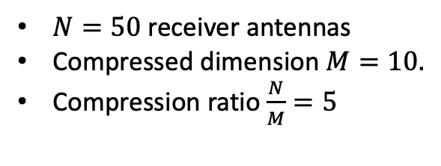
Performances
The estimated spectrum converges to have sharp peaks at the true signal DOAs
After 30 time samples
After 50 time samples
After 100 time samples
4 fully connected layer
500 nodes in each layer
Drop out rate = 0.3
No of training data = 10,000
No of test data = 1000
Input SNR is chosen randomly between 0 to 20dB
Learning rate progressively decreasing from 0.1 to 0.001.
$N=50$receiver antennas
Compressed dimension $M=10.$
Compression ratio $\frac{N}{M}=5$

Slide 9
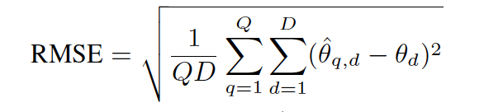
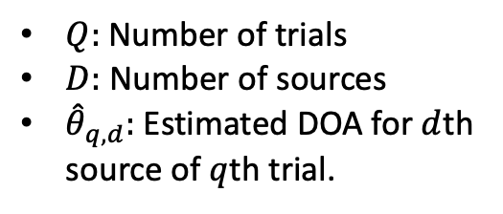
Performances
$Q:$Number of trials
$D:$ Number of sources
${\hat{θ}}_{q,d}:$ Estimated DOA for $d$th
source of $q$th trial.

Slide 10
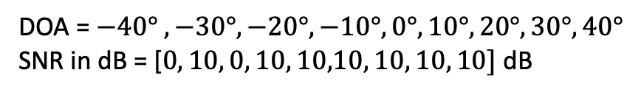
Problem with weak signals
However, the MVDR beamforming generally favors strong signals.
When signals have mixed strengths, it may progressively decrease weak signals as the iterations progress
After time sample 30
After time sample 50
After time sample 100
DOA = $−40° , −30°, −20°, −10°, 0°, 10°, 20°, 30°, 40°$
SNR in dB = [$0, 10, 0, 10, 10,10, 10, 10, 10]$ dB

Slide 11
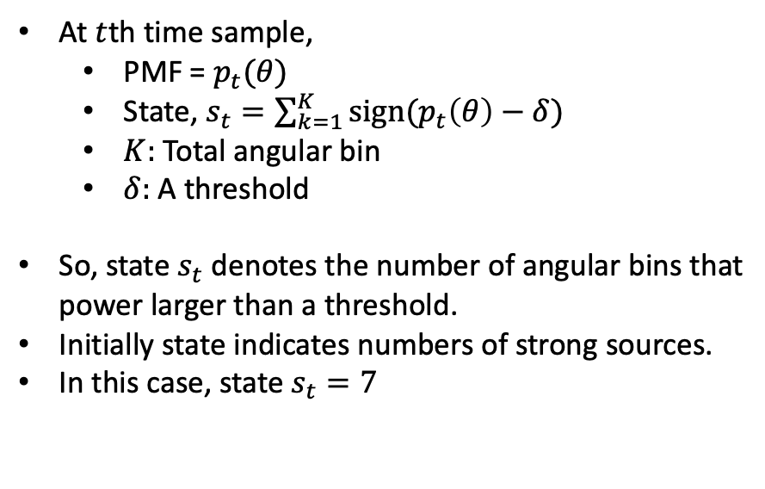
Reinforcement learning based weak signal protection
SARSA ( state-action-reward-state-action) approach is exploited to enhance the weak signals.
The idea is instead of directly use the normalized power spectrum as prior for next iteration, the PMF is
adjusted based on SARSA strategy.
State selection:
At $t$th time sample,
  PMF = $p_{t}(θ)$
  State, $s_{t}=\sum_{k=1}^{K}{sign(p_{t}\left(θ\right)−δ)}$
  $K:$Total angular bin
  $δ:$ A threshold
So, state $s_{t}$ denotes the number of angular bins that
power larger than a threshold.
Initially state indicates numbers of strong sources.
In this case, state $s_{t}=7$

Slide 12
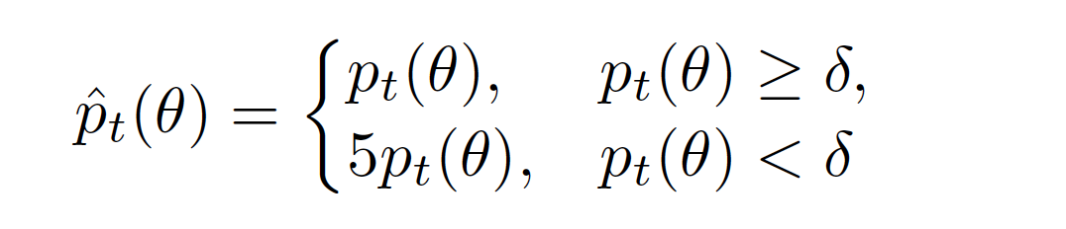
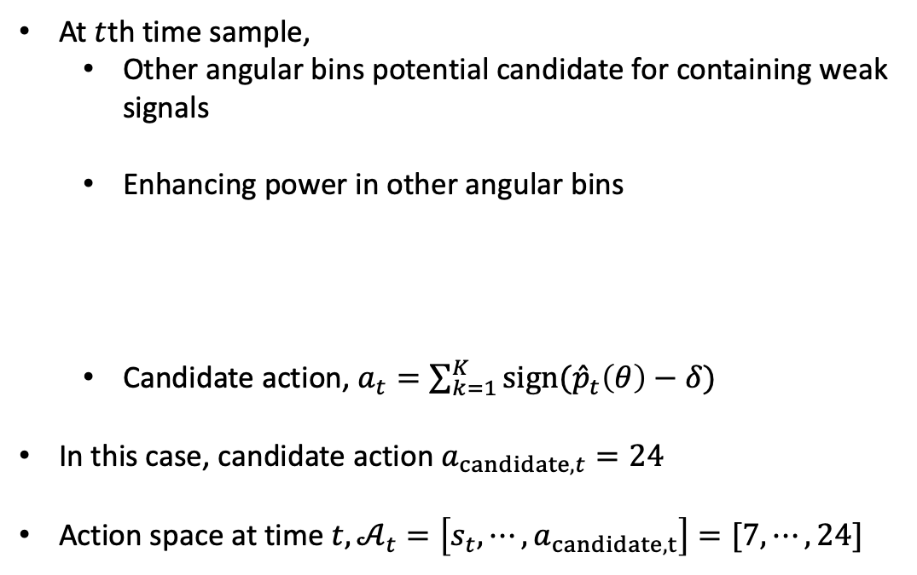
Reinforcement learning based weak signal protection
Action selection:
At $t$th time sample,
  Other angular bins potential candidate for containing weak
  signals
  Enhancing power in other angular bins
  Candidate action, $a_{t}=\sum_{k=1}^{K}{sign({\hat{p}}_{t}\left(θ\right)−δ)}$
In this case, candidate action $a_{candidate,t}=24$
Action space at time $t, 𝒜_{t}=\left[s_{t}, ⋯,a_{candidate,t}\right]=[7, ⋯,24]$

Slide 13
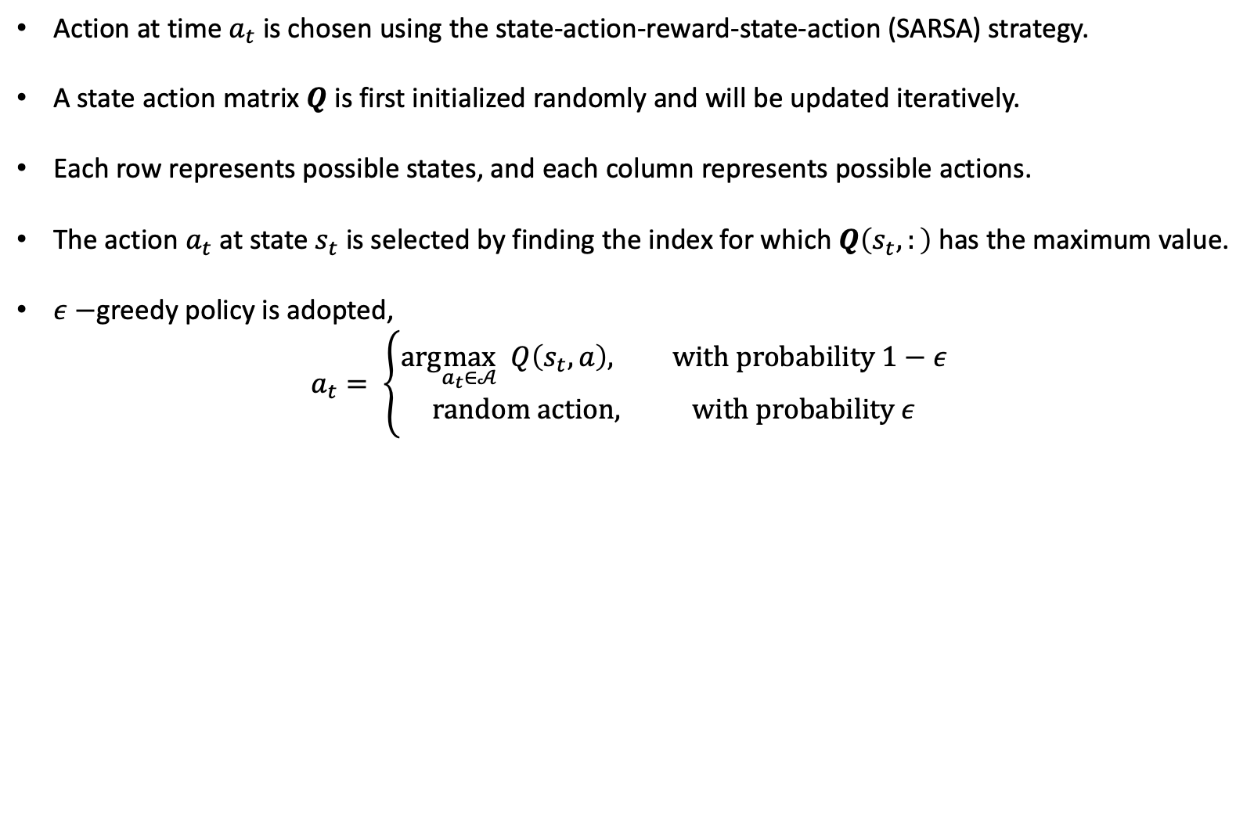
Reinforcement learning based weak signal protection
Action selection:
Action at time $a_{t}$ is chosen using the state-action-reward-state-action (SARSA) strategy.
A state action matrix $Q$ is first initialized randomly and will be updated iteratively.
Each row represents possible states, and each column represents possible actions.
The action $a_{t}$ at state $s_{t}$ is selected by finding the index for which $Q\left(s_{t},:\right)$has the maximum value.
$ε−$greedy policy is adopted,
$a_{t}= \left\{\begin{aligned}arg\max_{a_{t}∈𝒜} Q\left(s_{t},a\right), with probability 1−ε \\ random action, with probability ε\end{aligned}\right.$

Slide 14
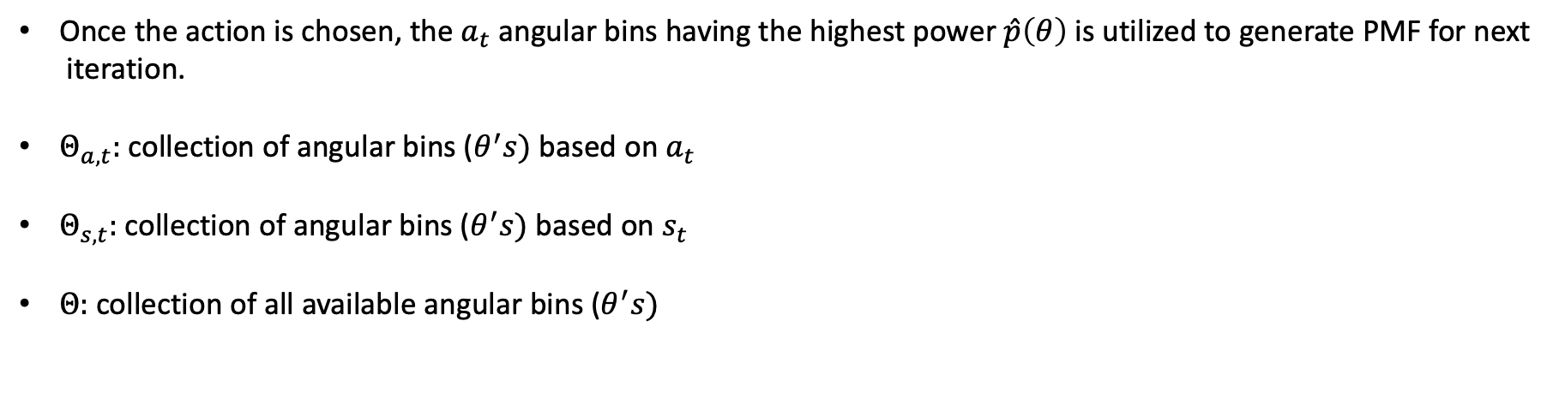
Reinforcement learning based weak signal protection
Once the action is chosen, the $a_{t}$angular bins having the highest power $\hat{p}\left(θ\right)$ is utilized to generate PMF for next
iteration.
$Θ_{a,t}:$collection of angular bins ($θ^{′}s)$based on $a_{t}$
$Θ_{s,t}:$collection of angular bins ($θ^{′}s)$based on $s_{t}$
$Θ:$collection of all available angular bins ($θ^{′}s)$

Slide 15
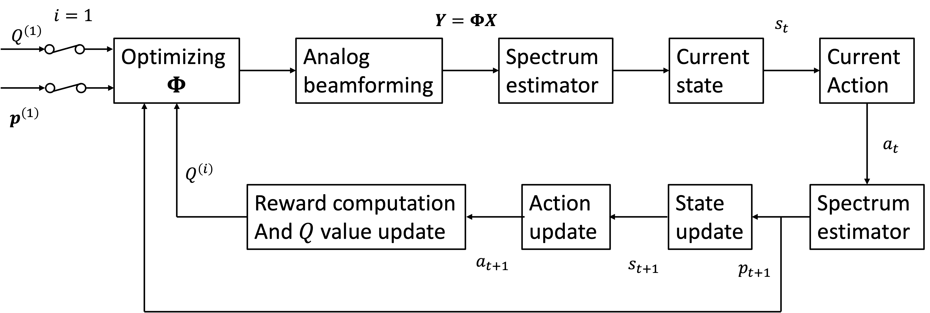
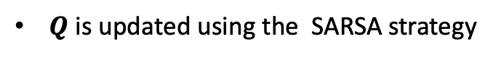
Reinforcement learning based weak signal protection
$Q$is updated using the SARSA strategy
$$Q\left(s_{t},a_{t}\right)←Q\left(s_{t},a_{t}\right)+α\left(r_{t+1}+γQ\left(s_{t+1},a_{t+1}\right)−Q\left(s_{t},a_{t}\right)\right)$$

Slide 16
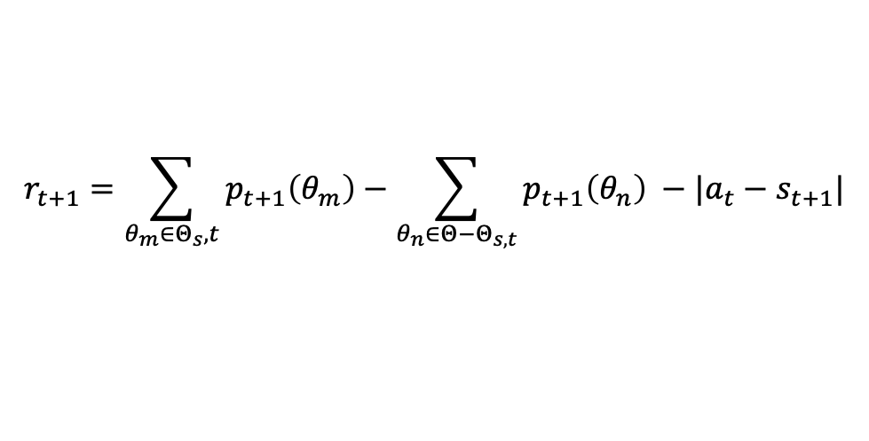
Reinforcement learning based weak signal protection
Reward function :
$$r_{t+1}=\sum_{θ_{m}∈Θ_{s},t}{p_{t+1}\left(θ_{m}\right)−\sum_{θ_{n}∈Θ−Θ_{s,t}}{p_{t+1}\left(θ_{n}\right) −|a_{t}−s_{t+1}|}}$$
The reward function has three parts:
  A positive reward for the accurate detection of angular bins from the previous state. (Possibly string sources)
  Penalizes detection at other angular bins.
  The third part imposes a penalty if the action from the previous step differs from the current state.
    The state defines angular bin corresponding to strong sources
    The action defines angular bins corresponding to strong sources + possibly weak sources + some unwanted
    sources.
    This penalty imposes the removal signal signal-free bins.
    If a weak signal containing bin is part of the action, a high PMF assigned to this bin may cause the power
    spectrum at this bin to exceed the threshold, which can be detected as a state. And the first part of the
    reward will ensure its survival.

Slide 17
Performance
Weak signals are now detected successfully.

Slide 18
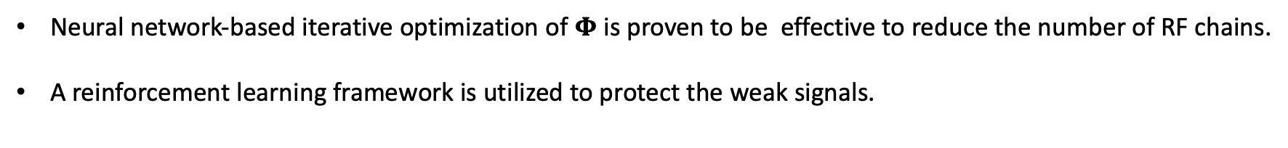
Conclusion
Neural network-based iterative optimization of $Φ$ is proven to be effective to reduce the number of RF chains.
A reinforcement learning framework is utilized to protect the weak signals.

Slide 19
Thank you

