Slide 1
Advancing Healthcare through XAI and Motion Analysis Integration
Presented by Thanh Nguyen

Slide 2
Introduction
Integration Challenges in Advanced Technology Era
Cutting-edge technologies face challenged in integration despite their promises
Explainable Artificial Intelligence (XAI) is powerful for decision-making but struggles with transparency and interpretability.
Motion Analysis as a Solution for XAI Enhancement
Motion analysis emerges as a key ally to enhance XAI's decision-making capabilities.
By analyzing intricate patterns in human motion, motion analysis serves as a supplementary tool to improve XAI algorithms.

Slide 3
Impact on Healthcare
Collaboration between motion analysis and XAI opens opportunities in healthcare.
It can advance diagnostic techniques, create tailored treatment plans, and pave the way for accurate decision-making in healthcare.

Slide 4
Explainable Artificial Intelligence

Slide 5
Potential of XAI in Healthcare
Technology’s Role
The primary goal is to bridge the gap between the complexity of advanced machine learning models and the need for transparency and accountability in decision-making
XAI can enhance the interpretability of medical diagnoses made by AI systems, helping medical professionals understand and trust the recommendations.
Role of XAI
XAI addresses ethical concerns related to biased or unfair decisions made by AI systems. It allows for the identification and mitigation of biases, promoting fairness and accountability.
XAI aims to enhance transparency, trust, and understanding among medical experts, facilitating better mental health interventions.
Notes:
[enhance transparency]..by allowing users to understand and trust the decisions made by AI models.

Slide 6
Challenges & Solutions
XAI flaws, such as uncertainty in results and safety concerns in medical applications, are recognized.
Integrating motion analysis with XAI is proposed as a potential solution to enhance accuracy and reliability in mental health applications, providing a more robust approach to decision-making.

Slide 7
Motion Analysis
Notes:
Motion analysis is a multidisciplinary approach that integrates biomechanics, computer vision, and AI to scrutinize human or object movement.
By automating the extraction of movement parameters, AI integration to facilitates biomechanical assessments it plays a pivotal role in sports science, rehabilitation, and healthcare

Slide 8
OpenPose Technology
Film Pre-processing
Initial stage involving transformations in video inputs, critical for standardization.
Includes flipping footage for specific movements to ensure optimal detection accuracy.
OpenPose Image Processing
OpenPose identifies 25 body keypoints and 21 finger/hand keypoints from processed videos.
Foundational data for calculating health indicators and further analysis of human movements.

Slide 9
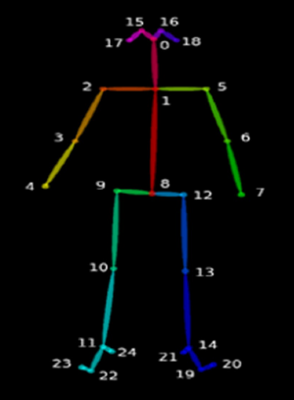
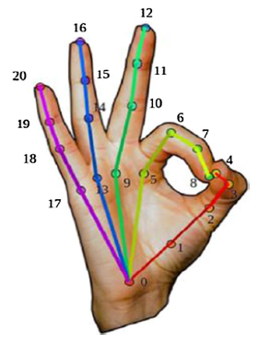

Slide 10
OpenPose Technology
Keypoint Processing
Establishment of ten health indicators for six fundamental movements, assessing torso stability, joint mobility, and movement correctness.
Adjustments made for accurate alignment of keypoints during movements like lying down and raising feet.
Comparison of Results
Rigorous evaluation of health indicators calculated by the system against manual measurements by physical therapists.
Serves as a validation process, assessing accuracy and reliability of the OpenPose-based system in detecting and analyzing physical health.

Slide 11
OpenPose Fall Detection

Slide 12
Fall Detection Experiment
Features Enhancement
Challenges in key point extraction using OpenPose are addressed to minimize bias and improve fall detection accuracy.
An algorithm combines OpenPose and MobileNetV2, utilizing pose features from annotated images to enhance feature extraction.
Fall Detection with MobileNetV2
Focuses on enhancing fall detection accuracy using the lightweight neural network MobileNetV2.

Slide 13
Fall Detection Experiment
Network Framework Modification
Incorporates a fully connected layer, softmax classifier, and Convolutional Block Attention Module (CBAM) attention mechanism for improved learning ability.
Optimization and Keypoint Extraction
Keypoint extraction accuracy is enhanced by adjusting brightness in dark images, normalizing pixel values, and preventing pixel overflow.
Fall detection model employs cross-entropy loss function and the Adam algorithm for parameter optimization.
Notes:
MobileNetV2 framework is extended with additional components such as [read incorporating a fully…]
MobileNetV2 is fine-tuned and employed for fall classification detection, outperforming other networks in comparative experiments.

Slide 14
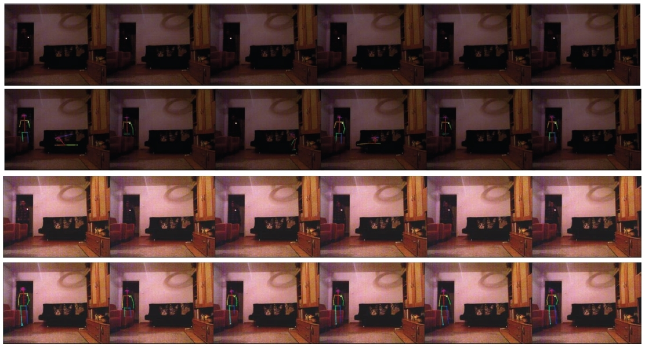
Notes:
Brightening Process:
In order to enhance the accuracy of keypoint extraction, we use [this] equation to adjust the brightness of excessively dark images
[DISCUSS IMAGE IF HAVE TIME]
Brightening Formula: We set the pixel existence interval to [1,99] to contain more pixel information.
Normalize the image pixels by mapping them back to the [0,255] interval, ensuring that outliers are removed.
And to prevent pixel overflow, we set the interval to [255*0.1,255*0.9].
Here, x_o represents the original pixel value, while x_p represents the highlighted pixel value.

Slide 15
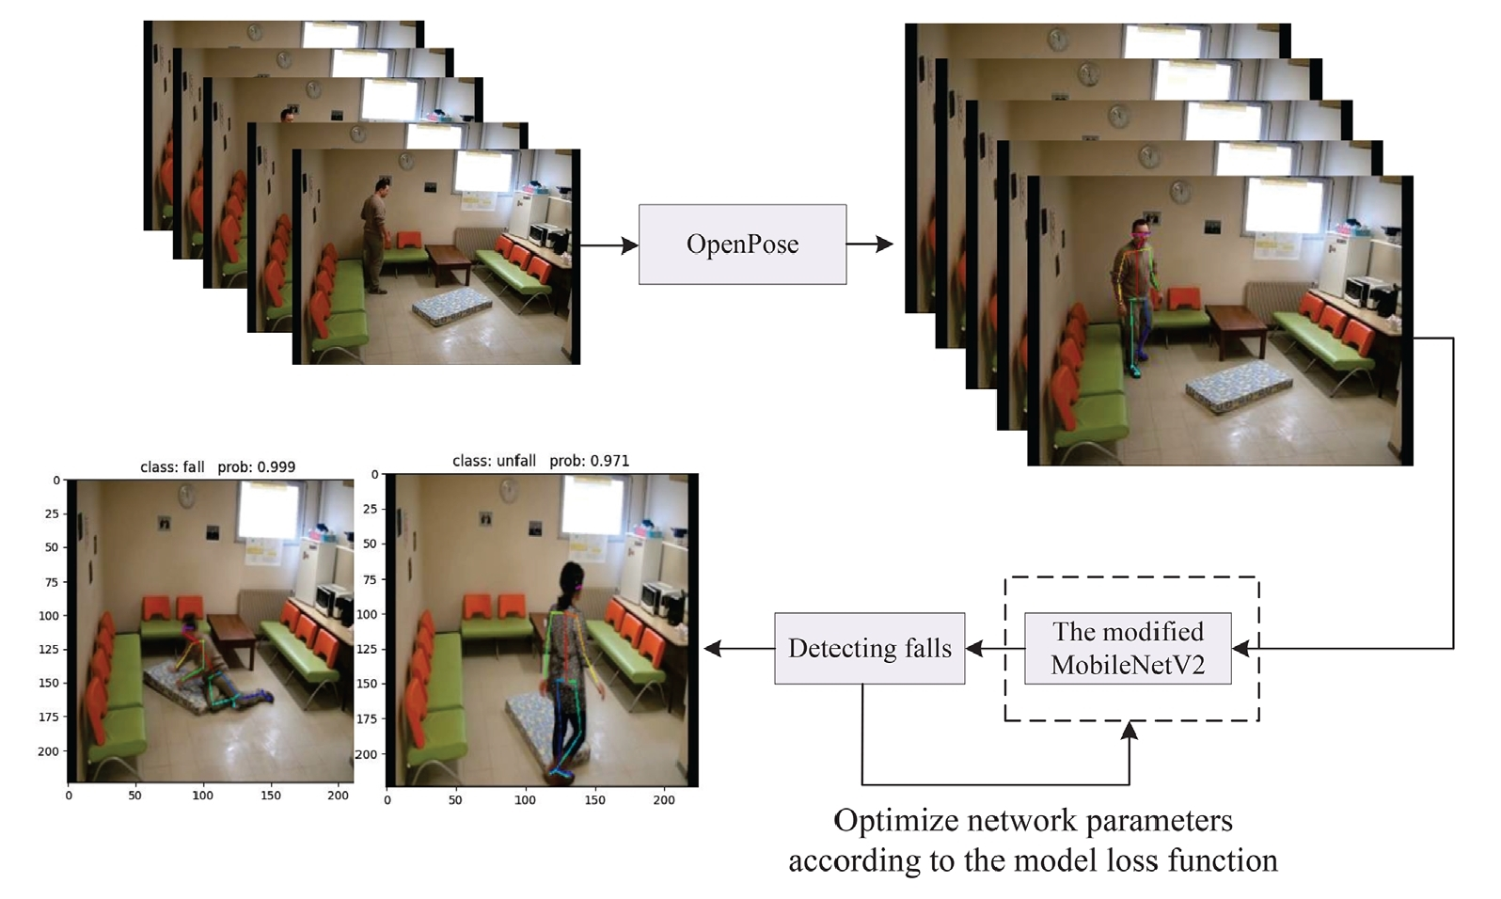
Notes:
Overall Framework:
Step 1: inputs the preprocessed image into the OpenPose network.
Step 2: extracts features. Step 3: predicts the position confidence map and part affinity fields domain of the limbs, while optimizing the network model parameters based on the loss function. Step 4: associates body parts with the human body and marks the image with key points.
=>These four steps utilize the OpenPose algorithm to label human key points in the picture.
Step 5: inputs images with key point information into MobileNetV2 and extracts features using the deep convolution module.
Step 6: employs the Adam algorithm to optimize the model parameters according to the loss function, enabling fall detection.
Loss Function: where m is the number of samples, q is the sample, y_t is the real category, y_p is the prediction category,
Result:
The final output, which indicates whether a fall has occurred or not, with its probability, is determined through [deep separable
convolution, average pooling, and fully connected layers] ultimately yields great accuracy with 98.60% and 99.75% for Le2i and UR datasets respectively.
- We can see this integration [OpenPose MobileNetV2 network] not only improves the accuracy of features without increasing the complexity of the images, but also corrects any labeling errors that may occur. It also demonstrates how interpretable insights from motion analysis can contribute to more reliable and transparent of XAI moving forward.

Slide 16
Thank You

Slide 17
References
Kirkpatrick, Keith. ”Artificial Intelligence and Mental Health: How AI Can Be Used to Improve Diagnosis of Mental Health Conditions.” Communications of the ACM, vol. 65, no. 5, May 2022, pp. 32–34. EBSCOhost, https://doi.org/10.1145/3524017.
Antoniou, Grigoris, et al. “Mental Health Diagnosis: A Case for Explainable Artificial Intelligence.” International Journal on Artificial Intelligence Tools, vol. 31, no. 3, May 2022, pp. 1–7. EBSCOhost, https://doi-org.libproxy.temple.edu/10.1142/S0218213022410032.
G´orriz, J. M., et al. “Computational Approaches to Explainable Artificial Intelligence: Advances in Theory, Applications and Trends.” Information Fusion, vol. 100, December 2023, p. N.PAG. EBSCOhost, https://doi-org.libproxy.temple.edu/10.1016/j.inffus.2023.101945.
Kiani, Mehrin, et al. ”Towards understanding human functional brain development with explainable artificial intelligence: Challenges and perspectives.” IEEE Computational Intelligence Magazine, 17.1 (2022): 16-33. Google Scholar, https://ieeexplore.ieee.org/document/9679739.
Lombardi, Angela, et al. ”A robust framework to investigate the reliability and stability of explainable artificial intelligence markers of Mild Cognitive Impairment and Alzheimer’s Disease.” Brain informatics, 9.1 (2022): 1-17. Google Scholar, https://braininformatics.springeropen.com/articles/10.1186/s40708-022-00165-5.
Huang, Lingfeng, and Genggeng Liu. “Functional Motion Detection Based on Artificial Intelligence.” Journal of Supercomputing, vol. 78, no. 3, Feb. 2022, pp. 4290–329. EBSCOhost, https://doi-org.libproxy.temple.edu/10.1007/s11227-021-04037-3.
Gao, Mengqi, et al. “Fall Detection Based on OpenPose and MobileNetV2 Network.” IET Image Processing (Wiley-Blackwell), vol. 17, no. 3, Feb. 2023, pp. 722–32. EBSCOhost, https://doi-org.libproxy.temple.edu/10.1049/ipr2.12667.
Ghassemi, Marzyeh, Luke Oakden-Rayner, and Andrew L. Beam. ”The false hope of current approaches to explainable artificial intelligence in health care.” The Lancet Digital Health, 3.11 (2021): e745-e750. Google Scholar, https://www.thelancet.com/journals/landig/article/PIIS2589-7500(21)00208-9/fulltext.

