Slide 1
Visual Reasoning For Visual Impaired People
Rahad Arman Nabid
tuq23789@Temple.edu

Slide 2
MOTIVATION
POPULATION: Approximately 8% of the US population has visual impairments
Accessibility Challenges: visual impairment USERS often struggle to interpret images in WEB.
Web Exclusivity: Individuals with visual impairments do not experience a sense of belonging on the web, in contrast to people without visual impairments. That’s why they use Screen magnifiers, high-contrast software, screen readers, voice recognition software, adjustable screen brightness controls, color adjustment software, Braille displays, text-to-speech (TTS) software, AI-powered image recognition tools, optical character recognition (OCR) software.
Need for Contextual Understanding: AI-Power image recognition tools provided general overview to the visual impaired people, but they don’t have the feature of reasoning explanation to explain the contextual understanding.

Slide 3
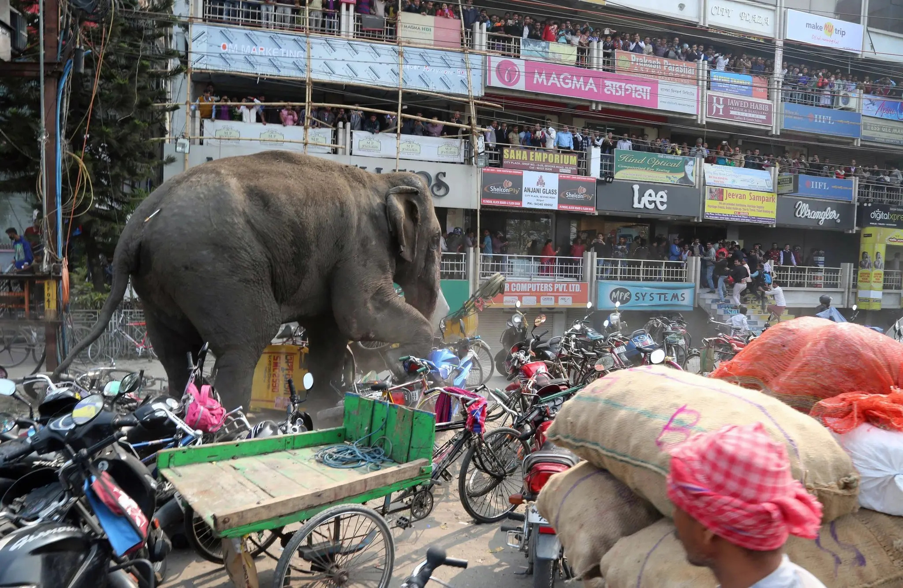
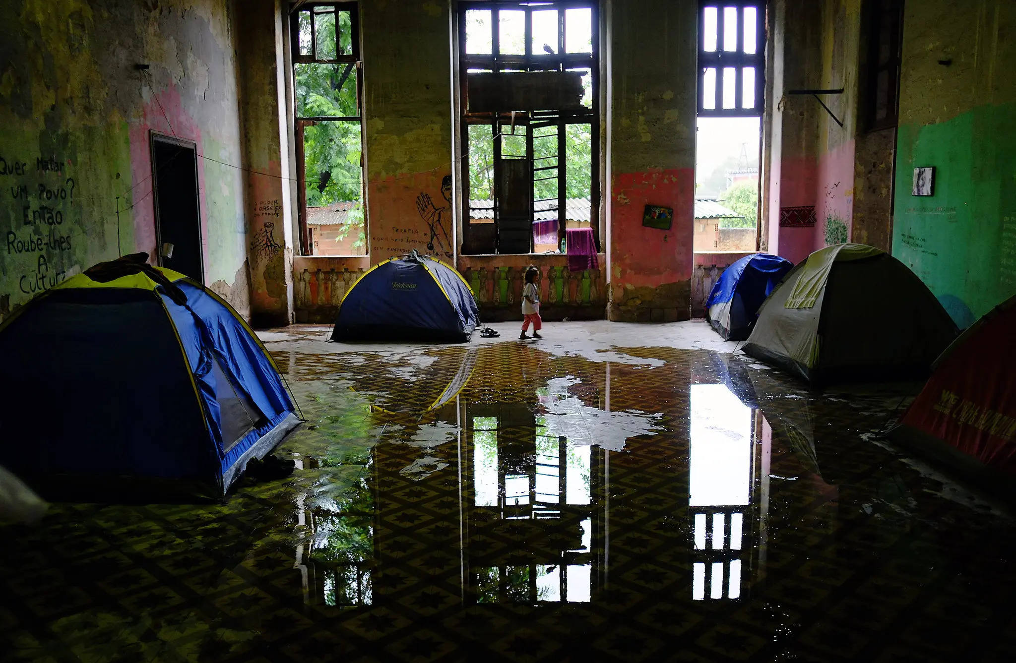
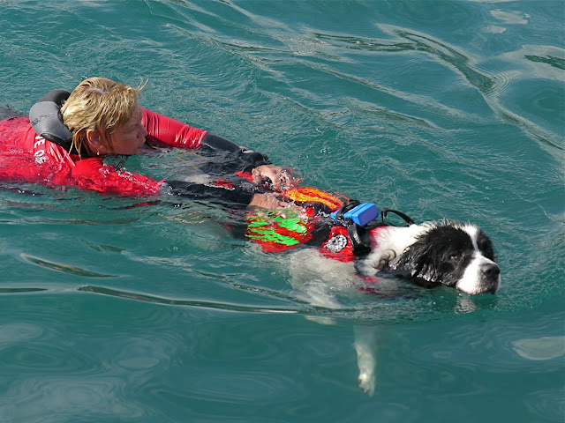
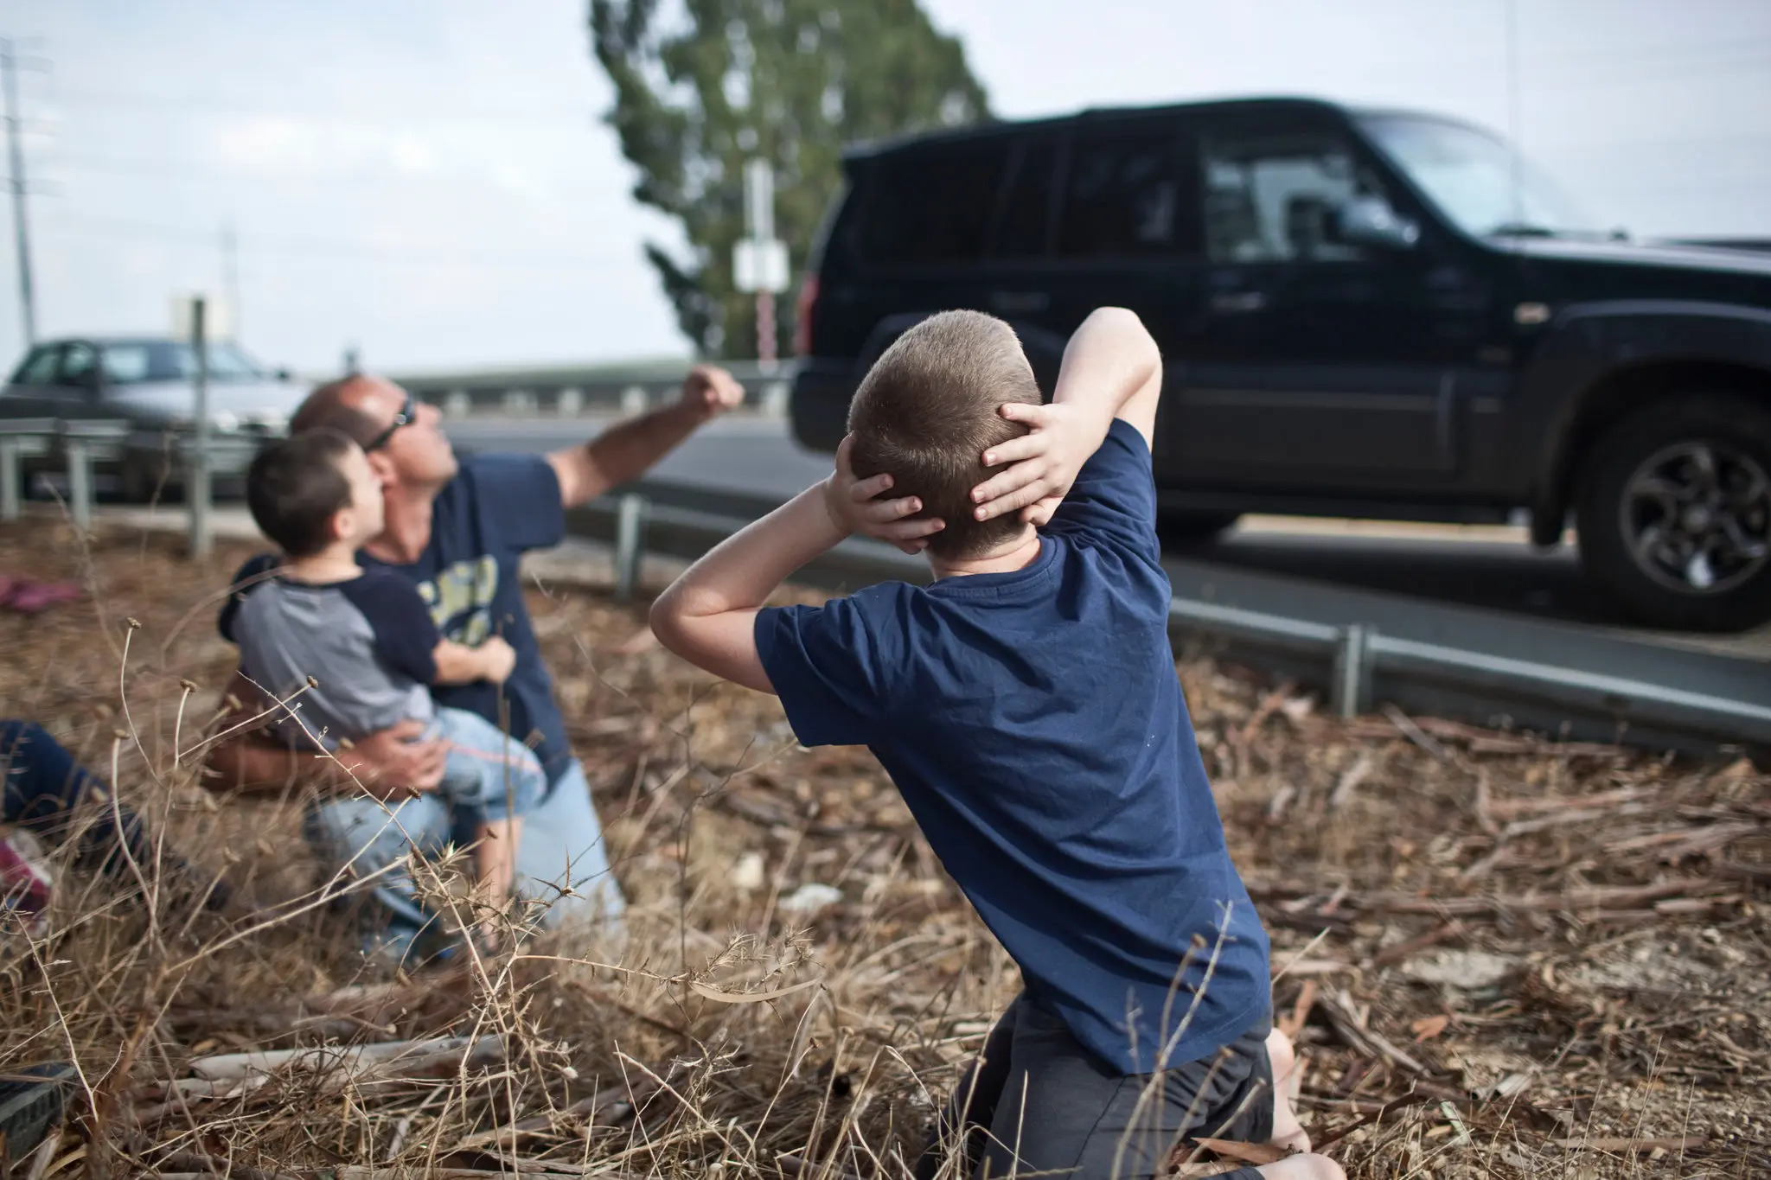
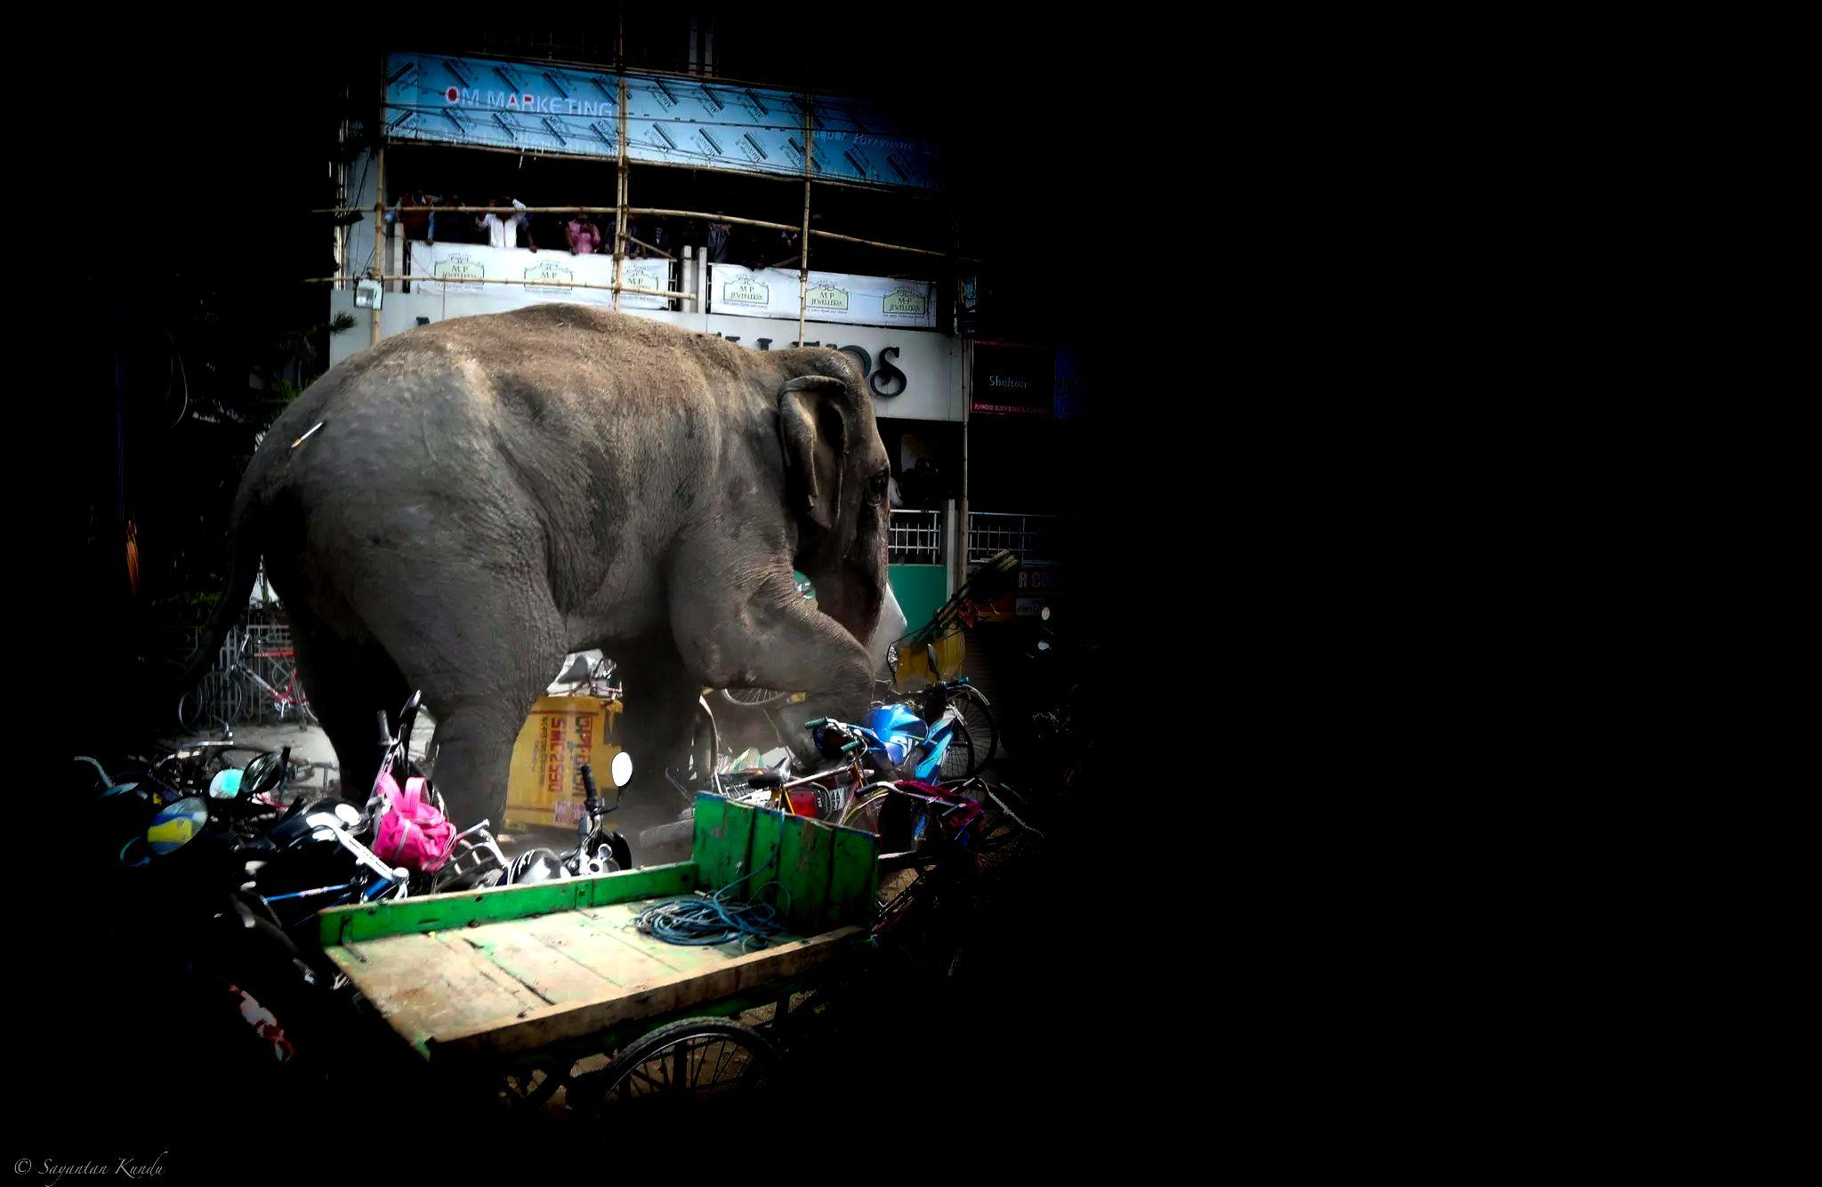
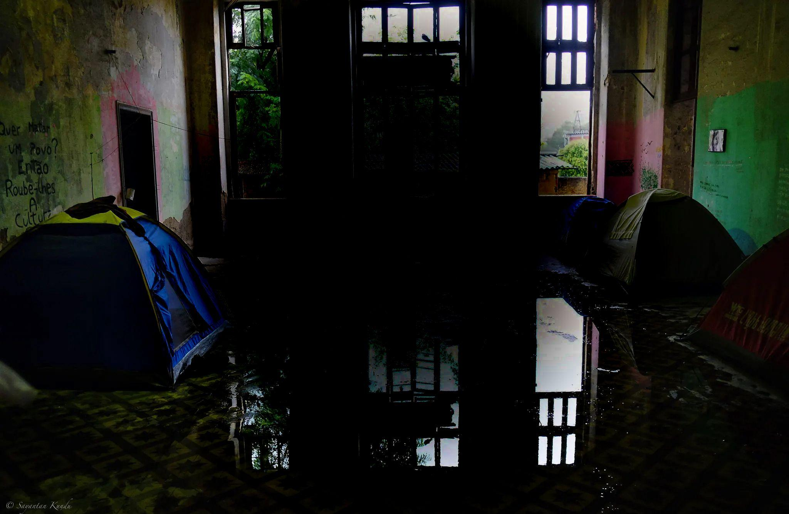
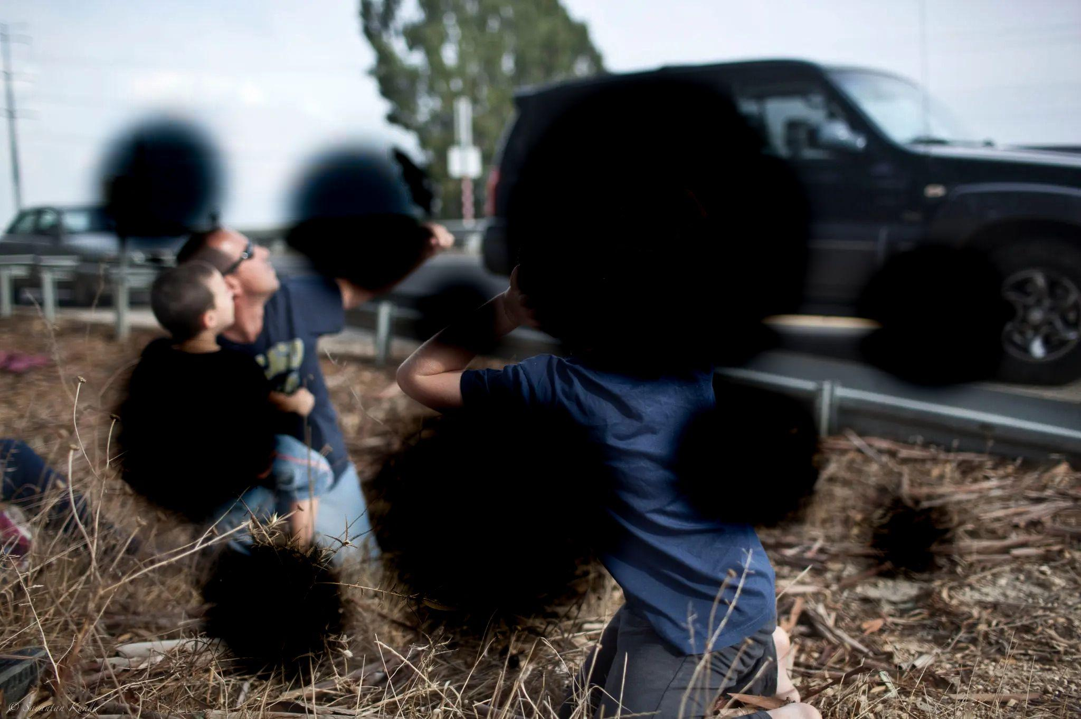
Sample IMAGEs How visual Impaired People SEE
Molecular Degeneration
Cataracts
GLAUCOMA
Diabetic Retinopathy

Slide 4
Literature Review
A Smart Personal AI Assistant for Visually Impaired People by Shubham Melvin Felix, Sumer Kumar, and A. Veeramuthu - made a android app that recognize objects in the surrounding, do text analysis to recognize the text in the hard copy document.
Answering Questions about Charts and Generating Visual Explanations - Enamul et al. explored a machine learning model to generate visual explanation and summarization from the chart.
Show, Attend and Tell: Neural Image Caption Generation with Visual Attention - kelvin et al. make a machine learning model that can be used to generate caption from image for the visually impaired people.

Slide 5
Focus
“Visual Reasoning for Visually Impaired People” project we explored a different strategy to guide visually impaired people, by providing sample reasoning questions that will help them to further ask AI system to get relevant answers.

Slide 6
DataSET Collection and Modification
ML model for - visual Question Generation & Visual question and answering
Testing on FLASK GUI
Methodology

Slide 7
DATaset Creation
QUEStion Generation
Arithmetic Reasoning Question
Converting captions to reasoning question
Binary Reasoning Question
Flickr-8k:
Image & Captions
Relational Reasoning
Causal Reasoning
Logical reasoning
Arithmetic Question
CLEVR dataset
Separating 3 set of questions
Binary Question
Other
Flickr dataset has 8000 images. Each image in the Flickr8k dataset is accompanied by five different captions that describe the scene in the image.
To train our model with a variety of reasoning questions, we employed a generative model on a set of 1000 images, creating five distinct reasoning questions for each image.
VISUAL QUESTION AND ANSWER Generation
The CLEVR dataset includes approximately 850,000 questions, along with their corresponding answers. But for the simplicity I took 1000 image with question and answer.
We separate three types of questions from this dataset.

Slide 8
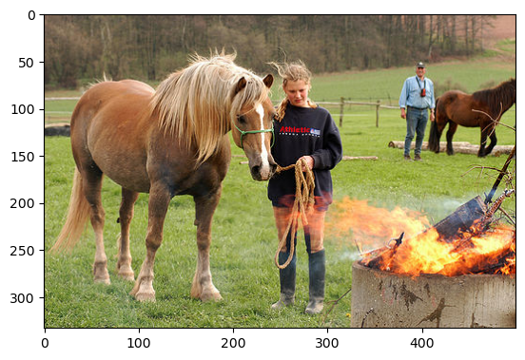
Encoder Decoder Model for question generation
<start>
A horse
Is
Fully connected layer linear
LSTM
LSTM
LSTM
CNN vGG16 Feature Extractor
<start>
A horse

Slide 9
CNN + LSTM model for VISual Question and answering
Fully connected layer linear
concat
Dense Layer
CNN vGG16 Feature Extractor
Softmax
output
LSTM
LSTM
LSTM
<start>
A horse
is

Slide 10
evaluation
IMAGE to Question generation
Visual question and ANswering Generation
Prototype : User Study
Standard metrics like BLEU (Bilingual Evaluation Understudy), METEOR (Metric for Evaluation of Translation with Explicit Ordering), ROUGE (Recall-Oriented Understudy for Gisting Evaluation), and CIDEr (Consensus-based Image Description Evaluation) for objective evaluation.
To evaluate visual question and answering we used standard metric of accuracy on three different field- arithmetic reasoning question, binary reasoning question and caption.
We created a GUI app to evaluate the human computer interaction experience to find out the qualitative result.

Slide 11
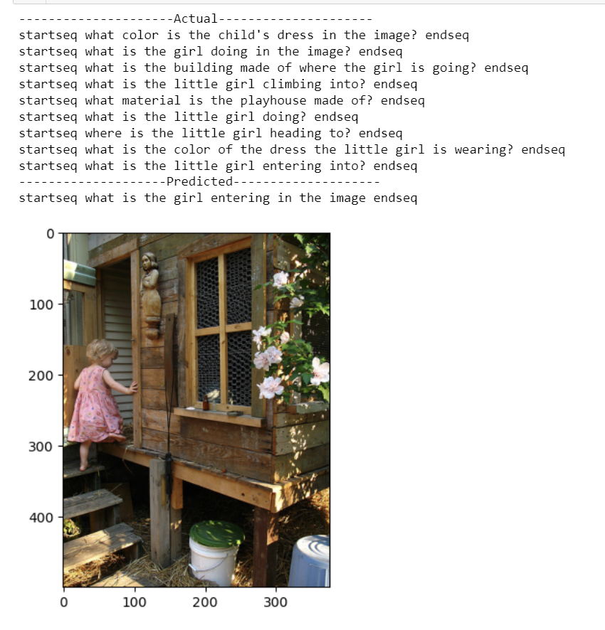
Image to question generation
Dataset | Model | BLEU-1 | BLEU-2 | BLEU-3 | BLEU-4
Flicker 8k | Google NIC(Vinyals et al., 2014) | 63 | 41 | 27
 | Log Bilinear (Kiros et al., 2014a) | 65.6 | 42.4 | 27.7 | 17.7
Flicker 8k (1000) | My Model | 75 | 57
Notes:
https://proceedings.mlr.press/v37/xuc15.pdf

Slide 12
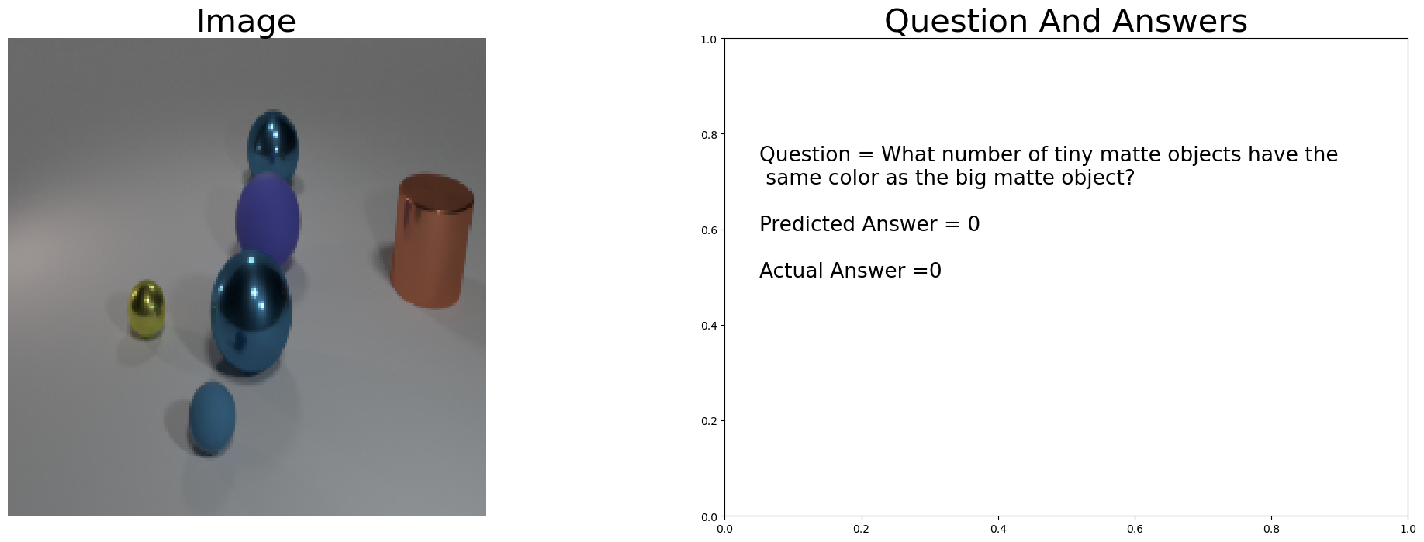
Visual Question and answering
Dataset | Model | Overall | Arithmetic Reasoning | Binary Reasoning | Other
CLEVR 850000 | VQA: Visual Question Answering(Stanislaw et al.) | 52.64 | 75.55 | 33.67 | 37.37
 | My VQA model | 48.02 | 55.67 | 40.2 | 33.9
Notes:
https://openaccess.thecvf.com/content_iccv_2015/papers/Antol_VQA_Visual_Question_ICCV_2015_paper.pdf

Slide 13
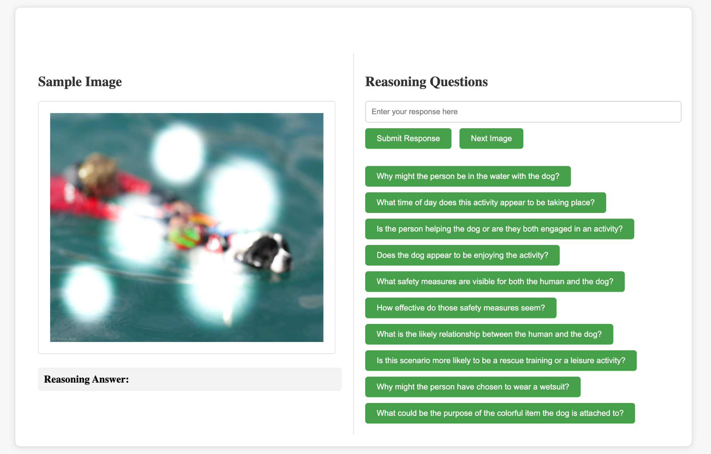
Prototype Evaluation
Question Asking
Model Generated Question
Answer

Slide 14
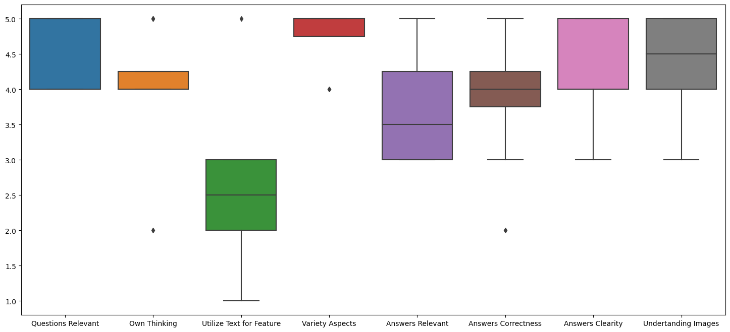
Survey Result (8 participants)

Slide 15
Overall Experience (8 people)
“It's very interesting that I can talk with an image. But sometimes the system generated answer that not appear in the image.”
“I find it very good as even I could not see some stuff initially but using this app I can visualize those”

Slide 16
Shortcomings
“From the sample reasoning questions the user could get the details about the image. However, many of the details could be uncertain or inaccurate. Therefore, the user might be mislead to get the big idea by combining all the details.”
“One shortcoming could be if the eyes reflect black spots, what if this question answers they couldn't read through as some of the texts are being blocked? I hope in future there are text to speech extensions are added in this app if they feel trouble to read through the texts.”

Slide 17
Thank You so much
Demo of my system is available on my laptop.

Slide 18
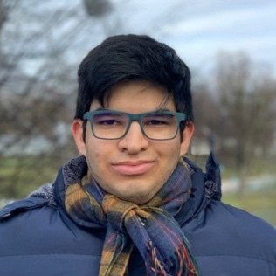
Special Acknowledgement
Special thanks to all who participate in my study.
Amir
Parsa
Tom
Nazia
Pavel
Sayantan
Alharbi
Abdulrahman

Slide 19
