Slide 1
Identifying relationship between genes and human ontology
By: Rushabh Patel

Slide 2
Outline
Introduction
What is HPO?
Objective
Data Description & source
Methods:
Representing data in Graph.
Extracting features from Nodes using Node2Vec.
Applying supervised machine learning algorithms to predict links.
Results
Future Work

Slide 3
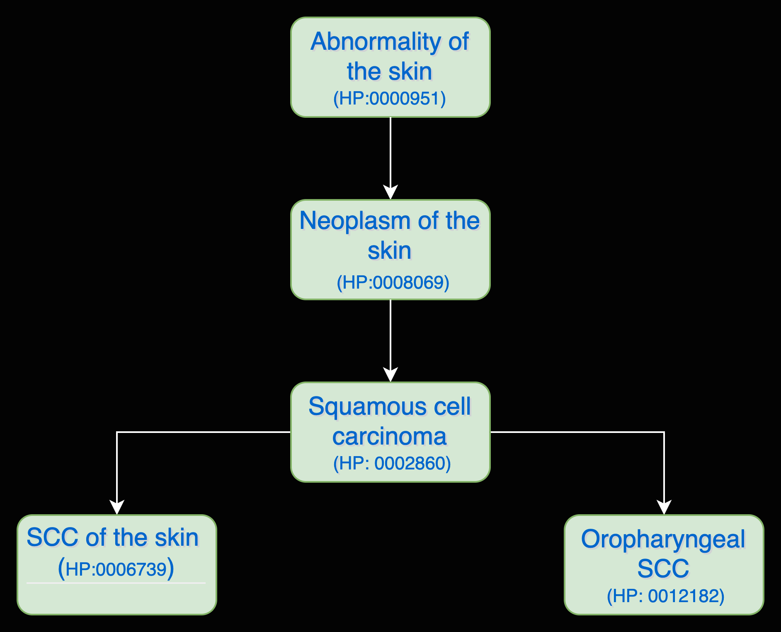
HPO Graph for Skin Cancer
Human phenotype ontology
The Human Phenotype Ontology (HPO) provides a standardized vocabulary of phenotypic abnormalities encountered in human disease.
Each term in the HPO describes a phenotypic abnormality, such as Atrial septal defect.

Slide 4
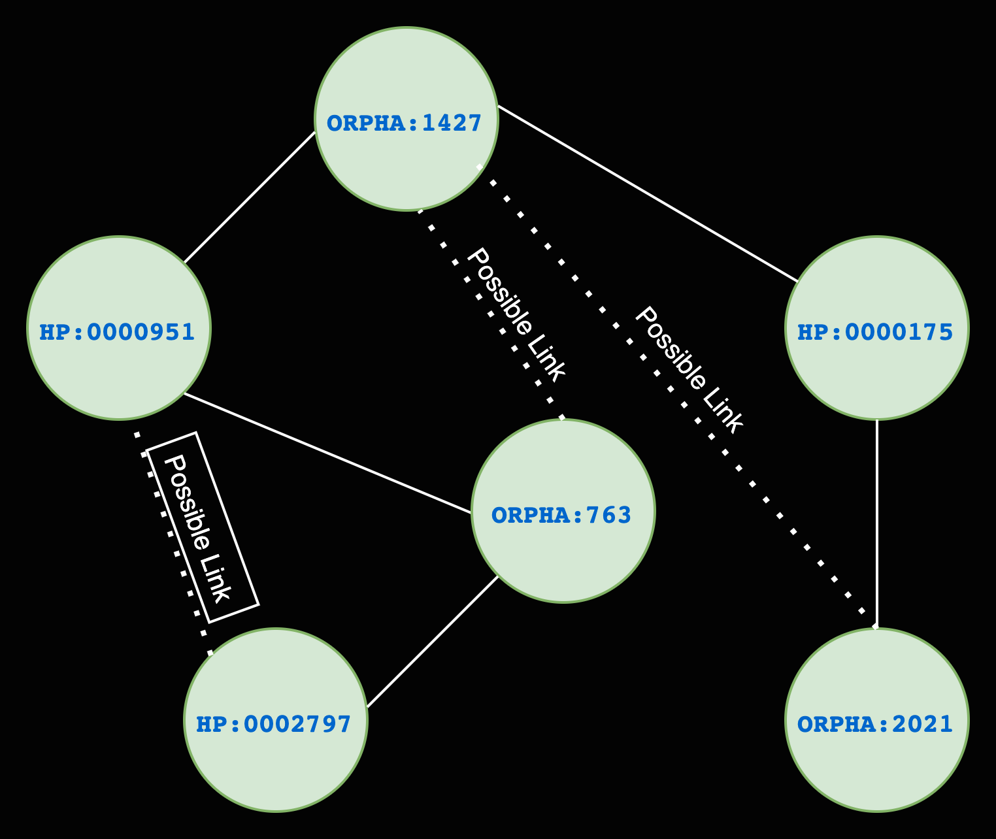
Objective
Link Prediction: The objective of link prediction is to identify pairs of nodes that will either form a link or not in the future.
GOAL: To predict plausible links between phenotypes and genes using supervised machine learning algorithms.

Slide 5
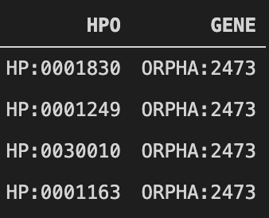
Data Description
The data provides link between gene & HPO terms.
Each HPO terms associated with variants in a gene are assigned to that gene in this data.
We will be using mappings from Orpha data for this project. It can be extended to use more larger dataset.
We have 8430 unique HPO & Gene types.

Slide 6
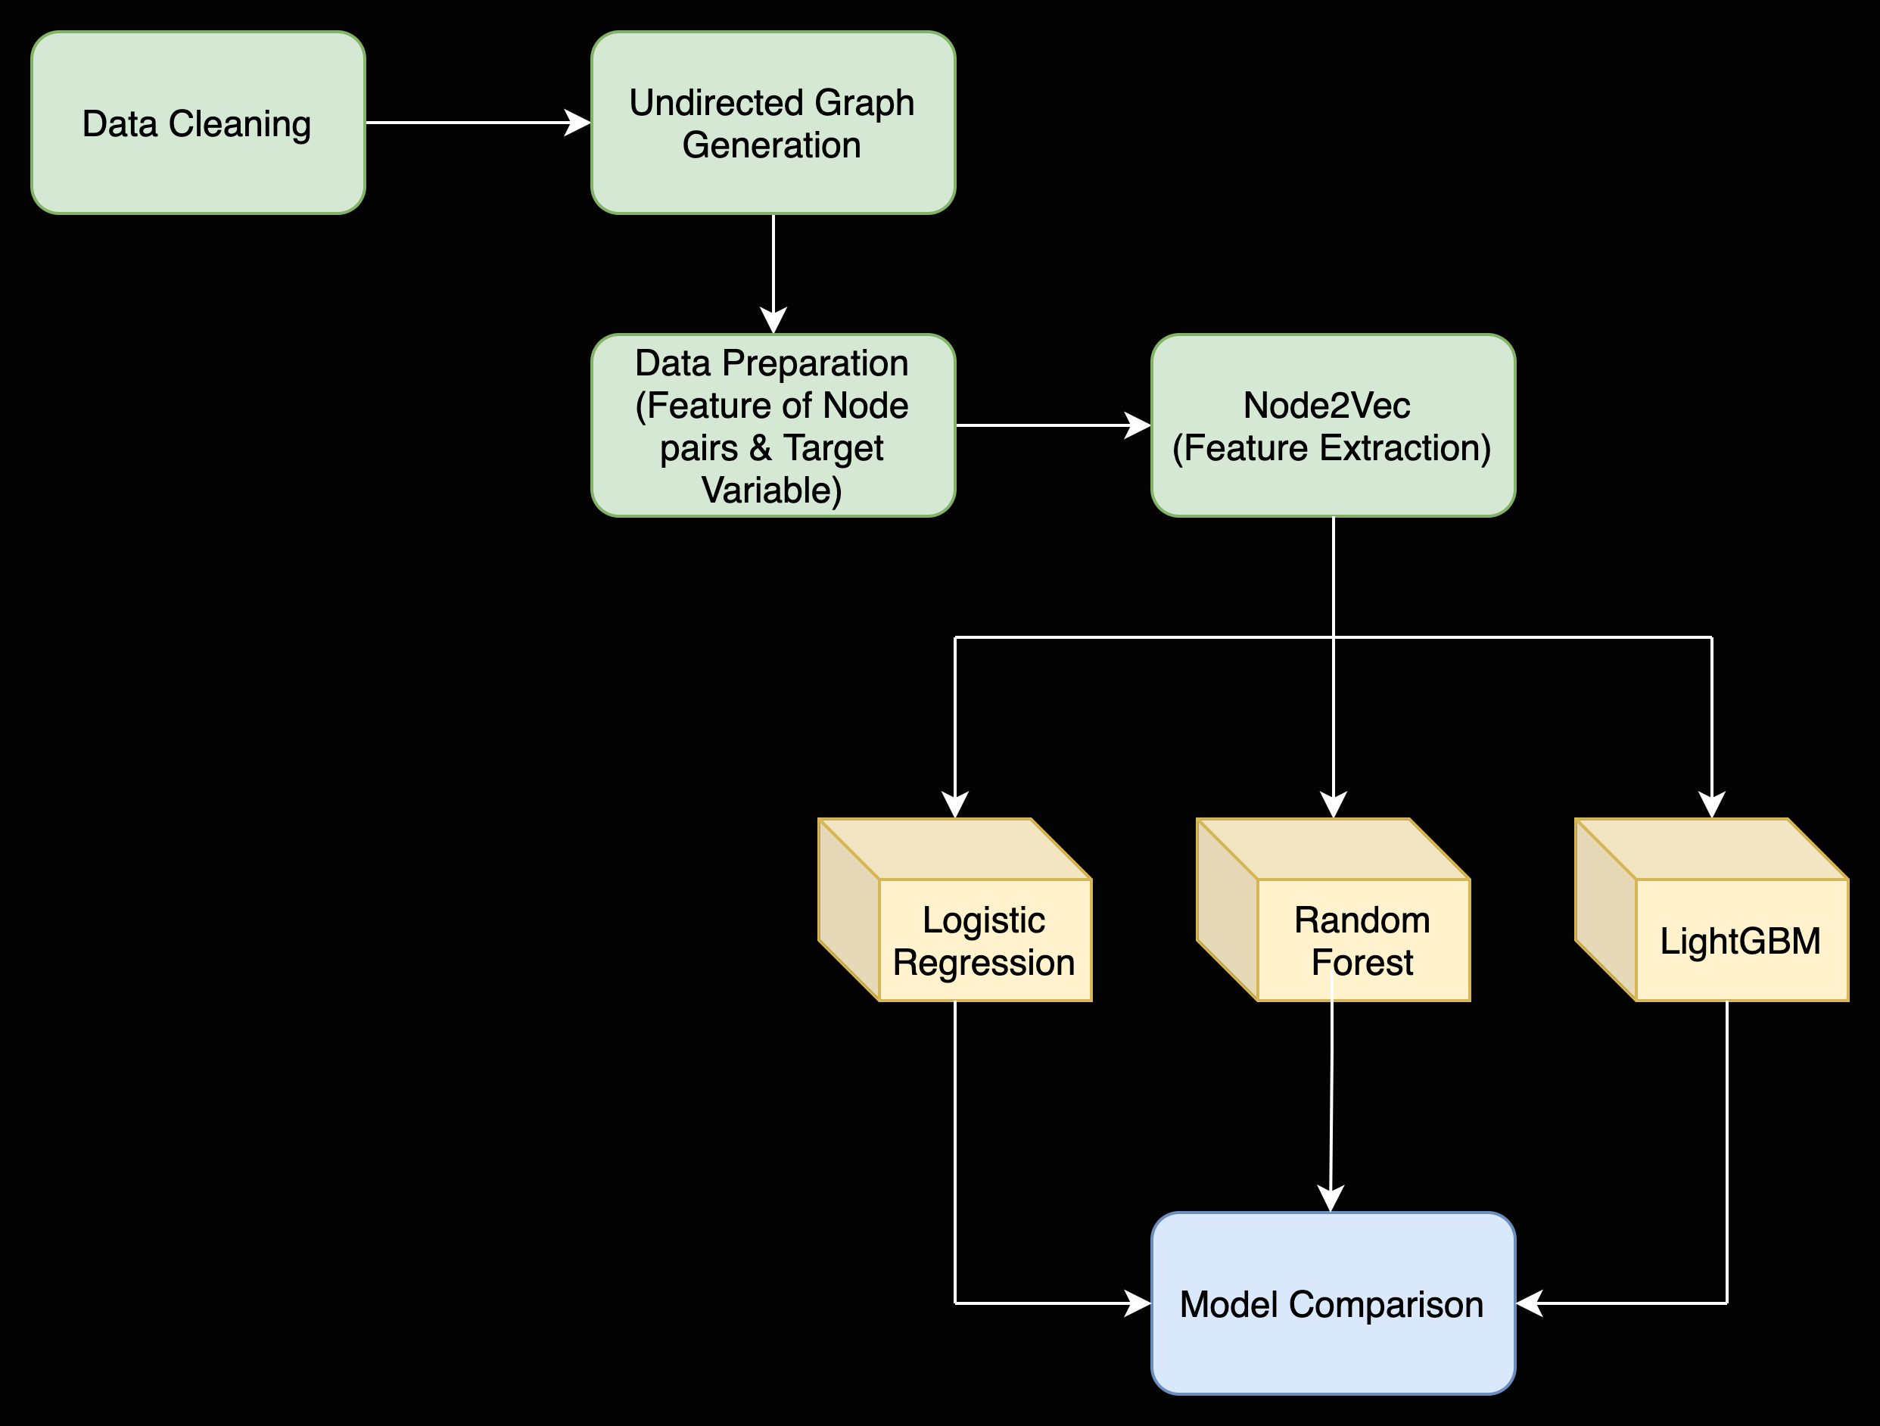
Flow Chart
Neural Network
Neural Network
……

Slide 7
Data Preparation
We prepare the dataset using undirected graph.
Retrieve Unconnected Node Pairs – Negative Samples
Retrieve Connected Node Pairs - Positive Samples
HP:0000175
ORPHA:1427
ORPHA:763
HP:0000175
HP:0000175
HP:0000951
ORPHA:1427
HP:0000951
0 | 1 | 0 | 0
1 | 0 | 1 | 1
0 | 1 | 0 | 1
0 | 1 | 1 | 0
ORPHA:1427
ORPHA:763
ORPHA:763
HP:0000175
HP:0000175

Slide 8
Feature Extraction
Learning useful representations from highly structured objects such as graphs is useful for a variety of machine learning applications.
The node2vec framework learns low-dimensional representations for nodes in a graph by optimizing a neighborhood preserving objective.
we will train the node2vec model on our graph .
Next, we will apply the trained node2vec model on each node pair in the data frame ‘data’. To compute the features of a pair or an edge.

Slide 9
Building our Link Prediction Model
Split data set into two parts – Training & Testing.
We build different models, including Logistic Regression, Random Forest, LightGBM, & Neural Network.
The dataset is highly imbalanced with only ~7.5% incidence rate.
We have used Stratified Cross-Validation to avoid overfitting/underfitting.

Slide 10
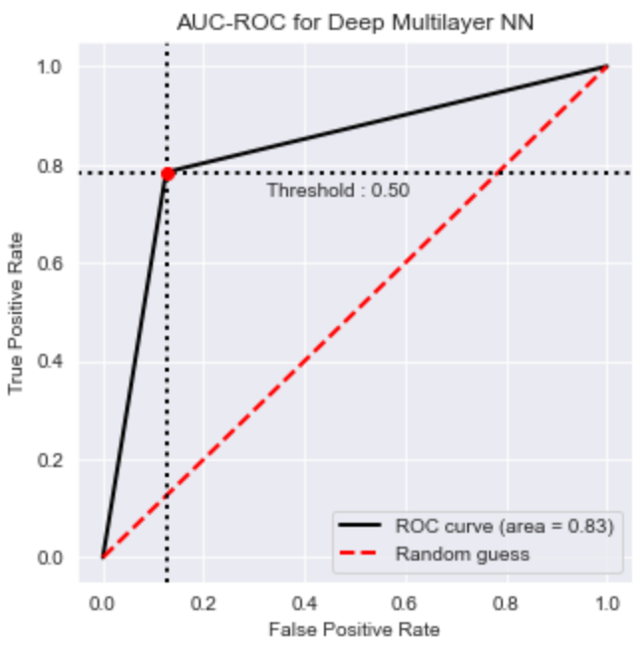
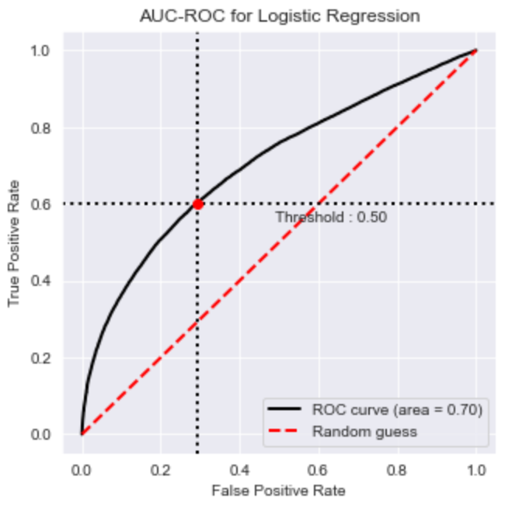
Results

Slide 11
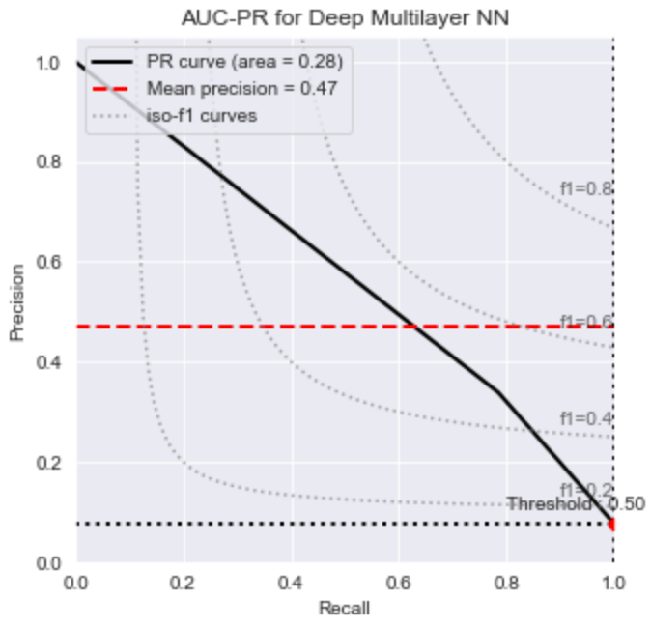
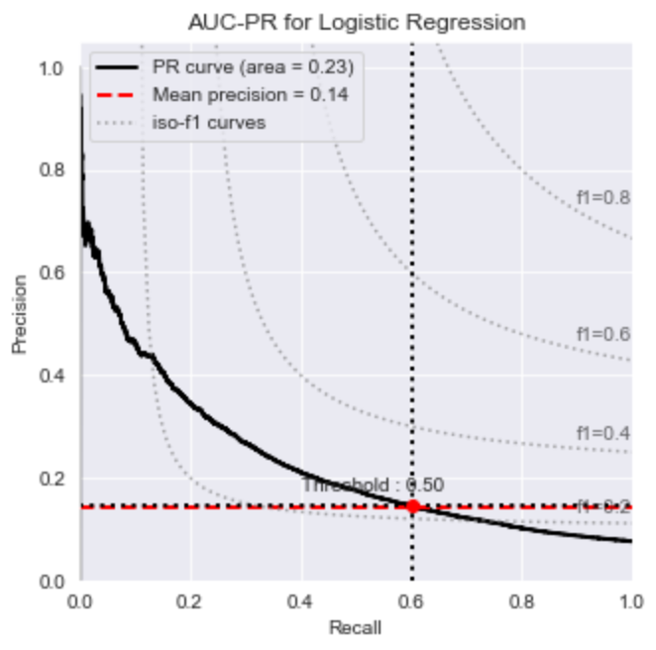
Results

Slide 12
Future Work
Using more data to train the model which basically includes omim dataset.
Hyper parameter tuning for models like Neural Network.
Prediction Interpretability using Shap values.

Slide 13
Thank You

