Slide 1
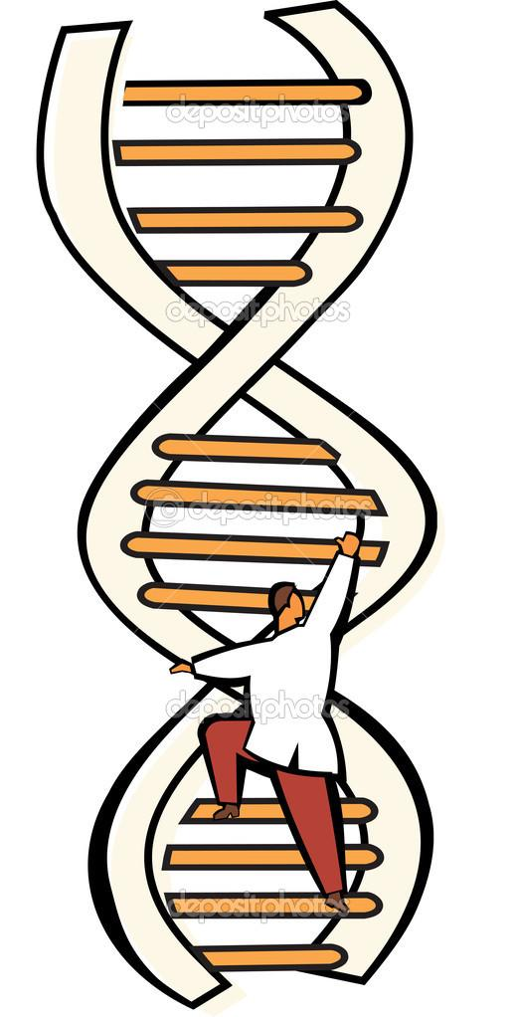
Trait Prediction using Deep Learning
Sanchari Biswas, M. Erfan Mowlaei
Temple University
April 2022

Slide 2
Contents
Introduction
Challenges
Our Approach
Methodology
Results
Conclusion

Slide 3
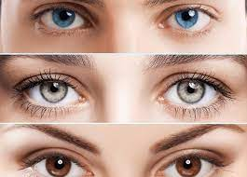
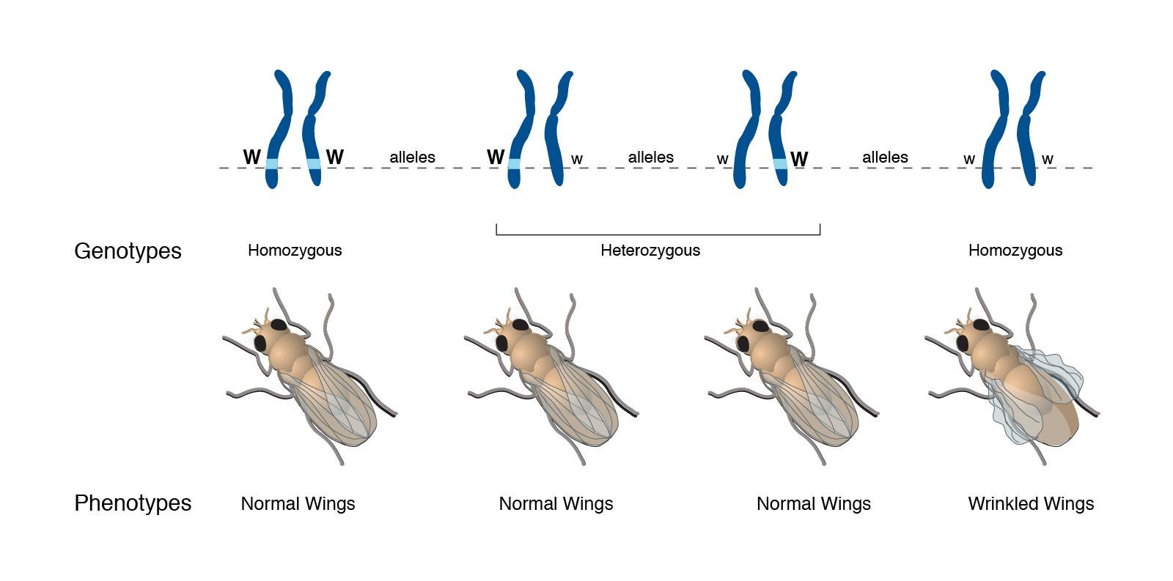
Introduction
Also known as DNA phenotyping
Predicting an organism's traits from knowledge of its genotype.
Applications:
Understanding disease risks and susceptibility
Improving breeding cycles of plants and animals
Recent advances have made genomics data available at an unprecedented scale.
Eg. second and third generation sequencing
Understanding the genetic contribution to complex phenotypes remains an open problem
Complexity of relation between genotypes and traits

Slide 4
Challenges
Genotype data suffers from the curse of dimensionality. In the diagram, n << p.
Classical solutions: filters, wrappers, embedded, and hybrid methods
Genetic variants may have linear (additive) or nonlinear (epistatic) relationship with trait values.
Significantly complex models needed to deal with epistatic effects

Slide 5
Our Approach
Transformer Model: A deep learning model that adopts the mechanism of self-attention, differentially weighting the significance of each part of the input data.
State of the Art (SoTA) deep learning model in majority of NLP and Computer Vision tasks
Attention
Mimics cognitive attention
A part of a neural architecture
Enables to dynamically highlight relevant features of the input data
Learns feature interactions
Can be used later for extracting features that contribute to trait prediction
Embedding
Mathematically involves embedding (or structure-preserving) from a space with many dimensions to a continuous vector space
Enables the model to learn efficient semantics of the input

Slide 6
Methodology
Our approach to trait prediction involves the following five major steps:
Data Collection
Yeast dataset
~4400 samples, 28220 features
Data Preprocessing
Feature scaling: min-max scaling
Remove records with missing value for the label/trait value
Model Development
Model Comparison
Conclusion
Gather Data
Data Preprocessing
Develop Model
Compare with other models
Conclusion

Slide 7
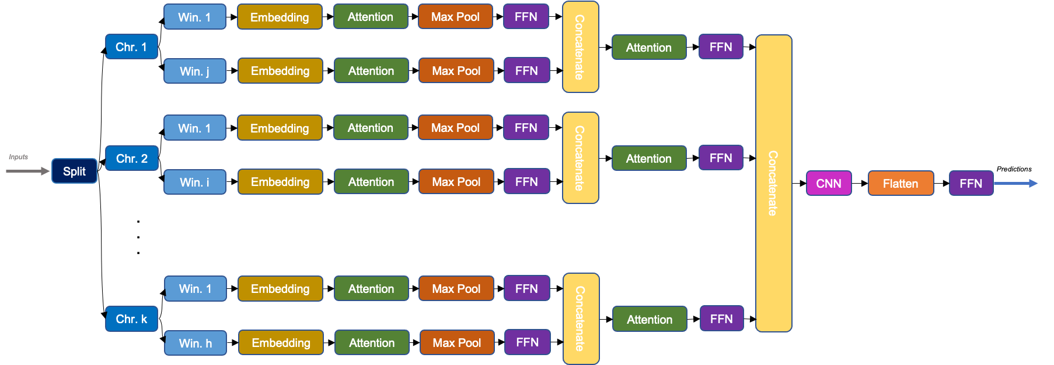
Proposed Model Overview
. . .
. . .
. . .
Figure 1: SplitTransformer architecture

Slide 8
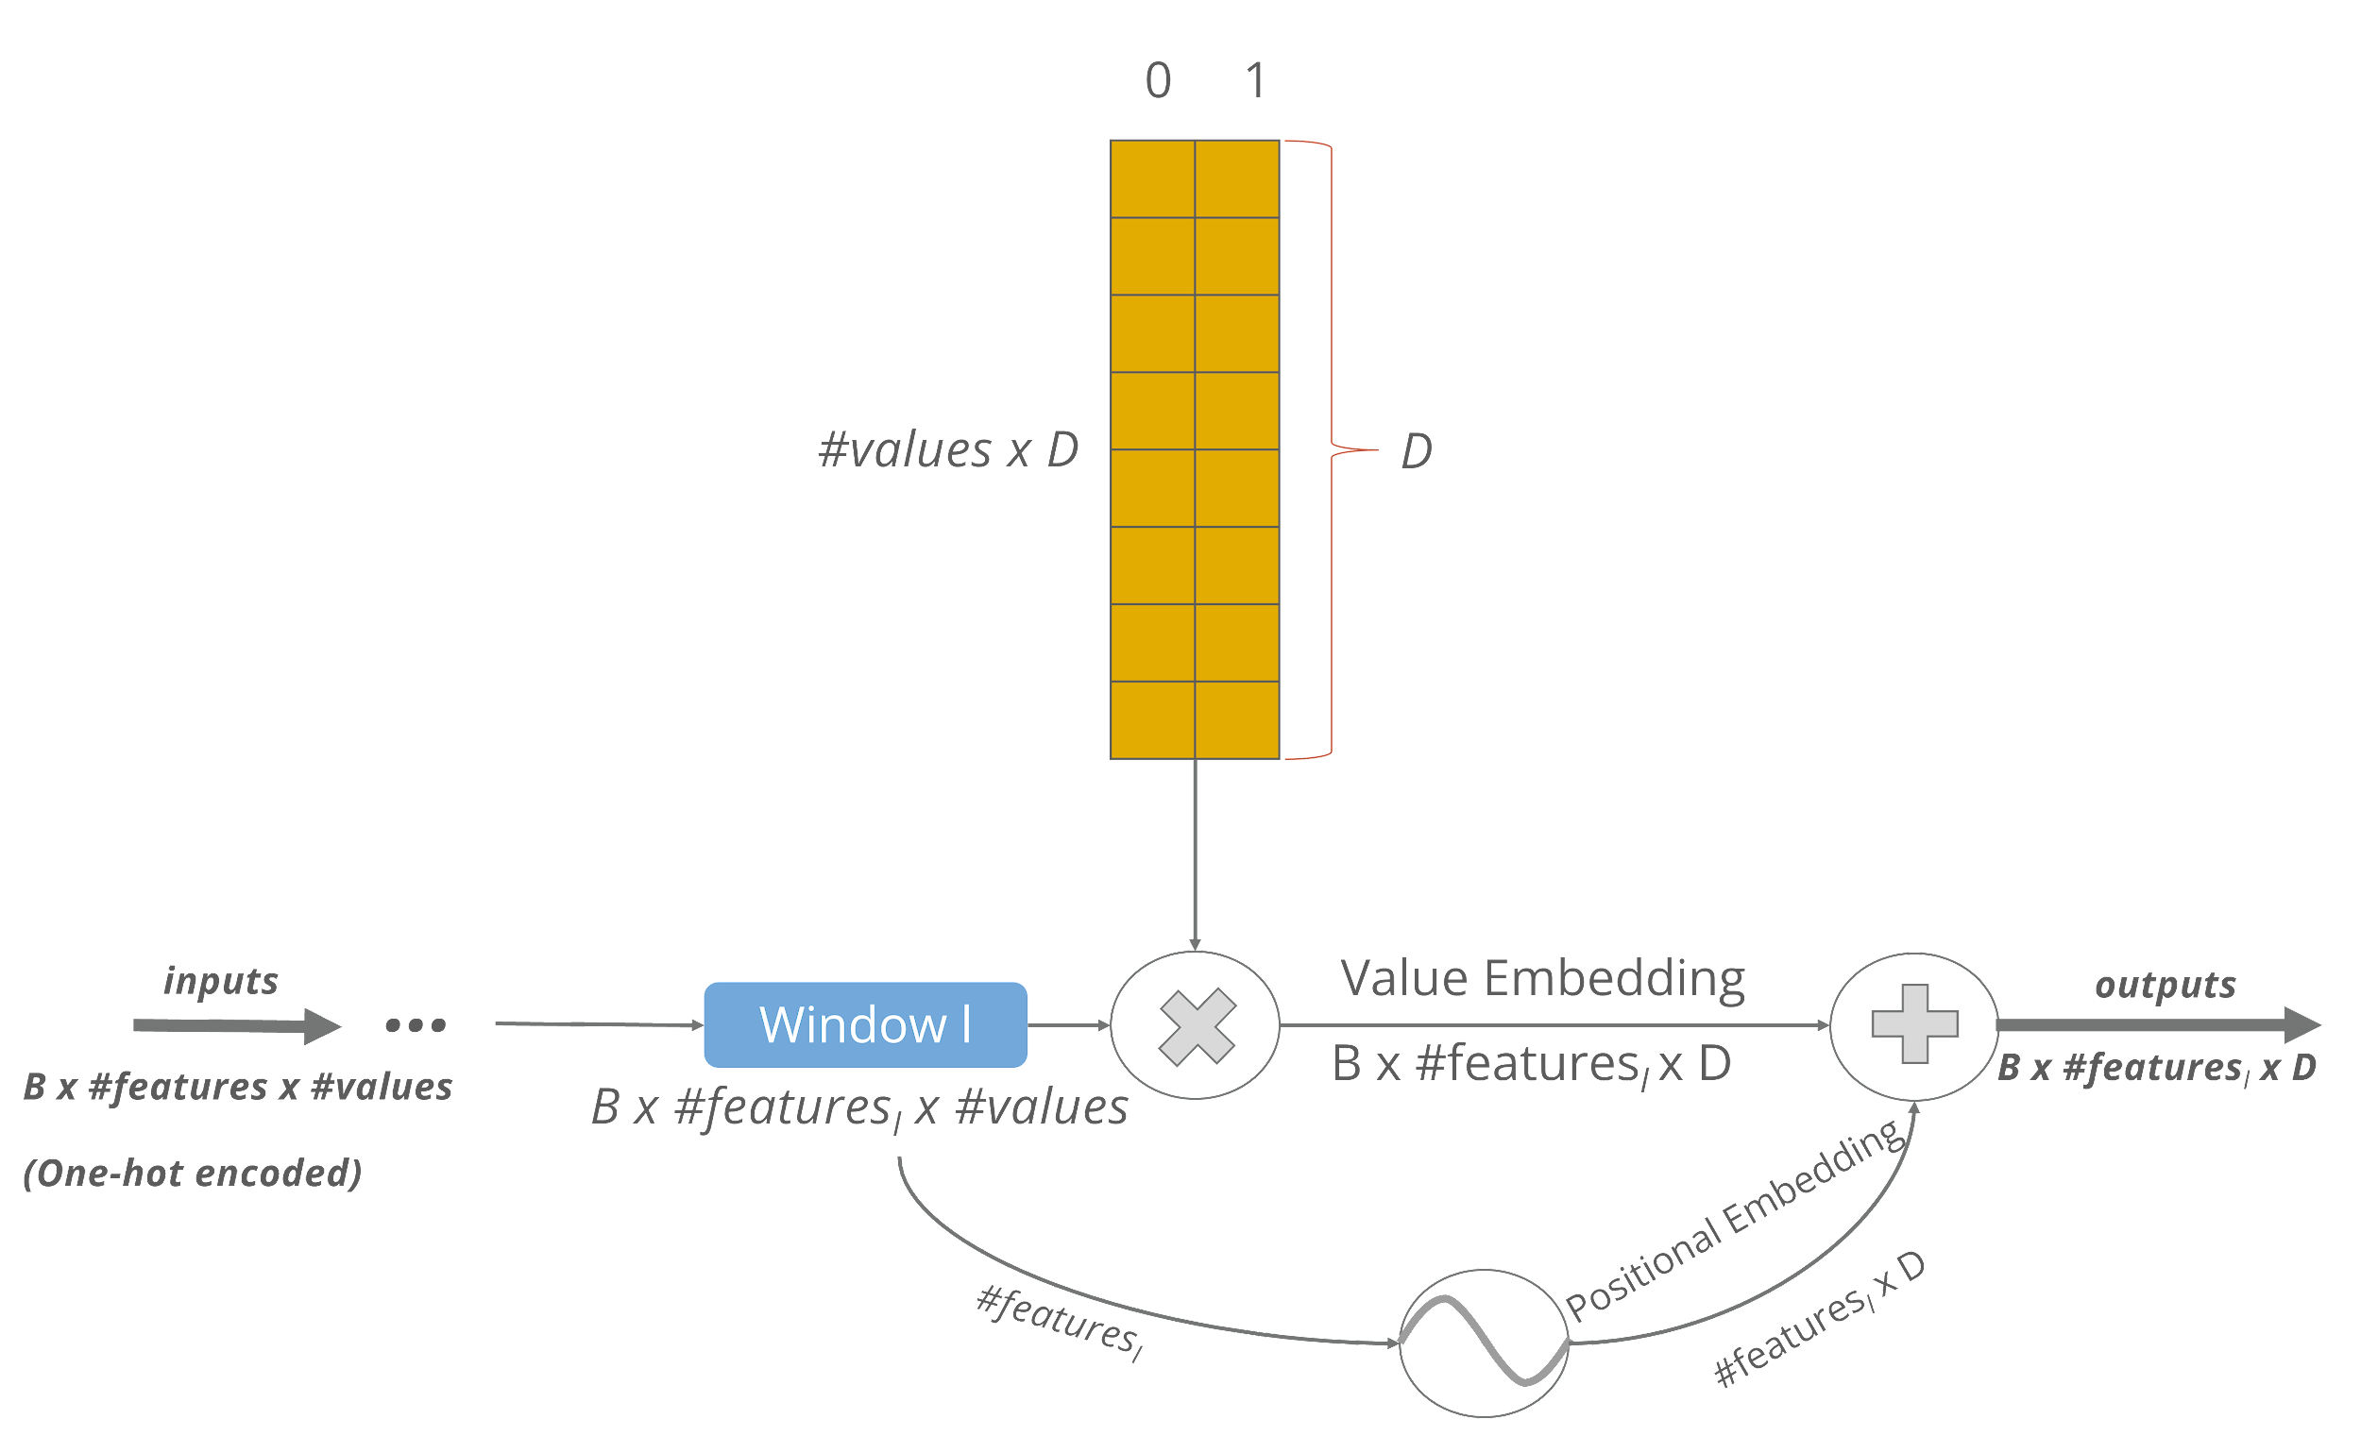
Proposed Model: Categorical Embedding
Figure 2: Categorical Embedding workflow

Slide 9
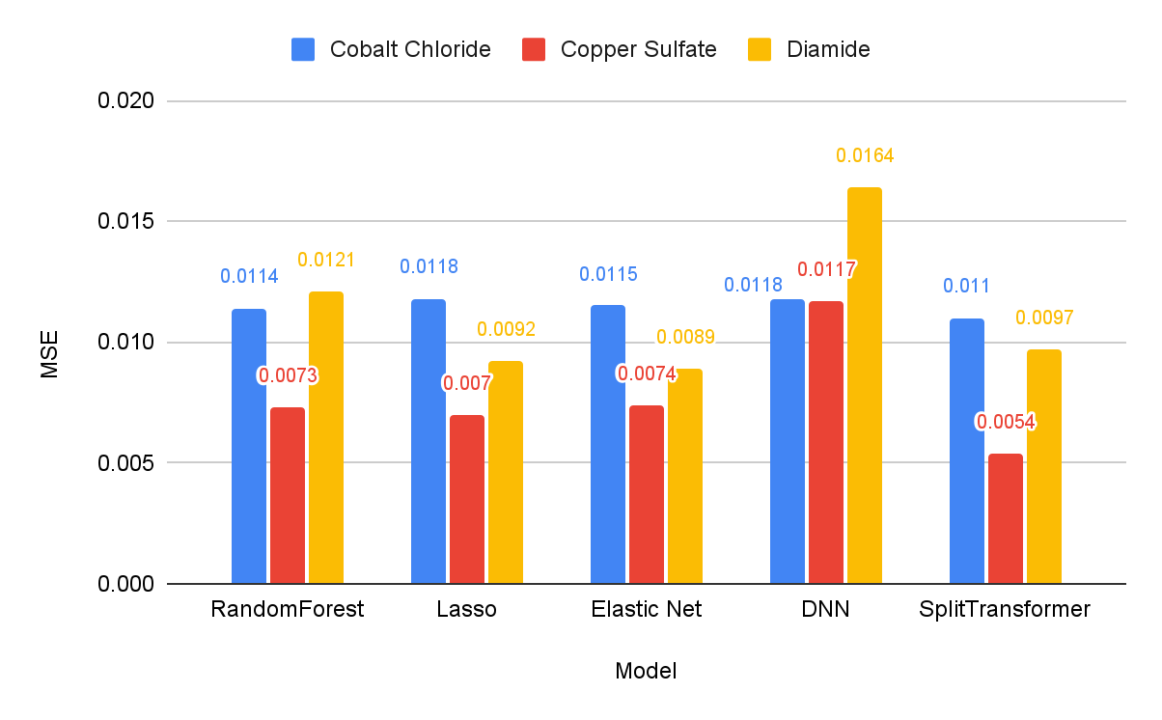
Results: Benchmarking
Table 1: QTL contribution based on Bloom et al. (2014) findings
 | #QTLs
 | Linear (additive) | Non-Linear (epistatic) | NL/L Ratio
Cobalt Chloride | 33 | 9 | 0.27
Copper Sulfate | 32 | 23 | 0.71
Diamide | 56 | 6 | 0.11
Figure 3: Performance comparison based on mean squared error (less is better)

Slide 10
Results: Embedding Study
Table 2: Improvement comparison in ST model based on MSE performance of Diamide prediction
 | Compare to
 | ST - Global Embedding | ST - No embedding
ST - Local Embedding | 3.4% | 4.3%
ST - Global Embedding | NA | 0.8%

Slide 11
Conclusion
SplitTransformer outperforms ML models where predictions rely mostly on complex feature interactions.
Our proposed categorical embedding makes it possible to use embedding for any categorical input data.
Local (categorical) embedding leads to better performance compared to global (categorical) embedding or not using any embeddings at all.
Future work involves improving the model to better predict the traits where the effects are mostly additive.

Slide 12
References
Bloom JS, Kotenko I, Sadhu MJ, Treusch S, Albert FW, Kruglyak L. Genetic interactions contribute less than additive effects to quantitative trait variation in yeast. Nature communications. 2015 Nov 5;6(1):1-6.
Pérez P, de Los Campos G. Genome-wide regression and prediction with the BGLR statistical package. Genetics. 2014 Oct 1;198(2):483-95.
Meuwissen TH, Hayes BJ, Goddard M. Prediction of total genetic value using genome-wide dense marker maps. Genetics. 2001 Apr 1;157(4):1819-29.
Vaswani A, Shazeer N, Parmar N, Uszkoreit J, Jones L, Gomez AN, Kaiser Ł, Polosukhin I. Attention is all you need. Advances in neural information processing systems. 2017;30.
Chen J, Shi X. A sparse convolutional predictor with denoising autoencoders for phenotype prediction. InProceedings of the 10th ACM International Conference on Bioinformatics, Computational Biology and Health Informatics 2019 Sep 4 (pp. 217-222).
What Are Heterozygous Traits? (2020, February 25). ThoughtCo. https://www.thoughtco.com/heterozygous-traits-3975676

Slide 13
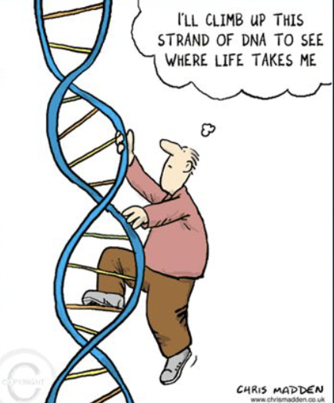
Thank You!
Questions?

