Slide 1
Artificial Intelligence-Based Connect 4 Player Using Python

Slide 2
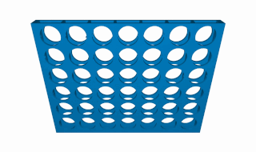
What is Connect 4?

Slide 3
Theoretical Analysis of the game
A rough upper bound for the number of possible situations in the game is $3^{6×7}≈1.1×{10}^{20}$ game situations.
A more accurate number for the number of possible situations can be calculated by evaluating the sequence of possible games corresponding to a specific number of discs
And then summing it up!

Slide 4
The sequence of possible situations
$1, 7, 49, 238, 1120, 4263, 16422, 54859, 184275, …$
The calculation of the sequence:
$S\left(0\right)=1$.
$S\left(1\right)=7$.
$S\left(2\right)=7×7=49$.
$S\left(3\right)=7×7×1+7×6×\frac{5}{2}+7×6×2=238$.
The total number of situations$≈4.5×{10}^{12}$.

Slide 5
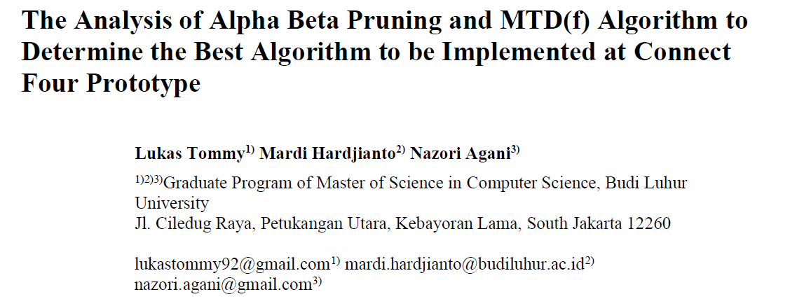
Related Work

Slide 6
Main AI Algorithm Used
Minimax algorithm

Slide 7
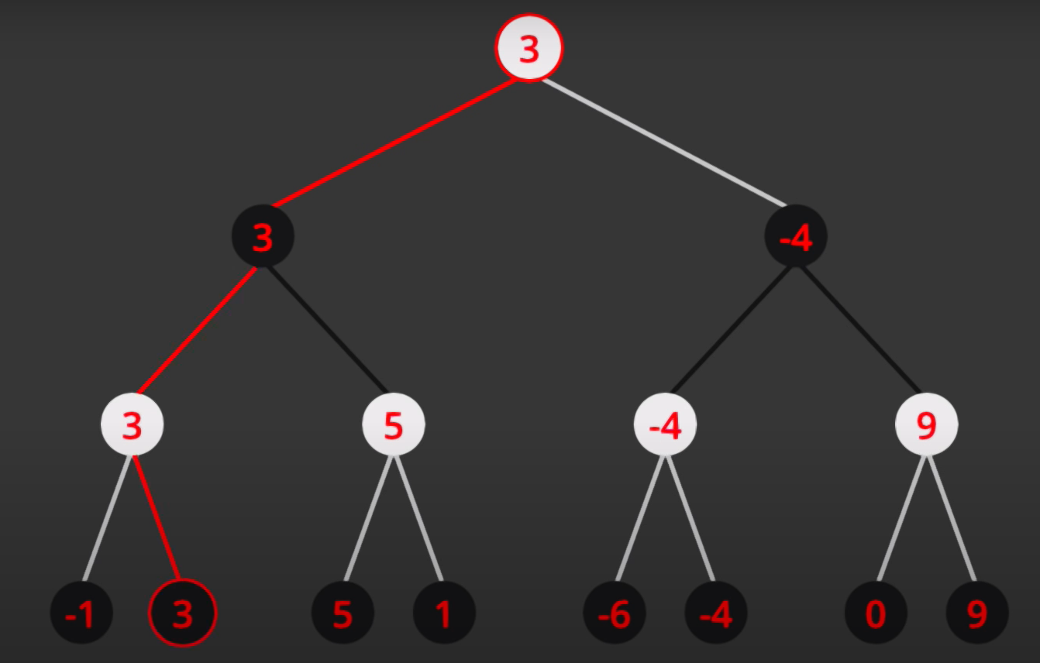
Minimax Algorithm Illustration

Slide 8
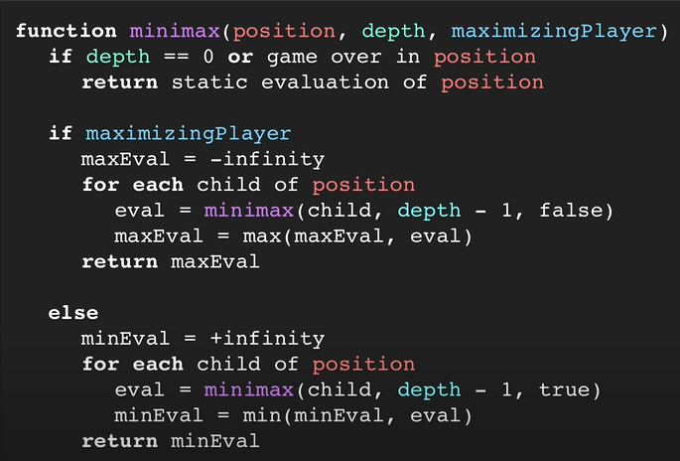
Minimax Algorithm Pseudocode

Slide 9
The Function’s Value Evaluator
The hardest part of the solution of the game.
If we can go through all the depth, it would not be hard.
A heuristic good way is to count the number of adjacent discs for each player and give points depending on the difference in them.
Considering the small gaps and the possible next steps in the process of calculating the function itself makes it more complicated.

Slide 10
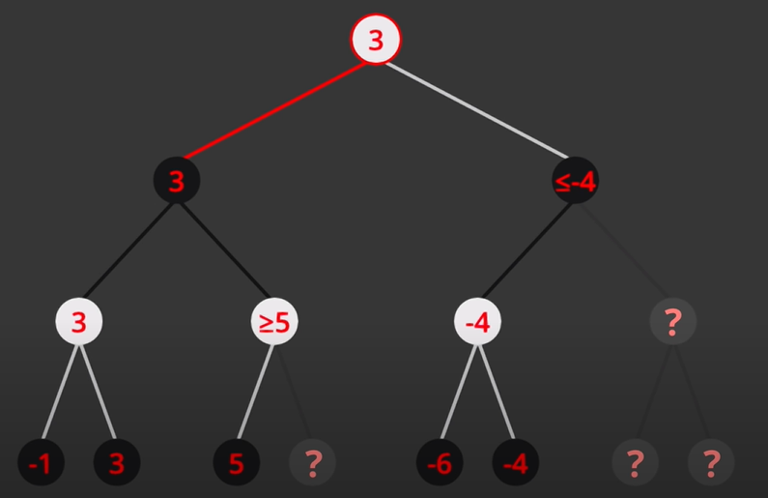
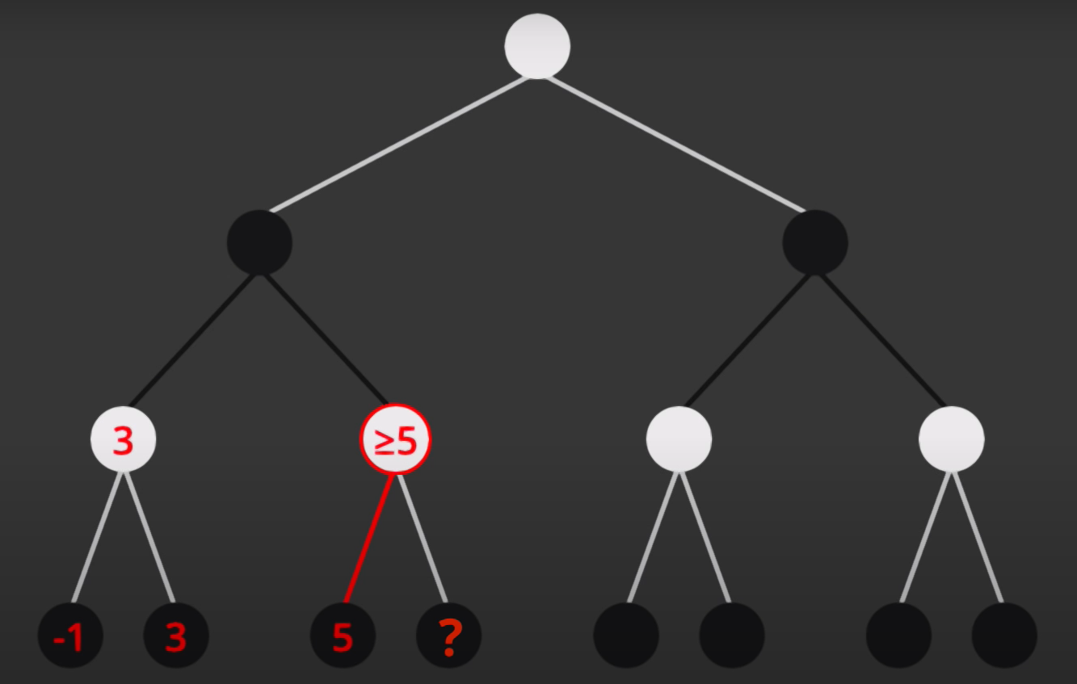
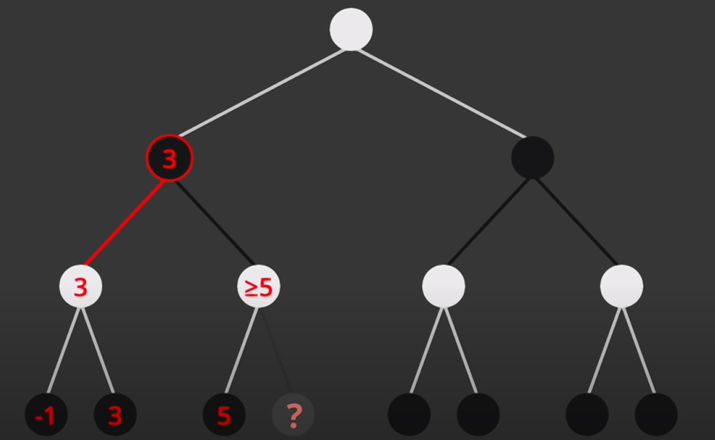
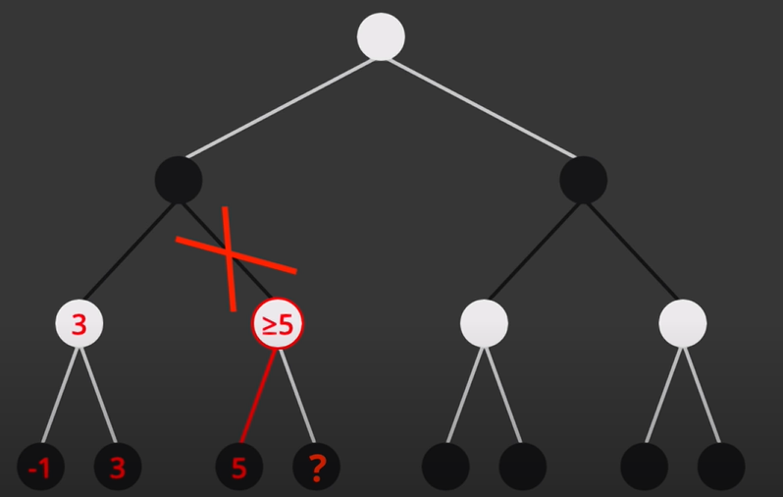
Enhancing: Alpha-Beta Pruning Algorithm

Slide 11
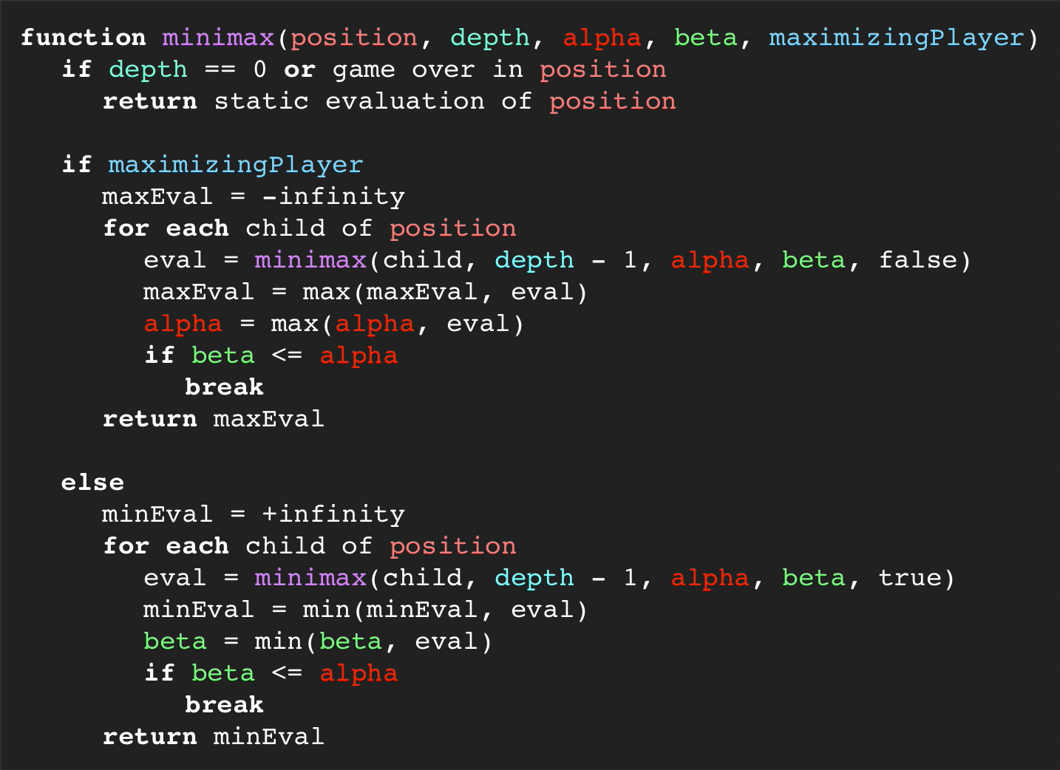
Alpha-Beta Pruning Algorithm Pseudocode

Slide 12
Hindrances for our AI
The time complexity.
the implementation of the value-evaluating function.

Slide 13
The Efficiency of our AI
It always beats a player playing randomly against it.
An AI assigned with a deeper depth always beats the AI assigned with a shallower one.
It needs a reasonable depth to start competing againts reasonable agents.

Slide 14
Conclusion
Our AI’s performance is strongly and strictly tied to the choice of the depth and the value-determining function.
The general methods to make our AI more efficient (like Alpha-Beta Pruning) are not very useful for their purpose, because of the small arbitrary factor in building the function.
Even though that, our AI can be competitive against reasonable players if assigned to a deep depth.

Slide 15
References
Tommy, L.; Hardjianto, M.;Agani, N. (2017). “The Analysis of Alpha Beta Pruning and MTD(f) Algorithm to Determine the Best Algorithm to be Implemented at Connect Four Prototype”. IOP Conf. Ser.: Mater. Sci. Eng. 190 012044
Yamaguchi, Y.; K. Yamaguchi; T. Tanaka; T. Kaneko (2012). "Infinite Connect-Four is solved: Draw". Advances in Computer Games, ACG 2011. LNCS 7168: 208–219.
https://archive.org/details/isbn_9781402756214
https://tsdr.uspto.gov/#caseNumber=73019915&caseType=SERIAL_NO&searchType=statusSearch
https://oeis.org/A212693

